Slide 1
Crystal packing of
N, N’-bis(4-chlorophenyl)thiourea N, N- dimethylformamide
Department of Chemistry and
School of Further and Continuing Education,
University of Fort Hare, Alice 5700, South Africa.
Ayodele T. Odularu, Horst Puschmann,
Johannes Z. Mbese, Peter A. Ajibade,
Opeoluwa O. Oyedeji
November 19, 2024.

Slide 2
Table of contents
Title page
Introduction and background study
Problem statement and significance of the study
Theoretical framework
Methodology
Result
Discussion
Conclusion and future study
References
Acknowledgement

Slide 3
Introduction and background study
Crystal packing is the arrangement of atoms, ions, and molecules in a crystalline solid. It gives the physical properties of crystalline materials.
Suitable techniques to give detailed picture of the crystal packing are the X-ray diffraction (X-ray crystallography) and the neutron diffraction.
The aim of this study is to examine the crystal packing of
N, N’-bis(4-chlorophenyl)thiourea N, N- dimethylformamide with X-ray crystallography. Lattice theory is used as the theoretical framework to support the study.

Slide 4
Problem statement and significance of the study
According to the International Union of Crystallography (IUCr), crystal packing is a subtle subject.
The significance of this study is the application in the pharmaceuticals and materials science.

Slide 5
Crystal packing and lattice types
In crystal packing where lattice theory is applicable, lattice types as essential aspect of lattice theory, are made of different crystal systems, such as cubic, hexagonal, monoclinic, orthorhombic, tetragonal, and triclinic.

Slide 6

Lattice theory
Lattice theory is the theoretical framework in line with crystal packing, which refers to the three-dimensional arrangement of atoms, ions, or molecules in a crystalline solid.
In this framework, a lattice is a three-dimensional geometric arrangement of points, where each point represents the position of an identical component in the crystal.
Essential aspects of lattice theory in crystal packing are lattice types, unit cell, packing efficiences, Bravais Lattices, and the coordinaion number.

Slide 7
Methodology
X-ray crystallography was the methodology used to determine the crystal structure, for it to further explain the atoms in crystal lattice of N, N’-bis(4-chlorophenyl)thiourea N, N- dimethylformamide.
The explanation was supported by the lattice theory.•

Slide 8
Synthensis of N, N’-bis(4-chlorophenyl)thiourea N, N- dimethylformamide
N, N’-bis(4-chlorophenyl)thiourea is an organic compound formed from the reaction of chloroaniline, carbon(IV) sulphide, and ammonia solution in methanol at a temperature of less than 4°C.
2C₆H₄ClNH_{2(aq)} + CS_{2(l)} + 2NH_{3(l)} → C₁₃H₁₀C_{l2}N₂S_{(s)} + 3H_{2(g})↑ +H₂S_{(g)} ↑+N_{2(g)}↑
N, N- dimethylformamide (DMF) is a polar (hydrophilic) aprotic solvent used to grow the crystals of N, N’-bis(4-chlorophenyl)thiourea.

Slide 9
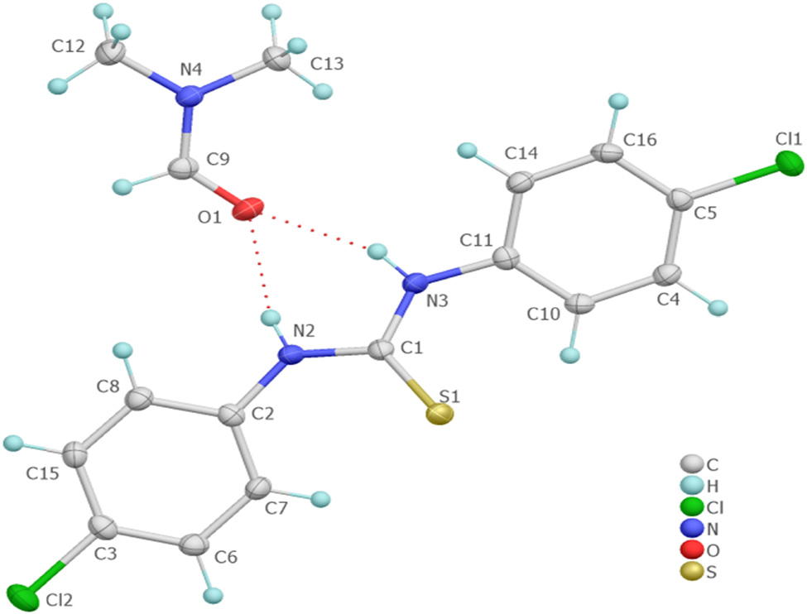
Crystal structure of
C₁₆H₁₇Cl₂N₃OS

Slide 10
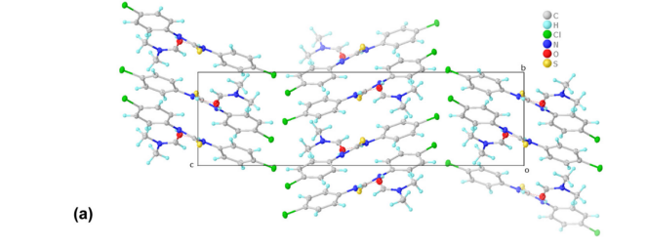
Result a: Crystal packing of a

Slide 11
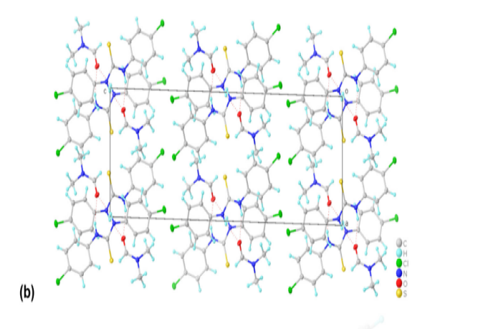
Result b: Crystal packing of b

Slide 12
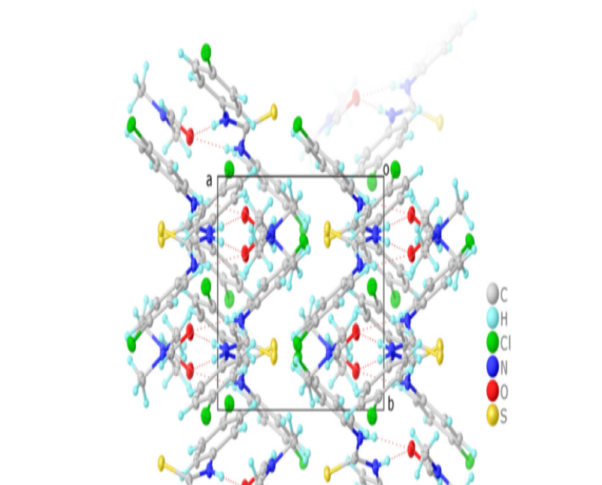
Result c: Crystal packing of c

Slide 13
checkCIF/PLATON (basic structural check)
Datablock
Cell a=9.2360 (4) b=7.2232 (2) c=25.55 (11)
alpha=90° beta=91.376°(3) gamma=90°
Temperature: 120K
Calculated Reported
Volume 1684.40(12) 1684.40(12)
Space group P 21/c P 1 21/c 1
Sum formula C₁₆H₁₇C_{l2}N₃OS C₁₆H₁₇C_{l2}N₃OS
Mr 370.29 370.30

Slide 14


Crystal System with axial lengths and angles
System | Axial lengths and angles
Cubic | a=b=c, α = β = γ = 90°
Tetragonal | a = b ≠ c, α = β = γ= 90°
Orthorhombic | a ≠ b ≠ c, α = β = γ= 90°
Rhombohedral | a = b = c, α = β = γ ≠ 90°
Hexagonal | a = b ≠ c, α = β = 90°, γ = 120°
Monoclinic | a ≠ b ≠ c, α = γ = 90°, β ≠ 90°
Triclinic | a ≠ b ≠ c, α ≠ β ≠ γ

Slide 15
Conclusion and future study
Conclusion
The aim of the study was achieved. Here, the lattice parameters (a, , and c wih angles) of N, N’-bis(4-chlorophenyl)thiourea N, N- dimethylformamide from the checkCIF dashblock gave results that validates and confirms the crystal packing of N, N’-bis(4-chlorophenyl)thiourea N, N- dimethylformamide as monoclinic.
Future study
This study will involve determining the packing efficiency of N, N’-bis(4-chlorophenyl)thiourea N, N- dimethylformamide and comparing it with known packing types.

Slide 16
References
1. Odularu, A.T., Ajibade, P. A., Mbese, J. Z., Oyedeji, ,O. O., Puschmann, H. Synthesis and crystal structure of N,N′-bis(4-chlorophenyl)thiourea N,N-dimethylformamide. Open Chem. 2021, 19, 511– 517.
2. Jambi, SMS. Characterization and synthesis of novel thiourea derivatives. Int J Chem Tech Res. 2019,. 12(3),.177–87.
3. Das C, Zhang H, Li R, Zou H. Synthesis and characterization of thiourea. Pol J Chem Tech. 2019,. 21(3), 35–39.
4.Saeed A, Qamar R, Fattah TA, Flörke U, Erben MF. Recent developments in chemistry, coordination, structure and biological aspects of 1-(acyl/aroyl)-3-(substituted) thioureas. Res ChemIntermed. 2017, 43, 3053–93.
5.Li M, Hou D. 1-(2,6-Dichlorobenzoyl)-3-(3-nitrophenyl)thiourea dimethylformamide solvate. Acta Cryst Sect E StructRep Online. 2010, 66(o280), 1–10.
6. Pilz SK, Mohr F. On the reactivity of thiourea derivatives with silver(I) oxide. Eur J Inorg Chem. 2020, 2020(23), 2285–2294.

Slide 17
Acknowledgement
Authors sincerely appreciate the Committee and Organizers of the African Light Source AfLS-2024 (7th) for allowing us as authors to participate in the AfLS-2024 conference.
Audience for the attention.

