Slide 1



Pb-doped Bismuth Oxide Electrolyte Materials for Intermediate Temperature Solid Oxide Fuel Cells
Emileo Naicker
PhD student
Supervised by
Prof C. Billing and Prof DG. Billing

Slide 2

Outline
Importance of this research
Electrolyte and Dopants
Conductivity performance
Powder X-ray diffraction from Synchrotron (SSRL)

Slide 3

Clean energy – environmentally friendly
CO₂ production resulting in global warming – climate change

Slide 4
Electrolyte
Bismuth oxide as an electrolyte due to its extremely high conductivity in the face centered cubic (fcc) phase
Pure bismuth oxide is only stable in the fcc structure between 730-824ºC which is not optimal for the cell operation and longevity
Aim
This work aims to use a combination of yttrium and cerium to stabilise the fcc phase and lead to increase conductivity.
Dopants
Pb
Y
Ce
help with conductivity
help with stability of the fcc phase
help with aging

Slide 5
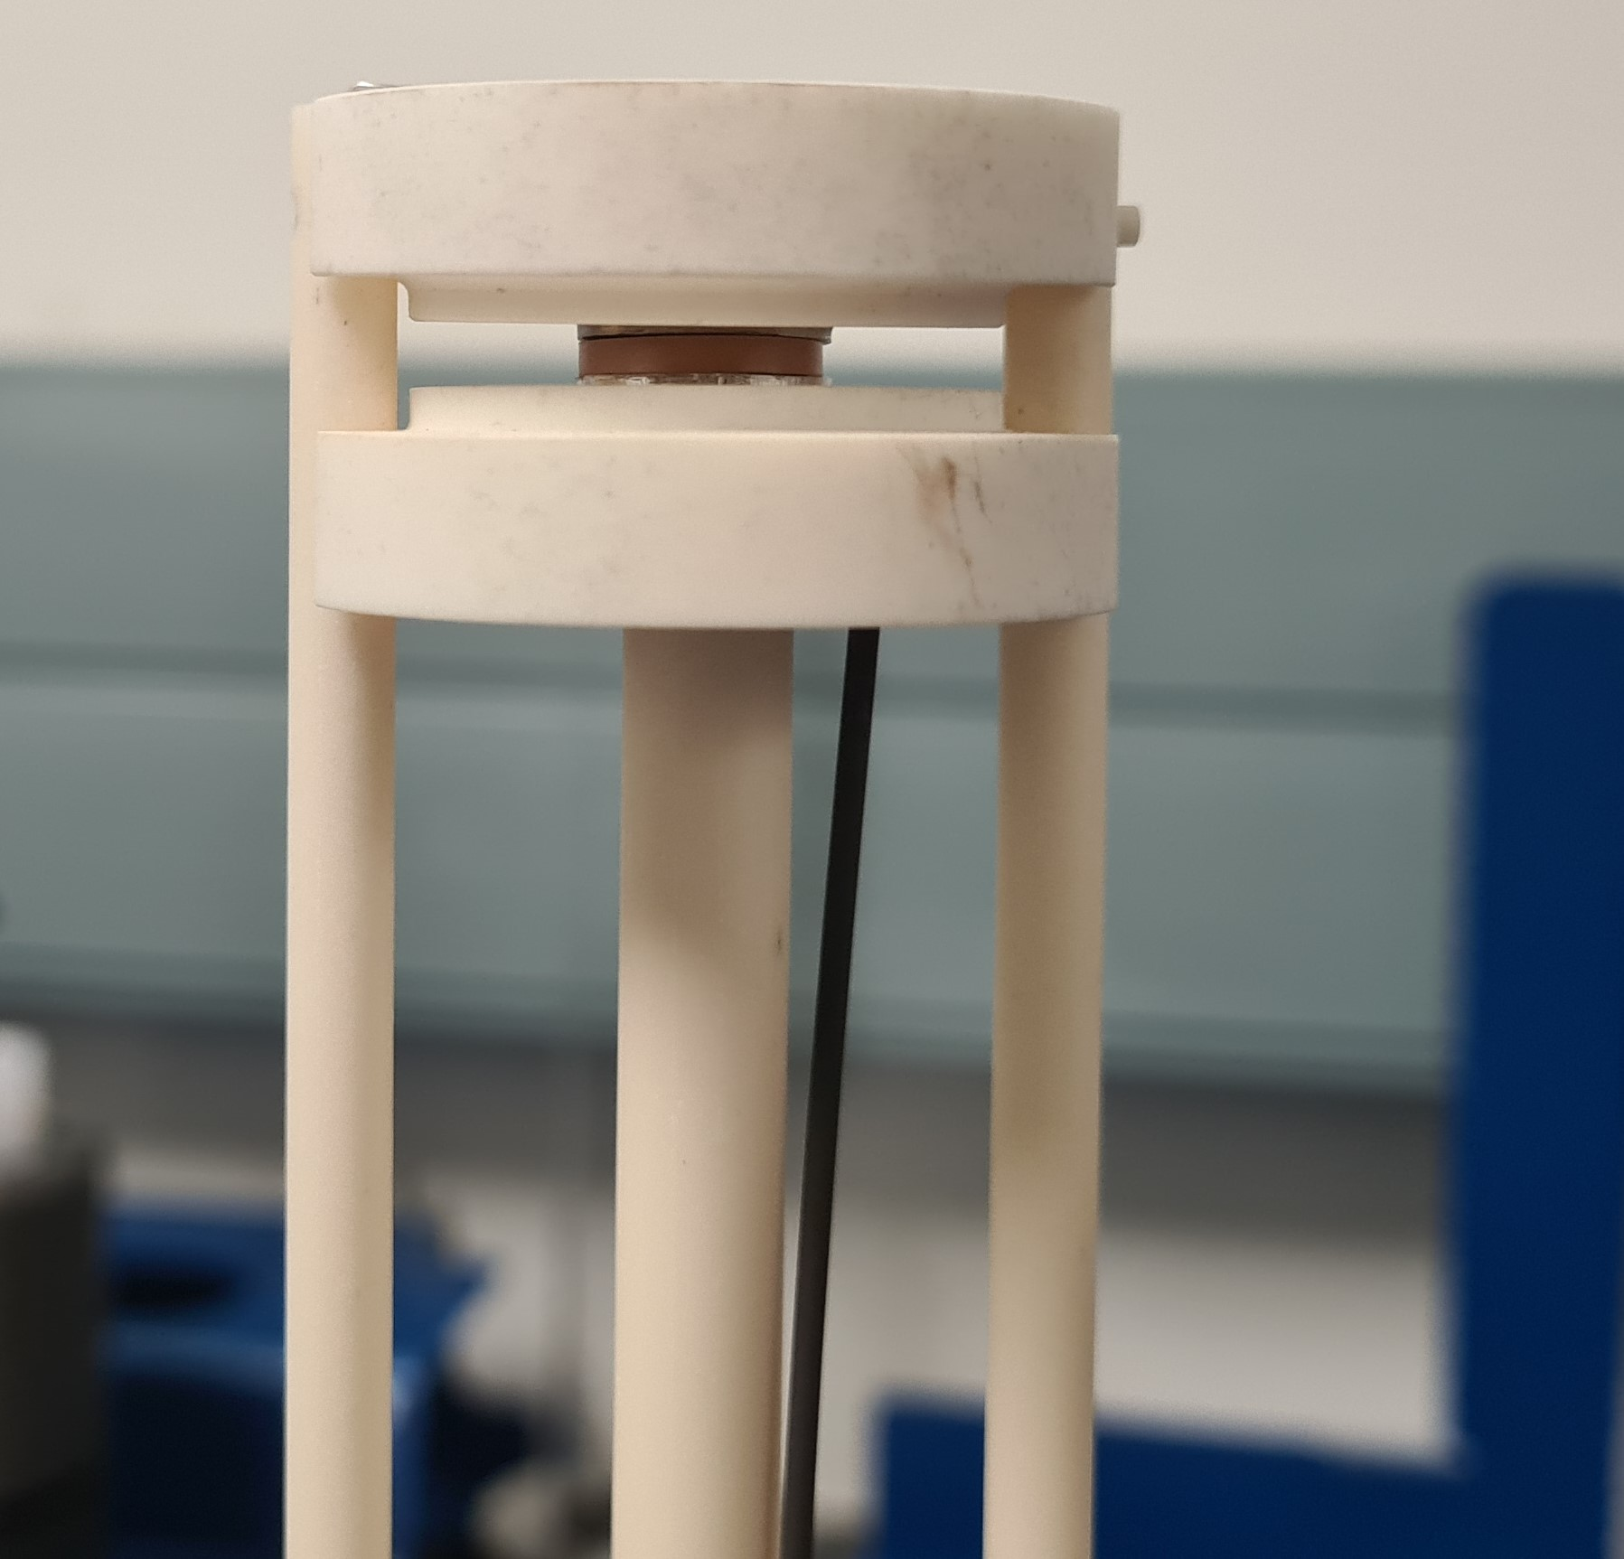
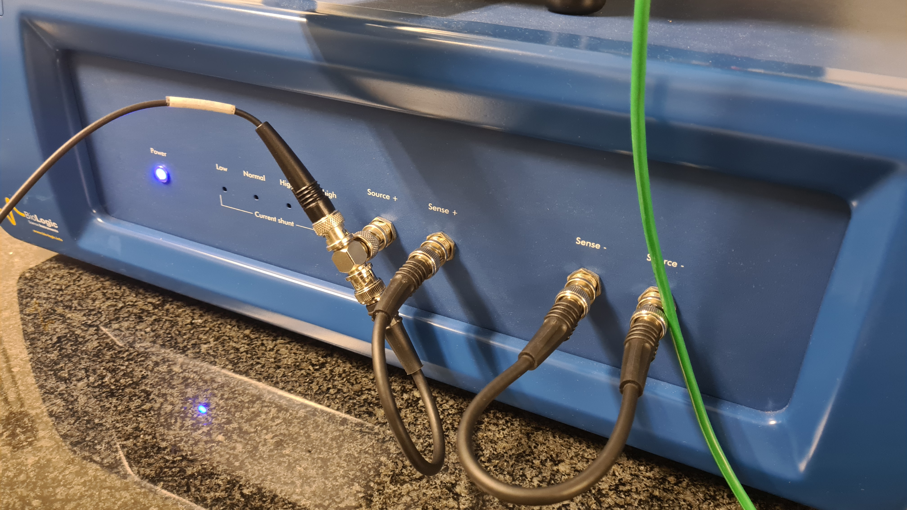
Bismuth Oxide pellet synthesis and EIS measurement
Bismuth Oxide pellet
Synthesis
Citrate gel method
Mix correct stochiometric amounts to produce
20Y10Ce10Pb and 20Y10Ce5Pb systems
Bruker D2 Phaser instrument was used for initial phase identification
Measurement
uniaxial cold press at a constant pressure of 500 MPa with Poly Vinyl Alcohol
Electrochemical impedance spectroscopy (EIS) was done using the MTZ-35 frequency with a 10mV amplitude
EIS was done between 350 °C to 750 °C

Slide 6

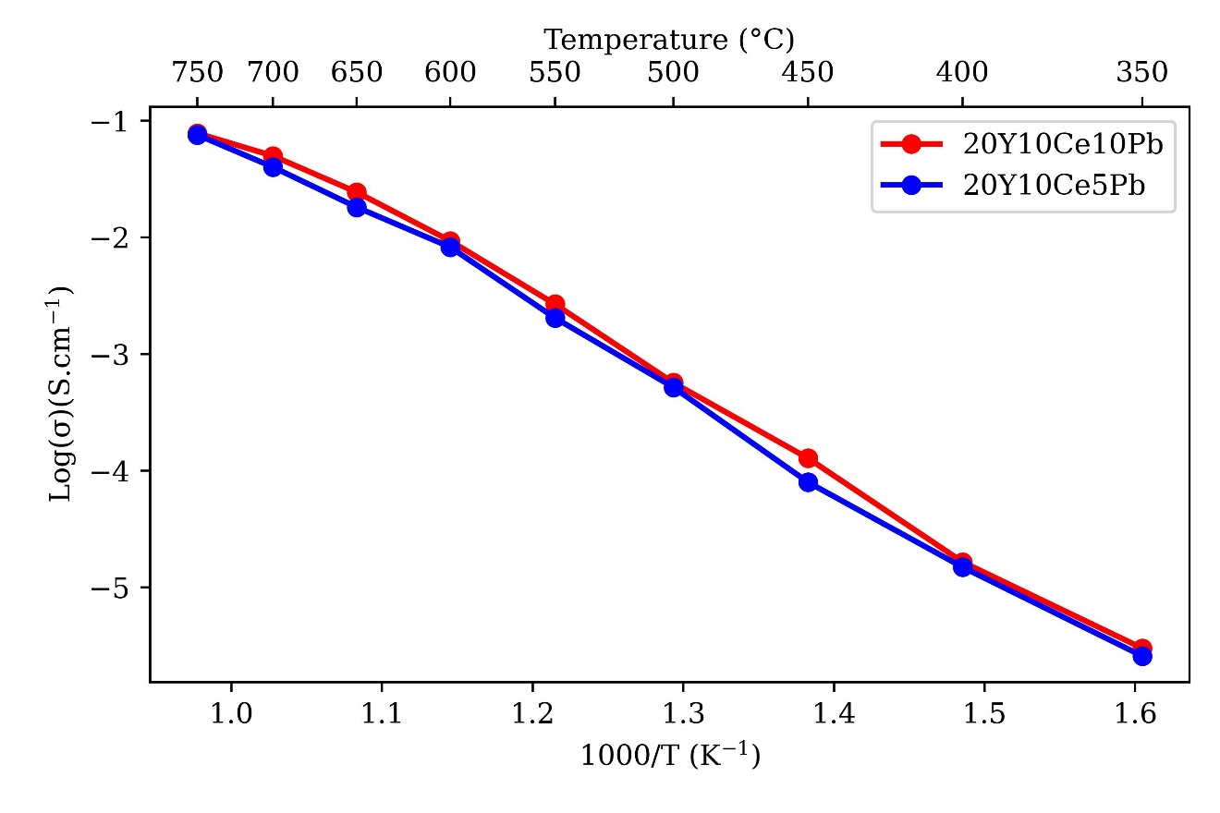
Arrhenius Plot and Conductivities
Temperature (º C) | 20Y10Ce10Pb (S.cm⁻¹) | 20Y10Ce5Pb (S.cm⁻¹)
350 | 2.58E-06 | 2.28E-06
450 | 0.0001 | 7.97E-05
550 | 0.002558 | 0.002041
650 | 0.022568 | 0.018158
750 | 0.096008 | 0.07583

Slide 7
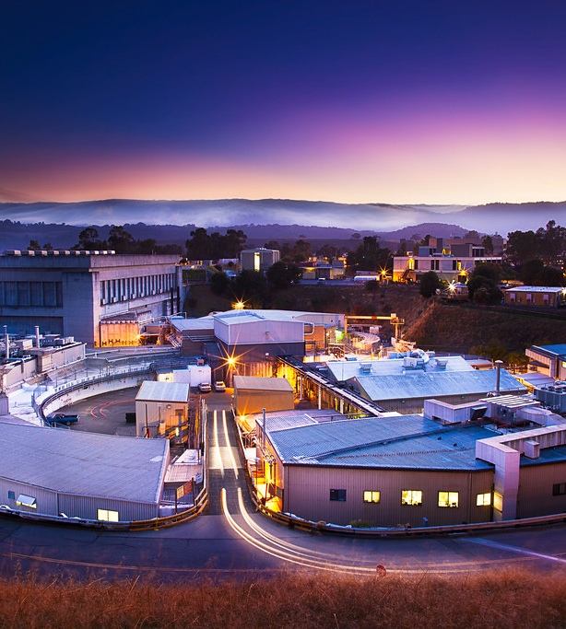
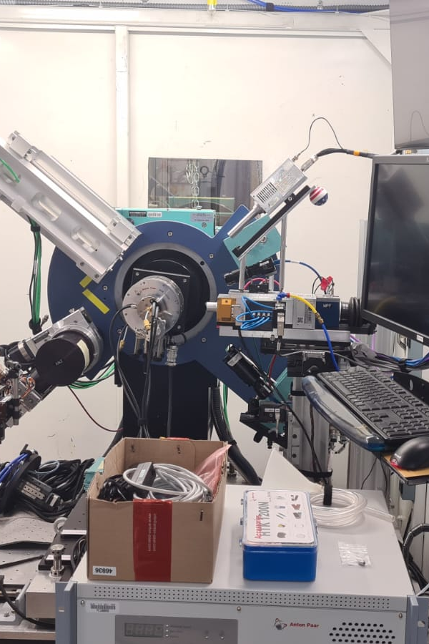
Stanford Synchrotron Radiation Lightsource

Slide 8
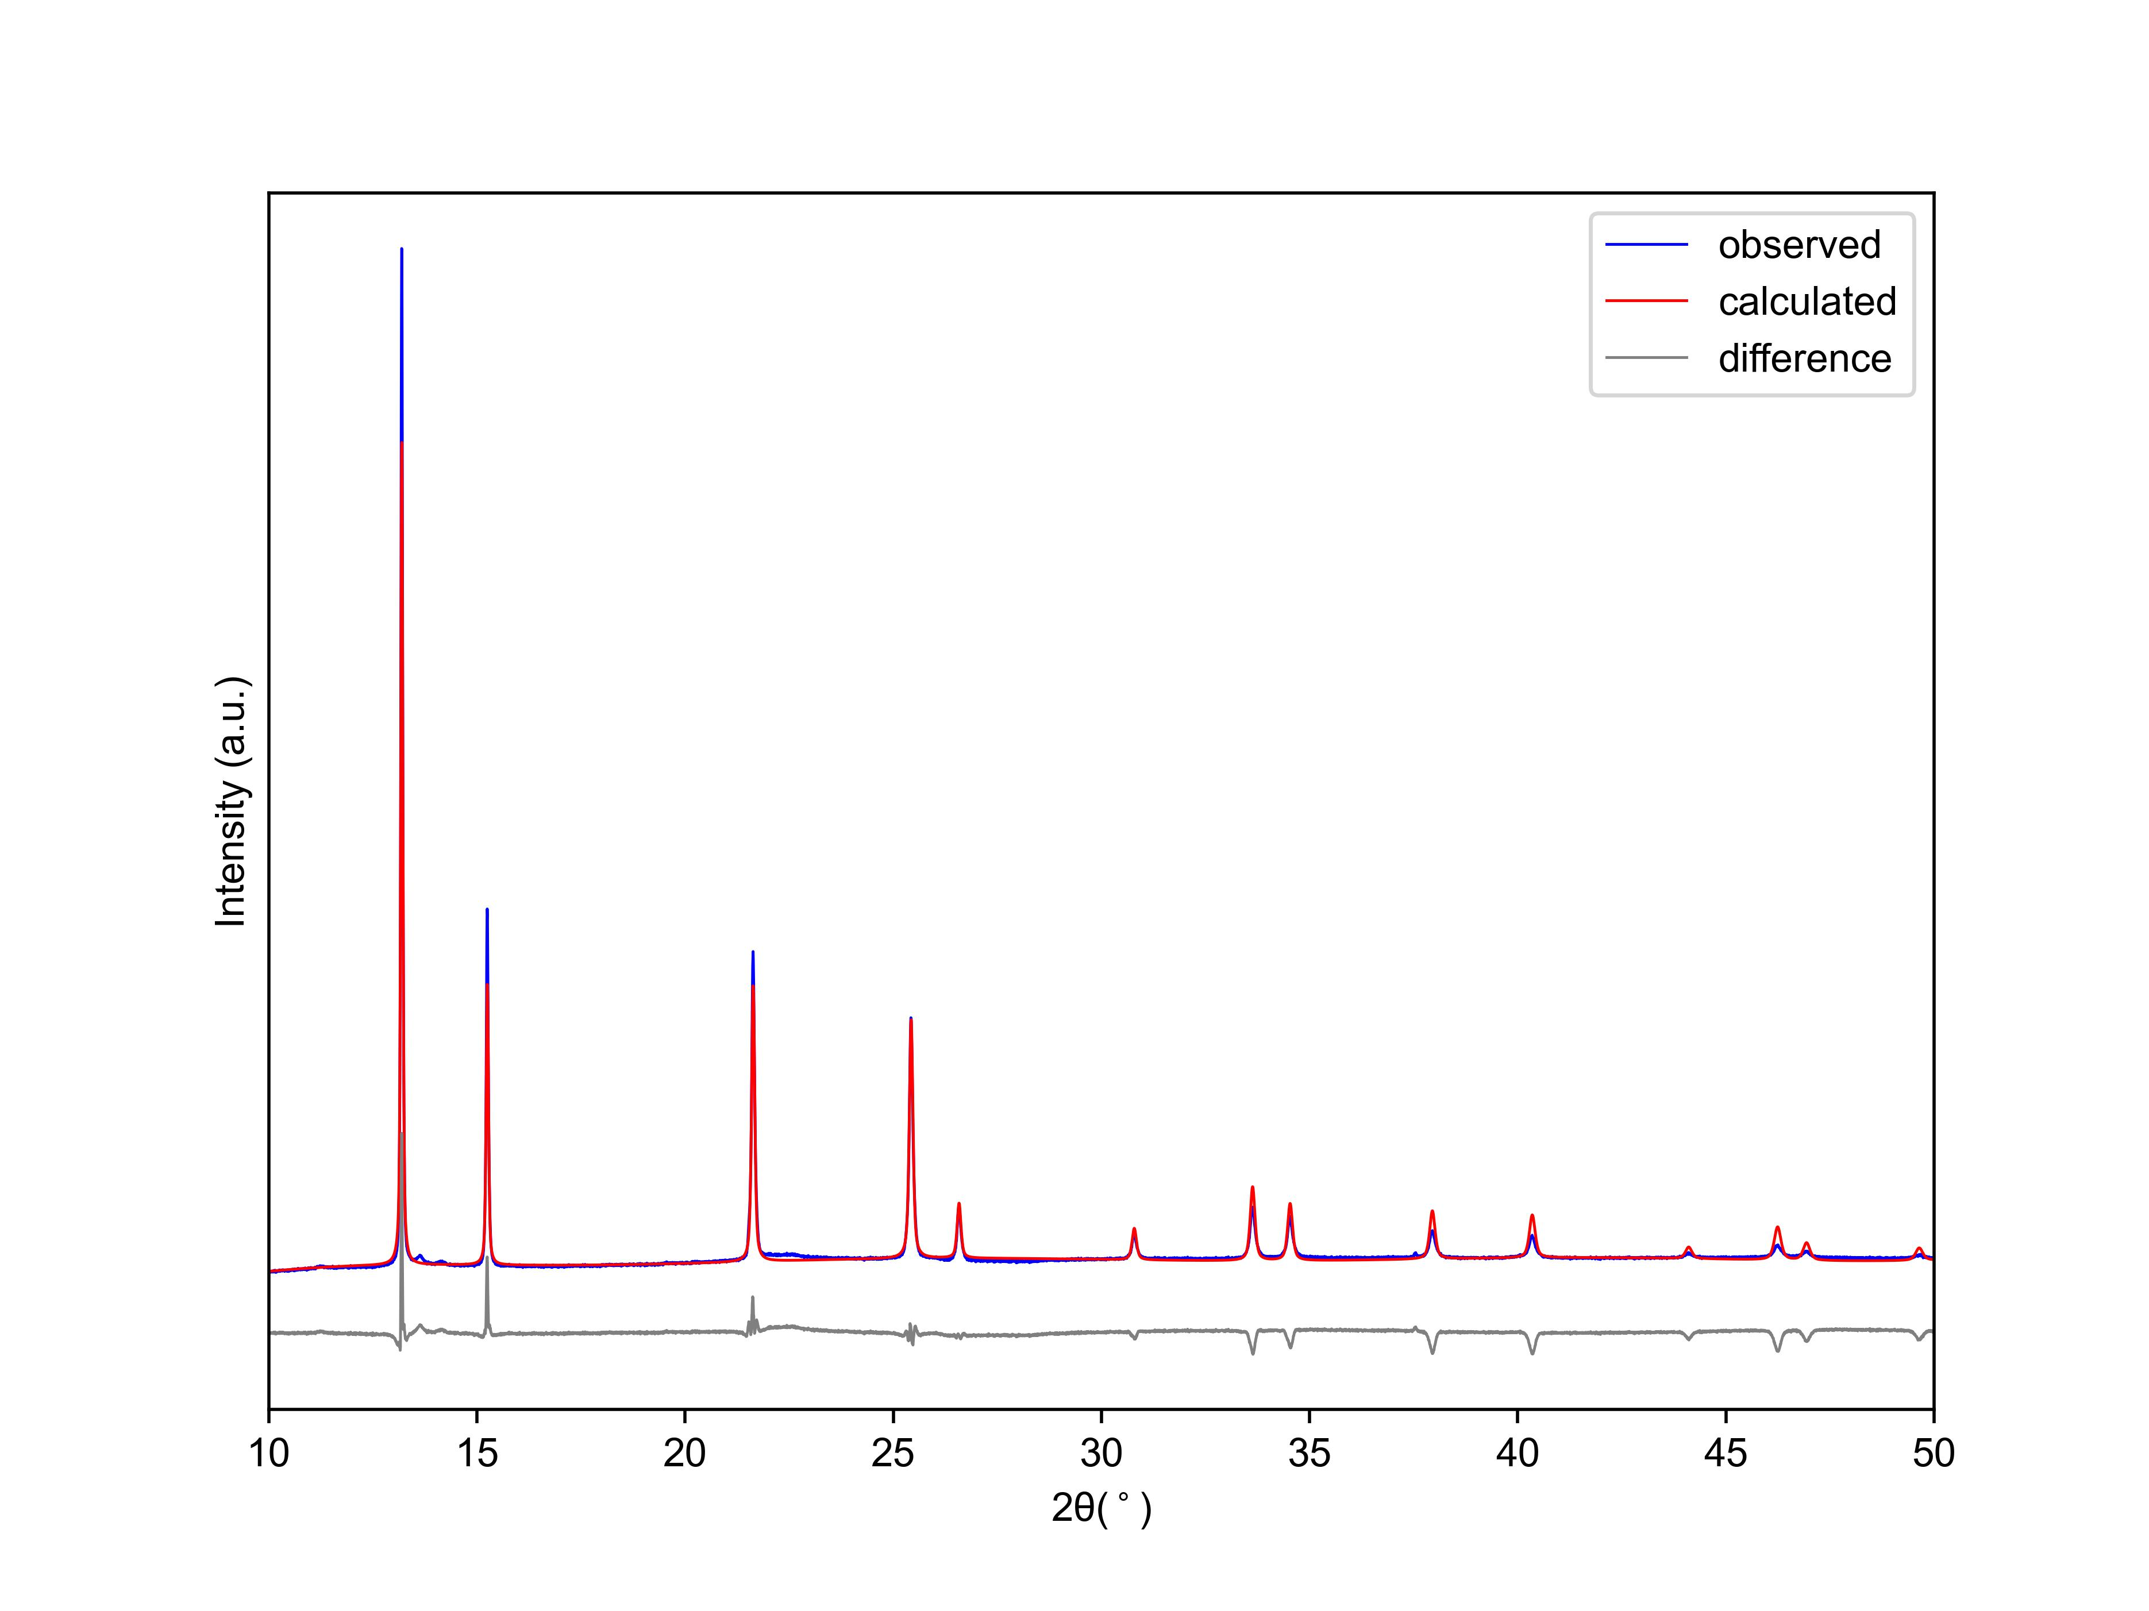
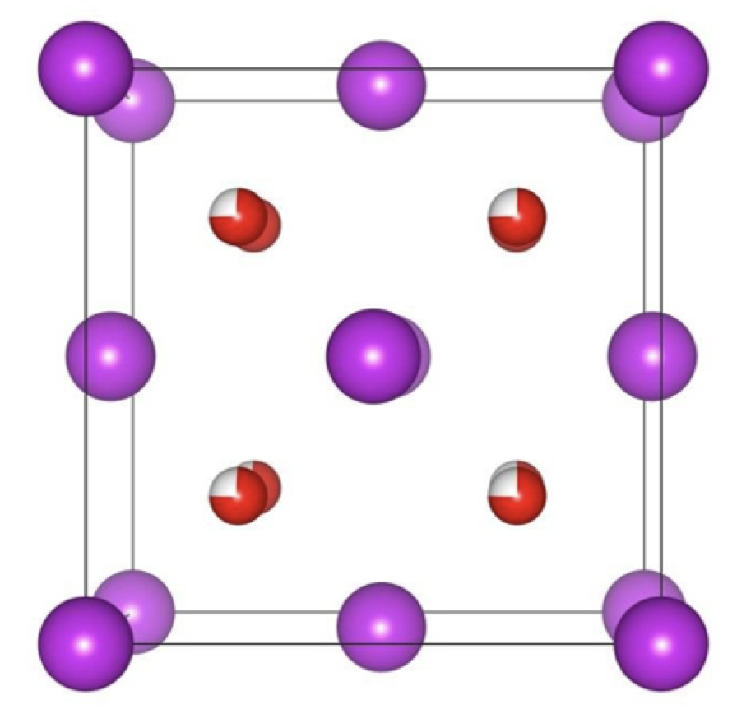
Room Temperature Measurement
2 theta(degrees) λ= 0.7288 Å
DIFFRAC.TOPAS software use for Rietveld Refinement using Bismuth yttrium oxide cubic (Fm-3m) structure

Slide 9
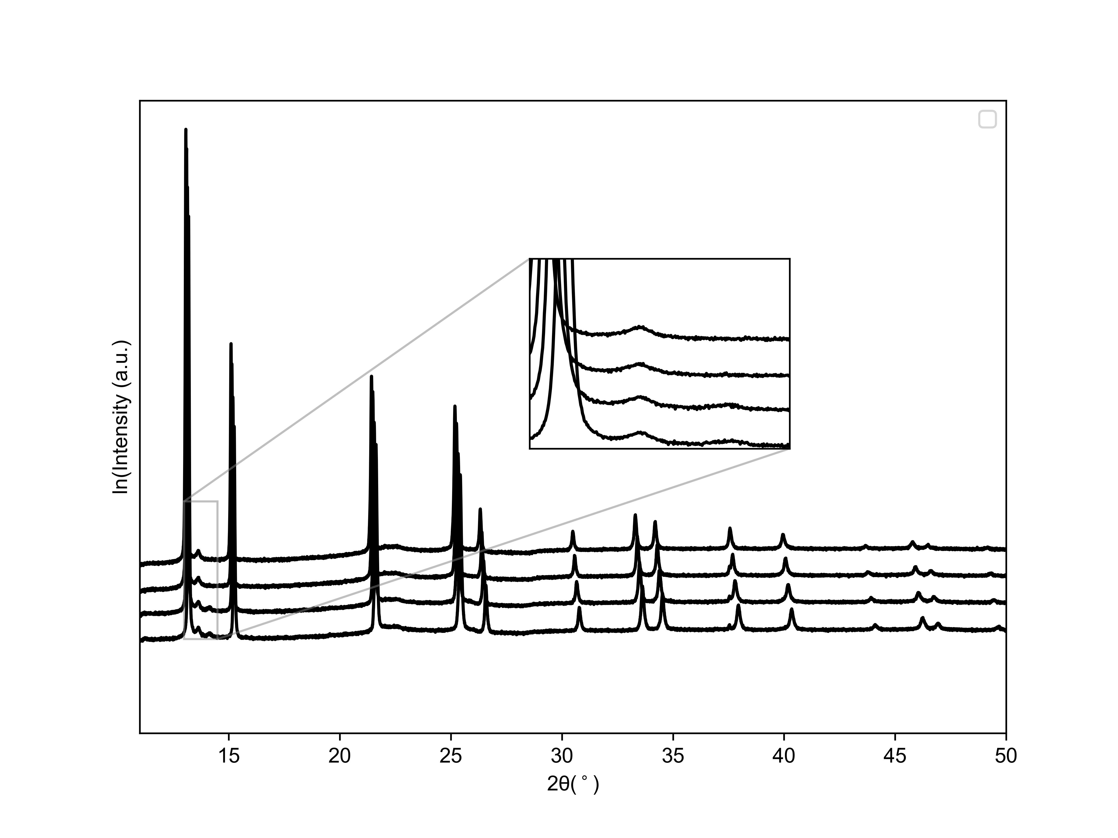
Variable Temperature measurement between 350ºC to 600ºC
2 theta(degrees) λ= 0.7288 Å

Slide 10
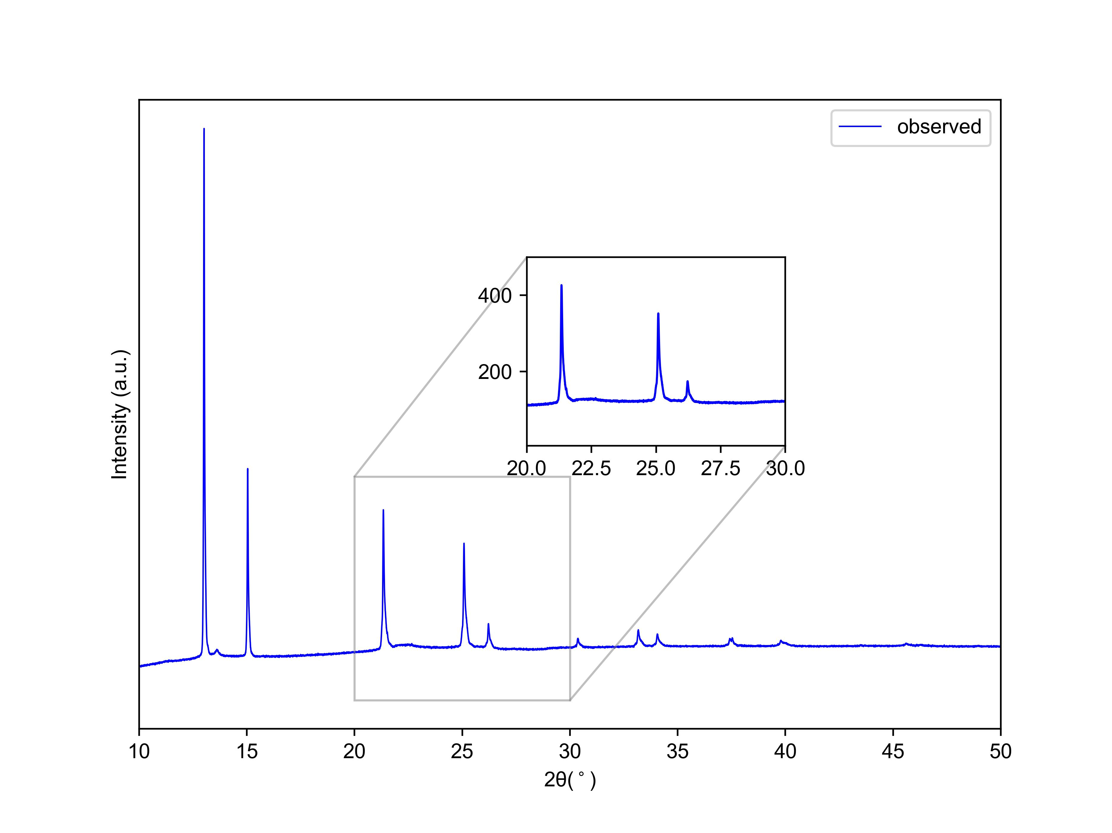
750ºC Measurement
2 theta(degrees) λ= 0.7288 Å

Slide 11
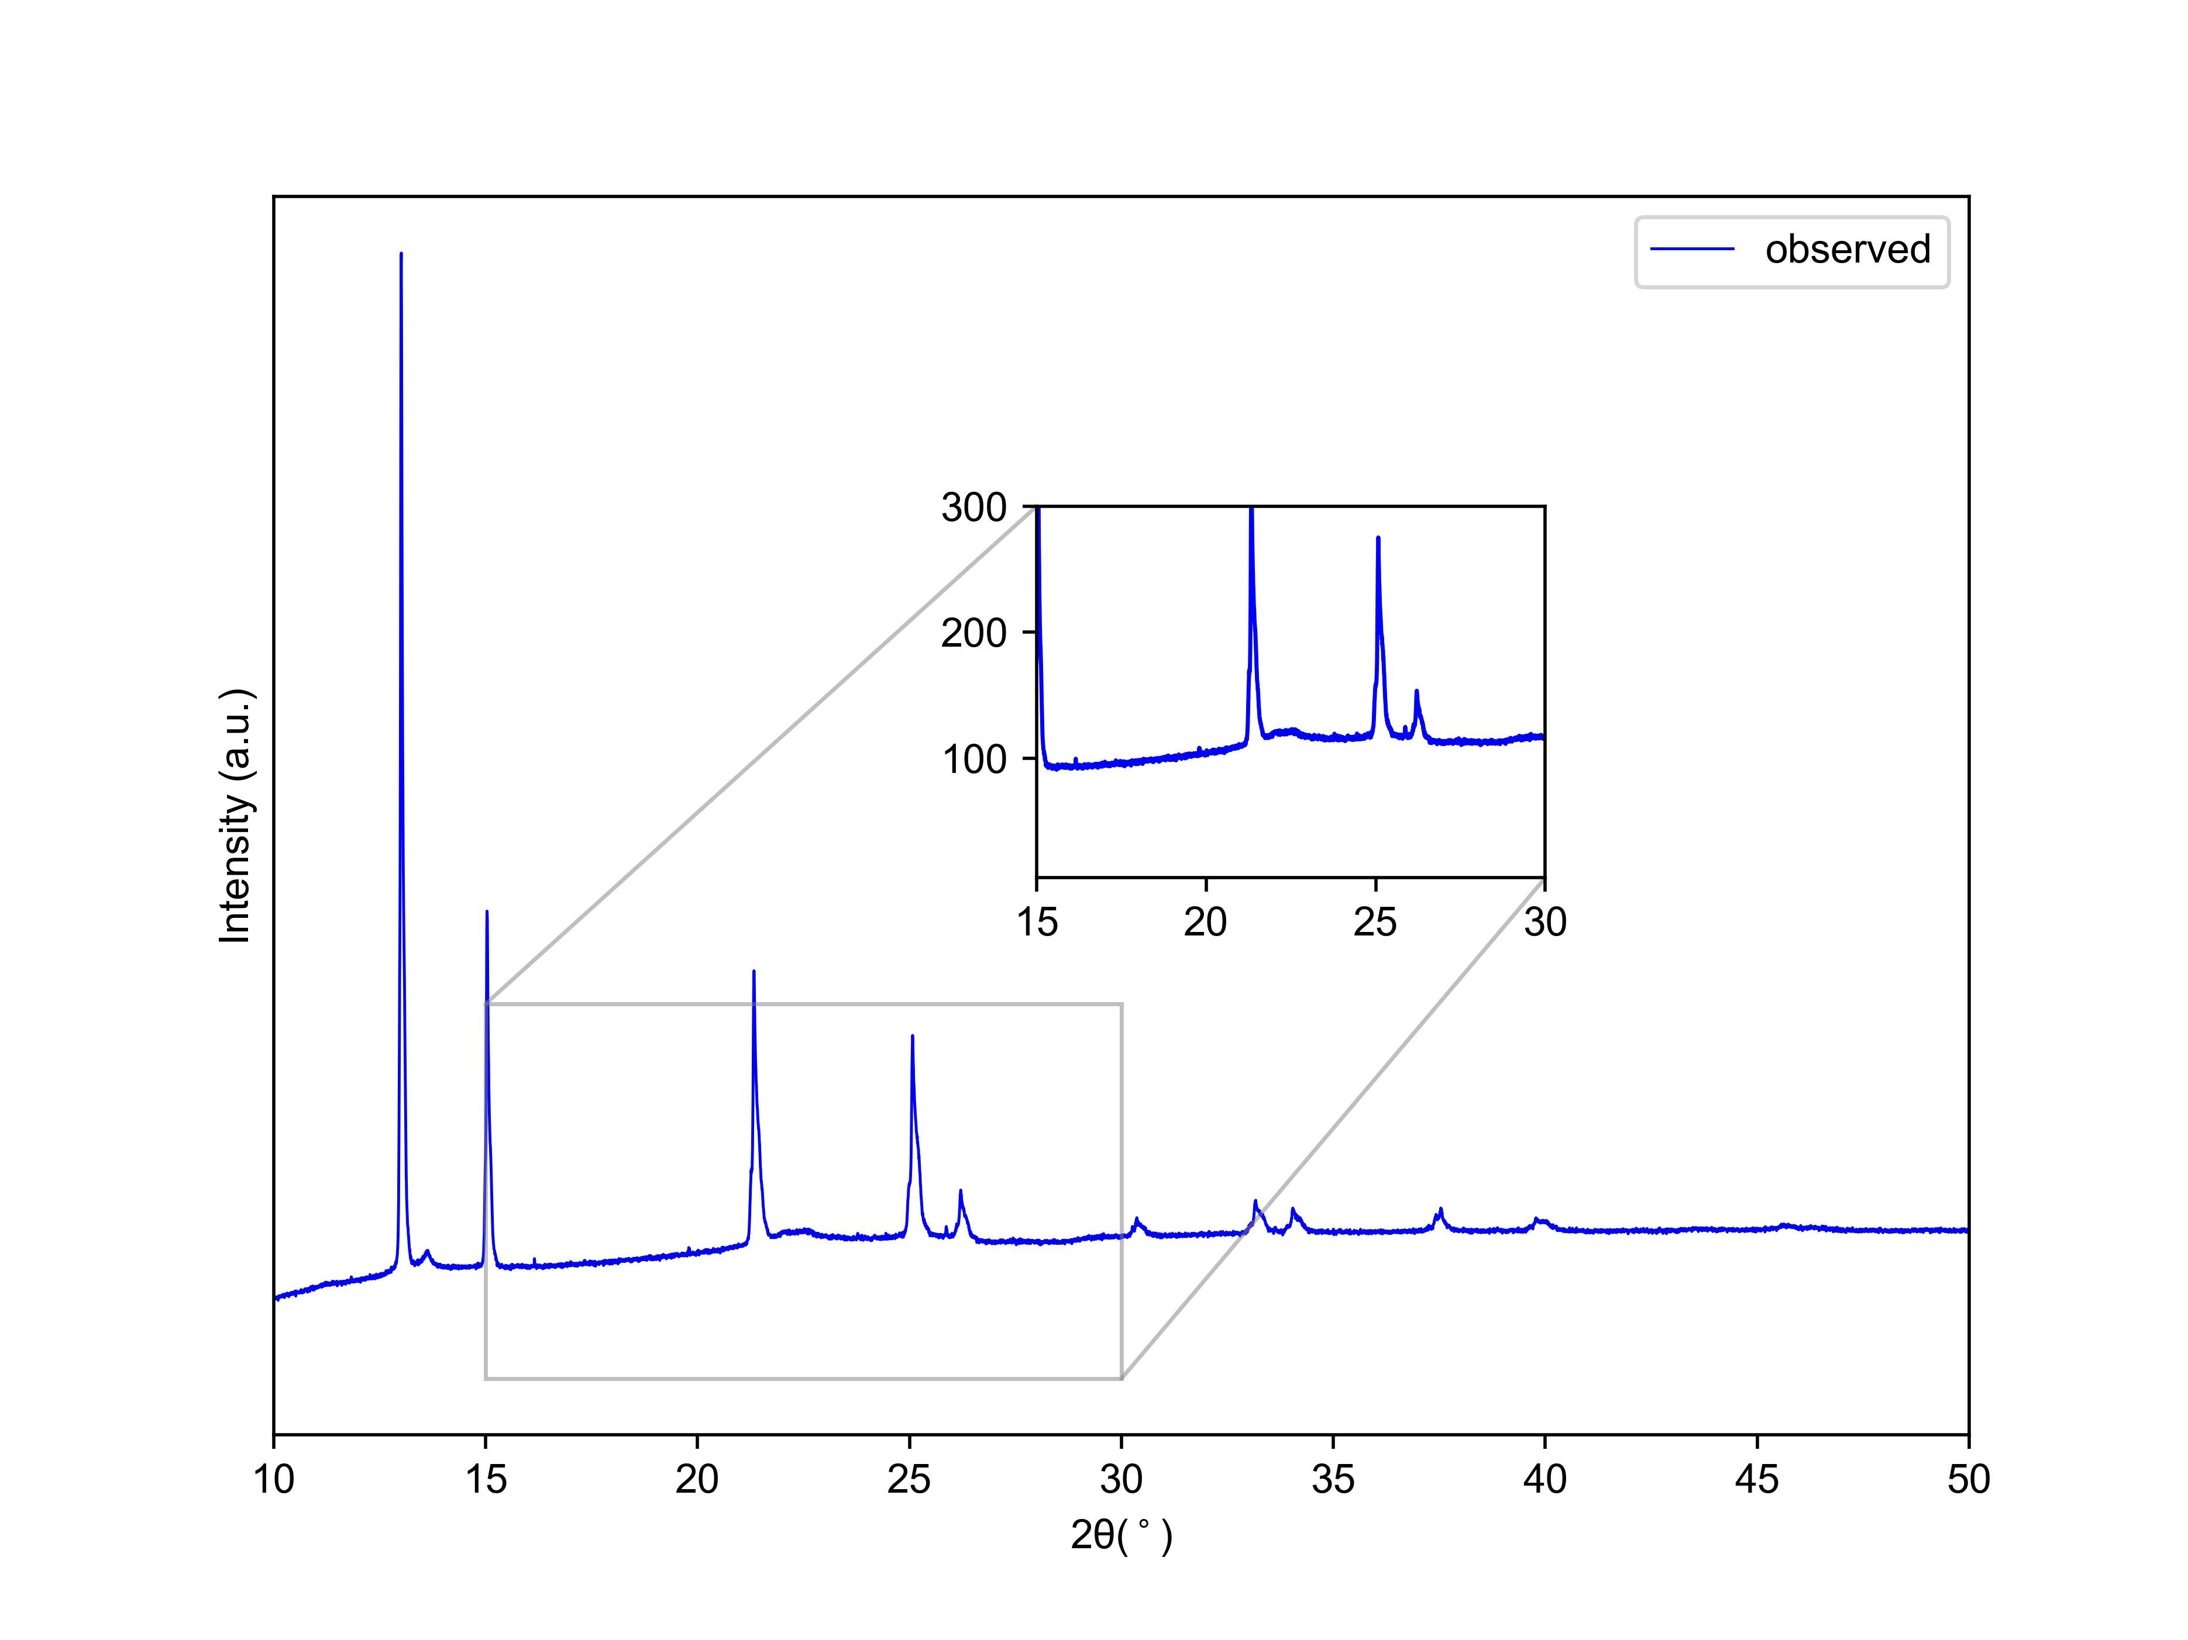
775ºC Measurement
2 theta(degrees) λ= 0.7288 Å

Slide 12
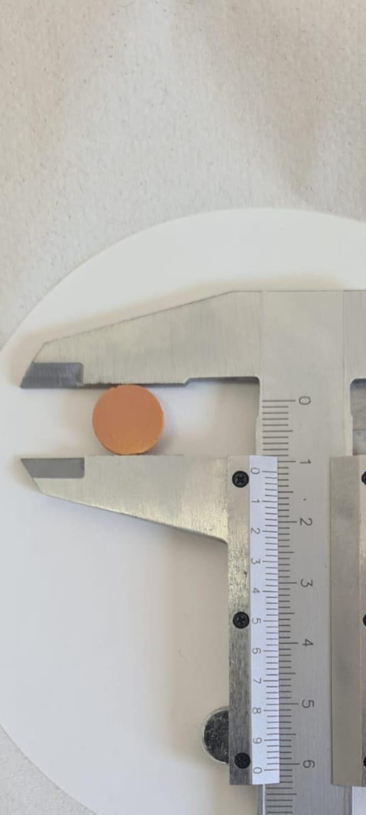
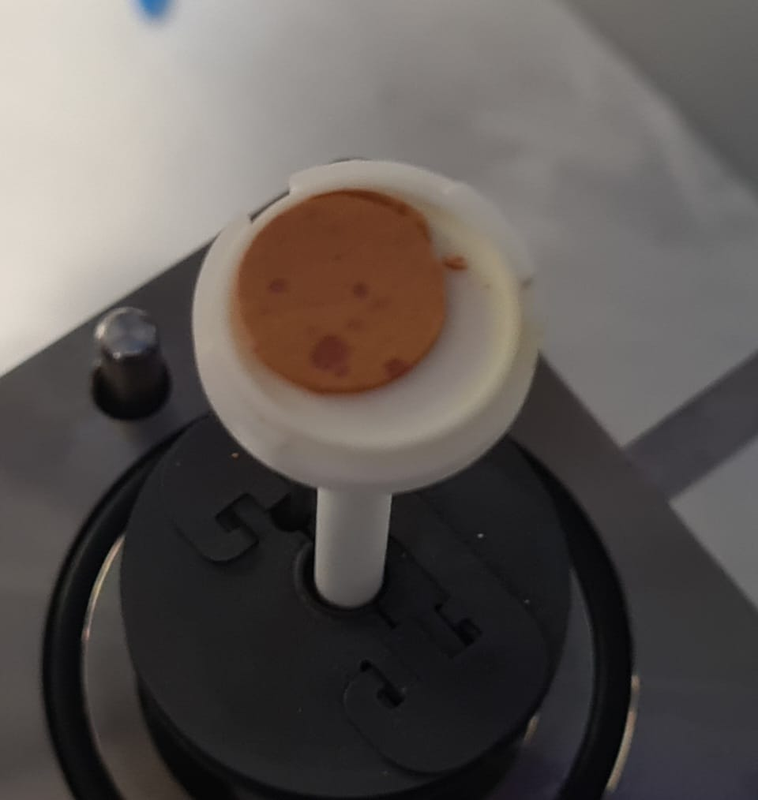
Pellet after measurement
Before
After

Slide 13
Conclusions and Future work
Pb works within a certain temperature range
At 750ºC lead starts to migrates from structure
Raman Spectroscopy on Pellets
Longer conductivity measurements at certain temperatures

Slide 14


Acknowledgements

Slide 15

Questions
1833066@students.wits.ac.za

