Slide 1
Taphonomy and palaeoecology of a monospecific microvertebrate bonebed: behavioural implications for the late Permian parareptile Owenetta revealed by synchrotron X-ray microcomputed tomography by Lutendo Mukwevho (1944548)
Supervisors: Professor Jonah Choiniere & Professor Roger Smith
0000-0003-2927-7057
Notes:
Good day, I hope that everyone is well. My name is Lutendo Mukwevho , I am a PhD student from the university if Witwatersrannd and today I will be telling you about my master’s project which is titld, taphonomy and palaecoecology of a monospecific micrvertebrate bonebed, behavioural implications for the late permina parareptiles Owenetta revealed by synchrotron x-ray microcomputed tomography.

Slide 2
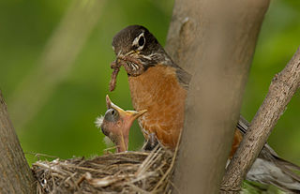
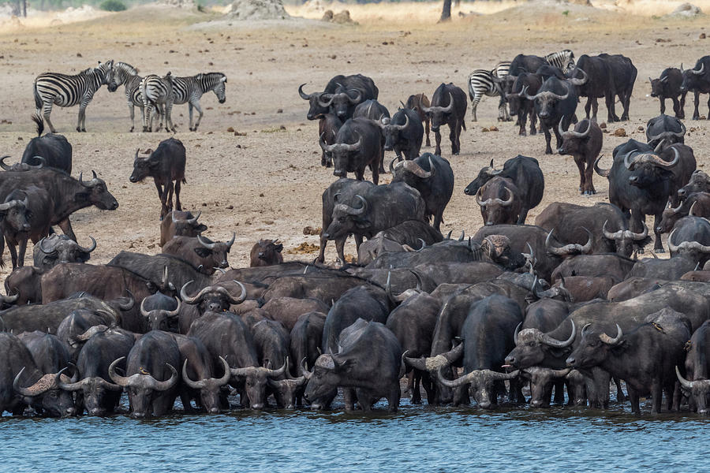
ANIMAL BEHAVIOUR
Suricata suricatta – Meerkat
Cooperative huddling between six individuals
Christa Lesté-Lasserre-2021
Syncerus caffer- Cape buffalo
Herd consisting of a couple of hundred individuals
Bill Cubitt- 2019
Turdus migratorius- America robin
Parent feeding it’s young
William H. Majoros-2010
Notes:
Animal behaviour has for a long time been a major area of scientific interest due to its importance for ecology, biodiversity and conservation. It it extremely diverse, encompassing a wide range of encounters and activities that. Today i will be focusing on the social behavioral aspect, which is a behaviour that encompasses interactions between multiple individuals of the same species. Its repertoire is wide, ranging from just two individuals to a couple of hundred individuals that form highly organized and complex organisations

Slide 3
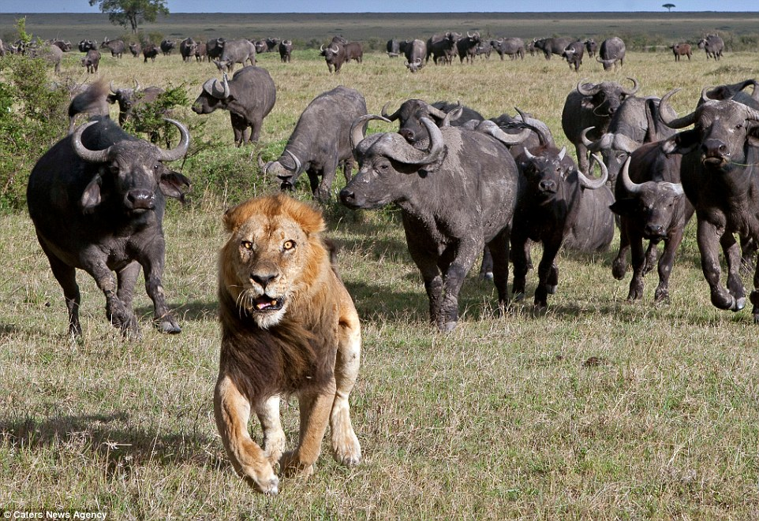
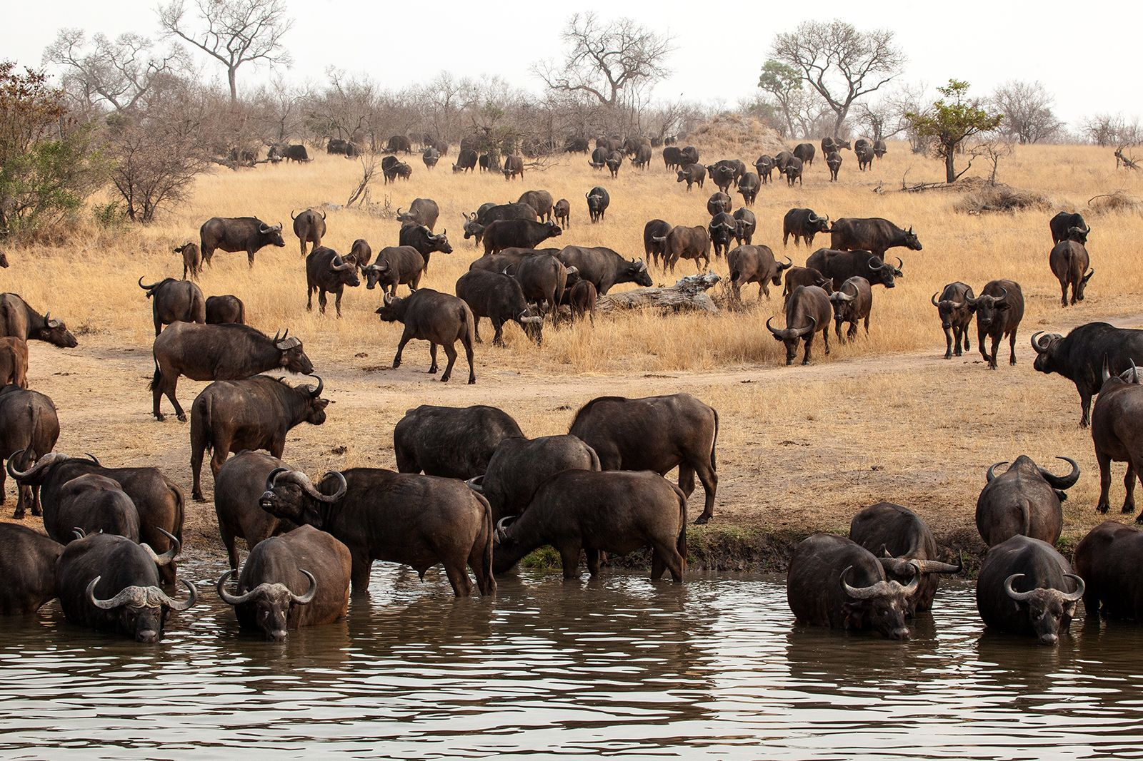
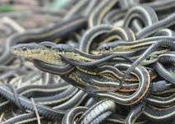
1. Who is exhibiting this behaviour ?
2. How did it occur?
3. Why did it occur ?
Notes:
Often when we study a behaviour we want to know who is exhibiting it?, how it occurred? , and why it occurred. And for extant animals, these questions can be answered by collecting observational data. However it is close to impossible to obtain this sort of data for extinct animals. We as palaeontologists therefore rely heavily on bonebeds to inform us of social behavioural repertoires from the fossil record.

Slide 4
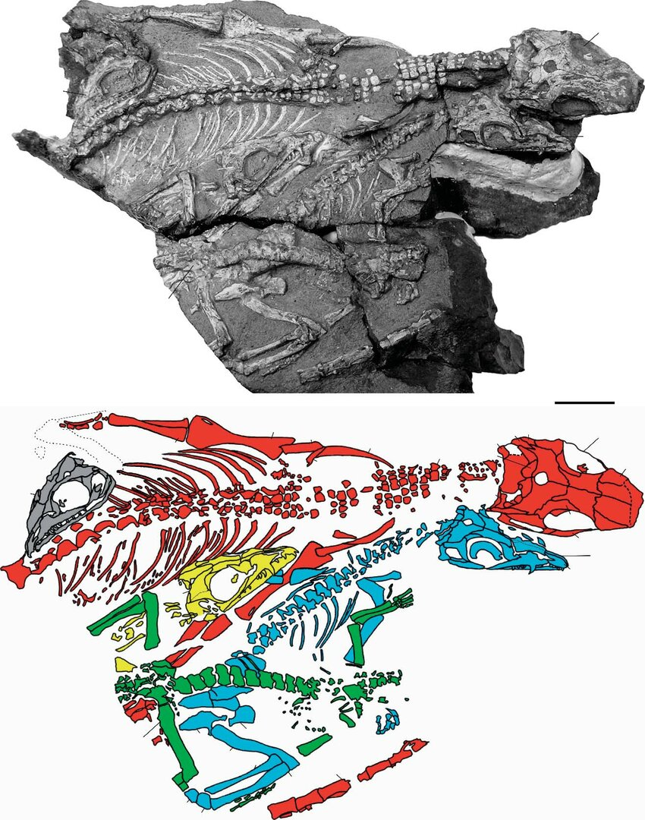
Varanopid aggregation-SAM-PK-K8305
Botha and Modesto-2007
Younginiform aggregation-SAM-PK-K7710
Smith and Evans-1996
Lystrosarurus aggregation-SAM-PK-K8551
Viglietti, Smith and Compton-2013
Notes:
So what are bonebeds? Bonebeds are aggregations of skeletal material from multiple individuals. And some famous examples include this aggregation of younginiforms from the Late Permian, all the individuals in this bonebed are juveniles therefore leading to the interpretation that this aggregation is a brood. Another example includes this aggregation of a varanopid adult along with 4 juveniles, this aggregation is interpreted as parental care.
We are extremely fortunate when we recover aggregations that exhibit a high level of articulation and organization, and when we are not so lucky we recover bonebed that are jumbled mess of bones.

Slide 5
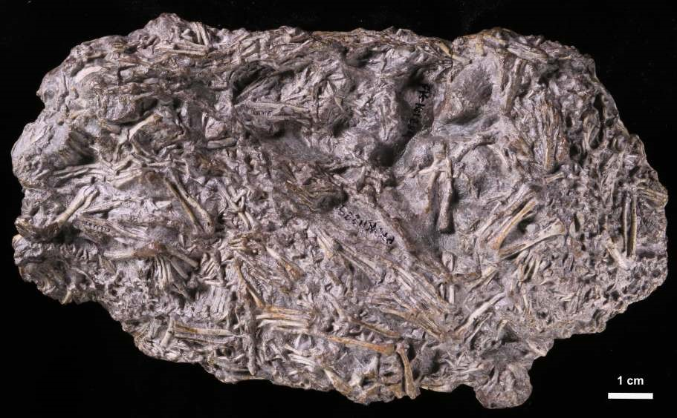
BONEBED SAM-PK-11289
Notes:
And to addd to that list i present this boned. SAM-PK-K11289 is a microfossil bonebed that is 160 mm long, 85 mm wide and 55 mm thick. It has an elliptical planimetric shape.
During the course of my research I investigated, documented and characterized this bonebed answering the questions I flagged before, which are who is in this bonebed? How did this bonebed occur and why did it occur? aLL THIS WAS MADE POSSIBLE BY SYNCHROTRON MICRO COMPUTED TOMOGRAPHY

Slide 6
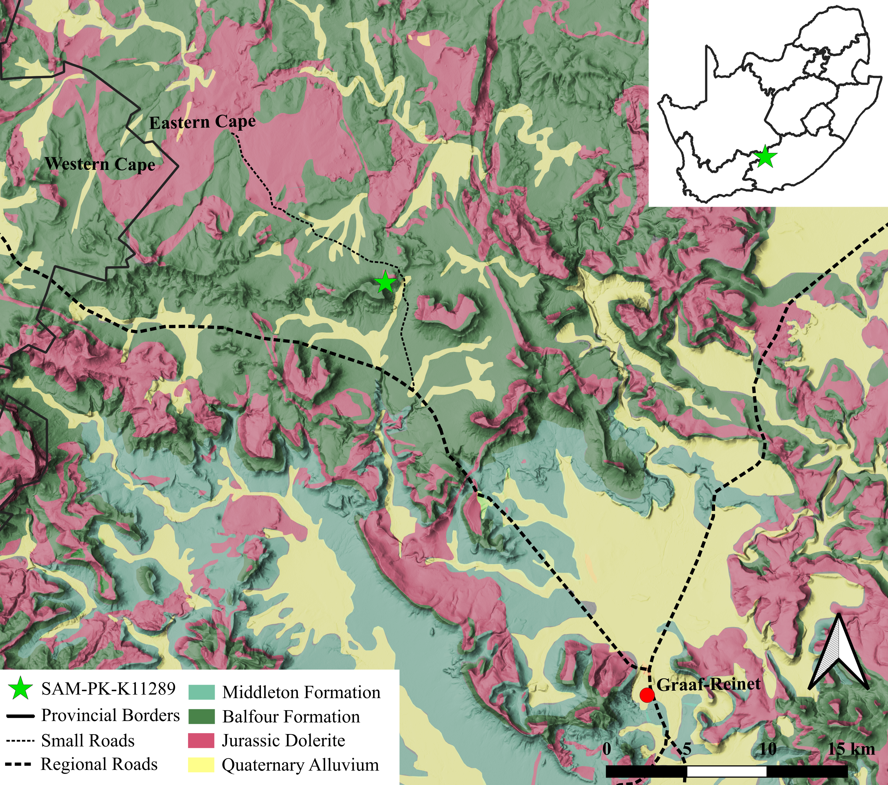
FARM OSFONTEIN- EASTERN CAPE, SOUTH AFRICA
Notes:
This bonebed was recovered from farm osfrontein WHICH IS IN THE ESATERN CAPE . THIS IS A HIGHLY FOLLIFEROUS AREA AND IS THE ORIGIN PLACE OF SOME OF THE SPECIMENS YOU SAW AT ESI IF you went for the tour lead by my collegue chandale .

Slide 7
1. Who is exhibiting this behaviour ?
2. How did it occur?
3. Why did it occur ?
Taxonomic make-up
Size/Age represented
Taphonomic Analysis
Data from 1 and 2 was used to infer why this aggregation occurred
Notes:
And to answer who is in this bonebed, I identified the taxonomic make-up of the bonebed using comparative anatomy and identified the age represented by the bonebed by taking linear measurements and statistically assessing them in R. To answer how it occurred, I assessed taphonomic modifications, recording any changes to shape, color size ect. Both these data helped me answer why this aggregation occurred.

Slide 8
Notes:
In order to answer all these questions , this bonebed was synchrotron scanned at the European Synchrotron Facility of Radiation . This data was then processed using VG Studio max at the Evolutionary Studies Institute. At this point AI was still relatively new so I had to manually segenment over 300 bones, so as you can imagine that was quite lovely.

Slide 9
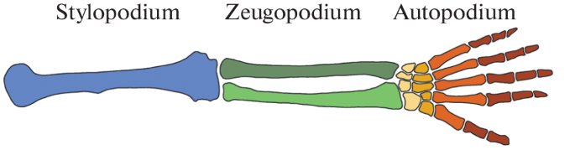
Notes:
The 3D renderings of the elements in the bonebed allow the differentiate the sylopodia, from the zuegopodia and autopodia.

Slide 10
Notes:
The 3D renderings of the elements in the bonebed allow the differentiation of some discrete elements

Slide 11
Notes:
The 3D renderings of the elements in the bonebed allow the differentiation of Stylopodia from zeugopodia and autopod.

Slide 12
Notes:
The 3D renderings of the elements in the bonebed allow the differentiation of Stylopodia from zeugopodia and autopod.

Slide 13
Notes:
The 3D renderings of the elements in the bonebed allow the differentiation of Stylopodia from zeugopodia and autopod.

Slide 14
Taxonomic make–up
Notes:
All the identifiable cranial and post cranail skeletal elements in bonebed SAM-PK-K11289 are ascribed to Owenetta. The maxilla of Owenetta forms the major part of the snout. Its premaxillary process, anterodorsal and suborbital ramus are well developed. The premaxillary process contributes to the border of the external nares (see Figure 16). This is observed in Owenetta as seen in BP/1/4195a. The way in which the teeth are implanted in SAM-PK-K11289 is identical to BP-1-4195- The holotype of

Slide 15
Skeletal representation and MNI
Skeletal element | Right | Left | Total
Femur | 21 | 31 | 52
Humerus | 24 | 20 | 44
Tibia | 16 | 13 | 19
Fibula | 11 | 13 | 24
Radius | 12 | 11 | 23
Ulna | 4 | 7 | 11
NISP=316
MNI= 31
Notes:
The NISP (Total number of identifiable specimens) is at least 316 . This number theoretically represents the highest possible number of individuals in bonebed SAMPK-K11289. However in reality this number grossly exaggerates the MNI as one individual clearly contributes multiple elements to the assemblage. The MNI based on the left femur is estimated to be 31. For elements whose exact frequencies in the bonebed could be confidently determined, the expected frequency of the individual element is compared to the actual frequency observed (see Figure 24). Based on the MNI of 31,

Slide 16
Size Distribution
Notes:
Body size was used as a proxy for ontogeny in this study. Size does not directly imply growth stage, but can be used to infer the probable age (Merritt, 2015). The size distribution of the humeri and femora were assessed here using standard statistical analysis. We prioritize proximal limb bones because research reveals that they are the most reflective of body size

Slide 17
Humerus
Notes:
I assessed for the distribution of the femoral length and femoral circumference. Both of which exhibit statistically insignificance differences.

Slide 18
Femur
Notes:
I did the same analysis for the Humerus.
The variation observed in SAM-PK-K11289 is statistically insignificant such that it can be concluded that the elements were drawn from the same population, in this case they were drawn from individuals in the same ontogenetic class.

Slide 19
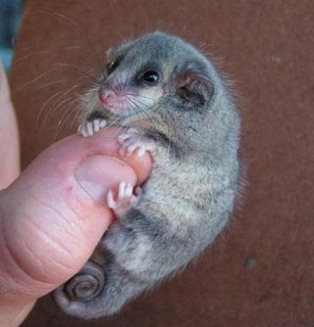
Body mass
Body Mass = 2.8479 ∗ 𝑙𝑜𝑔𝐶_{F}− 0.4587
Body Mass = 2.6861 ∗ 𝑙𝑜𝑔𝐶_{H} − 0.1438
Cercartetus nanus- Pygmy possum
10-45 grams
Jamie Harris - 2016
8.211 g -13,135 g
Campione and Evans -2012
Notes:
Body mass estimates were made from the skeletal scaling relationships outlined by Campione and Evans. The stylopodial circumferences were fitted into the appropriate equations to estimate body mass. To estimate body mass from the femora this equation was used:
Where 𝐶" is the femoral circumference in mm.
To estimate body mass from the humerus
Where 𝐶# is the humeral circumference in mm.
The

Slide 20
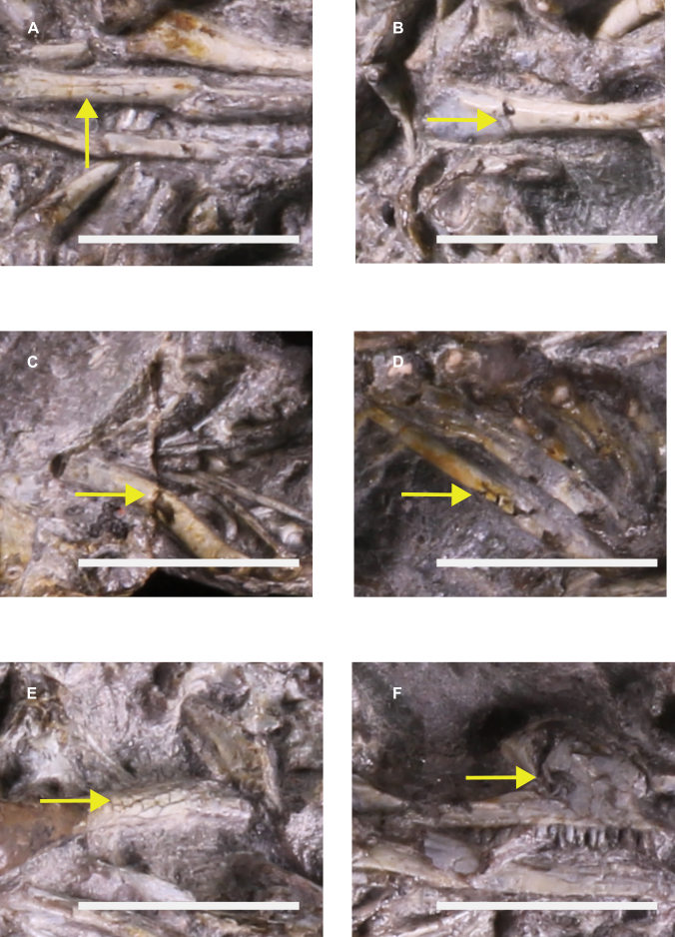
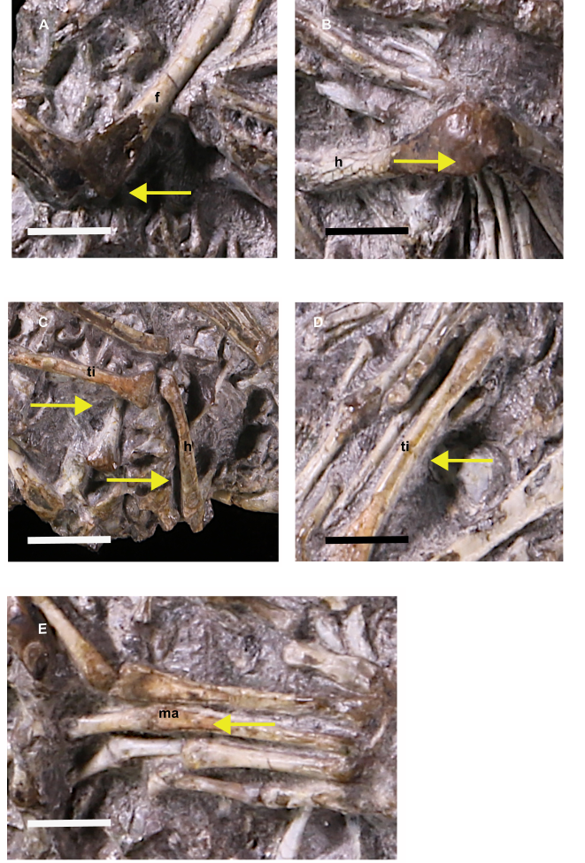
Taphonomic modifications

Slide 21
Articulation and Association
Notes:
Overall, the degree of articulation and element association of individual skeletons that make up the bonebed is relatively high. Only two individuals are preserved in nearly complete articulation, preserving bones of the axial and appendicular skeletons in near-life positions on the dorsal surface of the bonebed.

Slide 22
Articulation and Association
O1
O2
Notes:
Another common style of articulation and association observed in the bonebed involves the vertebral column

Slide 23
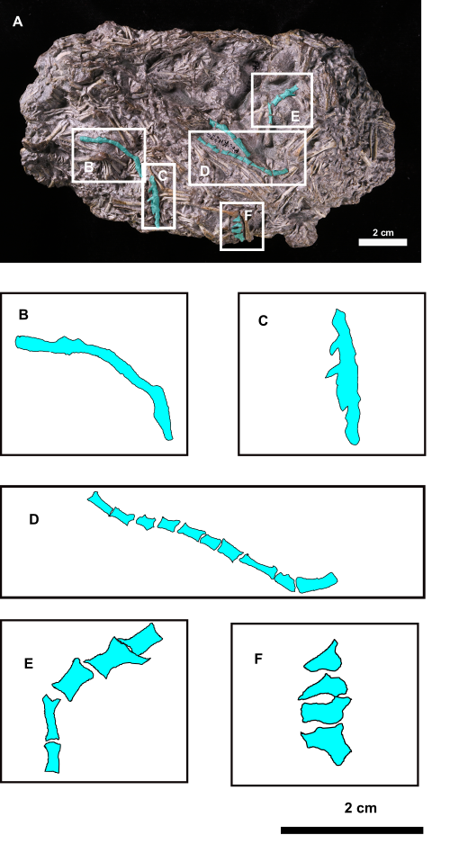
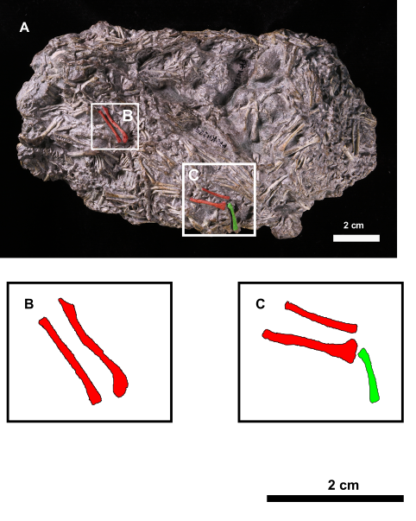
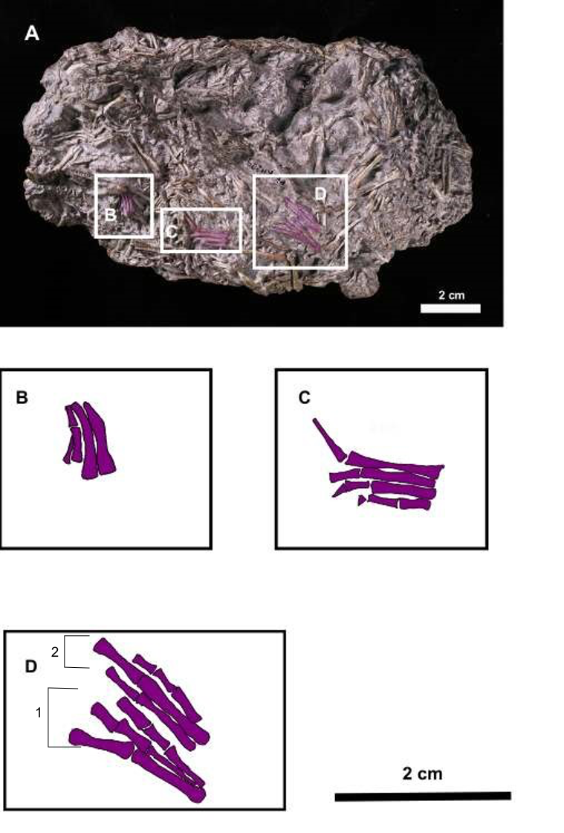
Notes:
The articulated segments of different sections of the vertebral column are commonly found in the bonebed. Each series differs in length from the next. The number of individual vertebrae in a series can range from 4 to 12. In some series, the individual vertebral element cannot be determined because the matrix around the vertebral column is not fully prepared in order to preserve the delicate elements. Some vertebral series preserve their true anatomical positions, such that the series forms a curve. And in other series, the vertebral elements have been slightly displaced but remain strongly associated.
The limbs are commonly found dismembered from the rest of the skeleton but remain articulated or strongly associated. This articulation style is an obvious feature of the bonebed, recorded 21 times on the surface.
The most interesting articulation and association style observed in the bonebed involves pedal and manual digit bones. This mode of articulation is relatively abundant in the bonebed, with 12 instances of the autopod in articulation

Slide 24
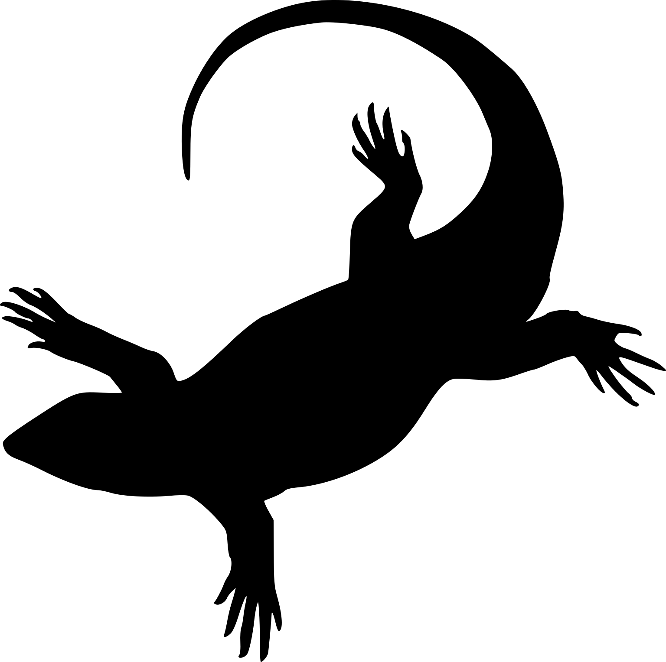
Conclusion
Owennetta
Single age/size class
31 individuals
Predator or behavioural aggregation ?
Evidence for a behaviourally driven aggregation for bonebed SAM-PK-K11289 specimen is the strongest
Notes:
.

Slide 25
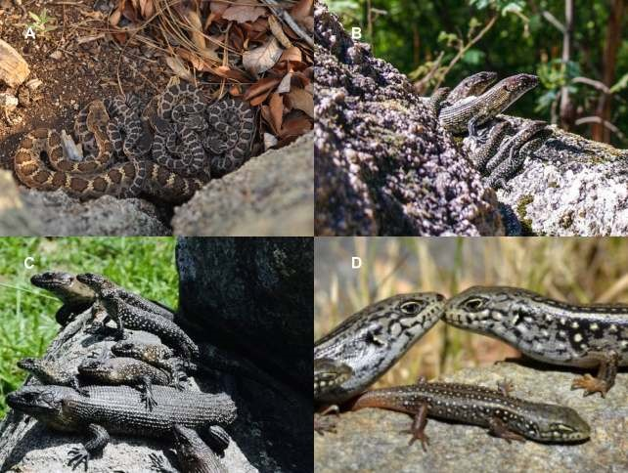
SAM-PK-K11289
(A) Arizona black rattlesnake (Crotalus cerberus), (B) Group living in Cunningham’s skinks (Ergenia cunninghami) ,(C) Cunningham’s skink (Ergenia cunninghami) with, and (D), Egernia lizards (Ergenia saxatilis).
Meiri et al - 2020

Slide 26
Bonebed SAM-PK-K10818
Notes:
Specimens SAM-PK-K10818 (see Figure 35) is an aggregation that is identical to SAM-PK-K11289 that was found less than 3 km away from Osfontein farm where SAM-PK-K11289 was found and 20 m lower in the stratigraphic succession. However even more interesting is that it exhibits a taphonomic style that is similar if not identical to that of SAM-PK-K11289. Both these bonebeds share the same level of articulation. Elements of the limb are strongly associated but not preserved in their anatomical positions. The vertebrae here also form strings and ribs are severely underrepresented as in SAM-PK-K11289.

Slide 27
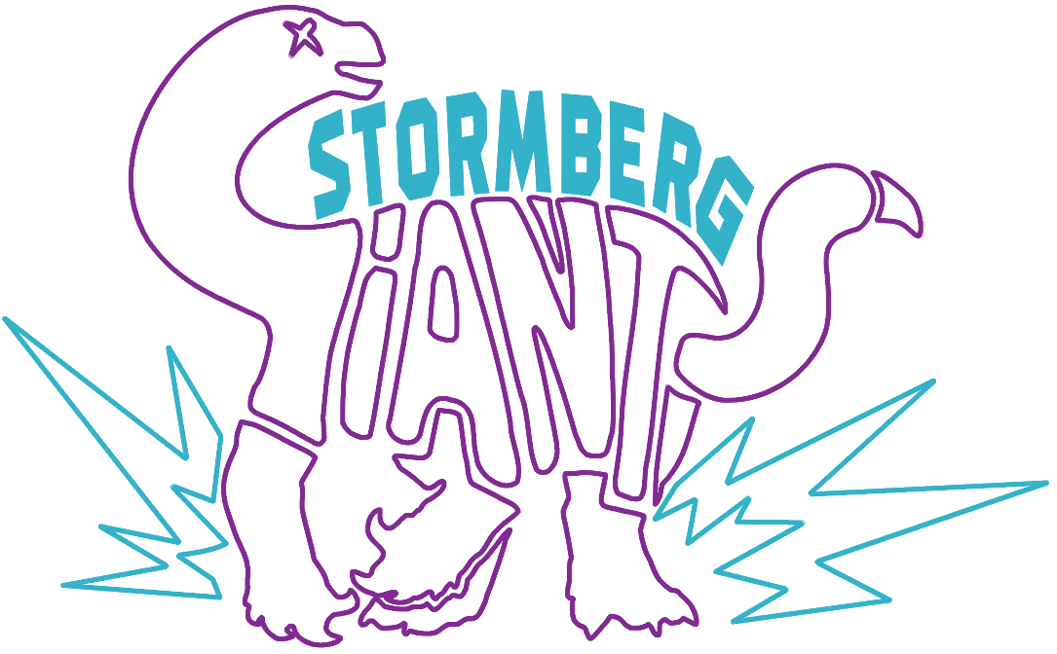
THANK YOU!
Kathleen Dollman, Vincent Fernandez, Stormberg Giants, Christian Kammerer,
Roger Benson, Marc Van den Brandt, Heidi Fourie , Zaituna Skosan, Julien Benoit,
Jeniffer Botha, Kimberly Chapelle, Bernhard Zipfel and Sifelani Jireh
Notes:
Thank you for listening to my minimally physics focused talk.

