Slide 1
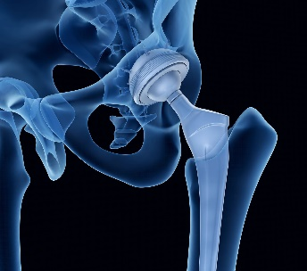
UNIVERSITY OF PRETORIA
Investigation of Biomimetic Coatings on Glassy Carbon and Ti-6Al-4V Substrates: Impact of Varying Surface Preparation Methods
Unaisa Dockrat
AfLS-2024 (7th)

Slide 2
Outline
Introduction & Background
Experimental Procedure
Results & Discussion
Conclusion
Acknowledgements

Slide 3
Introduction & Background
Biomaterials are evolving with the need for biomedical devices to enhance the interaction between synthetic materials and biological systems on the rise.
Biomaterial coatings produced via thermal spray, immersed in simulated body fluid, revealed the formation precipitate layer on the coating surface.
Biomimetic coatings replicate the intricate mechanisms and superior properties observed in biological systems.
Glassy carbon (GC): Excellent biocompatibility, unique mechanical properties, chemical resistance (Fischer & Scholz, 1999).
Ti-6Al-4V (Ti64): High strength, low density and superior corrosion resistance (Geetha et al., 2009).
UNIVERSITY OF PRETORIA
Fischer, J., & Scholz, F. (1999). J. Electroanal. Chem., 465(1), 157-163.
Geetha, M., Singh, A. K., Asokamani, R., & Gogia, A. K. (2009). Ti-6Al-4V alloy for biomedical implants. Journal of the Mechanical Behavior of Biomedical Materials, 1(4), 316-332.

Slide 4
Introduction & Background contd.
Surface preparation is a critical factor influencing the performance of biomimetic coatings.
Surface characteristics of the substrates such as roughness, chemical composition, and microstructure affect adhesion, durability and bioactivity of the coatings.
The aim of this study is: (1) to study the apatite layer previously observed on thermal sprayed coatings (2) to investigate the viability of biomimetic processes as a coating technical for biomaterial coating and (3) to examine the effects of different surface treatments on pure GC and Ti64 substrates.

Slide 5
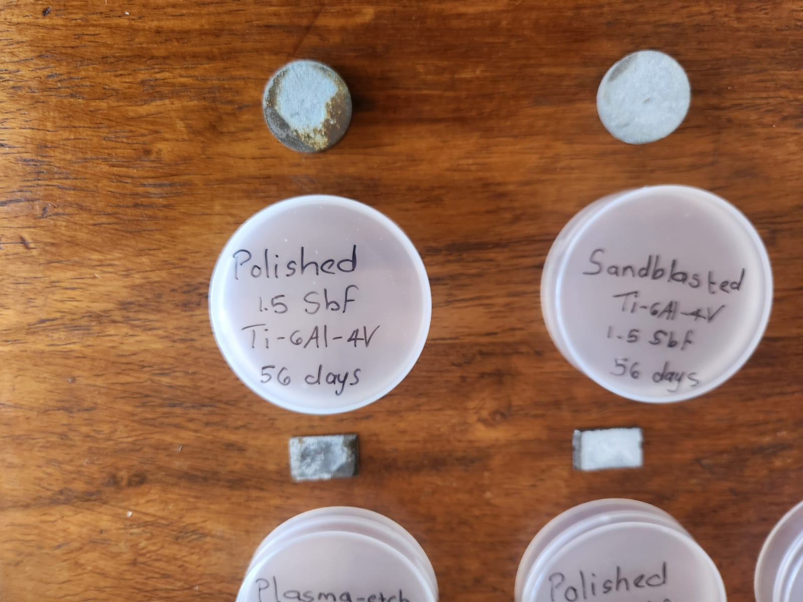
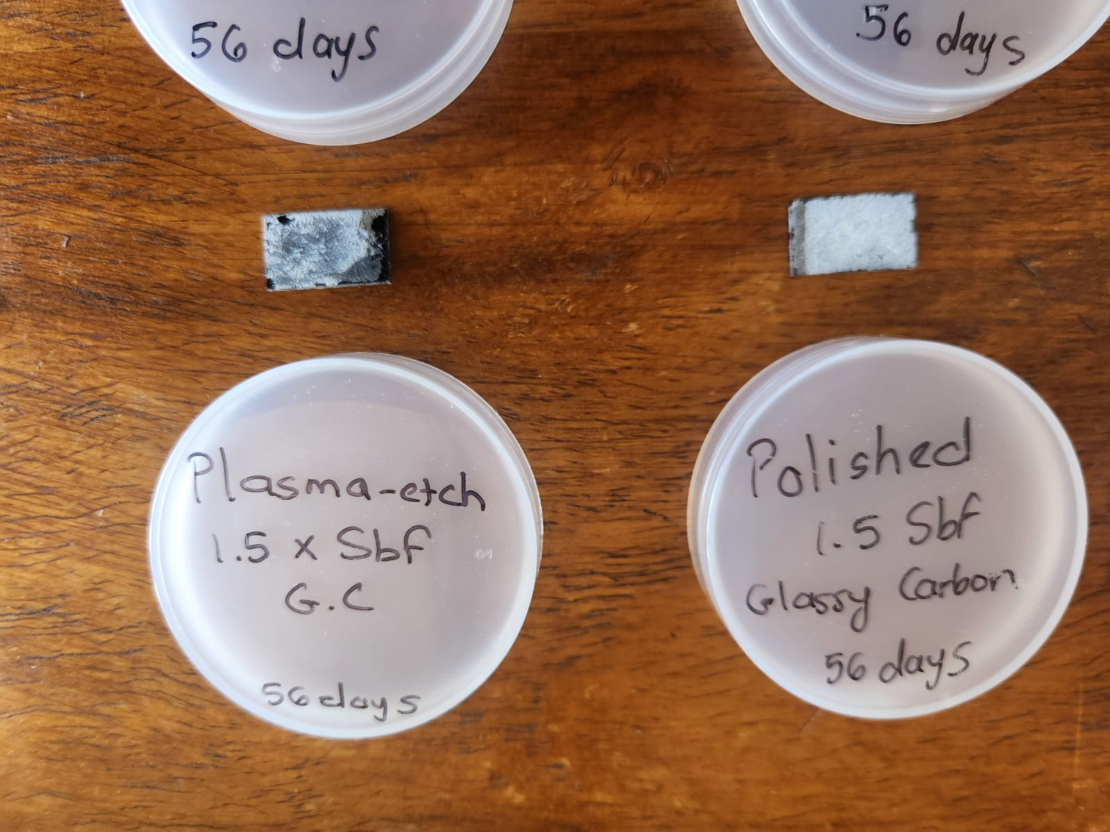
Experimental procedure
Substrate material:
Ti-6Al-4V & Glassy Carbon (GC)
Substrate Surface treatment:
Sandblasting - Ti64
Plasma Etching - Ti64 & GC
Polishing - Ti64 & GC
Incubation in Simulated Bodily Fluid (SBF):
Chemical salts for SBF
Incubation time: 56 days
Analysis techniques:
Scanning Electron Microscopy, Energy Dispersive X-ray Spectroscopy, Atomic Force Microscopy and X-ray Diffraction & Micro-CT Imaging.

Slide 6
Results and Discussion

Slide 7
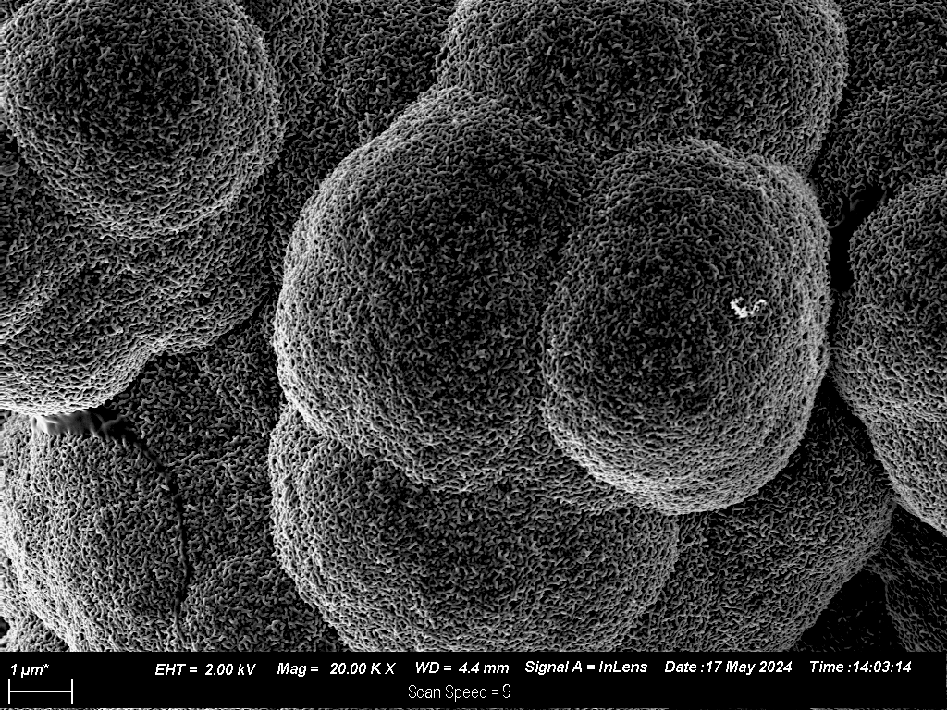
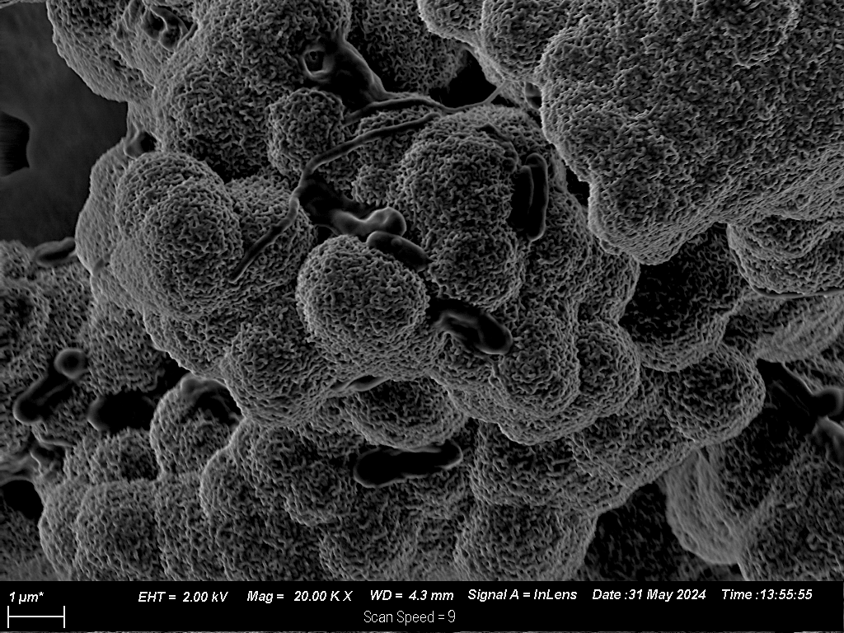
Scanning Electron Microscopy
(a)
(b)
Figure 1: SEM images of Glassy Carbon surfaces for the different surface preparation methods (a) plasma-etched, (b) polished.

Slide 8
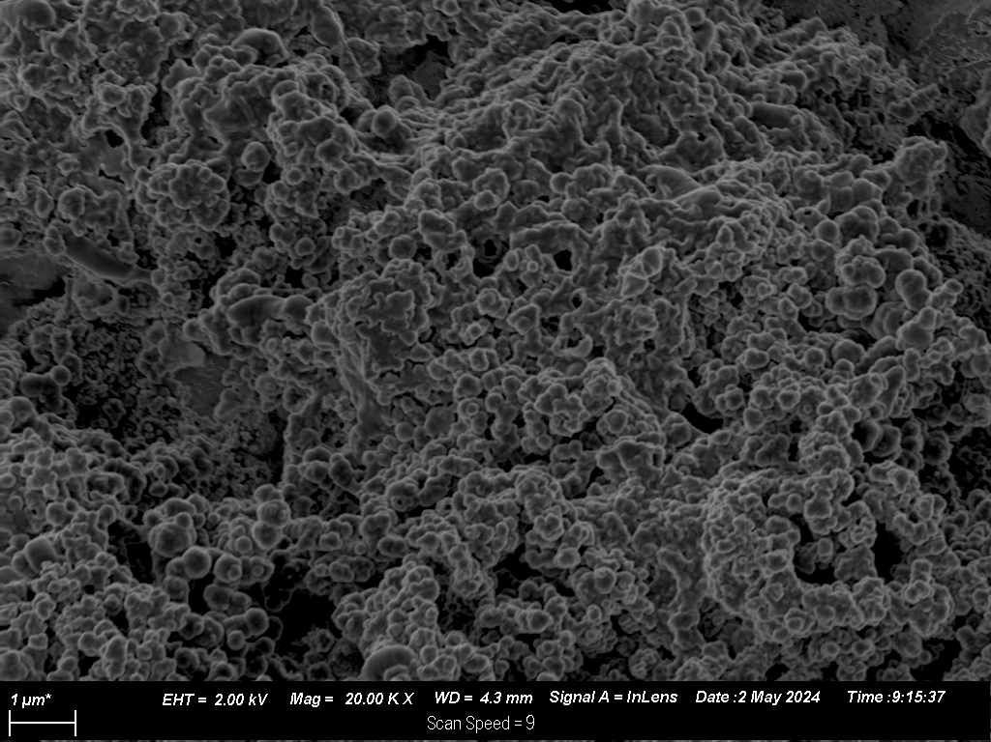
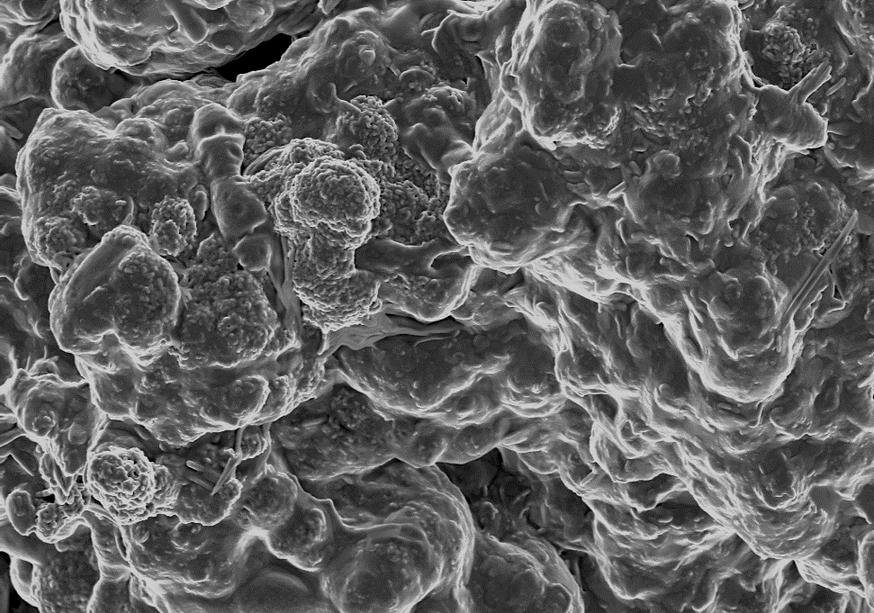
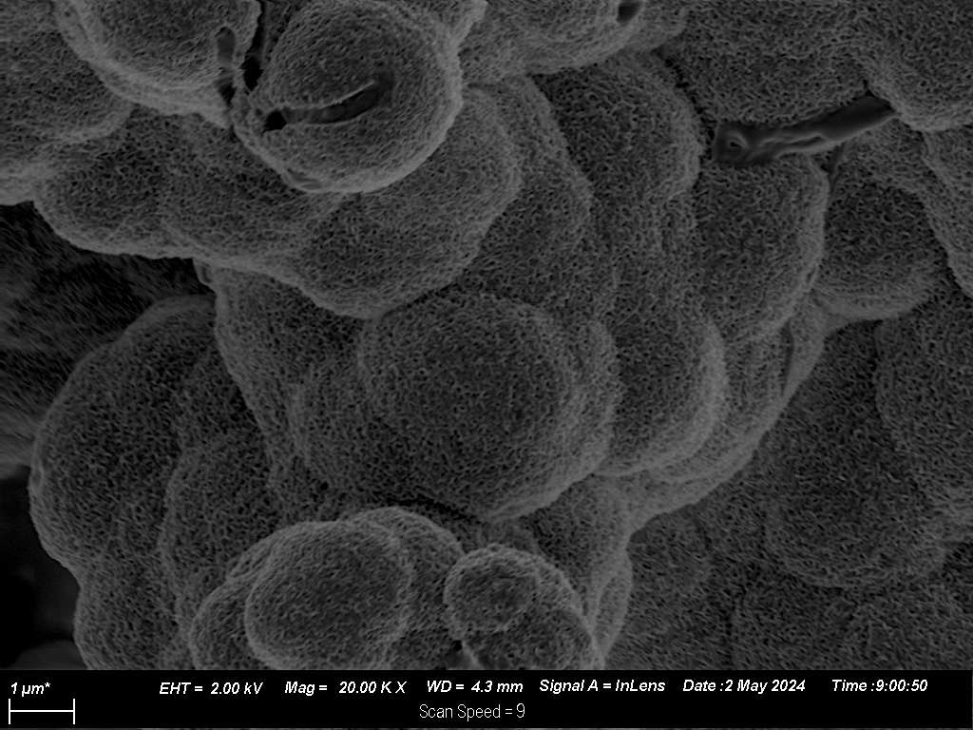
(c)
(d)
(e)
Figure 2: SEM images of Ti64 surfaces for the different surface preparation methods (c) plasma-etched, (d) polished and (e) sandblasted
Chandran, R., Kumar, S., & Behera, P. (2019). J. Mater. Sci. Technol., 35(4), 658-666.

Slide 9
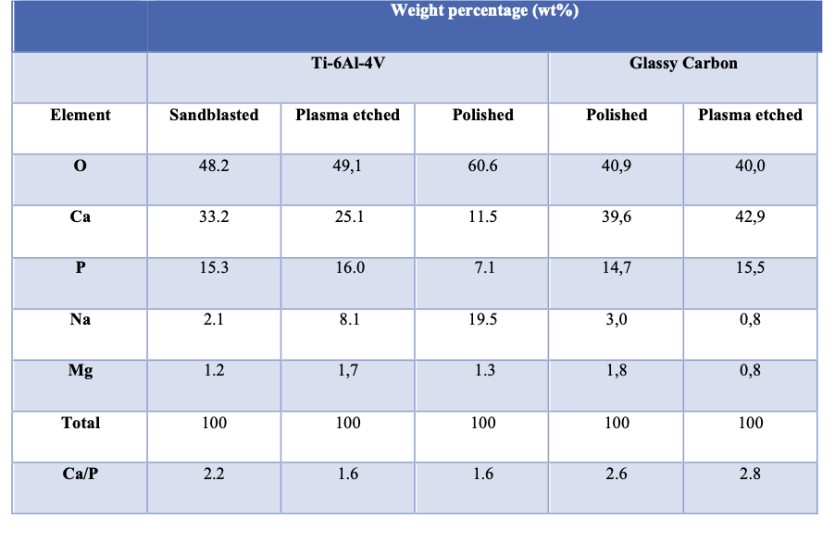
Energy Dispersive X-ray Spectroscopy
Table 1: Elemental composition of the surfaces for the GC and Ti64 samples for the different preparation methods

Slide 10
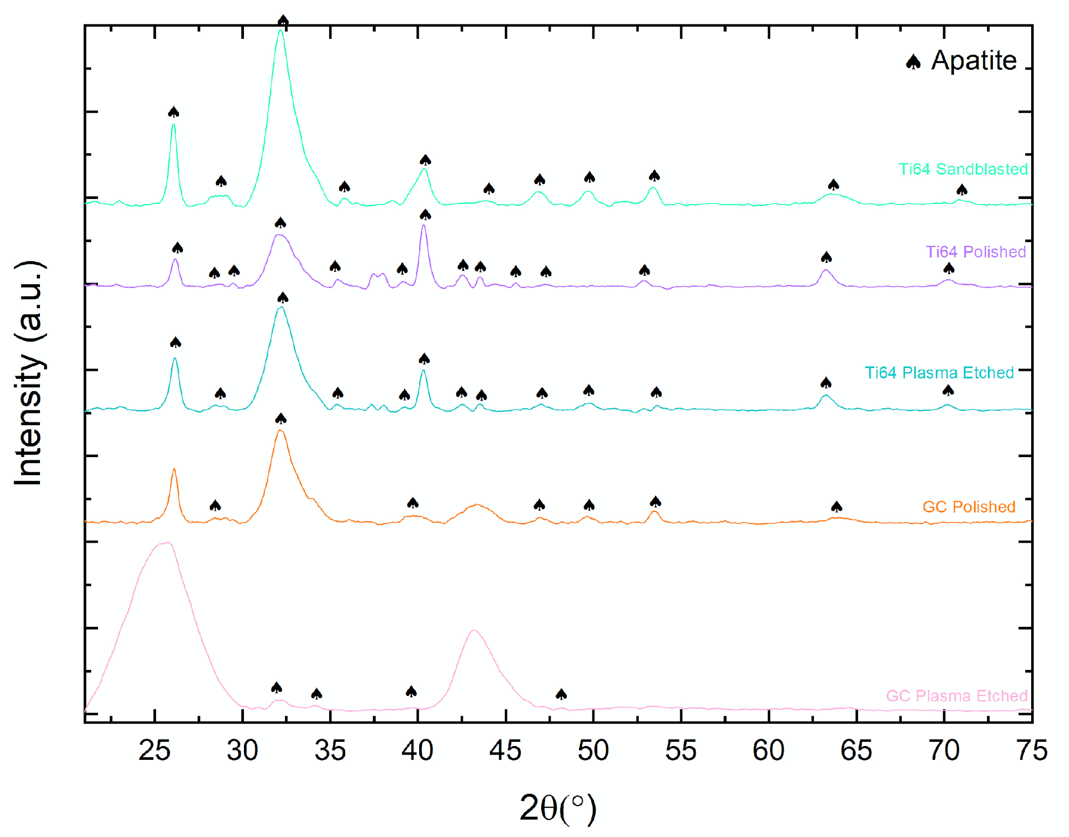
X-Ray Diffraction
Figure 3: XRD patterns of the GC & Ti64 samples immersed in SBF for 56 days.

Slide 11
Atomic Force Microscopy
Table 2: Young’s Modulus of the surfaces for the GC and Ti64 samples for the different preparation methods
Young’s Modulus of cortical bone: 17 - 25 GPa

Slide 12
Micro CT Imaging
(a)
(b)
(c)
Figure 4 : Micro-CT image of the Ti64 surfaces for the different surface preparation methods (a)sandblasted, (b) plasma-etched and (c) polished after immersion

Slide 13
Conclusion
Visual inspection confirmed that biomemotic process is a viable technique for biomaterial coating
EDS and XRD revealed that the precipitate layer was apatite (hydroxyapatite).
Analysis revealed surface pretreatments significantly impacts the formation and crystallinity of biomimetic apatite coatings.
Plasma-etching & sandblasted surfaces showed most effective for biomimetic coating formation.
GC exhibited a Young’s Modulus comparable to that of cortical bone, 17 GPa with Ti64 is higher.

Slide 14
Future work
Pressure studies at Synchrotron facility (XRD, GIXRD, XRF, XANES and SR-microCT) for: coating microstructure, elemental composition & coating stability.
Durability of biomimetic coatings in implant technology.
Durability of biomimetic coatings in implant technology.
Mechanical tests such as adhesion, hardness test etc.

Slide 15
Acknowledgements
Dr T.T. Thabethe
Dr T.P. Ntsoane
Prof J.B. Malherbe
Prof C. Theron
Physics Department
Friends
FAMILY

