Slide 1

Societal and Economic Impact of a Synchrotron Light Source
Qun Shen
Deputy Director for Science
National Synchrotron Light Source II (NSLS-II)
Brookhaven National Laboratory
AfLS-7 Conference, Johannesburg, SA, November 18-22, 2024

Slide 2
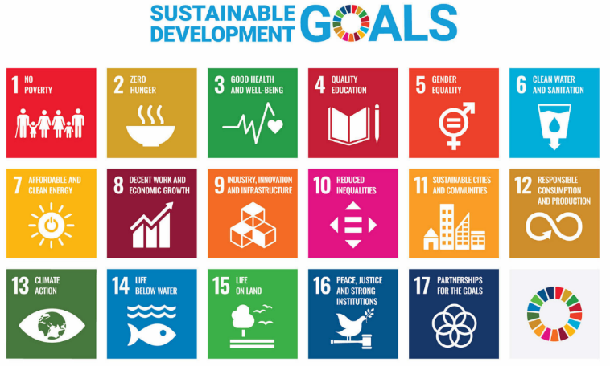
Outline
Introduction to light sources
Science programs and highlights
Societal & economic impact
  UN sustainable development goals
  Connecting & engaging communities
  Help develop local workforce
  Contributing to local economy
Summary

Slide 3
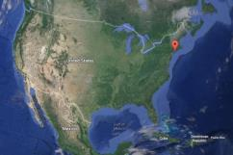
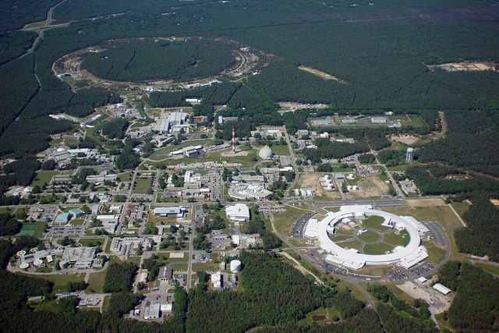
Brookhaven National Laboratory
  Located on Long Island
  Land: 5322 acres
Multidisciplinary programs
~3000 staff, postdocs, students
RHIC → EIC
ENV
PHYS
CHEM
CSI
ISB
CFN
NST
NSLS-II
BIO
Notes:
3

Slide 4
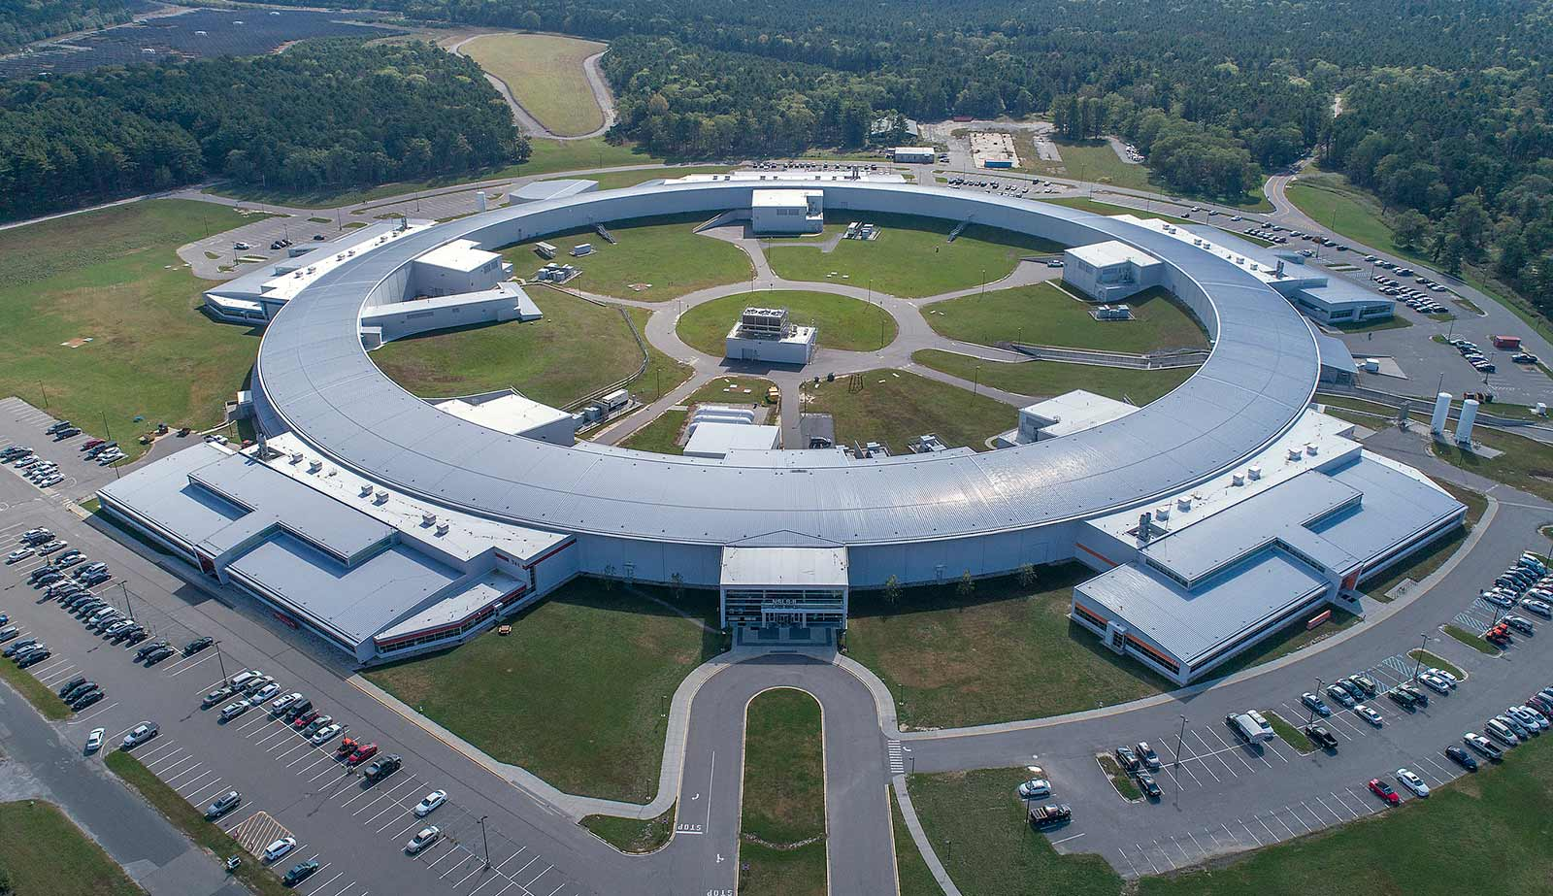
Storage Ring Circumference 792 m
NSLS-II
Beamlines ~70-110 m

Slide 5
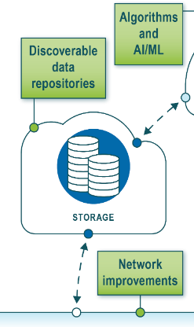
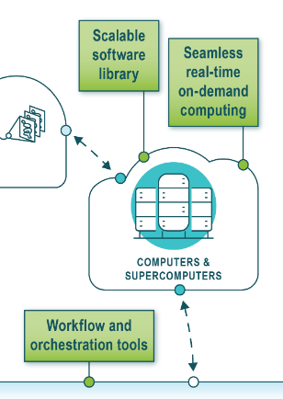
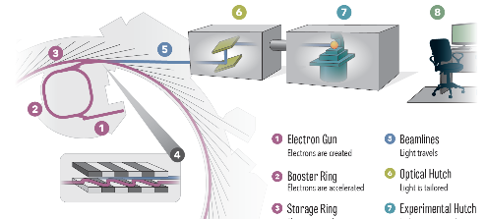

Synchrotron Light Source User Facility
  Accelerator: accelerate electrons to circulate in storage ring at almost speed of light, producing bright synchrotron light
  Beamlines dedicated for spectroscopy, scattering, diffraction, imaging, dynamics
  LINAC
  Booster ring
  Storage ring
  Insertion device
  Beamline
  Users – visiting / remote researchers access via peer-reviewed beamtime proposals
  Data science: data storage & infrastructure, remote operations, AI/ML tools, autonomous experiments
Notes:
Every beamline is a little different from another. You may ask why. The reason is that when synchrotron X-rays hit your sample, they create interactions with atoms in your sample. There are two main types of basic interactions ….

Slide 6
Why X-rays? X-rays as Waves or as Particles
The fact that E-M waves can be described by either waves or by quantum particles is very useful materials applications, as it allows applying the most convenient theory to our experiments
Scattering: Waves
Spectroscopy: Photons
Materials structure: → Where are the atoms?
e
Chemical states of atoms: → How are atoms bonded?
Absorption spectroscopy
Emission spectroscopy
Photoelectron spectroscopy
γ’
γ

Slide 7
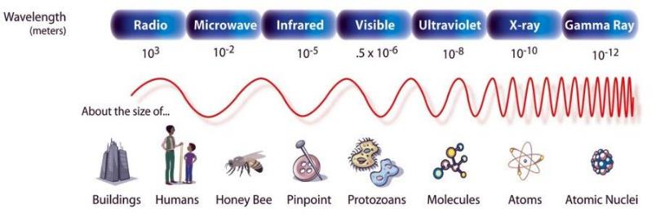
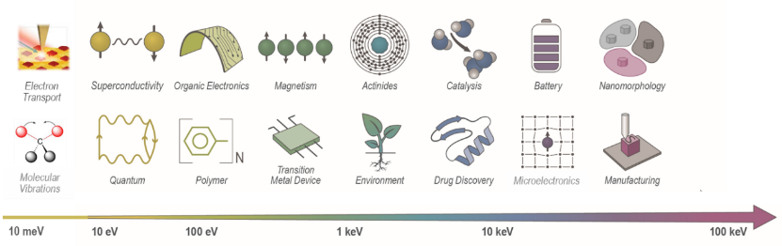
Synchrotron Light Can Extend Human Vision to See the Nano- and Atomic World
Light source extends human vision and allows us to see tiny things from microstructures to molecules and atoms
Science at light sources cover very broad range of research fields → research impact many areas in people’s lives
Notes:
Because NSLS-II produces light at very short wavelengths, i.e. X-rays, we are able to “see” individual atoms and molecules, which helps scientists understand how materials function. We can learn about the structure and the chemical makeup of many kinds of materials at atomic resolution.

Slide 8
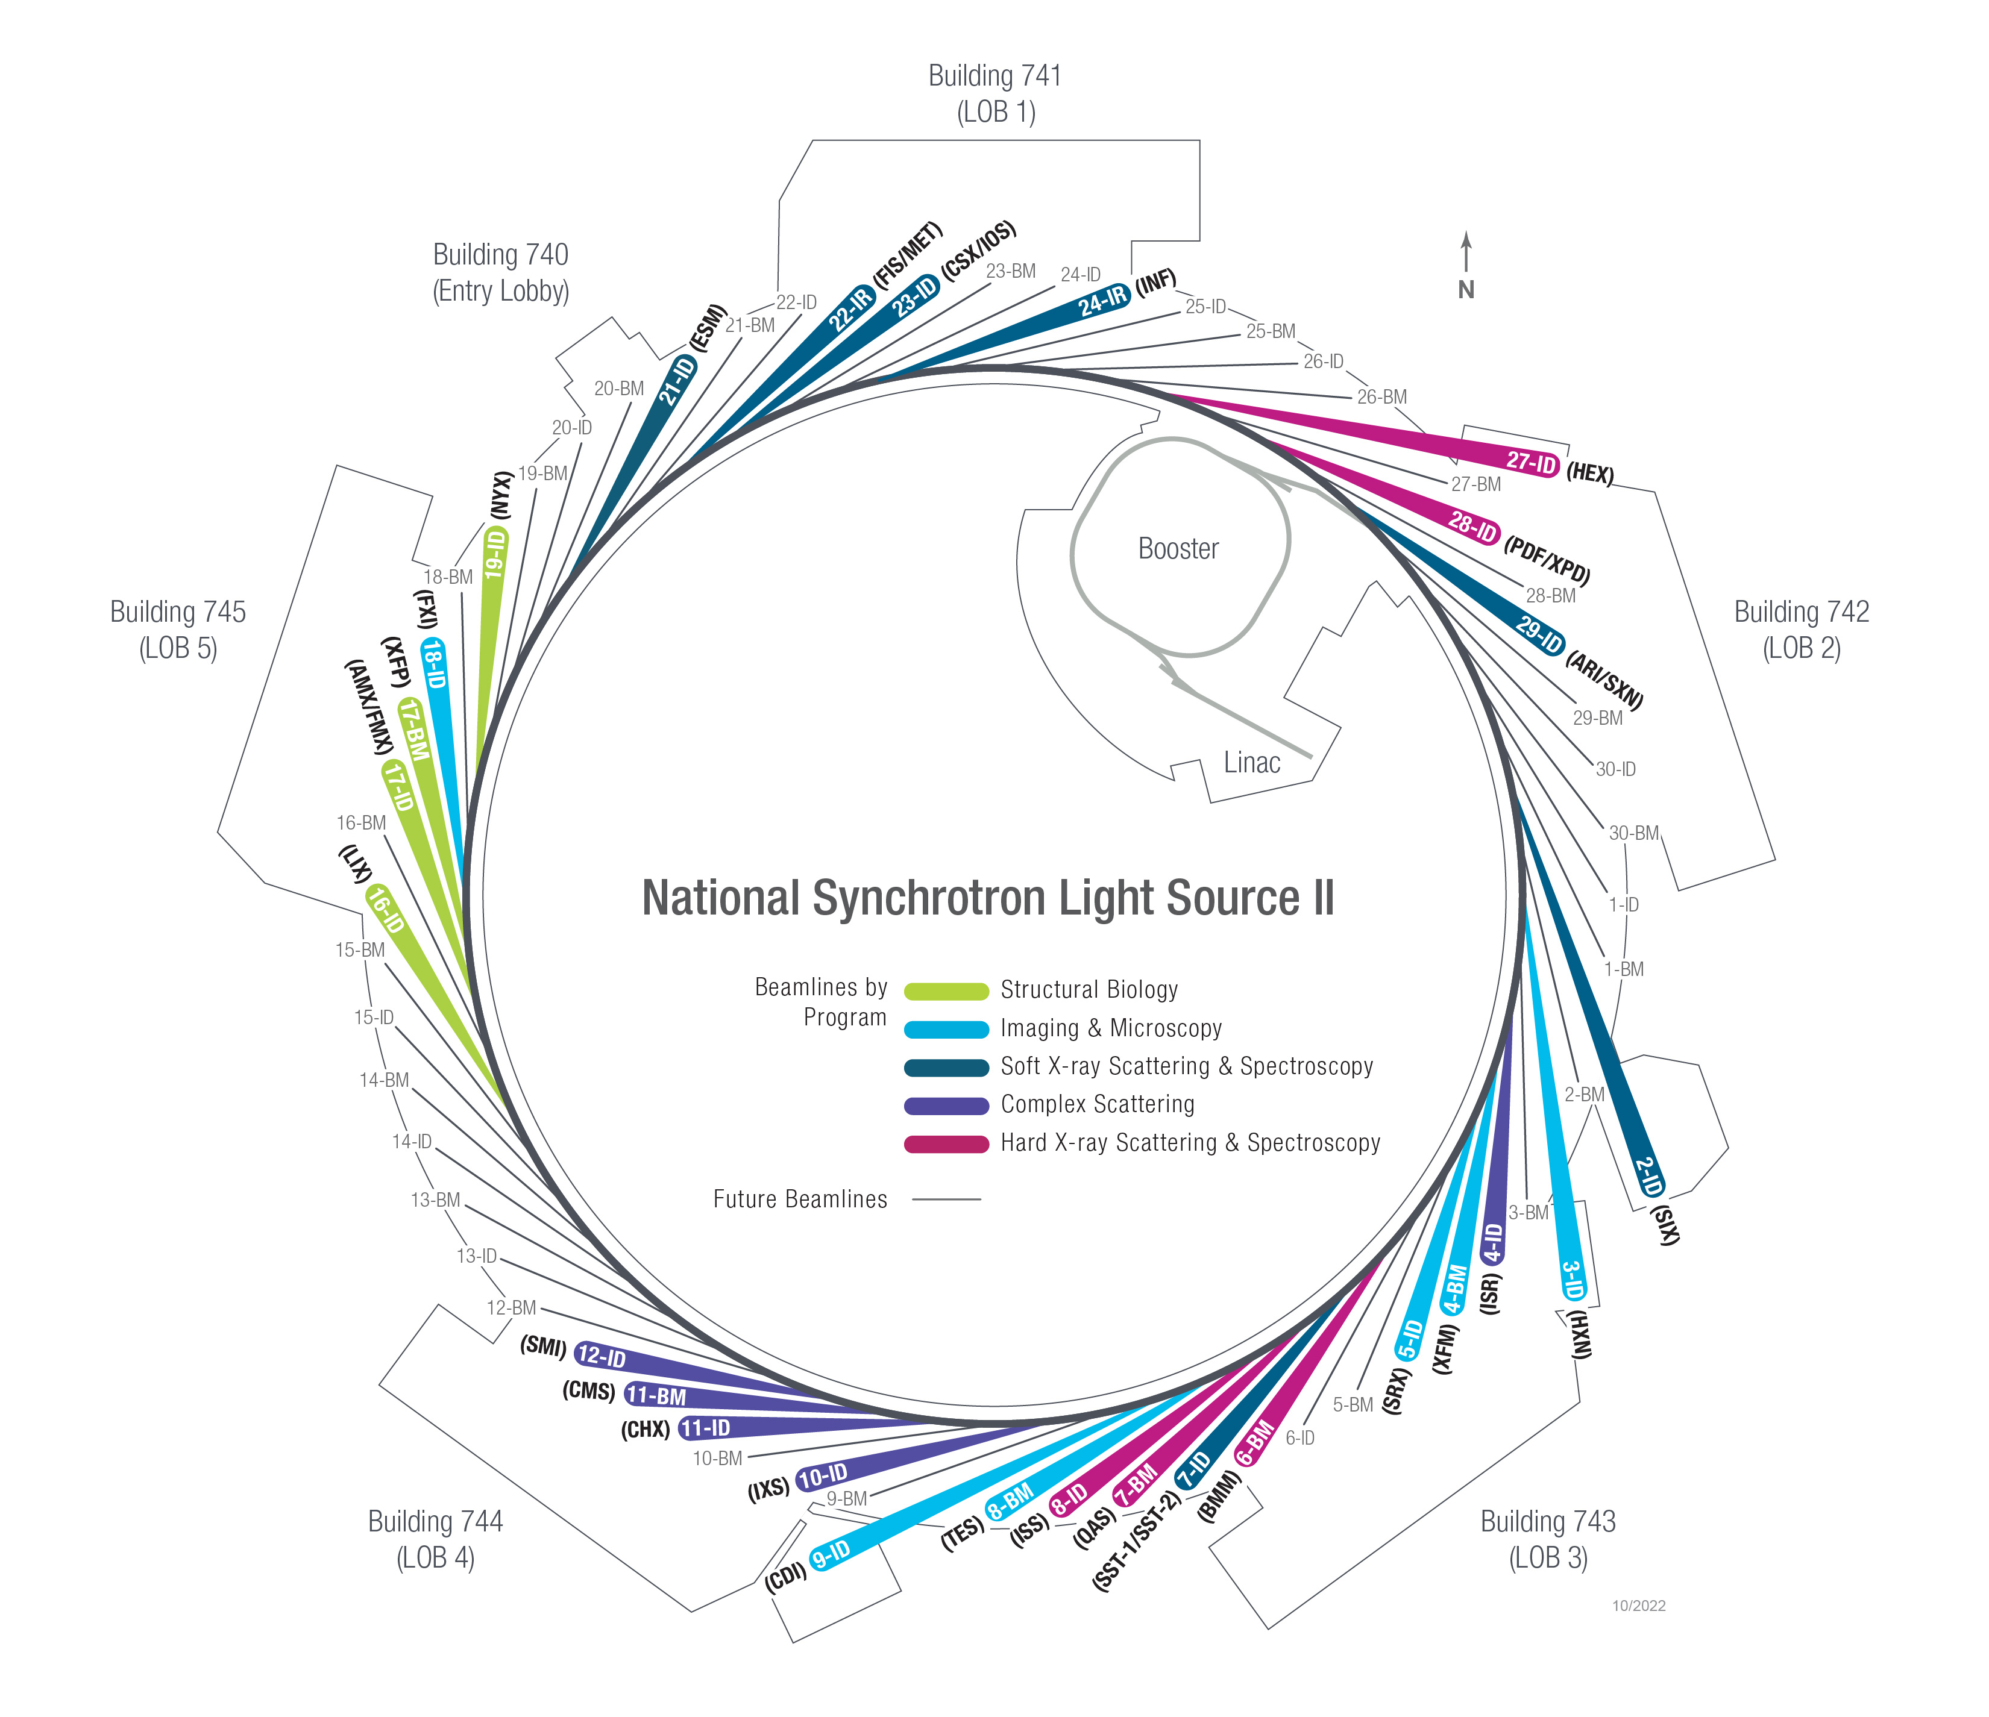
NSLS-II at a Glance
NSLS-II storage ring: 3 GeV, 792 m, 500 mA
User operations started July 2015
Enable research using broad spectra of light, from IR to hard X-rays
29 BLs in operation, 8 beamlines under development
Capacity for ~60 BLs: New NEXT-III project approved by DOE to develop additional up to 12 new BLs
https://www.bnl.gov/nsls2/images/nsls2-beamlinesclock-jpg.jpg

Slide 9
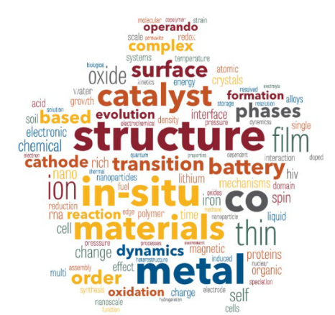
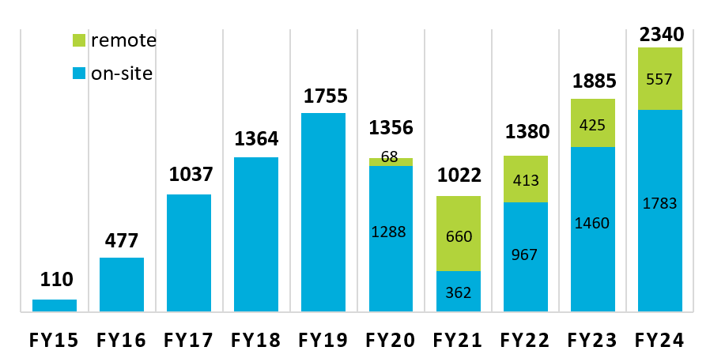
NSLS-II Users
FY24 Fraction Onsite users: 76%
FY24 First-time users:
On-site: 608
Remote: 153
Fraction onsite: 80%
FY24 User visits (no staff):
On-site: 4109
Remote: 1689
Fraction on-site: 71%
*** RECORD NUMBER of users already in 2024***
22% increase over 2023
As of September 30, 2024

Slide 10
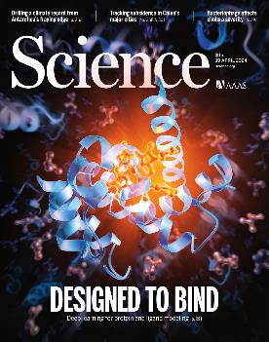
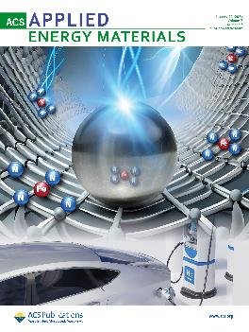
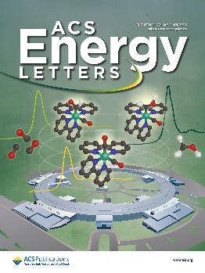
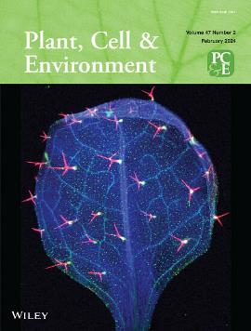
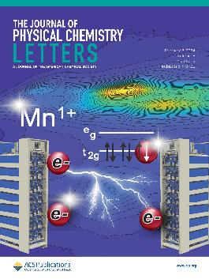
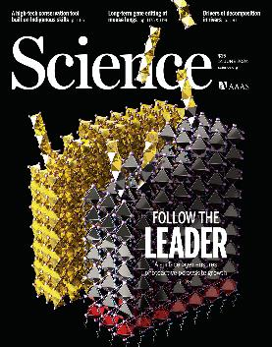
FY24 NSLS-II Journal Covers
BMM
CMS
XPD
ISS
ISS
TES
SST-1
AMX
R. Krishna, et al.,
Science 384, 6693 (2024).
C.‐C. Chung, et al. Adv. Mater. Interfaces 10, (2023).
R. Ezhov, et al. ACS Appl. Energy Mater. (2023).
I. Barba-Nieto, et al. ACS Energy Lett., 3815 (2024).
ISS
FXI
PDF
XPD
XFM
ISS
CMS
I.E. Mathew, et al., Plant Cell & Environ. 47, 557 (2024).
X. Liu, et al., Phys. Chem. Chem. Phys. (2024).
O. Maximova, et al., J. Phys. Chem. Lett. 15, 1521 (2024).
S. Sidhik, et al. Science, 384, 1227 (2024).

Slide 11
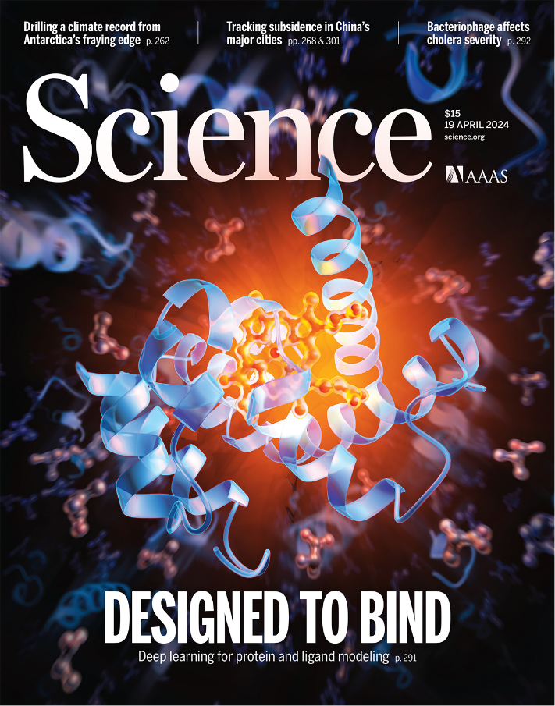
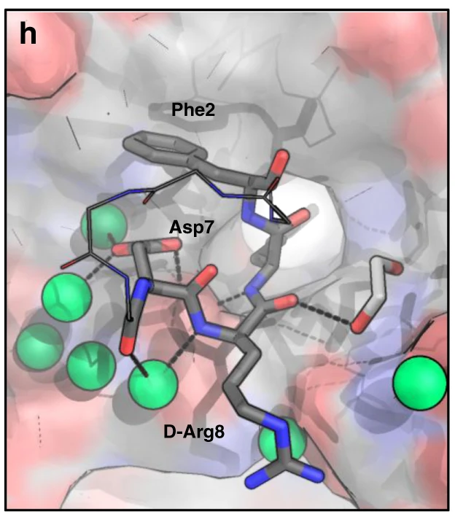
2024 Nobel Prize in Chemistry
Congratulations to David Baker!
NSLS-II AMX
Two scientists, Demis Hassabis, John Jumper, at Google DeepMind and an American biochemist, Prof. David Baker in Univ. of Washington (NSLS-II user) have been awarded the 2024 Nobel prize in chemistry for breakthroughs in predicting and designing the structure of proteins
BES light sources including NSLS-II have played critical roles in providing the protein structural data from the past decades to train ML models, and in experimental verifications of biomolecular modelling and predictions by AI engines
R. Krishna, et al., Science (2024). DOI: 10.1126/science.adl2528
Parisa Hosseinzadeh, …, David Baker, Nature Comm. (2021). DOI: 10.1038/s41467-021-23609-8.

Slide 12
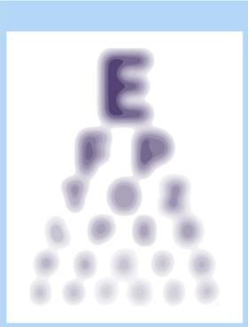
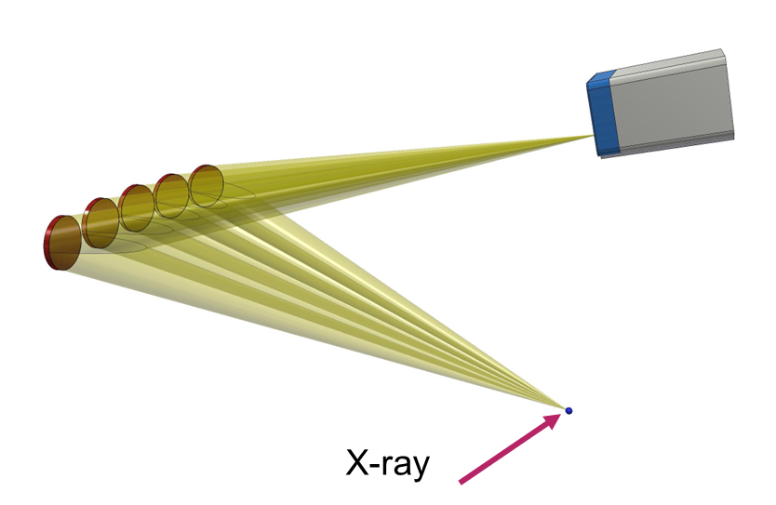
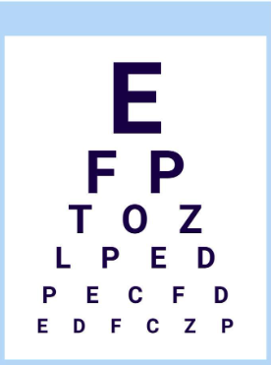
Unblurring X-ray Absorption Spectra with X-ray Emission Spectroscopy (XES)
Slide from Eli Stavitski
Hg metal
Sharpen the spectral feature – XES
Helps identify Hg chemical states → where toxic Hg may be coming from
Hg sulphate
Hg oxide
Hg acetate
12280
12290
12300
12310
12320
12280
12300
12320
12340
12360
Energy, eV
Energy, eV

Slide 13
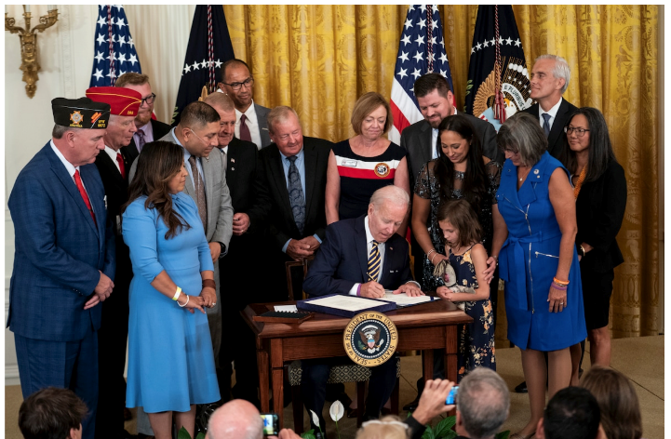
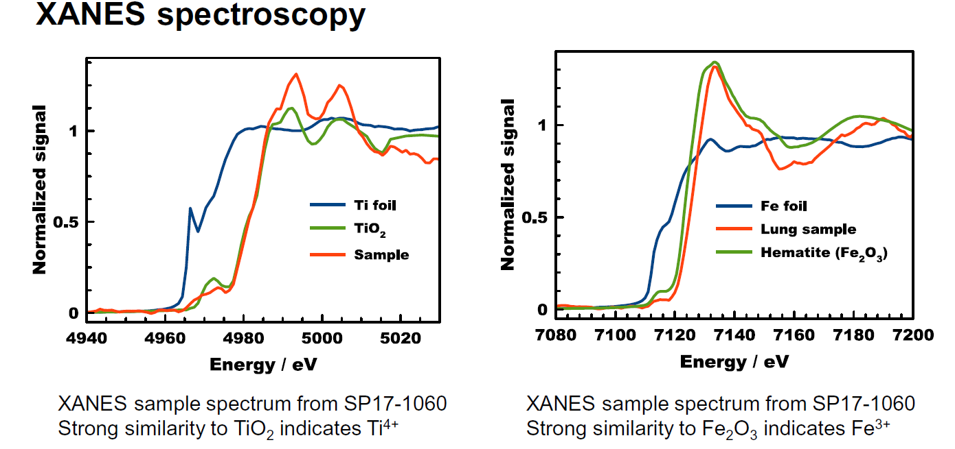
Toxic Metals in Soldiers’ Lungs From Burn Pit Exposure
Scientific Achievement
Scientists showed that oxidized titanium and iron accumulated in the lungs of war veterans after exposure to burn pits in Iraq and Afghanistan, likely contributing to chronic lung injury.
Significance and Impact
As a result of this study and many others, legislation was passed in August 2022 that provides expanded benefits and services for these war veterans.
President Biden signed into law the Pact Act on August 10, 2022 – bipartisan legislation to help veterans exposed to toxic burn pits in Iraq and Afghanistan (S. Silbiger, Washington Post).
T, Olsen, et al. Iraq/Afghanistan war lung injury reflects burn pits exposure. Sci Rep 12, 14671.
Work was performed in part at NSLS-II at Brookhaven National Lab.
Notes:
Summary:
Since 2003, previously-healthy Iraq and Afghanistan war veterans began to self-report new-onset respiratory symptoms associated with deployment. Exposure to airborne hazards, especially emissions from burn pits, are proposed as a causative factor. During these wars, disposal of massive amounts of waste was known to take place in open-air fashion without incinerators, using jet fuel as an ignition source. Materials burned included chemicals, paint, medical and human waste, electronics, plastics, and munitions. The resulting emissions contain a wide range of toxic chemicals, particulate matter, and heavy metals. However, between 2007 and 2020, the Department of Veterans Affairs denied 78% of disability claims for toxic exposures related to burn pits, indicating that there was insufficient scientific information on the long-term health affects of burn pit exposure.
This study aimed at confirming the link between war veteran lung injury and toxic burn pits by examining lung biopsies from affected Iraq and Afghanistan war veterans. These findings were correlated with non-invasive lung diagnostic testing.
Scientists imaged biopsy samples from Iraq and Afghanistan war veterans using X-ray fluorescence microscopy at the Sub-micron Resolution X-ray microscopy (SRX) beamline at the National Synchrotron Light Source II. NSLS-II is a U.S. Department of Energy (DOE) Office of Science User Facility located at DOE’s Brookhaven National Laboratory (BNL). Results showed that micron-sized particles of titanium and iron were found in all five lung samples examined. Micro-spectroscopy revealed that all metals were oxidized, i.e., Fe³⁺ or Ti⁴⁺, supporting inhalation of burned metals.
Raman spectroscopy of the lung tissue also identified carcinogenic polycyclic aromatic hydrocarbons (PAHs), which are a product of incomplete jet fuel combustion. The presence of PAHs, along with the oxidized metals, strongly suggested that inhalation of burn pit plumes was a key contributing factor to the lung injury.
As a result of this study and many others, President Biden signed into law the “Pact Act” on August 10, 2022. According to a White House statement, “The bill dramatically expands the benefits and services for veterans exposed to such toxins, mainly in the two wars, who may develop injuries and illnesses that take years to manifest themselves. Those realities often made it difficult for veterans to establish a direct connection between their service and disabilities, preventing them from getting the care they needed.” The law creates a $280 billion stream of federal funding, making it one of the largest expansions of veterans benefits in American history.
Present at the signing was the lead author of this paper, Anthony Szema.
Funding:
This research used beamline 5-ID, the sub-micron resolution X-ray spectroscopy (SRX) beamline, of the National Synchrotron Light Source II, a U.S. Department of Energy (DOE) Office of Science User Facility operated for the DOE Office of Science by Brookhaven National Laboratory under Contract No. DE-SC0012704.
Full Reference:
T, Olsen, D. Caruana, K. Cheslack-Postava, A. Szema, J. Thieme, A. Kiss, M. Singh, G. Smith, S. McClain, T. Glotch, M. Esposito, R. Promisloff, D. Ng, X. He, M. Egeblad, R. Kew, A. Szema. Iraq/Afghanistan war lung injury reflects burn pits exposure. Sci Rep 12, 14671 (2022). DOI: 10.1038/s41598-022-18252-2

Slide 14
Light Source: Ideal Infrastructure to Address UN Sustainable Development Goals
Community and quality education for workforce development
Capabilities to enable research for sustainable development
Outreach that promote diversity, equity, inclusion & accessibility

Slide 15



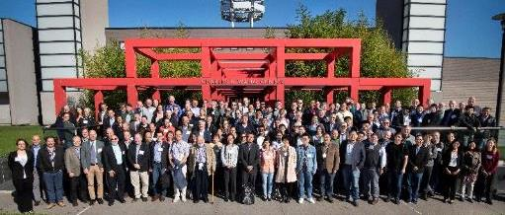
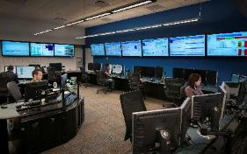
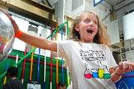
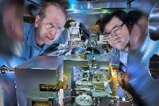
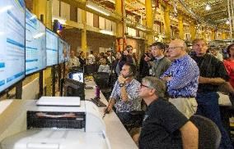
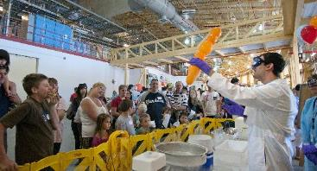
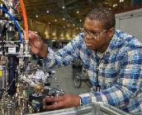
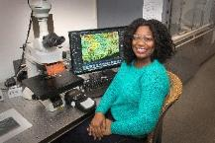
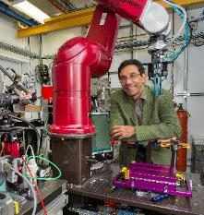
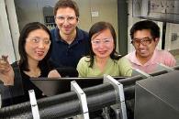
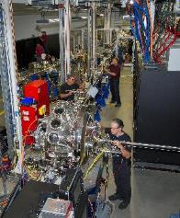

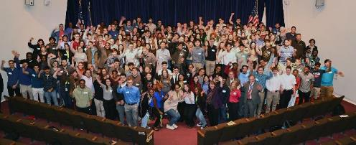


NSLS-II Users and Community

Slide 16







Industrial Research at NSLS-II
New Materials
Advanced Manufacturing
Bioscience & Environment
Energy Storage & Renewables
Petrochemicals & Catalysis
Microelectronics & Quantum
Pharmaceuticals & Human Health
https://www.bnl.gov/nsls2/industry/research.php

Slide 17
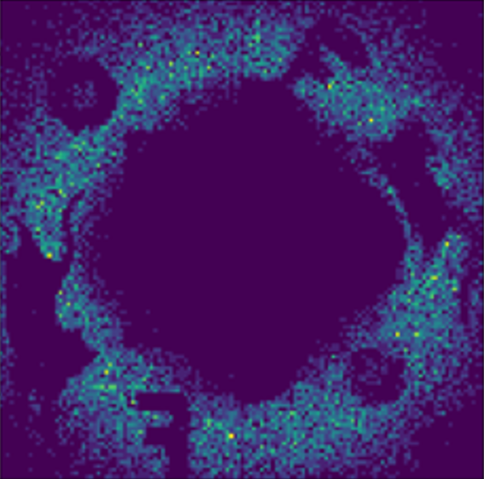
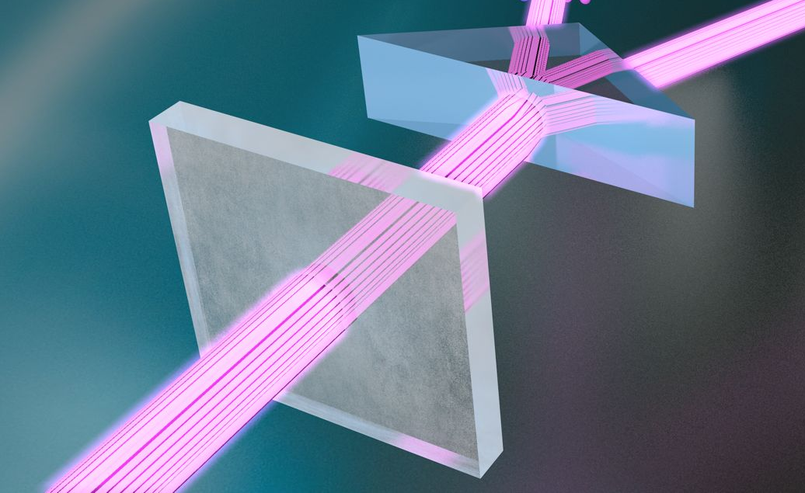
Quantum Ghost Imaging and Scattering Using Entangled X-ray Photons
Science Question:
Can we observe biological interactions and dynamics as a function time in crowded environments in specimen’s natural states with reduced radiation dose?
Research needs: Development of novel X-ray imaging and scattering methods that require much reduced dose, e.g. based on quantum ghost imaging using entangled X-ray photons.
  NSLS-II:
  First-ever ghost imaging using entangled X-ray photons
    Coherent scattering in biological and soft materials can reveal dynamics at millisecond and mesoscale resolutions
Quantum Ghost
Quantum Direct
Sample (cat)
Imaging demonstration at NSLS-II's CHX beamline using down converted entangles photons
Notes:
XQCS consists in exploiting the non-local correlations between two "copies" of a (coherent) scattering experiment, only one of which includes scattering from the sample. This scheme results in a reduction of the dose required in a (coherent scattering) experiment. The proposed XQCS method would employ state of the art detectors achieving time resolution of 1ns or better and beam splitting techniques (kinoform optics) to enable unprecedented time resolutions for X-ray Photon Correlation Spectroscopy and spatial resolutions for Coherent Diffraction Imaging
https://doi.org/10.1103/PhysRevA.101.013820 - "Ghost imaging at an XUV free-electron laser" Using electron bunch shot noise as an HBT non-local correlation source.
https://www.pnas.org/doi/full/10.1073/pnas.1904839116 - "Quantum phase-sensitive diffraction and imaging using entangled photons" ~Ip^(½) scaling of the resolution with the incident field intensity

Slide 18


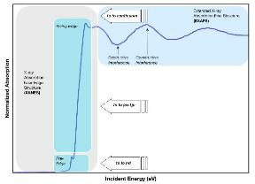
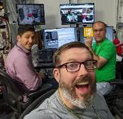
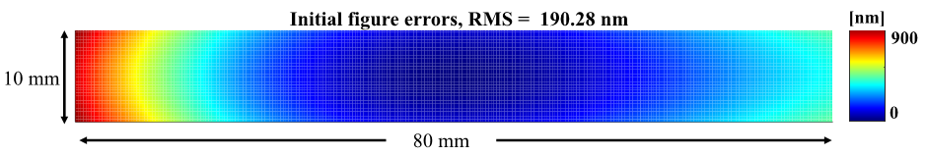
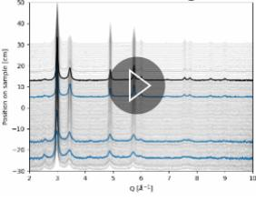
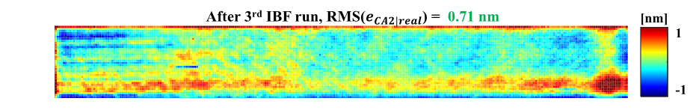
Engineering and Data Science
Development of Diffraction-Limited X-ray Mirrors
Autonomous Experiments for Accelerated Materials Discovery via AI and ML
Fabrication of diffraction limited x-ray mirrors using ion beam figuring (IBF) with sub-nm optical metrology
6-BM BMM - XAS
AI
Starting mirror (sphere)
28-ID-1 PDF - XRD
Finished mirror (1D ellipse)
T. Wang et al., Opt. Express 29,15114 (2021)
Notes:
Modern light sources produce highly coherent and bright x-rays – in other words, x-rays with truly exquisite properties. In order to use these x-rays, we need to put in its path a variety of x-ray optics, such as x-ray mirrors, in order to manipulate the x-rays to our needs. Unfortunately, everything we put in its path deteriorates the beam coherence – this is especially so for x-ray mirrors.
Point out the scale of the figure error map.

Slide 19
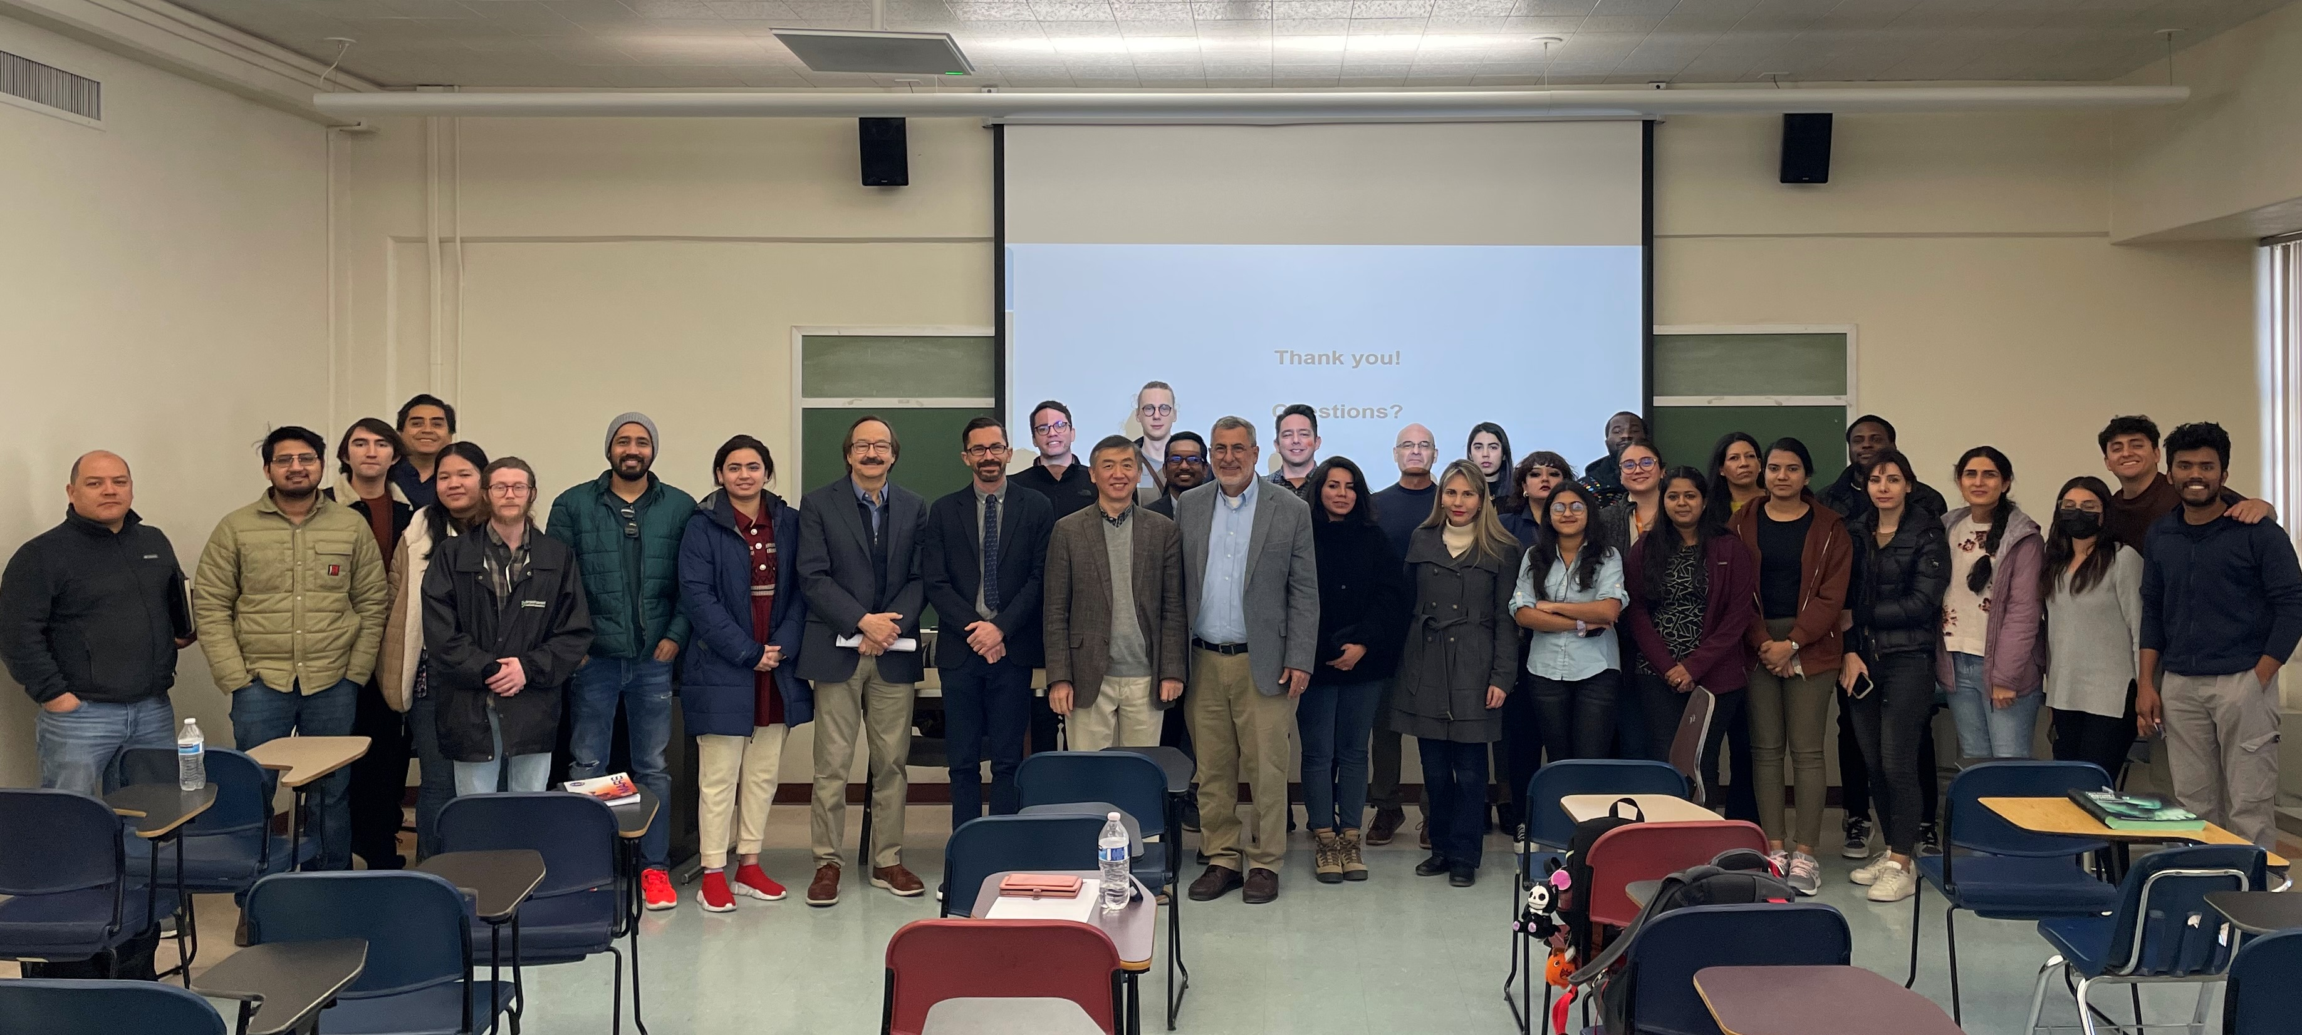
NSLS-II Online Course on Synchrotrons to HBCUs, MSIs, and LAAAMP Schools
In collaboration with InCREASE, NSLS-II initiated an online course for HBCUs, MSIs, and IUCr supported LAAAMP (Lightsources for Africa, Americas, Asia, Middle-east, & Pacific) participating schools
Covers widely-used synchrotron techniques for undergrad and grad students:
  12 weekly 2 hrs lectures, via Zoom
  Weekly homework + final exam; Logistics coordinated by a faculty in each school
  2020: 140 students & faculties, 14 universities
  2023: fall semester class, co-hosted by UTEP. Thank You!
Participates totaling well over 400 (2018-2023)
Fall 2023 Course co-hosted by University of Texas at El Paso (UTEP)

Slide 20




Lightsource Users’ Contribution to Local Economy

Slide 21
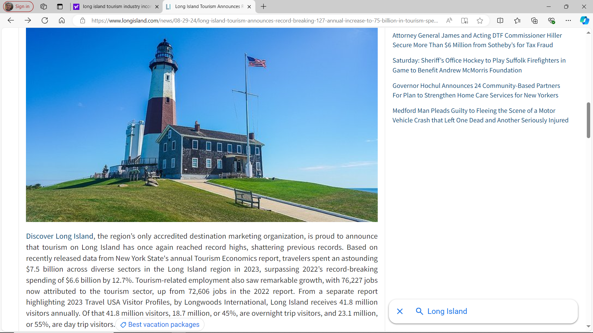
https://www.longisland.com/news/08-29-24
In addition to users, NSLS-II also do business with local industries and service providers

Slide 22



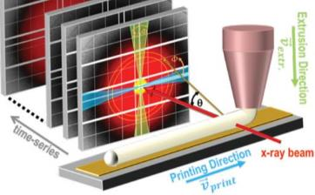
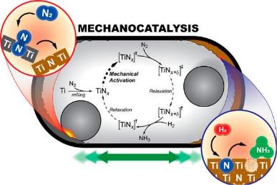
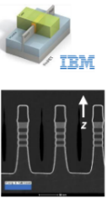
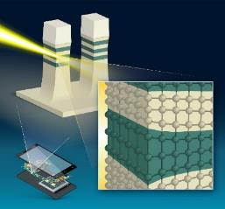

Encouraging Development and Innovation by Users
HXN
ISS
CHX
In-situ X-ray Photon Correlation Spectroscopy (XPCS) to study dynamics of curing process during 3d printing
Mater Today Phys, ID(100220) (2020).
IBM Nanosheet Fin-FET and strain mapping at HXN
Tricker, et al. ACS Energy Lett. 5, 3362–3367 (2020).
Nature Comm. Eng. (2022).

Slide 23





Sustainable Partnerships
− an example
New York State Energy Research & Development Authority (NYSERDA) funded the construction of a new High Energy X-ray (HEX) beamline at NSLS-II
Scientific objective: advance clean energy technology through understandings of 3D structures of materials and devices (e.g. energy storage) in real time and under actual operating conditions
Societal impact: promote NYS industry to conduct R&D at NSLS-II → to enhance economic and societal impact in NY State
HEX General User operation starts in early 2024. NYSERDA researchers receive dedicated beamtime to pursue their research
Notes:
5000 hrs/yr * 0.95 / 3 /24 = 66 days/cycle; 6 days = 9%; 4 days = 6%

Slide 24

Regional Usage of Synchrotron Light Sources
NSLS-II Users (FY23)
New York State 34%
Rest of Northeast 25%
Other US States 34%
International 7%

Slide 25


Summary
Light sources have become irreplaceable part of science & technology infrastructure in the US and around the world
Promote a network of research enterprise and enable impactful scientific research
Encourage economic development, engage the local community, and make broader indirect societal impact
Strong benefits to local and regional economy → Well beyond their science and technology impacts

Slide 26
Thank You!

