Slide 1








NEPHEWS
funding and training opportunities for students and researchers
Big Science and Big Goals for Africa, AfLS-2024 / AfPS2024
19th November 2024, University of Johannesburg
Prof. Cormac McGuinness
European Synchrotron and FEL Users
Organisation (ESUO)
& TCD - Trinity College Dublin, Ireland
On behalf of NEPHEWS project
coordinated by SOLARIS

Slide 2

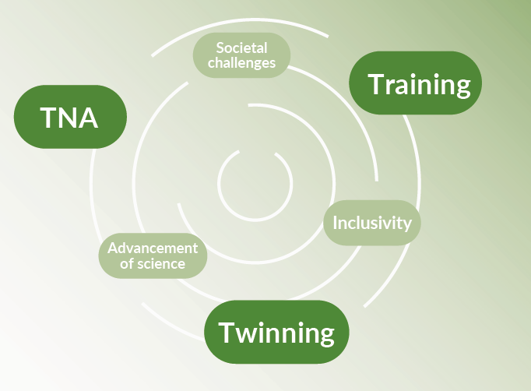
What is NEPHEWS?
NEPHEWS - Neutrons and Photons
Elevating Worldwide Science
An international collaboration that fosters:
A way to access leading photon and neutron research infrastructures (RI) of Europe
via Trans-National Access (TNA) funds
Tailored training for young researchers
Personalized twinning with experienced users of the RIs
HORIZON-INFRA-2023-SERV-01-03 - Research infrastructure services advancing frontier knowledge: co-fund pilots with pan-European RIs and/or national RIs
EU Funding: HORIZON COFUND: 4,7M €
Funding rate: 70%
Project budget: 6,8M €
Timeframe: 01/2024 – 12/2026

Slide 3

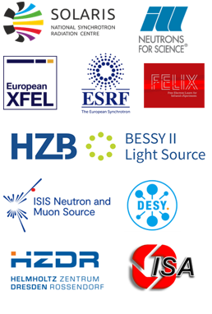



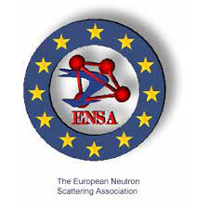
Who are NEPHEWS?
Consortium: 23 Partners (18 infrastructures)
NEPHEWS uniquely
combines the synchrotron (SR), free-electron laser (FEL) and advanced neutron (N) facilities of Europe together with
the European Users Organisations, ESUO and ENSA representing national user communities,
with the goals:
Advancement of European science for the benefit of global society
Support and fast-track access through trans-national access (TNA) for excellent scientists, no matter their origin
Development of early stage researchers
Widening of user communities
WPs structure:
WP1 Management (SOLARIS)
WP2 Community building, users’ training and twinning, outreach to Widening countries and Africa (TCD>ESUO>ENSA)
WP3 Communication, Outreach and Policy Impact (EUXFEL)
WP4-17 Transnational access to RIs
WP18 Ethics requirements (SOLARIS)
Prof. Cormac McGuinness - ESUO - European Synchrotron and FEL Users Organisation & TCD - Trinity College Dublin, Ireland

Slide 4
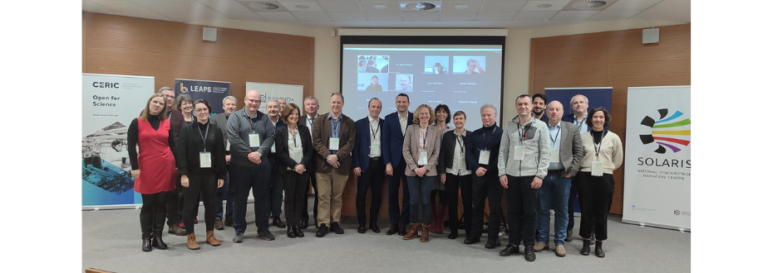
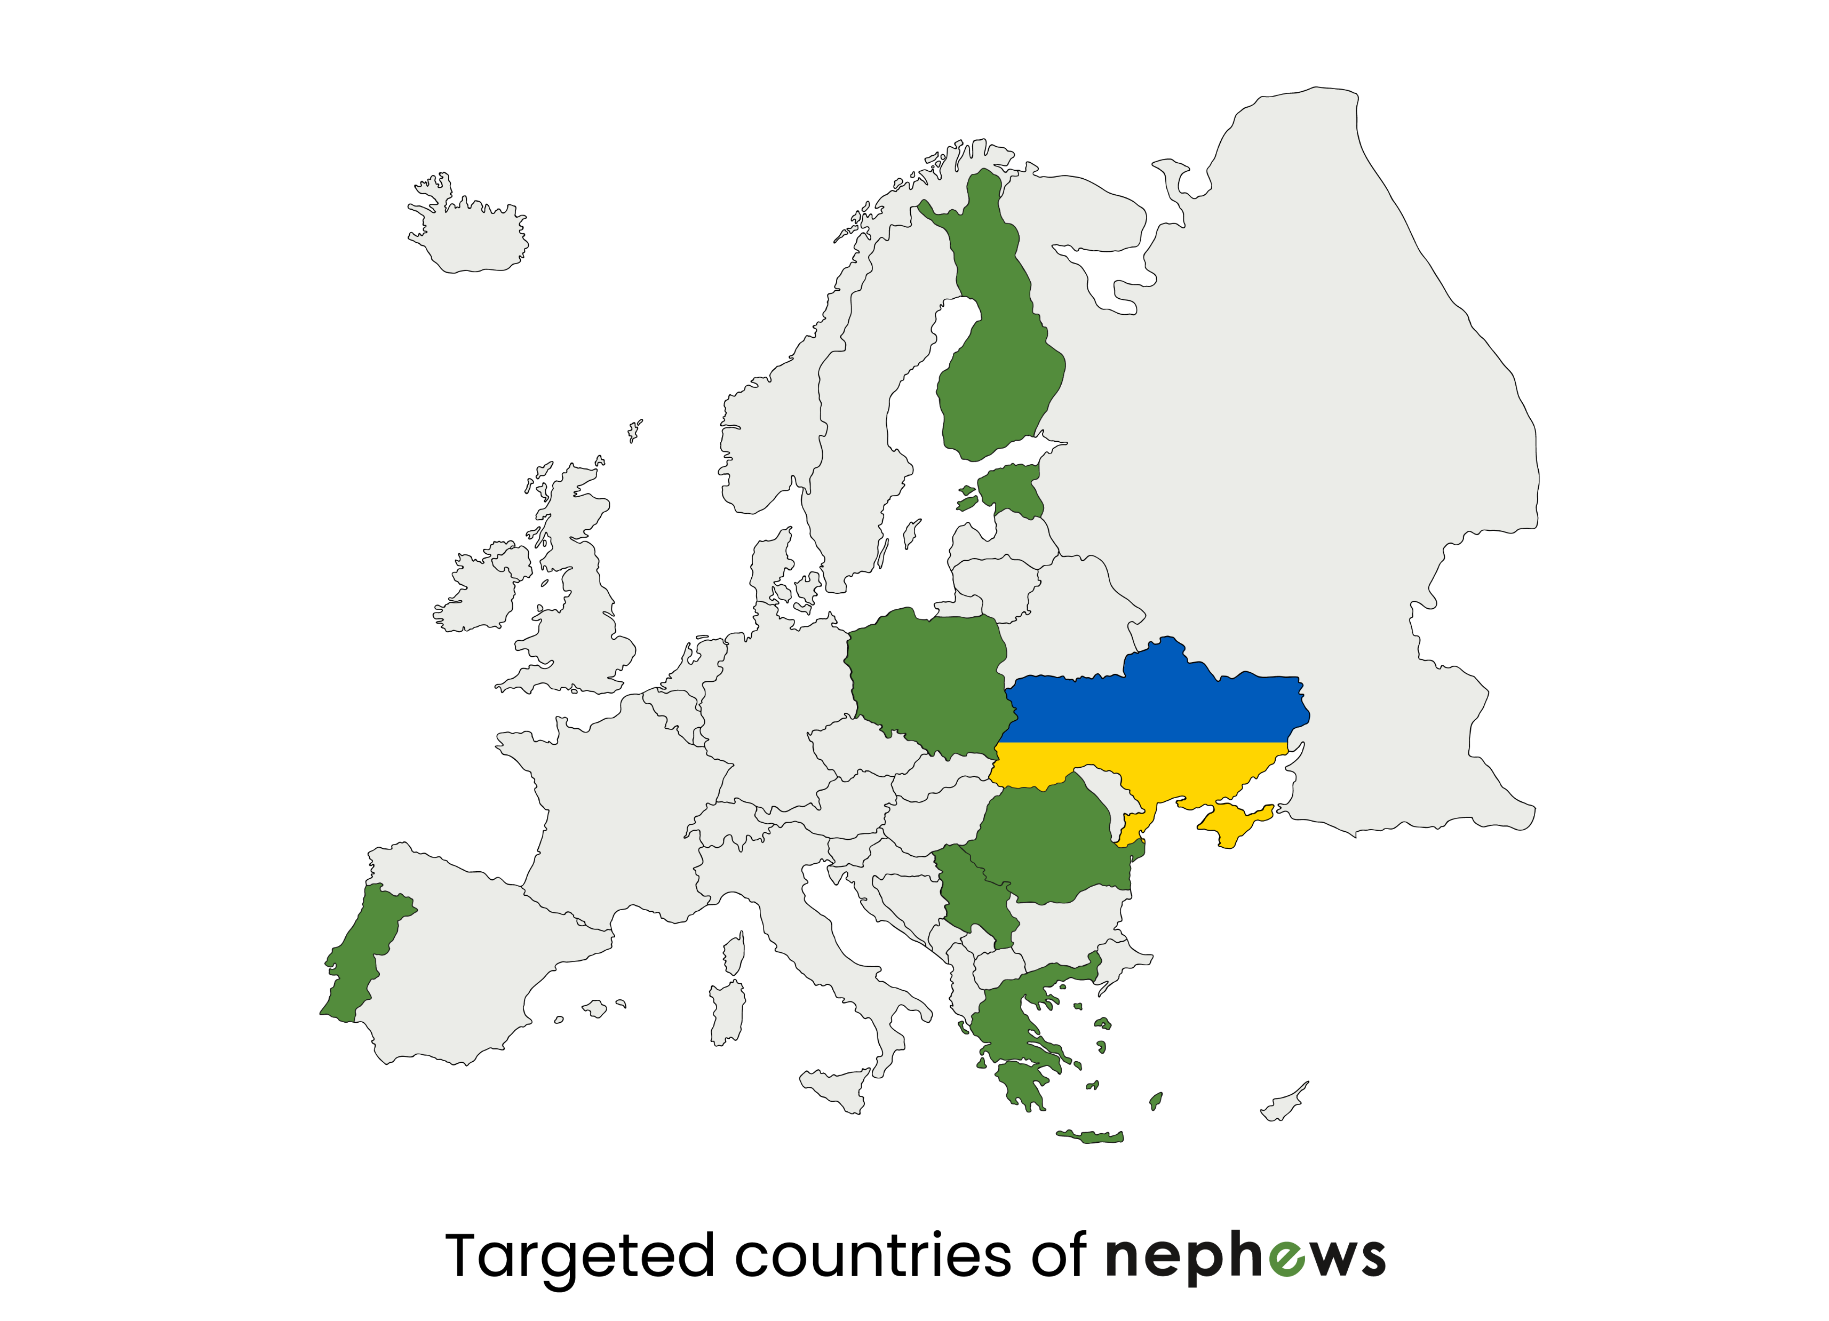

Actions under NEPHEWS
NEPHEWS was kicked-off at the beginning of February
Actions in Europe: The selection process of 8 targeted countries within Europe
was conducted (widening and non-facility countries).
User communities from 13 countries submitted the „Expression of interest”
NEPHEWS actions status:
a/ TNA* (38290 h) – already activated in all 14 neutron and photon RIs
*Access for user groups with a majority of users not working in a EU Member State or Horizon Europe associated country is limited to 20% of the total amount of units of access provided under the grant
b/ User-Twinning programme
c/ Early-stage researchers support
d/ Virtual training – open access at the project website
e/ Opportunities for Africa
Project website (platform) is available at
Contact to project coordinator: nephews@uj.edu.pl

Slide 5
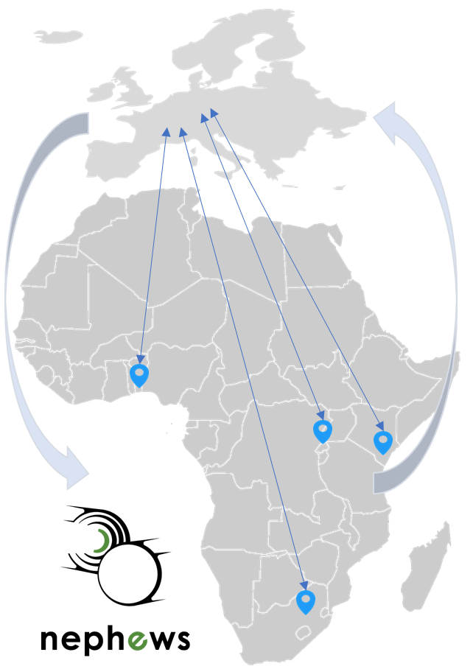

Community building Actions in Africa
Opportunities for Africa within NEPHEWS
Twinning Opportunities
Next year 8 experienced researchers can be selected, acting as future ambassadors of SR/FEL- and N-based science in their regions
Actions
Visits to 4 regions in Africa
Promotion and dissemination of the information on TNA to local/regional scientific communities
e.g. at AfLS/APS meeting
and at 2024 African MRS
meeting, Rwanda.
Training Opportunities
Next Year selected PhD students from 4 African regions will participate in the 2026 HERCULES school Hercules-school.eu
X-Tech
AMRS
Kenya
Access
See NEPHEWS website
Virtual Training Opportunities
Online training in techniques, methods; and in developing proposals for access
U. Wits

Slide 6

Community building Actions in Africa
Opportunities for Africa within NEPHEWS
African MRS, Kigali, Rwanda
Satellite Pre-conference Workshop,
Sunday 1st December, Saturday 14th & Sunday 15th December
Visit: https://africanmrs.net/rwanda-2024/pre-conference-worskhops/
Scientific User Facilities and Proposal Writing Skills for Access
Access to scientific facilities in Europe and the US is based on proposals for beamtime to be awarded based on scientific excellence. This workshop – limited to 24 participants is aimed at participants learning to write effective and successful proposals
Organising partners
Argonne National Laboratory (www.anl.gov)
Wake Forest University (www.wfu.edu)
NEPHEWS (www.beatime.eu)
ESRF (www.esrf.eu)
AMRS
https://africanmrs.net/rwanda-2024/wp-content/uploads/2024/07/AMRS2024-Preconference-Workshop-Scientific-User-Facilities-and-Proposal-Writing-Skills-for-Access-1.pdf

Slide 7
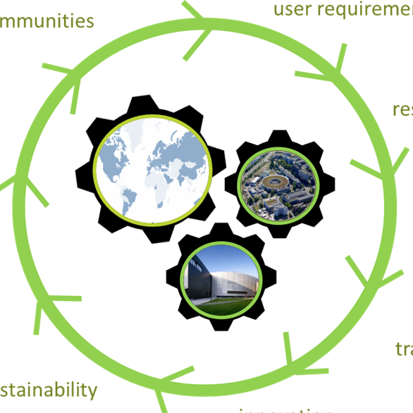
NEPHEWS Twinning Programme
General questions? Missing experience?
How and where to start?
How to find international partners?
Get to know us
Join an experiment of an experienced group
Become part of the large scale facility family
Twinning brings together experienced large scale facility users with newcomers
Free access to the light/neutron source
Coverage of your travel and subsistence costs
Training in how to use our facilities
Experience in executing a beamtime
Tailor made twinning teams according
to your research field
Discussion and support in writing your proposals
Possibility to start long term cooperations

Slide 8


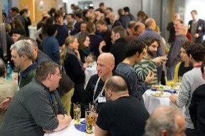
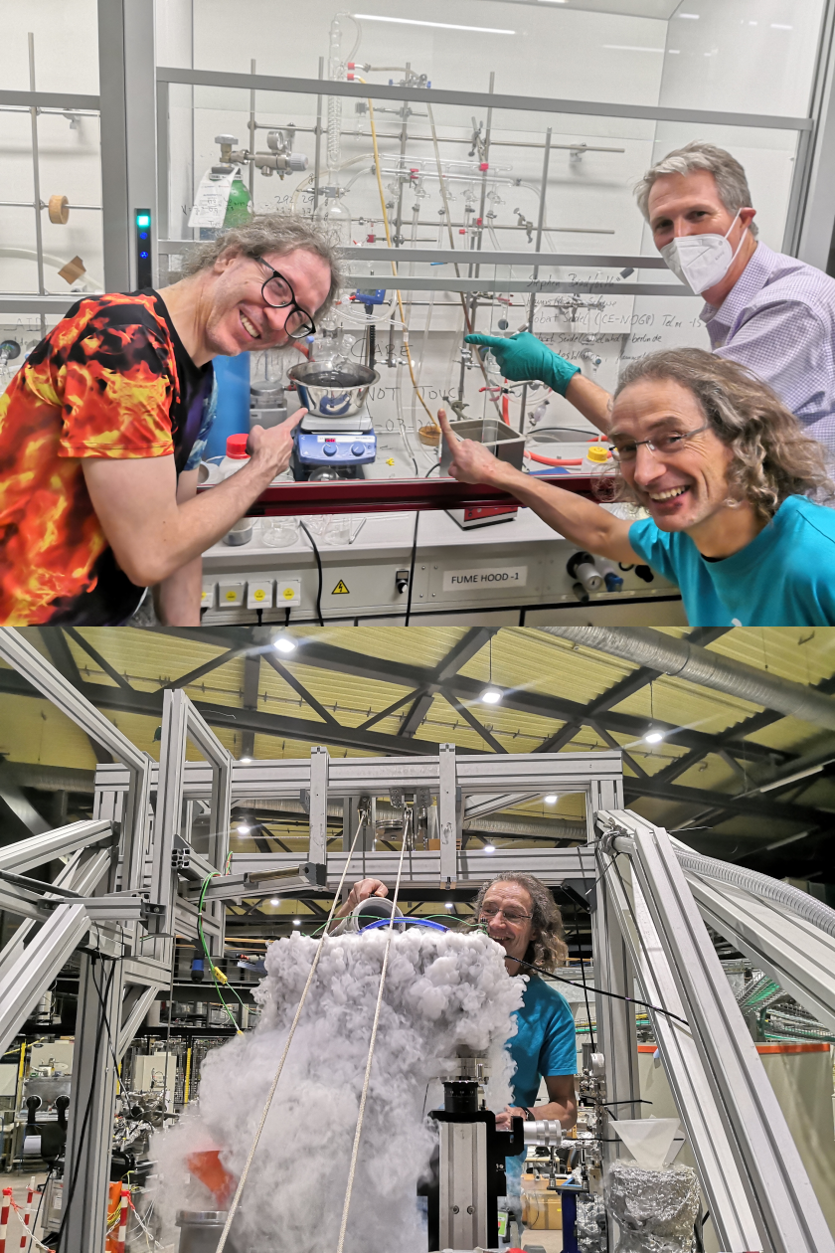
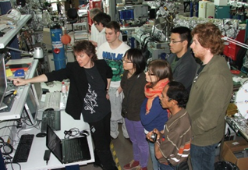
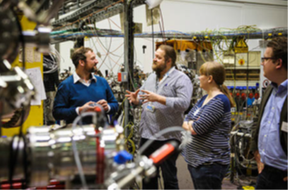
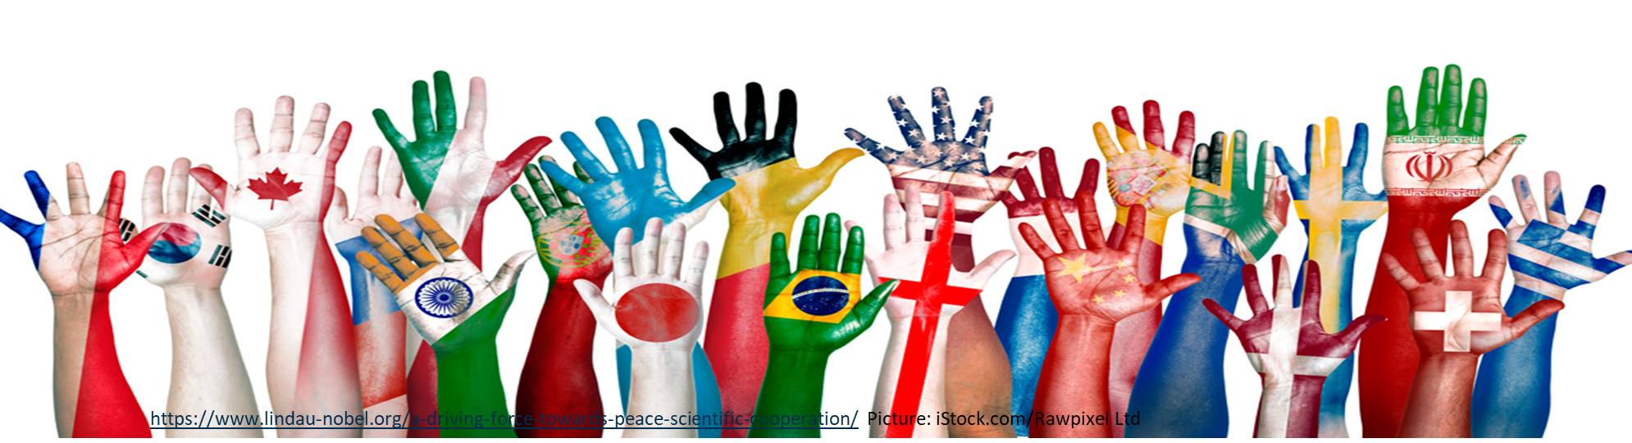
In the twinning program we invite you to participate in a beamtime of an experienced user group
Changes start with ideas
Confidence gives new ideas
Ideas grow with networks
Scientists are ambassadors for knowledge,
for development, for peaceful cooperation, for solutions…
Experience creates confidence
Networks start with
information…
Twinning builds experience

Slide 9

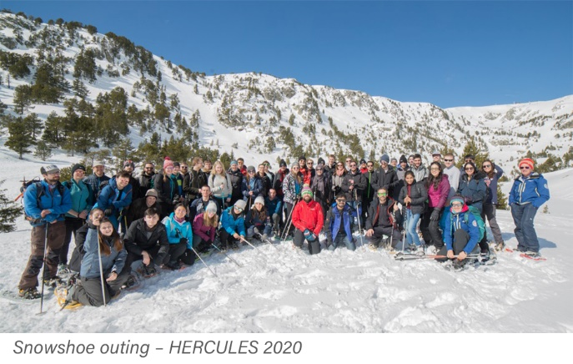
Opportunities for Training: HERCULES 2026
NEPHEWS has funding for 4 African PhD researchers registered with an African university to participate in the renowned HERCULES EUROPEAN SCHOOL:
A five week-course coordinated by the Université Grenoble Alpes providing training in the field of Neutrons, X-ray Synchrotron Radiation, and Free Electron Lasers for Biology, Chemistry, Physics, Materials Science, Geosciences, Industrial applications.
Lectures, practicals, tutorials, and visits to: ALBA in Barcelona, KIT in Karlsruhe, DESY and European XFEL in Hamburg, Elettra and FERMI in Trieste, ESRF and ILL in Grenoble, SOLEIL in Paris-Saclay and PSI in Villigen.
The language of the course is English.
Held annually in early Spring. Applications from young African researchers for the NEPHEWS bursaries will open in April 2025, closing in mid May 2025 for the course in Spring 2026.
Notes:
HERCULES programme application
Panel committee selected by 28 February 2025
Call opens Monday 7 April 2025
Call closes Friday 16 May 2025
Decision made for 6 preliminary candidates 6 June 2025
Interview committee organized between 9 and 20 June
Decision released 28 June 2025
candidates register by December 2025
for participation in HERCULES programme March to April 2026

Slide 10
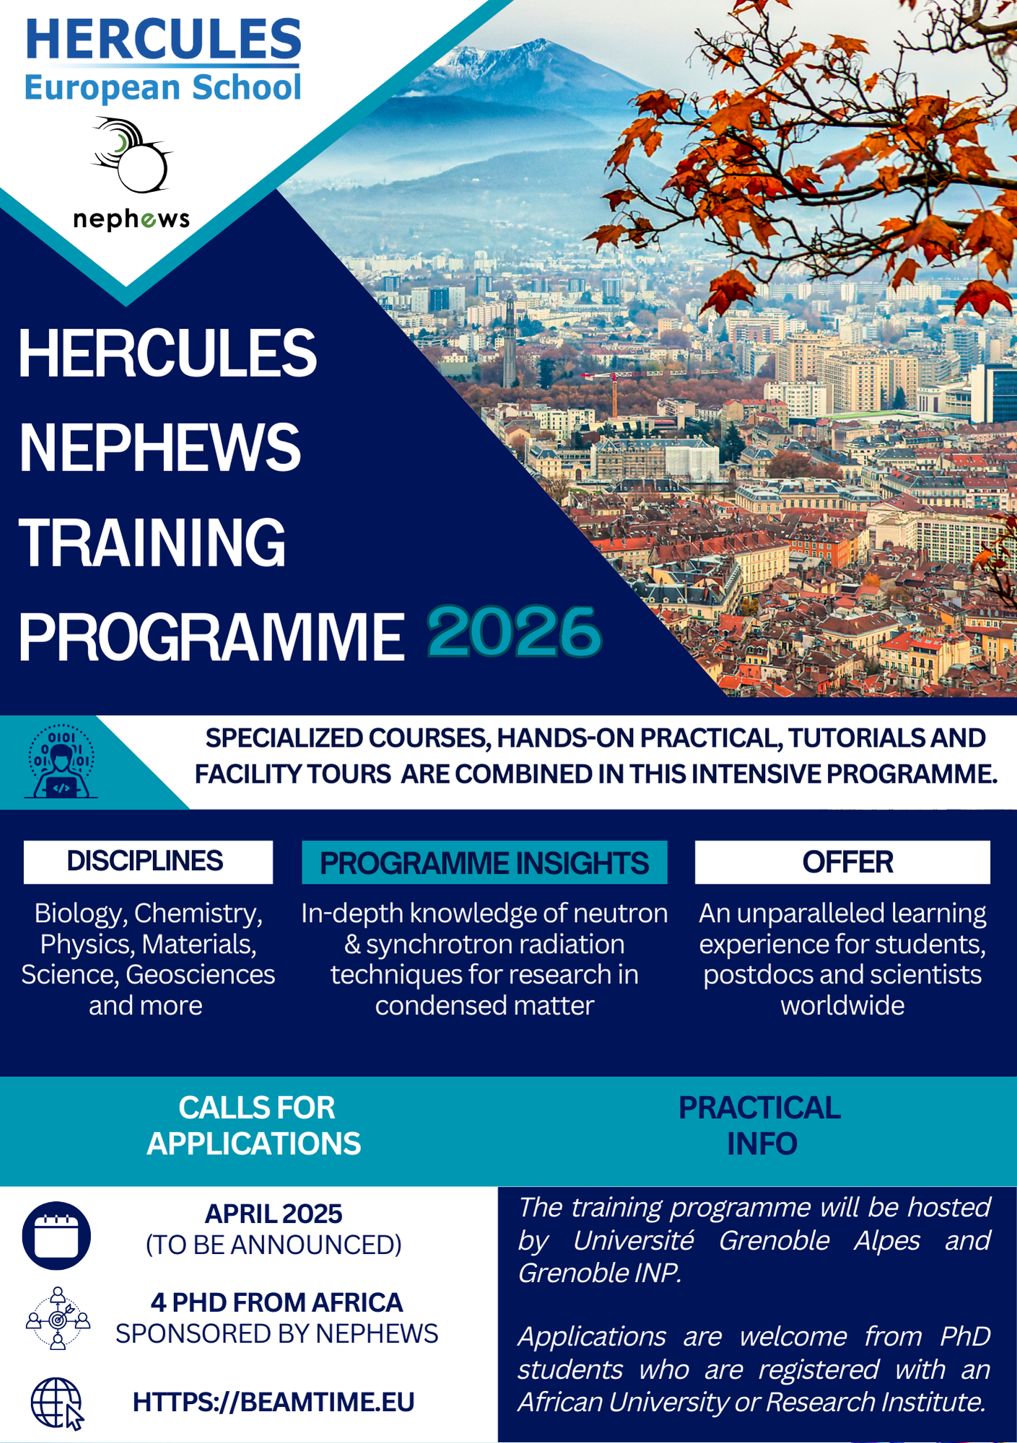
Opportunities for Training: HERCULES programme March – April 2026
DISCIPLINES Biology, Chemistry, Materials Science, Geosciences and more
Programme insights: In-depth knowledge of neutron and synchrotron radiation techniques for research in condensed matter
Offer: An unparalleled learning experience for 4 PhD positions for African students sponsored by NEPHEWS
Applications: open early April 2025; closing mid May 2025; shortlisting and interviews June
Notes:
HERCULES programme application
Panel committee selected by 28 February 2025
Call opens Monday 7 April 2025
Call closes Friday 16 May 2025
Decision made for 6 preliminary candidates 6 June 2025
Interview committee organized between 9 and 20 June
Decision released 28 June 2025
candidates register by December 2025
for participation in HERCULES programme March to April 2026

Slide 11
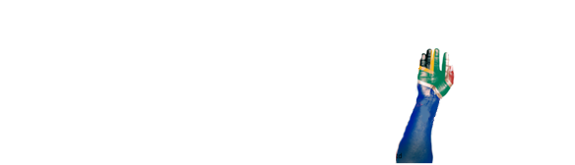
?
Questions about NEPHEWS
Happy to answer questions anytime today
... or in the future
Leave name and email in chat
Contact to project
coordinator:
nephews@uj.edu.pl
Prof. Cormac McGuinness
- ESUO - European Synchrotron and FEL Users Organisation
& TCD - Trinity College Dublin, Ireland
Cormac.McGuinness@tcd.ie

Slide 14
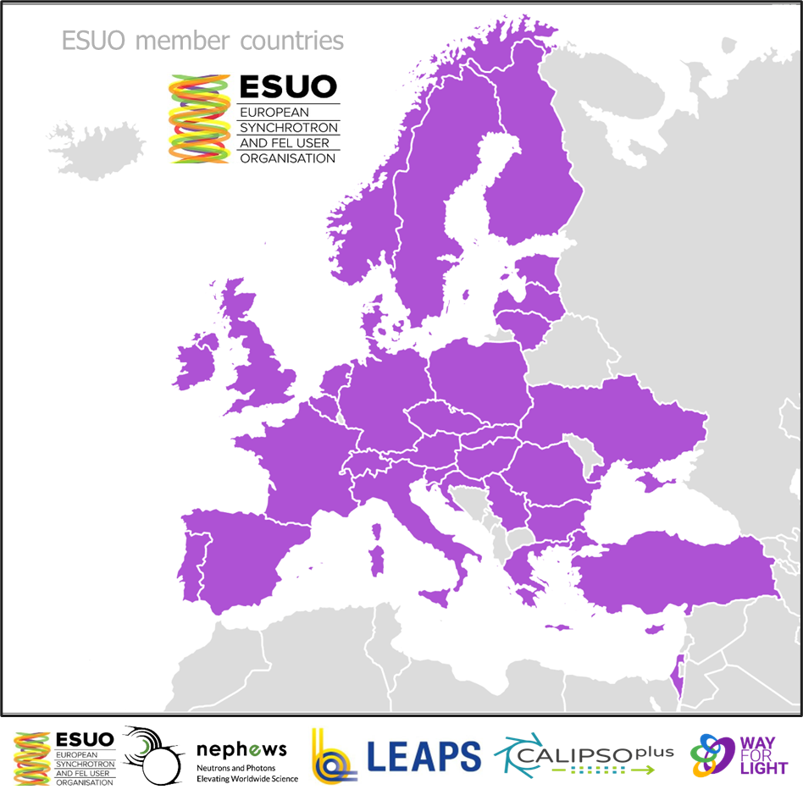
What is the European Synchrotron and FEL User Organisation (ESUO)?
ESUO was established in 2010 to represent all European photon science users*. [U. Pietsch and M. J. Cooper, J. Synchrotron Rad. (2010) 17, 428-429]
Today, ESUO represents ~35,000 users of the European synchrotron (SR) and Free-Electron Laser (FEL) facilities.
Users of 32 nations from European member states, EU candidate and associated countries, are represented by ESUO national delegates nominated from National User, Facility User Organisations (NUOs/FUOs).
Multiple delegates to ESUO from nations with large user communities and/or multiple facilities (FUOs), giving 50+ national delegates.
ESUO supports establishment of National User Organizations (NUOs).
ESUO is a fully registered non-profit international organization (AISBL) under Belgian law since September 2021.
ESUO has been a strategic partner of LEAPS – the League of European Advanced Photon Sources
32 nations are represented in ESUO by delegates and NUOs, most recently Romania in 2022, and Ukraine in 2023.

Slide 15

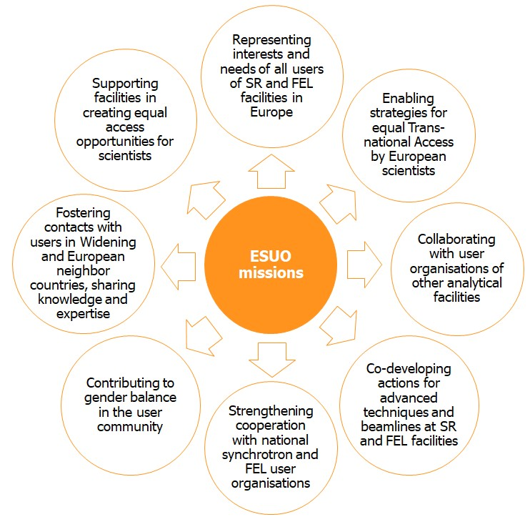

ESUO: Vision and Missions
ESUO vision
Is to support a thriving (European) synchrotron and FEL user community with equal opportunities of access and participation for all scientists based solely on the scientific merit of their ideas
Promote Trans-national Access (TNA) to European light sources and European Commission
Lobbying to support elimination of geographic or financial barriers in user participation, with as simple an access model as practicable.
Our manifesto “Towards Even Brighter European Photon Science” from 2014. **
** ESUO website,
and Barrier et al, J. Synchrotron Rad. (2014). 21, 638-639

Slide 16

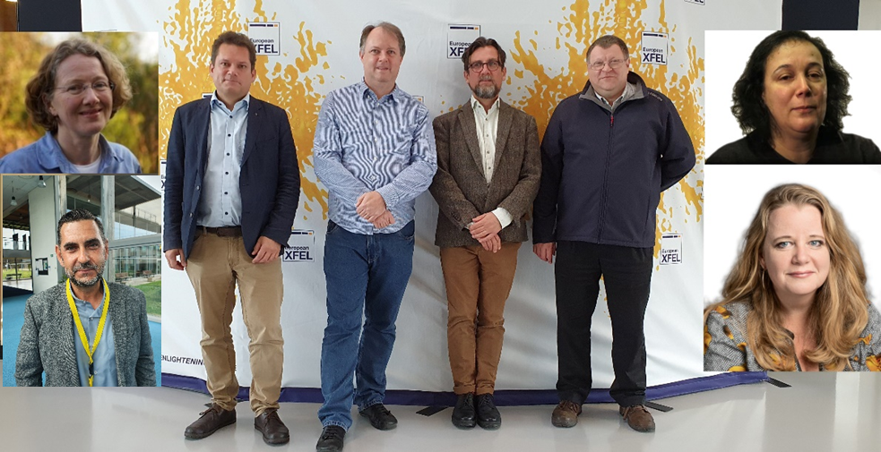
Who are ESUO and ESUO Executive Board?
Executive Board of 8 is elected from delegates with rules for national diversity, sufficient SR/FEL representation, and gender diversity.
President and Executive board
ESUO President: Cormac McGuinness (IE) [Trinity College Dublin]
ESUO Vice President: Bridget Murphy (DE) [Kiel University, Germany]
Carla Bittencourt (BE) [University of Mons] (Treasurer)
Tom Hase (UK) [University of Warwick]
Derek Logan (SE) [University of Lund] (Secretary)
Rainer Lechner (AT) [Montanuniversität Leoben]
Moniek Tromp (NL) [University of Groningen]
Wojciech Gawelda (ES) [Universidad Autonoma de Madrid]
AfLS2024 19th November

