Slide 1

Thermal expansion behaviour of BPO₄ studied by X-ray thermodiffractometry
Wilson Mogodi
Notes:
Two themes of this presentation
Going to inspire you why pxrd is exciting and why you should use it… eng, phy, material scince, chemistry viz. how powderful PXRD can be
Broad overview of the research in my PhD.

Slide 2
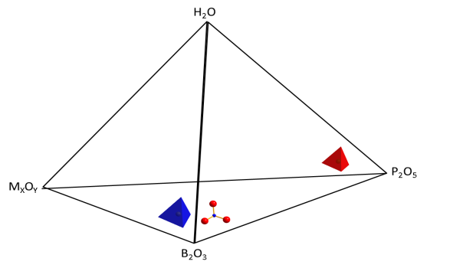
Borophosphates
Traditional functional materials; aluminosilicates and metal phosphates have been extensively used.
Borophosphates = Intermediate compounds of the systems
M_{x}O_{y­­}-B₂O₃-P₂O₅-(H₂O)
(M = main group/transition metal, ammonium)
Are a young class of materials.
Exhibit large variety of connection pattern of the anionic unit ∞[BxPyOz]^{n-}.
From this, diverse and exciting materials have been synthesized:
Notes:
Ion exchange, separation and catalysis.
Borophoshates; have some structural similarity of aluminosilicates and metal phosphates

Slide 3
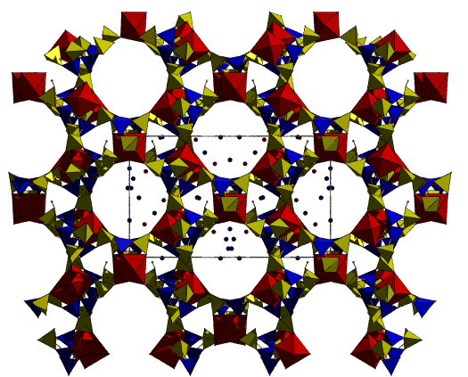
Borophosphates: Three-dimensional open framework/porous
Examples:
Technological importance in shape-selective catalysis and ion exchange applications.
Yang et al. Dalton Trans., 2011, 40, 2549

Slide 4
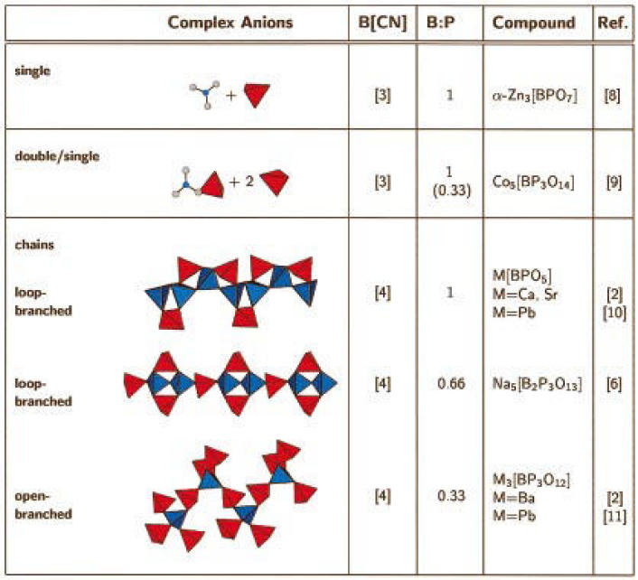
Borophosphates: Low-porosity anhydrous phases
Borophosphate anion includes isolated species, oligomers, chains and even layers.
Kniep et. al. Chem. Mater. 1998, 10, 2930 - 2934
Notes:
Isolated = Isolated trigonal planar borate and tetrahedral phosphate (red polyhedra) species
Double single = Isolated trigonal planar borate sharing an oxygen with phosphate tetrahedron and two isolated phophate groups

Slide 5
Non-porous Borophosphate
Thermal expansion behaviour of BPO₄
Thermal Expansion:
Low Positive Thermal Expansion (LPTE) = Minor Expansion when heated
Zero Thermal Expansion (ZTE) = No Expansion/Contraction when heated
Negative Thermal Expansion (NTE) = Contract when heated

Slide 6
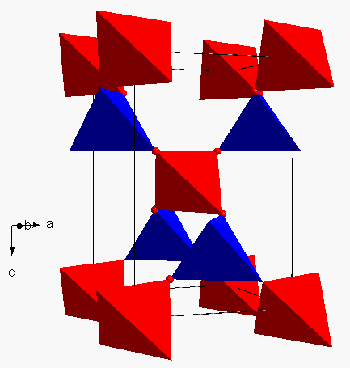
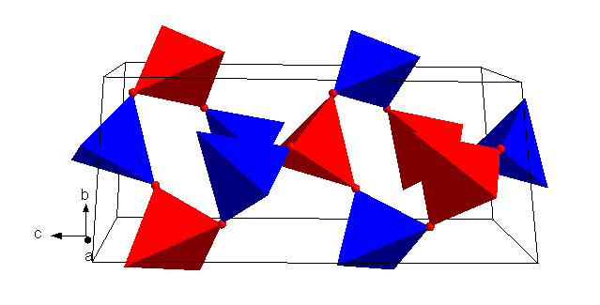
BPO₄: Structure-property relation
BPO₄ of interest because of its isostructural relationship with SiO₂.
Two polymorphs:
High-cristobalite-type Quartz-type
Trigonal lattice, space group P3₁21
Tetragonal lattice, space group I4
Notes:
BPO₄: Structure-property relation = How the crystal structures provide an explanation for the unusual thermal expansion behaviour.
In both structures, the crystal structures are build of corner sharing BO₄ and PO₄ TETRAHEDRAL UNITS.
Quartz = Under high temperature and pressure conditions.

Slide 7


Slide 8
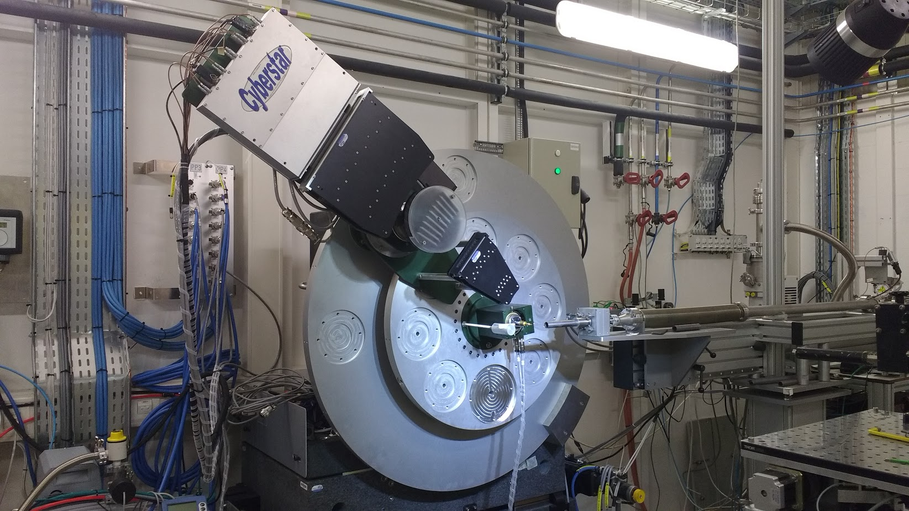
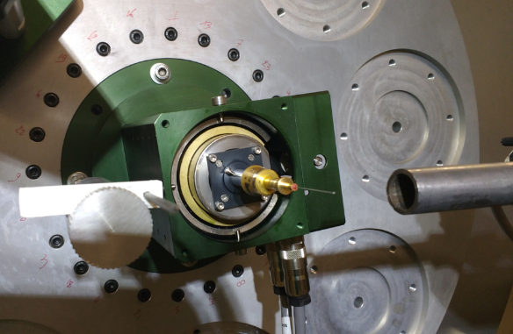
ESRF ID22 Powder Diffractometer
Nine channel multianalyser stage
Notes:
Nine channel multianalyser stage

Slide 9
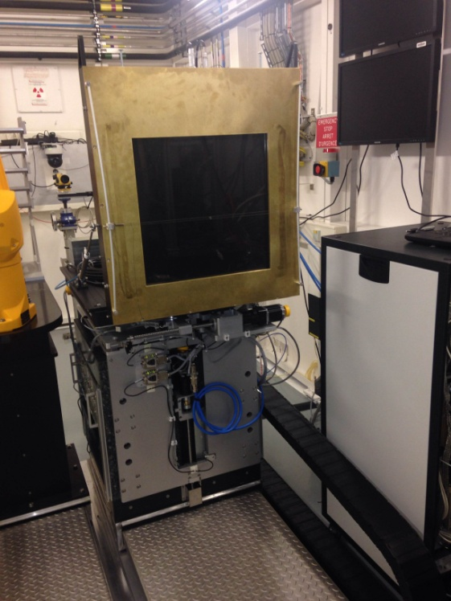
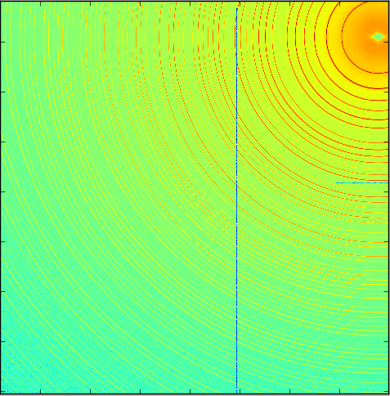
2D flat panel detector for fast PDF
41 x 41 cm² Perkin Elmer XRD 1611 medical imaging detector

Slide 10
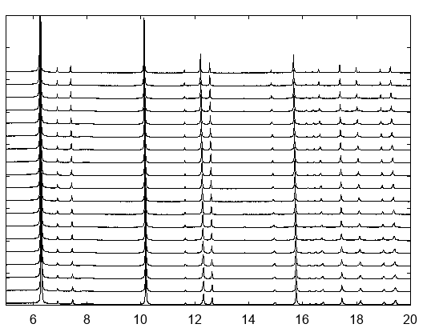
Variable temperature PXRD results for BPO₄
Collection of 19 diffractograms. Each diffractogram was analysed via Rietveld refinement method.
900 °C
30 °C
2θ
Notes:
Stack plot of diffraction patterns one on top of the other.

Slide 11
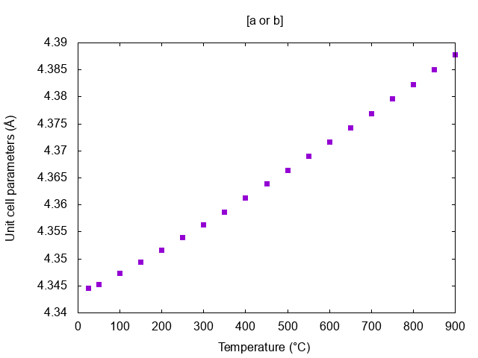
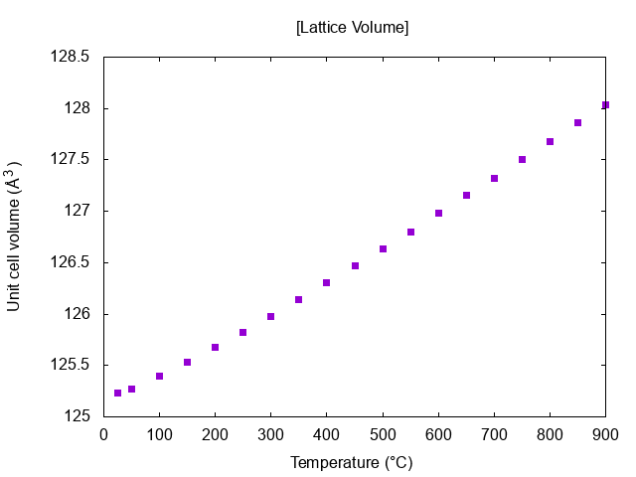
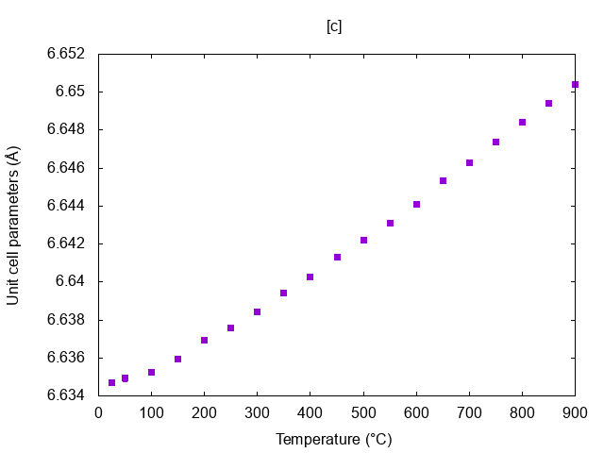
Unit cell dimensions as a function of temperature
Highly anisotropic lattice (c/a value is 1.52 at 30 °C).
In temperature range 30-900 °C :
α_{a/b} = 10.5 ppm/°C
α_{c} = 2.71 ppm/°C
α_{v} = 24.0 ppm/°C
By definition, BPO₄ is a low positive thermal expansion material.

Slide 12
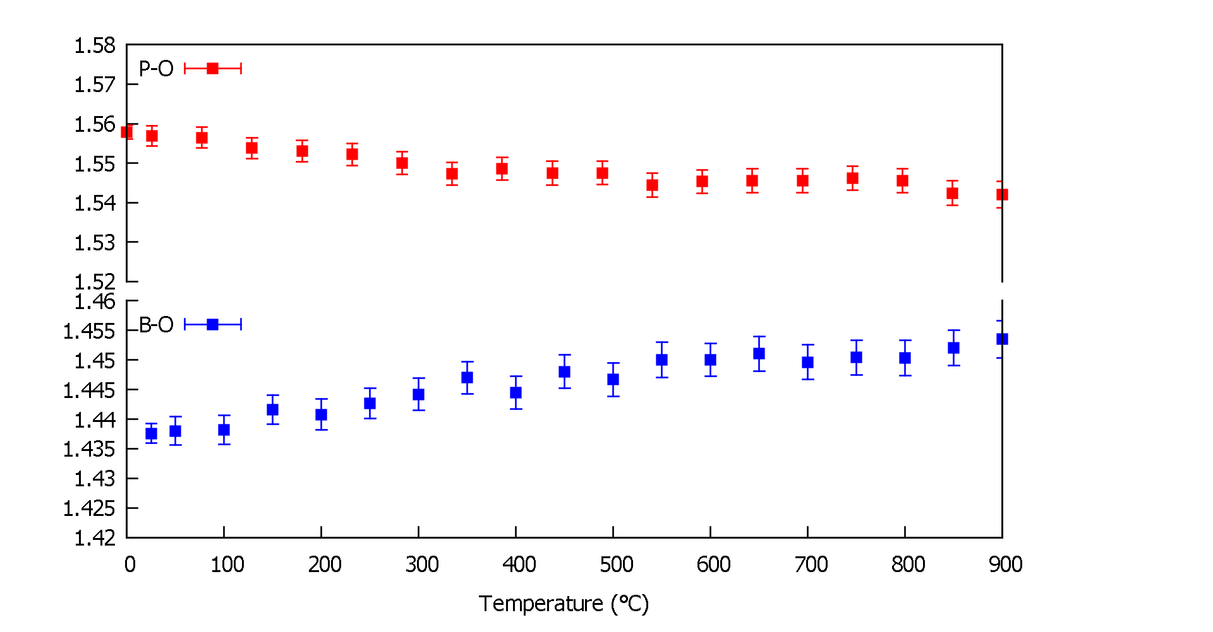
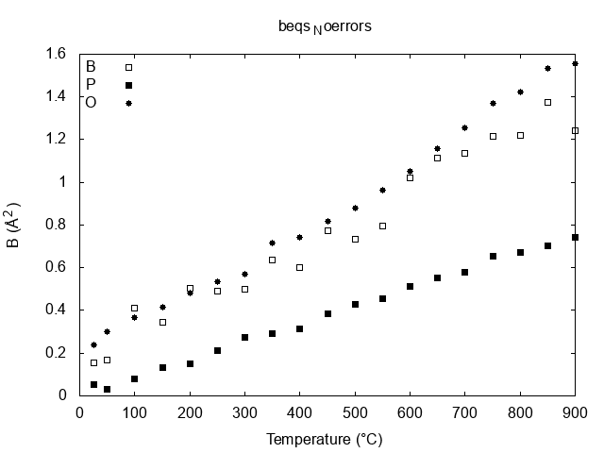
Interpolyhedral distances and Atomic displacement parameters
B
P
Bond length (Å)
O
Unphysical decrease in P-O bond and increase in B-O bond lengths with temperature.
The increase in thermal motion of O atoms lead to shortening of P-O bond. Also seen in Y₂(WO₄)₃, Sc₂(WO₄)₃ (Evans and co-workers)
B (Å²)

Slide 13
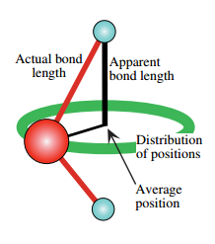
Dynamic disorder in BPO₄
The oxygen atom between tetrahedral can rotate about the bond axis
In conventional (Bragg) diffraction analysis:
Average positions of the atoms = the centre of the distribution of positions
Amplitude of thermal motion = the width of the distribution of the positions
Bragg diffraction does not measure bond lengths directly:
Associate average positions of two atoms with interatomic distances (bond lengths)
The mid point of the distribution determined by the analysis may not be the true midpoint
Tucker et al. 2000
Notes:
Reason for average structural model failing at low r:

Slide 14
Dynamic disorder in BPO₄
Consequently from Bragg analysis:
The P-O-P bond in the average structure is straight
True P-O-P bond should be around 130° and oxygen atom rotates around bond
Tucker et al. 2000
Notes:
Reason for average structural model failing at low r:

Slide 15
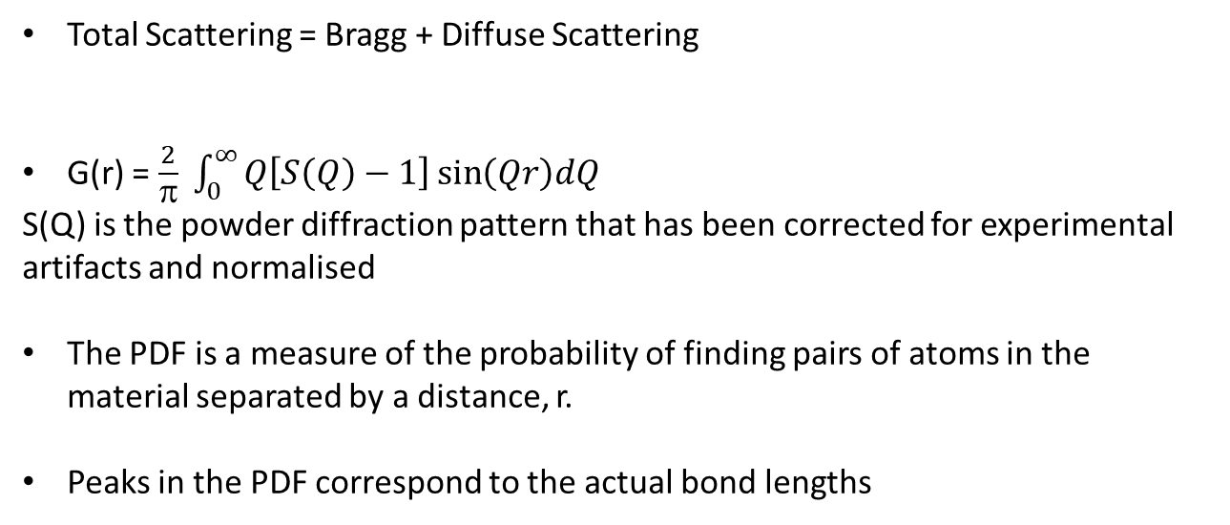
Pair distribution function, G(r)
Total Scattering = Bragg + Diffuse Scattering
G(r) = $\frac{2}{π} \int_{0}^{∞}{Q\left[S\left(Q\right)−1\right]\sin\left(Qr\right)dQ}$
S(Q) is the powder diffraction pattern that has been corrected for experimental artifacts and normalised
The PDF is a measure of the probability of finding pairs of atoms in the material separated by a distance, r.
Peaks in the PDF correspond to the actual bond lengths
Notes:
Reason for average structural model failing at low r:

Slide 16
G(r) function of BPO₄ at 30°C
B - O
P - O
Rw = 25.64 %
G(r)
r(Å)
The first peak in the G(r) corresponds to the B-O and P-O bonds
Notes:
stereochemical restraint refinement
The weighting factors, tol, defines the weighting given to the particular stereochemical restraint.
Applies penalties restraining distances and angles between sites

Slide 17
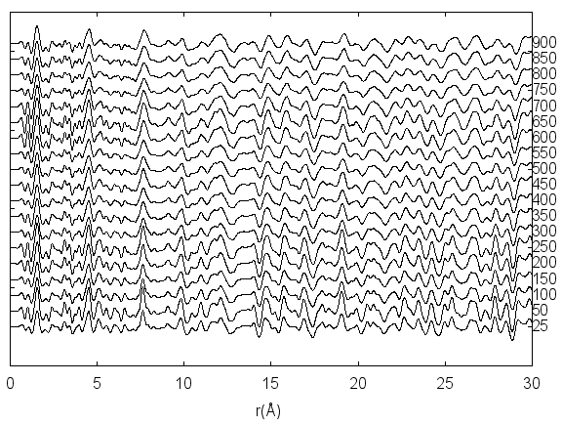
Variable temperature PDF experiment of BPO₄
900 °C
30 °C
The B-O and P-O bond lengths was extracted from all measurements

Slide 18
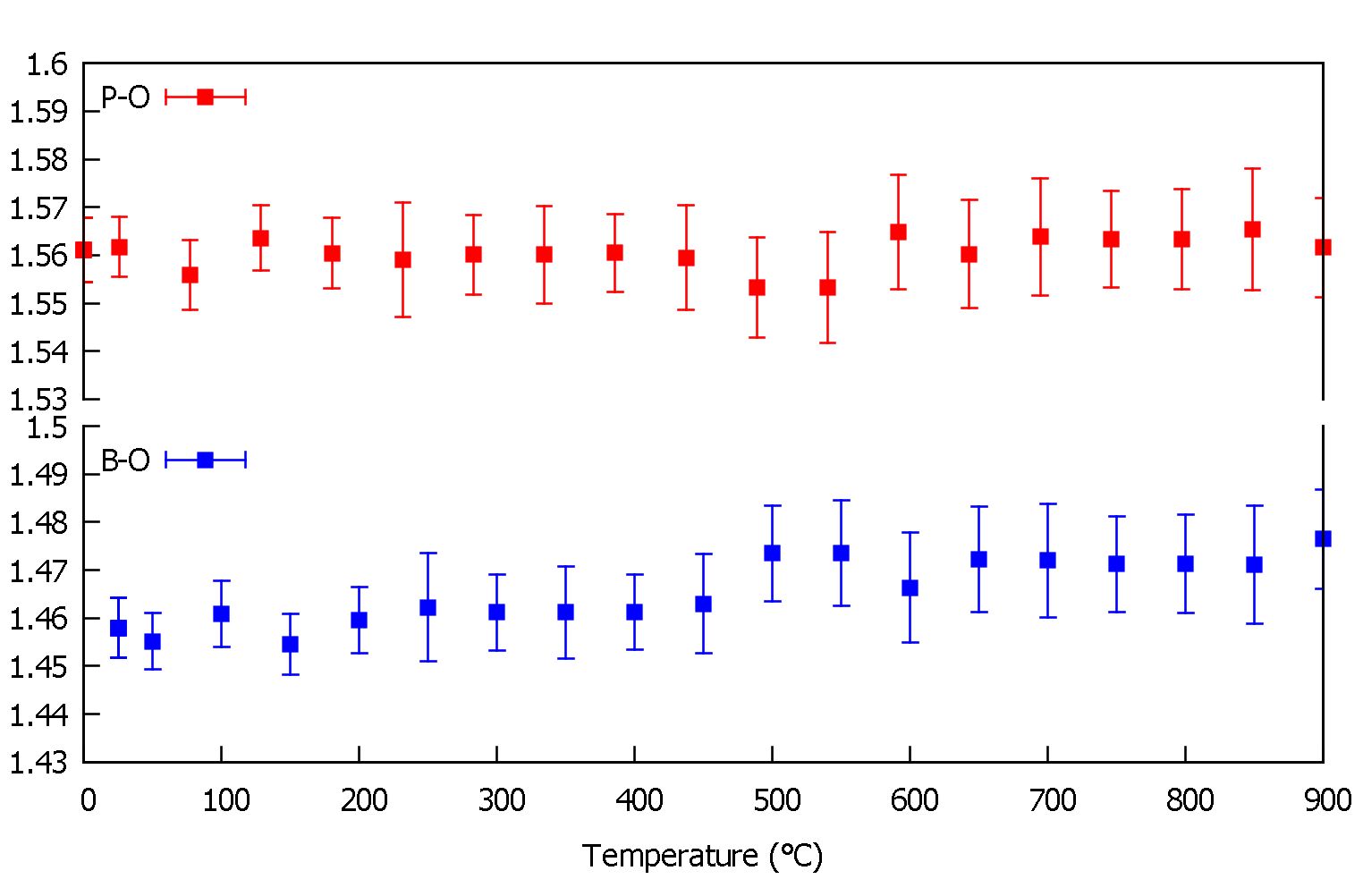
Interpolyhedral distances
Bragg analysis
PDF analysis
Bond length (Å)
Bond length (Å)
Notes:
Modest increase in P-O distance as a function of temperature

Slide 19
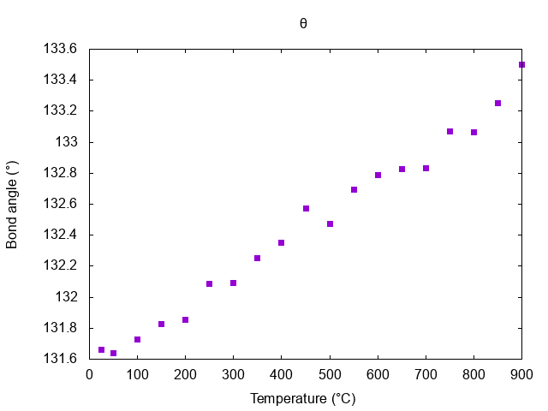
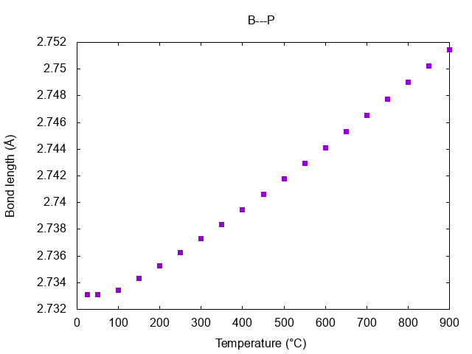
Interpolyhedral angles and distances
B
P
O
θ
Increase in B-O-P bond angle (θ) with temperature.
This increase in bond angle is reflected by an increase in B--P separations.
Contributes to an increase in the a and c lattice parameters.

Slide 20
Conclusions
The variation in the crystal structure provides an explanation for this low thermal expansion behaviour.
Common feature of thermally stable/robust materials:
    Strong covalence of chemical bonds i.e. B-O and P-O.
    Flexible crystal structures.
Future work: “Big”-box refinements
(vs “Small”-box refinements)
Notes:
A relationship between the synthetic approach and the resulting crystal structure of the borophosphate compounds was also established.
Strong covalence of chemical bonds i.e. B-O and P-O = lead to rigid polyhedra

Slide 21
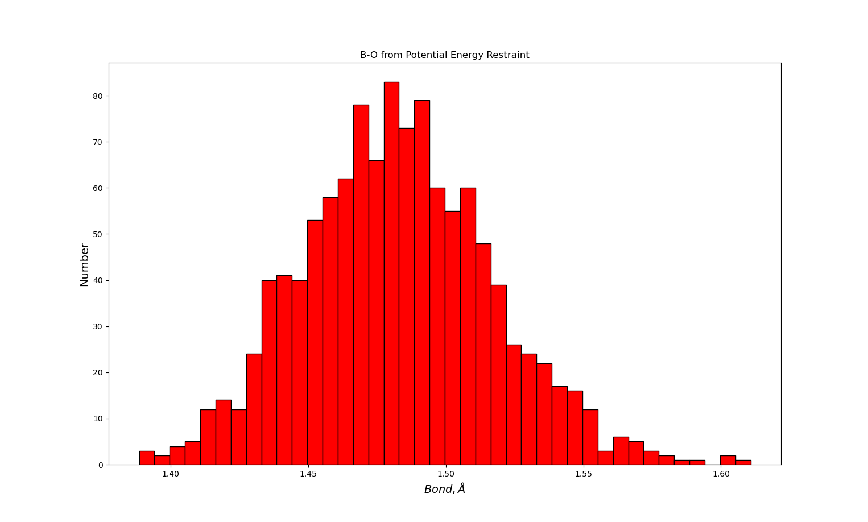
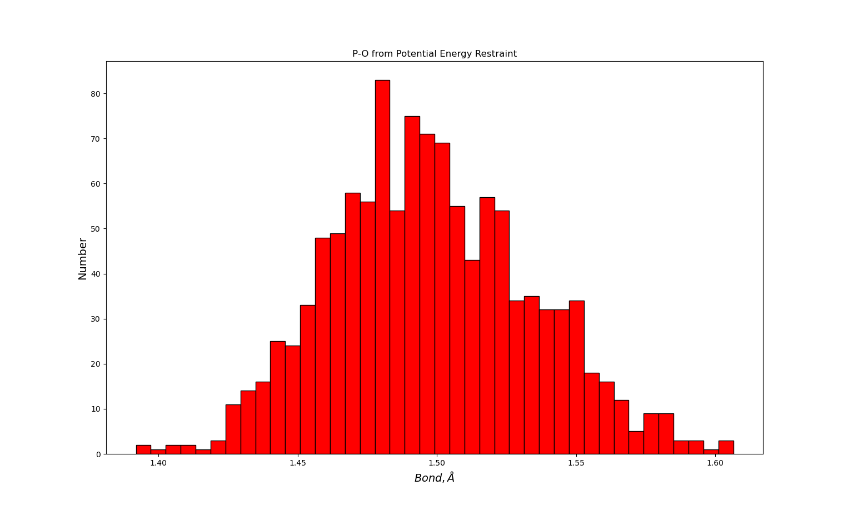
Bond length distribution

Slide 22
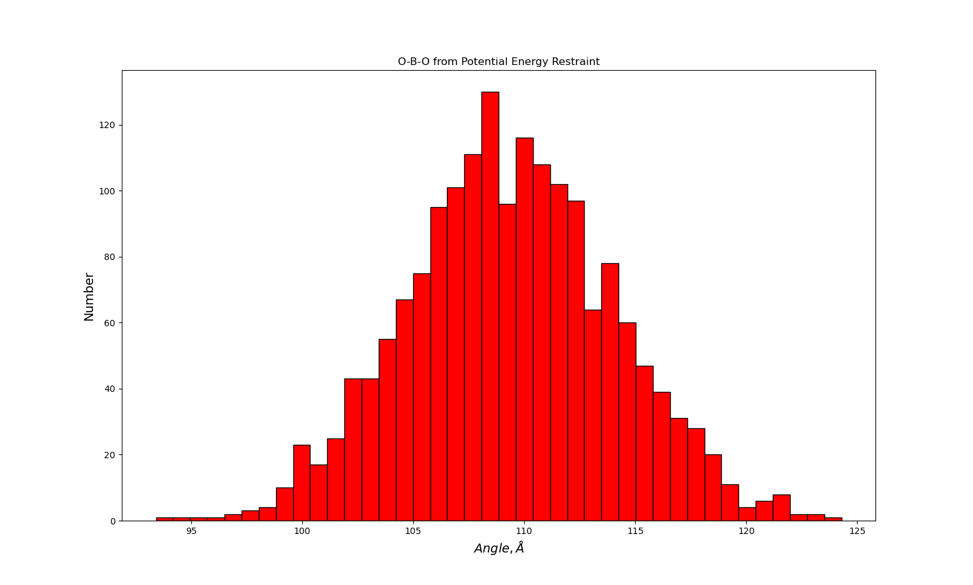
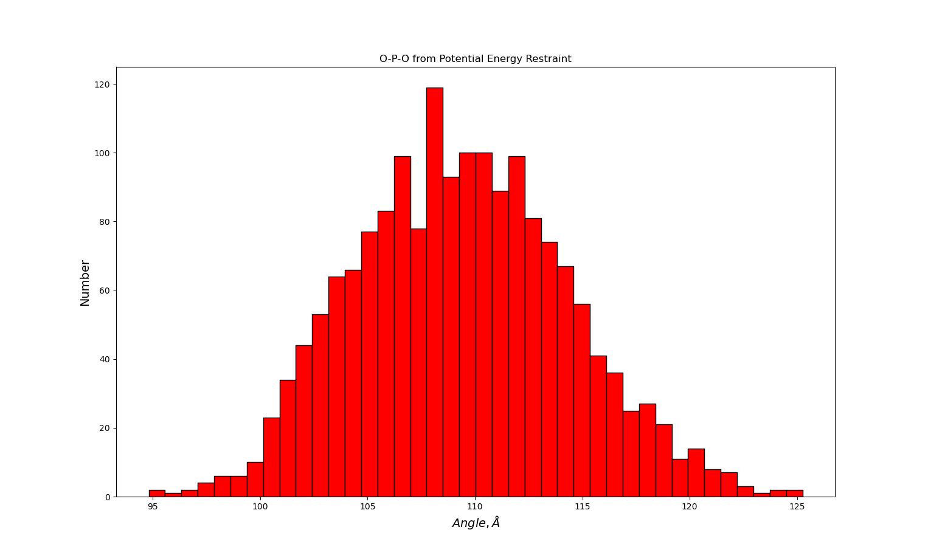
Bond angle distribution

Slide 23


Acknowledgements
Andy Fitch
Catherine Dejoie
Carlotta Giacobbe
Mauro Coduri
Olivier Grimaldi
University of the Witwatersrand
David Billing
Manuel Fernandes

