Slide 1
Evaluating the Impact of Substrate Thickness on the Structural Integrity of Plasma-Sprayed Hydroxyapatite Coatings
Tshepo Ntsoane
Necsa Research and Innovation
22 November 2024

Slide 2
Outline
Introduction
Sample preparation
Experimental
Results and discussion
Conclusion
SA’s ESRF membership

Slide 3
Introduction
Worldwide, an increasing number of patients rely on biomedical implants for repair and replacement of body parts to restore lost functions such as mobility. Applications of biomaterial ranges from hip implants to intraocular lenses for eye surgery. Factors contributing to this include:
Aging population,
Longer life expectancies,
Embrittlement due to osteoporosis in elderly patients mostly women,
Increasing number of accident incidents in young people.

Slide 4
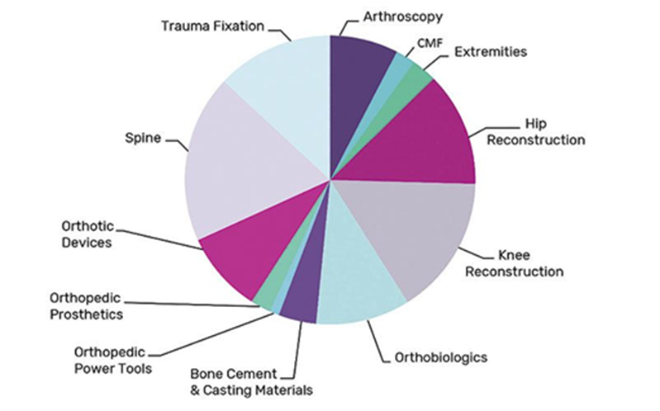
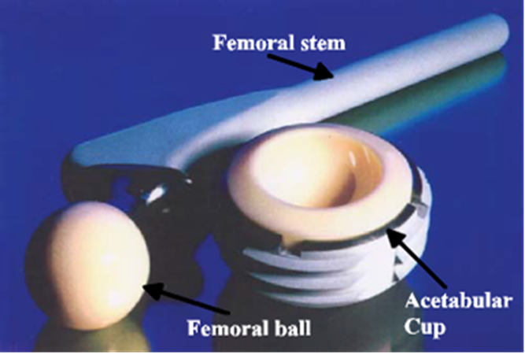
Introduction cont.’
Global orthopedics market share - ~US$40.5B (2018) with a growth of 4.4% compared to the previous year. The projected growth is expected to reach US$67.9B by the end of 2023 with growth rate of 3.3%.

Slide 5
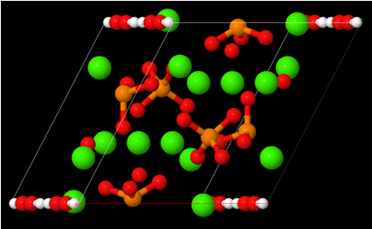
Introduction cont.’
Biomaterials: Metals, Ceramics, composites
Choice depends on the application.
Load bearing application, hydroxyapatite (Ca₁₀(PO₄)₆((OH)₂, owing to it’s similarity to the mineral component of the bone
Disadvantage: Poor mechanical properties
  Brittleness: Limitation in load bearing application
  Coated on a metallic substrate such as Ta, Steel etc.
Coating techniques:
  Sol-gel, Sputter coating, PLD, Electrophoretic deposition, Dip coating
  Thermal spraying

Slide 6
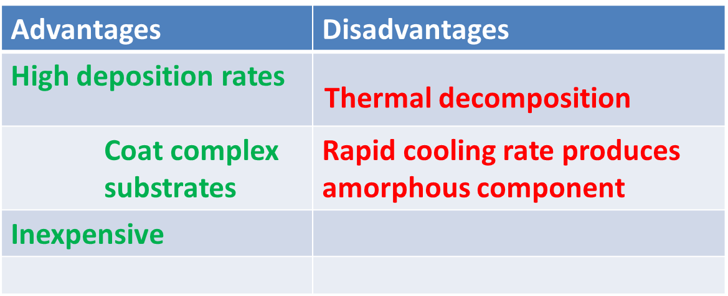
Introduction cont.’
Thermal spray
Although excellent coating results have been observed, studies have shown coating do failure (adhesively and cohesive)
Aim: Investigate the effect of substrate thickness on thermal spray coating. Phase identification, crystallinity and residual stress

Slide 7
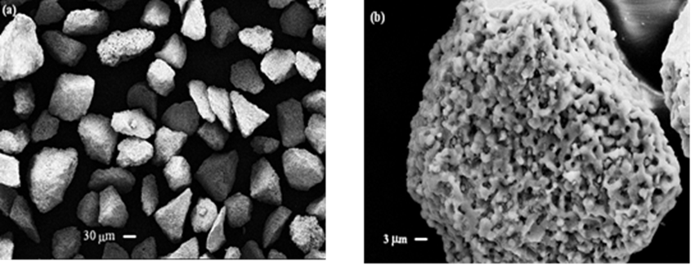
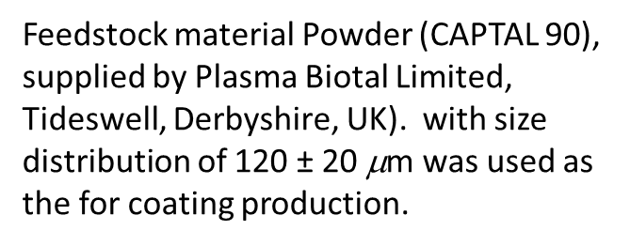
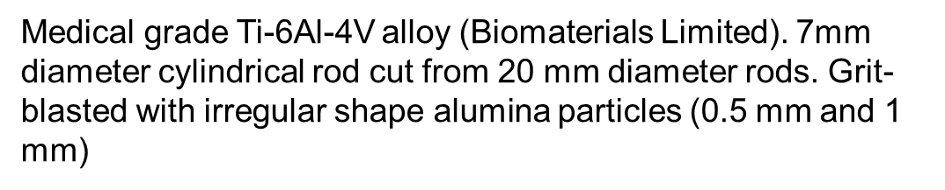
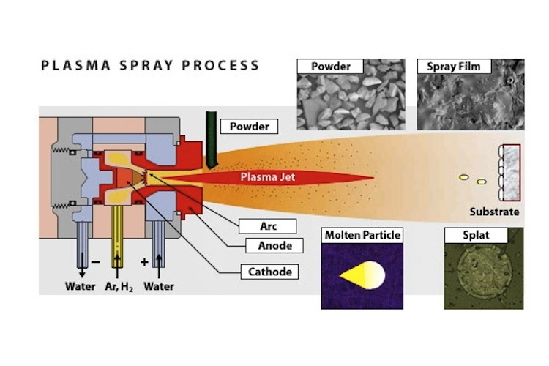
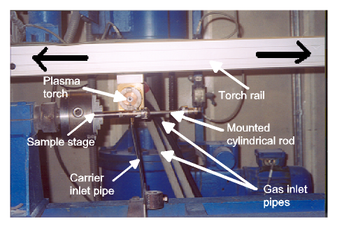
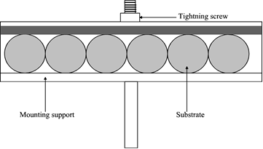
Sample Preparation
https://www.sciencelearn.org.nz/images/250-plasma-spray-process

Slide 8
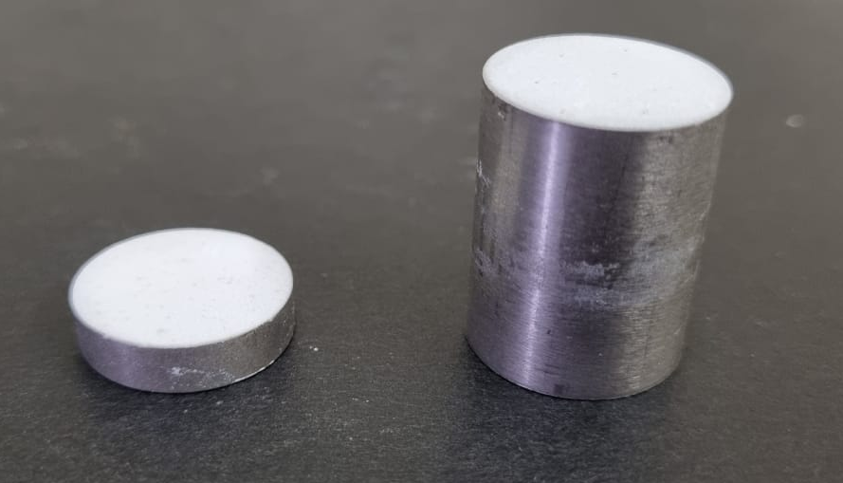
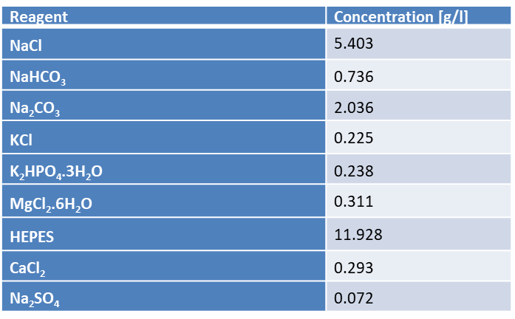
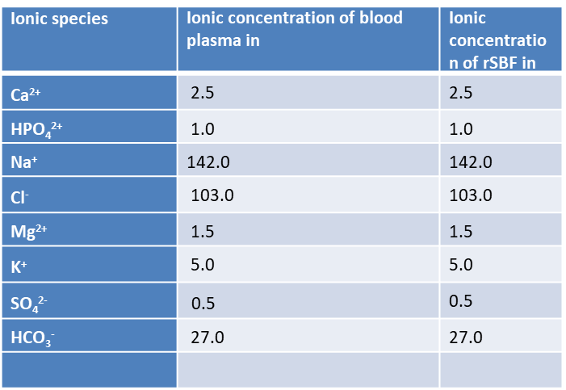
Sample preparation cont.’
Spraying parameters
Parameter | Value
Primary plasma gas (Ar) | 45 slpm
Secondary plasma gas (H₂) | 6.5 slpm
Carrier gas (Ar) | 5 slpm
Relative powder feed rate | 20 %
Relative hopper stirrer rate | 40 %
Spray distance | 90 mm
Plasma power | 30 kW
Horizontal speed | 0.1 m/s
Traverse speed | 0.017 m/s
SBF salts
Ionic concentration comparison

Slide 9
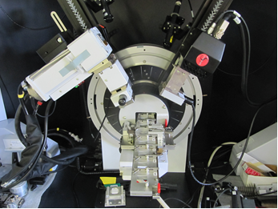
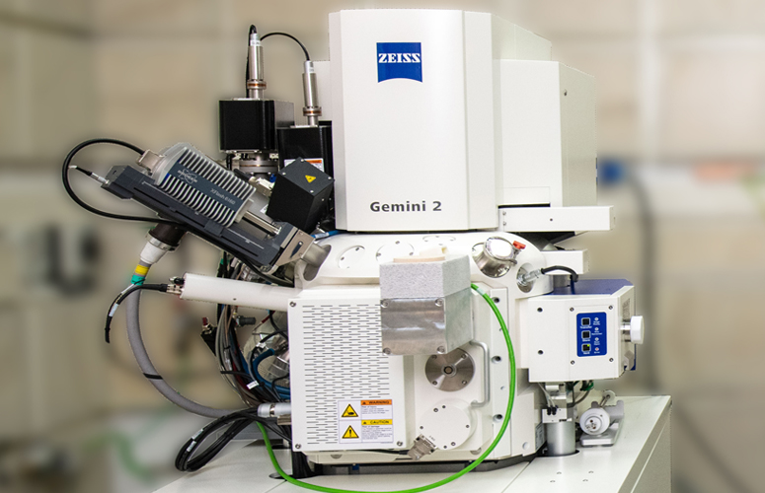

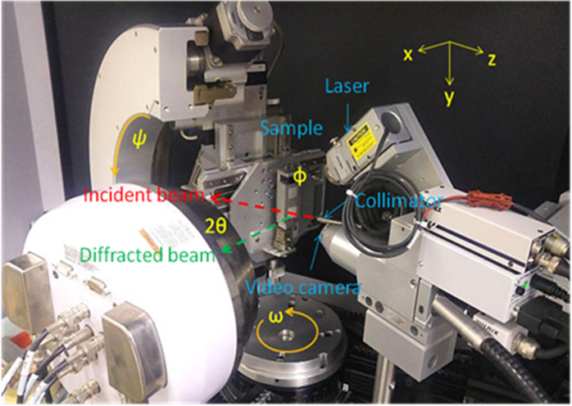

Experimental
Near-surface investigation
Strain scanner

Slide 10
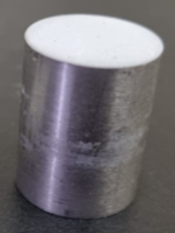
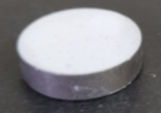
Results
Near surface region

Slide 11
Results cont.’
Near surface : PIXE

Slide 12
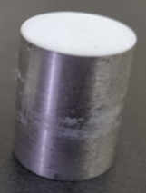
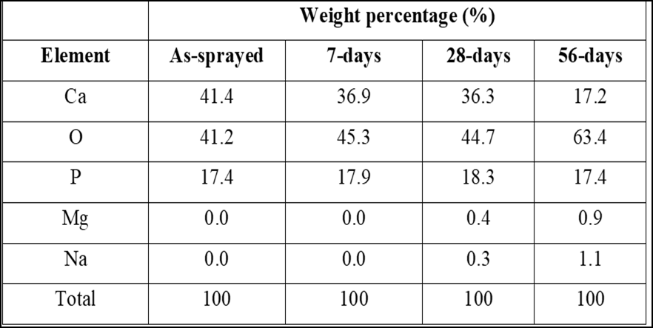
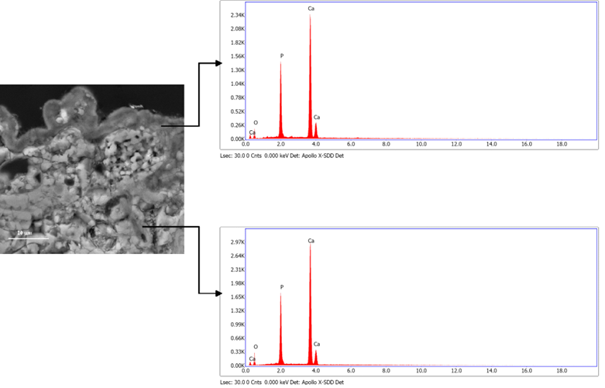
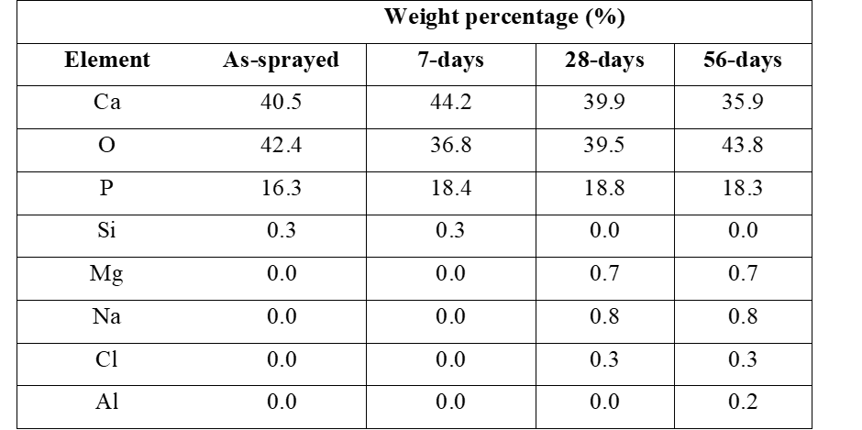

Results cont.’

Slide 13
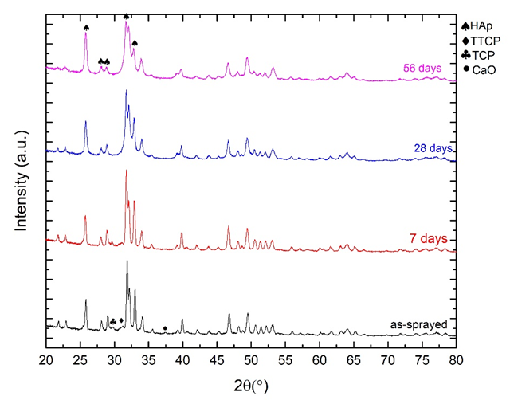
Results cont.’

Slide 14
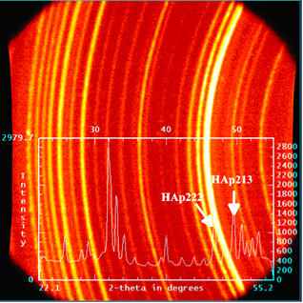
Results and discussion
Near surface residual stress

Slide 15
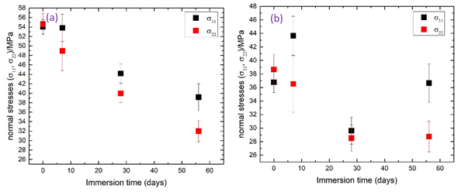
Results and discussion cont’

Slide 16


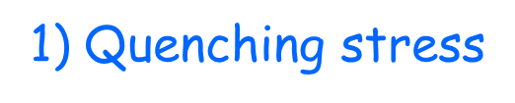



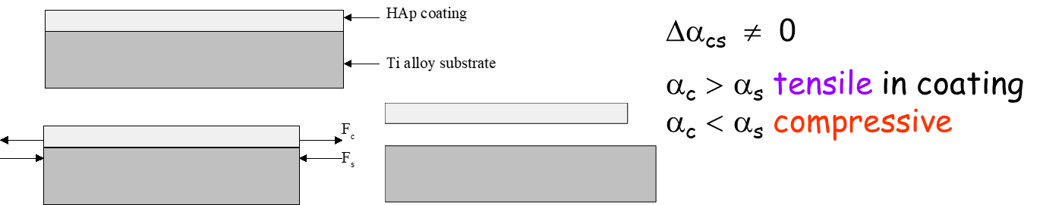
Origin of residual stresses (RS)

Slide 17
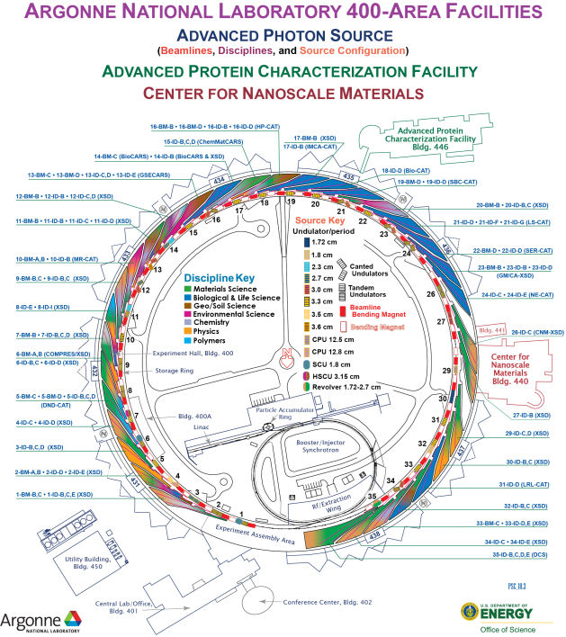
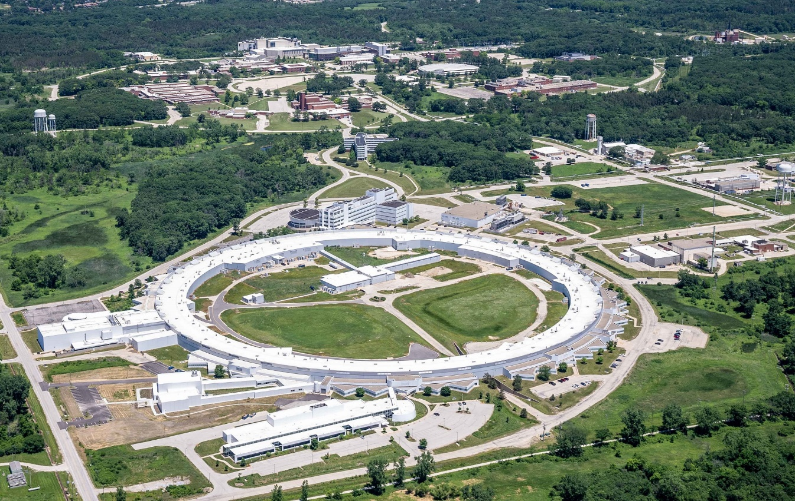
Experimental
Depth resolved investigations

Slide 18
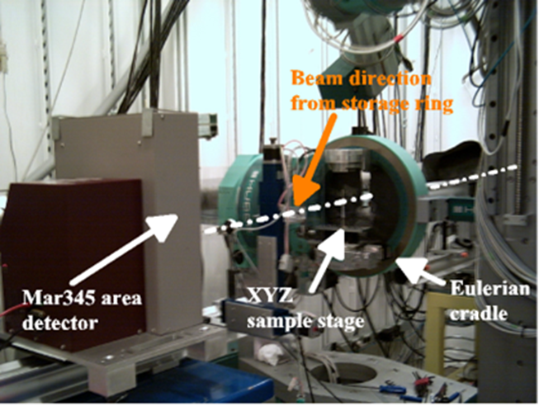
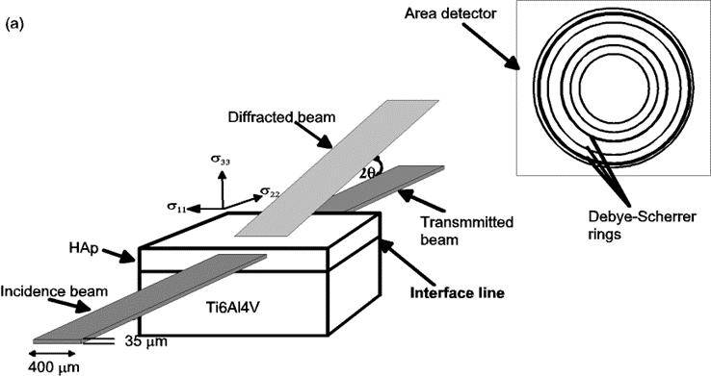
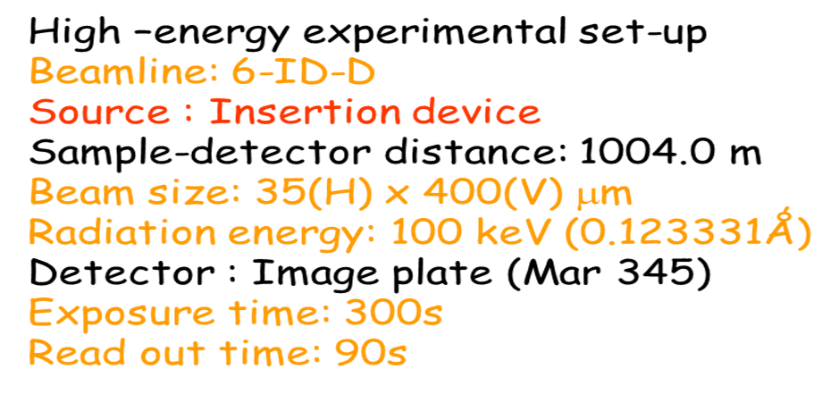

Slide 19
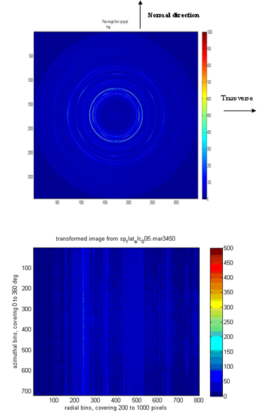
Results cont.’
Depth resolved investigation

Slide 20
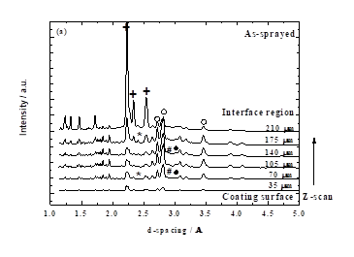
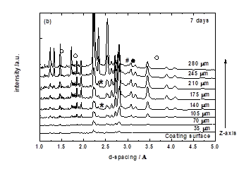
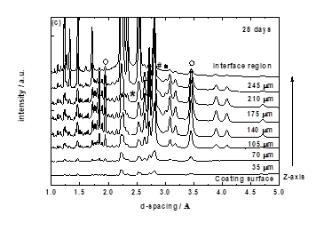
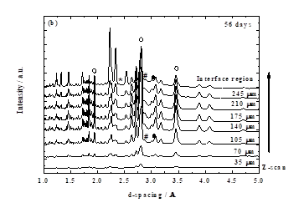
Results
Depth resolved phase composition

Slide 21
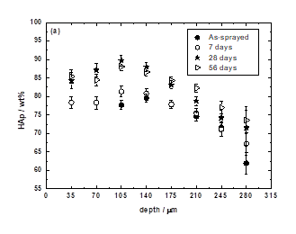
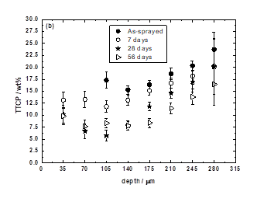
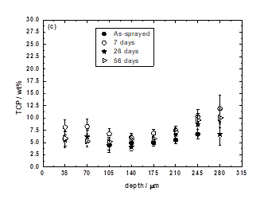
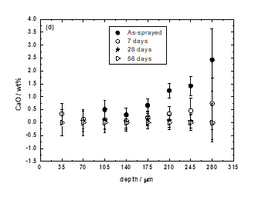
Depth resolved phase composition
Disk

Slide 22
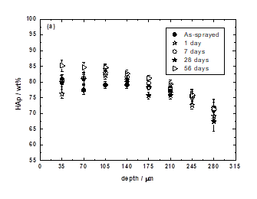
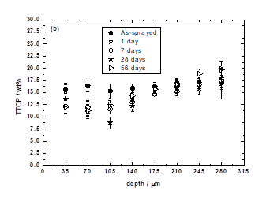
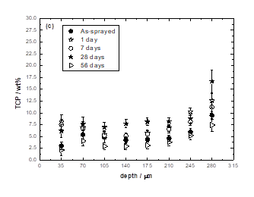
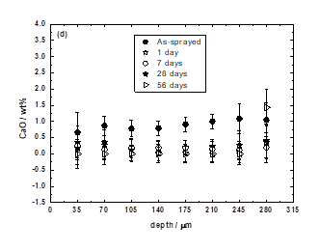
Depth resolved phase composition cont.’
Cylinder

Slide 23
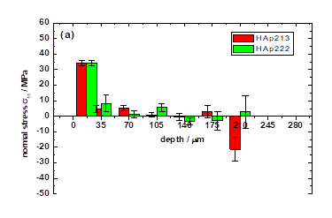
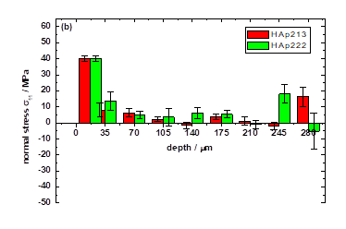
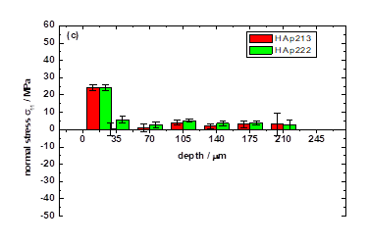
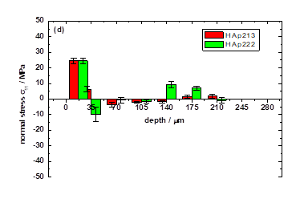
Depth resolved residual stress
Disk : Normal planar stress

Slide 24
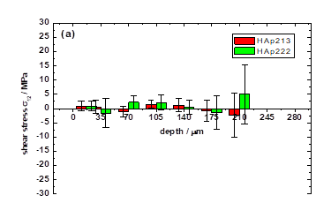



Shear components

Slide 25




Cylinder

Slide 26




Shear component

Slide 27



Slide 28
Conclusions
In both geometry, HAp is the predominant phase with TTCP the main thermal product across coating thickness.
HAp and thermal products increases initially and decreases respectively with immersion before subsequently decreasing and increasing gradually
The high and low crystallinity indices at the near-surface and near-interface region of the coating respectively predominantly amorphous near-interface region respectively.
Microscopy studies revealed a secondary HAp precipitate forming on the coating surface after 28 days of immersion; the precipitate grows in thickness and surface area with immersion period. Cross-section analysis indicated that the precipitate extends deeper into the coating through a network of channels.
Residual stress concentrated in the near-surface region
Higher residual stress observed in the cylinder.

Slide 29
Government support: Access and mobility
SA’s ESRF membership
  Medium Term Agreement
  Initial signed 2013, renewed number of times. Current agreement 2025
  Non-proprietary use of the facility
  Level @ 0.3%
  Access to beam time
    Travel costs, Accommodation, Meals (Canteen card)
  Training of Post-Docs, scientists

Slide 30
Acknowledgements
Dr T.T. Thabethe (UP)
Prof J.B. Malherbe (UP)
Prof C. Theron (UP)
Ms Unaisa Dockrat (UP)
Necsa Applied Radiation
Dr Jon Almer (APS)
Dr Rob Robinson (APS)

