Slide 1

Antifungal and antibacterial potential of isoflavones from Millettia thonningii
Prof. RK Adaboh
Department of Chemistry
University of Ghana

Slide 2
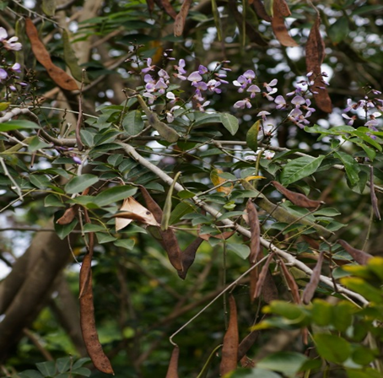
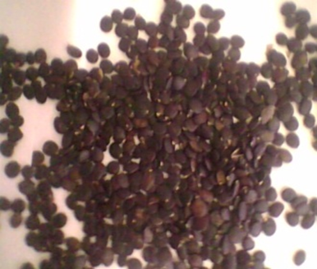
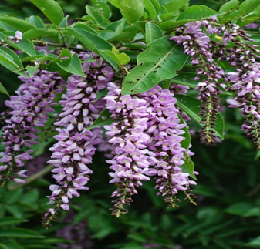
Millettia thonningii
Medicinal Uses
Dysentery
Intestinal pain
Worms
Menstrual disorder
Measles
Chicken pox
Abbiw, D.K. Useful plants of Ghana: West African uses of wild and cultivated plants, 1990.

Slide 3
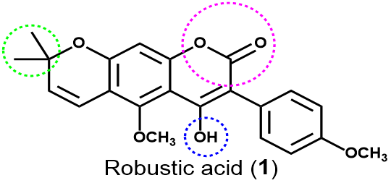
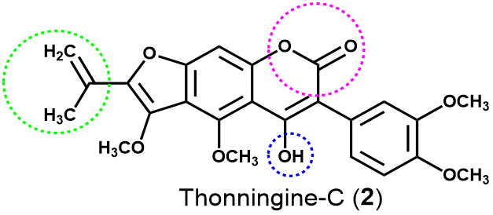

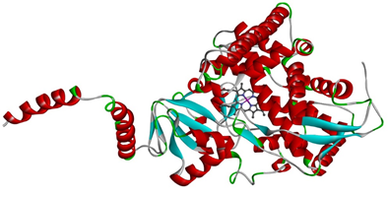
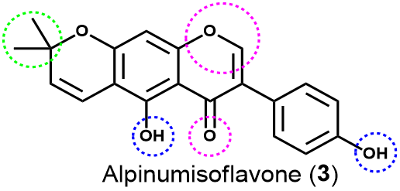
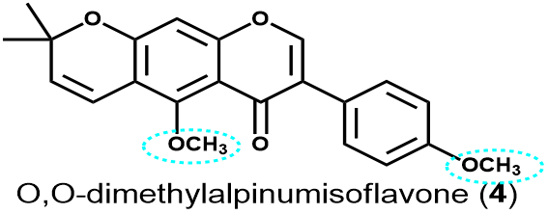
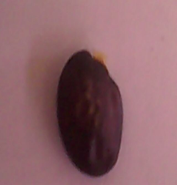
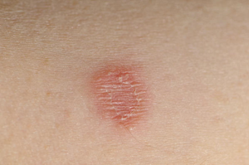
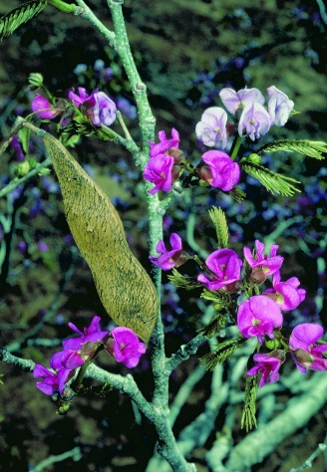
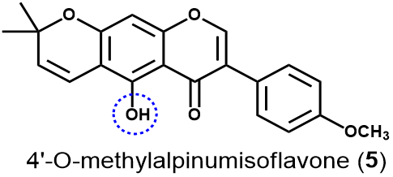
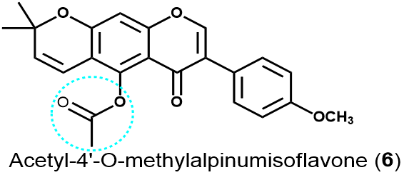
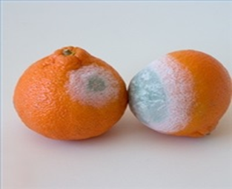
Coumarin Antifungal Lead Compounds from Millettia thonningii and Their Predicted Mechanism of Action

Slide 4
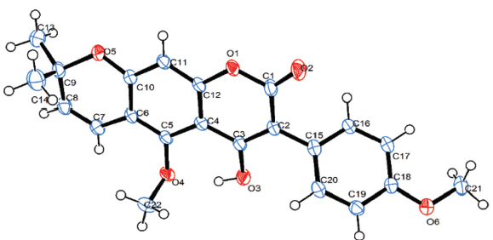
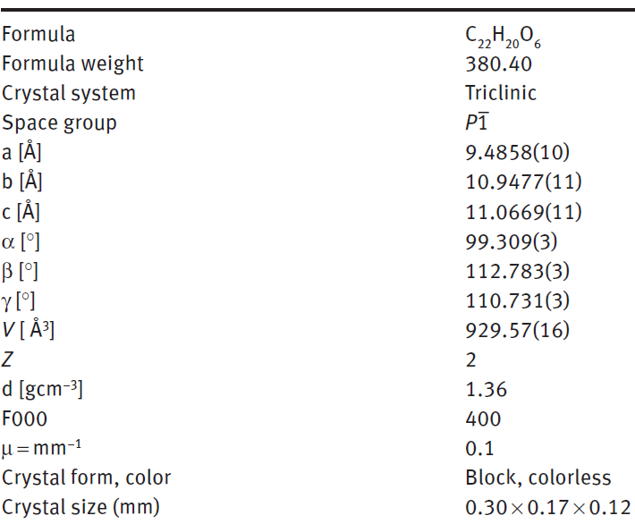
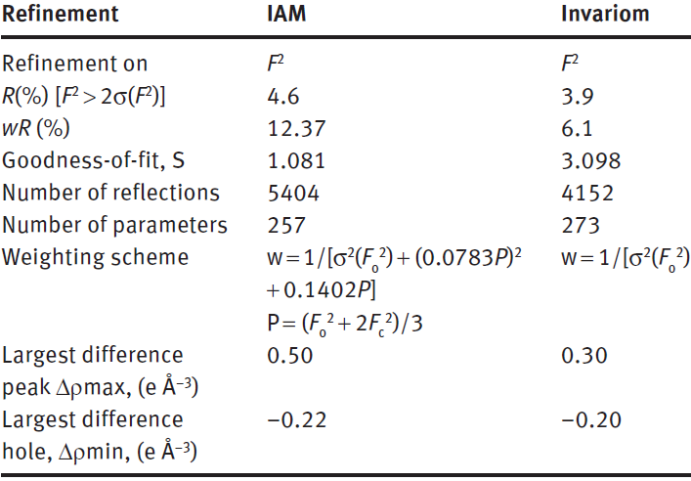
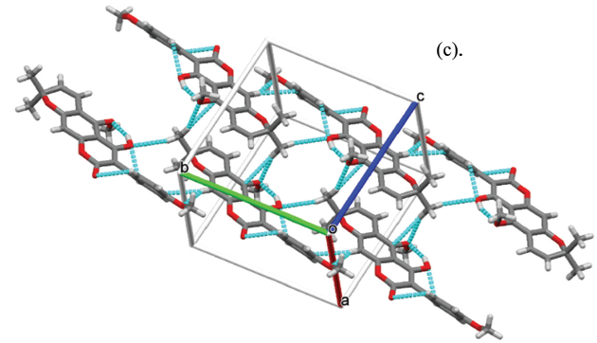
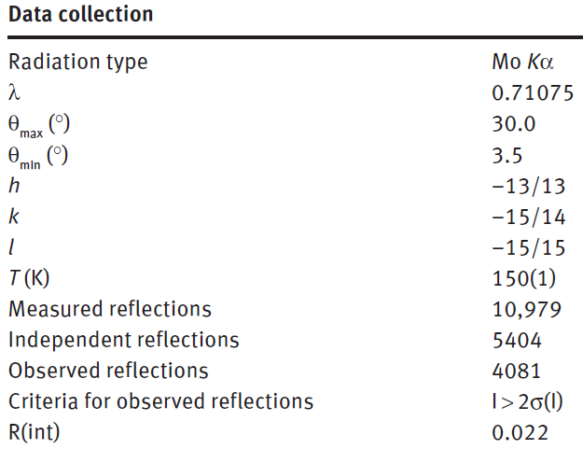
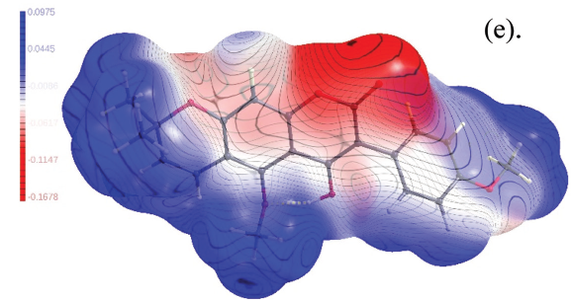
Crystal structure of robustic acid

Slide 5
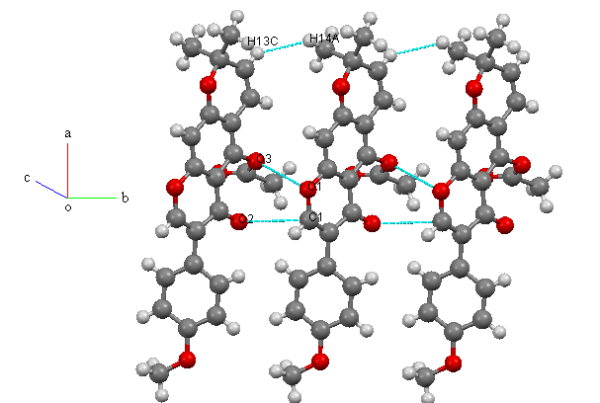
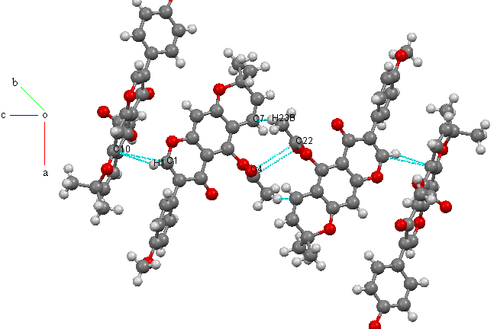
Crystal structure of acetyl-4-O-methylalpinumisoflavone
Data collection
Diffactometer Rigaku RAXIS-RAPID Data collection method ω scans Independant reflection 4472 Measured reflection 19224 Reflection with I>2σ(I) 2577 R(int) 0.05 Ө_{max} 27.5º Dataset -20<h<20, -7<k<6, -30<l<30 Min and max transmission 0.691, 0.992
Crystal data
Empirical formula C₂₃H₂₀O₆ Formula weight 392.41 Crystal system monoclinic Space group P2₁/c a 15.5071(15)Å, b 5.8961(5)Å, c 23.112(2)Å, β 112.482(3)º Crystal form block, colourless Crystal size 0.23×0.14×0.08mm Volume 1952.6(3)Å³ Z 4 F(000) 824.00 Density (calculated) 1.335Mgm⁻¹ Temperature 296K Wavelength of Mo Kα radiation 0.71075Å Absorption coefficient 0.10mm⁻¹

Slide 6
Crystal structure of robustic acid

Slide 7
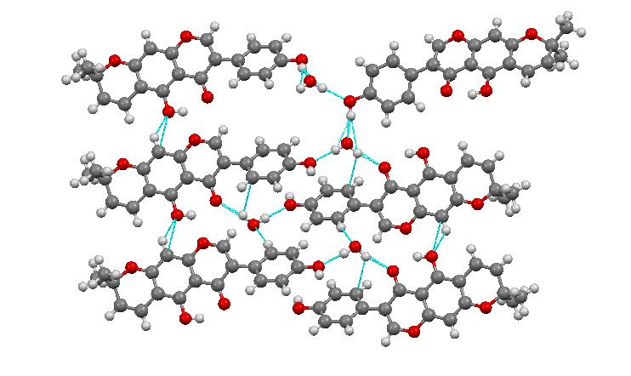
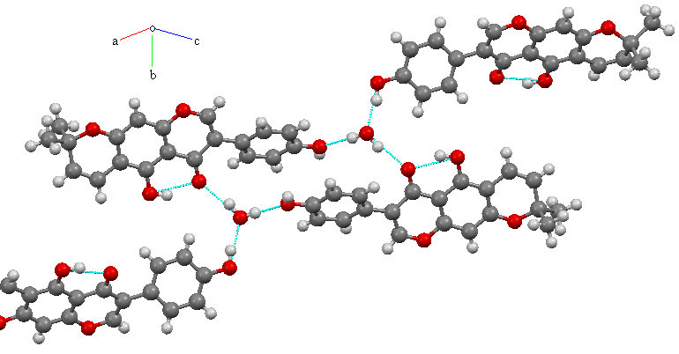
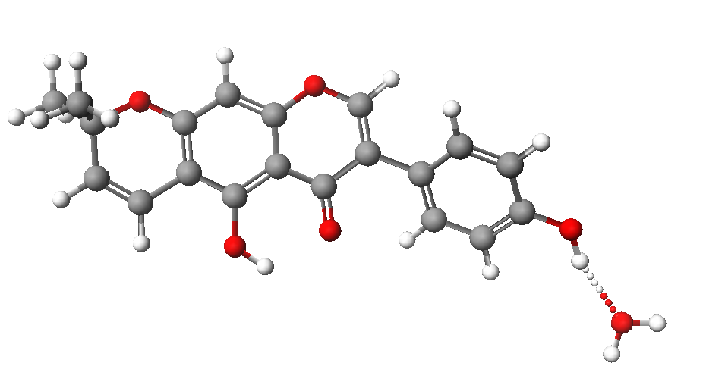
Crystal structure of alpinumisoflavone-monohydrate
C₂₀H₁₈O₆
M_{r} = 354.34 | D_{x} = 1.383 Mg m⁻³
Monoclinic, P2₁/a | Melting point: 485 K
Hall symbol: -P2yab | Mo Kα radiation, λ = 0.71075 Å
a = 12.534 (3) Å | Cell parameters from 35756 reflections
b = 7.0156 (14) Å | θ = 3.1–32.0°
c = 19.405 (4) Å | µ = 0.10 mm⁻¹
β = 94.463 (11)° | T = 93 K
V = 1701.1 (7) Å³ | Needlelike, yellow
Z = 4 | 0.54 × 0.54 × 0.20 mm
F(000) = 744
Rigaku RAXIS-RAPIDII diffractometer | 5891 independent reflections
Radiation source: fine-focus sealed tube | 5129 reflections with I > 2σ(I)
graphite | R_{int} = 0.020
Detector resolution: 10.0 pixels mm⁻¹ | θ_{max} = 32.0°, θ_{min} = 3.1°
ω scans | h = −18 18
Absorption correction: multi-scan numerical | k = −910
T_{min} = 0.949, T_{max} = 0.981 | l = −2828
35628 measured reflections

Slide 8
Bioactivities of the compounds
Two coumarins, robustic acid and thonningine-C isolated from Millettia thonningii, show promising activity against the fungus Candida albicans with minimum fungicidal concentration of 1.0 and 0.5 mg/mL, respectively. Also, at a minimum inhibitory concentration of ~1 mg/mL, alpinumisoflavone and robustic acid were found to be cytotoxic to Staphylococcus aureus (ATCC 25923) showing a zone of inhibition (ZOI) of ~9 mm.

Slide 9
Molecular modelling against the putative bio-molecular target (lanosterol 14α-dimethylase, CYP51) REVEAL A PLAUSIBLE BINDING MODE for the active compounds

Slide 10
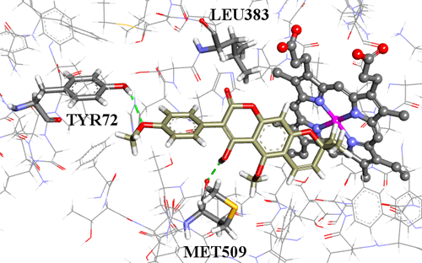
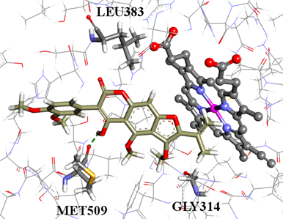
Binding mode of robustic acid and thonningine-C
A
B
MFC - 1.0 mg/mL
MFC - 0.5 mg/mL
Figure 1: (A) The docked configuration of robustic acid (1) in the binding site of lanosterol 14α-demethylase (CYP51) and (B) the docked configuration of thonningine-C (2) in the binding site. Hydrogen bonds are shown as green dotted lines.

Slide 11
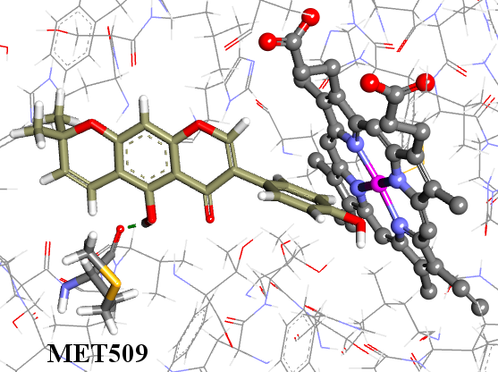
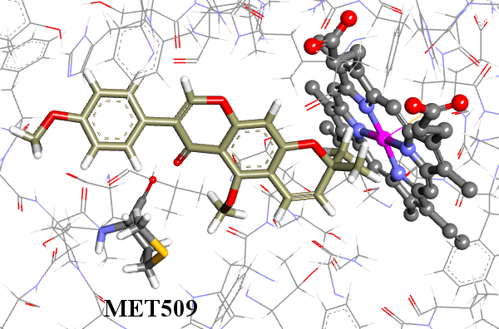
Binding mode of isoflavone (3) and (4)
A
B
Fungistatic
Inactive
Figure 2: (A) the docked configuration of alpinumisoflavone (3) in the binding site of CYP51; and (B) the docked configuration of O,O-dimethylalpinumisoflavone (4) in the binding site. Hydrogen bonds are shown as green dotted lines.
Ayine-Tora, Kingsford-Adaboh, Asomaning, Harrison,Mills-Robertson, Bukari,Sakyi, Kaminta, Reynisson; Molecules, 2016, 21, 1369

Slide 12
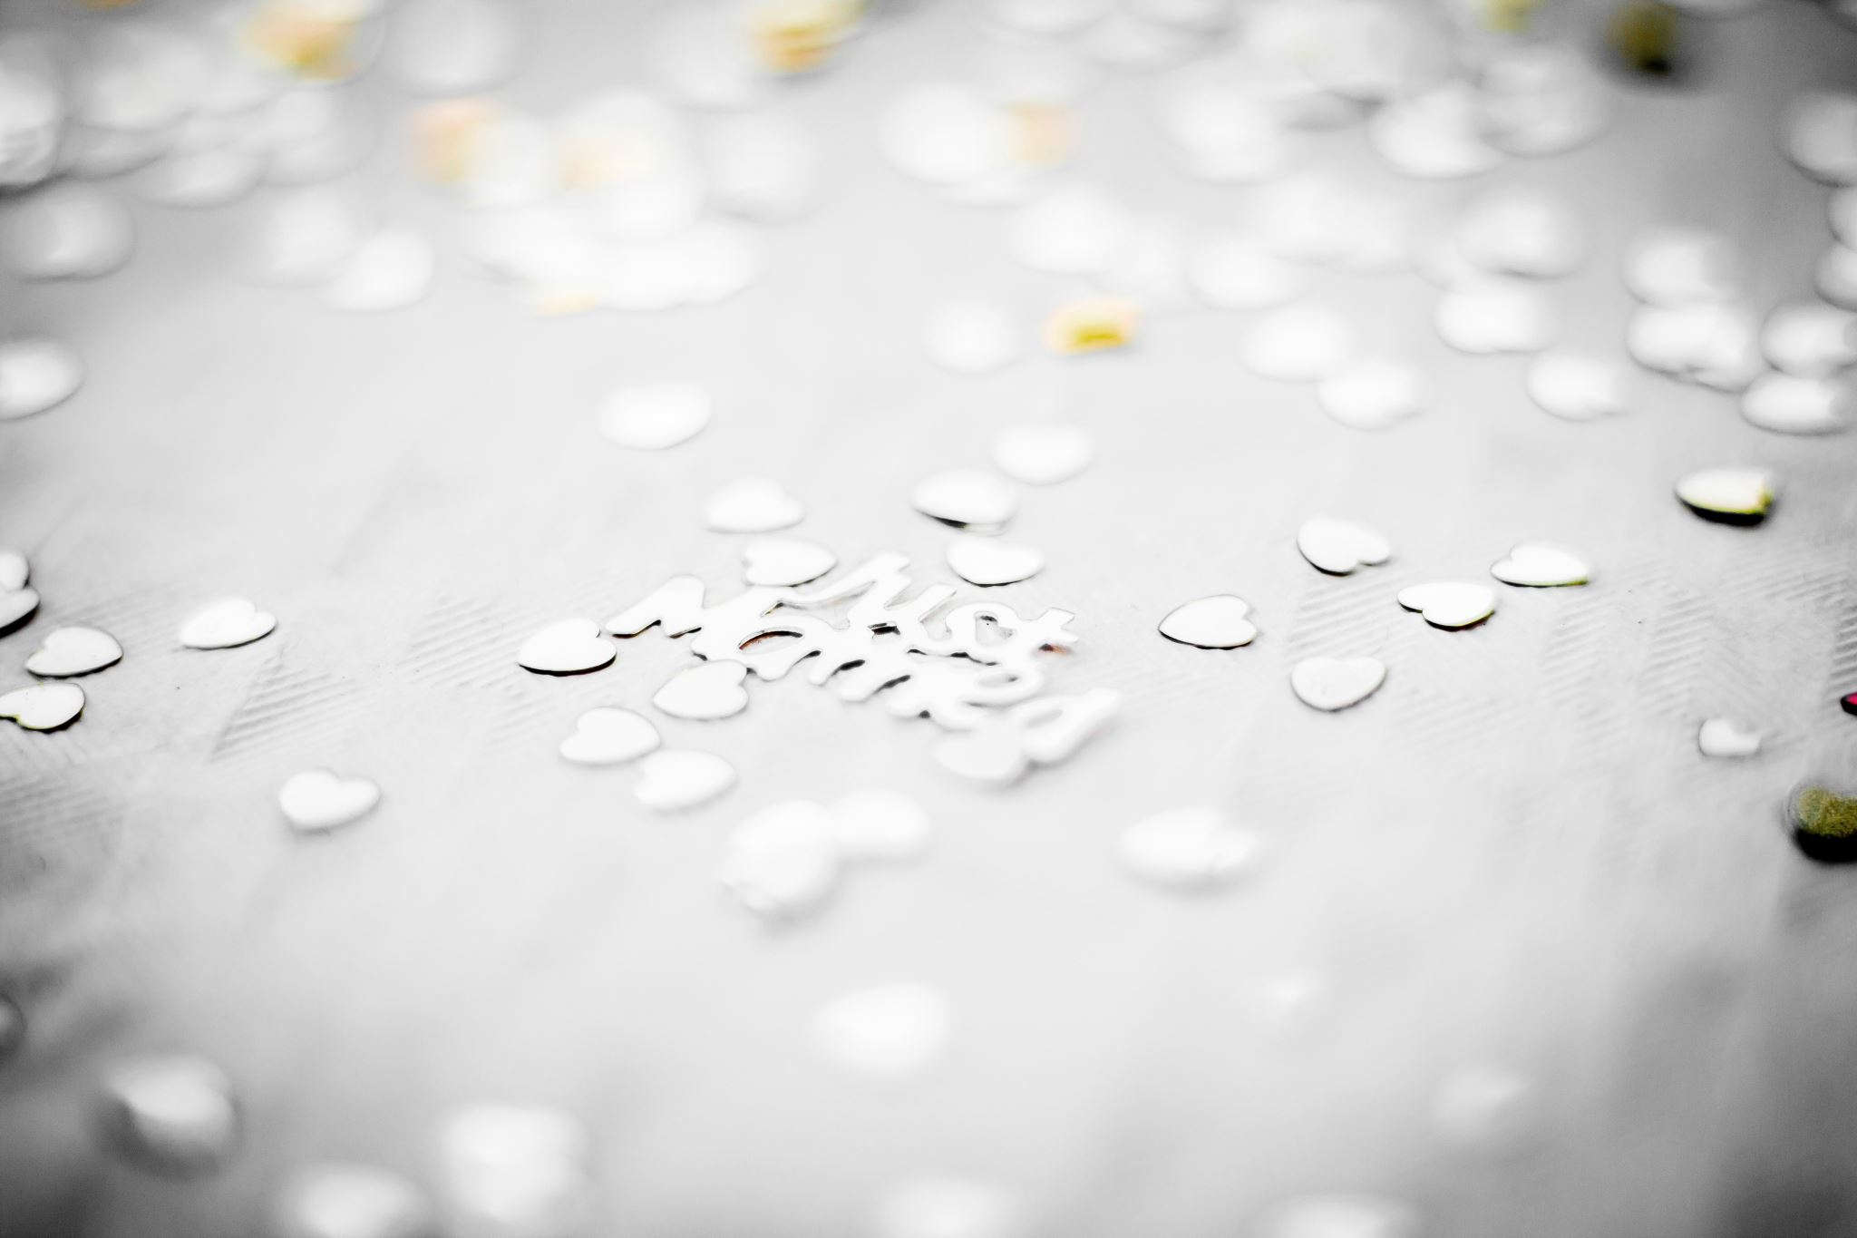
Thank you

