Slide 1
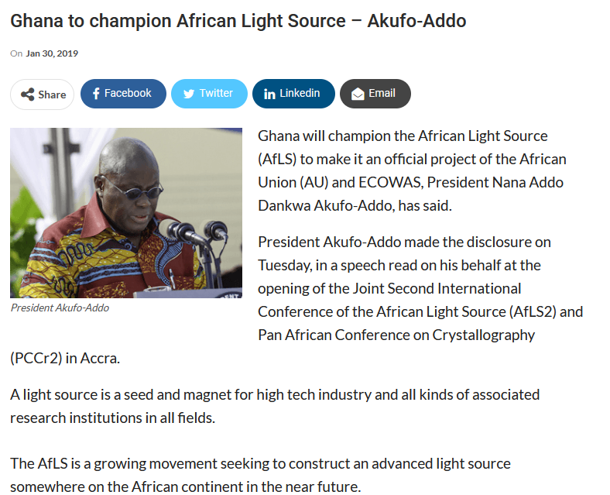
Ghana presidency pledges to champion African Light Source project
President Akufo-Addo said, Ghana would continue to advocate for multilateral relationships between the world’s light sources and various AU member states, along with their universities, research institutions and commercial industries.
“Support bursaries for students in synchrontron-related science and technology, as well as visiting appointments for post-PhD scientists and engineers, both Ghanaian light sources and personnel from light sources to Ghana.”
Professor Samuel Kwame Offei, the Pro-Vice Chancellor, Academic and Students Affairs, University of Ghana, said the University was committed to promoting science and technology education to the highest level possible.

Slide 2
How Is This Manifesting?
From a sterile downtown office/secretariat to a campus-based community of scholars and activists at the University of Ghana campus
The presidency had originally promised an office for a secretariat downtown. Upon further reflection we decided it was best to host the office/secretariat on the campus of the University of Ghana, the site of training, research, policy analysis, student and faculty advocacy and activism.
  Said secretariat would survive changes in personnel and political party that might result at any moment with any given president, cabinet, or election.
High-level visits to light sources around the world
The chair of the parliamentary science committee is planning a multi-national (ECOWAS) delegation to X- Tech Lab in Benin.
A visit to NSLS-II (USA) remains on his radar screen. Visits to Diamond, SOLEIL, ESRF, et al, also possible.
Chair of the Ghana Council for Scientific & Industrial Research (CSIR) visited CHESS at Cornell University.

Slide 3
African Light Source Faculty/Student Interest Group at UGh
College of Basic and Applied Sciences
  Physical and Mathematical Sciences
  Biological Sciences
  Agriculture
  Engineering Sciences
  Veterinary Medicine
College of Education
  Continuing and Distance Education
College of Health Sciences
  Medical, Dental, Pharmacy, Nursing, Biomedical Sciences
College of Humanities
  Business, Law, Social Sciences, Arts
A total university group that covers not only the S&T training and research, but the policy, political, social, and economic aspects of multi-national big science in Africa as well.

Slide 4
Specific Objectives of UGh African Light Source Interest Group
Build a Community of Scholars across disciplines, problems/applications, departments, schools, colleges, and even institutions in Ghana, Africa, and beyond
Develop training resources for students and young faculty
Be a bona fide think-tank for conceptual and technical design development as well as on policy advisory and advocacy functions
Be science diplomacy actors in ECOWAS and rest of Africa, Commonwealth, CARICOM, Latin America, US and Canada, Europe, Middle East and Asia

Slide 5
Specific Activities of UGh African Light Source Interest Group
Build our local infrastructure for training in synchrotron techniques across disciplines, labs and courses
Invite experts in for both in-person, on-campus colloquia and zoominars
Engage with NGOs in the various disciplines, national, Pan African and global
Resource bursaries and whole academic programs specifically in synchrotron sciences, and same for faculty research grants
Make periodic briefings of parliamentarians and IGO representatives
Develop international partnerships, e.g., with University of West Indies, Cornell University, Pan African University, and others, incl, UCC and KNUST in Ghana.

Slide 6
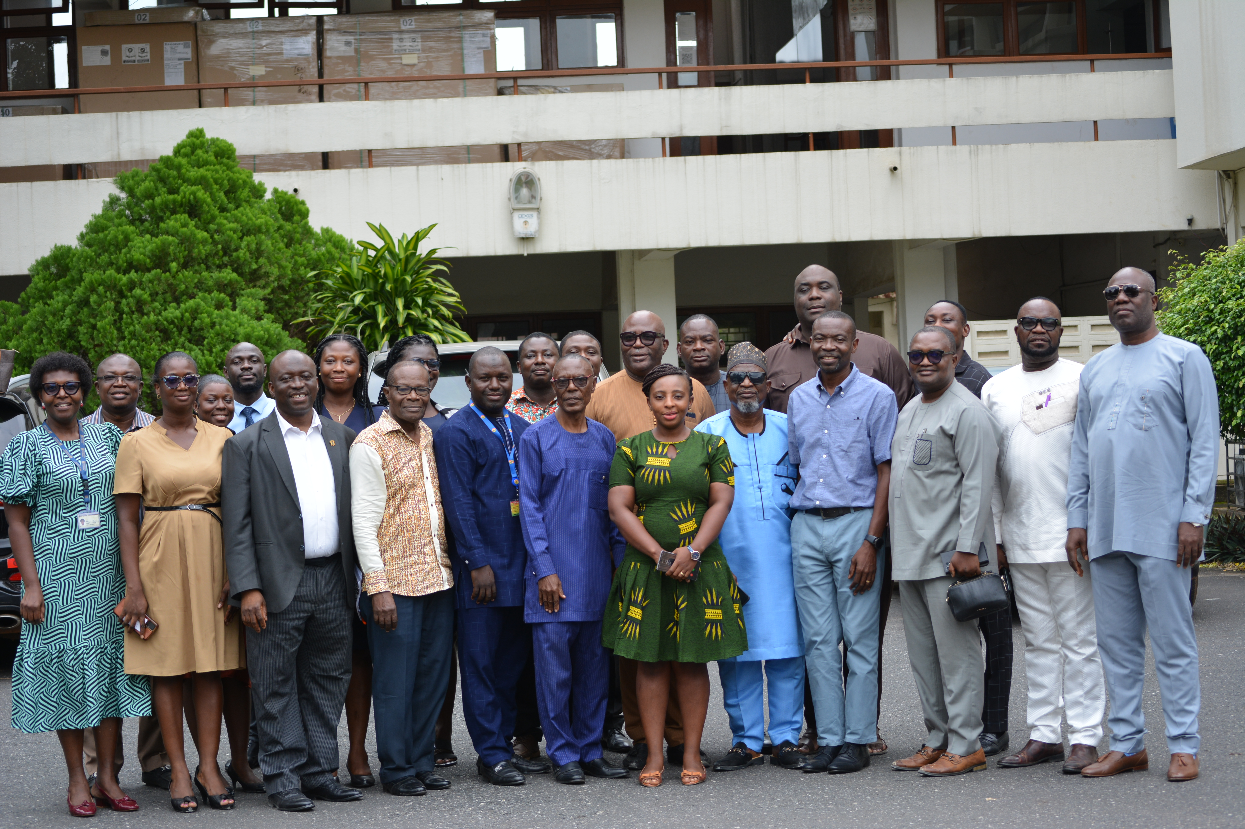
A visit by Parliametarians

Slide 7
Fate of Political Advocacy for AfLS in Ghana
Ghana presidency and parliamentary elections are in December
HE President Akufo-Addo is term-limited. Vice President Bawumia is the NPP candidate. He has been invited to AfLS before, has a speech in his files on the subject. He is a Ph.D. economist and has a book on Key Determinants of National Development
A leading science advocate for the opposition party recently spoke at a monthly AfLS / AfPS zoominar.
The two leading parties might disagree on ordering of priorities, but expect both to be advocates for AfLS to some degree. Expect the commitment of the UGh to be steadfast no matter what.

Slide 8
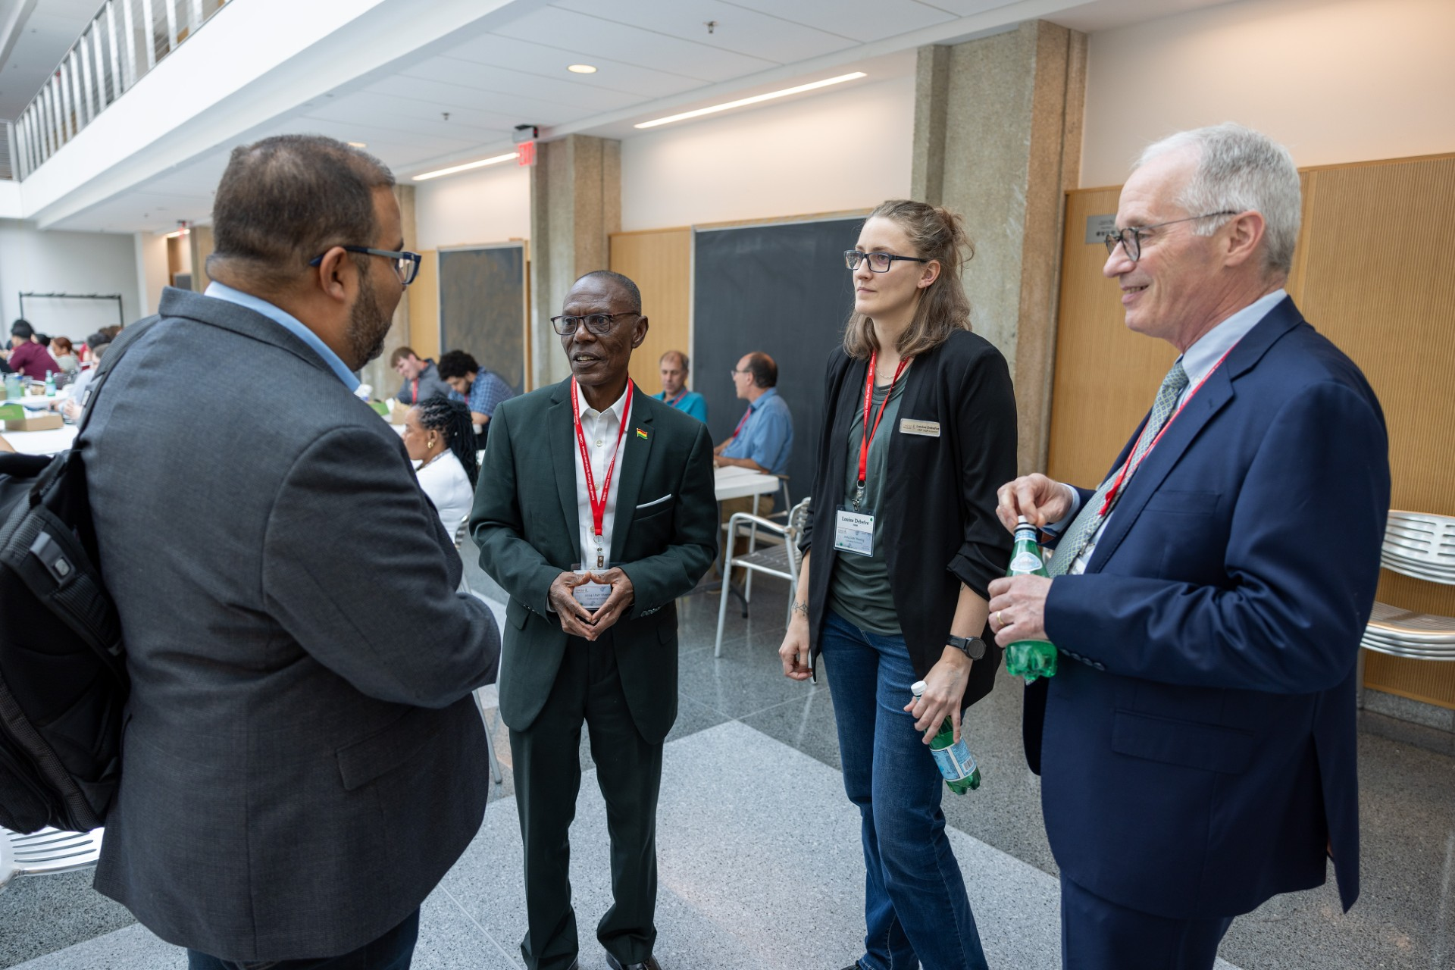

Slide 9
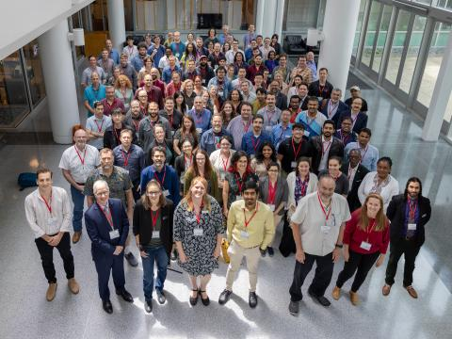

Slide 10
THANKS

