Slide 1

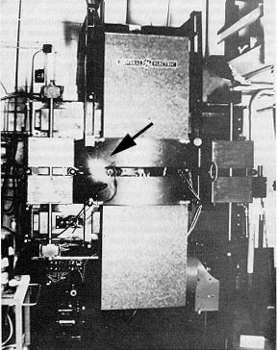
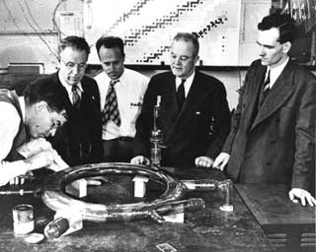
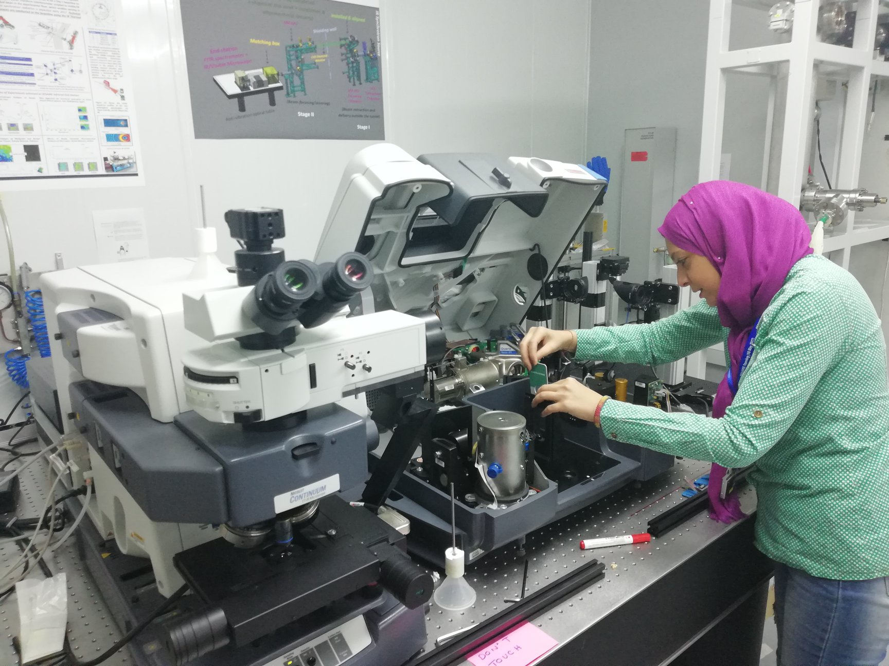

How can synchrotrons lead to local scientific and industrial development?
Minerals, Metals and Materials: Understanding the World around Us
Jeffrey Cutler

Slide 2
A Few Statistics - Globally*
60 Operational and planned synchrotrons
  26 countries
  51 operational (14 upgrades) and 9 new
14 Free-electron lasers
Most have some form of an industrial program
183,000+ unique articles published
130,000+ protein structures deposited
8,000+ employees
*https://lightsources.org/

Slide 3
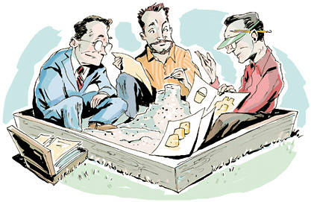
How to Get Industry to Play in the Sandbox

Slide 4


Partnerships

Slide 5


Stakeholders
Users
Training
Academia
Users/clients
Public
Industry
Supply chain
Government
Funders
Policy

Slide 6







Industrial Science
Industrial Science is a service but also acts as an access route for a variety of people/organizations that will become users as well as regular clients.
I want to try
something that
may not work
I have more
money than time
The proposal
turnaround
is too long
I’m doing
proprietary
research
My proposal
was rejected!
I want to try
a small
experiment
Analysis
is hard!
2
Notes:
The Industrial Science group is much more than a cost recovery arm of the CLS.
We provide a more straight-forward access route to get synchrotron results without being a synchrotron scientist.
In addition to proprietary work
Analysis
Industry supported academics that provide a guaranteed rapid access mechanism
Users/Clients on a tight timeline

Slide 7
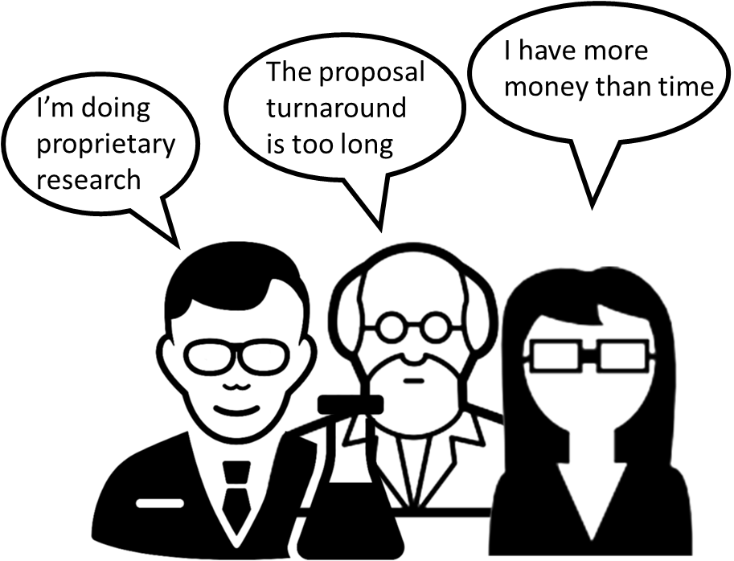
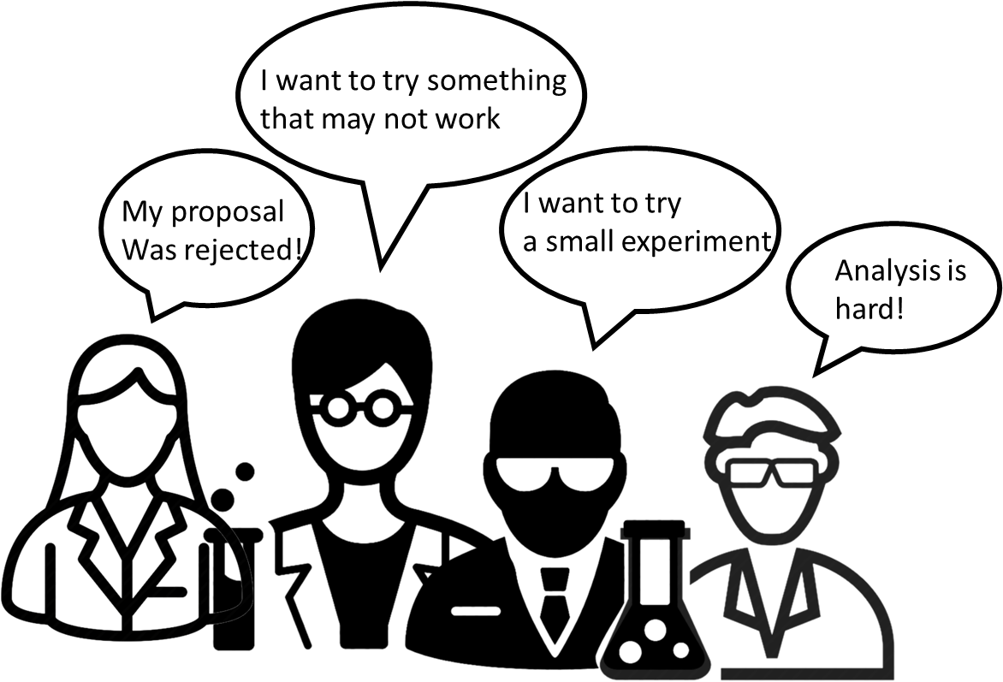

Industrial Science
Some clients transition through industrial science to the general user program
Client-like
User-like
Deliverables
Experimental Design
Data Analysis
academic purchased access users
- usually industry-supported measurements
Training
Experimental Design
Collaborative Data Analysis
3
Notes:
Trained Clients graduate towards Users
Established techniques become SOP

Slide 8
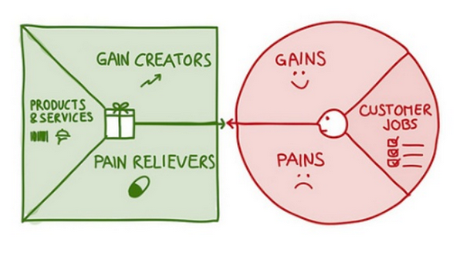
What am I Selling?
Value Proposition
Customer Segment

Slide 9
Industrial Science
INDUSTRIAL SCIENCE MISSION
To solve industrial problems using synchrotron science
PROGRAM FOCUSES
Collaborative research with industry, academia and facility staff
Mining/Oil/Gas
Analytical technique development
Clean technology
Drug development/design/MX
…….

Slide 10
Industrial Science Value Proposition
LS Industrial Science is an R&D consulting service that provides advanced materials analysis, expertise, and guidance to research and development professionals utilizing synchrotron techniques.
What is it?
For whom?
Values?

Slide 11
Engagement Strategies
R&D activities of target companies can differ by sector as well within a company
important consideration in devising a strategy for engaging potential clients is an understanding of how these businesses do their R&D
Primarily three R&D strategies companies’ use:
Own in-house research and development capabilities
  have own staff and a research focus
engage the University research community through the funding of research chairs
  with University support, engage project research, fund pure and applied research and allow publications
contract research activities to private consultants or some combination thereof
  creates another layer of complexity to get to the right people

Slide 12

Steps in being a Client
Service
Novice
Intermediate
Expert
First time SESAME users
Data
Applications
Facilities
Orientation
Beamline
Orientation
Experimental
Orientation
Experimental
Run
Data
Processing
Data
Analysis
Interpretation
Facility & Orientation
Examples
Food and Health
Beamline Orientation
Energy
Interpretation
Clean Water
Data Analysis
Advanced Materials
Catalyst Design
Experimental Orientation
Petrochemical
Cultural Heritage
Data Processing
Experimental Run

Slide 13
Industrial Science
TECHNOLOGY PORTFOLIO
Develop an understanding of IP and technology transfer opportunities
  What is the facilities technology landscape?
INCREASED INTERACTIONS IN RESEARCH
Work on opportunities to engage a broader cross section of staff in directed projects
  Round table discussions with industry clients to develop project ideas

Slide 14
Industrial Science
SPIN-OFFS AND SPIN-OUTS
a type of corporate action where a company "splits off" sections as a separate business
Examine opportunities to develop stand alone entities from internal programs or acquire a small company that complements current industrial focus areas
  Macromolecular crystallography
  Material characterization

Slide 15
Industrial Science
INTRAPRENEURSHIP
is the act of behaving like an entrepreneur while working within a large organization
  e.g. Skunk Works at Lockheed-Martin
Develop a culture that encourages innovation
  Running a series of lunch time videos on the entrepreneurial process
  Support various forms of collaboration that have identifiable benefits for the facility

Slide 16

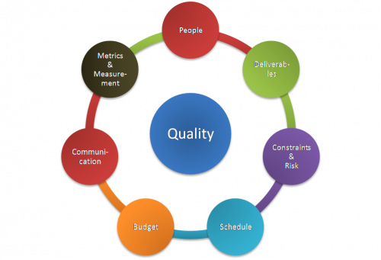
Aspects of the Industrial Science Program
Industrial services should focus on equitable benefit for the facility
  financial compensation
  in-kind contributions (specialized equipment and/or sample environments)
  HQP (post-doctoral researchers in the building)
  publications (is there a history of publishing research)
  technique development (feasibility projects)
  strategic area (are synergies present with existing research priorities)
Industrial services are focused on quality management
  chain of custody, best practices in data collection and analysis, document review procedures, client satisfaction, continual improvement through internal audits
  advise clients on appropriate sample collection & shipping procedures
Notes:
Contrast equitable benefit with GUP which is focused primarily on Scientific Merit (not even on the list for Industrial Science)
Discounts on beamtime are available based on the number and type of equitable benefit criteria that a client meets

Slide 17

It takes time!!!

Slide 18



To Answer Grand Societal Challenges

Slide 19



Answer S&T questions in the future
Ex Situ
In Situ
In Operando

Slide 20
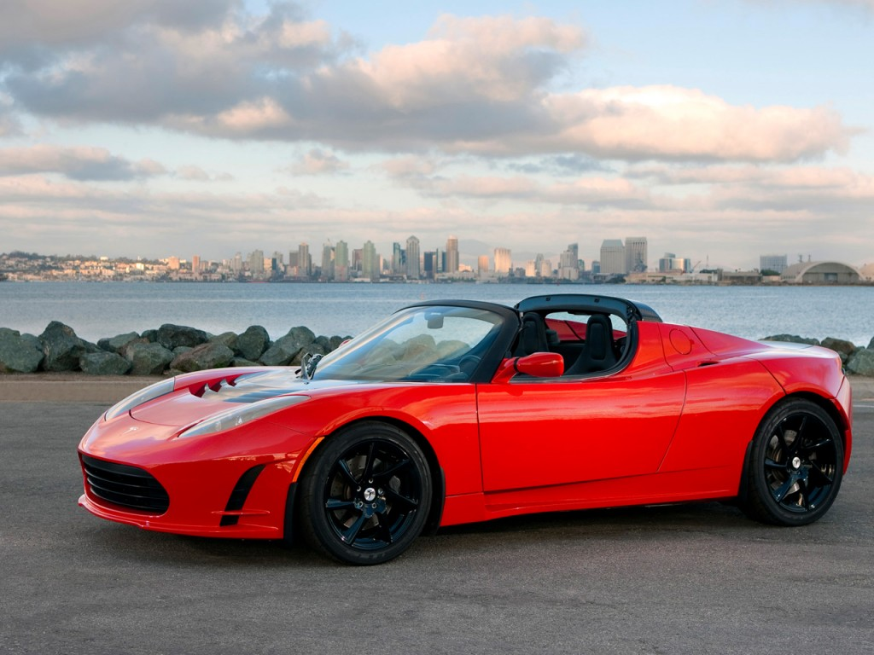
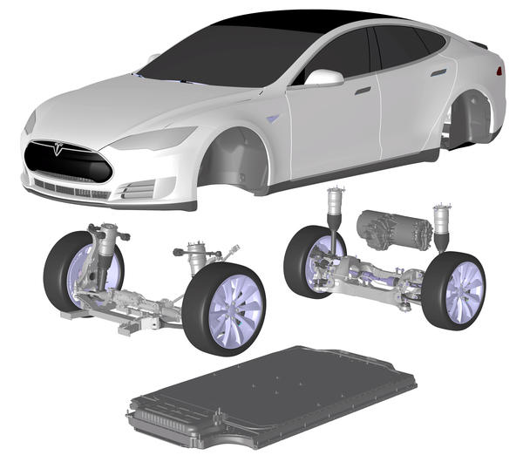
Clean Technologies

Slide 21
Battery Value Chain
Design of materials
Understand material behaviour
Cell Production
Understand cell function
~
~
Component Production
Assembly of single cell
Module Production
Anode
Cathode
Active materials
Binder
Electrolyte
Separator
Configuration of cells into larger module
Pack Assembly
Reuse & Recycle
Modules with systems that manage power, charging and temperature
Deconstruction
Cleaning
~
Use
Pack Integration
Aid in recovery of materials
Comparison of structure difference between used and unused commercial batteries
In-device battery lifetime
Integration of pack into device or vehicle

Slide 22
In Situ XAS of Li-Ion Batteries
Using a pouch cell with LiNi_{0.33}Mn_{0.33}Co_{0.33}O₂ as the positive electrode, the following XAS spectra were collected during charge from 2.8 V to 4.2 V at C/10
The shift to higher energy in the Ni spectrum is consistent with oxidation of Ni²⁺ to Ni⁴⁺ as Li is deintercalated from the electrode
There is no rigid shift in the Mn or Co spectra, indicating that they do not participate in charge compensation (the observed changes in spectral features are due to changes in local coordination geometry)
Charge

Slide 23
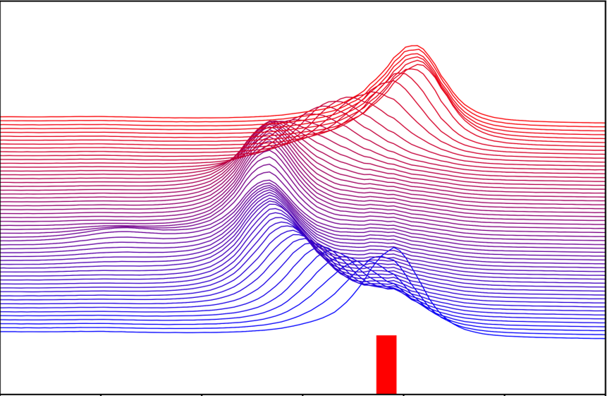

In situ and In operando Studies of Batteries
Degradation and Failure
Chemical/Structural changes during cycling
Notes:
General slide to show that we can use hard x-ray techniques (CT and XRD) to do in-situ/operando experiments with commercial form-factor batteries without any disassembly or modification of the cell. These aluminum “pouch cells” are used in most EVs (also cell phones, laptops, etc.), so they can be taken directly from used battery packs and studied on the beamline.

Slide 24
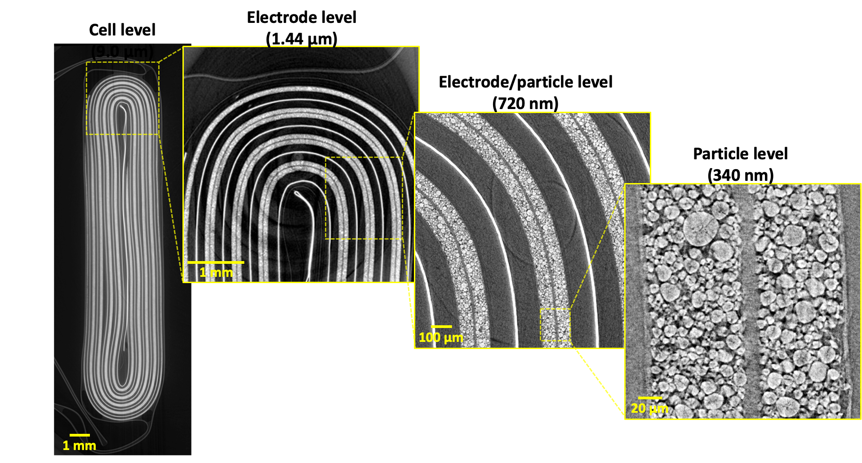
Imaging commercial batteries
Cell level
(9.0 µm)
Bond, et al. https://doi.org/10.1149/1945-7111/ac8a22
Notes:
We can image the cell at different magnifications to see how the cell degrades and how those effects propagate at different scales. You need a synchrotron to get the very high-resolution images in a large cell without cutting it up (normally lab-based scanners can only work with very small samples to get high resolution). We can get all this data at different spatial scales without ever dismantling or modifying the cell.

Slide 25
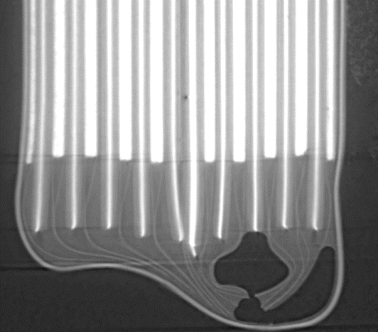
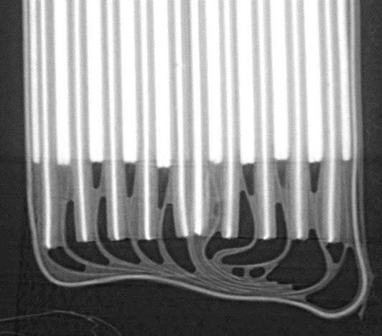
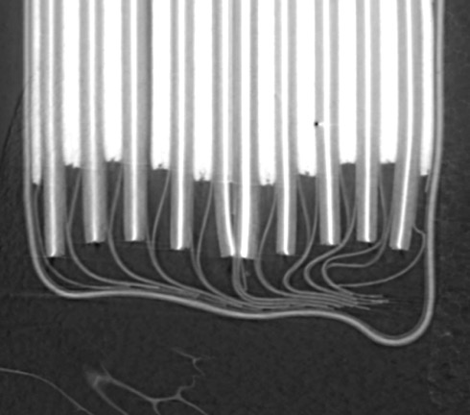
Tracking depletion of electrolyte
New battery
After light use for 2 years
After heavy use for 2 years
Electrolyte
Gas
After 1 year of charging and discharging slowly between 75% and 100% full charge, much of the excess electrolyte is gone
If the cell is charged and discharged quickly from 0% to 100%, all the excess electrolyte is gone and the cell is both swollen and deformed
The cell starts with lots of excess electrolyte (which is necessary to transport Li-ions back and forth)
Bond, et al. https://doi.org/10.1149/1945-7111/ac8a22
Notes:
Synchrotron CT also produces much better image contrast than regular CT, allowing us to see light materials like the electrolyte in the cell. The electrolyte in Li-ion batteries consists of an organic solvent and a Li salt (like LiPF6). We’ve been able to show that if you start with an excess of electrolyte, the electrolyte disappears as you cycle the cell. If you cycle it more aggressively, more electrolyte disappears.

Slide 26

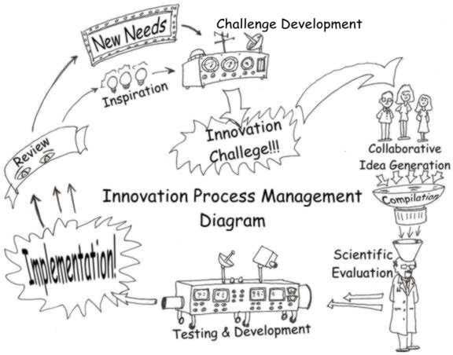
Industry needs to innovate
1 : the introduction of something new
2 : a new idea, method, or device : novelty
Opportunity for a WIN-WIN

Slide 27

Making a dollar is not a bad word

Slide 28




