Slide 1

  The Synthesis of Pyrroles Using Enaminone Precursors
SPEAKER: Kwanele Hlongwane
SUPERVISORS: DR M. SELEPE & DR S. MTHEMBU

Slide 2
Pyrroles
Pyrrole is a 5-membered aromatic nitrogen-containing heterocycle.
They are present in many natural products (heme and chlorophyll), biologically active compounds, and several drugs.
Pyrrole derivates have various applications in pharmaceutical and physiologically active drugs like antibiotics, anti-inflammatory drugs, and anticancer agents.

Slide 3
Enaminones
Enaminones are an essential class of synthetic intermediates that are highly versatile in reactivity because of the O=C–C=C–N structural part embedded in them.
Through their electrophilic and nucleophilic substitution reactions, enaminones are effective as building blocks in the organic synthesis of acyclic, aromatic, and heterocyclic compounds.

Slide 4
Aim and Objectives
The aim of this research is to develop a synthetic approach for the preparation of pyrroles from the enaminone derivatives. The specific objectives of achieving this aim are:-
Synthesis of enaminone precursors,
Characterization of the synthesized enaminone derivatives using Nuclear Magnetic Resonance (NMR), High-Resolution Mass Spectroscopy (HRMS), and Infrared Spectroscopy (IR). etc.,
To develop a procedure for the preparation of pyrrole scaffolds,
To optimize the pyrrole derivatives,
To do the bioassay for the enaminones and pyrroles.

Slide 5
Methodology
Scheme 1: Synthetic route of enaminones to pyrroles.

Slide 6
Results and Discussion
Table 1: The synthesised enaminone derivatives
Entry | R | R’ | Yield (%)
3aa | H | H | 81
3ab | H | 2,4-dimethyl | 65
3ac | H | 4-fluoro | 87
3ad | H | 4-chloro | 84
3ae | H | 2,3-dichloro | 83
3af | H | 2,4,5-trichloro | 81
3ba | 4-fluoro | H | 95
3bb | 4-fluoro | 2,4-dimethyl | 89
3bc | 4-fluoro | 4-fluoro | 91
3bd | 4-fluoro | 4-chloro | 96
3be | 4-fluoro | 2,3-dichloro | 89
3bf | 4-fluoro | 2,4,5-trichloro | 91
3ca | 4-methyl | H | 96
3cb | 4-methyl | 2,4-dimethyl | 76
3cc | 4-methyl | 4-fluoro | 94
3cd | 4-methyl | 4-chloro | 92
3ce | 4-methyl | 2,3-dichloro | 91
3cf | 4-methyl | 2,4,5-trichloro | 94

Slide 7
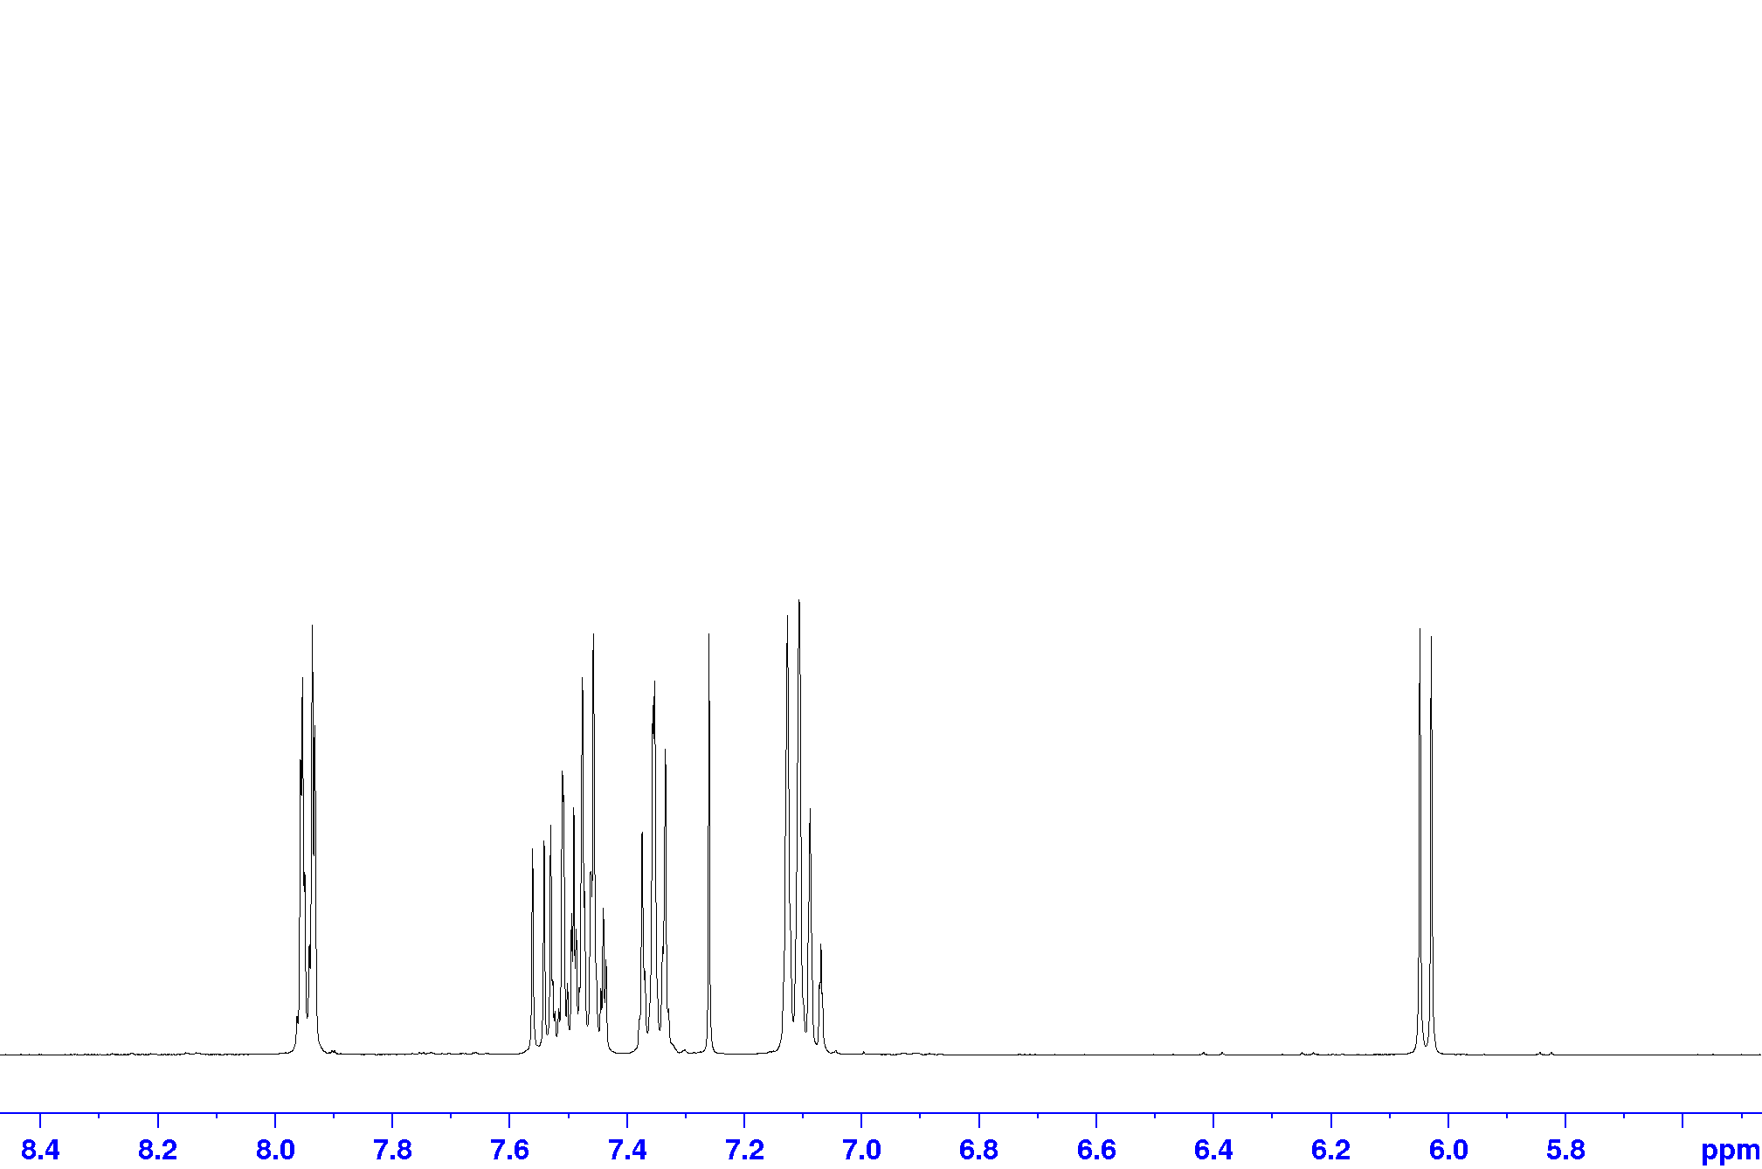
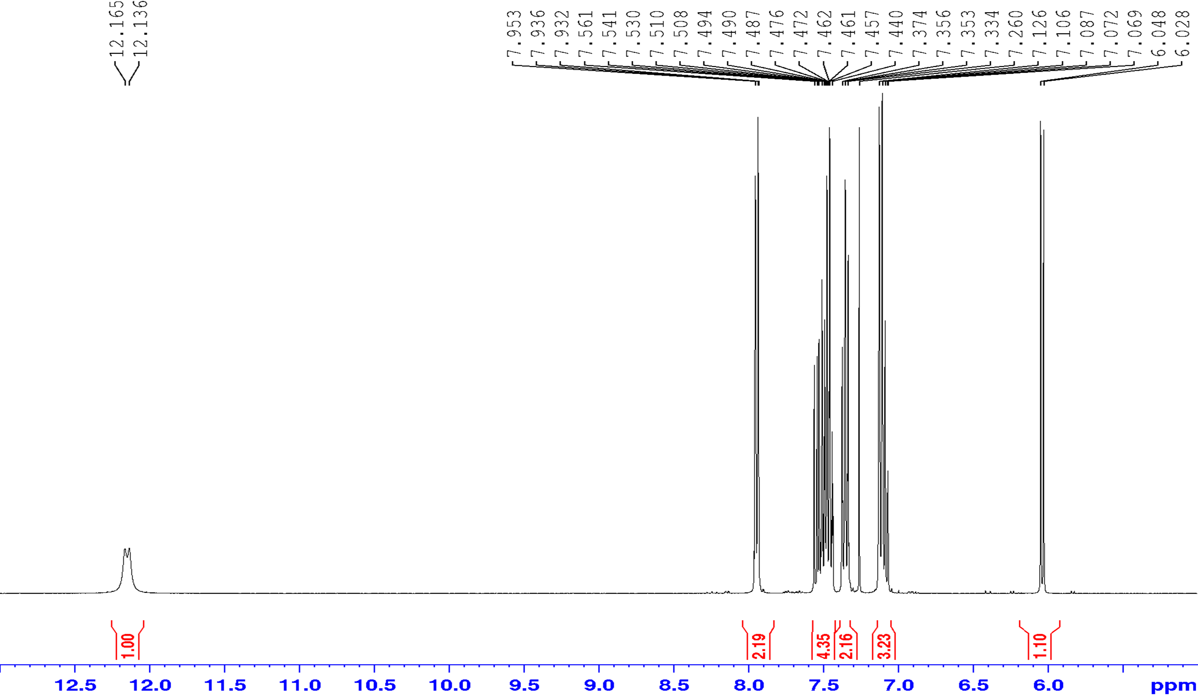
Results and Discussion
a,b
e
f
d,g,h
c
Figure 2: ¹H NMR of compound 3aa.

Slide 8
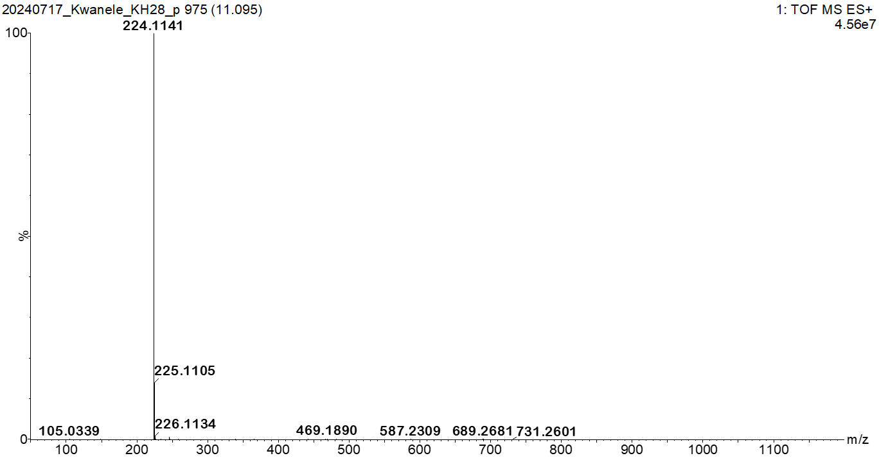
Results and Discussion
m/z [M + H]⁺= 224,1141
Figure 1: HRMS of compound 3aa.

Slide 9
Conclusions
Successful synthesis of enaminones and its derivates confirmed by NMR and HRMS.
Compounds are going to serve as intermediates for the synthesis of the pyrrole derivates.

Slide 10
Current and Future Work
Synthesis of pyrroles.
Biological studies of both enaminones and pyrroles.

Slide 11
References
S. C. Philkhana, F. O. Badmus, I. C. Dos Reis and R. Kartika, Synthesis, 2021, 53, 1531-1555.
I. Siddiqui, D. Kumar and S. Shamim, Journal of Heterocyclic Chemistry, 2013, 50, E111-E115.
D. K. Singh and R. Kumar, Beilstein Journal of Organic Chemistry, 2023, 19, 928-955.
I. J. Amaye, R. D. Haywood, E. M. Mandzo, J. J. Wirick and P. L. Jackson-Ayotunde, Tetrahedron, 2021, 83, 131984.

Slide 12
Acknowledgements
Special thanks to my supervisors, Dr Selepe and Mthembu,
Research group,
University of Pretoria, Chemistry department and the technicians,
NRF Free Standing Funding,
NRF Thuthuka Funding (Grant No: 0415594923 ),
USDP.

Slide 13
THANK YOU.

Slide 16
Scheme

Slide 17
Mechanism

