Slide 1
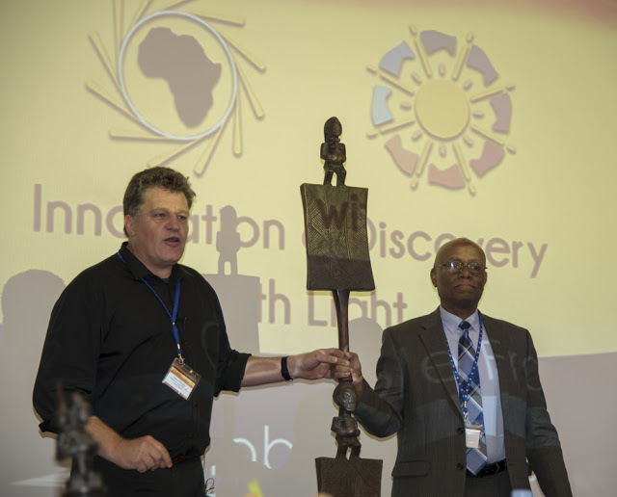
The African Light Source AfLS7-2024
Virtual Event : 18-22 Nov 2024
The AfLS Ceremonial calling stick
The AfLS African ceremonial calling stick summons us from around the world to participate in these Historic Events.
From within Africa, it first called us -
AfLS1 in Grenoble in November 2015.
AfLS2 in Ghana in Jan 2019.
AfLS3 1st Virtual Workshop in Nov 2020 - COVID.
AfLS4 in Benin in November 2021 (virtual)
AfLS5 in Botswana in November 2022 (virtual).
AfLS6 November 2023 (virtual).
AfLS7 November 2024 Johannesburg (hybrid).
The AfLS ceremonial calling stick hails from ancient Ashanti culture. Normally, it would be planted at a nexus of roads, where all would pass and note its message boards. For the AfLS, the message is the vision of an Advanced Light Source in Africa, delivering new scientific discoveries, of great relevance to Africa, and also the world.
The stick has the gravitas of a scepter. It depicts both genders equally Symbolically we have, inclusivity, and ubuntu. All are invited, and all will build the AfLS together.
At the end of these proceedings, it will call us again to the next conference …….
The calling stick final resting place is the future AfLS facility, where it will still call all people to its campus.

Slide 2
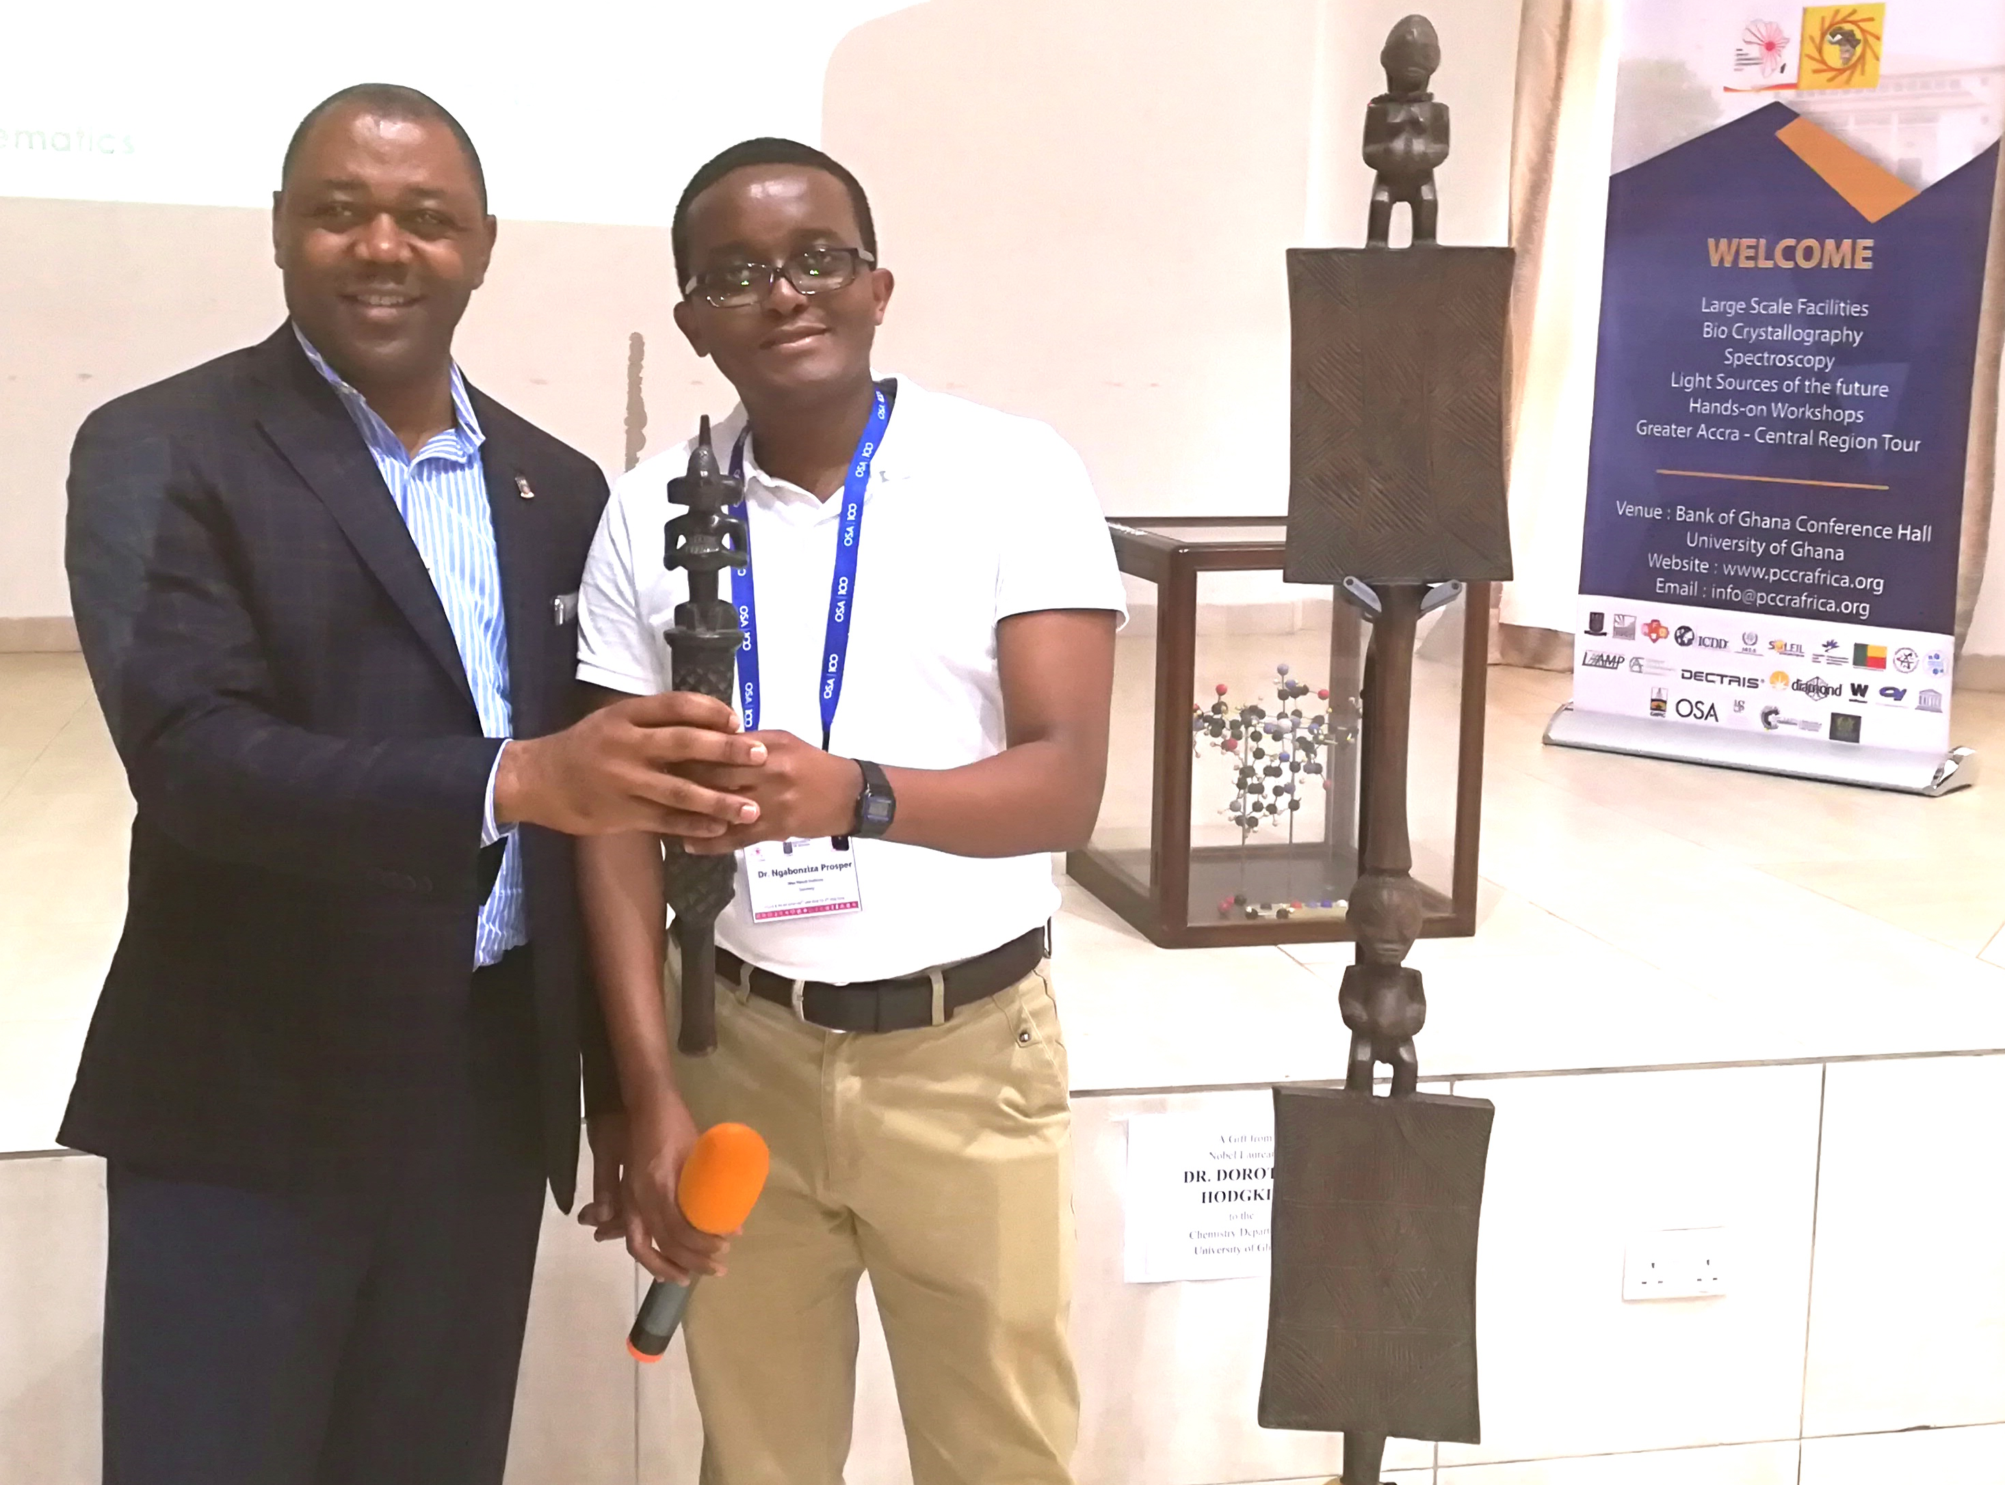
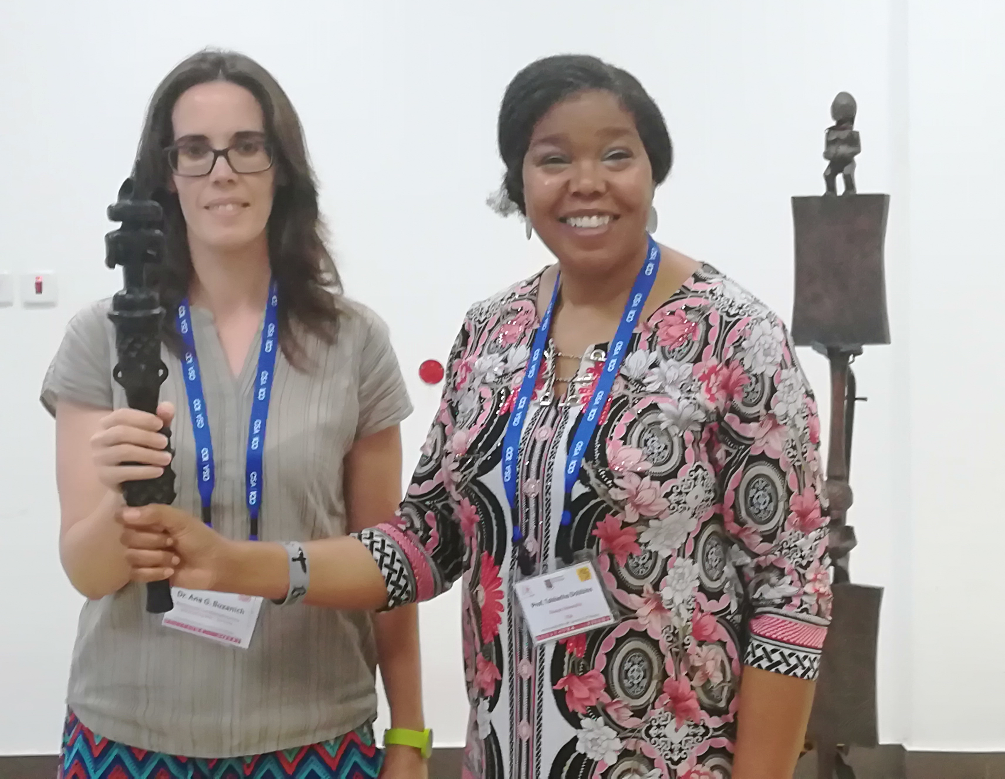
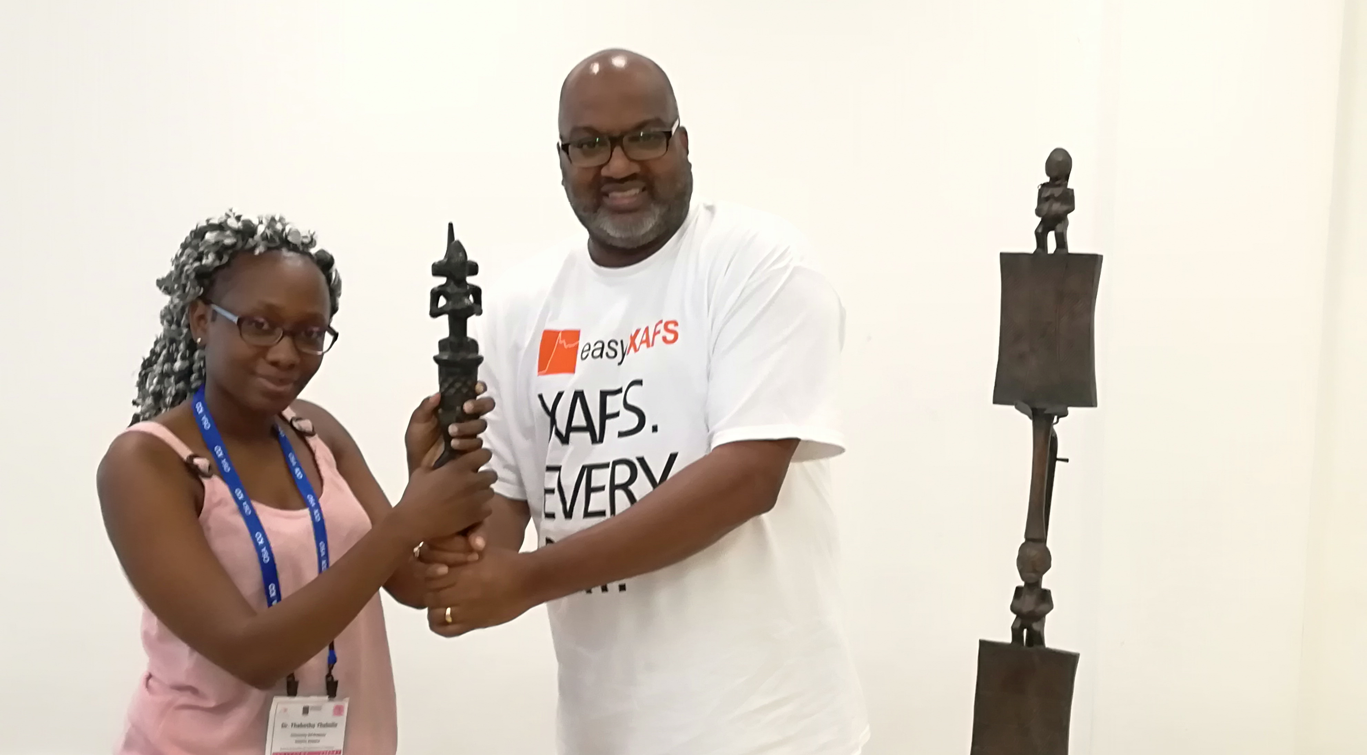
The African Light Source AfLS7-2024
Virtual Event : 18-22 Nov 2024
The AfLS Ceremonial speaking stick
The AfLS African ceremonial speaking stick, is used throughout the conference to endow, in the African tradition, each speaker in turn, with authority and wisdom to speak. The Speaking stick is handed over by the Session Chair to each next speaker, before they commence, and they return it to the chair as they leave. We use the moment of transfer for each official photograph of the speaker.
The AfLS speaking stick will be displayed at the future AfLS facility.

Slide 3
The African Light Source AfLS7-2024
Virtual Event : 18-22 Nov 2024
AfLS ceremonial calling stick and the speaking stick
Virtually was virtually held by our Conference Chair
Dr Philip Oladijo (BIUST)
Now physically held by our Conference Chair
Prof Simon Connell (U Johannesburg)

