Slide 1


AfLS/AfPS Conference 2024
Johannesburg 18-22 November 2024
South Africa
GEOPOLOTIQUE ET GEOSTRATEGIE DE L’ENERGIE FACE AUX TRANSITIONS ENERGETIQUE ET ECOLOGIQUE EN AFRIQUE POUR UN DEVELOPPEMENT DURABLE
Energy Resources in Africa and their Geopolitical and Geostrategic Implications for Sustainable Development in Africa.
Prof. Ahmadou Wagué
Université Cheikh Anta Diop , Académie Nationale des Sciences et Techniques du Sénégal
President African Physical Society
Dakar Sénégal

Slide 2
RESUME : L’énergie et les transitions énergétique et écologique constituent à l’heure actuelle de grands défis à travers le monde entier, particulièrement en Afrique où les effets du réchauffement climatique sont entrain de causer des dégâts énormes dans les écosystèmes environnementaux et agricoles. En plus la guerre en Ukraine est entrain de démonter l’importance pour l’Afrique de relever les défis de la souveraineté énergétique et alimentaire par une approche appropriée de la gestion des sources énergétiques énormes du continent. Ici on aborde les questions des ressources énergétiques en Afrique et leurs implications géopolitiques et géostratégique pour un développement durable en Afrique. Nous insistons particulièrement sur l’ importance du développement des énergies renouvelables et surtout sur l’ importance de l’ accès généralisé l’énergie solaire qui pourrait apporter des changements positifs considérables pour l’accès à l’énergie pour tous en Afrique.
_________________________________________________________________________
SUMMARY: Energy and ecological transitions are currently major challenges throughout the world, particularly in Africa, where the effects of global warming are causing enormous damage to environmental and agricultural ecosystems. In addition, the war in Ukraine is demonstrating how important it is for Africa to meet the challenges of energy and food sovereignty through an appropriate approach to the management of the continent's enormous energy sources. Here we address the issues of energy resources in Africa and their geopolitical and geostrategic implications for sustainable development in Africa. We place particular emphasis on the importance of developing renewable energies, and especially on the importance of widespread access to solar

Slide 3
SOMMAIRE
I. Les ressources énergétiques et la question du réchauffement climatique
II. Géopolitique et Géostratégie de l’Energie
III. Transition Energétique et Transition Ecologique .
IV. Les énergies renouvelables dans les transitions énergétiques et écologiques en Afrique pour un développement durable. La Place de l’Energie Solaire et du Nucléaire
V. Conclusion
Outline
I. Energy Resources and Climate Change Issues
II. Geopolitics and Geostrategy of Energy
III. Energy Transition and Ecological Transition
IV. Renewable Energies in Energy and Ecological Transitions in Africa for Sustainable Development: The Role of Solar and Nuclear Energy
V. Conclusion

Slide 4
Outline
I. Energy Resources and Climate Change Issues
II. Geopolitics and Geostrategy of Energy
III. Energy Transition and Ecological Transition
IV. Renewable Energies in Energy and Ecological Transitions in Africa for Sustainable Development: The Role of Solar and Nuclear Energy
V. Conclusion

Slide 5
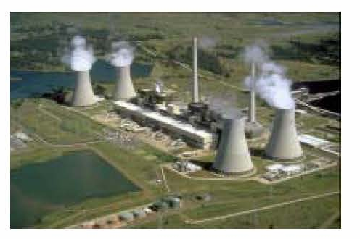
DIFFERENT ENERGY RESOURCES
COAL
OIL
GAS
NUCLEAR
RENEWABLE ENERGIES:
  HYDRAULIC ENERGY
  SOLAR ENERGY (Thermal and Photovoltaic)
  WIND ENERGY
  BIOMASS
  GEOTHERMAL ENERGY
CHALLENGES OF THE ENERGY AND ECOLOGICAL TRANSITION

Slide 6
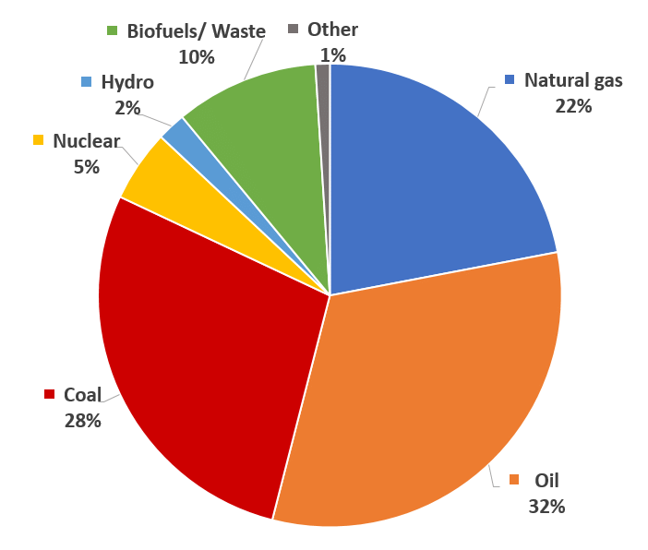
WORLD ENERGY PRODUCTION 2023 Source IEA

Slide 8
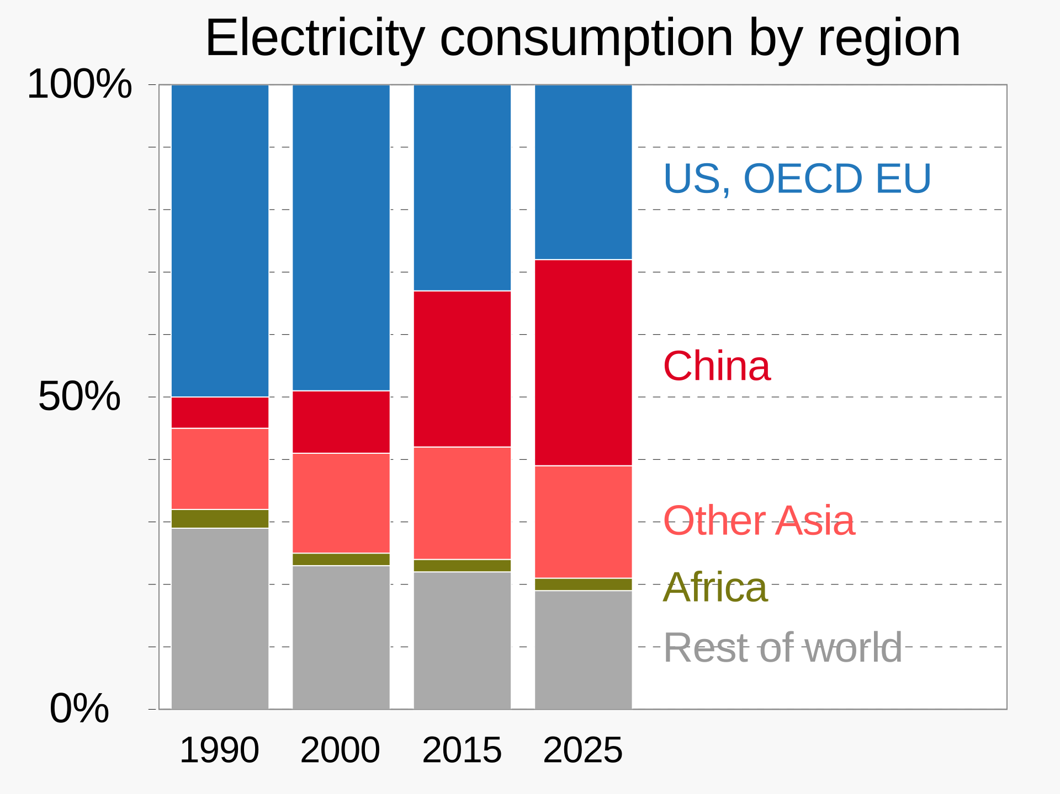
"Electricity Market Report 2023" (PDF). IEA.org. International Energy Agency. February 2023. p. 15.

Slide 9
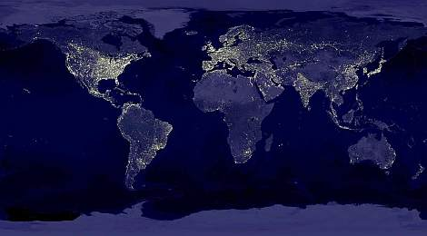
LA TERRE VUE DU CIEL LA NUIT
La Terre vue du ciel la nuit par un satellite de la NASA

Slide 10
ENERGY’S SYSTEMS MANAGEMENT ASPECTS
Energy can be presented from several aspects:
Scientific: sources, conversion, Storage
Political: Geopolitics and Geostrategy, energy independence and sovereignty
Environnemental and Sustainable Development: local pollution, global pollution, waste management, climate change, energy mix, energy efficiency, energy transition, ecological transition
Future Projection: Global energy systems management, prospects for future energies

Slide 11
Africa: Vast Energy Potential with many sources of renewable energies:
The Hydraulic Basin of Guinea, Central Africa, East and South Africa, North Africa
The Rift Valley Fault
The sunshine of the Continent
Renewable energy sources that are unique in the world but very little exploited

Slide 12
HYDRO ELECTRICITY FOR AFRICA

Slide 13
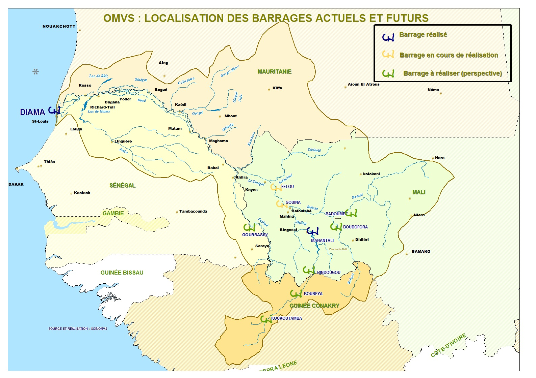

Slide 14
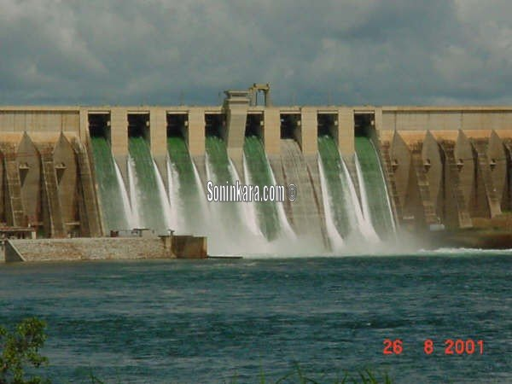
Barrage hydroélectrique de Manantali

Slide 15
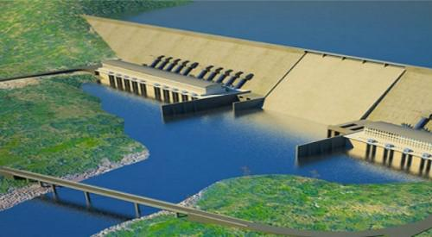
In Ethiopia, the Grand Renaissance Dam on the Blue Nile is a promise of prosperity and integration in Africa. Ultimately, according to local authorities, it will have the capacity to produce 6,000 megawatts and will allow the country to increase its electricity exports to neighboring countries(Sudan, Djibouti, Kenya, South Sudan, etc.

Slide 16
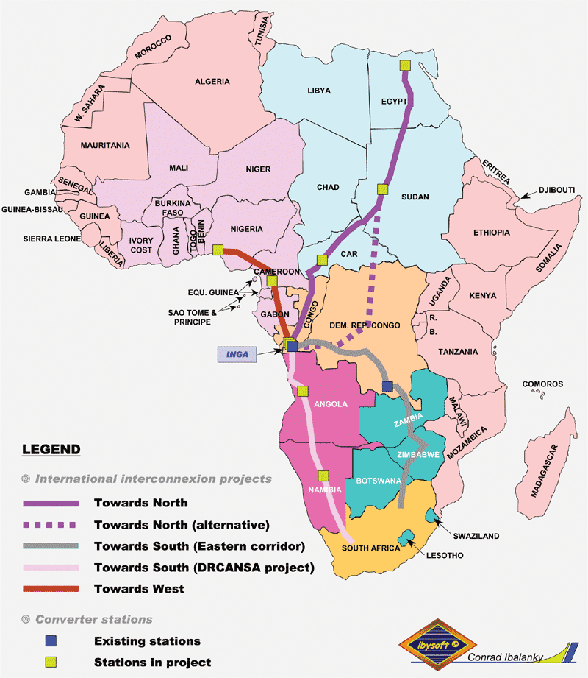
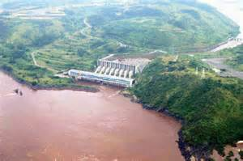
BARRAGE D’INGA DE L’ENERGIE POUR TOUTE L’AFRIQUE

Slide 17
The Cahora Bassa Dam is a dam built on the Zambezi River in northwestern Mozambique. It is associated with a hydroelectric power plant with an installed capacity of 2,075 MW, the second most powerful in Africa in 2020 after the Aswan High Dam (2,100 MW). It gave rise to the lake of Cahora Bassa.

Slide 18
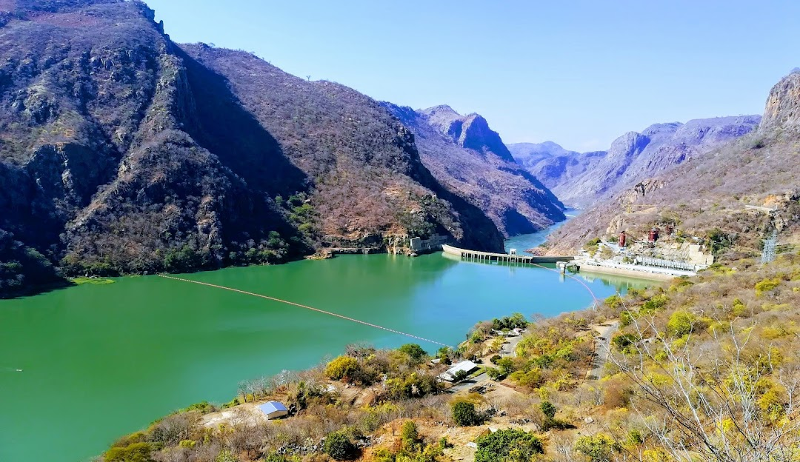

Slide 19
SOLAR ENERGY
The average annual solar radiation in Africa ranges from 5 to 7 kWh/m², comparable to the Arabian Peninsula, northern Australia, and northern Chile.
However, Africa only possesses 1.3% of global photovoltaic production capacity.
Immense potential remains to be harnessed geopolitically to provide energy to urban and rural populations and influence global energy geopolitics.
Satellite studies have shown that equipping just 0.3% of the planet's 40 million km² deserts with solar power plants could cover the world's electrical needs multiple times (at least 18,000 TWh/year).
The Sahara Desert is therefore a tremendous asset for Africa in a pan-African strategy for electricity supply to the continent's populations and the world.

Slide 20
>> Based on satellite studies, it has been shown that by equipping only 0.3% of the 40 million km2 of deserts on the planet with solar power plants, the planet's electricity needs could be covered several times over (at least 18,000 TWh/year)
>>The Sahara Desert is therefore a tremendous asset for Africa as part of a pan-African strategy to provide electricity to the people of the continent and the world

Slide 21
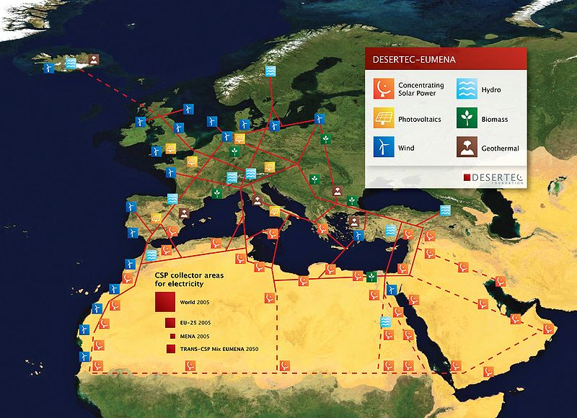
Projet DESERTEC

Slide 22
Centrale solaire de Malicounda au Senegal

Slide 23
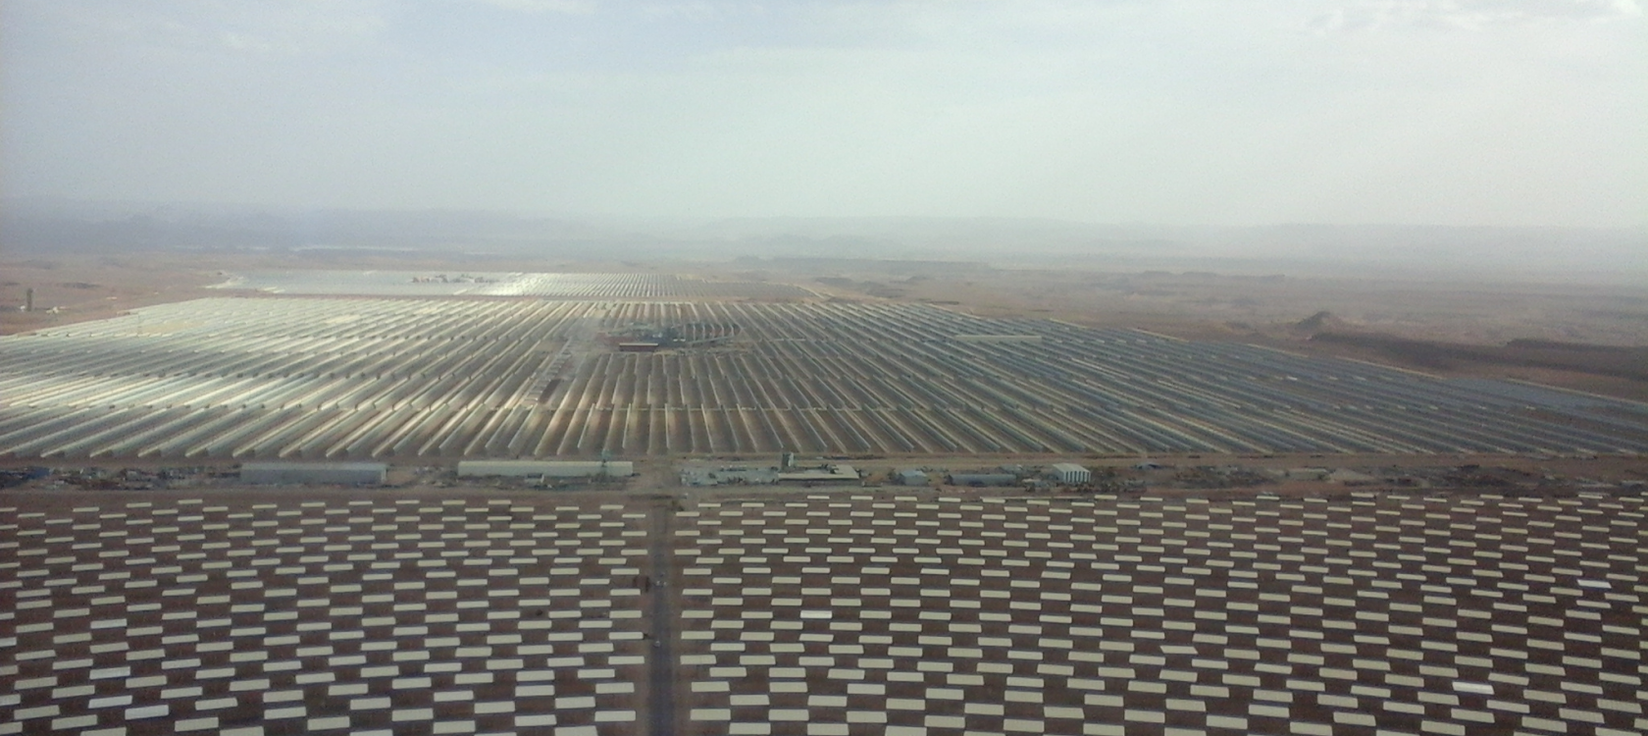
TOUR SOLAIRE DE WARZAZATE AU MAROC

Slide 24
CLIMAT CHANGE AND GLOBAL WORMING
According to the IPCC (Intergovernmental Panel on Climate Change) report of March 2023, greenhouse gas emissions from human activities have warmed the climate at an unprecedented rate:
the temperature of the surface of the globe has risen by 1.1 °C compared to the pre-industrial period (1861-1880).
Regardless of the emission scenarios, the IPCC estimates that global warming will reach 1.5°C by the early 2030s.

Slide 25
The rise in temperature will lead to
a rise in water,
Severe damage to biodiversity, a great loss in coral reefs,
Regional and global climate change with unpredictable consequences
If we want to limit the temperature rise to 1.5°C, according to the IPCC, we must reduce CO2 emissions by 45% by 2030 and achieve carbon neutrality by 2050.

Slide 26
The fight against global warming is a major challenge of our century, as mentioned in the COP21 conference of the parties in Paris and the other COPs that followed
Many promises have not been kept regarding the reduction of greenhouse gas emissions and the appropriate financing to deal with the issues of mitigation and adaptation to global warming
It is in this context that the global energy crisis manifests itself ( Coflicts in Ukraine , in Gaza Is rael and Libanon are perfect illustrations ) with the Geopolitical and Geostrategic issues on energy.
These issues are closely linked to the energy sovereignty and to the energy and ecological transitions .

Slide 27
THE GEOPOLITICS OF ENERGY
>>The geopolitics of energy deals with how states, international organizations, and companies interact to acquire, produce, transport, and distribute energy resources such as oil, natural gas, coal, uranium, and renewable energy.
>>The geopolitics of energy is influenced by factors such as geography, the environment, national and international policies, conflicts, alliances, and the economic and strategic interests of the actors involved in the energy sector.
For example, states with significant energy resources may have a political advantage and use these resources as a means of exerting pressure on other countries or groups of countries.

Slide 28
>>States that are dependent on energy imports may be vulnerable to price fluctuations, geopolitical tensions in energy-producing regions, and competition for access to energy resources.
>>The geopolitics of energy can also have impacts on the environment and global energy security. Energy policies and decisions can influence greenhouse gas emissions, air and water pollution, the security of energy infrastructure, and economic and political stability around the world

Slide 29
>>The geopolitics of energy is constantly evolving as new energy resources come into play and also as how those resources will be used.
>>The geopolitics of energy is linked to issues of energy security and sovereignty, peace and war (the current conflict in Ukraine is a perfect illustration of this).
>>The energy sovereignty sector is very important in terms of sustainable development,
for sustainable development it is essential to find appropriate solutions to energy security and sovereignity problems in order to protect populations and environmental and socio-economic ecosystems.

Slide 30
>> Energy security problems are the direct consequences of the vulnerability of energy resources and systems (depletion of resources, security of resources such as nuclear, supply systems, cyber or terrorist attacks).
>>These problems can have repercussions on public safety, the safety of people and property, the security and sovereignity of economies

Slide 31
The Geostrategy of Energy
The geostrategy of energy is closely linked to the geopolitics of energy.
It is an energy resource management policy that includes several plans:
A plan to develop energy security and sovereignity
A plan to reduce the environmental impact of the exploitation of energy resources
A sustainability development plan on the exploitation of energy resources and their economy

Slide 32
The energy transition
>>The energy transition consists of a series of major changes in energy production systems and consumption. It is a stakeholder in sustainable development strategies and the fight against global warming
>>The energy transition is based on technological progress and political will in the broad sense (governments, populations, NGOs, economic actors, etc.). for the gradual replacement of fossil fuels and nuclear energy with an energy mix favouring renewable energies
>>It is also a reduction in energy consumption and saving: reduction of energy waste, improvement of energy efficiency, transfer to electric transport

Slide 33
In the energy transition, the gradual transition from carbon-based, polluting or high-risk energies to clean, renewable and safe energies (solar, wind, geothermal, hydraulic and tidal) responds to a series of extremely important issues and challenges:
Reduction of greenhouse gas emissions;
Security of energy systems (nuclear issue);
Decentralization and redevelopment of infrastructure, with a better distribution of resources;
Reduction in consumption (energy efficiency);
Reducing inequalities in access to energy and advancing energy independence;
Protection of the health of populations.
>>One of the most fundamental objectives of the energy transition is to combat global warming.

Slide 34
THE ECOLOGICAL TRANSITION
>>The ecological transition represents a period of adaptation for new energy schemes favouring renewable energies, controlled thermonuclear fusion, and not fossil fuels (coal, oil, natural gas, nuclear fission, etc.)
>>It integrates the energy transition and seeks to rethink our ways of producing energy, working and living together by changing consumption behaviors and providing an economic and social response to the environmental and climatic challenges of our planet for sustainable development

Slide 35
ENERGY AND ECOLOGICAL TRANSITIONS IN AFRICA
>>The energy and ecological transition in Africa has a particular characteristic:
>>Most African countries are not under pressure to abandon coal or nuclear power in favor of other energy sources to meet their energy needs.
>>Access to energy for all and the fight against global warming for sustainable development requires the exploitation of the continent's significant renewable energy potential.

Slide 36
Geopolitics and Geostrategy of Energy in the Energy and Ecological Transition in Africa
>>Africa is facing several challenges related to energy and ecological transitions, which are closely linked to the geopolitics and geostrategy of energy in the region.
Here are some key points to consider:
1. Access to energy: According to the International Energy Agency, about 600 million people in sub-Saharan Africa do not have access to electricity. This lack of access to reliable and affordable energy is a major challenge to the economic development and social progress of the region.
2. Renewable energy potential: Africa has abundant renewable energy resources, including solar, wind, hydro, and geothermal energy. However, most countries in the region still rely heavily on fossil fuels,

Slide 37
3. Resource management: Competition for natural resources, particularly oil and gas reserves, has long been a major driver of geopolitical and geostrategic tensions in Africa. The mismanagement of these resources has also led to environmental degradation, social conflict and corruption.
4. Climate change: Africa is particularly vulnerable to the effects of climate change, including extreme weather events, droughts and sea-level rise, floodings. At the same time, the region's energy systems do not contribute significantly to global greenhouse gas emissions.

Slide 38
>>To address these challenges, African countries need to adopt a more sustainable and inclusive approach to energy and ecological transitions.
1. Operational geostrategy for the implementation of renewable energy infrastructure,
2. Geopolitics to establish energy sovereignty by giving added value to our immense energy resources, which are a formidable asset on a global scale
3. Development of regional energy markets and networks in renewable energies, with priority given to social and environmental sustainability.
4. Collaboration between governments, the private sector and civil society to ensure that the benefits of the transition are shared equitably and that risks are managed effectively.

Slide 39
THE PLACE OF SOLAR ENERGY FOR ENERGY SOVEREIGNTY IN AFRICA
Solar energy has an important role to play in the energy and ecological transition in Africa to ensure Africa's energy sovereignty, which is based on an appropriate geopolitics and geostrategy of energy.
The continent has abundant solar resources and their exploitation can help address the challenges of energy access, high energy costs and over-reliance on fossil fuels.
Some key points to consider regarding the role of solar energy in Africa's energy and ecological transition:

Slide 40
Solar potential: Africa has one of the highest levels of solar radiation in the world, making it an ideal region for solar energy development. The continent has the potential to generate more than 10 terawatts of solar energy, which is more than enough to meet its current and future energy needs.
2. Access to energy: Solar energy can play a crucial role in expanding access to energy for all in Africa, especially in rural areas. Off-grid solar systems can provide electricity to households, schools, health centers, and any communities that are not connected to the grid, improving their quality of life and allowing them to access essential services such as healthcare and education.

Slide 41
3.Rentabilité : L'énergie solaire est devenue de plus en plus rentable ces dernières années, ce qui en fait une option viable pour la production d'électricité à grande échelle. Le coût des systèmes solaires photovoltaïques innovants (PV) a considérablement baissé, et il est désormais moins cher de produire de l'électricité à partir de l'énergie solaire qu'à partir de combustibles fossiles dans de nombreuses régions d'Afrique.
4.Création d'emplois : L'énergie solaire peut créer d'importantes opportunités d'emploi en Afrique, en particulier dans l'installation et la maintenance des systèmes solaires. Cela peut contribuer à la réduction de la pauvreté et au développement économique durable.
5.Changement climatique : L'énergie solaire est une source d'énergie propre et renouvelable, et son adoption peut aider les pays africains à réduire leurs émissions de gaz à effet de serre et contribuer aux efforts mondiaux de lutte contre le réchauffement climatique.

Slide 42
3. Cost-effectiveness: Solar energy has become increasingly cost-effective in recent years, making it a viable option for large-scale power generation. The cost of innovative solar photovoltaic (PV) systems has dropped significantly, and it is now cheaper to generate electricity from solar energy than from fossil fuels in many parts of Africa.
4. Job creation: Solar energy can create significant employment opportunities in Africa, particularly in the installation and maintenance of solar systems. This can contribute to poverty reduction and sustainable economic development.
5. Climate change: Solar energy is a clean, renewable energy source, and its adoption can help African countries reduce their greenhouse gas emissions and contribute to global efforts to combat global warming.

Slide 43
The Question of Nuclear Energy in Geopolitics and Geostrategy of Energy in the Energy and Ecological Transition

Slide 44
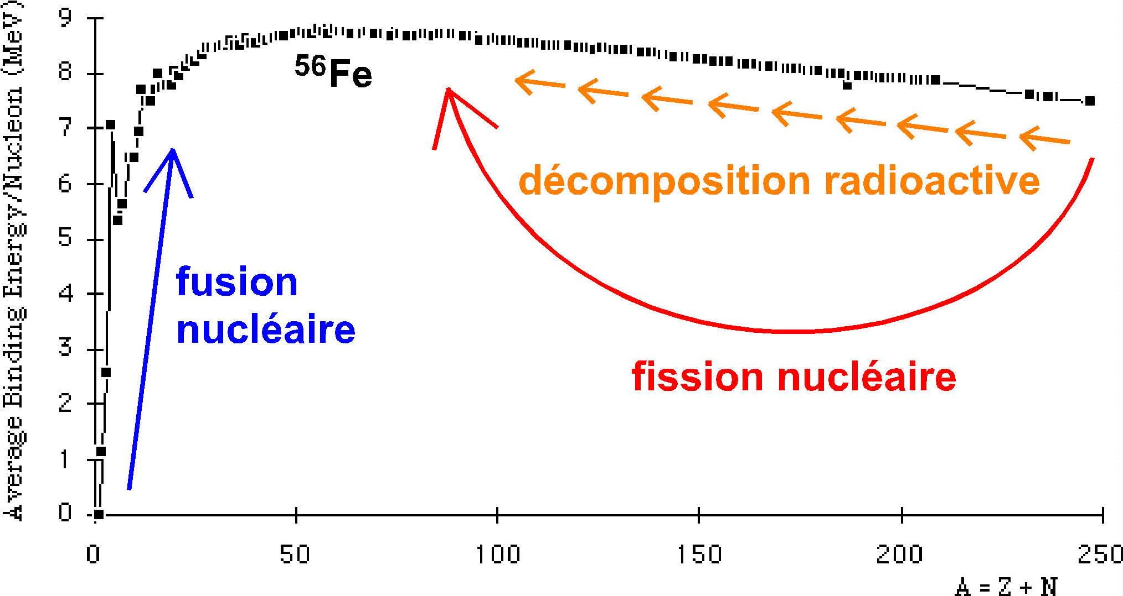
Libération de l’énergie nucléaire
Réactions de fusion et de fission
E = MC²

Slide 45
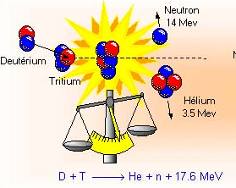
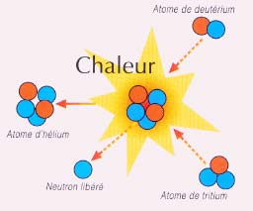
Thermonuclear Fusion
The most accessible fusion reaction is the reaction involving deuterium and tritium. It is on this reaction that research on controlled fusion is focused, because deuterium exists in large quantities in seawater. 1 liter of seawater contains about 40 mg of deuterium, which is equivalent to 3000 liters of oil
From Aventure des particules

Slide 46
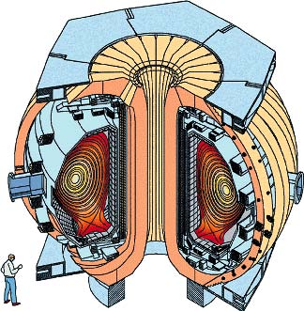
The magnetic confinement approach in TOKAMAKs:
A plasma formed from deuterium and tritium is enclosed, compressed in a toroidal magnetic field and heated by very high frequency electromagnetic waves.

Slide 47

* The inertial containment approach. Using extremely powerful laser beams, an attempt is made to heat granules of a mixture of deuterium and solid tritium from a temperature of -260°C to tens of millions of degrees Celsius in a time less (a few nanoseconds) than the evaporation of the granule

Slide 48
LE PROJET ITER
(INTERNATIONAL THERMONUCLEAR EXPERIMENTAL REACTOR)
CONSTRUCTION D’ UN RÉACTEUR EXPÉRIMENTAL DE FUSION CONTRÔLÉE PAR CONFINEMENT MAGNÉTIQUE.
DÉMONSTRATION DE LA FAISABILITÉ SCIENTIFIQUE D'UN RÉACTEUR ÉLECTROGÈNE ECONOMIQUEMENT RENTABLE.
LES PARTENAIRES DU PROJET :
L'UNION EUROPÉENNE, LE JAPON, LES ETATS-UNIS, LA RUSSIE, LA CHINE ET LA CORÉE DU SUD .
LE BRESIL ET L’INDE SONT CANDIDATS ET POURQUOI PAS L’AFRIQUE

Slide 49
THE ITER PROJECT (INTERNATIONAL THERMONUCLEAR EXPERIMENTAL REACTOR)
CONSTRUCTION OF AN EXPERIMENTAL MAGNETIC CONFINEMENT CONTROLLED FUSION REACTOR.
DEMONSTRATION OF THE SCIENTIFIC FEASIBILITY OF AN ECONOMICALLY PROFITABLE POWER REACTOR.
THE PROJECT PARTNERS:
THE EUROPEAN UNION, JAPAN, THE UNITED STATES, RUSSIA, CHINA AND SOUTH KOREA.
BRAZIL AND INDIA ARE CANDIDATES AND WHY NOT AFRICA

Slide 50
CONCLUSION
>>In Africa, the energy and ecological transition can open up many opportunities. Solar-based energy access solutions are among those that can be developed most rapidly in rural and urban areas.
The Role of Solar Energy in Energy Sovereignty in Africa
Africa has some of the highest solar radiation levels globally, making it an ideal region for solar energy development.
The continent has the potential to generate over 10 terawatts of solar energy, which is more than enough to meet both its current and future energy needs.
Solar energy can play a vital role in expanding energy access across Africa, particularly in rural areas. Off-grid solar systems can provide electricity to households,
schools, health centers, and entire communities not connected to the main grid, enhancing their quality of life and enabling access to essential services like healthcare and education.

Slide 51
>> Solar power plants, solar cookers, solar-powered and wind-powered irrigation pumps are less expensive to run than diesel-powered pumps and can improve food productivity and drought resilience.
>>Research, manufacturing, component production and renewable energy access solutions are opportunities for Africa's industrial development, which must position itself to become a major player in the extraction and processing of critical minerals, which are essential to build the batteries, green hydrogen technologies and renewable energies of the future.

Slide 52
To meet all the challenges of the energy and ecological transition, African countries must adopt an inclusive Geopolitical and Geostrategic approach in the energy and ecological transitions.
>>The continent can move beyond the shifting currents of the current global crisis to harness the momentum of energy and ecological transitions to achieve the Sustainable Development for Africa,
>>We will have to take an important step for universal access to renewable energy sources, especially solar energy, for all our urban and rural populations
>>We must count on the fact that we must do everything we can to ensure that we do not miss the train of green hydrogen and controlled thermonuclear fusion, which will be inexhaustible energies of the future from water

Slide 53
ACKNOWLEDGEMENT
Special Thanks to IUPAP, to SAIP,
To Prof. Simon, Prof. Sekazi, Prof. Rudzani and Dr. Brian Masara,
for their contributions in Funding , supporting and organizing this AfLS/ AfPS 2024 Conference

Slide 54
THANK YOU FOR YOUR KIND ATTENTION

