Slide 1
Optical Spectral and Lasing Potentials Analysis of Dysprosium and Samarium Ions Co-doped Strontium Magnesium Borate Glass Matrix
Presented By
Dr. Andrew Ichoja
Prof. Emmanuel. O. Odoh
Mr. Emmanuel. O. Adejo
Department of Physics, Faculty of Science, Federal University of Health
Sciences Otukpo, Benue State Nigeria
@2024 AFLS/AFPS Conference, South Africa 18 – 22 November 2024

Slide 2
PRESENTATION OUTLINE
Introduction
Problem Statement
Research Objectives
Significance of the Research
Research Methodology
Results and Discussion
Conclusion
Acknowledgement

Slide 3
INTRODUCTION
The current global technological advancement has led to a continuous quest for the development of novel and strategic optical materials with optimized performance for various industrial applications
Rare earth ions (REIs) doped glasses produces sharp and unambiguous spectral characteristics are potential materials to achieve the above result
However, selection of suitable host system for REIs doping to match the specific requirement remains a difficult task
Crystals and glasses have minimal scattering losses and could emerge as a dominant hosts for REIs
Glasses with random atomic arrangement offers te advantage of having the broader absorption and emission bandwidth
Among the various types of glass hosts, oxide glass matrix demonstrate striking spectroscopic features due to the high quantum efficiency and good REI solubility

Slide 4
INTRODUCTION CONT
Glass formers
Dopant ions
Modifier oxides
B₂O₃ (P₂O₅, Ge₂O₃, Si₂O₃, Te₂O₃)
Low melting temperature
Good optical transparency
Dy₂O₃ /Sm₂O₃ (Eu₂O₃, Er₂O₃, Nd₂O₃)
Remarkable emission spectra
Active centres
MgO, SrO, (Li₂O, Bi₂O, CaO, BaO, K₂O, Na₂O)
Great stability against atmospheric hydrolysis

Slide 5
INTRODUCTION CONT
The co-doping of the glass hosts with two non identical REIs has become a favourable pathway to minimize the luminescence quenching effect, thereby increasing the efficiency of the glass system
Sm3+ among other REIs demonstrates strong luminescence in the visible wavelength (450-750 nm), good emission cross-section and small non-radiative decay (Hima Bindu et al., 2016).
The choice of borate as the host matrix in this work is due to its unique physical and optical characteristics like low melting temperature, excellent heat firmness, high optical transparency and best glass forming ability
The Judd-Ofelt (J-O) theory is applied to theoretically predict the glass amplification properties and lasing potentials to ascertain the glass suitability for laser developments (Abubakar et al., 2020).
Hence, the present work intends to evaluate the impact of Sm3+ co-doping on the optical, structural and spectroscopic features of the as prepared glasses for possible technological applications

Slide 6
PROBLEM STATEMENT
The hygroscopic and volatile nature of borate reduces its resistivity against atmospheric hydrolysis.
High phonon energy of borate limits its emission proficiency for laser applications
Chronic shortage of critical and vital information on lasing potency of the current glass composition via Judd-Ofelt analysis
1
2
3

Slide 7
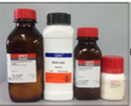
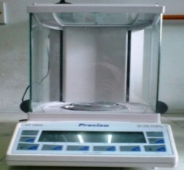
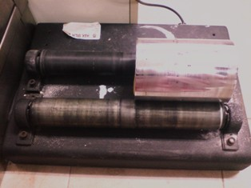
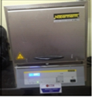
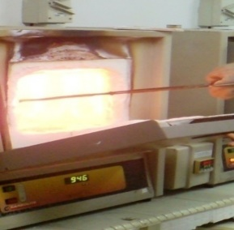
RESEARCH METHODOLOGY: MELT-QUENCHING TECHNIQUE
Weighing
Milling for 10 mins
Alumina crucible
Pre-heated at 300 ºC for 30 mins
Materials
Glass samples
Annealing process at 300 °C for 3 hrs
Melting at 1200 °C for 1hr

Slide 8
JUDD-OFELT THEORY FOR THE DETERMINATION OF LASING POTENCY
Experimental oscillator strength
Ratnakaram et al., (2012)
where $ɛ(v)$ is obtained from Beer–Lambert’s law:
$f_{exp}=4.32×{10}^{−9}\int{ε\left(ν\right)}dν$ and
Carnall et al., (1968a)
λ = 2, 4 and 6
Calculated oscillator strength
Electric and magnetic dipole radiative transition probability
Radiative transition probability (A_{rad})
Total radiative transition probability (A_{T})

Slide 9
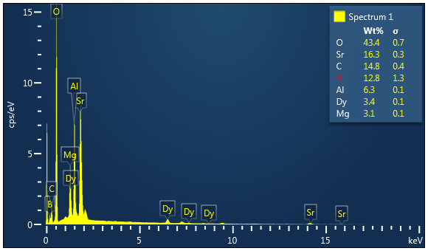
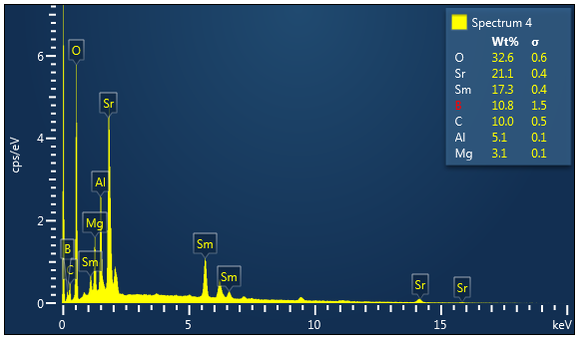
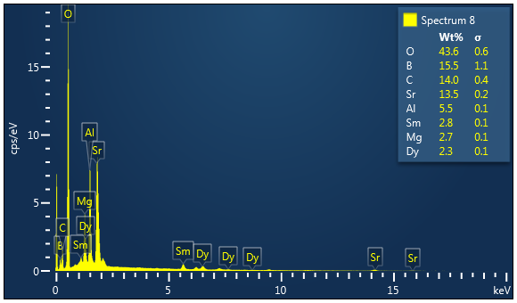
RESULTS AND DISCUSSION: STRUCTURAL FEATURES
A
B
C
D
E
F
A to C= XRD Patterns and D to F = EDX Patterns of the glass systems

Slide 10
OPTICAL PROPERTIES OF THE TITLED GLASS
(G)
(H)
G to I: Different inhomogeneous absorption
spectral of the glass systems
(I)

Slide 11
SPECTROSCOPIC PARAMETER ANALYSIS
Ω₂ > Ω₆ > Ω₄
Ω₆ > Ω₄ > Ω₂
K
J
Different J-O parameters with spectroscopic
quality factors less than unity indicative of
the lasing potency of the prepared glasses
Damdee et al.(2015)
Kindrat et al. (2023)
Abdullahi et al.(2024)
L
Ω₆ > Ω₄ > Ω₂

Slide 12
RADIATIVE PARAMETER ANALYSIS
Transitions | Parameters | 0.2mol% | 0.4mol% | 0.6mol% | 0.8mol% | 1.0mol%
⁴G_{5/2}→⁶H_{7/2} | λ_{p} | 600 | 601 | 600 | 600 | 600
 | A_{rad} | 354.85 | 353.75 | 355.61 | 356.48 | 356.79
 | β_{R} | 74.57 | 74.46 | 74.58 | 74.55 | 74.59
 | σ_{se} | 11.78 | 10.87 | 11.58 | 11.79 | 11.79
 | σ_{se} × τ_{rad} | 24.76 | 22.88 | 24.28 | 24.66 | 24.65
 | δ_{se} × FWHM | 2.10 | 2.10 | 2.10 | 2.11 | 2.11
⁴G_{5/2}→⁶H_{9/2} | λ_{p} | 647 | 647 | 647 | 647 | 647
 | A_{rad} | 74.61 | 74.68 | 74.74 | 74.89 | 74.94
 | β_{R} | 15.68 | 15.72 | 15.67 | 15.66 | 15.67
 | σ_{se} | 3.19 | 3.19 | 3.32 | 3.19 | 3.19
 | σ_{se} × τ_{rad} | 6.71 | 6.71 | 6.97 | 6.68 | 6.67
 | δ_{se} × FWHM | 0.60 | 0.60 | 0.60 | 0.60 | 0.60
⁴G_{5/2}→⁶H_{11/2} | λ_{p} | 708 | 707 | 708 | 707 | 708
 | A_{rad} | 46.41 | 46.65 | 46.49 | 46.78 | 46.62
 | β_{R} | 9.75 | 9.82 | 9.75 | 9.78 | 9.75
 | σ_{se} | 1.78 | 2.03 | 1.83 | 1.78 | 1.78
 | σ_{se} × τ_{rad} | 3.74 | 4.27 | 3.84 | 3.71 | 3.72
 | δ_{se} × FWHM | 0.53 | 0.53 | 0.53 | 0.53 | 0.53
 | A_{T} | 475.86 | 475.08 | 476.84 | 478.15 | 478.35
 | τ_{cal} | 2101.44 | 2104.92 | 2097.12 | 2091.38 | 2090.53

Slide 13
CONCLUSION
20SrO − MgO − (70 − z) B₂O₃ − 0.7Dy₂O₃ − zSm₂O₃ (z = 0.2 ≤ z ≤ 1.0 mol%) have been successfully prepared by melt quenching techniques and characterized by using different analytical tools
The structural and chemical composition of the titled glasses were verified using XRD and FESEM respectively
Optical properties using UV-Vis spectrophotometer demonstrate various inhomogeneous optical absorption spectra of various intensities
J-Ofelt intensity parameters (Ω₂, Ω₄, Ω₆ ) as well the spectroscopic quality factors indicated strong lasing potency of the current glass compositions
The evaluated radiative parameters revealed higher than 50% magnitude of branching ratio (β_{R}), acceptable values of stimulated emission cross-section (σ_{se}) and radiative lifetime (A_{rad})
In conclusion therefore, the prepared glass sample has demonstrated significant characteristics suggestive of its potential for laser applications.

Slide 14
REFERENCE
Abdullahi, I., Hashim, S., Ghoshal, S., & Ahmad, A. U. (2024). Structures and Spectroscopic Characteristics of Barium Sulfur-Telluro-Borate Glasses: Role of Sm³⁺ and Dy³⁺ Co-activation. Materials Chemistry and Physics, 122862.
Carnall, W., Fields, P., & Rajnak, K. (1968). Electronic energy levels in the trivalent lanthanide aquo ions. I. Pr³⁺, Nd³⁺, Pm³⁺, Sm³⁺, Dy³⁺, Ho³⁺, Er³⁺, and Tm³⁺. The Journal of Chemical Physics, 49(10), 4424-4442.
Damdee, B., Kirdsiri, K., & Kaewkhao, J. (2015). Optical spectroscopy of Dy³⁺ doped Lithium borate glasses for luminescence applications. 4th International Conference on Instrumentation, Communications, Information Technology, and Biomedical Engineering (ICICI-BME), 260-263
Kindrat, I., Padlyak, B., Mahlik, S., Kukliński, B., & Kulyk, Y. (2016). Spectroscopic properties of the Ce-doped borate glasses. Optical Materials, 59, 20-27.
Kumar, D., Rao, S., & Singh, S. P. (2023). Structural, optical, and thermoluminescence study of Dy³⁺ ion-doped sodium strontium borate glass. Journal of Non-Crystalline Solids, 464, 51-55.

Slide 15
ACKNOWLEDGENT
THANK YOU FOR LISTENING

