Slide 1


Debye Institute for
Nanomaterials Science
X-ray absorption spectroscopy & Resonant inelastic x-ray scattering
Frank de Groot
l.barberis@uu.nl
21st September 2022
NWO CHAINS 2022
f.m.f.degroot@uu.nl

Slide 2
XAS & RIXS
X-ray absorption spectroscopy (XAS)
Resonant inelastic x-ray scattering (RIXS)
Virtual beamlines

Slide 3
XAS of transition metal oxides
Electronic structure of a transition metal oxide
Main bonding:
O2p with metal 4sp
Gives valence band and conduction band,
Mixed in character
Additional bonding
O2p with metal 3d;
Gives mixed 3d bands split by crystal field in octahedral symmetry, T2g states have pi-bonding and Eg states have sigma-bonding.
oxygen 1s core state
is localized at an oxygen atom
4sp
E_{g}
T_{2g}
O2p
O2s
O 1s ~530 eV
Notes:
3

Slide 4
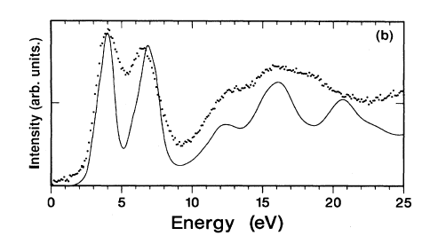
XAS of transition metal oxides
transition from oxygen 1s state
to an empty state
oxygen 1s core state
is localized at an oxygen atom
local empty DOS
dipole selection rule:
p-projected DOS
4sp
E_{g}
T_{2g}
O2p
O2s
O 1s ~530 eV
Fermi Golden Rule:
I_{XAS} = |<Φ_{f}|dipole| Φ_{i}>|² δ_{[ΔE=0]}
[Phys. Rev. B. 40, 5715 (1989); review in Chem. Rev. 120, 4056 (2020)]
Notes:
4

Slide 5
oxygen 1s XAS
Crystal structure
Electronic structure calculation,
for example Density Functional Theory (DFT)
(in the presence of the core hole;
or TDDFT/BSE)
Calculation of the oxygen
p-projected local empty DOS
Compare with experiment
CODES: FEFF, Wien2K, VASP, QE, etc.

Slide 6
Metal 2p XAS
4sp
E_{g}
T_{2g}
O2p
O2s
Ti 2p ~460 eV
Expect local empty DOS
Expect the d (and s-) projected DOS
Why is experiment different?
Notes:
6

Slide 7
Metal 2p XAS
4sp
E_{g}
T_{2g}
O2p
O2s
Ti 2p ~460 eV
Expect local d-projected DOS
Core spin-orbit splitting
Notes:
7

Slide 8
Metal 2p XAS
4sp
E_{g}
T_{2g}
O2p
O2s
Ti 2p ~460 eV
Expect local d-projected DOS
Core spin-orbit splitting
Overlap of core 2p and valence 3d states
Notes:
8

Slide 9
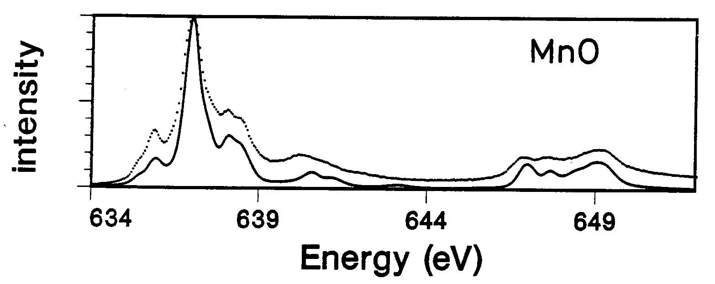
Metal 2p XAS
Can NOT neglect 3d-3d interactions
Can NOT approximate 2p-3d interaction as extra potential
Large core hole spin-orbit coupling
I_{XAS} = |< 2p⁵ 3d⁶ |dipole| 3d⁵>|² δ_{[ΔE=0]}
CODES: CRISPY/QUANTY, CTM4XAS
[Phys. Rev. B. 42, 5459 (1990); REVIEW: J. Elec. Spec 249, 147061 (2021)]

Slide 10
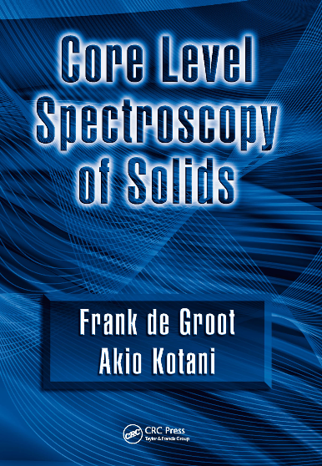
XAS spectral shape
calculate energy states (DOS)
dipole transition to empty DOS
apply multiplet theory
structure
of molecule or solid
1s ↔ 2p
(ask via email)

Slide 11
X-ray Absorption Spectroscopy
Element specific
Sensitive to low concentrations
Applicable under extreme conditions
SPACE: Combination with x-ray microscopy
TIME: femtosecond XAS
RESONANCE: RIXS, RPES, R diffraction
Notes:
XAS is element specific because each element has specific binding energies for its core levels.
The XAS edge energy is essentially given by the core level binding energy.

Slide 12
XAS & RIXS
X-ray absorption spectroscopy (XAS)
Resonant inelastic x-ray scattering (RIXS)
Virtual beamlines

Slide 13
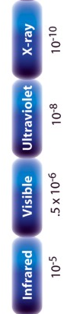
RIXS and excited states
Core level
1000 eV
1 eV
100 meV
electronic
dd, CT
magnon
phonon
Ψ0

Slide 14
RIXS and excited states
Core level
1000 eV
1 eV
100 meV
electronic
dd, CT
UV/Vis
magnon
phonon
IR
Ψ0

Slide 15
RIXS and excited states
Core level
1000 eV
1 eV
100 meV
electronic
dd, CT
(Resonant) Raman
magnon
phonon
Ψ0

Slide 16
RIXS and excited states
Core level
1000 eV
1 eV
100 meV
Resonant X-ray Raman
= RIXS
Resonant Inelastic
X-ray Scattering
electronic
dd, CT
magnon
phonon
Ψ0

Slide 17
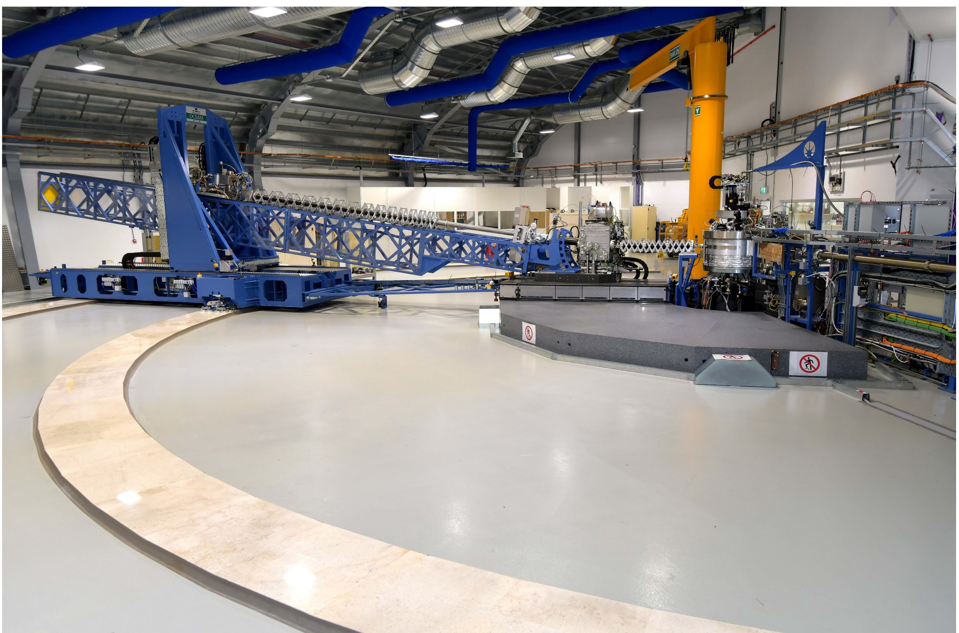
Resonant Inelastic X-ray Scattering
I20 at Diamond, UK

Slide 18
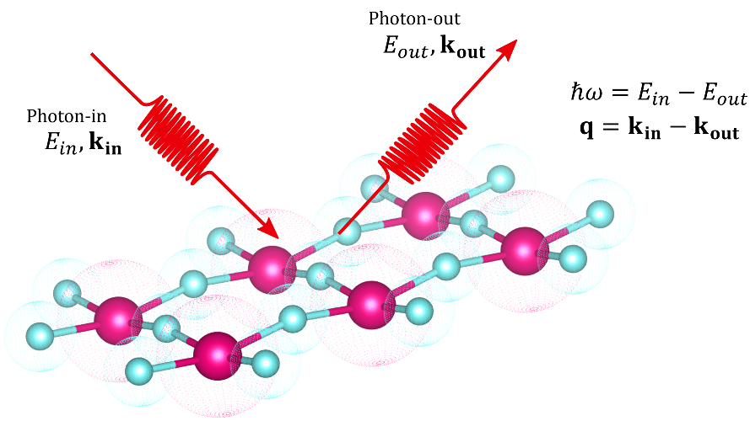

Resonant Inelastic X-ray Scattering
E_{in},, k_{in}, e_{in}
E_{out}, ,k_{out}, e_{out}
E_{in,} k_{in}, e_{in}
E_{out ,}k_{out}, e_{out}
h𝝎= E_{in} - E_{out}
q = k_{in} - k_{out}
Energy
Polarization
Momentum

Slide 19
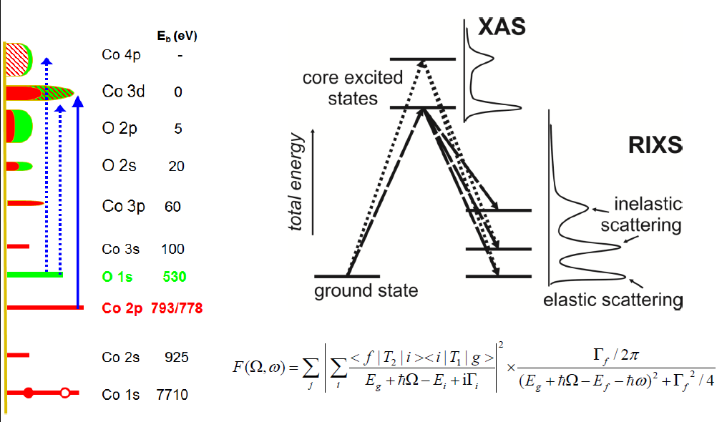
RIXS (resonances)
Transfer of:
Energy
Momentum
Polarization
Notes:
19

Slide 20
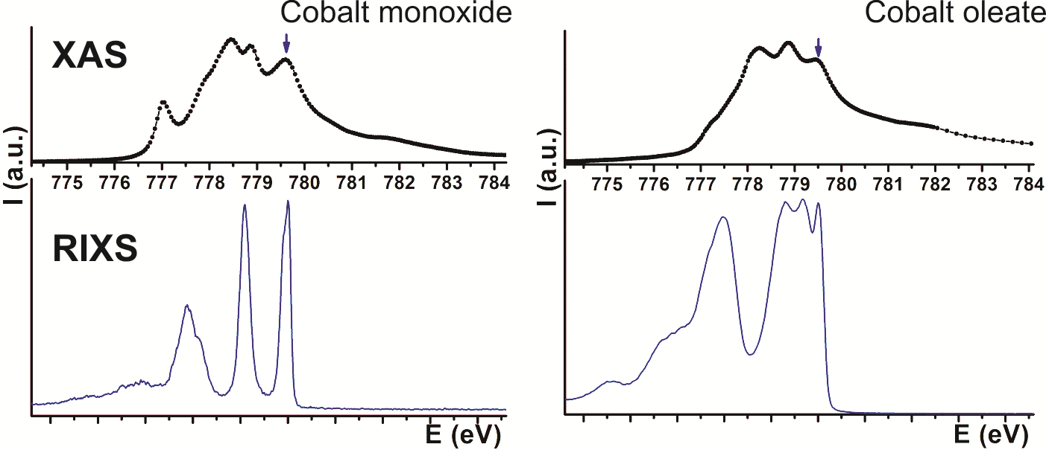
2p3d RIXS of transition metal ions
core
electronic
dd, CT
magnon
vibrations
Ψ0
3 2 1 0

Slide 21
Resonant Inelastic X-ray scattering
Δω-RIXS: energy dependence
Δk-RIXS: momentum dependence
Δε-RIXS: polarization dependence
Δω-RIXS of Fe2O3 Δk-RIXS of LaCoO₃ Δε-RIXS of Fe₃O₄
Nat.Comm. 14,2749 (2023) PRB 98, 035149 (2018) ACS Appl.Mat.11, 36213 (2019)

Slide 22
Momentum dependent dd excitations (LaCoO3)
q-dep. RIXS
[Wang et al. Phys. Rev. B. 98, 035149 (2018)]
Notes:
Low-loss region of RIXS in NiO.
Ground state: 3A2
Double group: T2, not split without exchange
Echange field H splits ground state into three Ms states as H times Ms,
So three states at –H, 0, +H.
The spin-flip peak in the figure is at 2H.
H is related to the superexchaneg energy

Slide 23
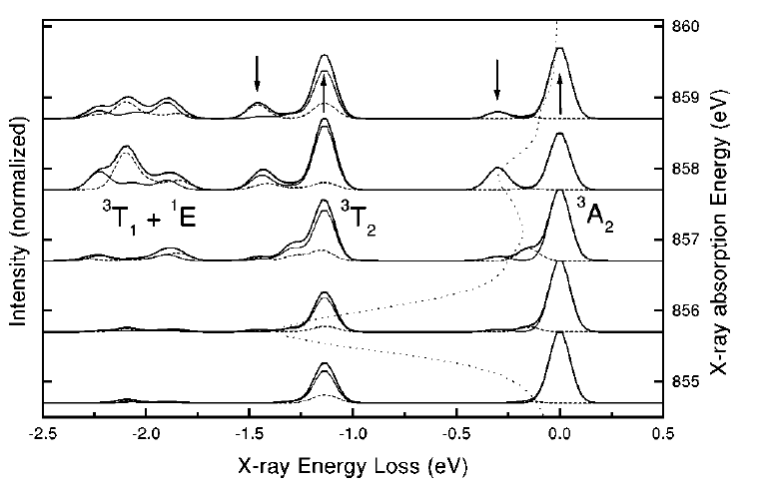
2p3d RIXS of NiO
ΔS
ΔM_{S}
‘spin-flip’
dd
spin-flip
[Phys. Rev. B. 57, 14584 (1998)]
Notes:
Low-loss region of RIXS in NiO.
Ground state: 3A2
Double group: T2, not split without exchange
Echange field H splits ground state into three Ms states as H times Ms,
So three states at –H, 0, +H.
The spin-flip peak in the figure is at 2H.
H is related to the superexchaneg energy

Slide 24
2p3d RIXS of NiO
[Nag, Phys. Rev. Lett. 124, 067202 (2020)]
Notes:
Low-loss region of RIXS in NiO.
Ground state: 3A2
Double group: T2, not split without exchange
Echange field H splits ground state into three Ms states as H times Ms,
So three states at –H, 0, +H.
The spin-flip peak in the figure is at 2H.
H is related to the superexchaneg energy

Slide 25
2p3d RIXS of Fe2O3
[Elnaggar, Nature Comm. 14, 2749 (2023)]

Slide 26
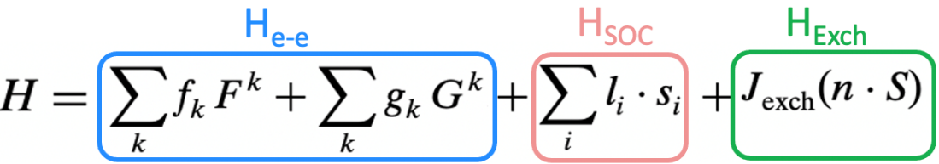
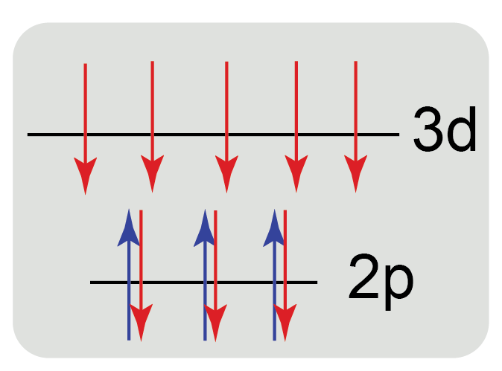
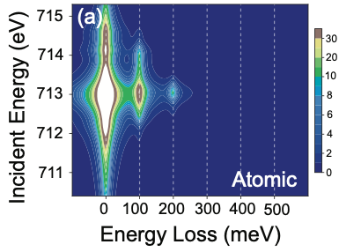
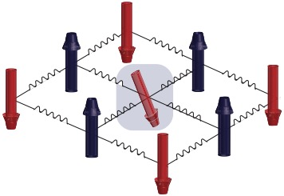
2p3d RIXS of Fe3+ ions (atomic)
Fe³⁺ Ion
Ground State:
3d⁵
S_{z} = 5/2
Elastic
ΔM_{S} = 0
Classical Magnon
ΔM_{S} = 1
Double Magnon
ΔM_{S} = 2
2 photons
=
2 spin flips

Slide 27
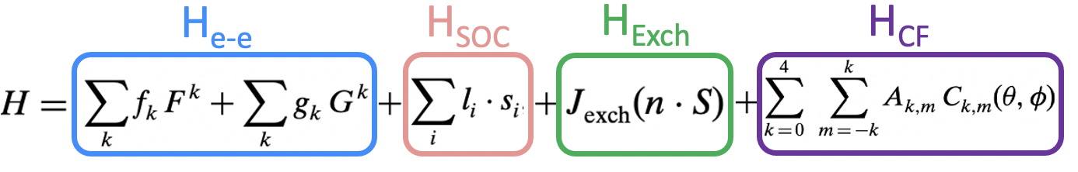
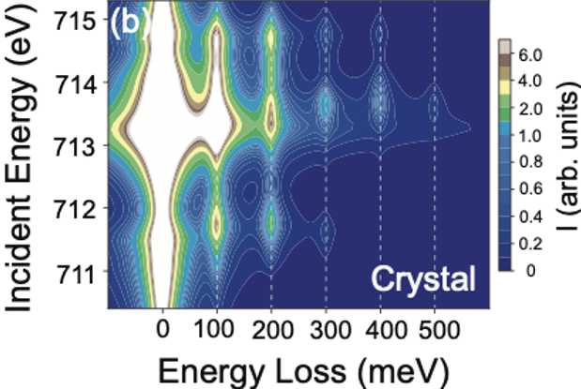
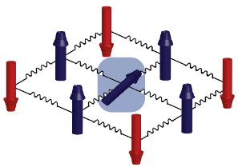
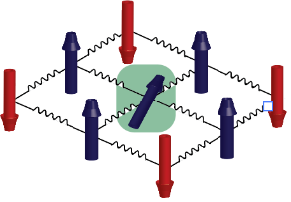
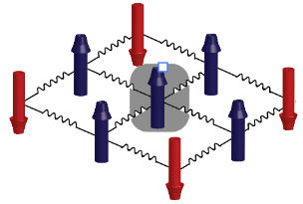
2p3d RIXS of Fe3+ ions (octahedral)
Fe³⁺ Ion
Ground State:
3d⁵
S_{z} = 5/2
ΔM_{S}=3,
E ~ 0.3 eV
ΔM_{S}=4,
E ~ 0.4 eV
ΔM_{S}=5,
E ~ 0.5 eV
Elnaggar et al, Nature Communications 14,2749 (2023)

Slide 28
Resonant Inelastic X-ray Scattering
Element specific
Applicable under extreme conditions (hard x-rays)
Momentum dependent phonons, magnons
Remove lifetime broadening
High-resolution & operando (hard x-rays)
Valence-selective EXAFS (hard x-rays)
Notes:
XAS is element specific because each element has specific binding energies for its core levels.
The XAS edge energy is essentially given by the core level binding energy.

Slide 29
XAS & RIXS
X-ray absorption spectroscopy (XAS)
Resonant inelastic x-ray scattering (RIXS)
Virtual beamlines

Slide 30
Virtual synchrotron
Virtual beamlines (XAS, RIXS, EXAFS, XMCD)
Develop theoretical spectroscopy students/groups
Develop knowledge of synchrotron user communities
Assist in beamline proposals at existing synchrotrons

Slide 31
Virtual synchrotron
Virtual beamline: Only need group of smart students
Can be developed at every university/institute
I would be pleased to help/assist f.m.f.degroot@uu.nl

