Slide 1
AfLS7
Comments on the Geopolitical Conceptual Design Report for an African Light Source
Sekazi K. Mtingwa
Chair, Executive Committee, LAAAMP
Member, Executive Committee, AfLS
21 November 2024

Slide 2
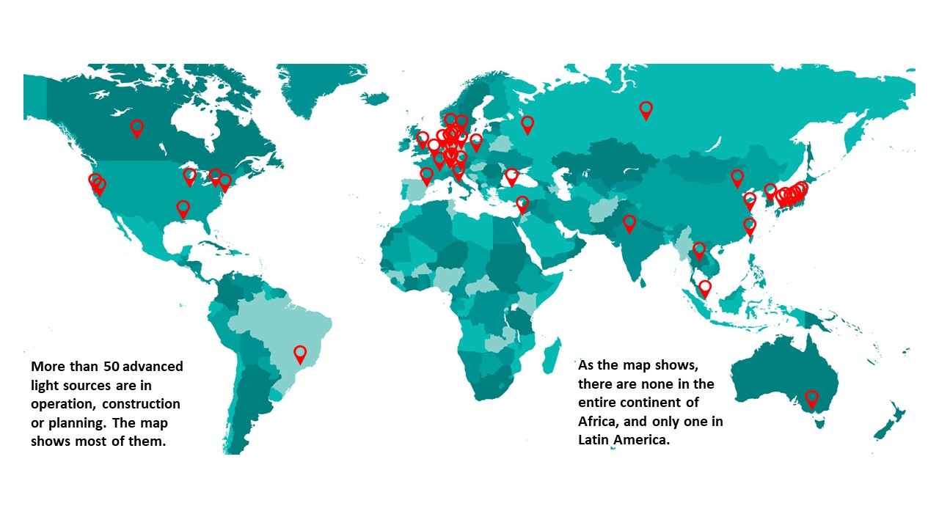
World Map of advanced Light Sources

Slide 3
1st formal Pan-African call. AfLS is in the ALC launch docs
Global conversations about the AfLS
Formation of AfLS Interim Steering Committee
AfLS1 Conference and AfLS SC
AfLS2020
IAC, LoS/MoU
CDR Process
AfLS2 Conference
First publications from Egypt then SA
1990
1995
2000
2005
2010
2015
2020
Letter to SA-NRF
1st African HE Summit : AfLS in the Declaration
AfLS Foundation Legal Entity
SA Synchrotron Initiative
AFLS3
Conference
AU: STC-EST, AAS call to support AfLS as a Pan African initiative
EBASI call to enhance local laser infrastructure toward a Pan-African LS.
AU: Exec Council call to support AfLS as a Pan African initiative
Ghana Govt support
+ several others
AAS-ASI
Many AfLS Roadmap related activities

Slide 4
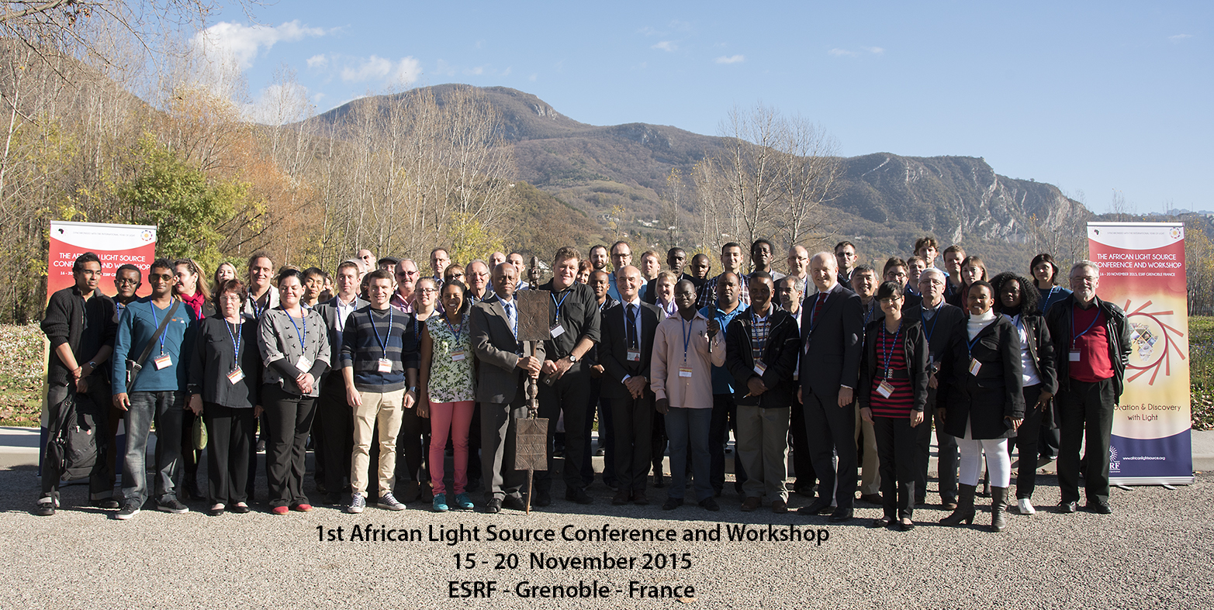

Slide 5
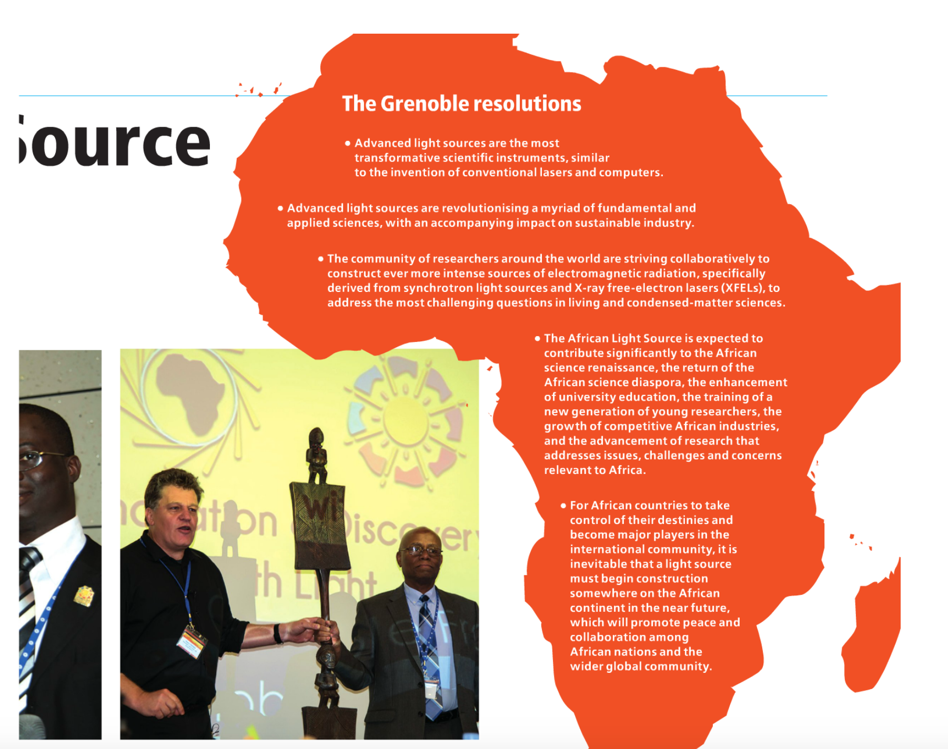
Why is an AfLS essential?

Slide 6
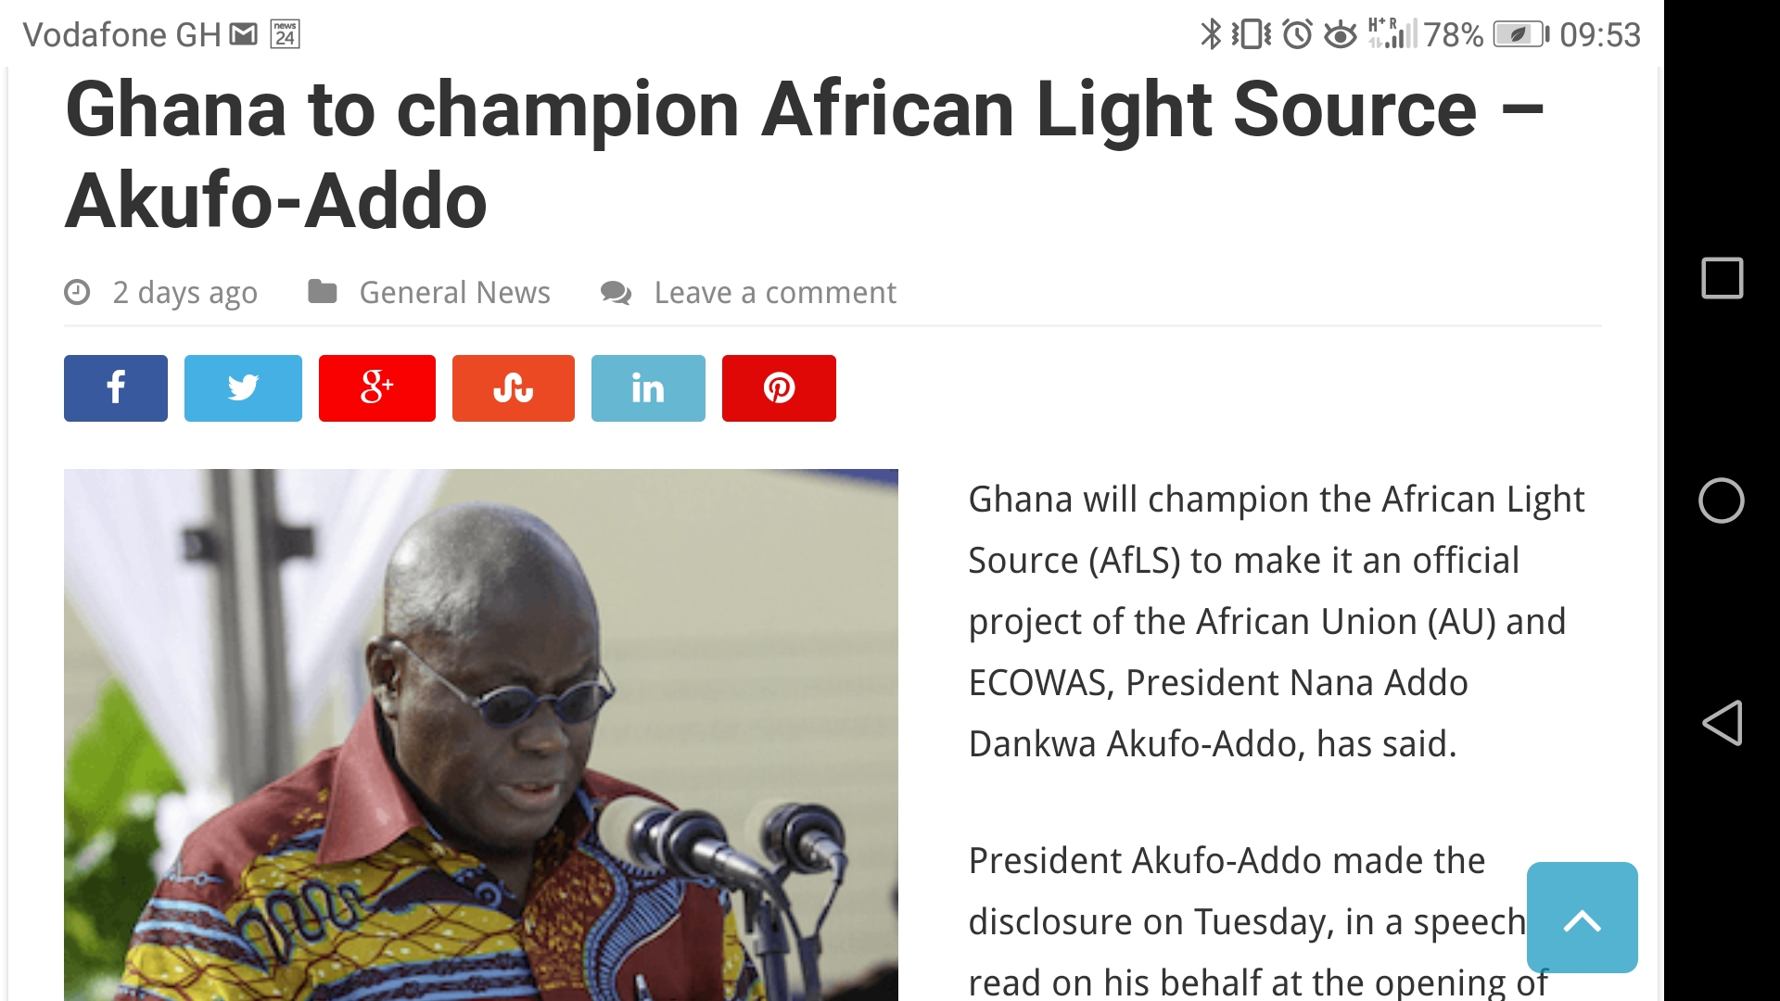
Top-Down

Slide 7


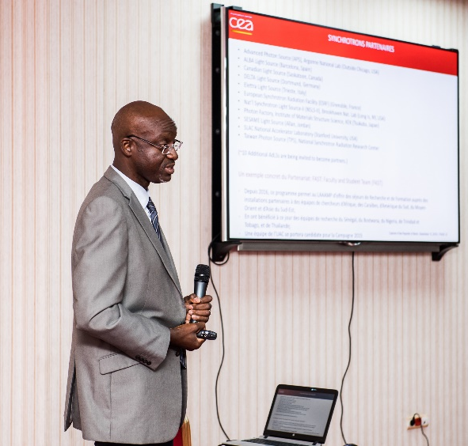
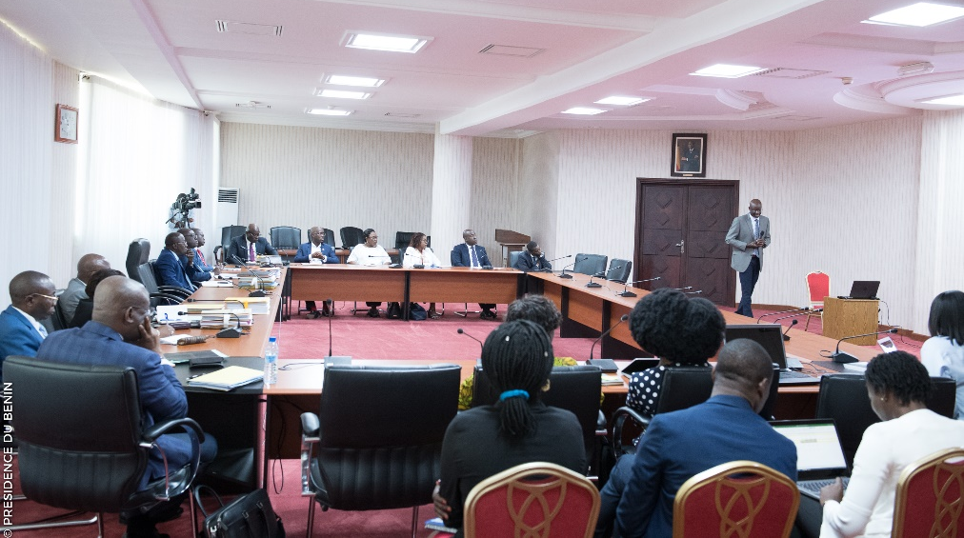

Bottom-Up
X-TechLab at Sèmè City, Benin
Thierry d’Almeida presenting LAAAMP and the X-TechLab project to the Cabinet of the Government of Benin.
X-TechLab is aimed at training Faculty and Master’s and Ph.D. students from African countries every year, and at establishing a permanent user research facility with experienced, permanent staff to act as a hub for the region.

Slide 8
Bottom-Up
FAculty-STudent (FAST) teams visits at Synchrotrons
Eligibility
Faculty members at universities in Africa, the Caribbean, Latin America, Central Asia, SE Asia, Middle East, and Pacific. Interested in using AdLSs to further one’s research and training endeavors. Previous experience with using AdLSs is limited to a year or less. Ability to spend 2 months as a full-time visitor in residence at an AdLS that is a LAAMP collaborative partner.
Student registered as full-time Ph.D. student and supervised by the Faculty member.
Categories
Continuing and New applications are considered.
Financial Support
LAAAMP provides 2,000 Euros per person to cover transportation and (partially) accommodation costs. The remainder of accommodation and subsistence should be negotiated with the host AdLS and other sources of support.

Slide 9
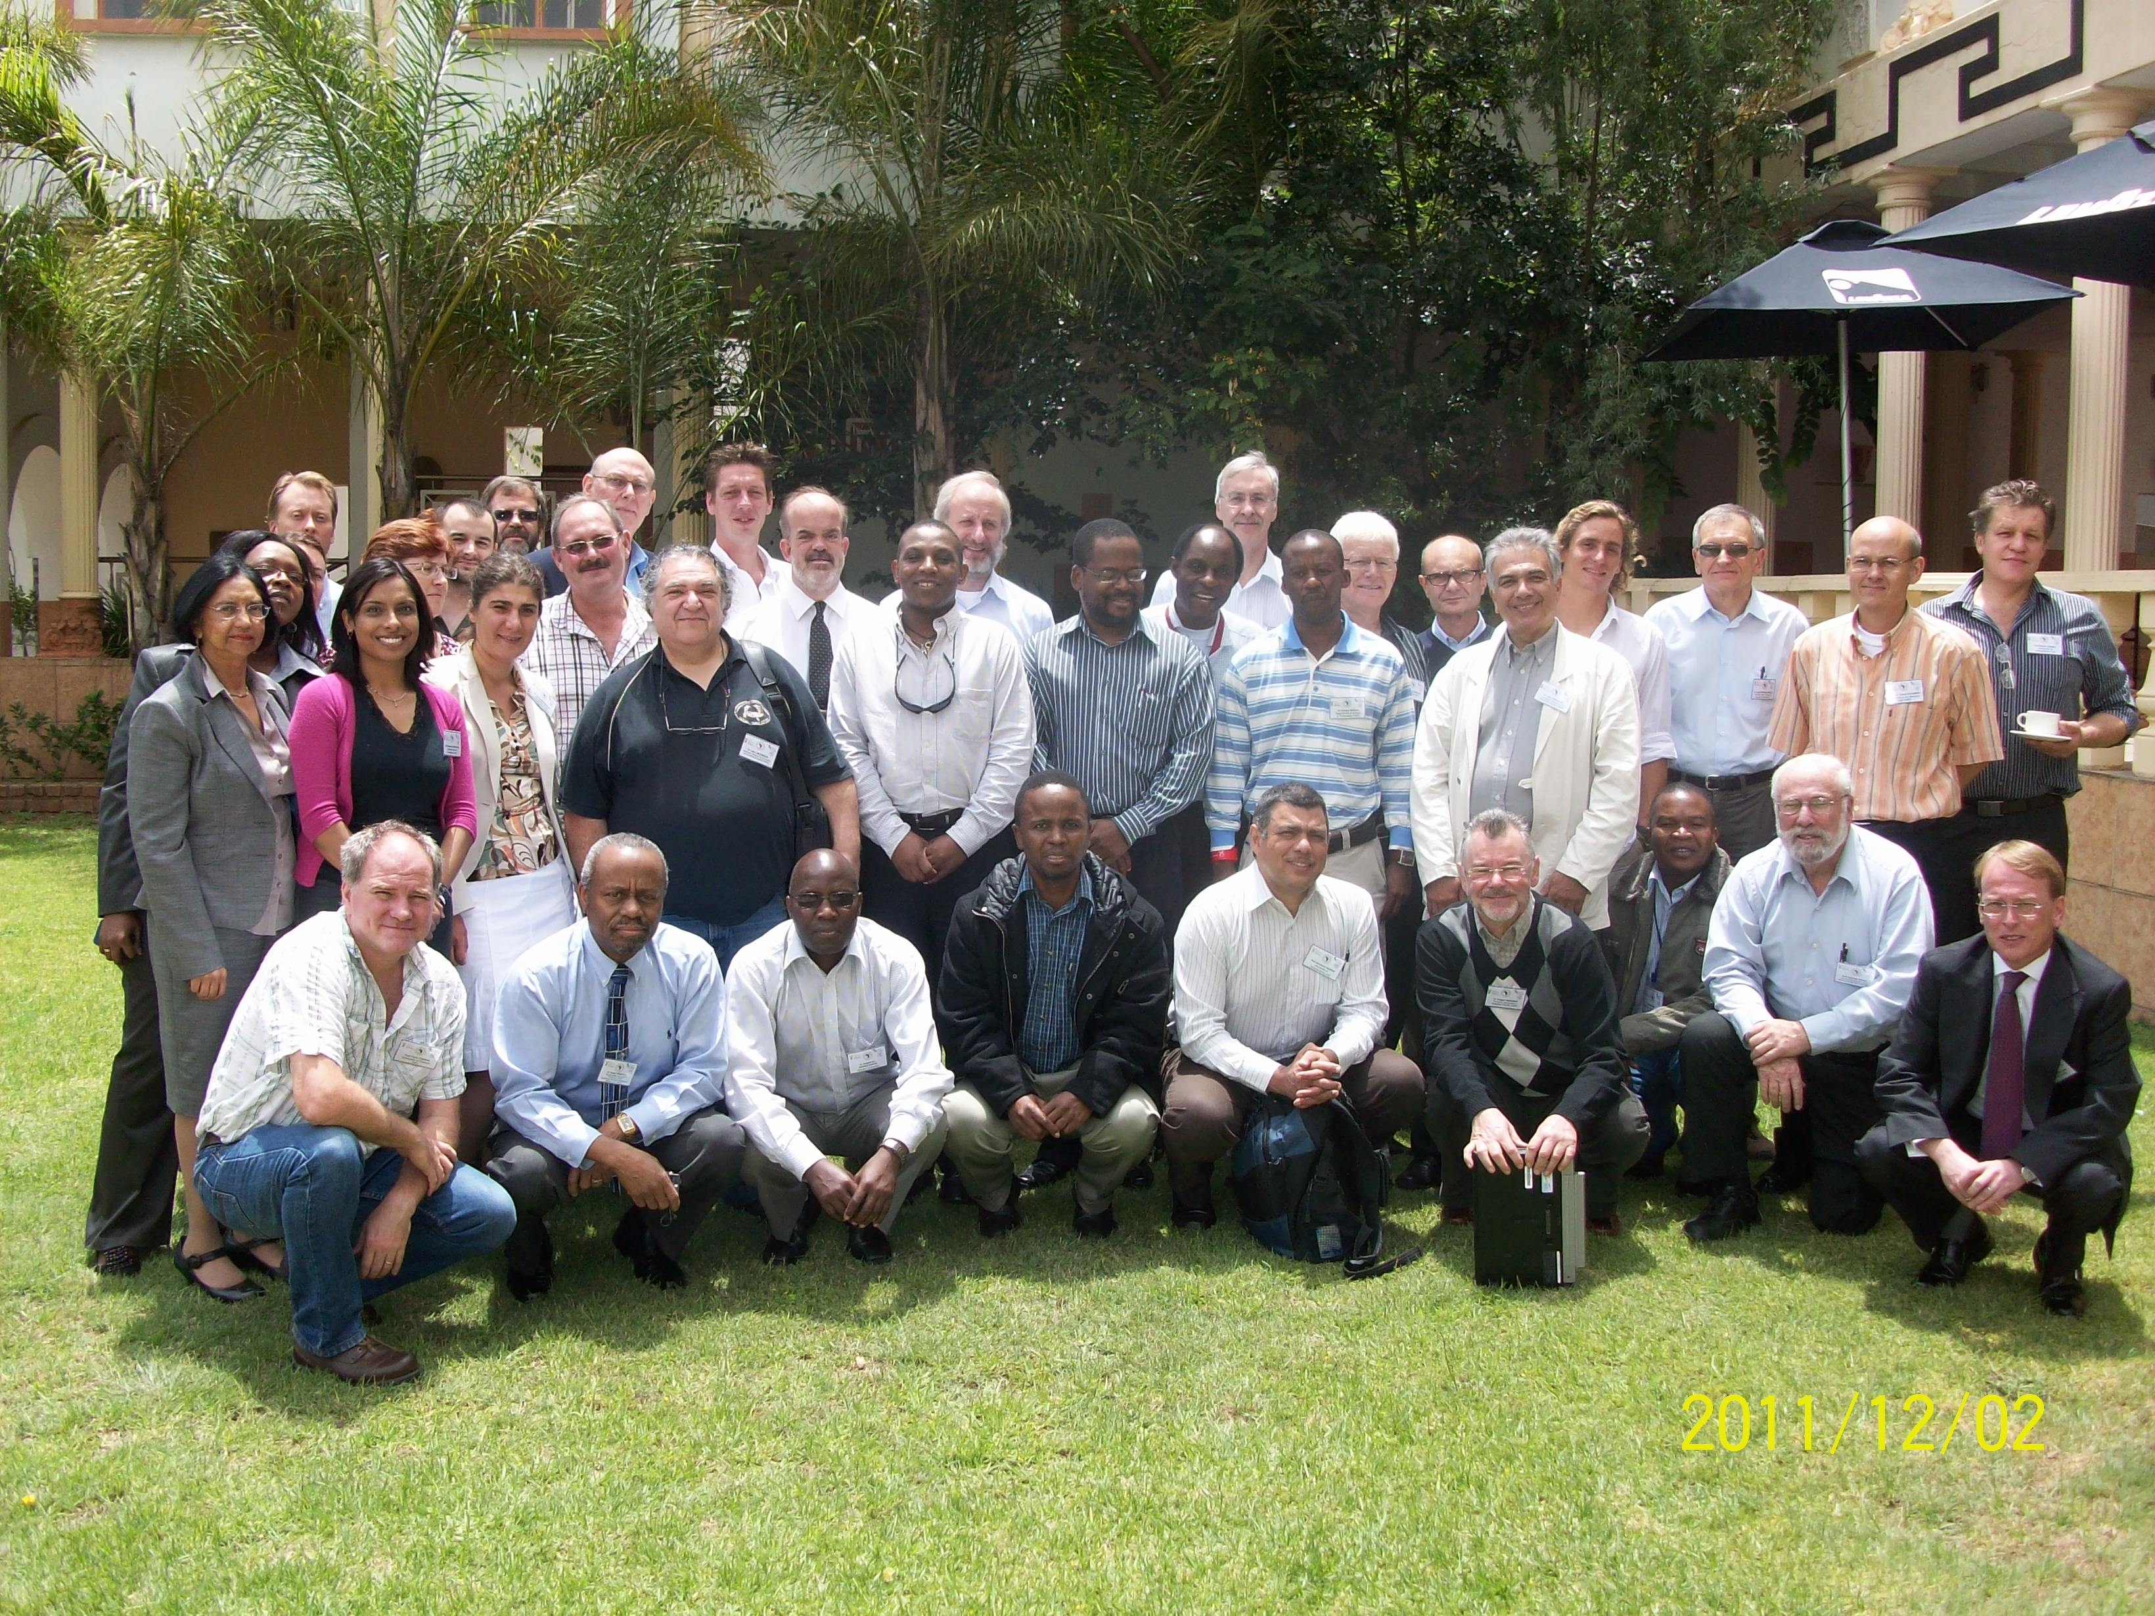
Synchrotron Science Workshop, Pretoria, 1-2 December 2011

Slide 10

Major Outcome Was Strategic Plan Adopted by South African Government
As recommended by Strategic Plan, on 21 May, 2013, South Africa signed a medium-term arrangement with the ESRF at a level of 0.3% and became the 20th country to join the ESRF.

Slide 11
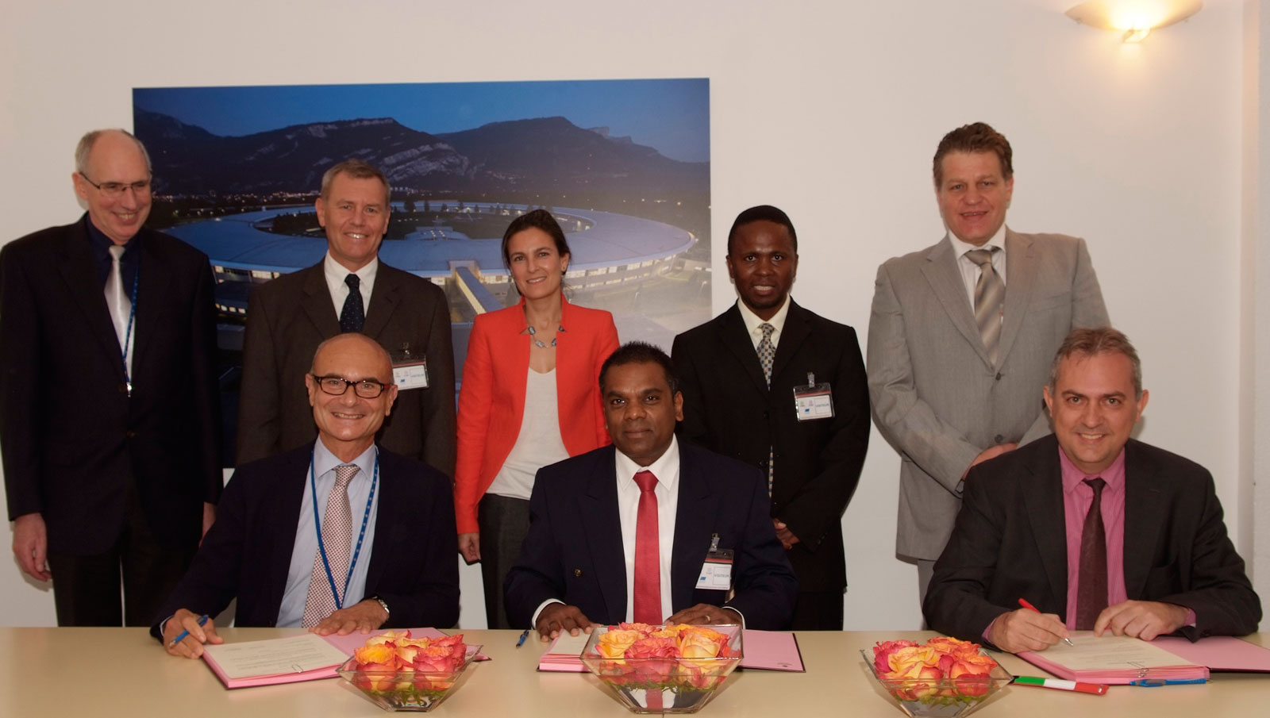
Signing ceremony for South Africa joining the ESRF (2013)

Slide 12
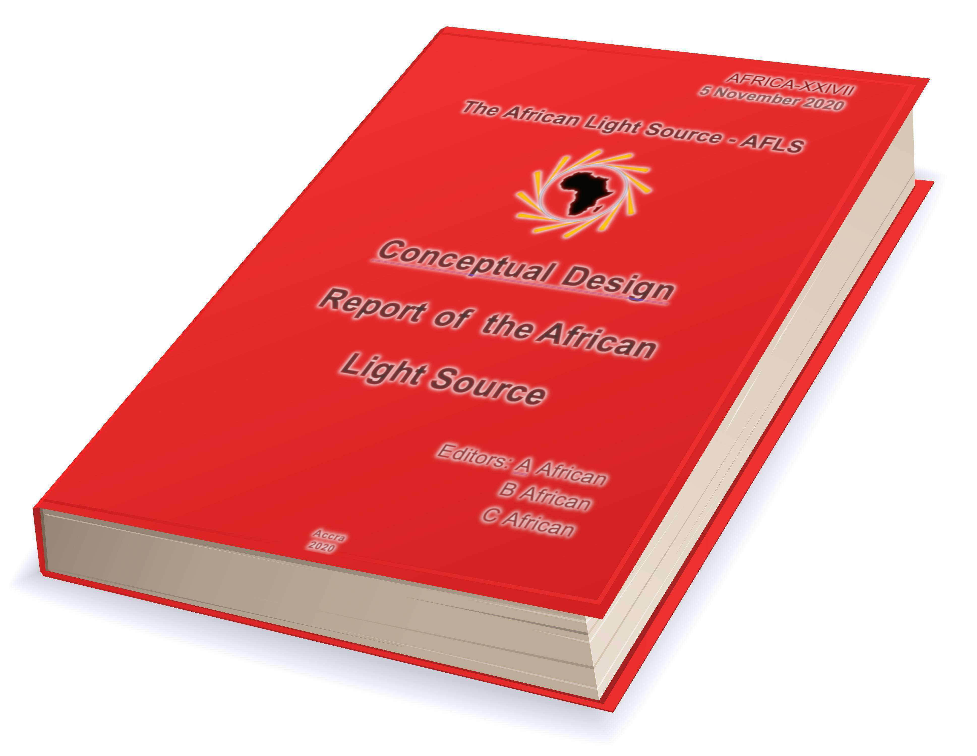
Conceptual Design Report
Motivation for an African Light Source

Slide 13
Editorial Staff
Professor Tabbetha Dobbins
Chair, CDR Organizing Committee
Rowan University, USA
Professor Sekazi K. Mtingwa
Editor-in-Chief, Conceptual Design Report
Chair, LAAAMP Executive Committee
IUPAP C13 Commission
IUPAP Working Group 14 on Accelerator Science
Professor Connie L. McNeely
Deputy Editor, Conceptual Design Report
George Mason University, USA
Professor Michael Steinitz
Senior Editor, Conceptual Design Report
St. Francis University, Canada
Mr. Dorian Bohler
Co-Editor: Machine Design Concepts
SLAC National Accelerator Laboratory, USA
Professor Simon Connell
Editor: Technical Infrastructure and Building Design
University of Johannesburg, South Africa
Dr. Christine Darve
Co-Editor: Machine Design Concepts
European Spallation Source, Sweden
Dr. Ken Evans-Lutterodt
Editor: Sci. Capabilities & Beamline Tech. Concepts
Brookhaven National Laboratory, USA
Originally from Ghana
Professor Jean-Pierre Ezin
Editor: Multinational Governance and Finance
Institute of Mathematics and Physical Sciences, Benin
Professor Marcus Newton
Editor: Scientific, Socio-Economic, Ed. & Pol. Benefits
University of Southampton, UK

Slide 14
CDR Contributors
Hitoshi Abe (Japan), Marielle Agbahoungbata (Benin), Omololu Akin-Ojo (Rwanda, Nigeria), Thierry d’Almeida (France, Benin), El-Hachemi Amara (Algeria), Aba Andam (Ghana), Felix Emeka Anyiam (Nigeria), Riccardo Bartolini (Germany, Italy), Julien Benoit (South Africa), Asmeret Asefaw Berhe (USA, Eritrea), Muaaz Bhamjee (South Africa), Saphina Biira (Uganda), Caterina Biscari (Spain, Italy), Paul Buah-Bassuah (Ghana), Carlos Cabrera (USA, Puerto Rico), Richard Catlow (UK), Kelly Chibale (South Africa, Zambia), George Clerk (UK), Lowry Conradie (South Africa), Joseph Daafour (Ghana), Mmantsae Diale (South Africa), Rudolf Dimper (France, Germany), Tabbetha Dobbins (USA), Tchana Kamgne Duclair (Cameroon), Ahmed El-Hussein (Egypt), Ken Evans-Lutterodt (USA, Ghana), Ndèye Coumba Yandé FALL (Senegal), Vincent Fernandez (UK), Michel Fodje (Canada, Cameroon), Alfonso Franciosi (Italy), Benson Frimpong (Ghana), Gabriel Gwanmesia (USA, Cameroon), Maria Hamunyela (Namibia, South Africa), Messaoud Harfouche (Jordan, Algeria), Andrew Harrison (UK), Delia Haynes (South Africa), Kudakwashe Jakata (South Africa, Zimbabwe), W. Estella Johnson (USA), Akorede Kalejaiye (Nigeria), Gihan Kamel (Jordan, Egypt), Paul Abidemi Kappo (Nigeria, South Africa), Abebe Kebede (USA, Ethiopia), Patrice Kenfack (Cameroon), Nkem Khumbah (USA, Cameroon), Diouma Kobor (Senegal), Frank Lehner (Germany), Enzo Lombi (Australia), Kirsi Lorentz (Cyprus, Finland), Malik Maaza (South Africa, Algeria), Ernie Malamud (France, USA), Priscilla Masamba (South Africa), Brian Masara (South Africa, Zimbabwe), Genito Maure (Mozambique), Wilfred Mbacham (Cameroon), Stephen McGuire (USA), Connie L. McNeely (USA), Mongezi Mdhluli (South Africa), Gift Mehlana (Zimbabwe),
Country of origin listed second

Slide 15
CDR Contributors (cont’d)
Roland Mfondoum (Austria, Cameroon), Edward Mitchell (France, UK), Thandeka Moyo-Gwete (South Africa), Alfred Msezane (USA, South Africa), Célestin Nzanzu Mudogo (Democratic Republic of Congo), Andani Mulelu (South Africa), Kiran Mundboth (Canada, Mauritius), Amor Nadji (France), Peter Ngene (The Netherlands, Nigeria), Jean-Paul Ngome Abiaga (Jamaica, Gabon), Lawrence Norris (USA), Tshepo Ntsoane (South Africa), Abimfoluwa, Oluseyi Philip Oladijo (Botswana, Nigeria), Gideon Olaleye (Canada, Nigeria), Özgül Öztürk (Germany, Turkey), Resego Phiri (Botswana), María Josefina Robles Águila (Mexico), Alakendra N. Roychoudhury (South Africa), Ana Karen Sánchez-Hernández (Mexico), Yasien Sayed (South Africa), Sandro Scandolo (Italy), Wolf-Dieter Schubert (South Africa), Dereje Seifu (USA, Ethiopia), Bridinette Thiodjio Sendja (Cameroon), Francesco Sette (France, Italy), Trevor Sewell (South Africa), Sam Sloetjes (Sweden), Dawit Solomon (USA), Michael Steinitz (Canada, USA), Jean Susini (France), Mourad Telmini (Tunisia), Khaled Toukan (Jordan), Daouda Traore (France, UK, Mali), Bjorn von der Heyden (South Africa), Ahmadou Wagué (Senegal), Herman Winick (USA), Paul Woafo (Cameroon), Mostafa Zeidan (Egypt), Michele Zema (Italy)
List not quite complete: ~100 Contributors

Slide 16
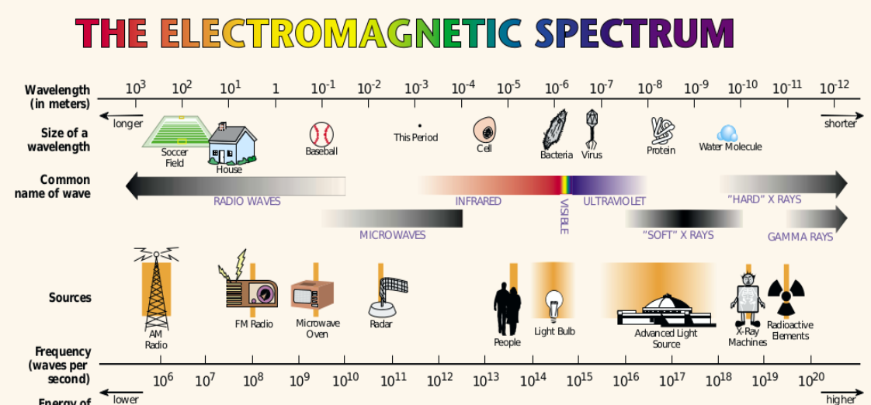
Chapter 1: Overview and Description of an Advanced Light Source
EM spectrum compared to well-known objects and sources of radiation
(Figure courtesy of Lawrence Berkeley National Laboratory, USA)

Slide 17
Chapter 2: Scientific Benefits
2.1 Structural Biology
2.1.3 Role of Synchrotron Light Sources in Studying Infectious Diseases Prevalent in Africa
2.2 Materials for Energy Applications
2.2.2 Solar Energy
2.2.3 Rechargeable Batteries
2.3 Geoscience
2.4 Environmental Science
2.5 Plant and Soil Science
2.6 Palaeontology and Archaeology

Slide 18
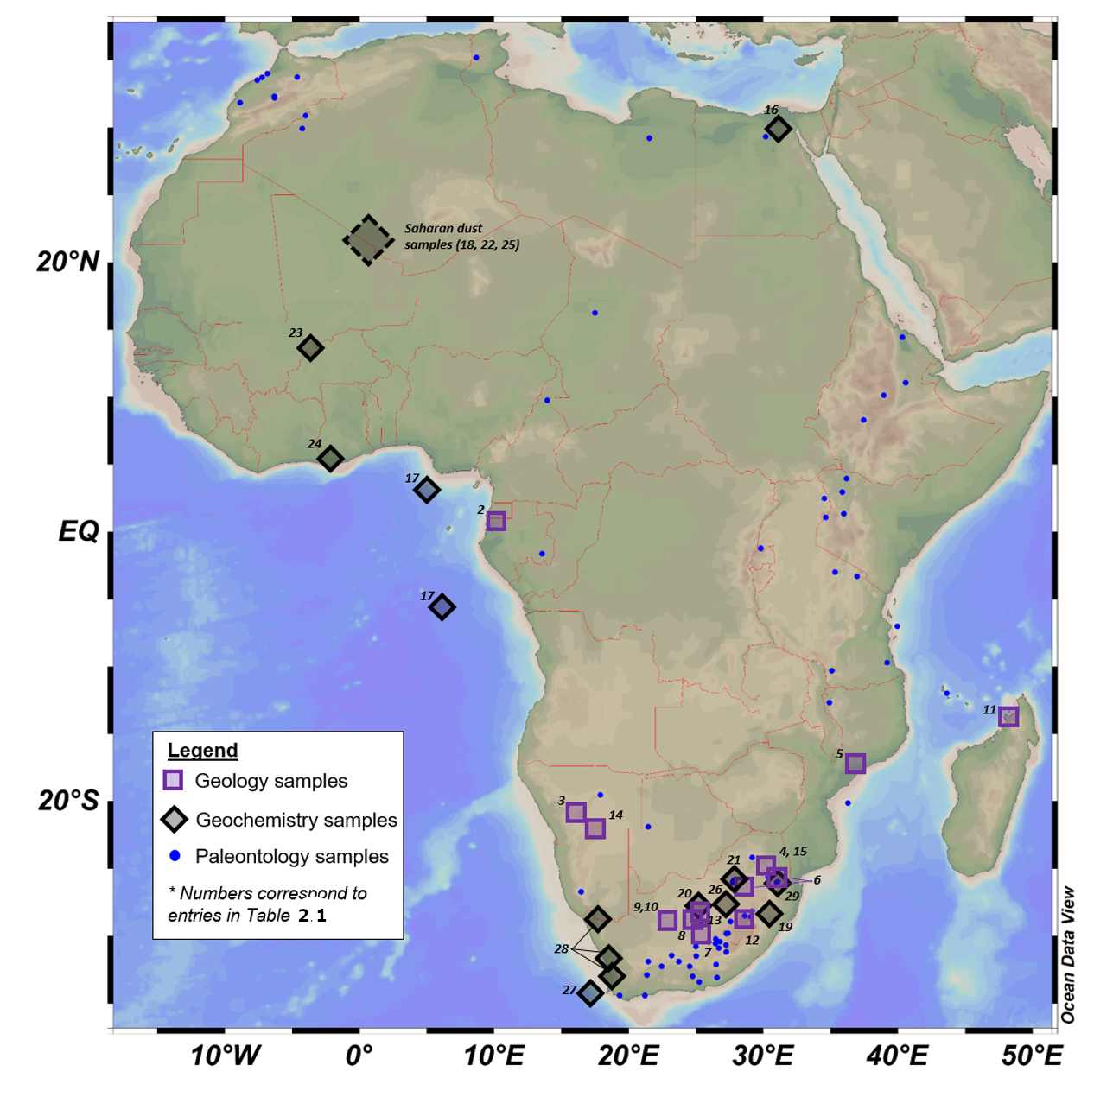
Distribution of African Earth science sample materials that have been investigated utilising synchrotrons
(Figure from Bjorn von der Heyden)

Slide 19
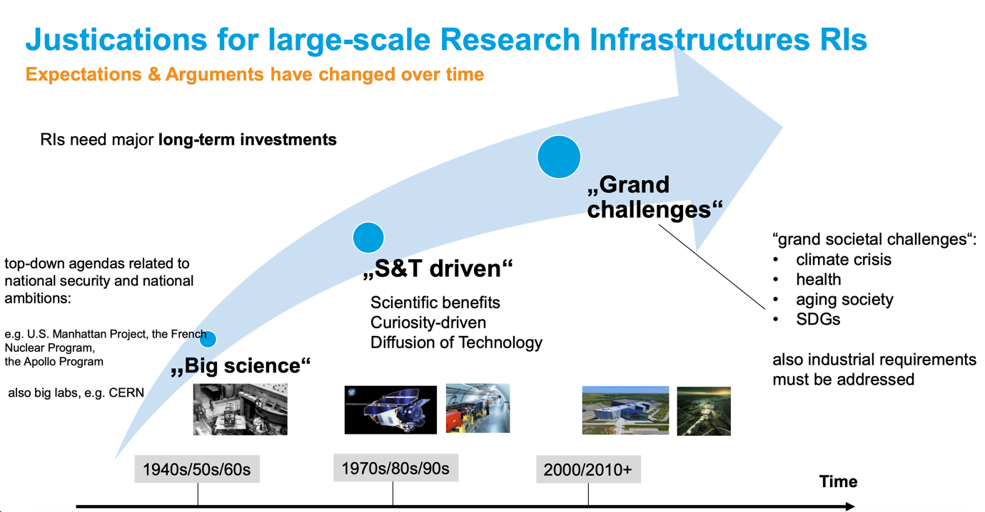
Chapter 3: Social and Economic Benefits
History of Big Science Infrastructures
(Figure Courtesy of DESY)

Slide 20
Social and Economic Benefits
(cont’d)
3.1.1 Disease Prevention and Cure
3.1.2 Food Security
    Improvements in food and packaging characterisation; structure determination of products, including chocolate, oils and fats; and determining the oxidation states of products used for agriculture .
3.1.3 Clean Energy
    AfLS would prove to be a powerful tool for developing materials and processes, including batteries, fuel cells, catalysts and catalytic processes.
    AfLS would characterise sources of ecological damage, such as CO₂ and asbestos, and develop catalysts and materials to convert them to less harmful products.
3.2 Economic Benefits
    According to Andrew Harrison, Former CEO, Diamond Light Source
    “For every English pound put into the facility, 3.5 pounds come back into the economy.”

Slide 21
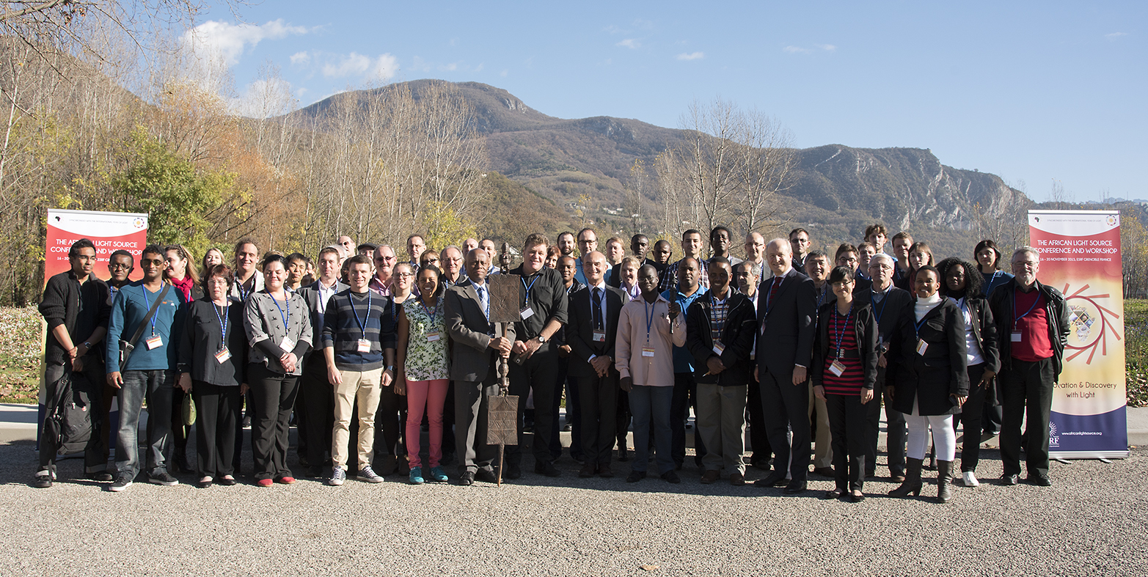
Chapter 4: History of the African Light Source
Group Photo of the 1st African Light Source Conference and Workshop
ESRF, Grenoble, France, 2015

Slide 22
Chapter 5: Local Technical Infrastructures and Human Capacity Building
5.1 African Laser Centre (ALC, https://africanlasercenter.org/)
To Transform the Laser Community in Africa
5.2 Atomic, Molecular and Optical Sciences Network (LAM Network)
To Develop Optics and Photonics in Africa (https://lamoptinet.org/)
5.3 Lightsources for Africa, the Americas, Asia, Middle East and Pacific (LAAAMP, https://laaamp.iucr.org/)
To Enhance the Utilisation of Crystallography and Advanced Light Sources in the Developing World
5.4 X-TechLab (https://www.xtechlab.co/)
To Transform Crystallography Research and Training in Africa

Slide 23
Local Technical Infrastructures and Human Capacity Building (cont’d)
5.6 ICTP School on Synchrotron Light Sources and their Applications
https://indico.ictp.it/event/10057/ 23 Jan – 3 Feb 2023 (Free Virtual School)
5.9 African Crystallographic Association
(AfCA, https://www.iucr.org/outreach/africa/afca/)
To advance science on the African continent via crystallography
5.10 BioStruct-Africa (https://www.biostructafrica.org/)
To build capacity in the field of structural biology for Africa-based scientists.
5.11 Synchrotron Techniques for African Research and Technology
(START, https://start-project.org/)
Seeks to foster the development of synchrotron techniques for African research and technology, with initial emphasis on structural biology and energy materials.

Slide 24
Chapter 7: Proposed Statutes of the African Light Source
ARTICLE I Purpose and Functions
ARTICLE II Membership and Participation
ARTICLE III The Council
ARTICLE IV Standing Committees
ARTICLE V Directorate
ARTICLE VI Duties of the Director-General
ARTICLE VII Legal Status
ARTICLE VIII Financial Arrangements
ARTICLE IX Contributions
ARTICLE X Other Contributions from the African Union et al.
ARTICLE XI Loss of Membership
ARTICLE XII Final Clauses

Slide 25
Chapter 8 4th Generation Synchrotron Light Source Accelerator
Explain why 4th Generation Multi-Bend Achromat (MBA) lattices improve electron beam emittances compared to 3rd Gen.
Describe a prototype 3 GeV, ~500 meter, ~100 psec horizontal emittance storage ring.
Describe Ancillary Requirements
Offices
Food Services
Guest Housing
Water
Waste Disposal
Describe Electrical Power Plant
Comments on a nominal 10 MW Solar Power Plant à la SESAME.

Slide 26
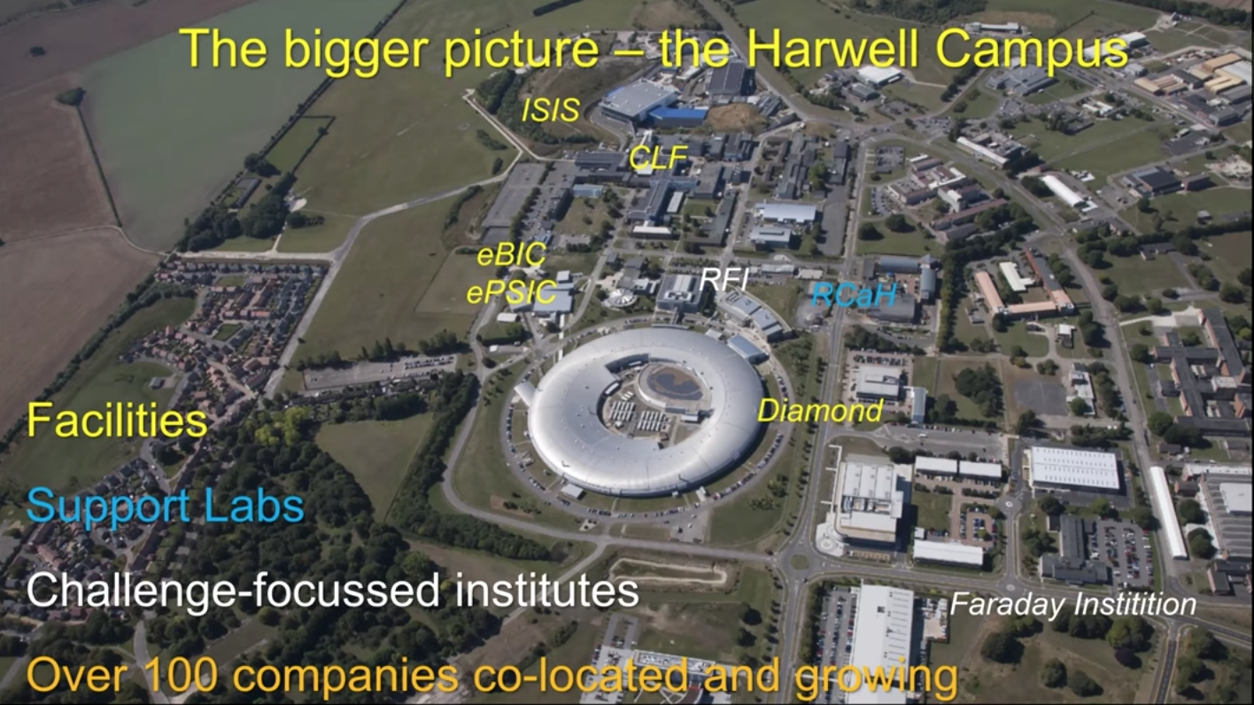
Chapter 9: Integrated Science and Technology Park

Slide 27
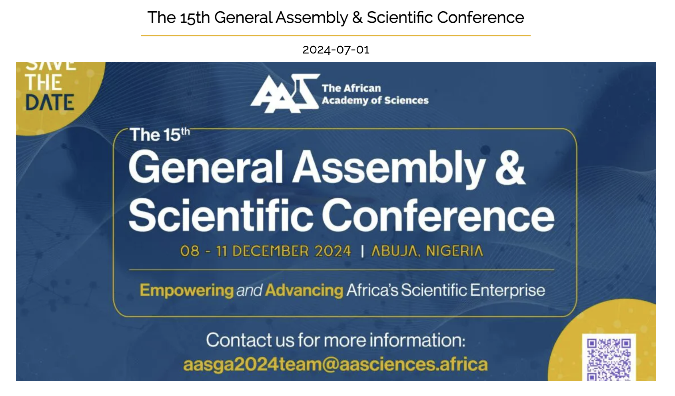
Launch of theAfLS Geopolitical Conceptual Design Report

Slide 28
THANKS FOR YOUR KIND ATTENTION!
sekazi.mtingwa@gmail.com

