Slide 1
LAMISTAD, A SYNCHROTRON FOR THE GREATER CARIBBEAN
Víctor M. Castaño
Universidad Nacional Autónoma de México

Slide 3
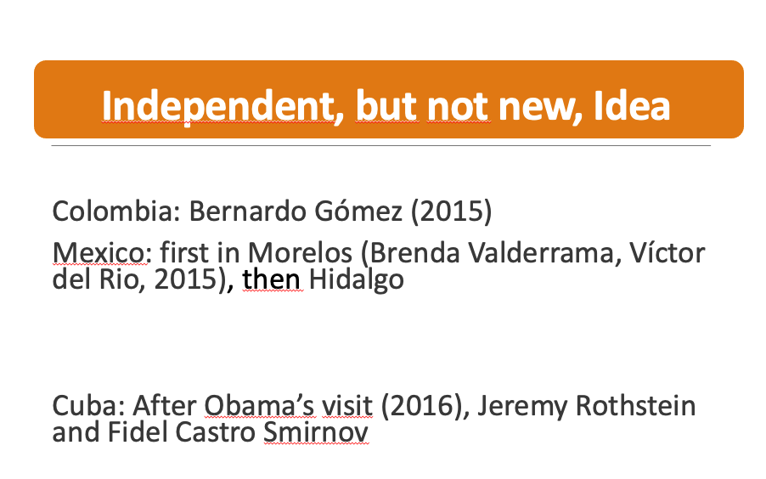
LAMISTAD=Latin American International Synchrotron for Technology, Analysis, and Development

Slide 5
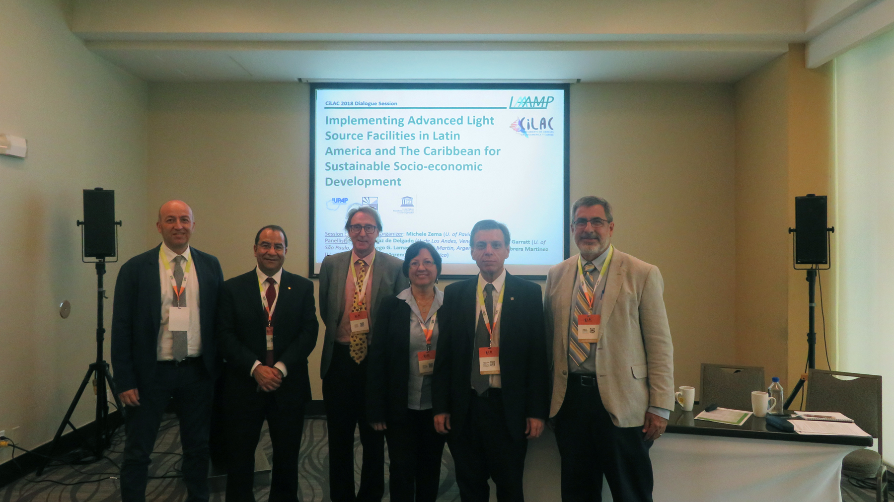
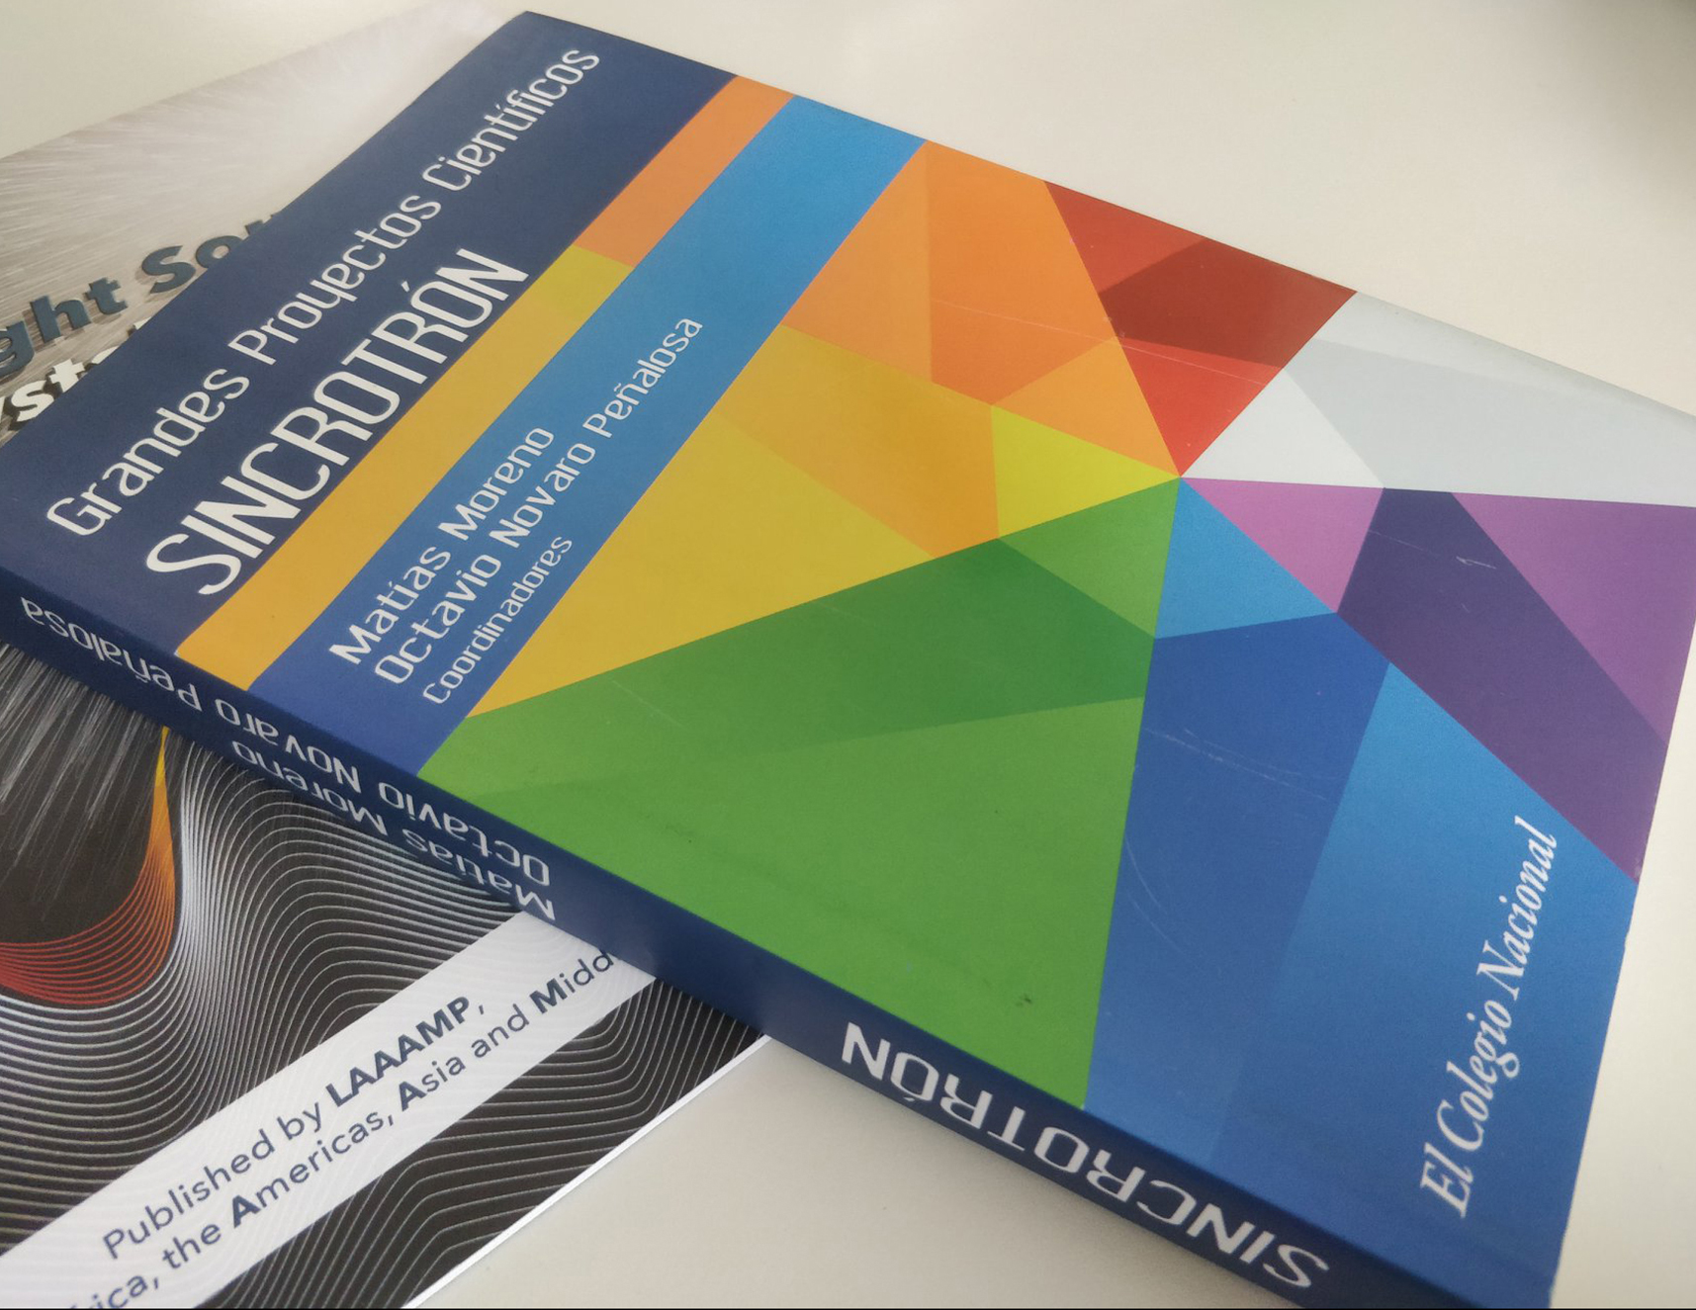

Slide 7
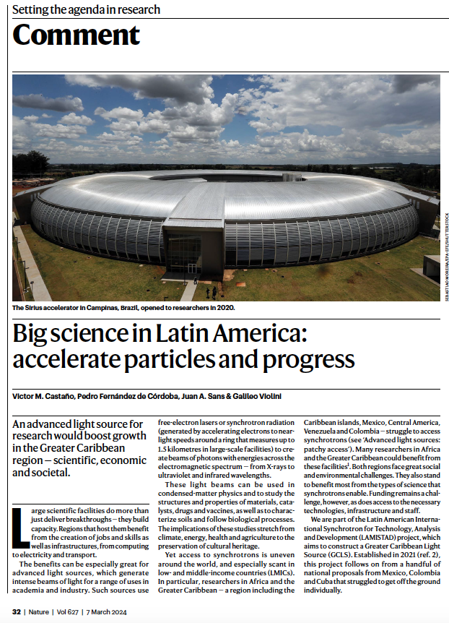

Slide 8
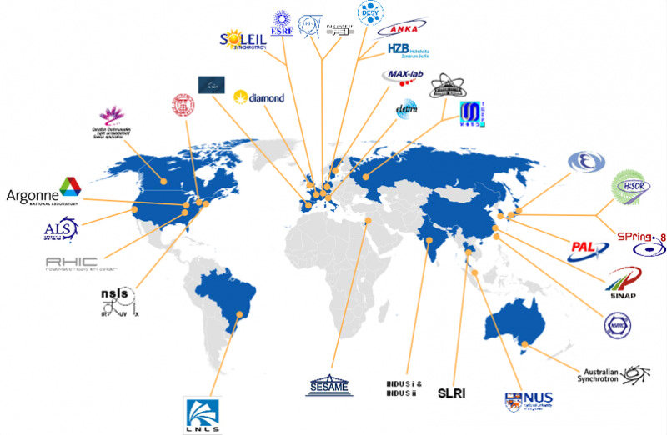

Slide 9
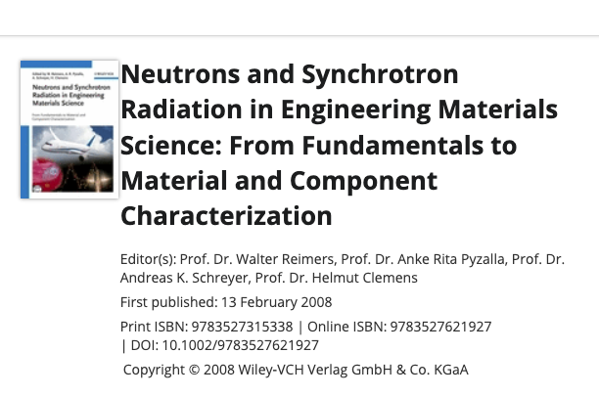

Slide 11
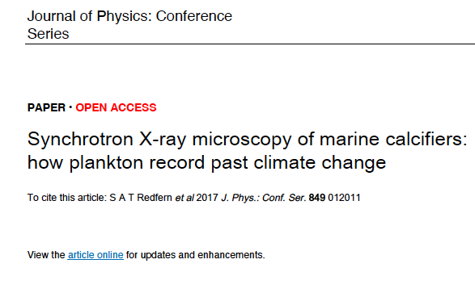

Slide 12
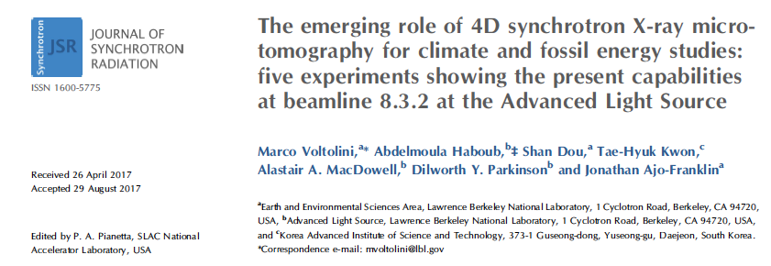

Slide 14
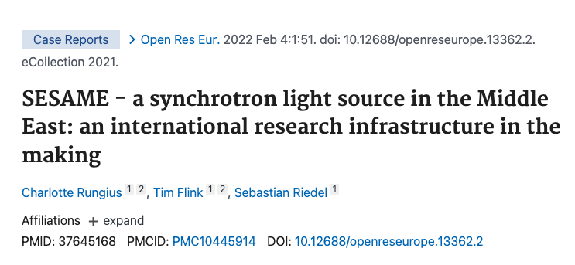

Slide 16
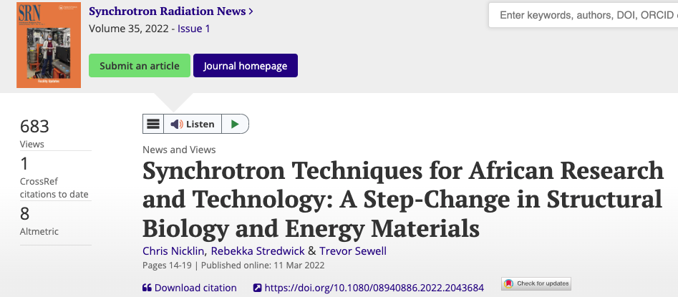

Slide 18
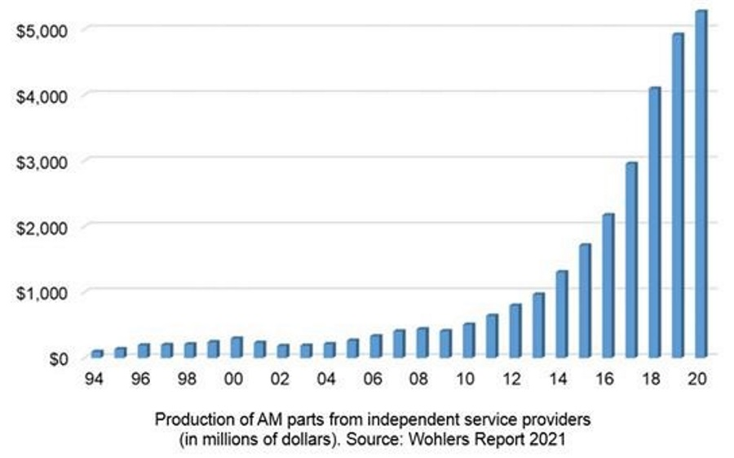

Slide 19
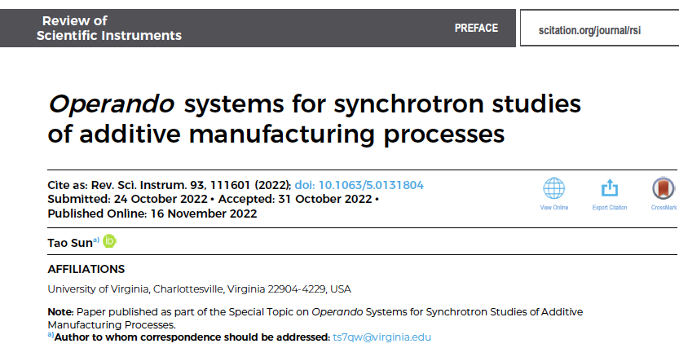

Slide 22
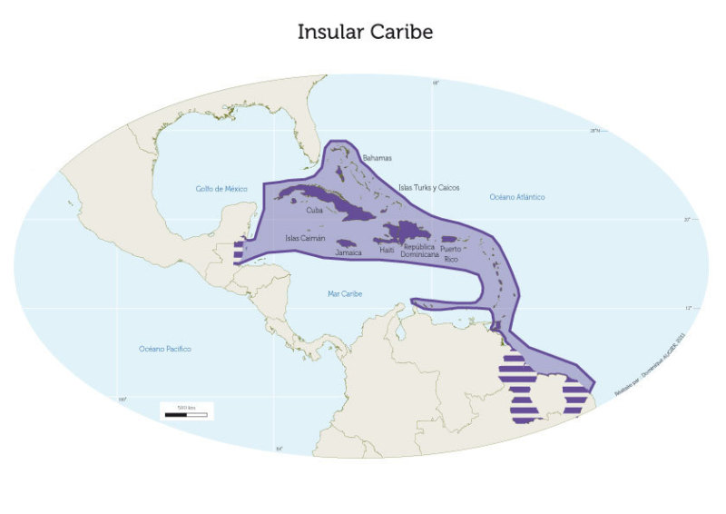

Slide 23
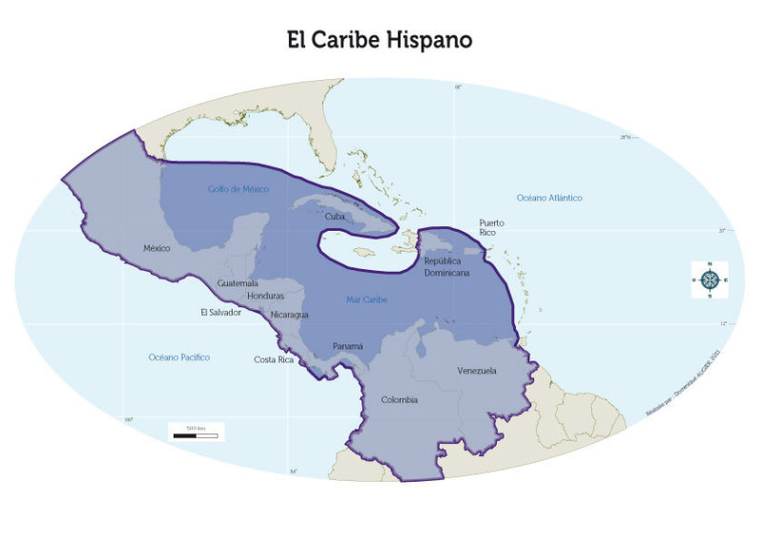

Slide 24
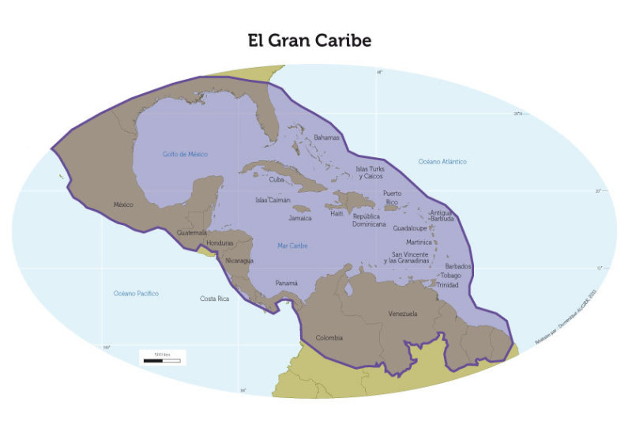

Slide 26
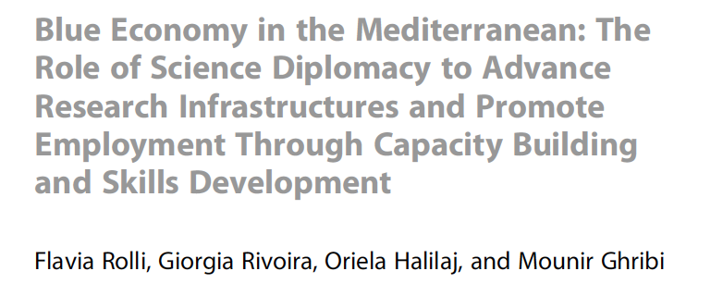

Slide 28
2021

Slide 29
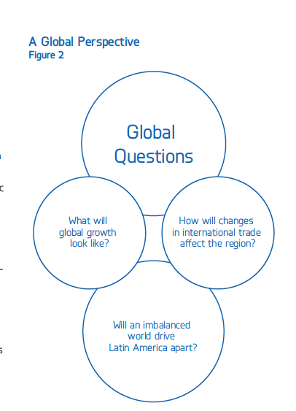

Slide 31
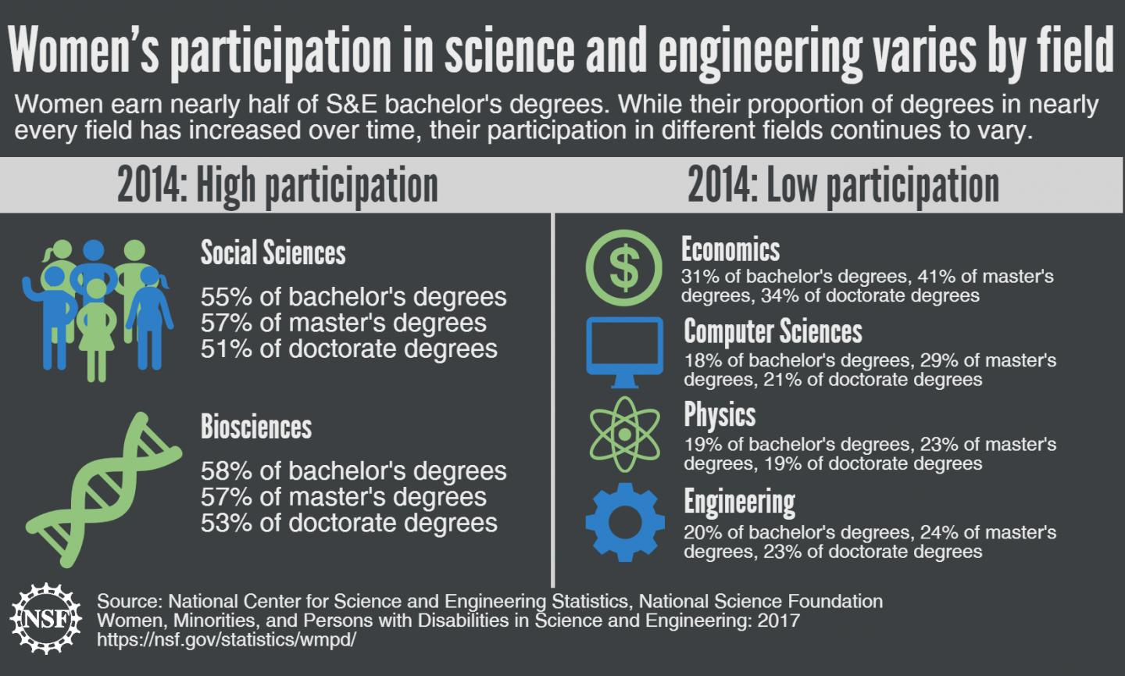

Slide 32
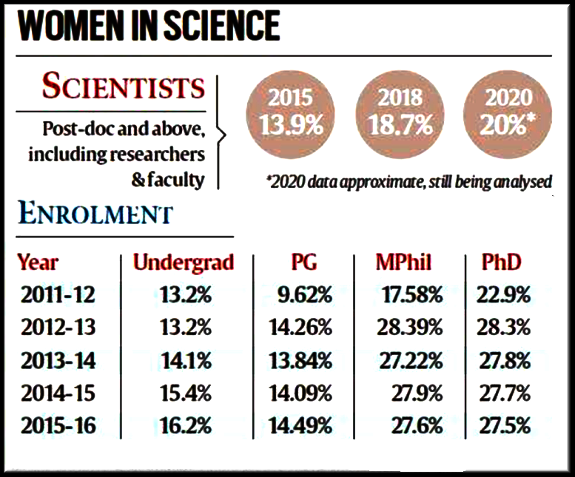

Slide 33
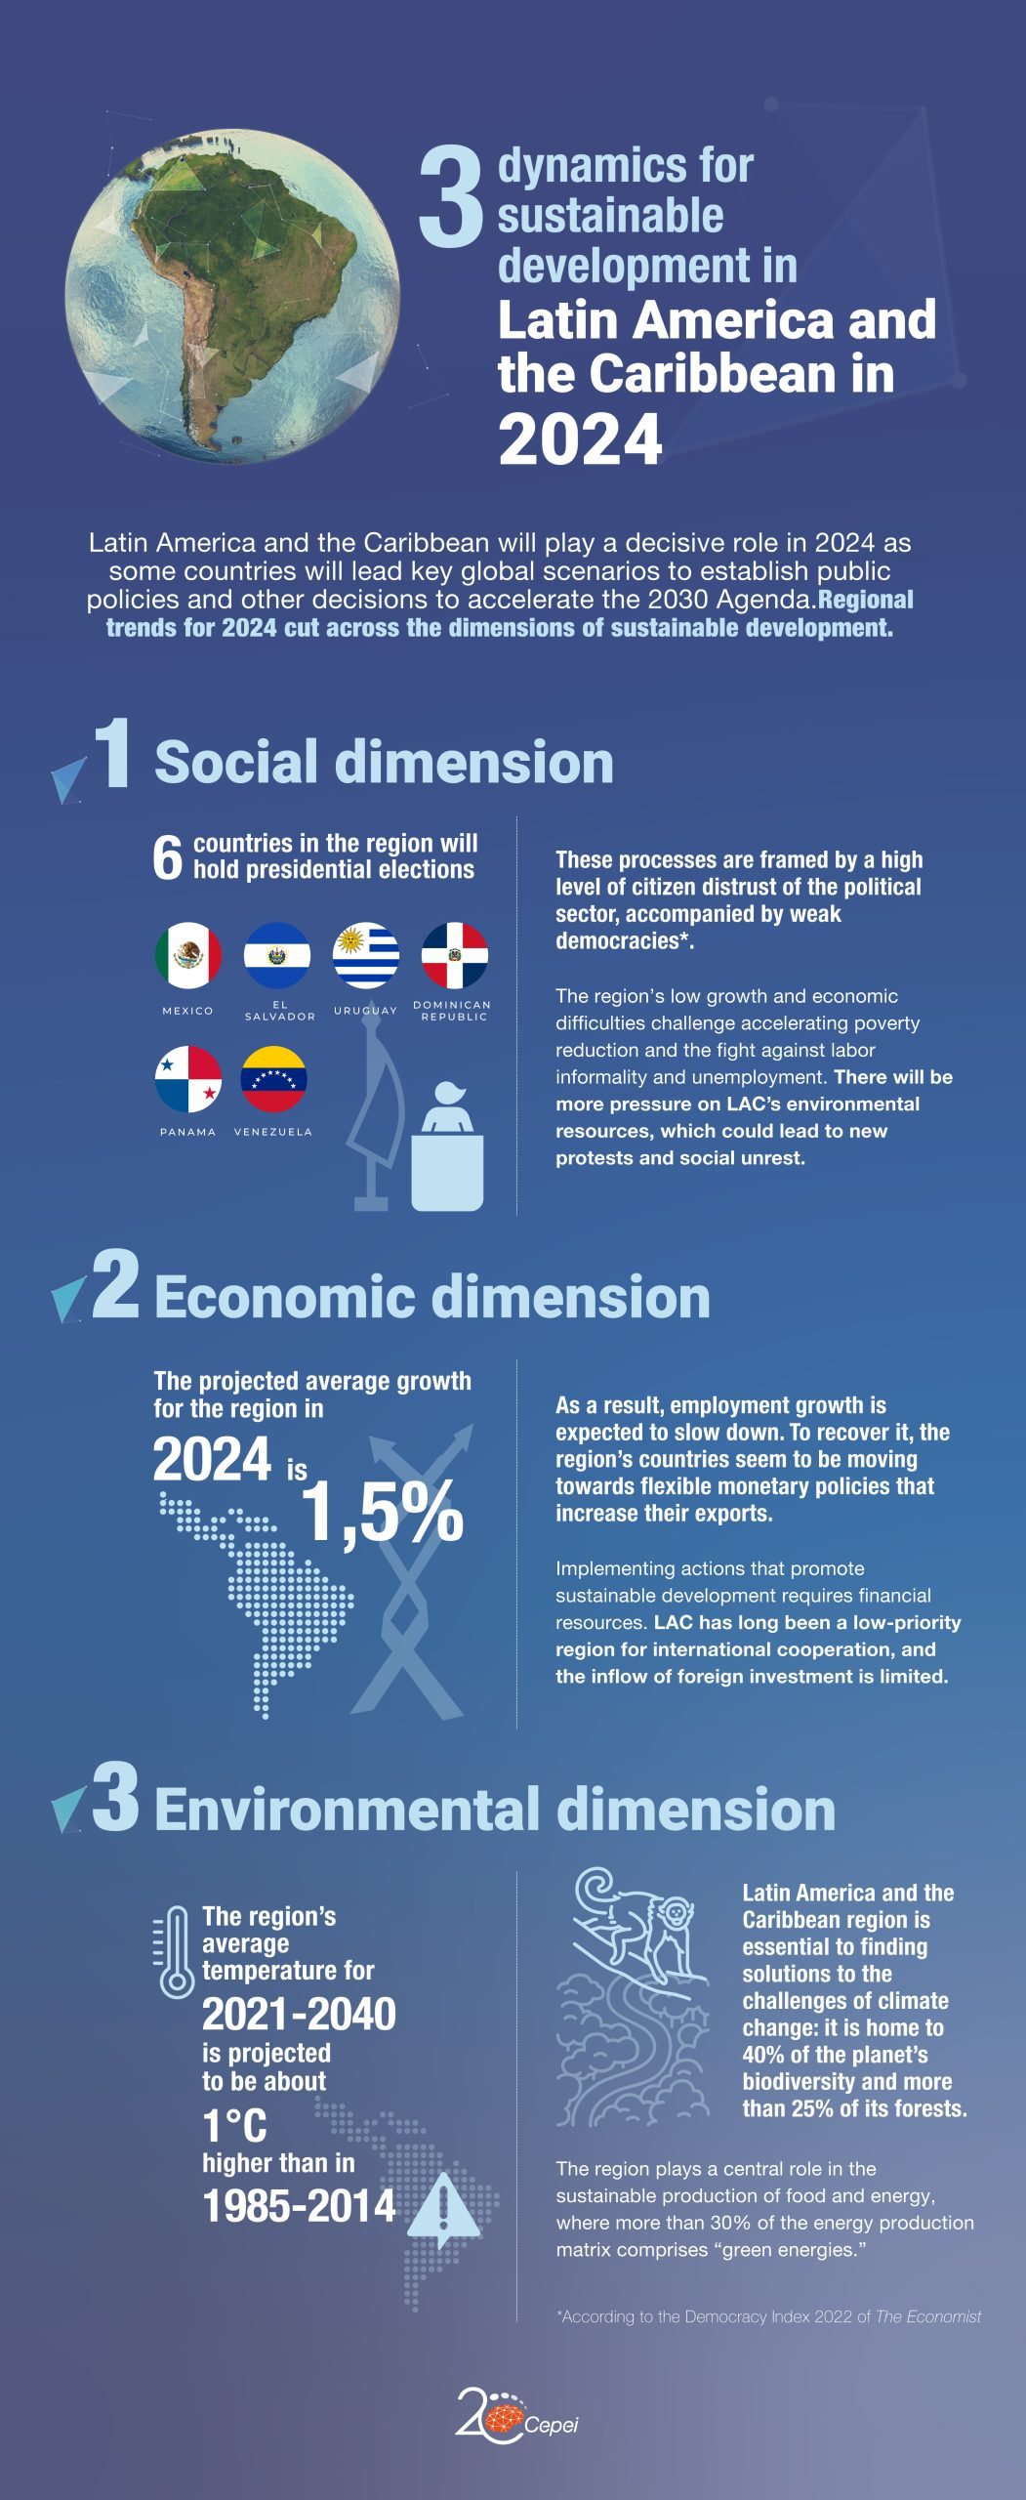

Slide 34
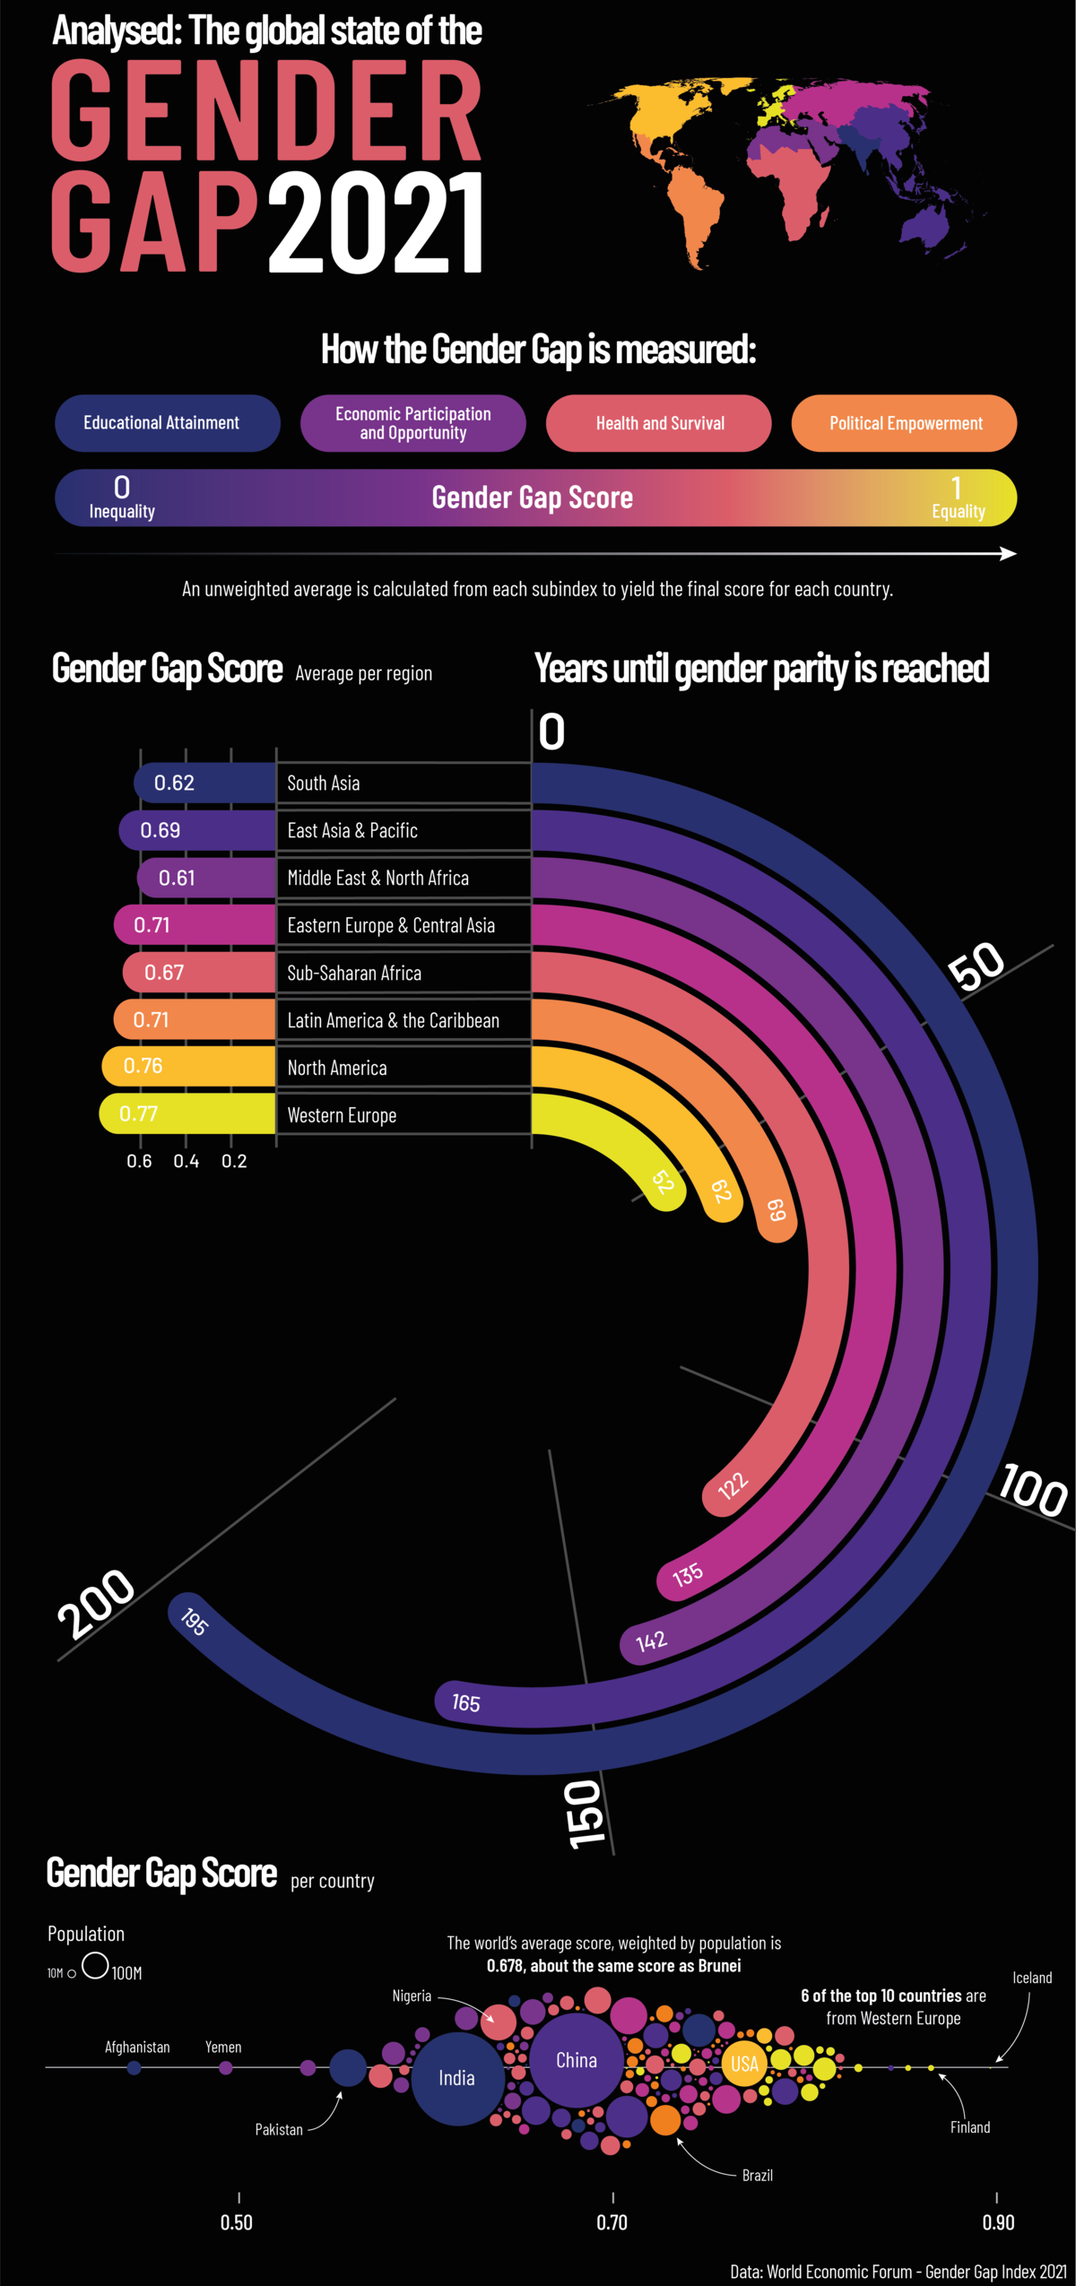

Slide 35
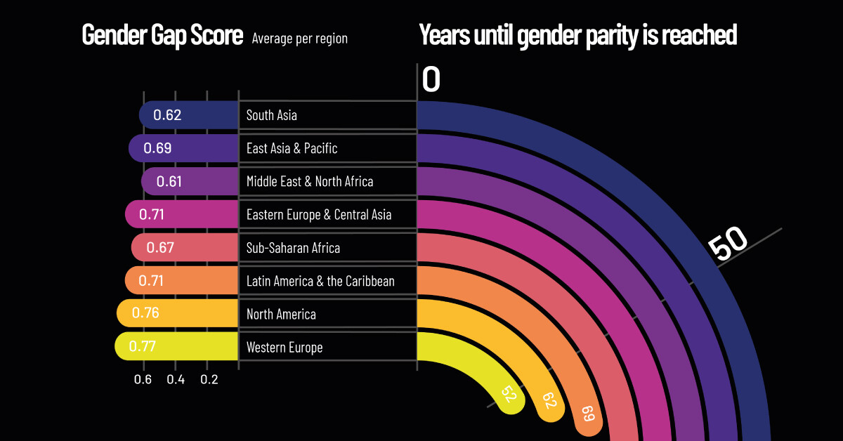

Slide 36
Victor M. Castaño
vmcastano@unam.mx
Facebook: victormanuel.castanomeneses
X: @vmcastano
Instagram: @98.131.864 (victor.m.castano)
Threads: victor.m.castano
Linkedin: Victor M. Castaño
Telegram: vmcastano

