Slide 1


Debye Institute for
Nanomaterials Science
XRS Studies on Nanocomposite Energy Storage Materials
Peter Ngene
Materials Chemistry and Catalysis, Debye Institute for Nanomaterials Science, Utrecht University.
AFLS-AfPS conference 2024
Notes:
Resume : Complex metal hydrides are a promising class of solid-state electrolytes for future generation all-solid-state batteries. In this presentation I will share information about the research in this field in our group over the past five years, most notably discussing: * improved conductivity in nanocomposites, by combining with high surface area/porous oxides ("interface engineering") * design rules how to maximum the room temperature conductivity * synergy between anion replacement and nanocomposites * progress towards practical room temperature all-solid-state batteries based on these electrolytes references: Suwarno et al, J. Phys Chem C 121 (2017) 4197 Zettl et al. J Phys Chem C 124 (2020), 2806 Gulino et al, ACS Appl. Ener. Mater. 121 (2017), 4941 de Kort et al, J. Alloys Comp. 901 (2022) 163474

Slide 2
Overview
Motivation (Energy transition and energy storage)
Nanocomposites for Reversible Hydrogen storage
Nanocomposites solid electrolytes for batteries
Conclusions and outlook
Notes:
changing focus, although classic fields still important, new fields emerging

Slide 3
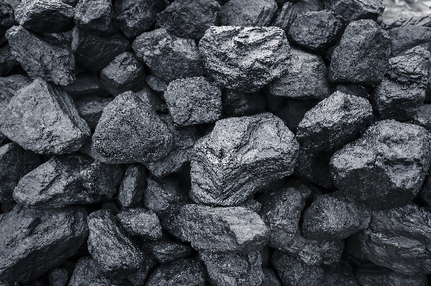



Energy and Economic development
Coal
Industrial revolution and economic development spurred by availability of energy resources (coal)

Slide 4
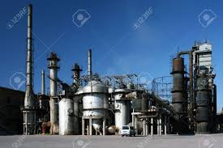


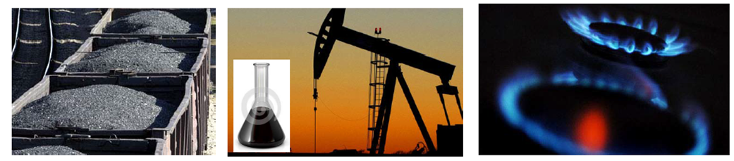




Energy and Economic development
Coal
Crude oil
Natural gas

Slide 5



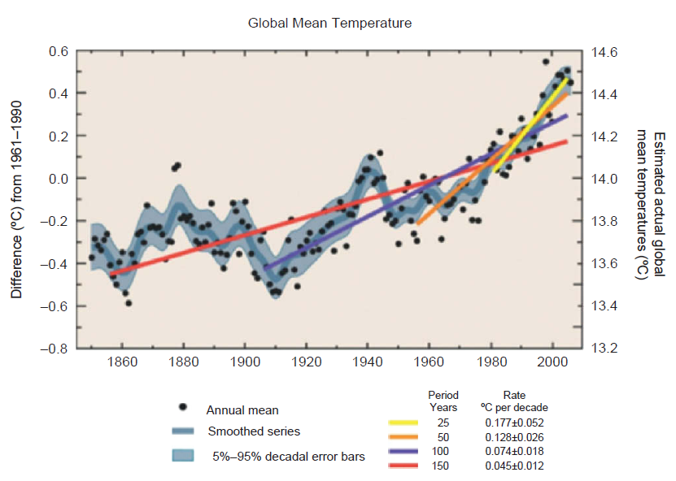
Energy and Economic development
The GDP per capita proportional to energy consumption
Increasing energy demand vs depleting oil reserves, pollution/global warming
David S. Ginley and David Cahen., Fundamentals of Materials for Energy and Environmental Sustainability

Slide 6




Energy Transition
Coal
Crude oil
Natural gas
www.simplerenewable.com

Slide 7
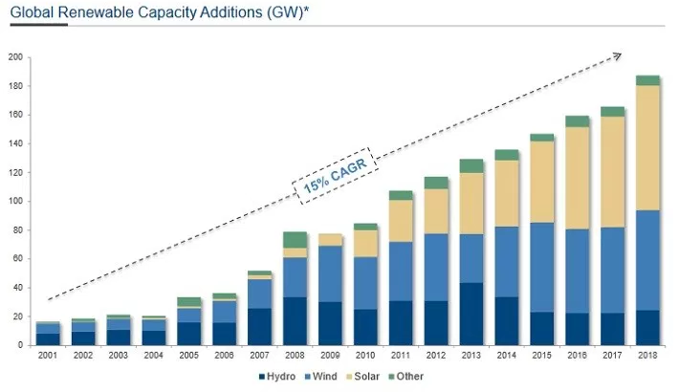
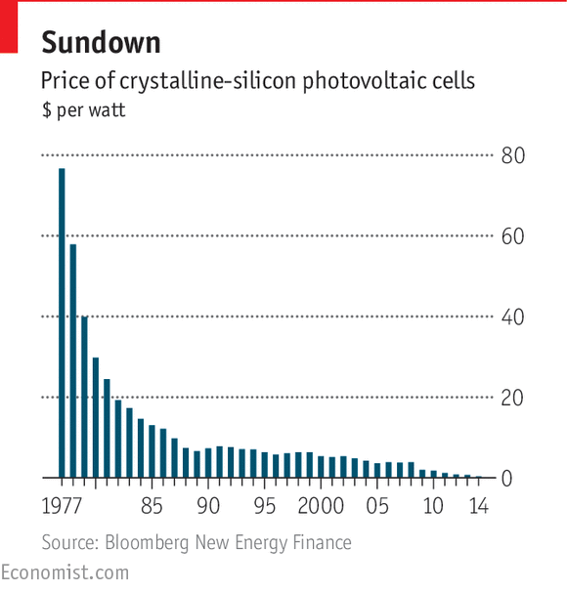
Energy from renewable resources
Cost
Growth is mostly driven by concern about climate change, decreasing cost of PV cells
CAGR: Compound annual growth rate

Slide 8
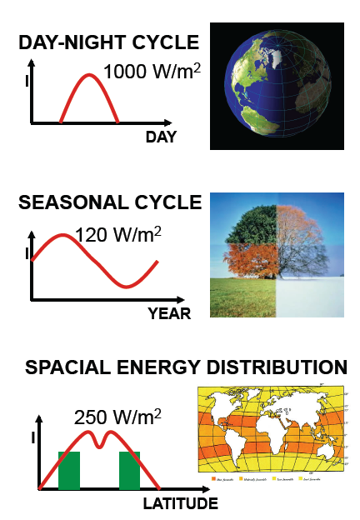
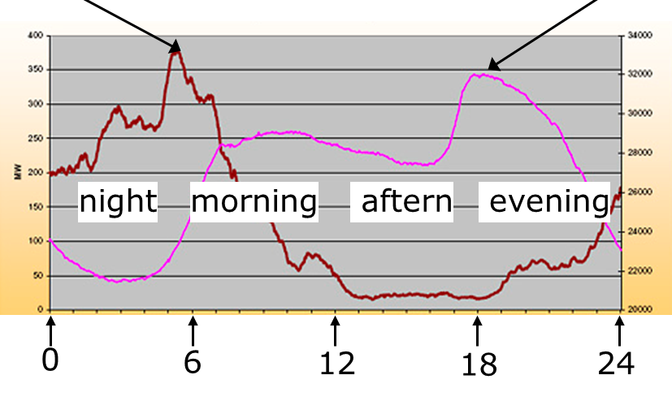
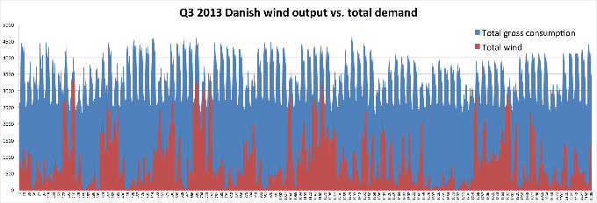
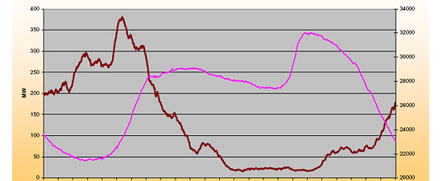
Energy storage: A challenge for renewables
Electricity from wind (California)
needed
Electricity needed
wind electricity
nacht
morgen
middag
avond
July
August
September
The transition to renewable energy requires suitable energy storage

Slide 9
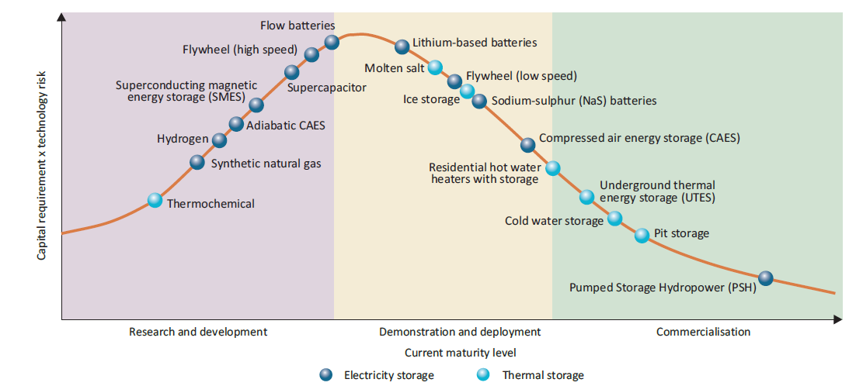
Energy storage: What options do we have?
Source: IEA 2014:Technology Roadmap for Energy storage

Slide 10

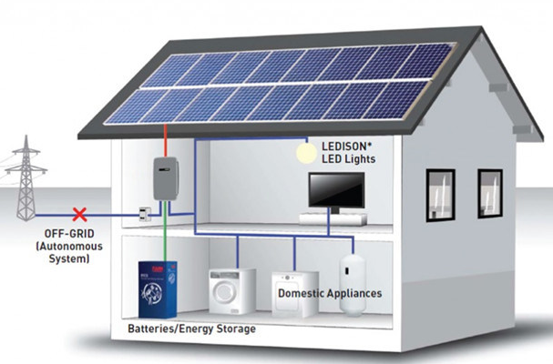
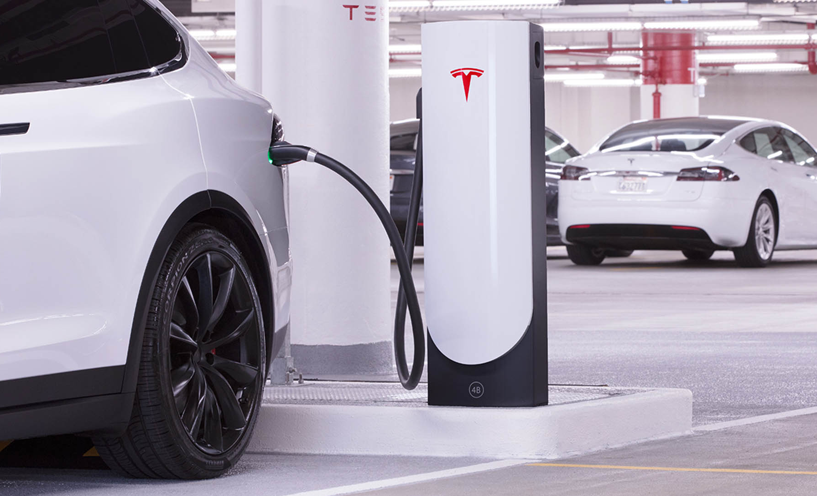
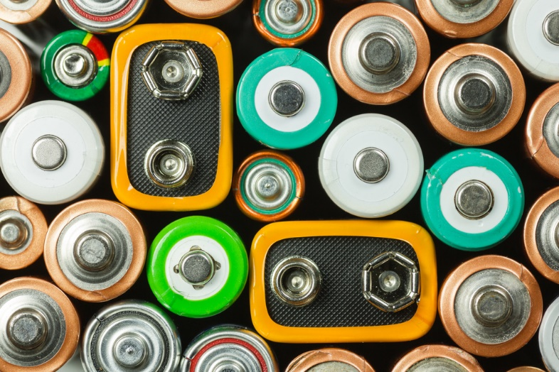
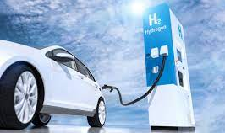

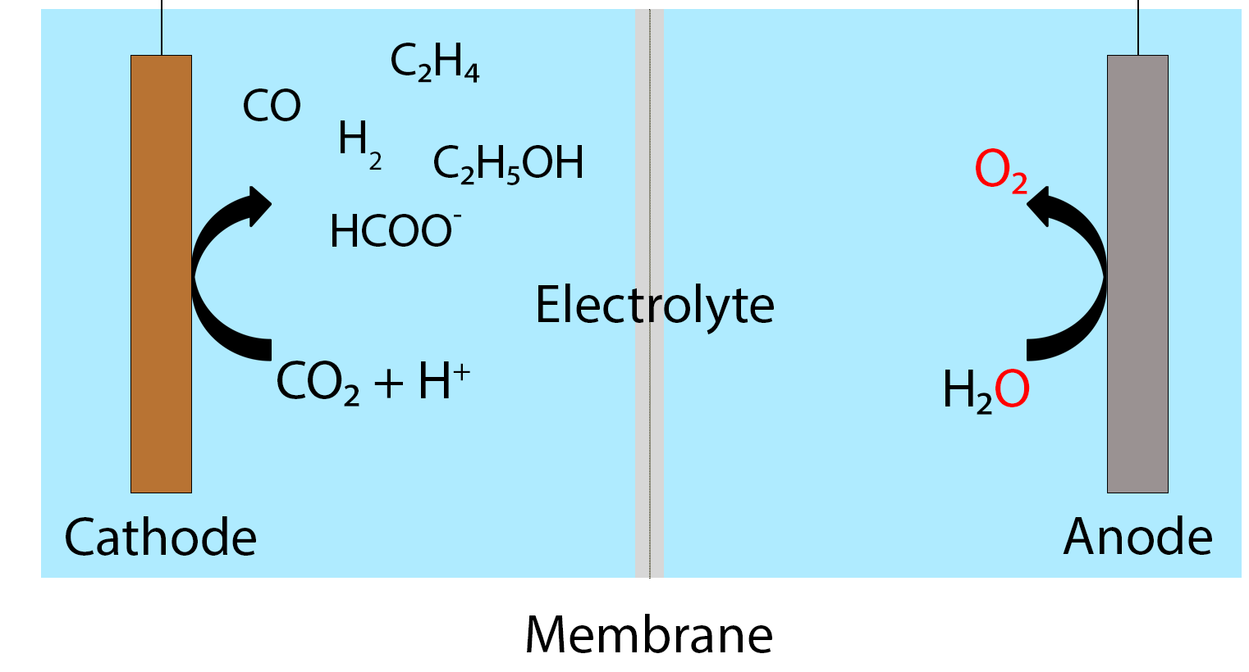
Motivation: Materials for energy conversion and storage
Electrolyzers
Hydrogen
Electricity
Fuel cells
Batteries
Fuel cells
Catalysis
CH₃OH
HCOOH
NH₃
H₂ storage

Slide 11
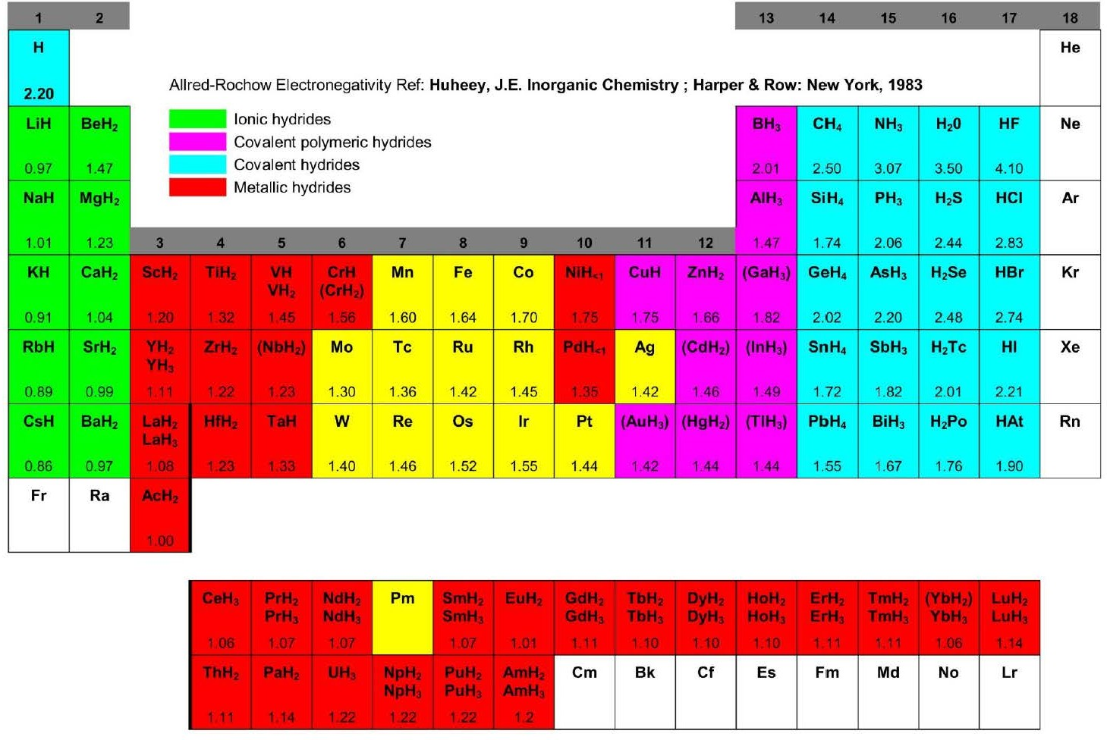
Hydrides: Multifunctional materials
11

Slide 12
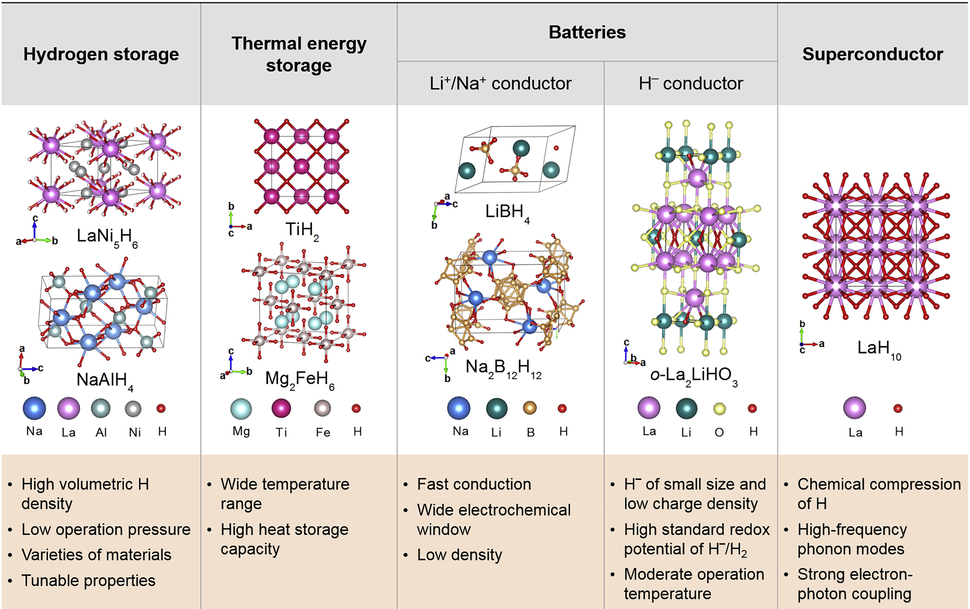
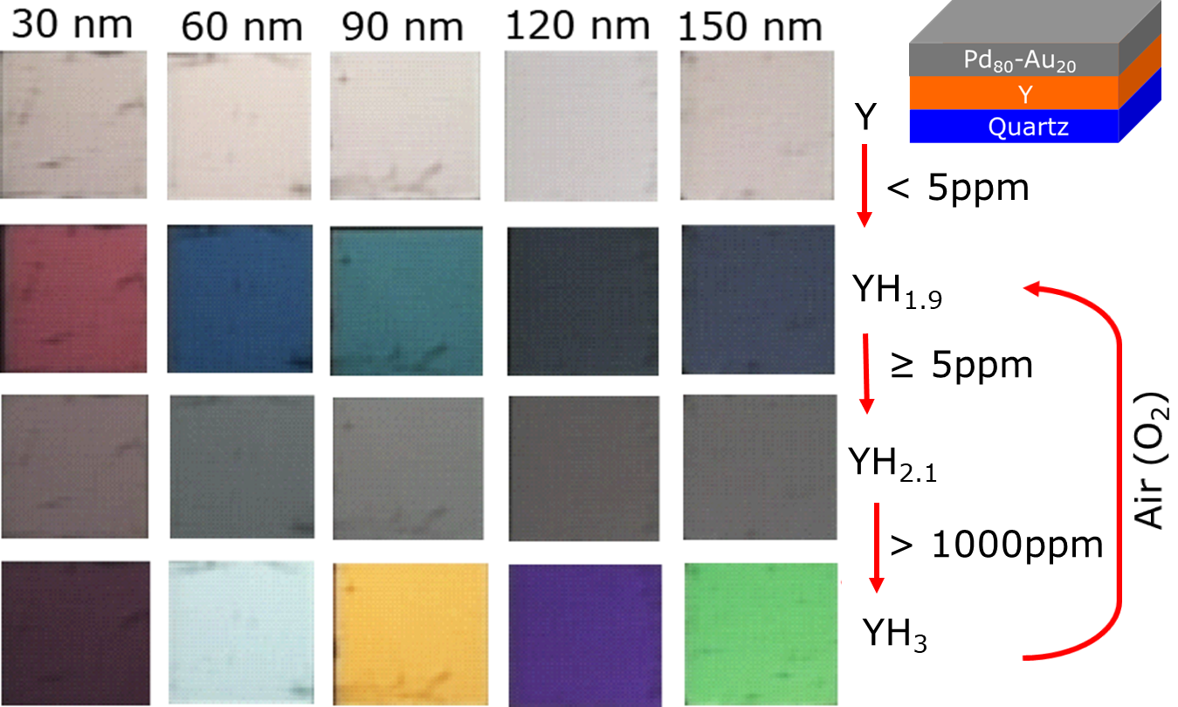
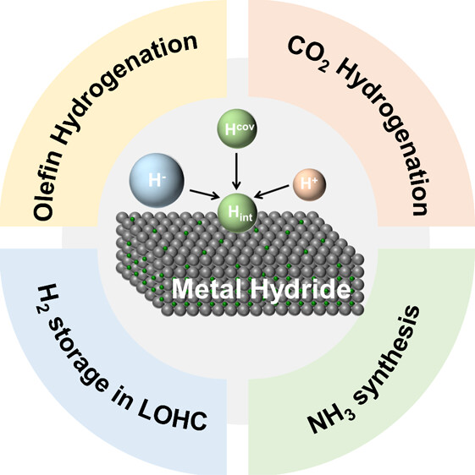
(Complex) metal hydrides: Multifunctional energy materials
H2 sensing/detection
Ngene, P. Dam, B. et al., Adv. Funct. Mater. 2014, 24, 2374. Nature Communications 2017, 8, 1846
Qianru Wang, et al. Joule, Volume 4, Issue 4, 2020, 705-709,
Catalysis
Catalysis
Luminescence
Sensing
Nuclear shield
Properties-Functionality relationship
Hongen Yu et al. ACS Catalysis 2024, 14, DOI: 10.1021/acscatal.3c05696
12

Slide 13
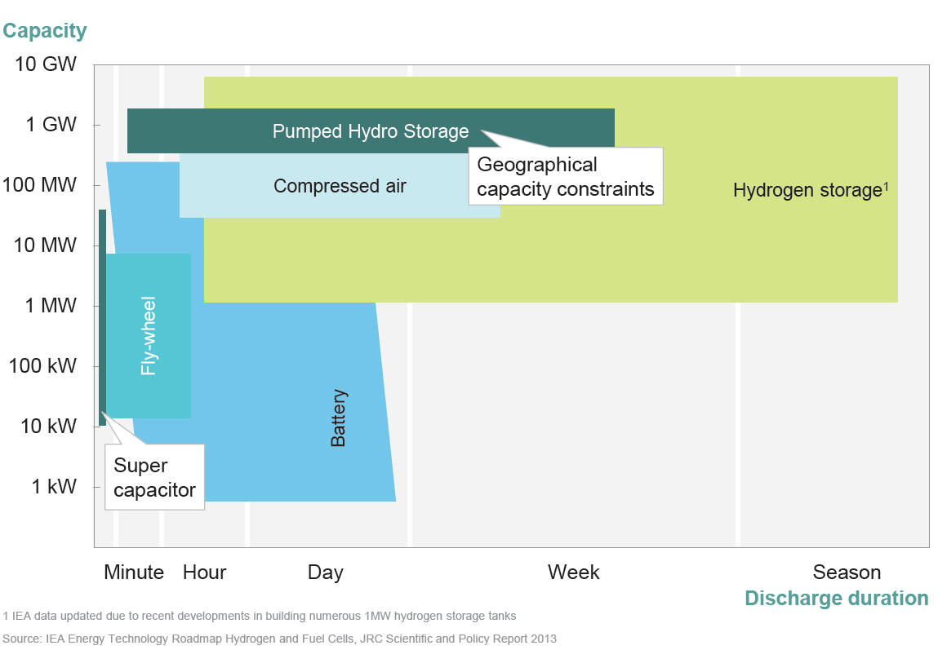
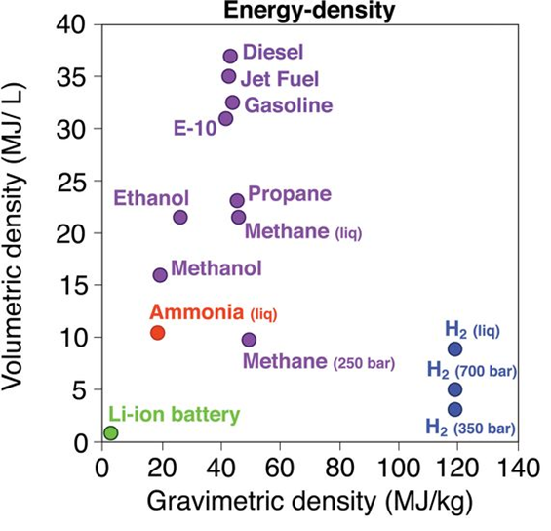
Hydrogen
Why hydrogen
From EC 2050 Scenario analysis by McKinsey
High Energy density
H₂ is most promising for long-term carbon-free seasonal storage
Züttel et al., Phil. Trans. R. Soc. 2010 vol. 368

Slide 14
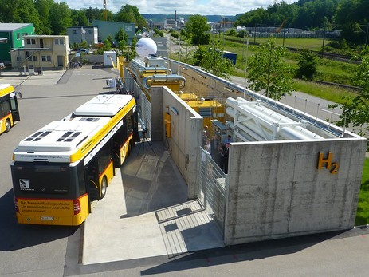
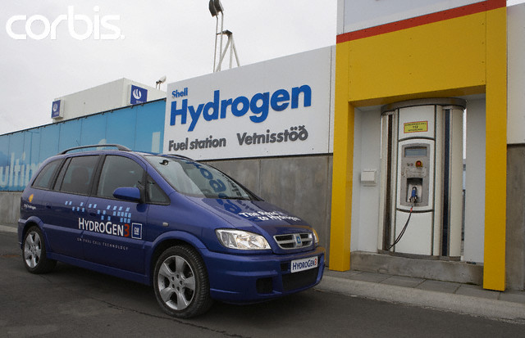
Why hydrogen storage?
Key figures:
35 kg of H₂ 350 bar regenerative breaking
>250 km range

Slide 15
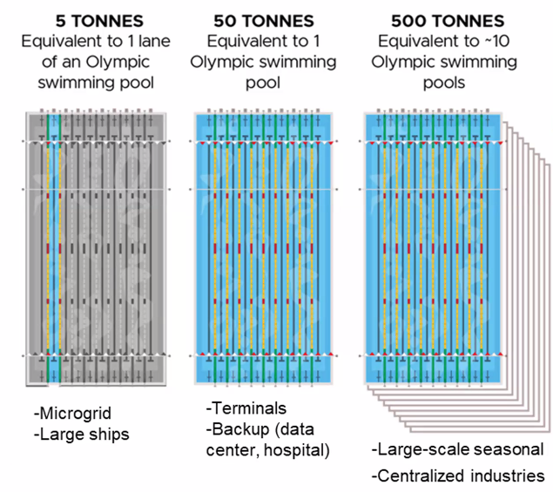

H₂ storage: why is it a big challenge ?
High gravimetric but low volumetric energy density
 | per kg [kWh/kg] | per liter [kWh/l]
Gasoline (liquid) | 12 | 8.6
Hydrogen (gas) | 33 | 0.003
Ambient conditions:
40 liter gasoline
34 x 34 x 34 cm
58,182 liter H₂ (5 kg)
3.9 x 3.9 x 3.9 meter
tank

Slide 16

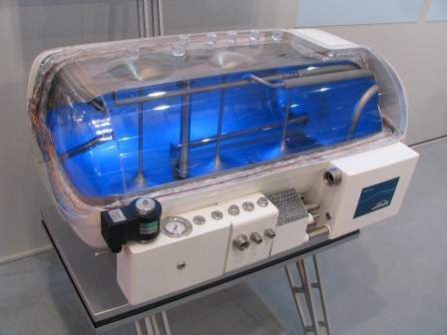
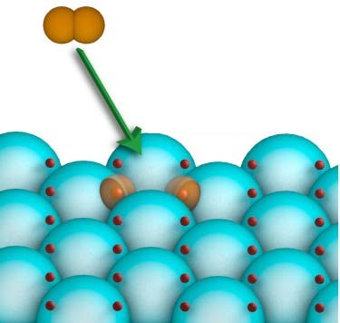

Hydrogen storage methods
High pressure cylinders
Liquid hydrogen storage (-253 °C)
Molecular adsorption on high surface area materials (OMMs)
Solid hydrogen storage in metals and alloys, complexes ( mgH₂, LiH)
ΔT, Δ P
LiBH₄ LiH + B +1.5 H₂
Ambient conditions:
40 liter gasoline
34 x 34 x 34 cm
58,182 liter H₂ (5 kg)
3.9 x 3.9 x 3.9 meter
45 kg LiBH₄
27 x 27 x 27 cm

Slide 17
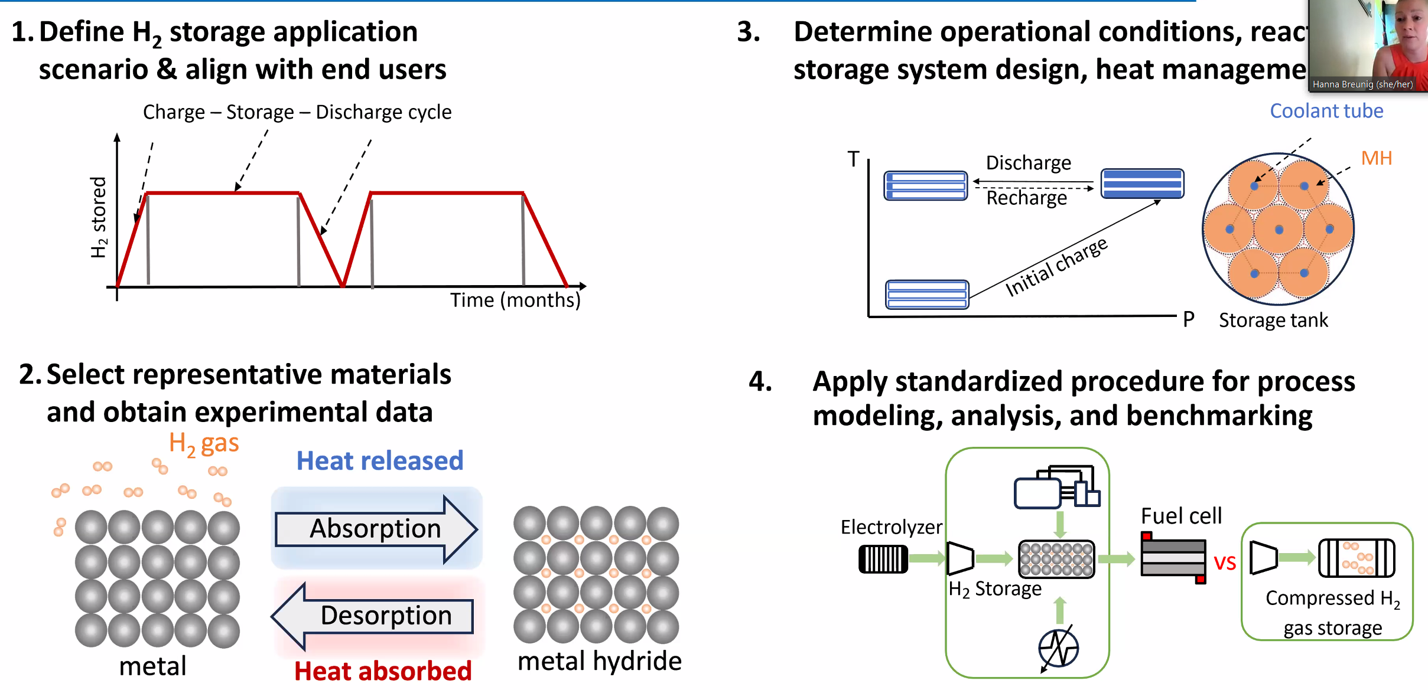
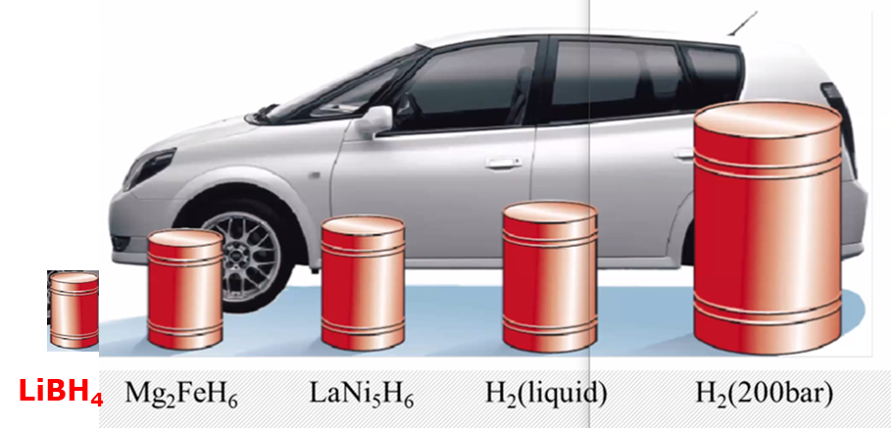
Hydrogen storage in metals (metal hydrides)
high storage capacity (weight, volume)
cost, mechanical properties
cycling stability
release by a trigger at relevant conditions
  Pressure
  Temperature
  UV light
  …

Slide 18
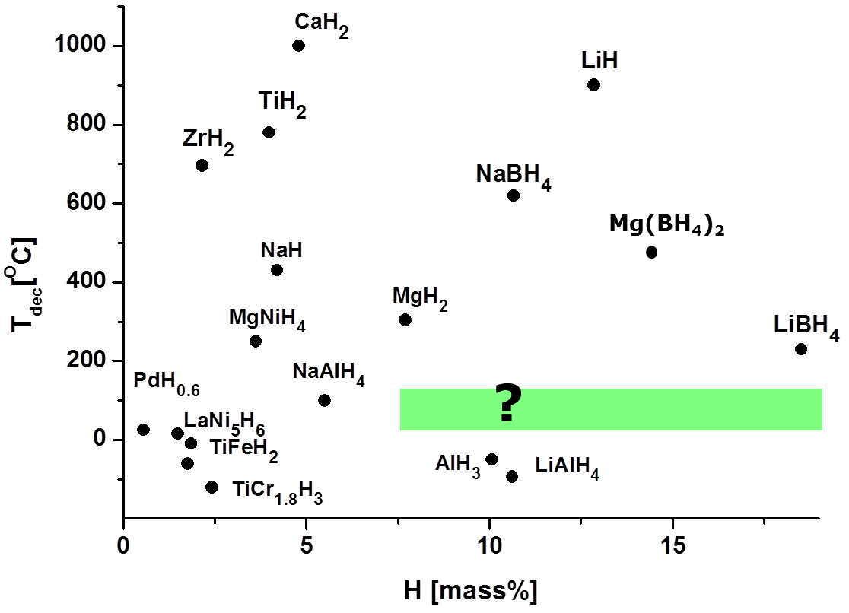
Reversible H₂ storage in metal hydrides
DOE Target: >5.5 wt% H₂ at 100-150 °C
Equilibrium decomposition
(1 bar H₂ equilibrium)
LiBH₄
Poor H₂ release kinetics
Poor reversibility (350 bar H₂, 650 °C for LiBH₄)

Slide 19
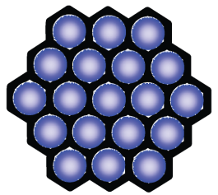
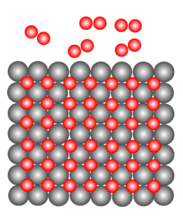
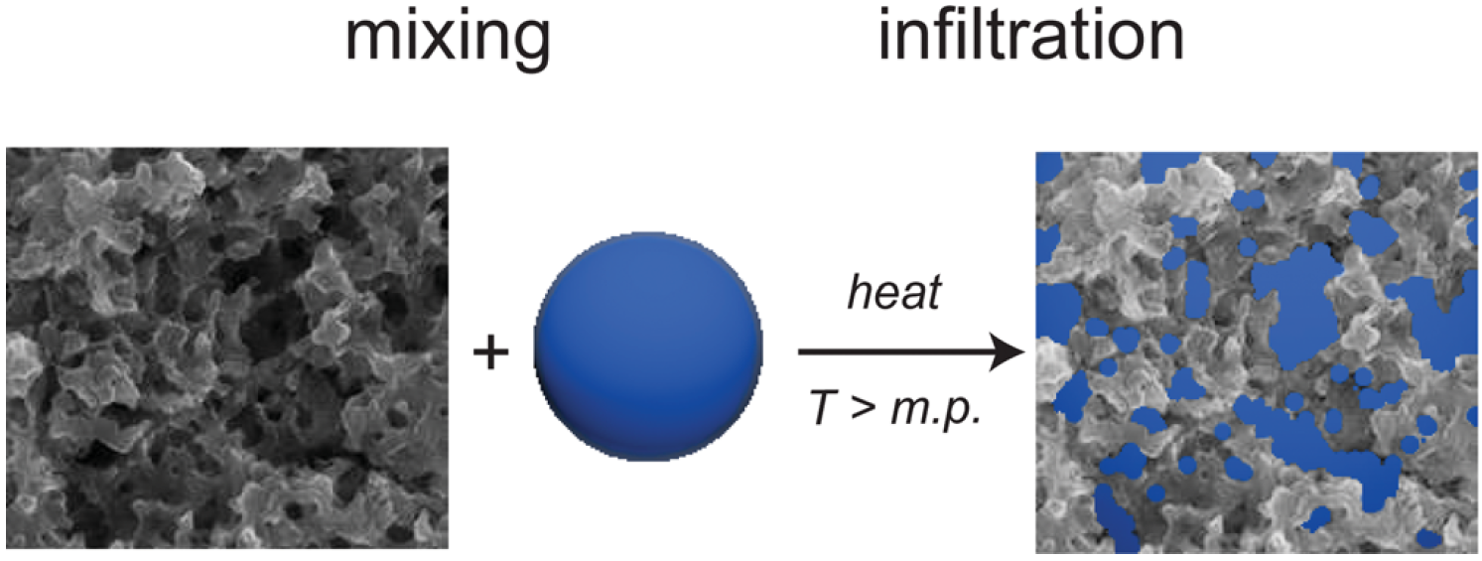
Approach: Interface engineering by nanoconfinement
Why Nanoconfinement?
Metal hydride
particle size effects
Hydride-support interaction
Restrict phase segregation
2LiBH₄ 2LiH + 2B + 3H₂
Clamping/physical constraint
Nanoscaffold
(carbon, MOFs, SiO₂)

Slide 20
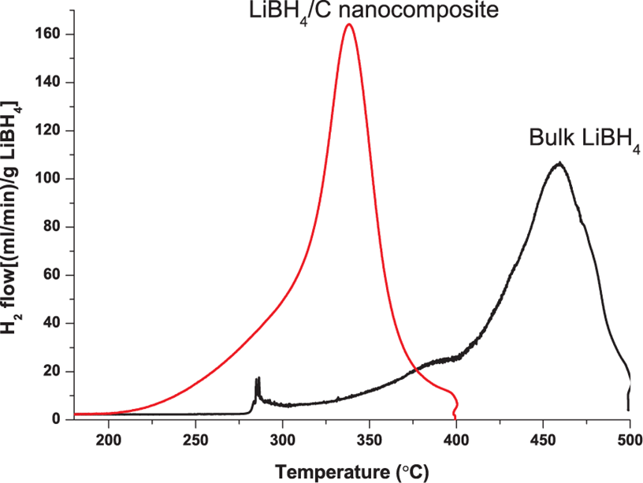
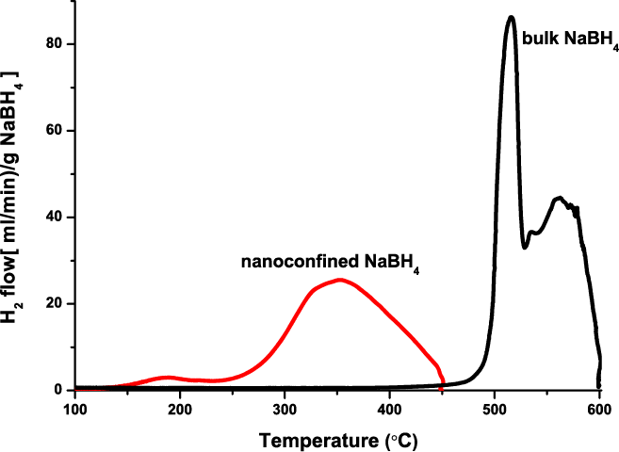
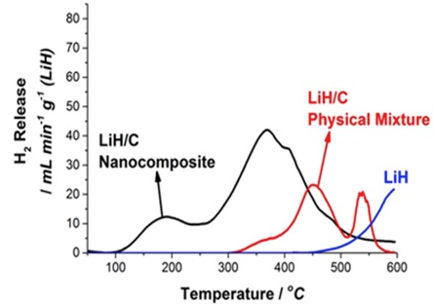
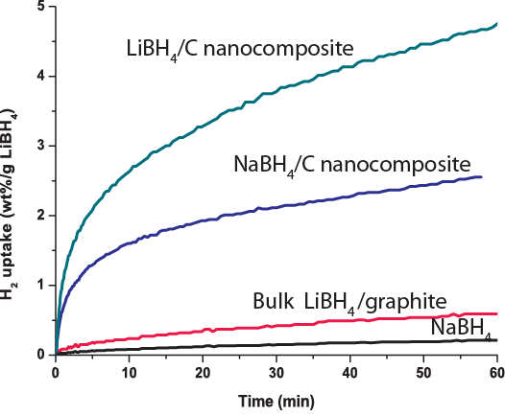
Reversible H₂ storage in nanoconfined metal hydrides
(8.1 wt% H₂)
(18 wt% H₂)
(13 wt% H₂)
(7.9 wt% H₂)
Reversibility (H uptake after decomposition)
What is the origin of the improved kinetics
Hydride-support interaction?
Change in decomposition pathway?
P. Ngene, A. P.M. Kentgens and P. E. de Jongh. et al Nano Energy 22, (2016)169
P.L. Bramwell, P. Ngene, P.E. de Jongh. Int. J. Hydrog. Energy 42 (2017) 5188
Ngene, de Jongh, et al. Energy Environ Sci. 2012, 4, 4108,
Chem. Commun. 2010, 46, 8201, Faraday Disc, 2011, 151,

Slide 21
Probing Nanocomposites with Xray Raman Scattering (XRS)
X-ray absorption
Thin samples required
High vacuum (all components)
Not in-situ
Concentrated samples due to low sensitivity
Mostly surface information (< 50 Å)
hole
Absorption of a photon with energy equal to the binding energy of the core electron (element specific)
For low absorption edges (Li, C, B, Na, F, N, Mg) soft XAS is used
Soft XAS: requires complicated experimental conditions

Slide 22
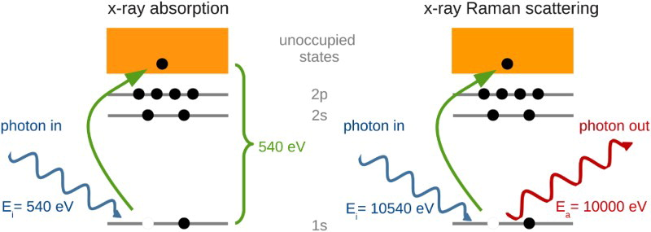
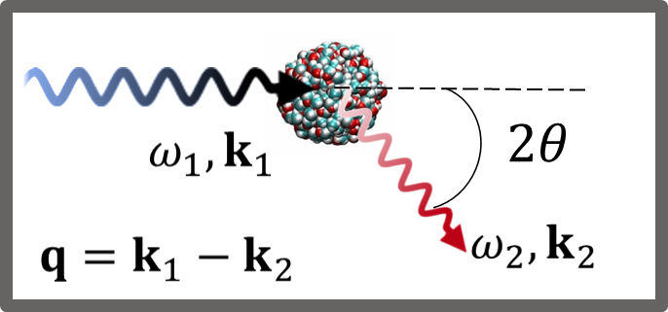
Interface composition: Xray Raman scattering (XRS)
Analyzer (fixed energy)
ΔE (E_{i}-E_{a})= BE
→ sample info
10,540-10000= 540 eV
Superb for light elements, overcomes experimental challenges of Soft XAS
Absorption of a photon with energy equal to the binding energy of the core electron
Similar to Raman scattering in optics
Core electron excited to continuum while a photon changes its energy from E_{i} to E_{a}
If ΔE (E_{i}-E_{a})= BE → sample info.
Scattering probability is angular dependent
U. Bergmann et al. Microchemical Journal 71 (2002) 221–230
S. Huotari, Ch. J. Sahle et al. J. Synchrotron Rad. (2017). 24, 521–530
Notes:
The process is in principle analogous to X-ray absorption (XAS), but the energy transfer plays the role of the X-ray photon energy absorbed in X-ray

Slide 23
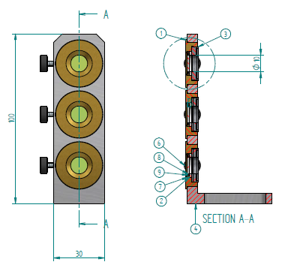

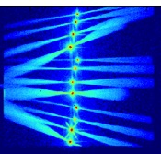
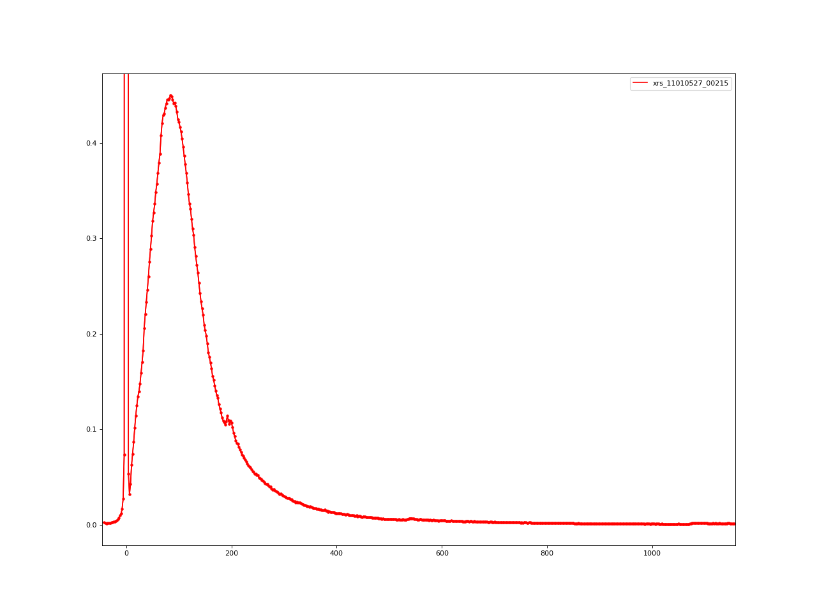
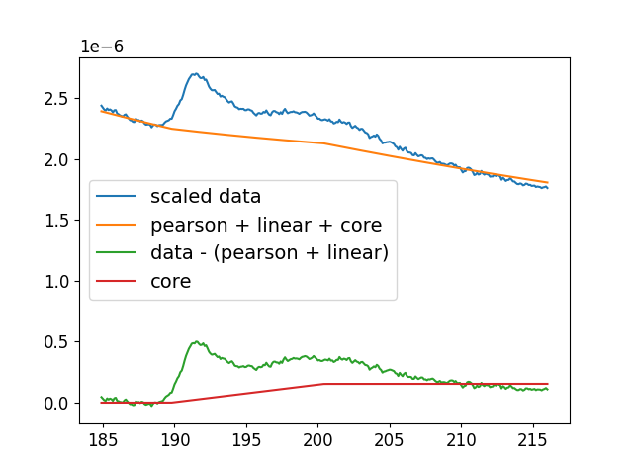

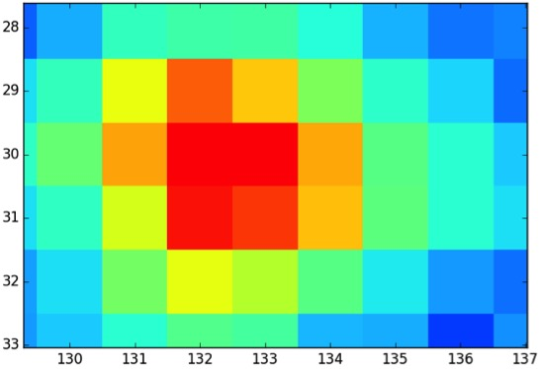
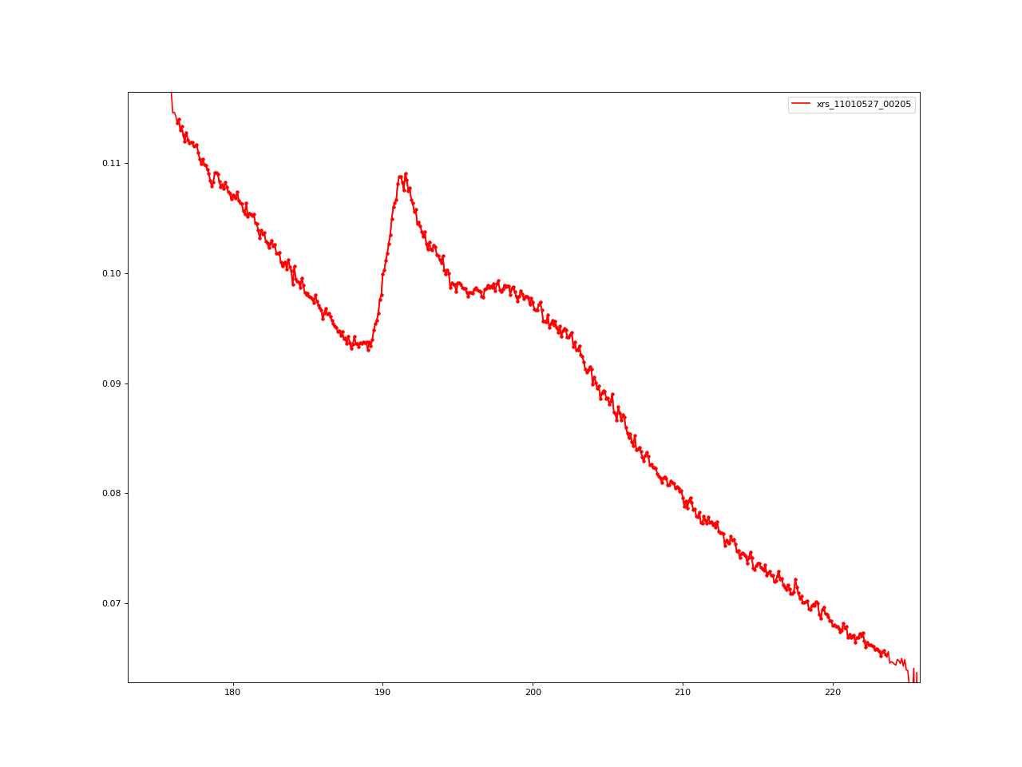
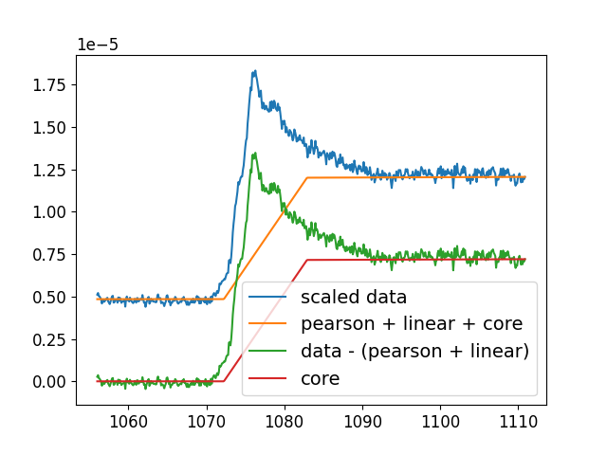
XRS measurements overview (SSRL, DESY, SOLEIL and ESRF)
Measurement cell
Output
Raw data
Normalized spectra
Intensity maps from
12 or 60 detectors
Addition of ROIs
of one scan
Addition multiple scans
and background substraction
Compton scan
B-edge
Scattered X-rays (E_{f})
X-ray beam(E₀)
B-edge
Na-edge
Sample
Kapton
Based on Sahle, C. J., et al. J. synchrotron radiation 22.2 (2015): 400-409.
17
11

Slide 24

XRS on LiBH₄/C nanocomposites
SSRL beamline BL6-2 ES2
Analyzer energy: 6.5 keV
Resolution of 0.3 eV.
Investigate the evolution of phases upon heating.
Bulk LiBH₄ shows different behaviour from nanoconfined
Miedema, Ngene, de Jongh, de Groot, et al. PCCP, 2012, 14, 5581–87, PCCP 2014, 16, 22651-58

Slide 25
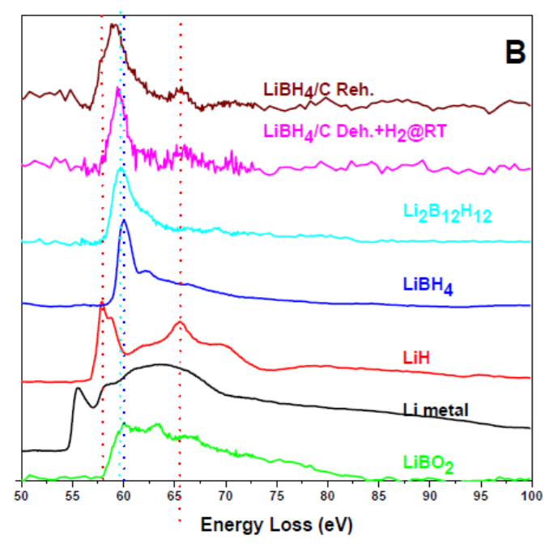
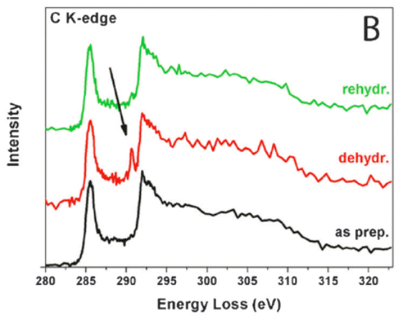
XRS on LiBH₄/C nanocomposites
B K-edge
Li K-edge
C K-edge
B-O bond?
Sample partially reversible so not completely B-O (LiBO₂)
Miedema, Ngene, de Jongh, de Groot, et al. PCCP, 2012, 14, 5581–87, PCCP 2014, 16, 22651-58

Slide 26
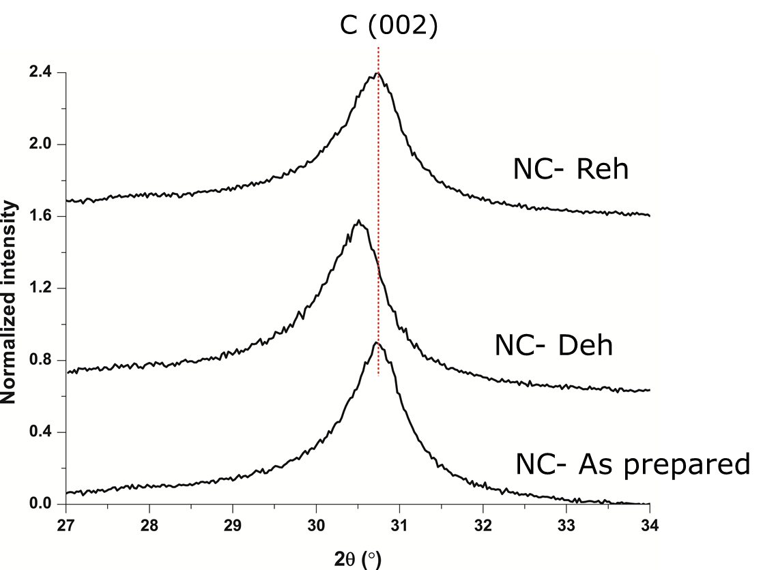
XRS on LiBH₄/C nanocomposites: Li intercalation?
LiBH₄ + 6 C ↔ LiC₆ + B + 2H₂ (18 wt.% H)
LiBH₄ ↔ LiH + B + 1.5 H₂ (13.5 wt.% H)
Li intercalation into the graphene layers stabilizes Li, destabilizes nanoconfined LiH
Ngene, de Jongh, et al. Nano Energy, 2016, 22, 169

Slide 27

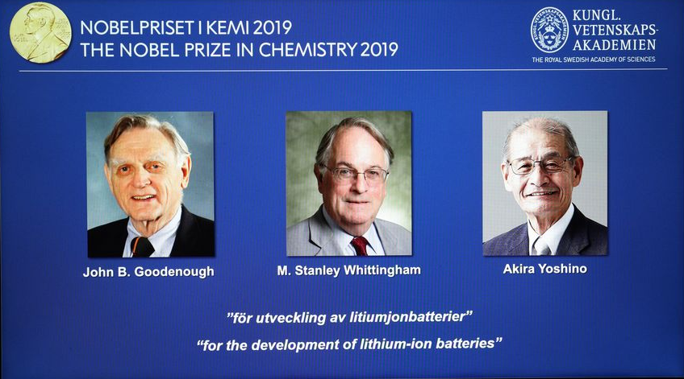



Solid electrolytes and rechargeable batteries
Nature( 2015), 526, S93
Notes:
In past decades rechargeable battery have emerged as high specific power portable energy storage devices
Extensively used in mobile phones, upcoming in electric vehicles and possibly utilized for large-scale on-site grid energy storage

Slide 28


Large scale electricity storage with batteries
13MW Lakeland Solar & Storage Project in Queensland Australia
Powers 4,015 average home air-conditioning units simultaneously for eight hours through the day
Project cost $17.4M (mostly due to batteries)

Slide 29


Battery and sustainability
Energy use by sector
Conventional car: combustion engine 8 liters per 100 km
8 liters of gasoline (heating value) = 70 kWh per 100 km
Electric vehicle:
20 kWh per 100 km
Electric cars are way more efficient compared to electric engines. Factor 3-4 !!
Batteries can transform chemical to electrical energy (and vice versa) with extremely high efficiency because the entropy change is very small
Transitioning to electric vehicles is a huge opportunity to save energy!

Slide 30

Increasing energy density, decreasing cost
Shirley Meng et al. Nature Energy 2022
Plackeet al., J. Solid State Electrochem. 2017, 21, 1939

Slide 31


Next-generation batteries

Slide 32



Limitations for Li-ion batteries
Eelectrolyte
LiPF₆, LiCFSO₃ in
high-boiling sol
vent (carbonates, ethers)
Safety issues
(evaporation and decomposition of electrolyte)
Limited Energy density
(new battery chemistry ASSB)
Anode
LiC₆
Cathode
LiCoO₂
High price of Li
(Na, Mg , other battery chemistries
P.C. Howlett et al. , J. Pow. Sources, 114(2003), 277-284

Slide 33

From liquid to solid electrolytes for batteries
Anode
LiC₆
Cathode
LiCoO₂
Anode
Li
Solid electrolyte
Cathode ( S)
Electrolyte
Improved safety: (prevent dendrites, high chemical and thermal stability)
Higher capacity electrodes (Li metal, sulfur: Li-S), 5-10 times increase in energy density
Inexpensive batteries: (Na, Mg, Cl- F- batteries)

Slide 34






Fast Li- and Na-ion conduction in complex hydrides
Hexagonal
~10⁻³ S cm⁻¹
at 120 ºC
n: concentration of ions q: ion charge
μ:mobility of ion carrier E_{a}: activation energy
Orthorhombic
~10⁻⁸ S cm⁻¹
at 30 ºC
High ionic conductivity but only at high T (LiBH₄ > 110 ºC)
Can the high-temperature phase be stabilized?
Matsuo & Orimo, Adv. En. Mater. 1 (2011) 161-172., Appl. Phys. Lett. 91 (2007), 224103
34

Slide 35


Approach: Interface engineering-Nanocomposite electrolytes
SBA-15 SiO₂
6 nm pores
Ngene, de Jongh et al, JPCC,114, (2010), 6167
D. Blanchard, P.E. de Jongh et al., Advanced Functional Materials 25.2 (2015): 184-192.
L. M. de Kort, V. Gulino, P. E. de Jongh, and P. Ngene, Journal of Alloys and Compounds 901 (2022): 163474.

Slide 36



ASSB-based on LiBH₄/SiO₂ nanocomposite
LiBH₄/SiO₂
bulk LiBH₄
Blanchard, Ngene, de Jongh, et al., Adv. Funct. Mater. (2015), 25, 184, ACS appl energy materials 2023,

Slide 37



Effect of different metal oxides
50 nm
25 v/v %
V. Gulino, et al., ACS Applied Energy Materials 3.5 (2020): 4941-4948.
9

Slide 38


Effect of different metal oxides, and hydrides
50 nm
About 1000 x increase in conductivity upon nanoconfinement
Applicable to Li, Na, and ion-substituted hydrides (LiBH₄-LiNH₂,)
The nature of the oxide influences ionic conductivity
A complex interplay between the properties of hydride and the oxide insulator
Gulino, Ngene, de Jongh, et al., ACS Applied Energy Materials 3.5 (2020): 4941-4948.
R. Zettl, L.M. de Kort, Ngene P. et al. Journal of Physical Chemistry C 124.5 (2020): 2806-2816.
L.M. de Kort, de Jongh P., Ngene P., et al. Journal of Materials Chemistry A 8.39 (2020): 20687-20697
L.M. de Kort, Ngene P., et al. Advanced Functional Materials 33 (2023) 2209122
9

Slide 39


XRS on LiBH₄/oxide nanocomposites
ID20 @ ESRF Grenoble
ID20 ESRF
Analyzer energy: 9690 eV
Resolution of 0.7 eV
Detector: Medipix (72: 12 X 6)
Imaging capability
2θ = 50–60°
2θ = 55° (DESY)
Notes:
At ESRF, the XRS spectra were collected using Medipix detectors (2D photon-counting X-ray detectors with a 55 µm spatial resolution) with an average q-vector of 4.1 to 4.9 Å⁻¹ (2θ = 50–60°). At DESY, the XRS spectra were collected using Medipix detectors with an average q-vector of 4.5 Å⁻¹ (2θ = 55°).

Slide 40


XRS: LiBH₄/SiO₂ nanocomposites
Presence of B-O bonds in the nanocomposites
Not completely oxidic B because LiBO₂, is not conductive
Si-O-BH_{x}Li? Interface composition depends strongly on the oxide used

Slide 41

XRS: LiBH₄/oxide nanocomposites
Conductivity is proportional to the amount of the trigonal B !
L. M. de Kort, M. Lazemi, A. Longo, V. Gulino, H. P. Rodenburg, D. Blanchard, C. Sahle, M. Sundermann, H. Gretarsson, A. M. J. van der Eerden, H. Elnaggar, F. M. F. de Groot, P. Ngene, Adv. Energy Mater. 2024, 2303381
V. Gulino, A. Longo, L. M. de Kort, H. P. Rodenburg, F. Murgia, M. Brighi, R. Černý, C. J. Sahle, M. Sundermann, H. Gretarsson, F. de Groot, P. Ngene, Small Methods 2024, 8, 2300833.

Slide 42


XRS: What have we learned?
Surface or interface interaction is crucial

Slide 43



Influence of oxide surface chemistry?
SBA-15 (6nm, 800m²/g)
SBA-15 (10nm)
~600m²/g)
Drying changes the silanol density and influences ion conductivity.
Surface interaction matters!!
Methyl-modified (functionalized) SBA-15 exhibits the lowest ionic conductivity!
P. Ngene, S. Lambregts, P.E de Jongh et al. PCCP 2019, 21, 22456 - 22466

Slide 44
Conclusions
(Complex) metal hydride nanocomposites are a promising class of energy materials: reversible hydrogen storage, solid electrolytes for batteries (also hydride ion conductors)
Interface effects play a crucial role in their properties
Synchrotron-based x-ray (and neutron) techniques are crucial to materials discovery
..there is still a lot to understand…!

Slide 45














Acknowledgement

Slide 46





Acknowledgement
Thank you
PO1
Martin Sundermann, Hlynur Gretarsson
ID 20:
Christoph Sahle, Alessandro. Longo

Slide 47


