Slide 1
The Impact of Industrial Synchrotron X-ray Powder Diffraction
BERND HINRICHSEN, CO-FOUNDER
MAX TERBEN, CO-FOUNDER
SEBASTIAN WINKLER, CO-FOUNDER
Notes:
Materials define human development
Their advance has announced societal changes through the eons
Momentum Transfer will power the future of materials
Their discovery
Their development

Slide 2
High Throughput

Slide 3
High Throughput

Slide 4
Our Solution
Sample changer
AUTOMATICALLY CYCLES THE HOLDERS THROUGH THE X-RAY BEAM
REGISTERS SAMPLE VIA QR CODE
ENSURES CONSISTENT POSITIONING
VIBRATES AND TRANSLATES TO PROBE LARGER SAMPLE VOLUME

Slide 6
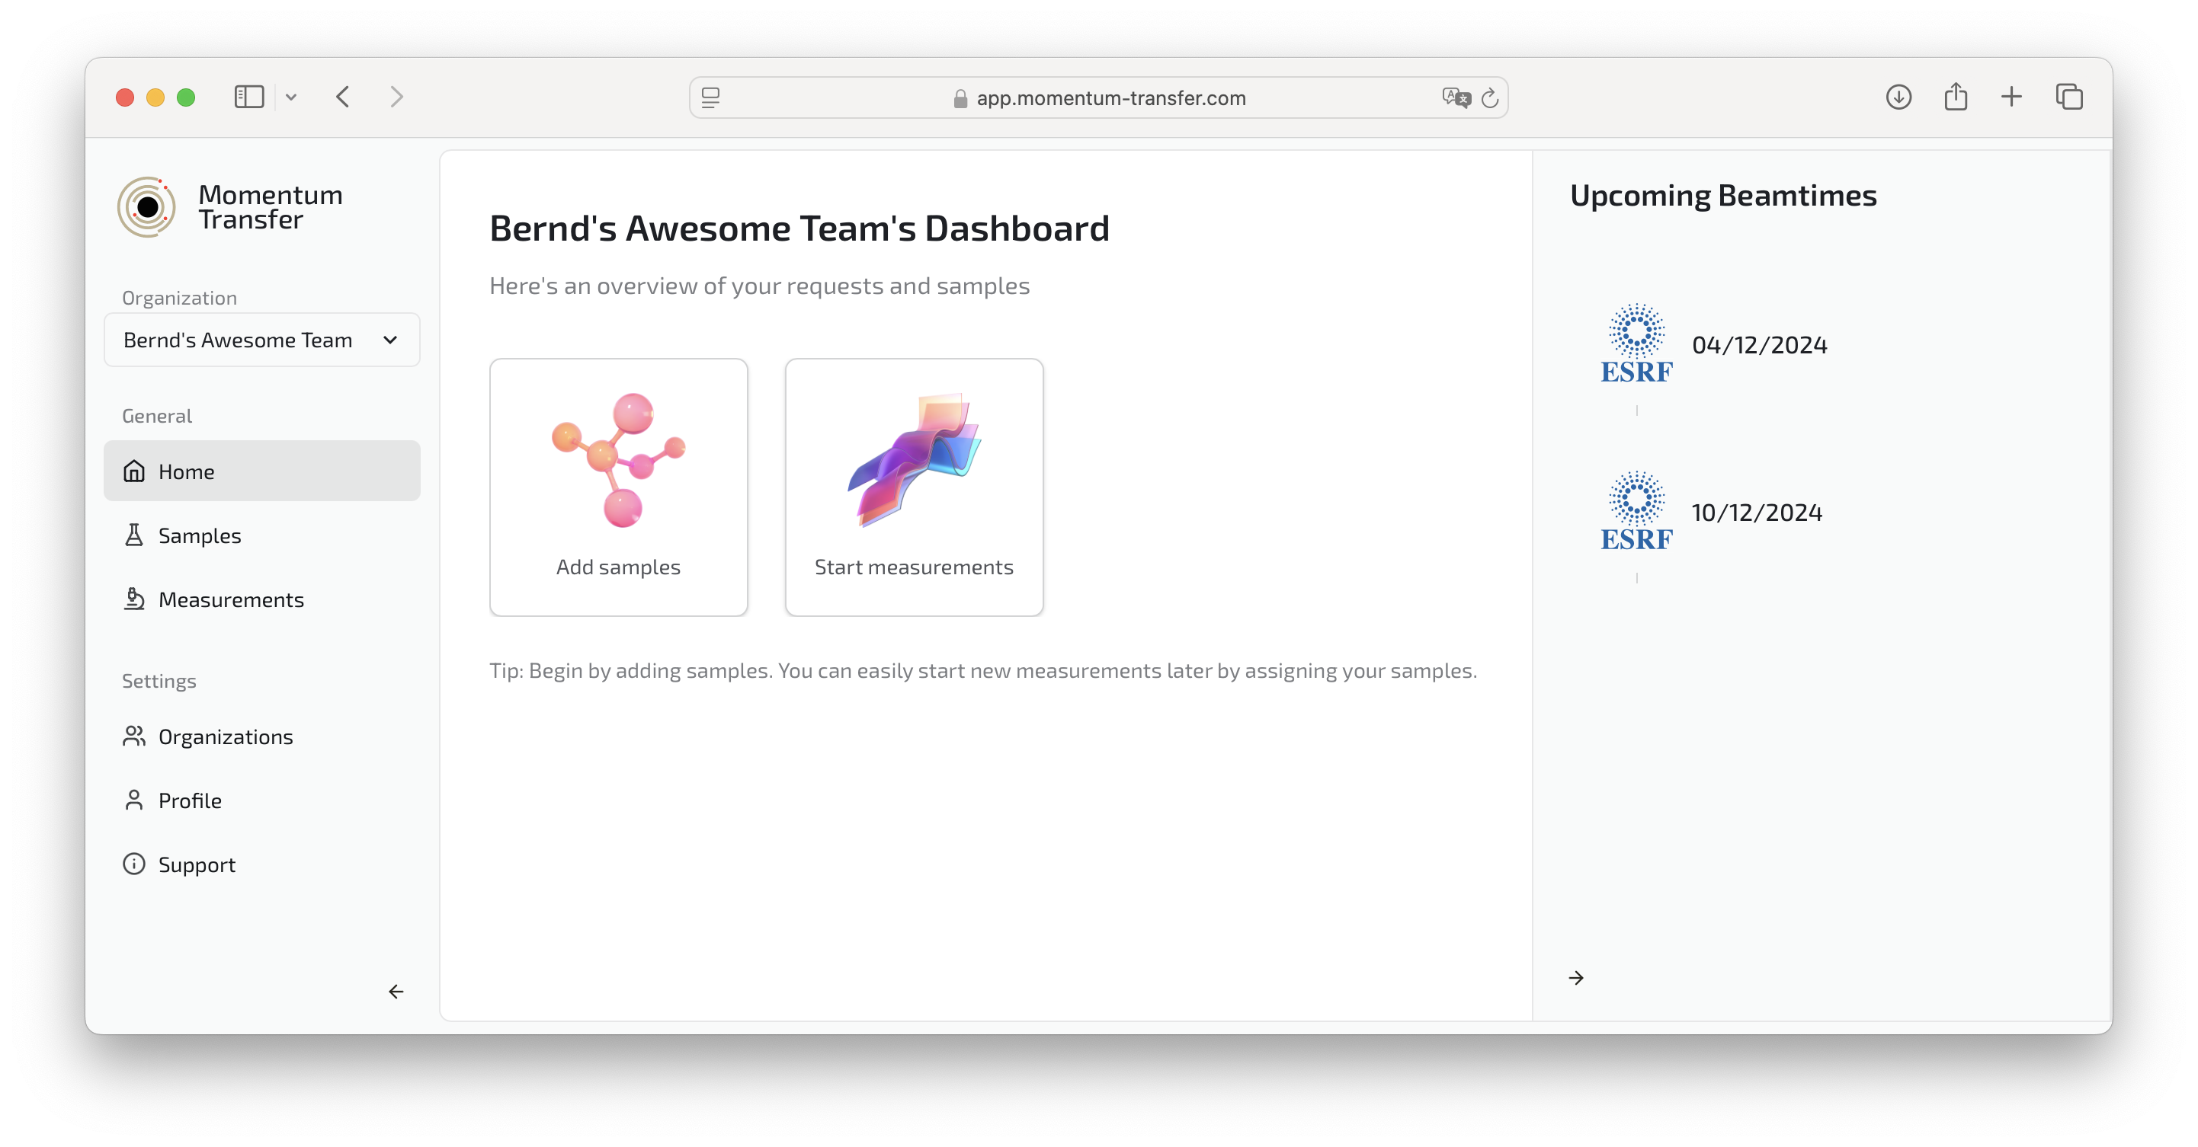
Our Solution

Slide 7
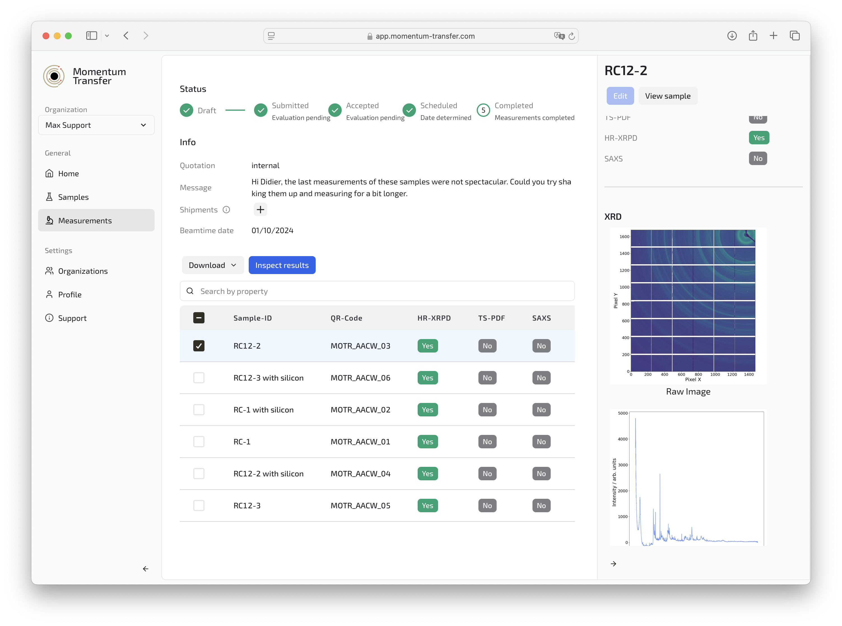
Our Solution

Slide 8
CAM Data

Slide 9
CAM Data

Slide 10
CAM Data
CRYSTALLITE SIZE
LATTICE PARAMETER
ANTI-SITE DISORDER
QUANTIFICATION
PHASE SEPARATION

Slide 11
PDF Data

Slide 12
Our Mission
RADICALLY CHANGE ACCESS TO SYNCHROTRON DATA
EMPOWER USERS WITH HIGHEST QUALITY INFORMATION
BUILD A COMMUNITY FOR SCIENTIFIC EXCHANGE
SUPPORT UNDER RESOURCED RESEARCH

Slide 13
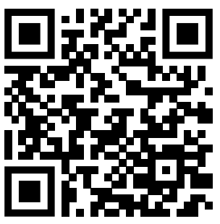
JOIN THE FUN!
OSCARS-MOMENTUM-TRANSFER.COM

Slide 14
JOIN THE FUN!
OSCARS-MOMENTUM-TRANSFER.COM

Slide 15
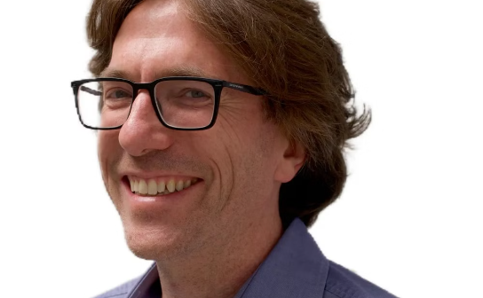
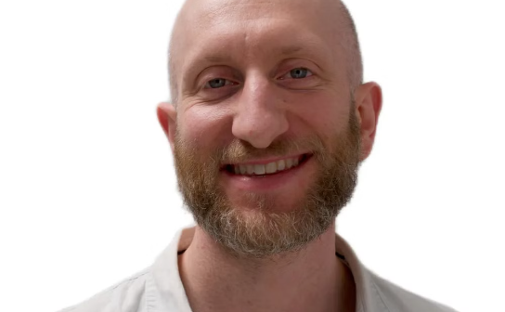
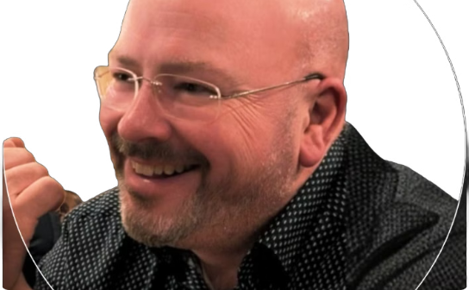
THE TEAM

Slide 16
THANK YOU!

