Slide 1





Exploration of the Earth’s Inner Core by using Synchrotron X-ray Radiation
E. Ohtani, D. Ikuta, H. Fukui, T. Sakamaki, D. Ishikawa, A. Q. R. Baron (Tohoku Univ, Okayama Univ, JSRI, RIKEN)
AfLS conference, 2024/11/18-22

Slide 2
Greetings from CPM (Commission of Physics of Minerals) of IMA
CPM covers
Earth Deep Interior
Spectroscopy, diffraction and new instrumentations in mineral physics
c) Glass and melt studies and their applications to geosciences and industry
d) Theoretical and computational mineral physics
We support strongly AfPS and AfLS joint activities and this conference
2

Slide 3
Central part of the Earth
Composition? States? Temperature?
COE
365GPa, 6000K
ICB
330GPa, 6000K
V_{p}, V_{s} (km/sec), ρ (g/cm³)
CMB 135GPa, 3000K
３

Slide 4
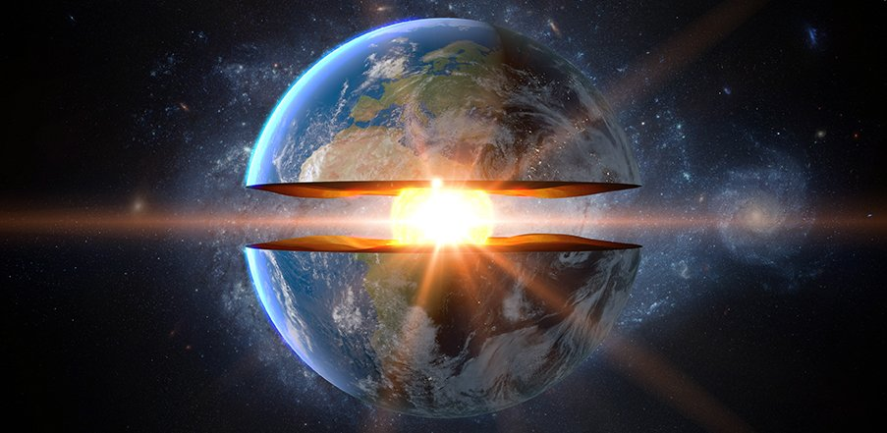
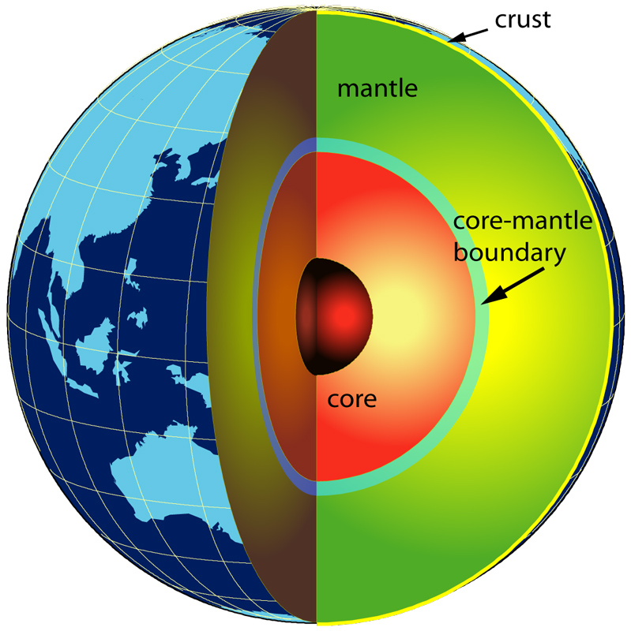
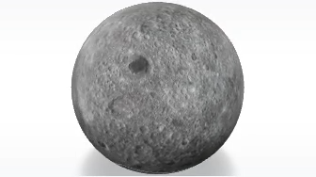
Inner Core of the Earth
Structure, Phase relation, Density, and Velocity:
Structure: hcp vs bcc
Density: light elements:
Moon
Earth
R= 1737 km
R= 1212 km
Inner Core: Smaller than Moon, but extreme conditions of 330-365 GPa and 5000-9000 K
４
１

Slide 5
Inner core: Possible constituents
・hcp iron-light elements: Popular idea
・bcc (or B2) iron-light element alloy:
Theory: Belonoshko et al., 2003; Vocadlo et al., 2003
Experiment: Dubrovinsky et al. (2007) and Ikuta et al. (2021)
・hcp and bcc (or B2)
Fischer and Campbell (2015), Ikuta et al. (2021)
5

Slide 6
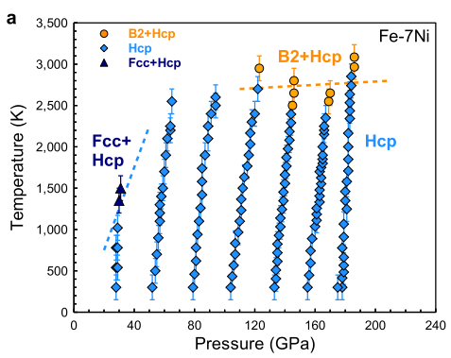
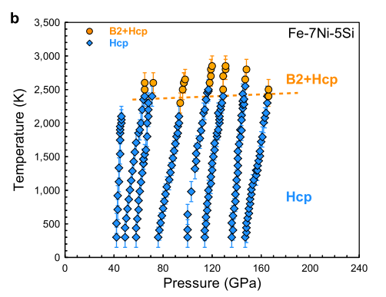
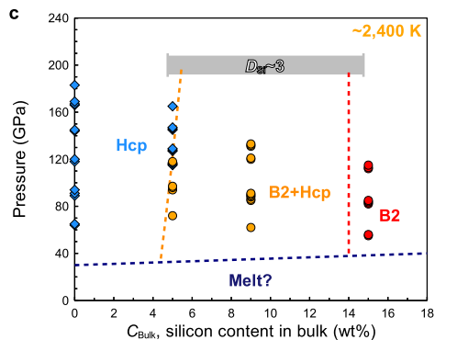
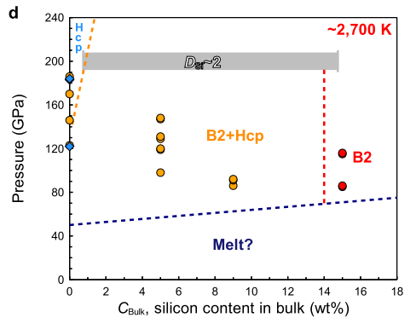
Inner Core may be composed a mixture of hcp- and B2-FeNiSi alloys
(Ikuta et al., 2021)
6

Slide 7
Sound velocity measurement of Fe-Ni-Si alloy to the Core Pressure by IXS
・B2-Fe_{0.68}Ni_{0.06}Si_{0.26} alloy to 130 GPa
and 2300 K
７
Notes:
Here, I would like to show our recent works on light elements in the inner core.
Phase relations of iron-nickel-silicon system,
And sound velocity of the iron and iron-alloy

Slide 8
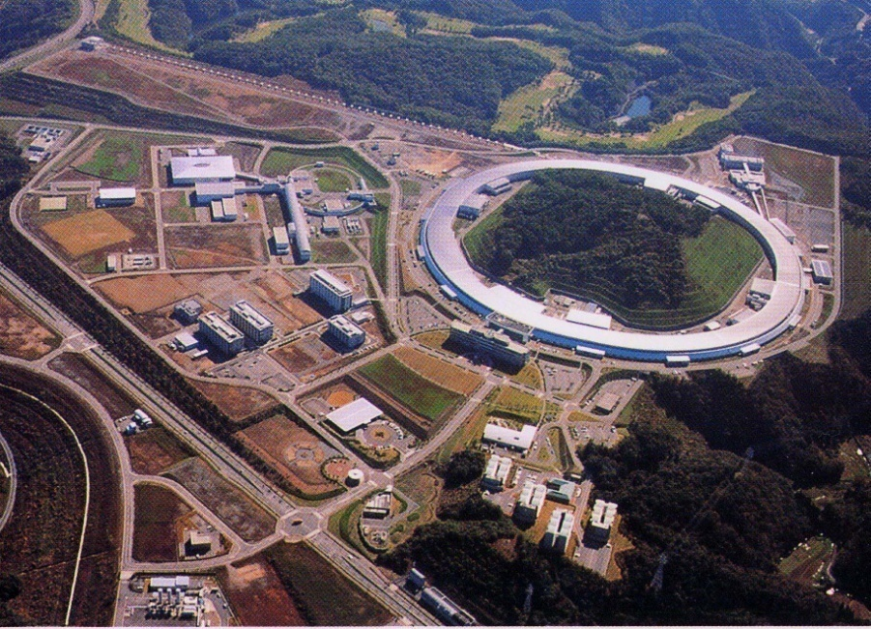
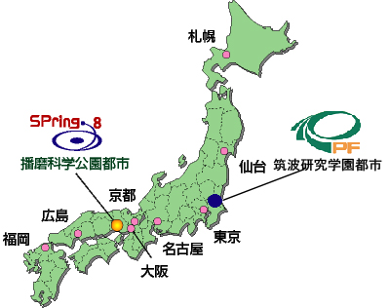
Facility: SPring-8, JASRI
Run under commission by the Japan Synchrotron Radiation Research Institute (JASRI)
The machine consists of a storage ring containing an 8 GeV electron beam
SPring-8
Photon Factory
8

Slide 9
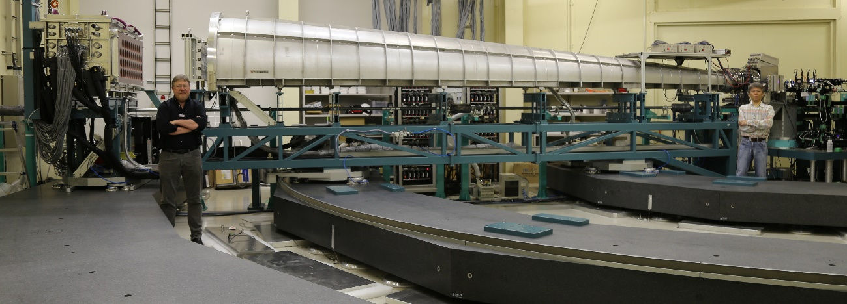
Method: IXS
Sound velocity of B2-Fe_{0.68}Ni_{0.06}Si_{0.26} alloy
BL43LXU@SPring-8
Baron et al. (2016; 2019)
DAC with 70-100 μm culet anvils to 130 GPa
The Si (9 9 9) reflection at 17.79 keV, a resolution of 2.8 meV.
A fine focused beam of 5 μm × 5 μm by a multilayer K-B mirror pair
We installed a Soller screen, a new slit system [Baron et al., 2019].
９
Notes:
This is the IXS beamline of BL43LXU of SPring-8.
DAC with 50 μm culet anvils to 13.2 g/cm3 (250 GPa)
Rhenium gasket without pressure medium
Powdered Fe sample was used for the experiments.
The Si (9 9 9) reflection at 17.79 keV, a resolution of 2.8 meV.
A fine focused X-ray beam of 5 μm × 5 μm by a multilayer K-B mirror pair
We installed a Soller screen, a new slit system [Baron 2019] to improve S/N ratio of the measurements.
9

Slide 10

Method: Sound velocity of Metals
E2 k2
photon
IXS (Inelastic X-ray scattering)
E1 k1
photon
phonon
Q
Energy transfer E1-E2= E
Momentum transfer k1-k2 =Q
・Fiquet et al. (2001) Fe-Vp @ESRF
・Antonangeli et al. (2004) :
Fe Anisotropy of Vp
・Z.Mao et al. (2012) Fe and FeSi
at HP and HT @APS
Sound velocity
E, meV
Phonon dispersion
Q
nm⁻¹
Baron @BL43LXU, Spring-8
10

Slide 11
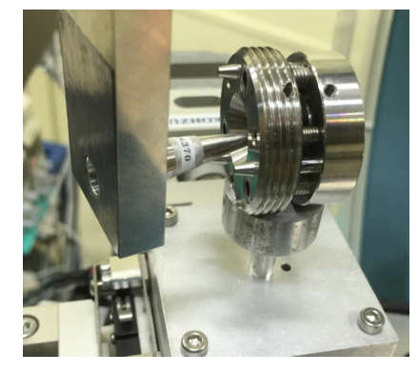
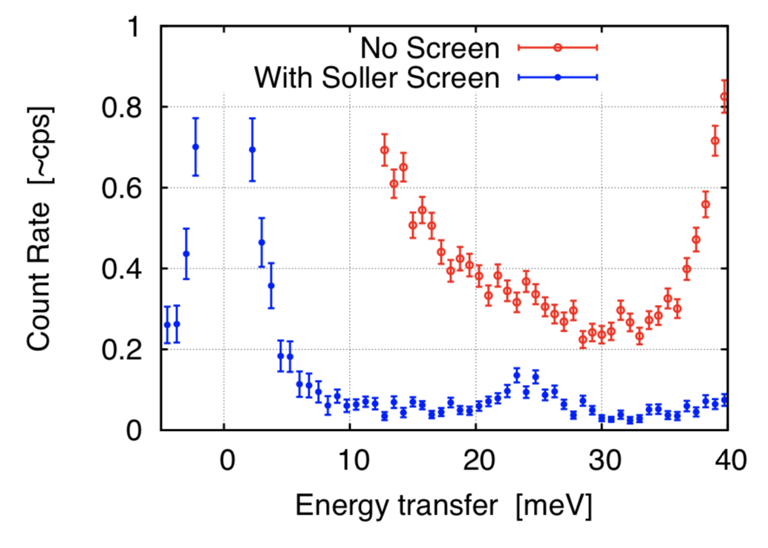
Optics :“Soller Screen” (Baron et al., 2019)
HP DAC work limited by background from diamonds (or Re gasket)
ie: parasitic scattering from within a few mm of the sample
Usual Solution:
(One Detector)
A small slit near the sample to limit the
view to only the sample
Would like a Soller slit but spacing is prohibitively small (~50 um slits needed)
“Soller Screen”: Two Flat W plates at 5 mm and 10mm from the sample with laser cut slots
Accepts beam to every second analyzer (24→12) and drastically
reduces the background
Soller Screen
DAC
９
11

Slide 12
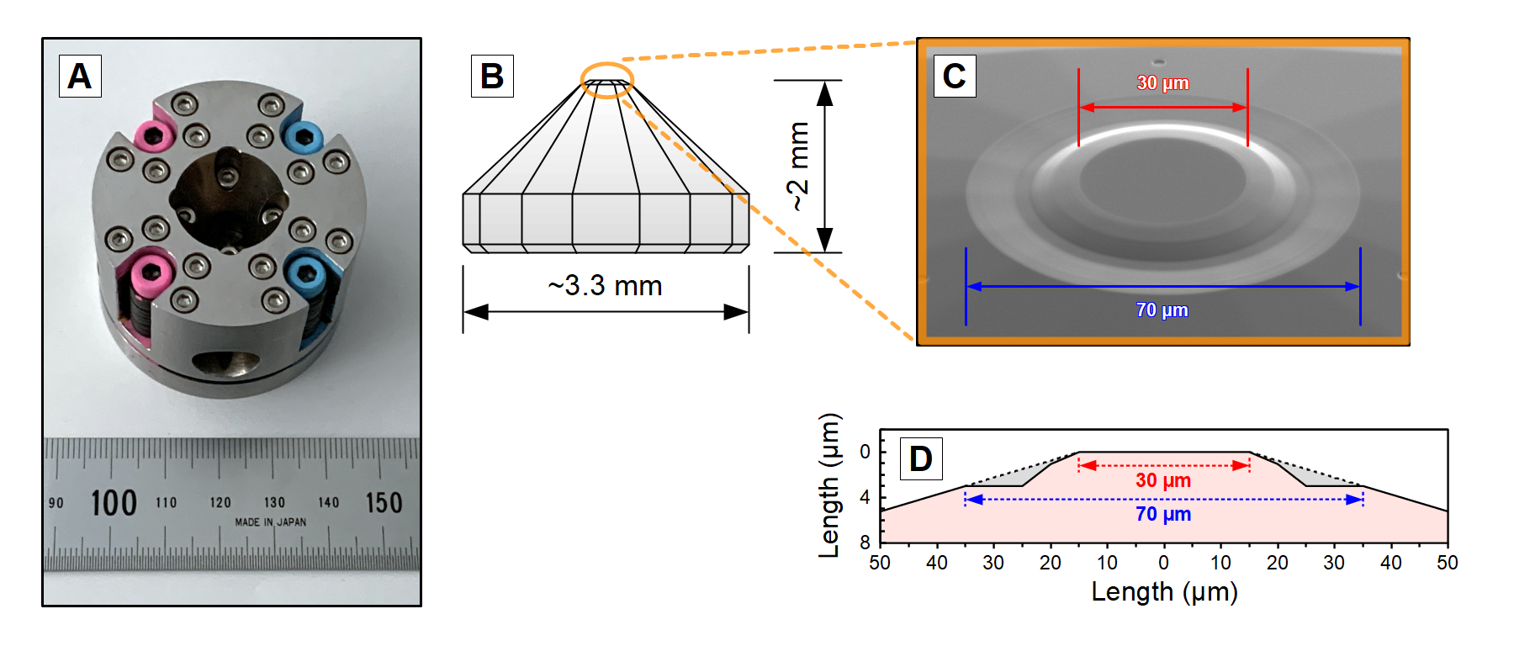
Pressure generation:
Diamond anvil cell
Caption: The diamond anvil cell used in this experiment. (A) Symmetric Diamond Anvil Cell, (B) Schematic diagram of a diamond anvil. Orange circle is the area corresponding to (C, D) (C) Image of the top of the (stepped beveled) diamond anvil designed for IXS measurement at ultrahigh pressure, (D) Cross-section of the diamond anvil corresponding to (C). Similar design to Toroidal cell (Fei et al., 2016, Dewaele et al. 2018).
12

Slide 13
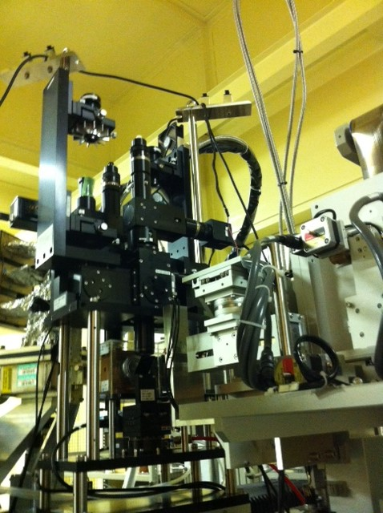
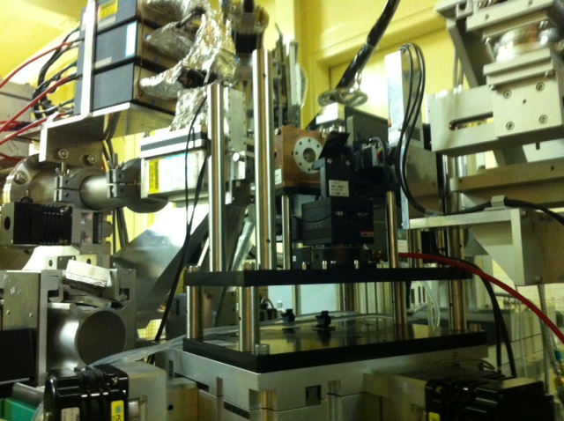
Heating:
Portable Laser heating system for IXS: COMPAT
COMpact system for generating extreme Pressures And Temperatures (Fukui et al., 2013)
31 hours stable heating at 2300 K and 10 hours heating at 3000 K
COMPAT
X-RAY
DAC
DAC
Laser: air-cooled fiber laser (SPI redPOWER R4, maximum output is 100 W
13

Slide 14
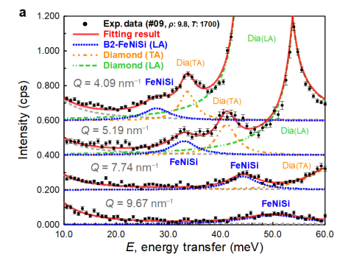
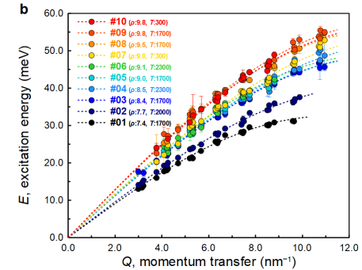
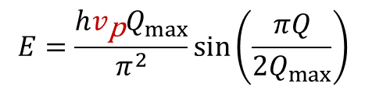
Results:
Sound velocity of B2-Fe_{0.68}Ni_{0.06}Si_{0.26} alloy
Compressional velocity Vp to 130 GPa at 1700 K by IXS
130 GPa and 1700 K
Data correction: ~12 hours at room temperature, ~6 hours at high temperature
$$E=\frac{h{v_{\text{p}}Q}_{max}}{π^{2}}\sin\left(\frac{πQ}{2Q_{max}}\right)$$
14
Notes:
This is the inelastic X-ray scattering spectra for different momentum transfer Q values at 250 GPa which is the highest pressure.
We observed LA compressional velocity mode of hcp-iron, and TA shear mode of diamond from DAC.
This is the dispersion curves at various pressures.
Vp can be expressed by this sine curve: $E=\frac{h{v_{\text{p}}Q}_{max}}{π^{2}}\sin\left(\frac{πQ}{2Q_{max}}\right)$
Sine curve fitting of this curve provide the Vp at high pressures.

Slide 15
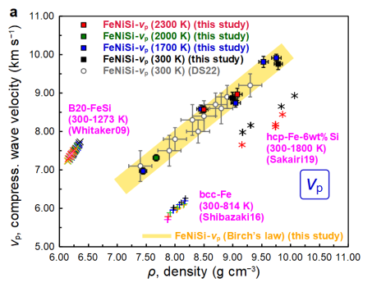
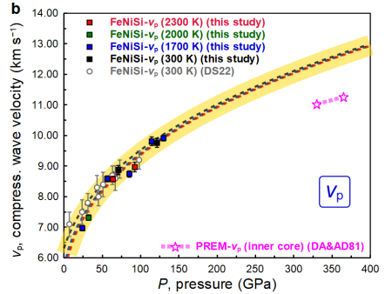
The v_{p}‒ρ relation of B2-Fe_{0.68}Ni_{0.06}Si_{0.26} at various temperature
The pressure dependency of v_{p}
B2-Fe_{0.68}Ni_{0.06}Si_{0.26} alloy shows
No temperature dependency in Vp−ρ relation
15

Slide 16
Extrapolation to the inner core : Inner core boundary (ICB) and Center of the Earth (COE)
COE
365GPa, 6000K
ICB
330GPa, 6000K
16

Slide 17
The most common candidates of the light elements in the inner core: Si and S: A Mixture of Fe-Ni, Fe-Ni-Si and Fe₃S
The density and Vp were extrapolated to ICB (330GPa, 6000K) and COE (365 GPa, 6000K) conditions.
Density dependency of V_{p} for B2 Fe-Ni-Si alloy (This work)
v_{p} (m s⁻¹) = 1.22(±0.04) ρ (kg m⁻³) – 2.04(±0.34)×10³ (m s⁻¹)
Density dependency of V_{p} for hcp Fe-Ni alloy and Fe₃S (similar to hcp-Fe: Ikuta et al., 2021)
v_{p} (m s⁻¹) = 1.162(±0.015) ρ (kg m⁻³) – 3.45(±0.166)×10³ –2.5(±0.2) ×10⁻⁵(T-300)(19.2-ρ) × 10³(m s⁻¹)
17

Slide 18
Averaging of V_{p} and ρ of the three-component mixtures of hcp-FeNi, B2-FeNiSi, and Fe₃S (Badro et al., 2007; Fischer and McDonough, 2024)
Density: Voigt Average
ρ_{m} = xρ₁+ yρ₂ +(1-x-y) ρ₃, where x, y is the volume fractions of the components 1, and 2
Sound velocity, V_{p} : Reuss Average
1/V_{m} = x/V₁ + y/V₂+ (1-x-y)/V₃, where x, y is the volume fractions of the components 1, and 2
18

Slide 19
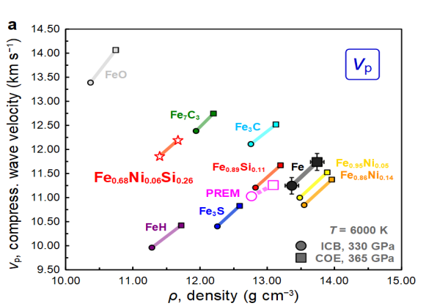
Comparison of v‒ρ relations between iron alloys B2-Fe_{0.68}Ni_{0.06}Si_{0.26} and hcp-Fe_{0.95}Ni_{0.05}, and Fe₃S with PREM (ICB at 6000 K)
ICB at 330 GPa and 6000 K
330GPa, 6000 K
B2
hcp
PREM-Inner Core (ICB) contains 4.5±0.7wt%Ni, 3±1wt%Si and 3±2wt%S, when it is composed of hcp and B2-FeNiSi alloys and Fe₃S.
19

Slide 20
Comparison of v‒ρ relations between iron alloys B2-Fe_{0.68}Ni_{0.06}Si_{0.26} and hcp-Fe_{0.95}Ni_{0.05}, and Fe₃S with PREM (COE at 6000 K)
COE at 365 GPa and 6000 K
365GPa, 6000 K
B2
hcp
PREM-Inner Core (ICB) contains 3.0±0.7wt%Ni, 1±1wt%Si and 7±2wt%S, when it is composed of hcp and B2-FeNiSi alloys and Fe₃S.
20

Slide 21
Compositional difference between ICB and COE
ICB: Si (± O, C) rich, B2-FeNiSi rich
i.e. High temperature component-rich (Shallow Inner Core)
COE: S (±Ni) rich, B2-FeNiSi depleted
i.e. Low temperature component-rich (Deep Inner Core)
Center of the Inner Core is low temperature component (S)-rich, whereas ICB is high temperature component (Si)-rich
Overturning by convection or lopsided growth of the Inner Core
21

Slide 22
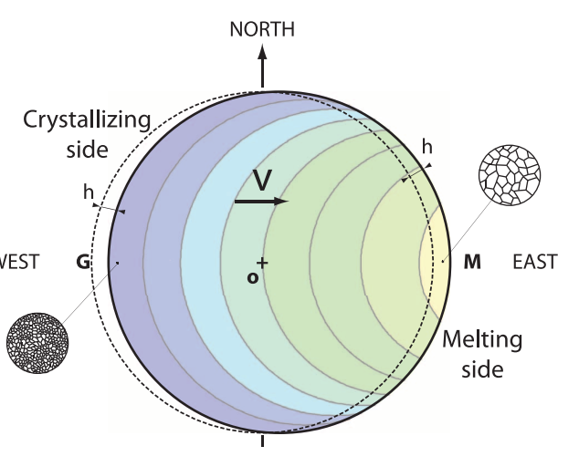
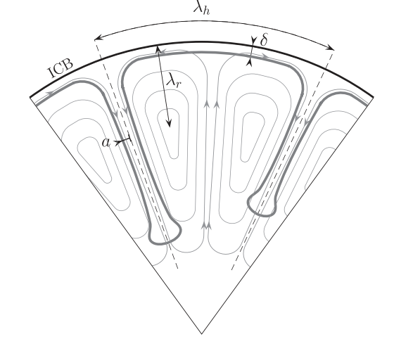
Evidence for Active Inner Core: Inner Core convection? Lopsided growth of the Inner Core?
Convection: Thermal and/or Thermochemical
Deguen er al. (2011, 2013)
Cottaar and Buffert (2012)
Lopsided growth of Inner Core
Monnereau et al. (2010)
22

Slide 23
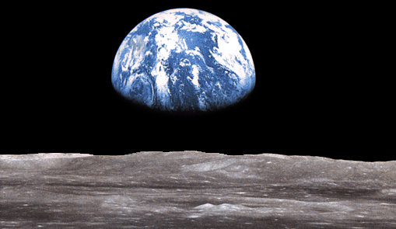
Thank you for your attention!
23

