Slide 1





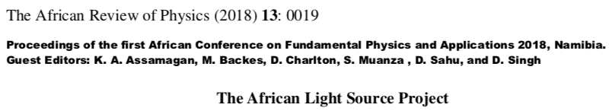
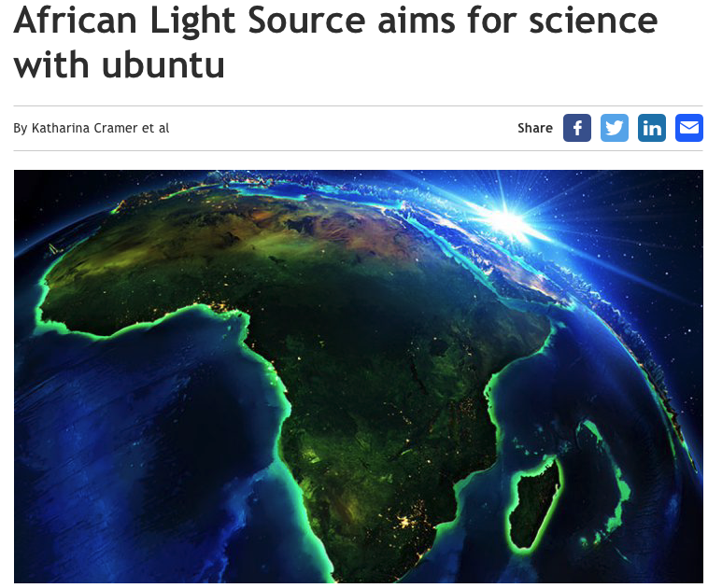
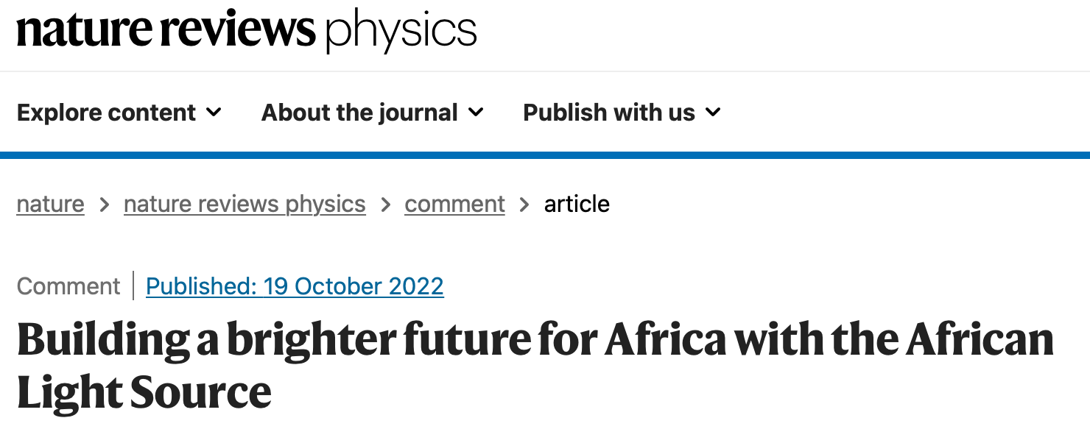


AfLS Website https://www.africanlightsource.org
The African Light Source:
history, context and future
JSR, 31(2024) 1-9
https://doi.org/10.1107/S1600577523009682
https://www.worldscientific.com/doi/abs/10.1142/S0217732318300033
Recent progress towards an African light source
Debating the Societal Impact of Big Science in the 21st Century
2023-06-14 Science and Public Policy 00 (2023) 1-12 “Science diplomacy from the Global South: the case of intergovernmental science organizations“
https://iopscience.iop.org/book/edit/978-0-7503-3631-4/chapter/bk978-0-7503-3631-4ch54
http://lamp.ictp.it/index.php/aphysrev/article/view/1610/586
https://i0.wp.com/www.africanlightsource.org/wp-content/uploads/2022/12/Nature-Review-Physics.png?ssl=1
https://www.researchprofessionalnews.com/rr-news-europe-views-of-europe-2022-5-african-light-source-aims-for-science-with-ubuntu/
https://www.worldscientific.com/doi/abs/10.1142/S0217732318300033
https://link.springer.com/article/10.1007/s12551-019-00578-3

Slide 2
Why the AfLS ?
African Challenges → Identify Science → Identify RI → AfLS
  Examples in these slides
  Health (African vaccine IP), Big Data Analytics, Others → All RIs
Insist on evolution towards major African funding
RI for Science Diplomacy → Developing Pan Africanism
  SESAME
  CERN
AfLS profile for African Government Science Policy, Regional Science Policy → Leave no country behind
Governance → African participation on RI Councils
African User Base development (Training, Youth)
  Schools, Workshops,
  Medium term visits,
  Sandwich programmes

Slide 3
Community Building:
  Training (LAAAMP, START, ESRF programme, IAEA INT0104, ICTP School)
  Conferences
  Audit of Users (DeCoREA, now UNESCO),
  Membership system (Coming Soon)
  AAS Partnerships in Training and other community building activities
  AfLS - AAS Awards Programme
CDR : Critical Design Report
Science Diplomacy, Strategic Government level
  AAS Partnerships
    LOIs, MOUs (SESAME, LAAAMP)
    MOU: AAS
    AfLS Executive Office
  Strategic Task Forces
    The African Beamline at an international AdLS
    The Collective African membership of an international AdLS
    African Regional Infrastructure
  Global Partnerships
    UNESCO Resolution
    Commonwealth profile
    European Commission
    Sunstone
    Nephews - Bursaries to HERCULES, Workshops.

Slide 4
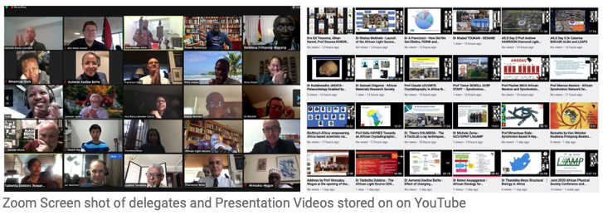
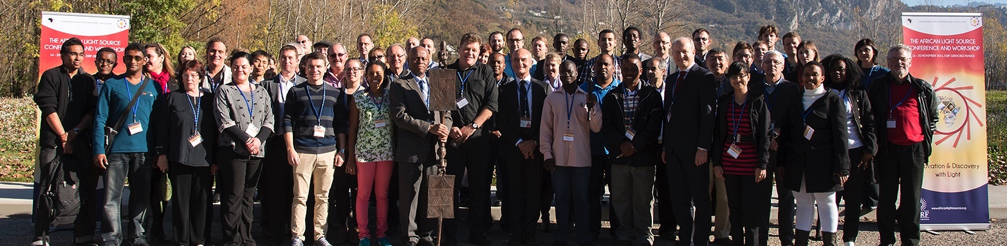
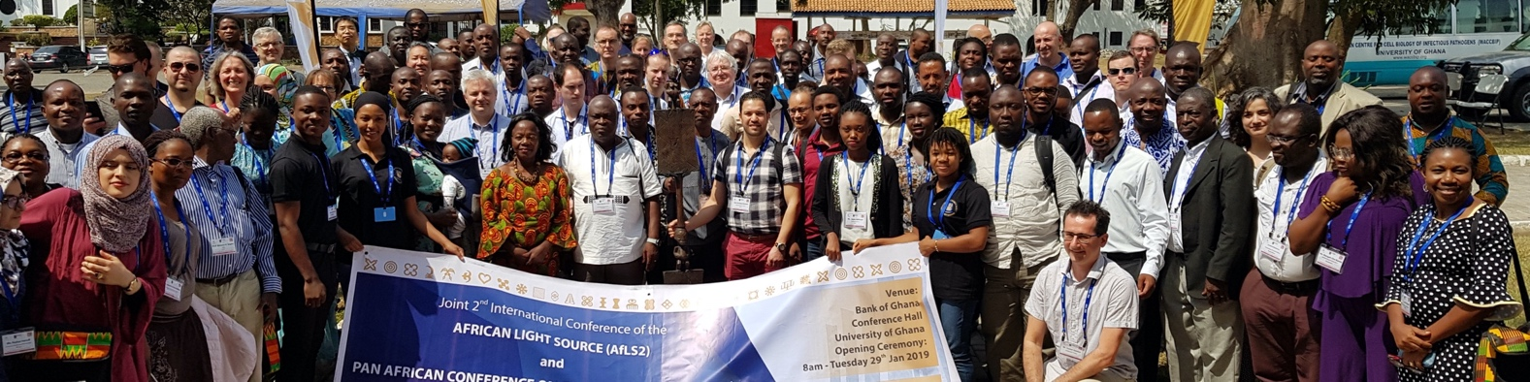
Conferences
2015, 2019, 2020,
2021, 2022,
2023, 2024
2021
Now 5 African Governments involved
Many co-conveners
Prof bodies
Academies
2022
~1000 registrations
2021
>500 registrations
  AfLS1 2015
  https://events.saip.org.za/event/61/
  AfLS2 2019
  https://events.saip.org.za/event/145/
  AfLS3 2020
  https://events.saip.org.za/event/211/
  AfLS4 2021
  https://events.saip.org.za/e/AFLS3
  AfLS5 2022
  https://events.saip.org.za/e/AfLS2022
  AfLS6 2023
  https://events.saip.org.za/event/243/
  AfLS7 2024
  https://events.saip.org.za/event/249/

Slide 5
3 Strategic Task Forces to report by Dec 2023
The African Beamline at an international AdLS
This is an African designed and operated beamline at an International AdLS that can address selected African Research Imperatives. It leads additionally to the training of engineers and technologists and will result in Technology Transfer.
The Collective African membership of an international AdLS
Here several African countries jointly acquire formal membership of an international AdLS. They leverage a threshold of participation that allows African Government involvement in the Council of the Facility, so that there is increased African Access of Researchers, technologists, Industries and also Governments.
African Regional Infrastructure
This is research infrastructure that is both highly competitive in its own right but which is also seen as important training and feeder infrastructure to an AdLS.
“Leave no country behind.”

Slide 6
AfLS Infrastructure Roadmap with milestones
African Light Source(s)
“Leave no country behind” : AU
African Memberships
African Beamlines and Instruments
Small lab sample prep
Small lab
X-ray facilities
Human Capacity activities accompanies the Infrastructural capacity
Menu of expenditure for African Governments

Slide 7
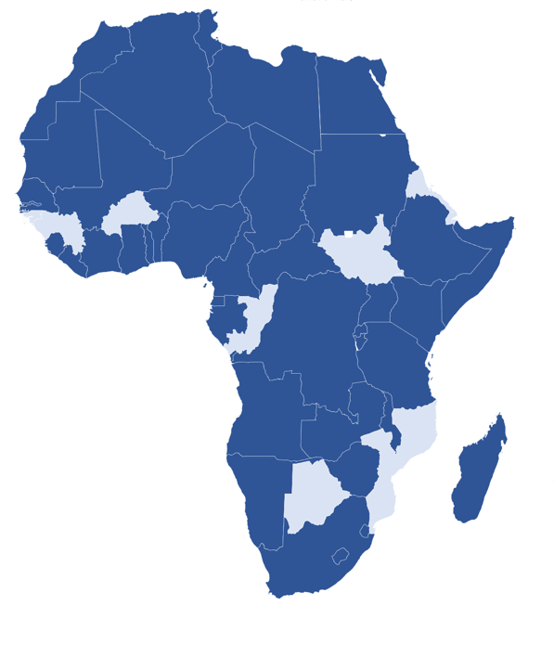
IAEA TC Project - INT0104
Enhancing Transnational
Collaboration among Light Sources and
Expanding the User Base
Training Platform / Material, Mapping →
Pan African Virtual University
Opportunity to expand Footprint within Africa,
and increase international linkages
49/56 Countries in Africa
within AFRA, NEST and with TC Support
African Country → National Liaison Office → Community

Slide 8
Milestones on the Timeline of the Roadmap
End 2023
6th AFLS Conference,
CDR published
Strategic Task Force feedback
End 2026
AfLS is a regular session in meetings such as AUC-ESTI, AfDB, All Pan African and Regional meetings of African National Science Ministries
End 2026
African joint National participation in an AdLS.
African Beamline at an AdLS
5 new National / Regional facilities (1 x CLS)
End 2025
Audit >1000 active
Updated Roadmap
African Light Source Secretariat
Executive Office
End 2026
Model for African National contributions.
Income stream → training, conferences, Executive office etc.
End 2026
The AfLS established as next large-scale research Infrastructure to follow on from the SKA
2035
An operational African light source, for Africa

Slide 9
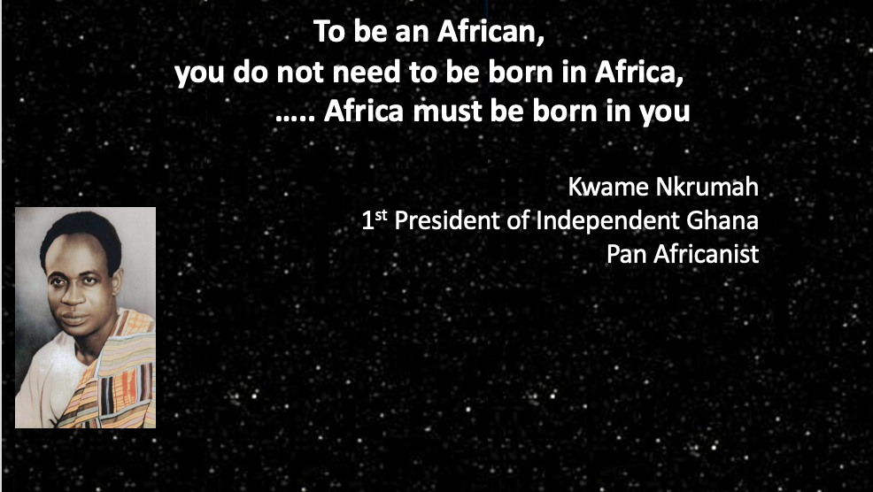


The Concept of Ubuntu and African Identity in Pursuit
of the African Light Source
Africans, Old Diaspora, recent Science Diaspora, Friends of Africa around the world.
AfLS and AAS to partner in this venture.

Slide 10
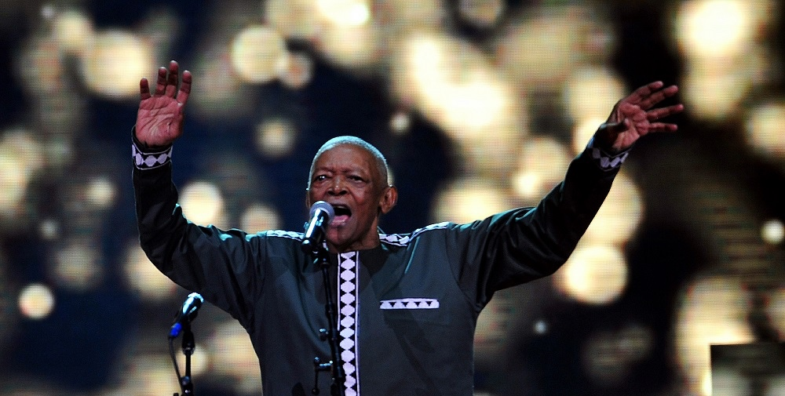
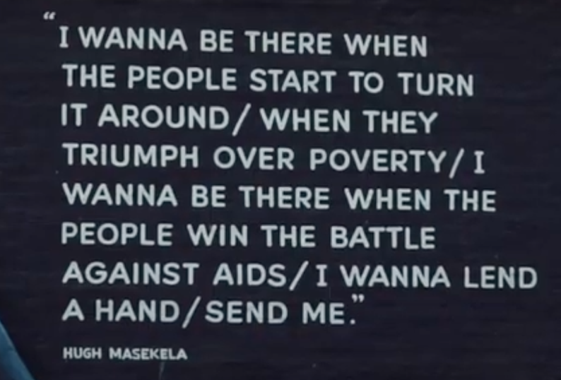
Thuma mina – Send Me
https://www.youtube.com/watch?v=d4Bwux-btq0
Musician Hugh Masekela
Simon Connell shconnell@uj.ac.za

