Slide 1
AfLS/AfPS 2024 Conference
18-22 November 2024
Johannesburg, South Africa
INTRODUCTION TO AFRICAN PHYSICAL SOCIETY
Prof. Ahmadou Wague
President African Physical Society
,
University Cheikh Anta Diop,
National Academy of Science and Techniques
Dakar
Senegal

Slide 2
Time line in the creation of the African Physical Society AfPS
In August of 1983 under the leadership of Prof. Francis K. Allotey, number of African physicists and mathematicians convened to form the Society of African Physicists and Mathematicians, SAPAM, the precursor to the AfPS. The SAPAM served as the primary professional organization for practicing physicists and mathematicians in Africa
In January 2007, at a summit at iThemba labs in Cape Town, South Africa , with numerous of physicists and national physical societies in Africa, the SAPAM formally announced that it will become the African Physical Society ,AfPS.
It was decided to convey the Official Launching of the AfPS in Dakar Senegal, during the forthcoming International Workshop of African Laser Atomics Molecular and Optical Science Network ,LAM Network

Slide 3
Presentation of the African Physical Society AfPS
The African Physical Society held its official launching ceremony on January 12, 2010 in Dakar, Senegal.
Following the launching ceremony. the AfPs held its first scientific meeting in Dakar .Prof. Francis K. A. Allotey, became the first President of the AfPS. Officially AfPS is incorporated in Ghana. We want to pay a tribute to Prof. Francis Allotey who passed away in November 2017
The main goals of AfPS are to promote and further research education and training in physical sciences and applications in order to enhance technological, economic and socio‑cultural development in Africa; to promote effective contacts and cooperation among African physicists; and to collaborate with other physical societies and international organizations in promoting scientific activities in Africa.
The African Physical Society has to serve as an important resource to all African Physicists and help leverage their communications and collaborations.
.

Slide 4
Some activities of the African Physical Society AfPS
. AfPS was among the main organizers of International Year of Light IYL in 2015, together with European Physical Society EPS and ICTP by involving UNESCO and UN for the implementation of IYL
.In October 2018 the AfPS with the support and together with of ICTP organized an international Workshop in Kigali Ruanda in order to put forward a new dynamic for AfPS .
.As a follow up of the 2018 international meeting in Kigali, due to the COVID-19 pandemic , instead of in person meeting , AfPS organized an online ZOOM international conference in 2020 in collaboration with ICTP. Participants were from all over Africa. This meeting was held in strong partnership with ICTP East African Institute for Fundamental Research- EAIFR-, and also with African Light Source,-AfLS- ,in holding common plenary sessions.
. AfPS and AfLS gave also an opportunity to African Strategy for Fundamental and Applied Physics to make his first public presentation of ASFAP project in Africa

Slide 5
Some activities of the African Physical Society
. In March 2021 AfPS was also among the main organizers of the online meeting “Biophysics in Africa “with a strong scientific participation of South African Institute of Physics (SAIP) and many other scientific organizations in Africa
. Since the creation of the SAPAM in 1983 , the AfPS , participated and organized many other scientific events together with the African laser Atomic Molecular and Optical Science Network (LAM Network), with the Edouard Bouchet Abdus Salam Institute( EBASI), , with the African Laser Centre (ALC) in Pretoria, and with African Light Source (AfLS)
. The African Physical Society bring is support to the initiative of African Strategy for Fondamental and Appled Physic ASFAP. It is an important step to bring together AfPS and ASFAP in building an effective strategy for the development of physical sciences in Africa.
.I will end my talk with some images where LAM Network and AfPS played important roles in promoting collaboration and cooperation in physical sciences in Africa.

Slide 6
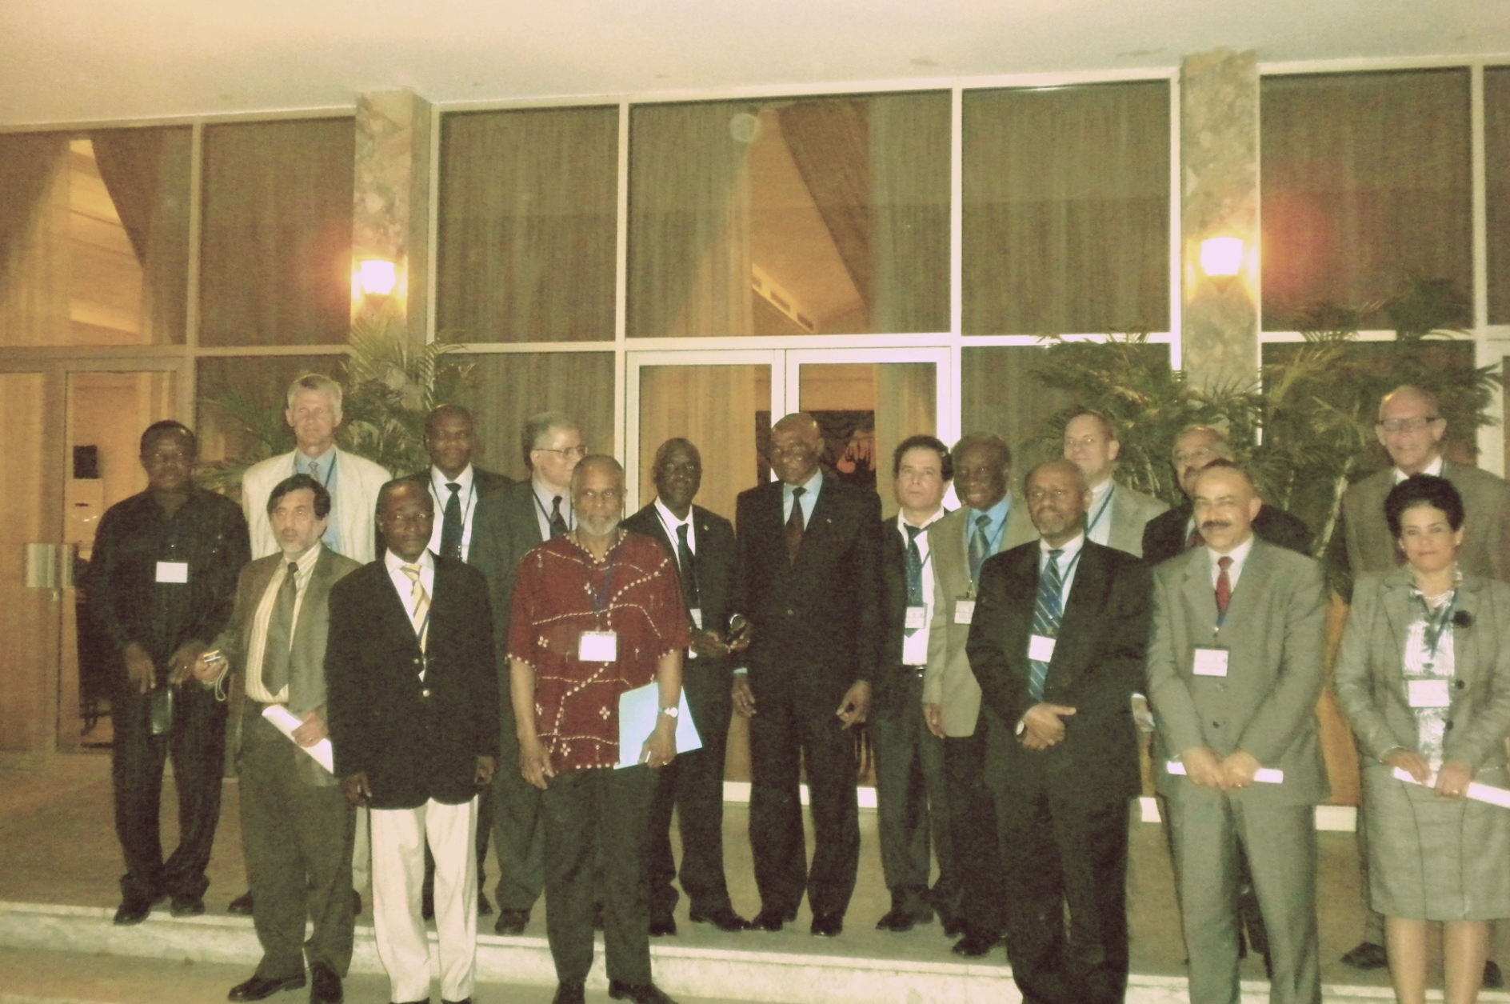
Delegates at the LAM 9 and AfPS launching in Dakar at the Presidential Palace With the President of Republic of SENEGAL- 11January 2010

Slide 7
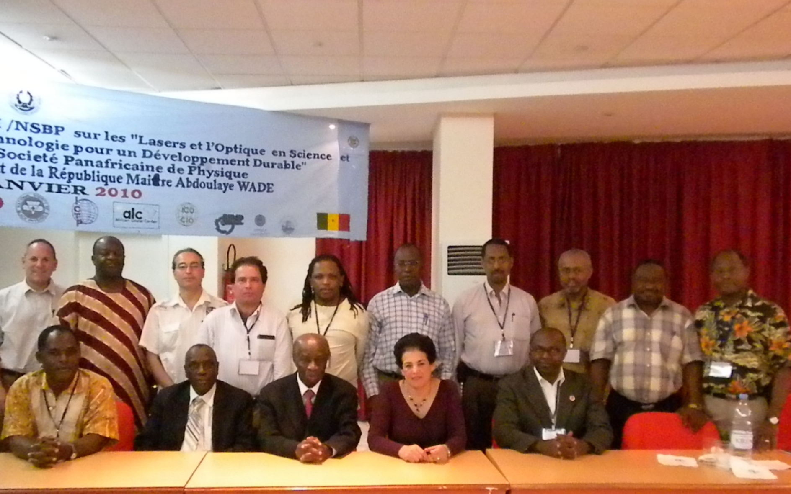
Photo of AfPS council , Dakar 14 January 2010

Slide 8
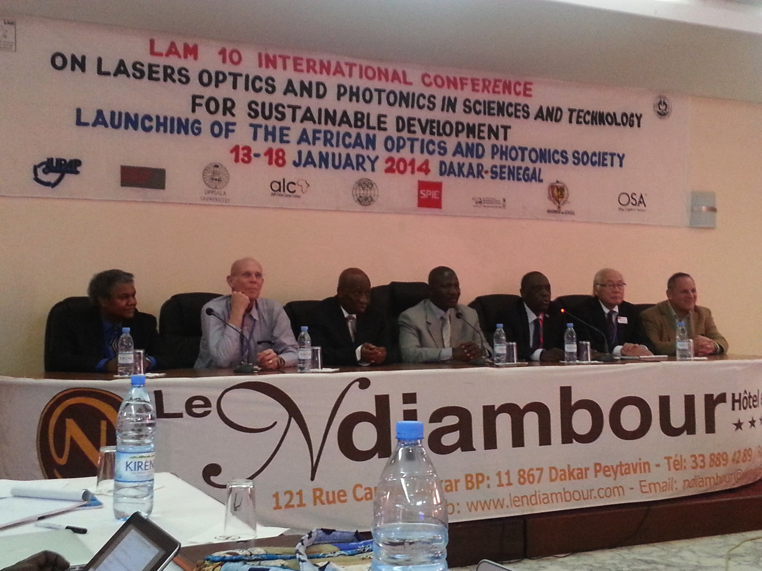

Slide 10
The IYL 2015 Africa Regional Conference in September 2015 In Accra, Ghana, organized by the African Physical Society , Government of Ghana and many other stake holders with representatives from Mexico, Sweden, Senegal, Algeria, Cameroon, Egypt, and many other countries attending the conference.

Slide 11
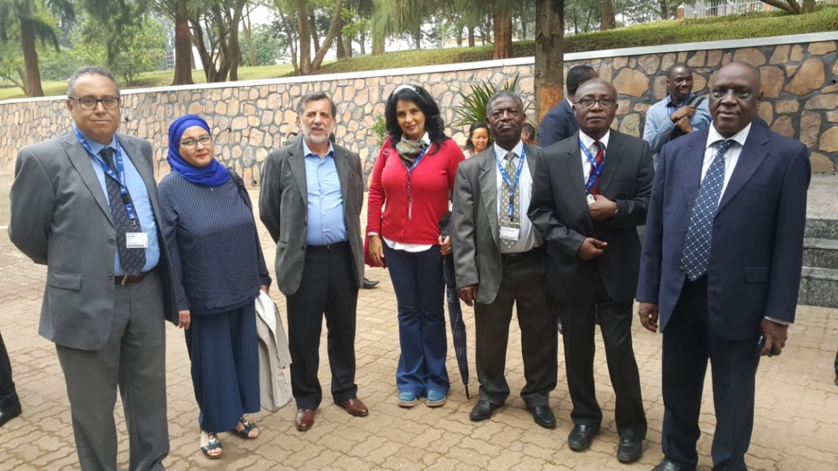
AfPS Kigali Workshop in October 2018: Some participants from Tunisia, Algeria , Morocco, Egypt, Ghana
Cote d ‘Ívoire, Senegal , Kenya, Benin ...

Slide 12
IUPAP CENTENNIAL CONFERENCE IN TRIESTE WITH AfPS Participation July 2022

Slide 13
MANY THANKS TO OUR PARTNERS AND SPONSORS
APS
ALC
AfLS
SAIP
GOVERNMENT OF SOUTH AFRICA
IOP
ISP
GOVERNMENT OF GHANA
GOVERNMENT OF SENEGAL

Slide 14
Thank you For your attention

