Slide 1
X-ray phase contrast imaging: An alternative approach to laboratory-based sources Gideon chinamatira

Slide 2
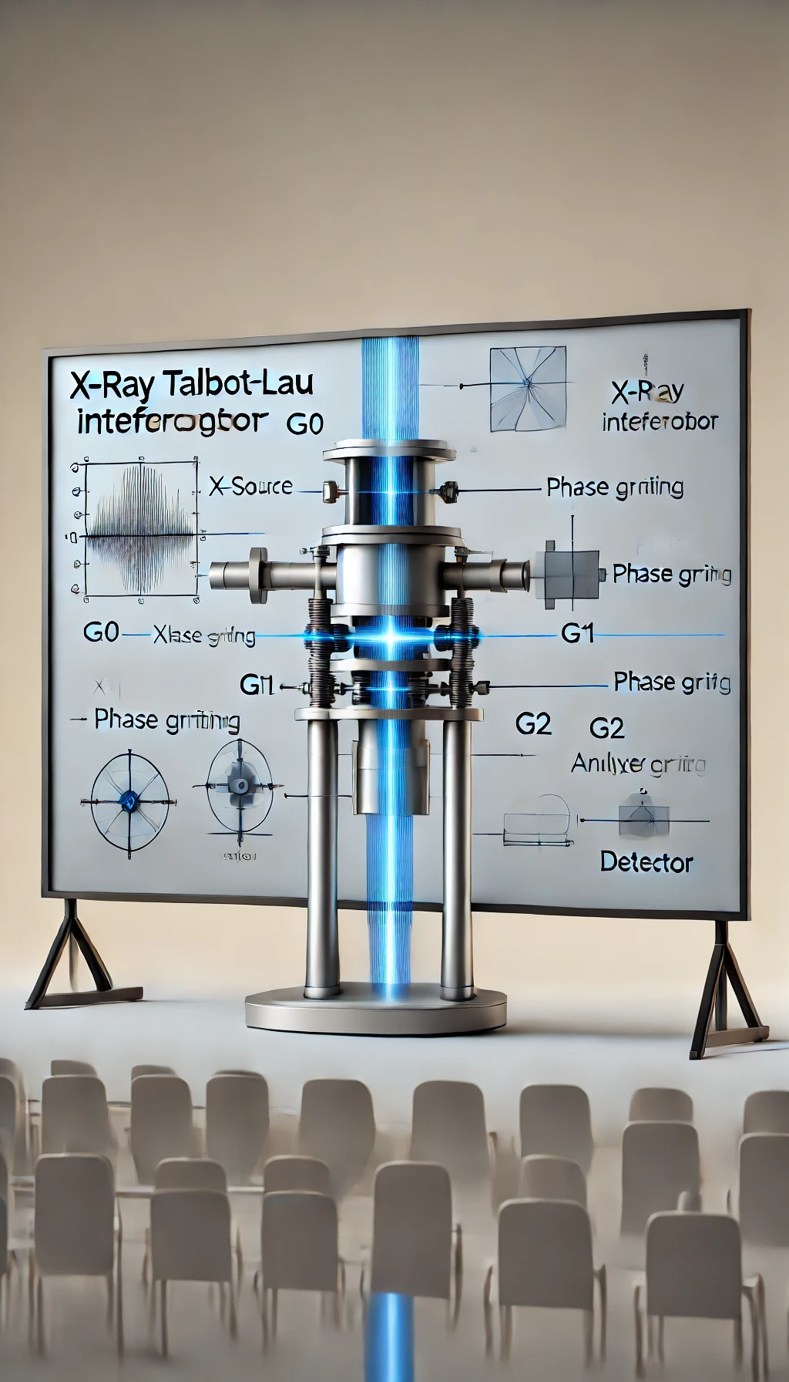
Outline
Introduction
Overview of conventional methods
Motivation
Goals of using the Talbot-Lau interferometer.
Methodology
System description, experimental setup and procedures.
Results
System performance (visibility, sensitivity, stability).
Imaging examples (circuit board and beetle).
Conclusion
Future work.
Acknowledgments

Slide 3
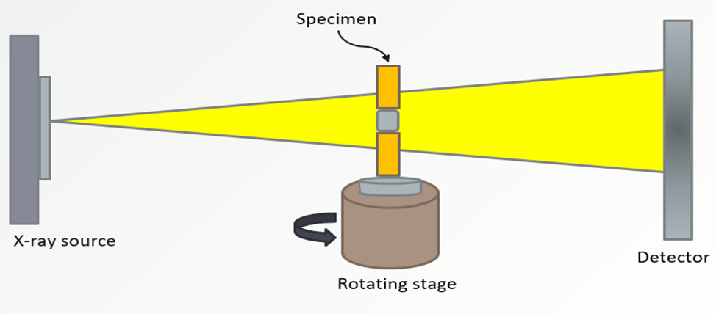
Introduction
There is a reduction in the beam intensity when X-rays pass through objects which occurs according to the Beer-Lambert law:
$$I=I_{0}e^{(−\int{µ\left(x,y\right)ds)}}$$
A schematic showing laboratory-based X-ray computed tomography technique

Slide 4
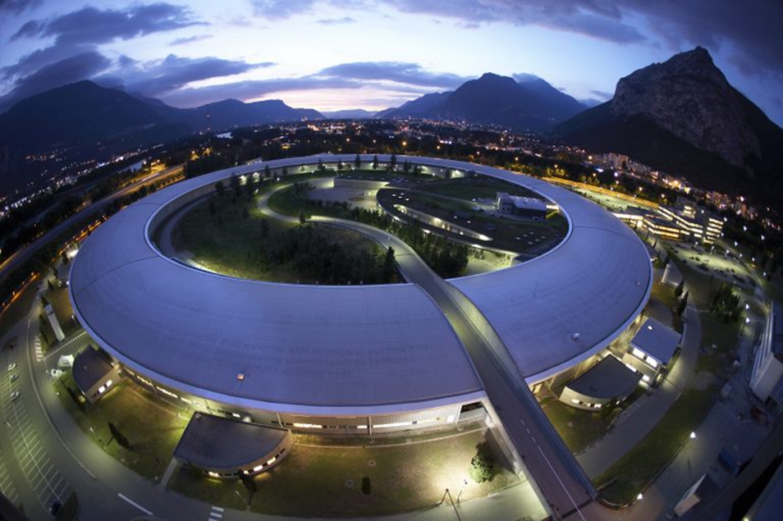
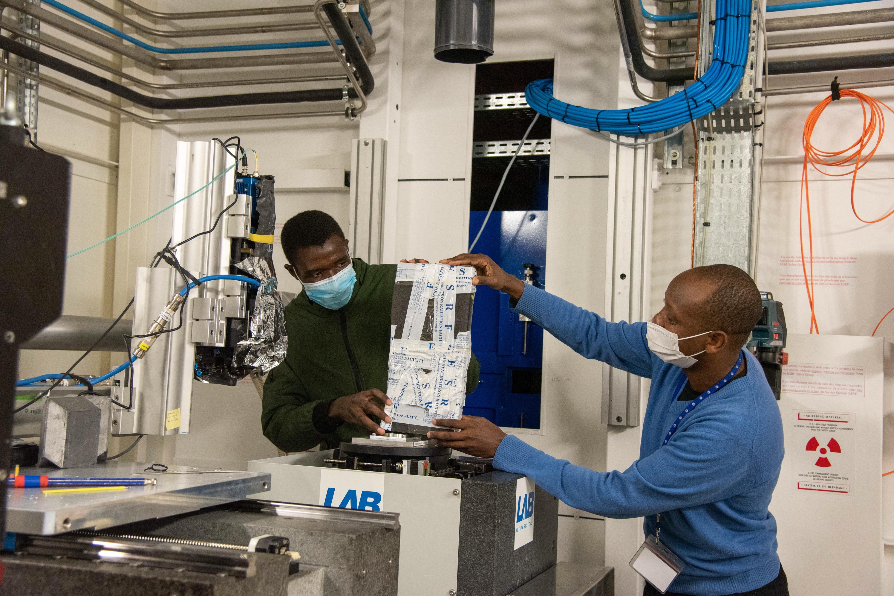
Motivation……….

Slide 5
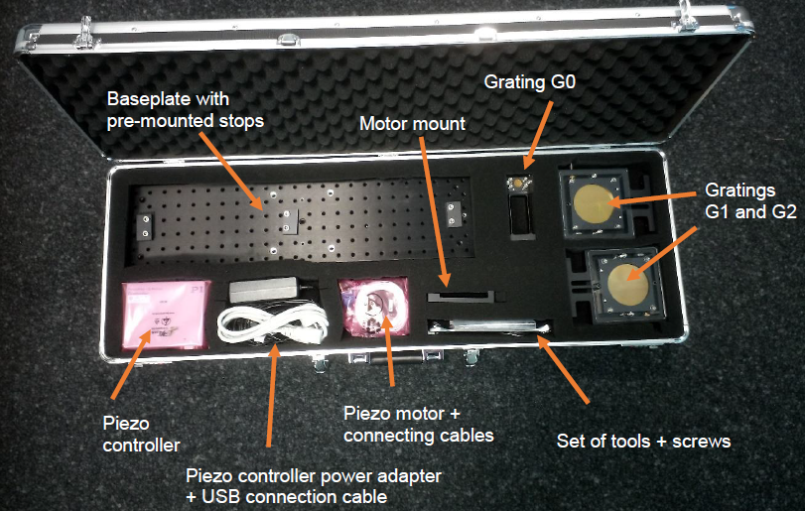
The Talint system

Slide 6
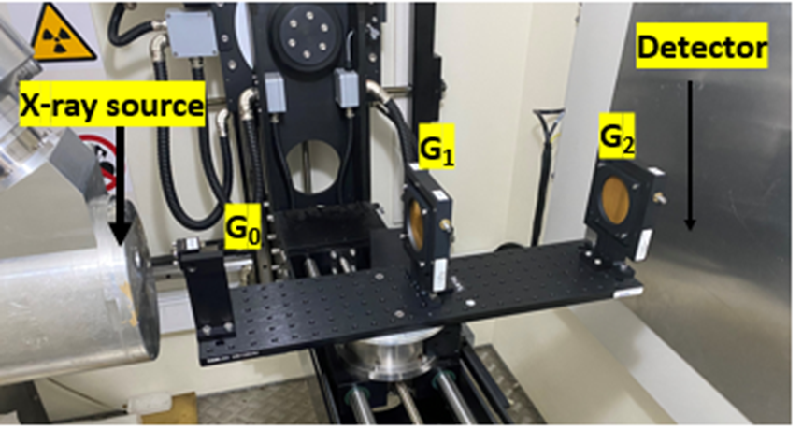
The TALBOT Lau interferometer
G₀ (Source Grating) introduces spatial coherence to the X-ray beam.
G₁ Introduces a phase shift to the X-rays, creating an interference pattern that is sensitive to the phase shifts induced by the sample.
The G₂ grating is placed near the detector and is used to analyze the interference pattern by converting phase variations into intensity modulations.

Slide 7
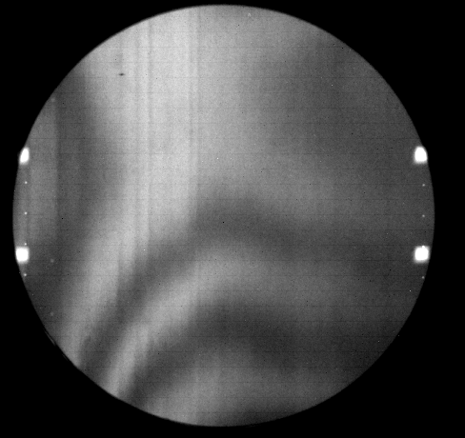
Moire fringe visibility
The superposition of the gratings leads to the appearance of Moire fringes.
The periodic interference pattern generated by the phase prating introduces phase shifts into the X-ray beam, creating an interference pattern downstream.
The analyzer grating has its own periodic structure (alternating slits of transparent and absorbing material).G₂ interacts with the interference pattern from G₁.
The intensity modulation of the fringes is known as Moiré fringe visibility. It is readily calculated via the following formula
$$v_{Moire}=2\frac{I_{max}{−I}_{min}}{I_{max}{+I}_{min}}$$

Slide 8
Phase Stepping
Image acquisitions with the Talint system are separated in two steps:
Perform phase stepping without sample for the reference
2. Perform a second phase stepping with the sample moved into the beam
Afterwards the stepping curves of each pixel are compared to obtain the alterations caused by attenuation, refraction and scattering.
From this the absorption, dark field and phase contrast images can be calculated with a suitable software.

Slide 9
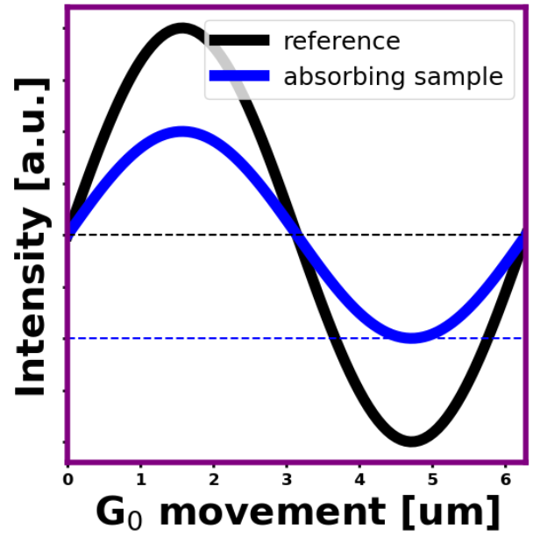
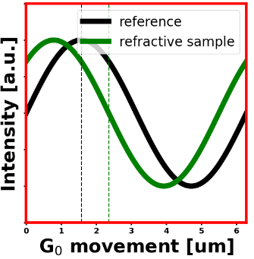
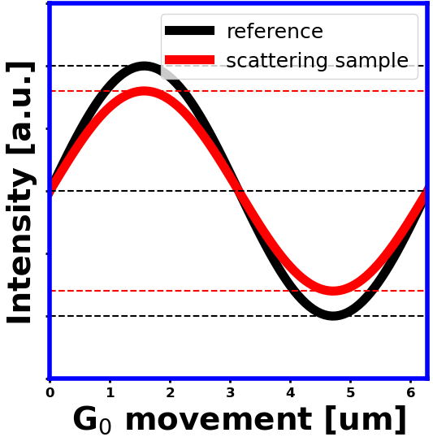
Phase stepping
We evaluate the acquired images during the phase stepping process by analysing each pixel. Each phase stepping results in a sinusoidal intensity curve for each pixel.
The sinusoidal curve recorded in the reference image is modified by the sample due to attenuation, refraction, and scattering effects.
a
b
c
Intensity curves plotted to illustrate phase-stepping in one pixel. The black solid line depicts the reference phase-stepping with no sample in the beam. The blue, green and red curves depict alterations due to a sample in the beam caused by a) attenuation, b) refraction and c) scattering.

Slide 10
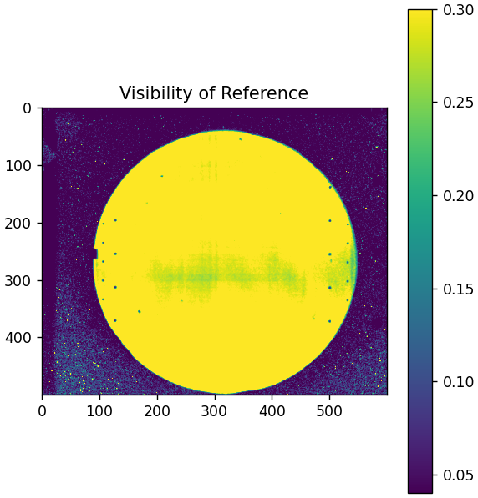
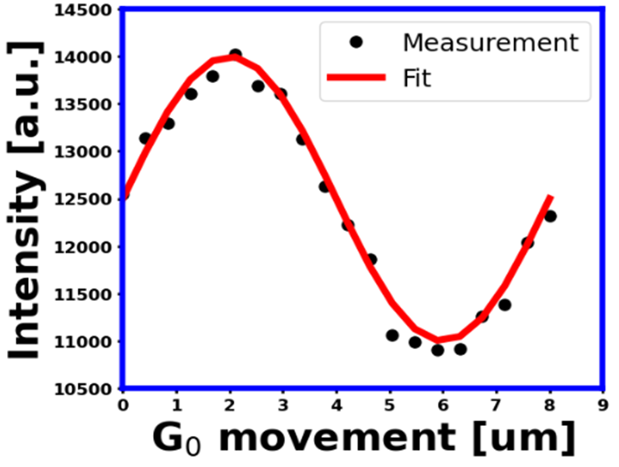
Visibility of the talint system
Flatfield measurements acquired with the Talint lab system at the Wits University MicroCT facility a) reference stepping curve measured in a single pixel with a stepsize of 0.2 μm. b) Visibility distribution of the Talint lab system

Slide 11
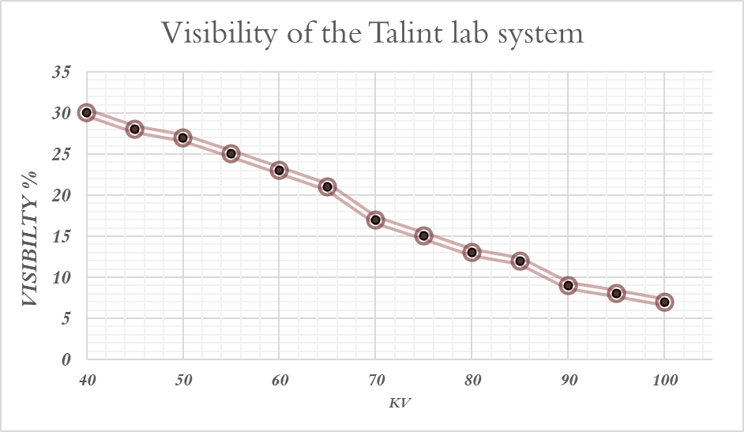
Visibility of the talint system

Slide 12
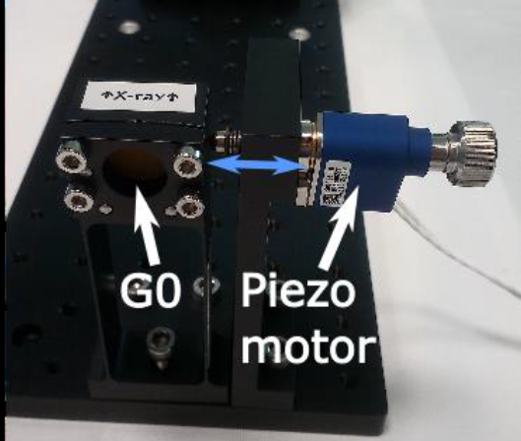
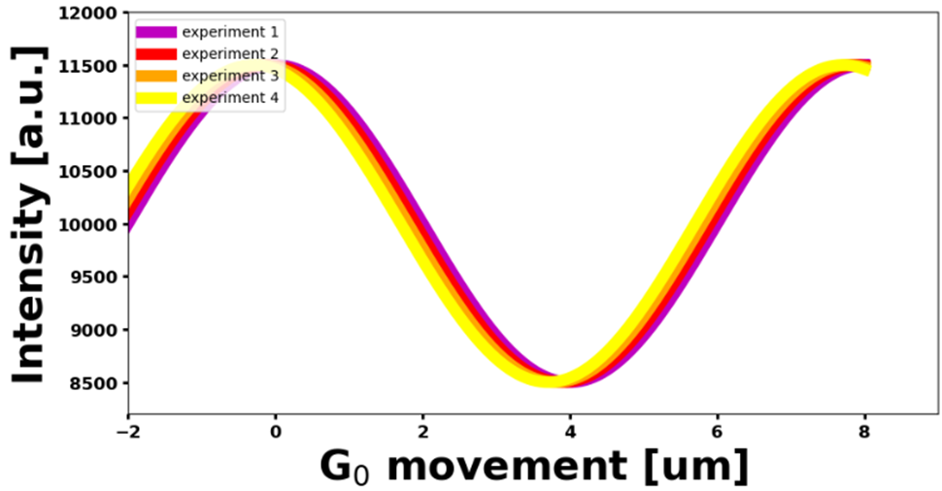
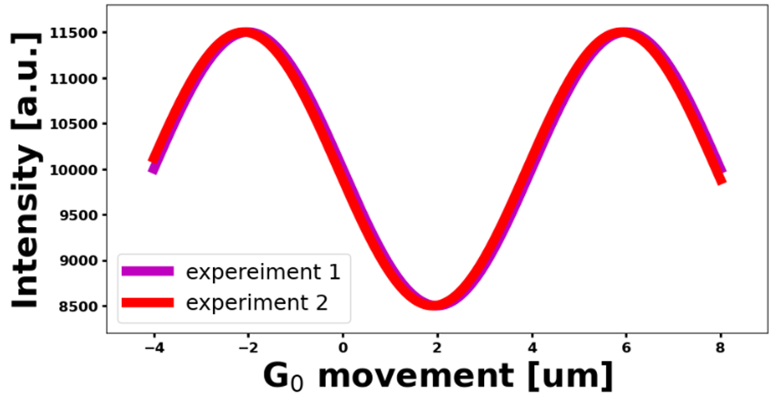
Phase stepping and stability
Mechanical systems often encounter hysteresis, where the displacement of the motor doesn't precisely correspond to the input signal due to internal friction and material properties.
These stability measurements allow for reliable imaging, ensuring that any changes in the observed patterns are due to the sample's properties and not fluctuations in the system
Phase stepping and stability

Slide 13
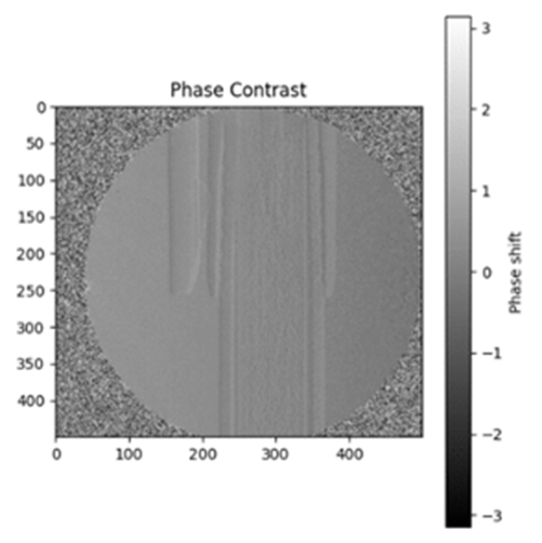
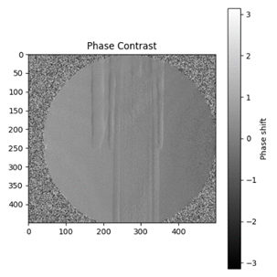
Grating sensitivity
Sensitivity in this context refers to the ability of the imaging system to detect and measure small variations in the phase shift caused by the sample.
As the sample moves closer to G₁, the phase contrast images becomes sharper enhancing the detail of the captured images. This observation highlights the significance of the sample's placement in relation to the grating for achieving optimal imaging results.
b
c
Grating sensitivity with varying distance from G_{1 ,} (a=13cm), (b= 8cm) and (c= 3cm).

Slide 14
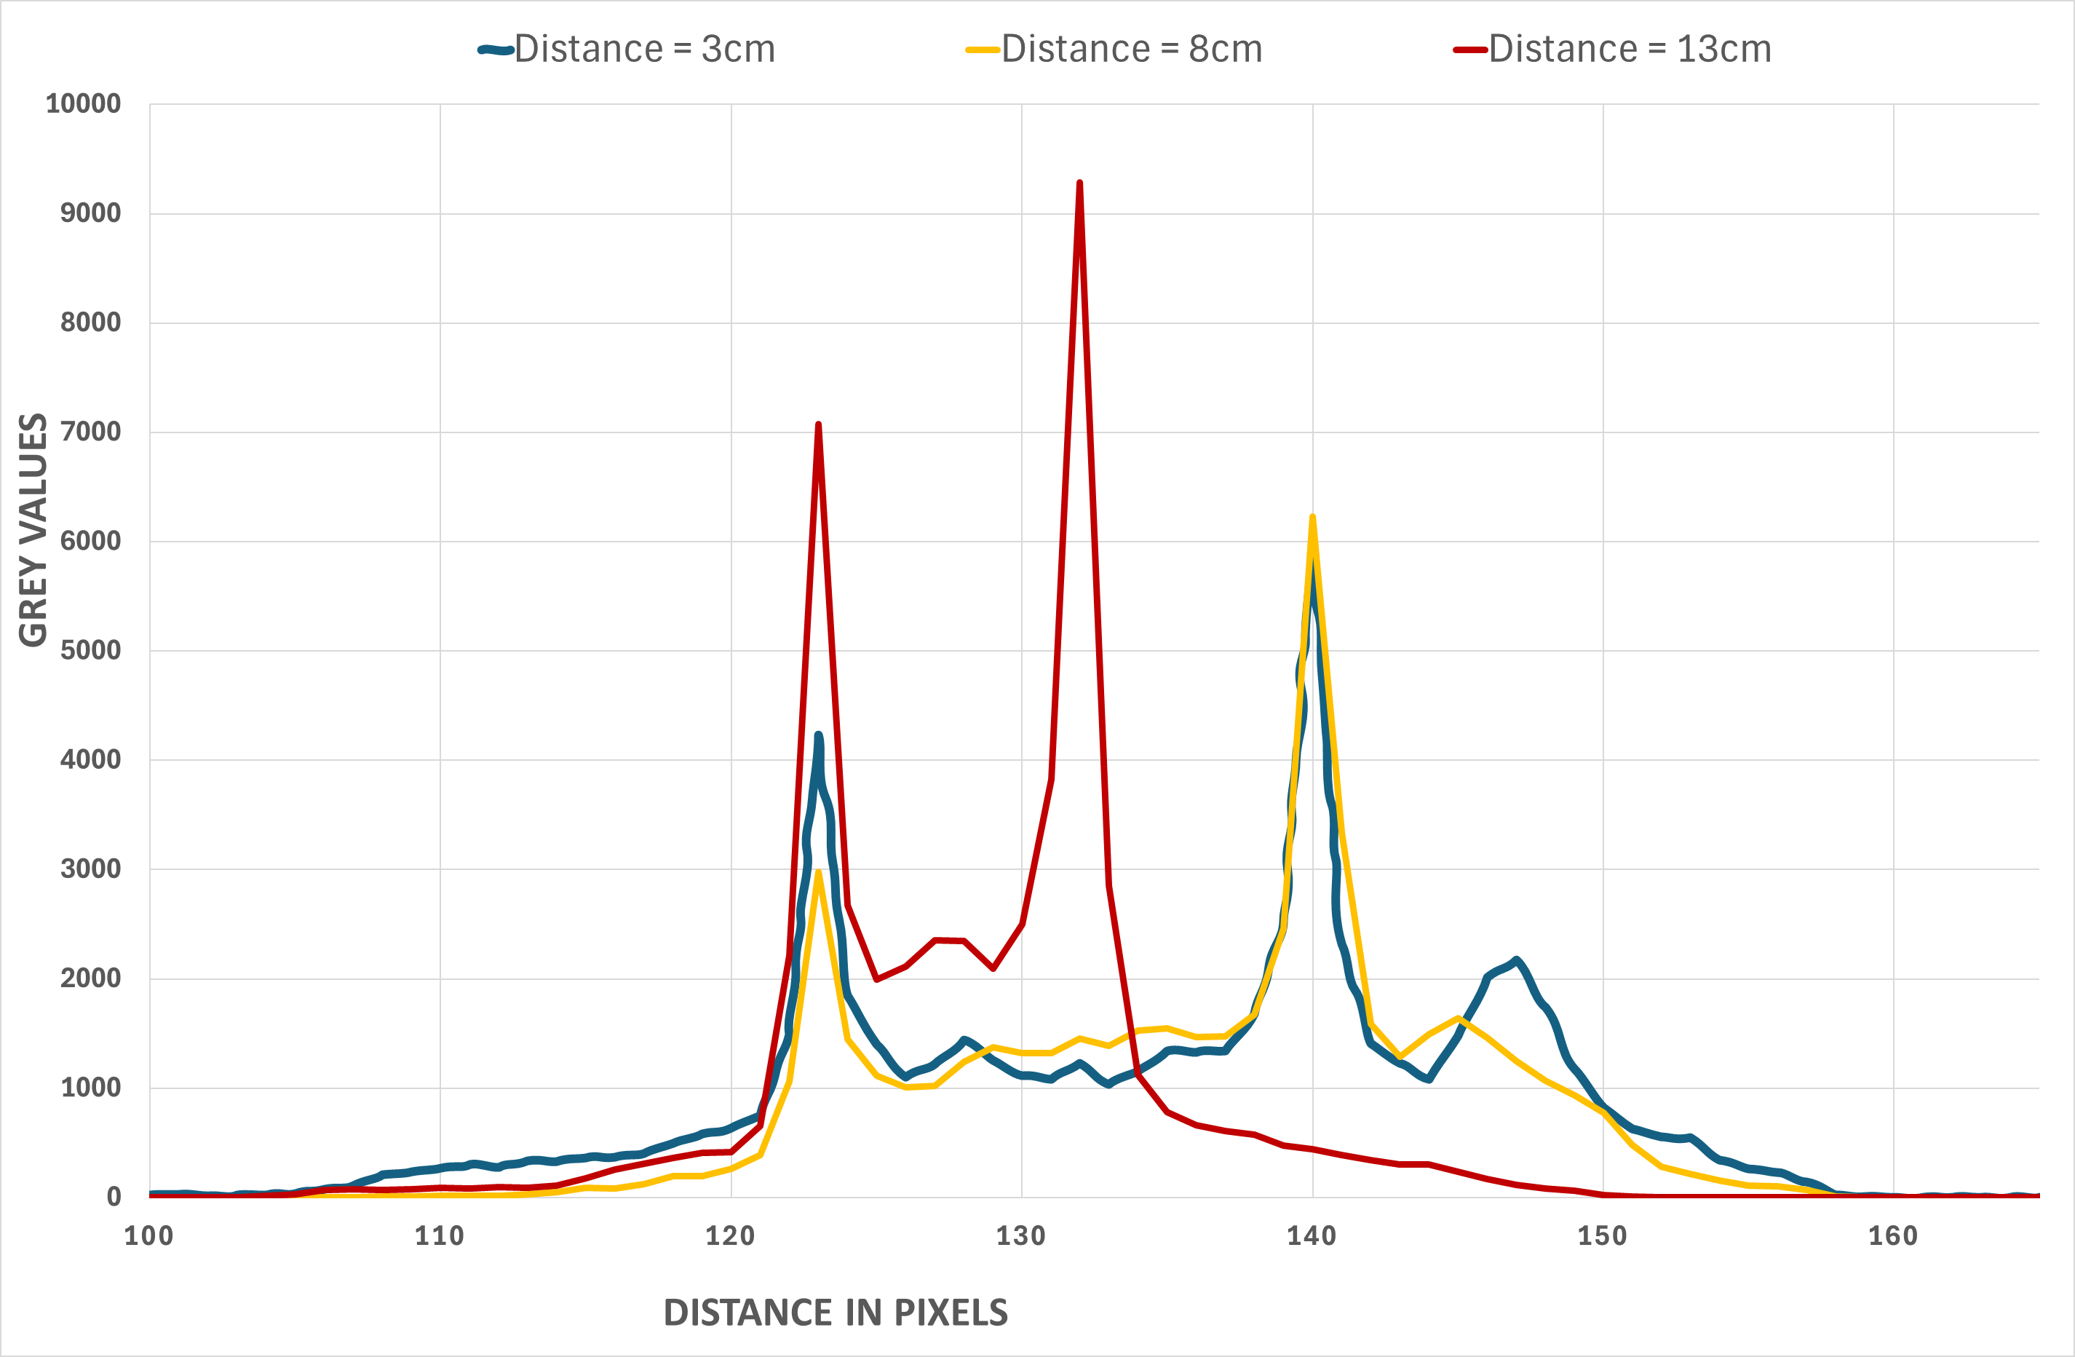
Grating sensitivity
Histogram analysis of phase contrast images captured at 3 different distances from G₁

Slide 15
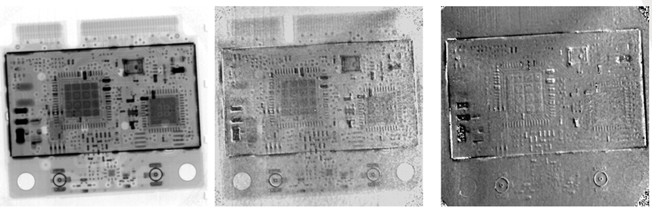
Results
The absorption, dark field and phase contrast imaging techniques provide complementary information about the internal structure of a circuit board, enabling a more comprehensive analysis by combining details about material and its features
a
b
c
Displaying (a) absorption, (b)dark-field, and (c)phase contrast images of a circuit board obtained using the Talint system

Slide 16
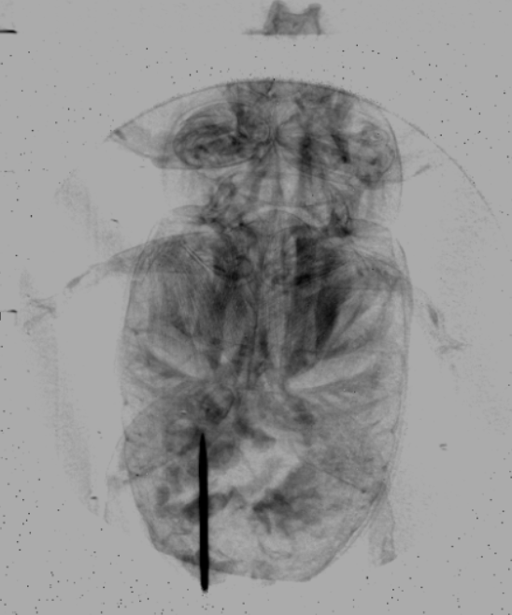
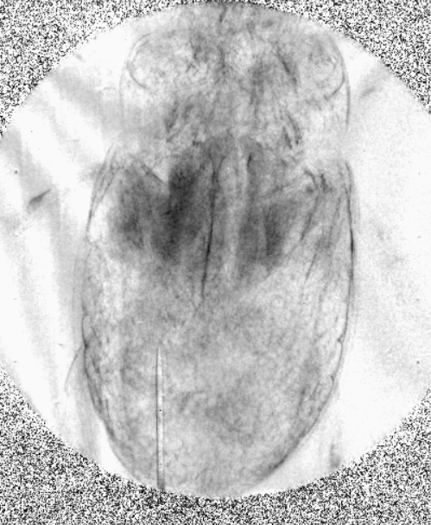
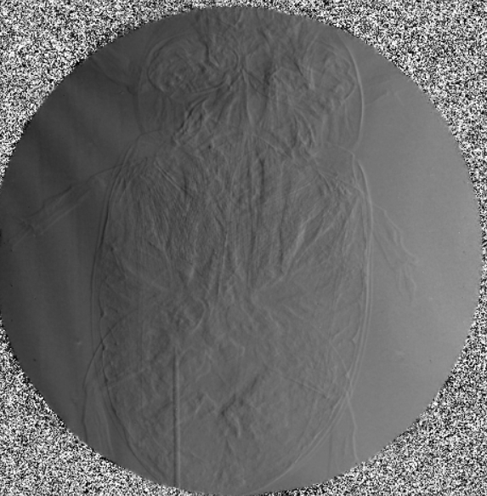
Results
The absorption, dark field and phase contrast imaging techniques provide complementary information about the internal structure of the beetle, enabling a more comprehensive analysis by combining details about material and its features.
a
b
c
Displaying (a) absorption, (b)dark-field, and (c)phase contrast images of a beetle obtained using the Talint system

Slide 17
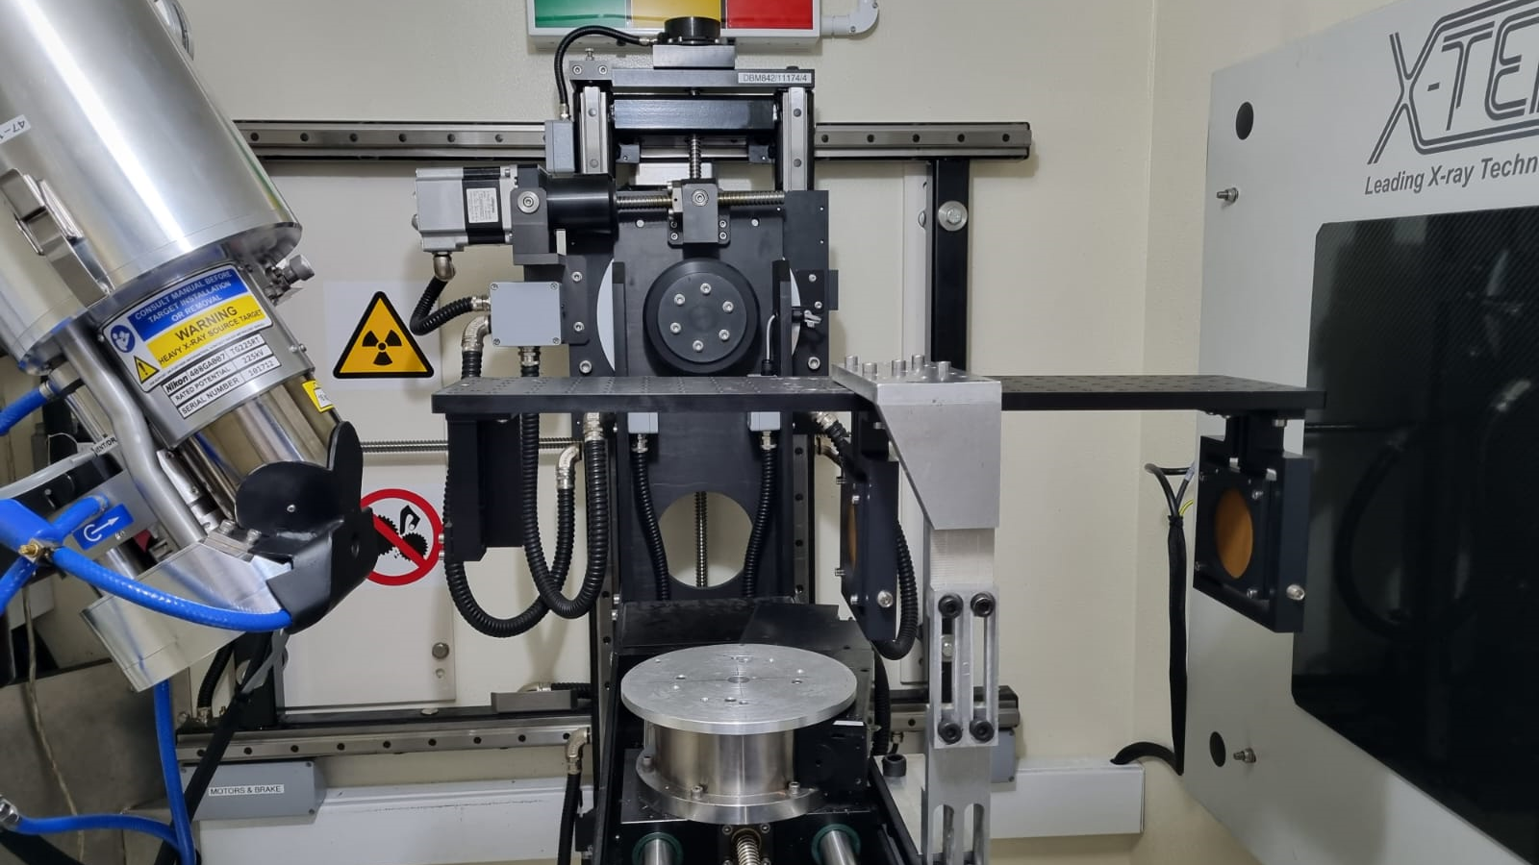
Future work….

Slide 18
Acknowledgements
Supervisors
K. Jakata (Diamond Light Source)
H. Masenda (Wits)
A. Du Plessis (Stellenbosch)
Financial Support
Palaeontological Scientific Trust (PAST).

Slide 19
Thank you
Gideon Chinamatira
gideon.chinamatira@wits.ac.za
https://www.linkedin.com/in/gideon-chinamatira/

