Slide 1
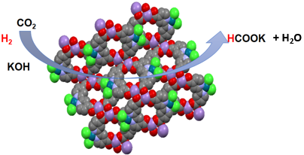

Harnessing Metal Organic Frameworks for CO₂ Conversion: Unlocking New Pathways for Formate Synthesis .
Dr Piwai Tshuma
Midlands State University
Department of Chemical Sciences

Slide 2



Introduction

Slide 3
Introduction
Challenge in CO₂ utilisation
Highly active catalysts required
Homogeneous catalysts
Heterogeneous catalyst

Slide 4
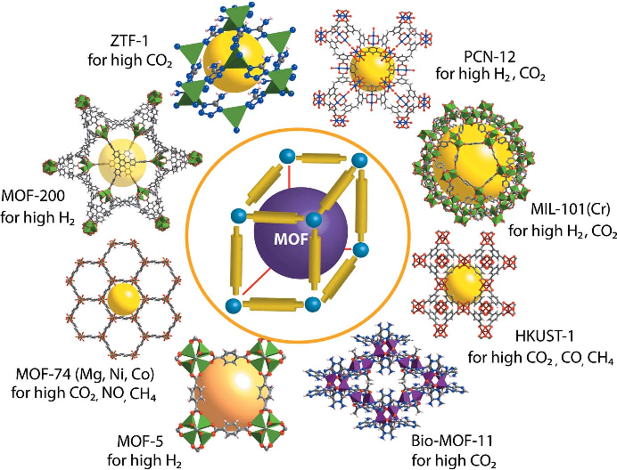
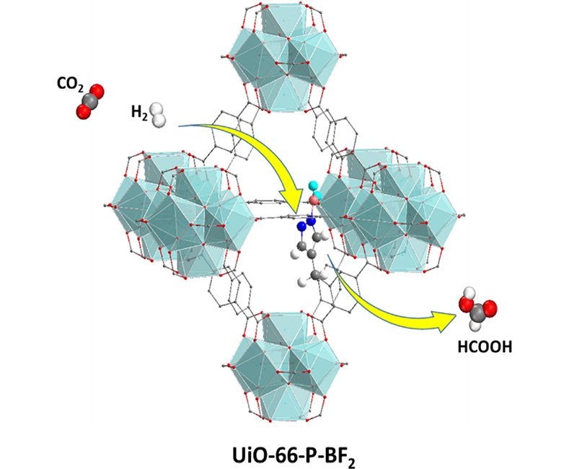
Metal Organic frameworks (MOFs)
Abelegi et al. American Journal of Environmental Protection, 2017, 5, 61-67
Ye J, Johnson JK. ACS Catal. 2015, 10, 6219-6229

Slide 5
Methodology
C1
Pd@Mg:JMS-2 and Pd@Mn:JMS-2

Slide 6
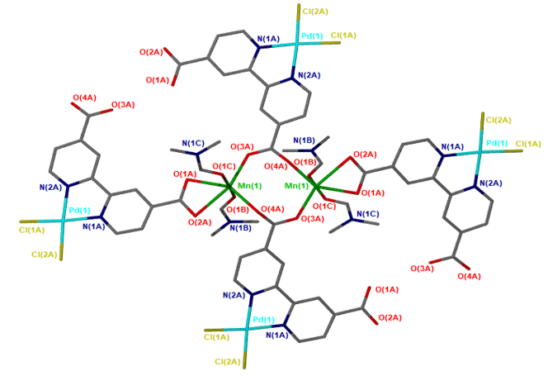
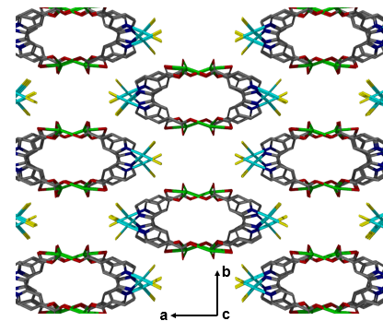
Structural description
 | Pd@MgJMS-2 | Pd@MnJMS-2
Crystal system | monoclinic | monoclinic
Space group | C2/c | C2/c
Volume(Å³⁾ | 4596.9 | 4742.3
a(Å) | 27.22 | 27.53
b(Å) | 7.76 | 7.86
c(Å) | 22.32 | 22.47
β/° | 102.76 | 102.68
Goof | 1.071 | 1.035
z | 8 | 8
Void volume 43.8% and 46.6% for Pd@Mg:JMS-2 and Pd@Mn:JMS-2 respectively

Slide 7
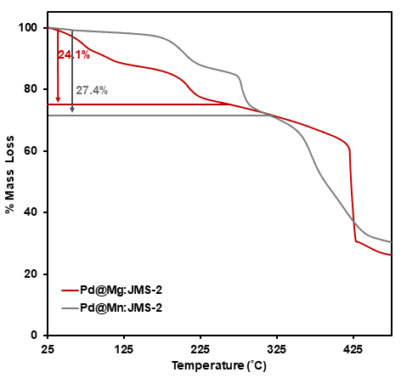
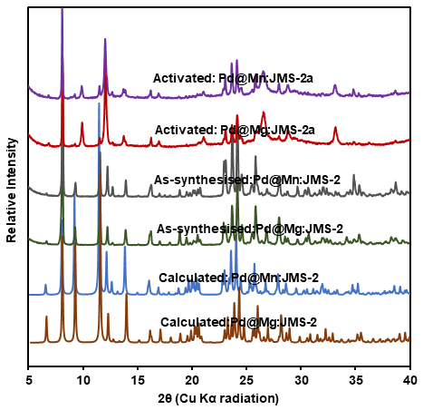
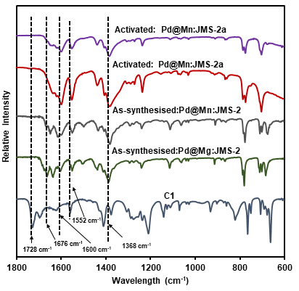
Thermal, PXRD and FTIR analysis

Slide 8
Catalysis Studies
Entry | Catalyst | Base | Temp(°C) | Pressure (bars) (CO₂:H₂) | TON | TOF
1 | Pd@Mn:JMS-2a | Et₃N | 90 | 40 (1:3) | 2448 | 102
2 | Pd@Mn:JMS-2a | KOH | 90 | 40 (1:3) | 4896 | 204
3 | Pd@Mn:JMS-2a | NaHCO₃ | 90 | 40 (1:3) | 3672 | 153
4 | Pd@Mn:JMS-2a | K₂CO₃ | 90 | 40 (1:3) | 484 | 121
5 | Pd@Mn:JMS-2a | None | 90 | 40 (1:3) | 0 | 0
6 | None | KOH | 90 | 40 (1:3) | 0 | 0
7 | Pd@Mn:JMS-2a | KOH | 90 | 20 (1:1) | 1752 | 73
8 | Pd@Mn:JMS-2a | KOH | 90 | 30 (1:2) | 2880 | 120
9 | Pd@Mn:JMS-2a | KOH | 90 | 50 (1:4) | 7488 | 312
10 | Pd@Mn:JMS-2a | KOH | 90 | 40 (0:4) | 0 | 0
11 | Pd@Mn:JMS-2a | KOH | 90 | 10 (1:0) | 0 | 0
12 | Pd@Mn:JMS-2a | KOH | 100 | 50 (1:4) | 9816 | 409
13 | Pd@Mn:JMS-2a | KOH | 100 | 50 (1:4) | 7272 | 303
14 | C1 | KOH | 100 | 50 (1:4) | 4080 | 170
Conditions: Time (24 hours), ethanol (8 mL) and base (5 mmol) and TONs are based on Pd (0.46 µmol). The yield based on ¹H NMR analysis using acetone as an internal standard.

Slide 9
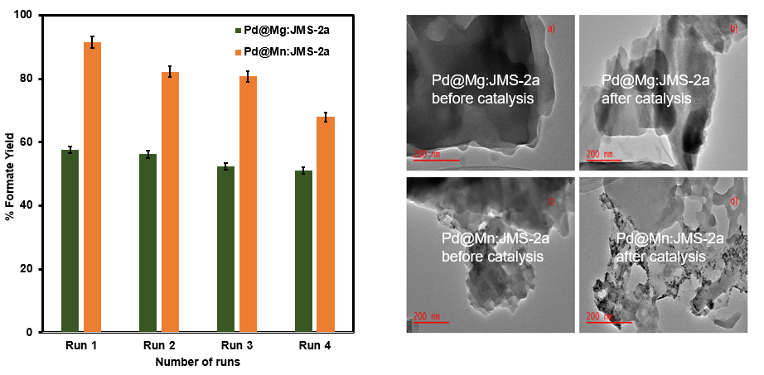
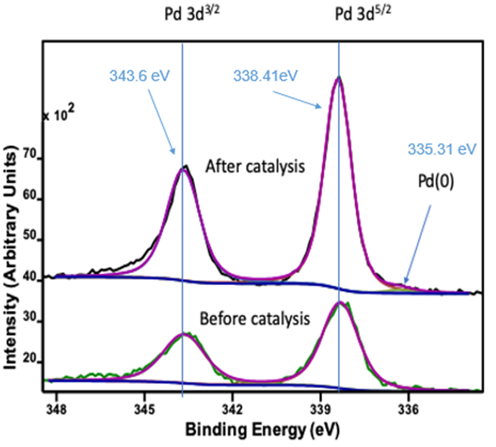
Recyclability Studies

Slide 10
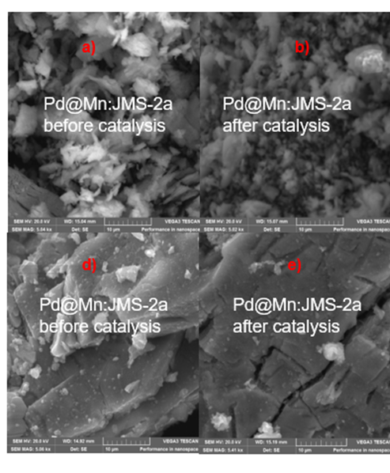
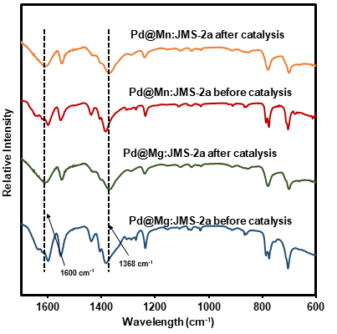
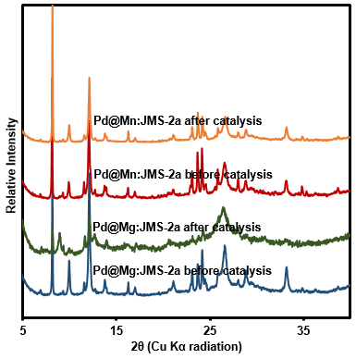
Recyclability Studies

Slide 11
Conclusion
The functionalised MOFs, Pd@Mn:JMS-2a, Pd@Mg:JMS-2a displayed excellent catalytic hydrogenation of CO₂ to formate under relatively mild conditions.
Catalytic performance of homogeneous catalysts can be improved by incorporating them in MOFs as organic linkers bearing catalytic sites.
Future work
Testing the catalysts in a packed bed flow reactor-a crucial step in scaling up the process for industrial applications.

Slide 12
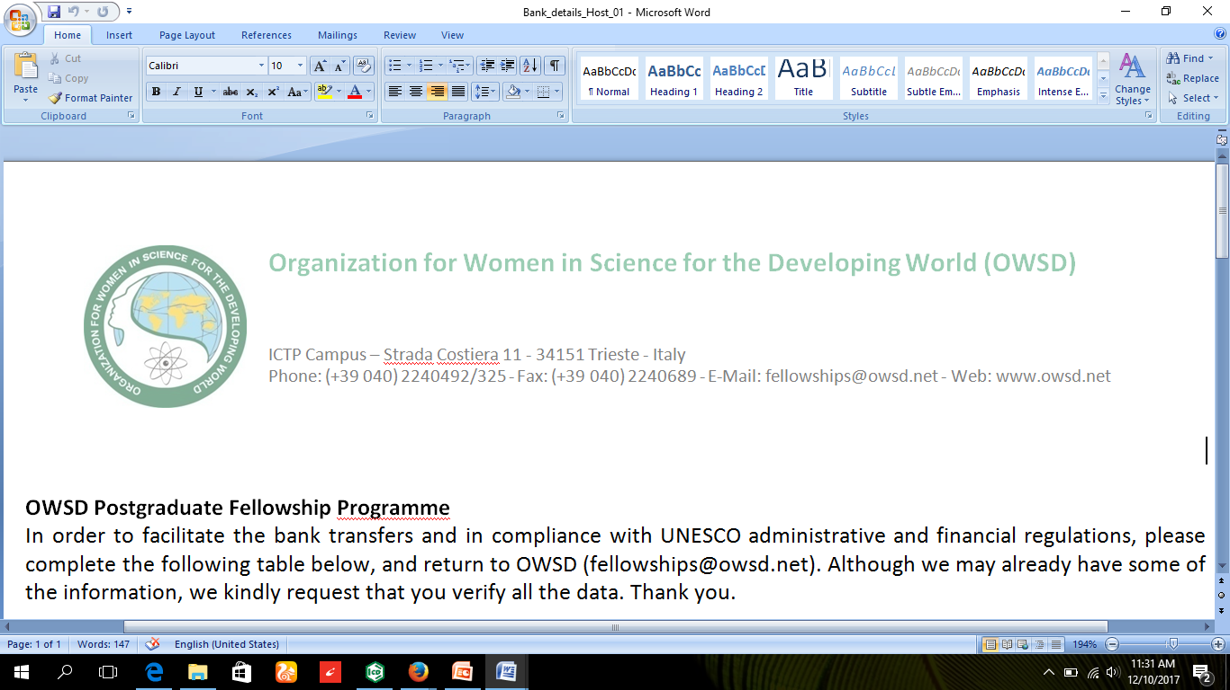



Acknowledgements
Prof. Gift Mehlana
Prof Banothile Makhubela
Dr N Bingwa
Dr Hong Su
Organometallic Group
Gift Mehlana Research Group

