Slide 1
An Optical Analysis of Radiation-Induced Damage in Nuclear Reactor Optical Fibres
Bongani Maqabuka¹, E. Chinaka², S. H. Connell¹, G. Daniels², E. Niyoyadutumye, Tshepo Ntsoane², Kefilwe Thoane²
1. Department of Mechanical Engineering, University of Johannesburg,
2. South African Nuclear Energy Corporation, Research and Technology Development, Pelindaba,
18-22 November 2024
2024 AfLS7 Conference

Slide 2
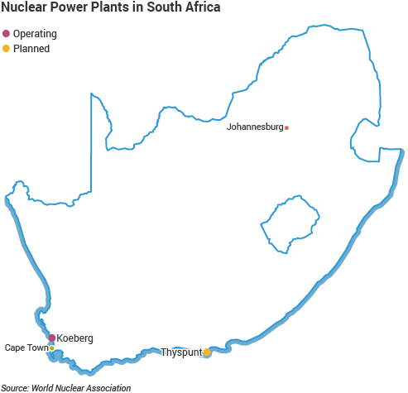
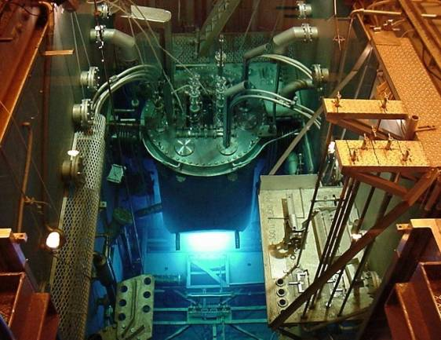
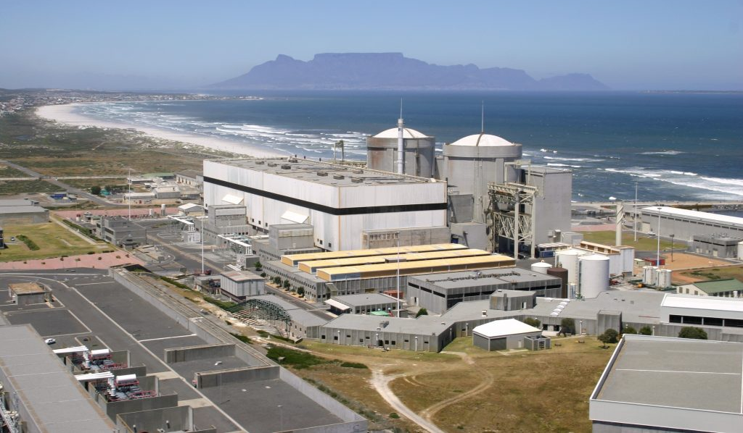
2
South Africa Nuclear Energy Corporation
Koeberg Nuclear Power Station with 2 units of PWR type reactor.
Produce about 1800MW (5% electricity) to the national grid.
NECSA located 20 km West of Pretoria.
SAFARI-1 is a Tank-in-pool, 20MW Material Test Reactor, uses light water as a coolant and moderator.
2

Slide 3
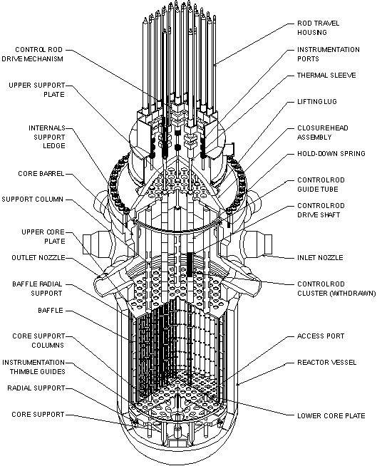
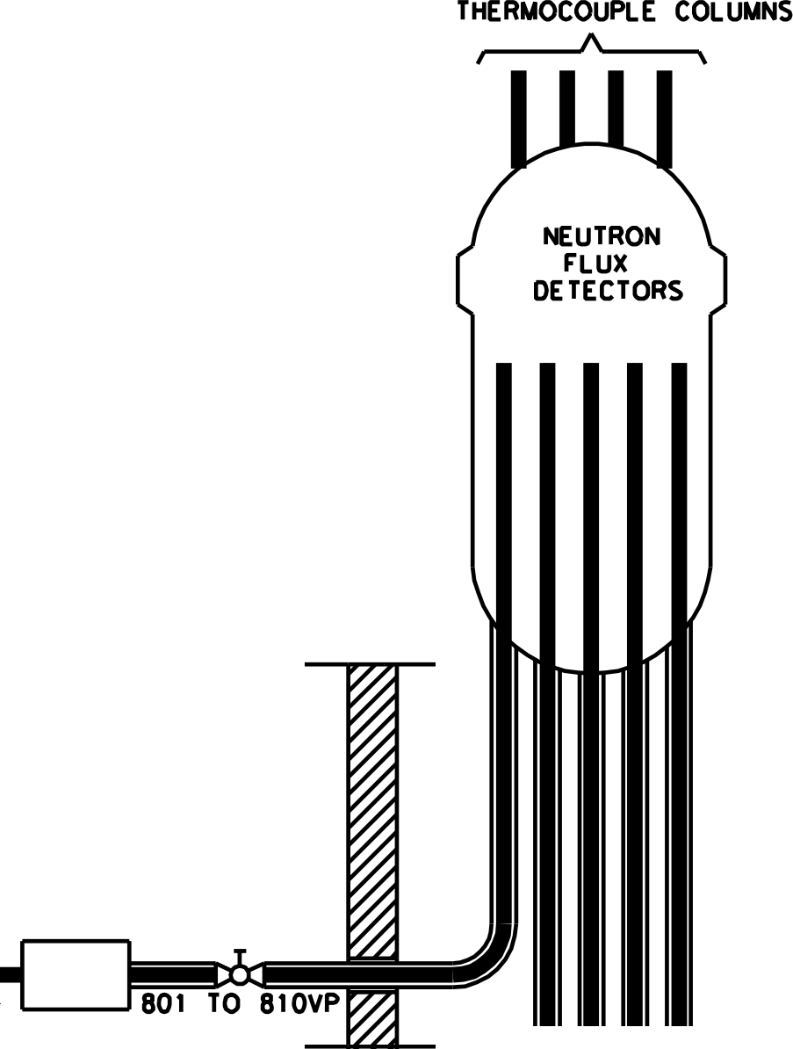
FOS in Nuclear Reactors
3
Pressurized Water Reactor Vessel
Set-up at Koeberg PWR
Koeberg PWR reactor core is 3m x 3m in size.
The core has ~40 blind access tubes penetrating the core.
There is a manifold that approach each tube for the access of the FOS sensors.
There is an emergency crimp sealer.
There are regulatory issues to be carefully considered here.
3

Slide 4
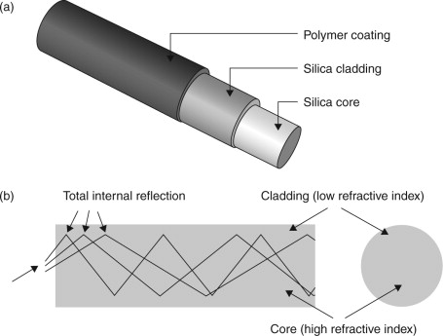
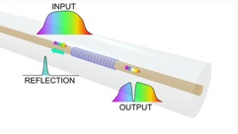
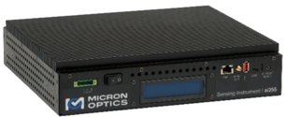
FOS in Nuclear Reactors
4
Pressurized Water Reactor Vessel
Fibre Optic Sensors (FOS)
Novel, First-of-a-kind, survives harsh radiation environments; Many new applications: bio-sensors, space, nuclear reactors, aviation, etc.
φ = 245 μm
φ = 125 μm
φ = 7 μm
Credit: Maria Konstantaki, Foundation of Research and Technology - Hellas)
Developing FOS for measurement of a wide range of nuclear reactor parameters: temperature, water level, dose measurement, pressure, chemical sensing, etc.
NB: there is no technology available to do 3D mapping, in real-time and online of a nuclear reactor.
Fibres can work as point sensors (FBG/LPGs) or in a distributed mode.

Slide 5
Non-exhaustive list of advantages and drawbacks of fibre-optics in nuclear environment
Advantages of fibre-optics
Drawbacks of fibre-optics
Immunity to electromagnetic interference.
Intrinsically safe and passive
Small size, low weight
Less cabling
Multiplexing capabilities
Functions in difficult temperature-radiation conditions
Enhanced redundancy possibilities
Low amount of generated nuclear waste
High potential for remote sensing
High data-rate capacity
Low-cost potential
Sensing with high sensitivity, wide dynamic range
No history of industrial use in nuclear environment.
Unestablished long-term reliability.
Needs special equipment.
Cost associated with implementing new technology.
Maintenance staff is untrained on the technology.
5

Slide 6
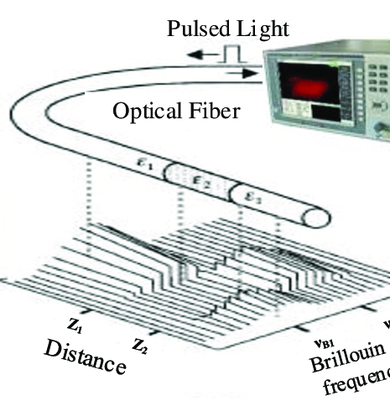
Distributed Optical Fibre Radiation Sensor (DOFRS)
DOFRS is a new radiation monitoring technology which uses doped Optical Fibre (OF) as a sensing unit.
It uses Optical Time Domain Reflectometer (OTDR) to inject high powered optical pulses into the OF.
It is well adapted for radiation detection and dosimetry in large facilities and accelerators.
It allows for online monitoring of the cumulated radiation dose over hundreds of meters with a spatial resolution down to 1 m and a dose resolution down to 10-15 Gy.
Fibres are doped to enhance/amplify the damage of the fibres, e.g., with boron:
Boron $σ_{ }=3^{′}837 barns$
6

Slide 7
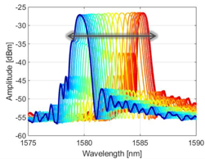
Fibre Optic Sensors: Fibre Bragg Grating (FBG)
from https://indico.cern.ch/event/837593/
7

Slide 8
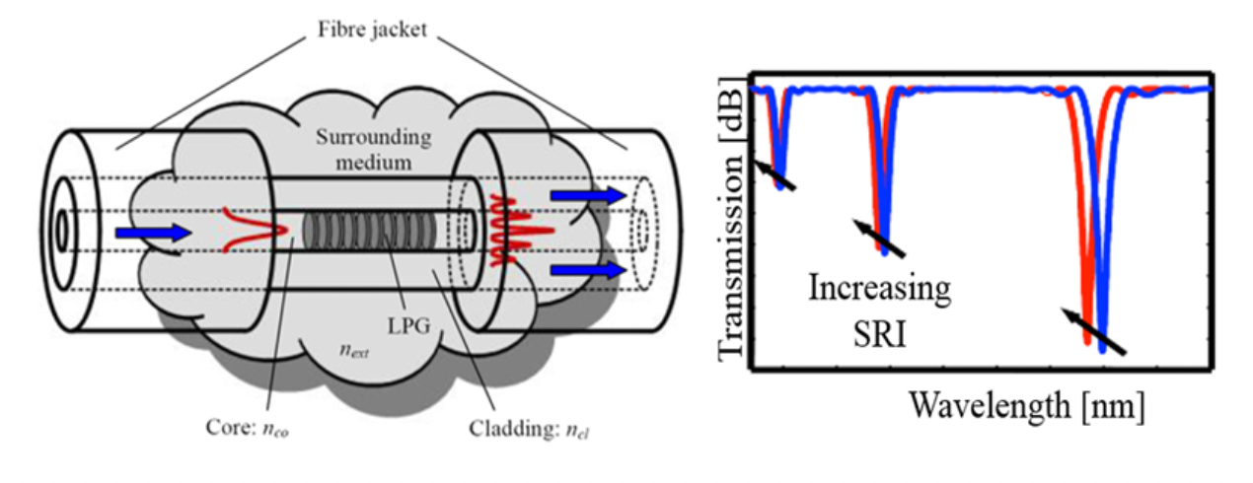
Fibre Optic Sensors: Long Period Grating Sensors (LPGs)
LPG structure is like FBGs; however, the perturbation is longer: the length of the grating is usually around 2-3 cm.
The perturbation allows for the power coupling from the fundamental guided core mode to a discrete number of forward propagating cladding modes. Each coupling happens at a distinct wavelength, where the so-called phase matching condition is satisfied:
8

Slide 9
Selected Fibres for Irradiation Tests
3 Types of Fibres have been selected - irradiated 7 cm long samples in an enclosed capsule in-core.
Acrylate coated fibre;
ORMOCER (ORganic MOdified CERamic) coated;
Naked fibre.
 | Acrylate | ORMOCER
1. Core NA | 0.14 +/- 0.01
2. Attenuation @ 1550 [dB/km] | 0.2 | 2.5
3. Outside Cladding diameter [µm] | 125 +/- 5 | 125
4. Coating diameter [µm] | 245 +/- 15 | 195
5. Core material | Pure Silica | Pure Silica
6. Operating temperature range [⁰C] | -60/300 | -200/200
9

Slide 10
Non-instrumented FOS irradiation
Simple irradiation tests done to determine changes in physical and mechanical properties of the fibres as the radiation level is increased.
For an estimated flux level of 6.5 x 10¹⁴ n/cm²-s
from fast neutron spectrum E_{n} > 1 MeV
Total Fluence [n/cm²] | 1.18 x 10²¹ | 3.14 x 10²¹ | 4.72 x 10²¹ | 6.29 x 10²¹
No. of Days | 21 days | 56 days | 84 days | 112 days
10

Slide 11
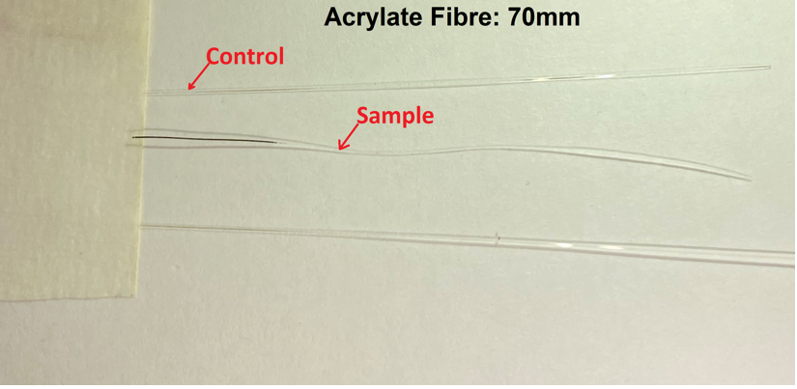
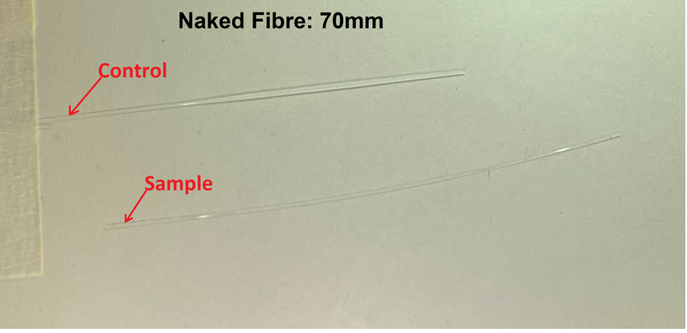
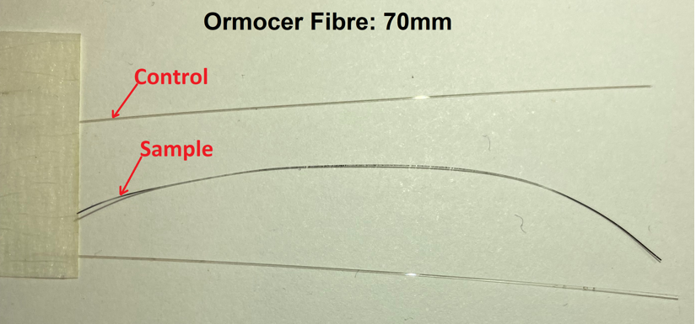
Our Irradiation Test Results from SAFARI-1
Both coated fibres, acrylate and ormocer coated fibres were extremely brittle after irradiation tests in the nuclear reactor making further analysis impossible on them.
The naked quartz fibre came out of irradiation stronger than the coated fibres.
11

Slide 12
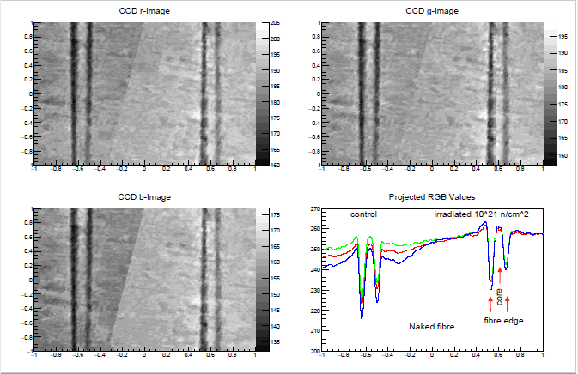
Optical Image Analysis of the Naked fibres
12

Slide 13
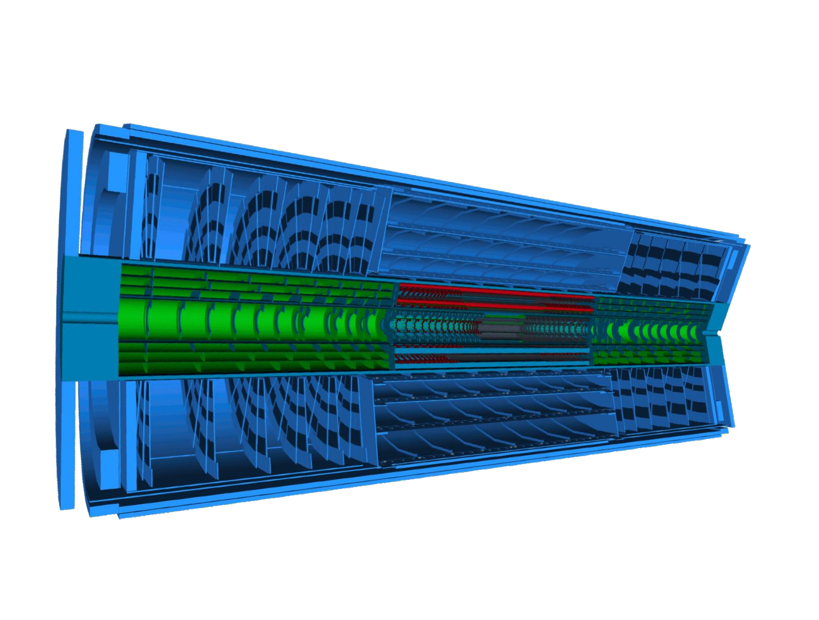
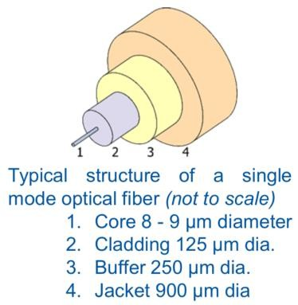
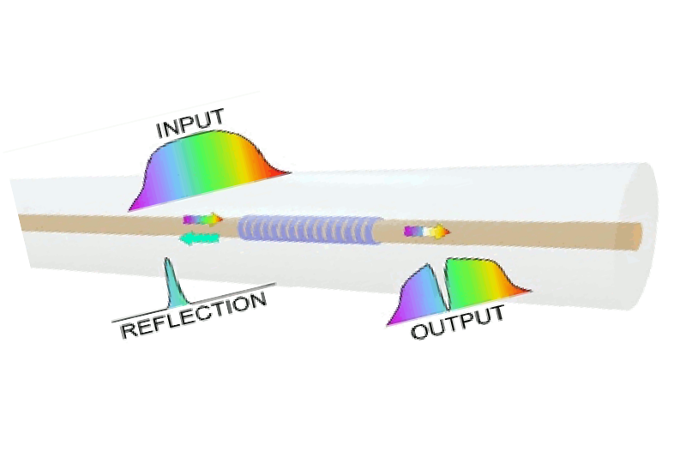
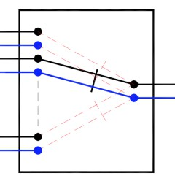
UJ FOS at CERN: Humidity Sensing
Sensitive region
ATLAS ITK
New radiation hard
fibre optic
humidity sensors
OPC
UA Server
ATLAS
P1
DAQ PC
13

Slide 14
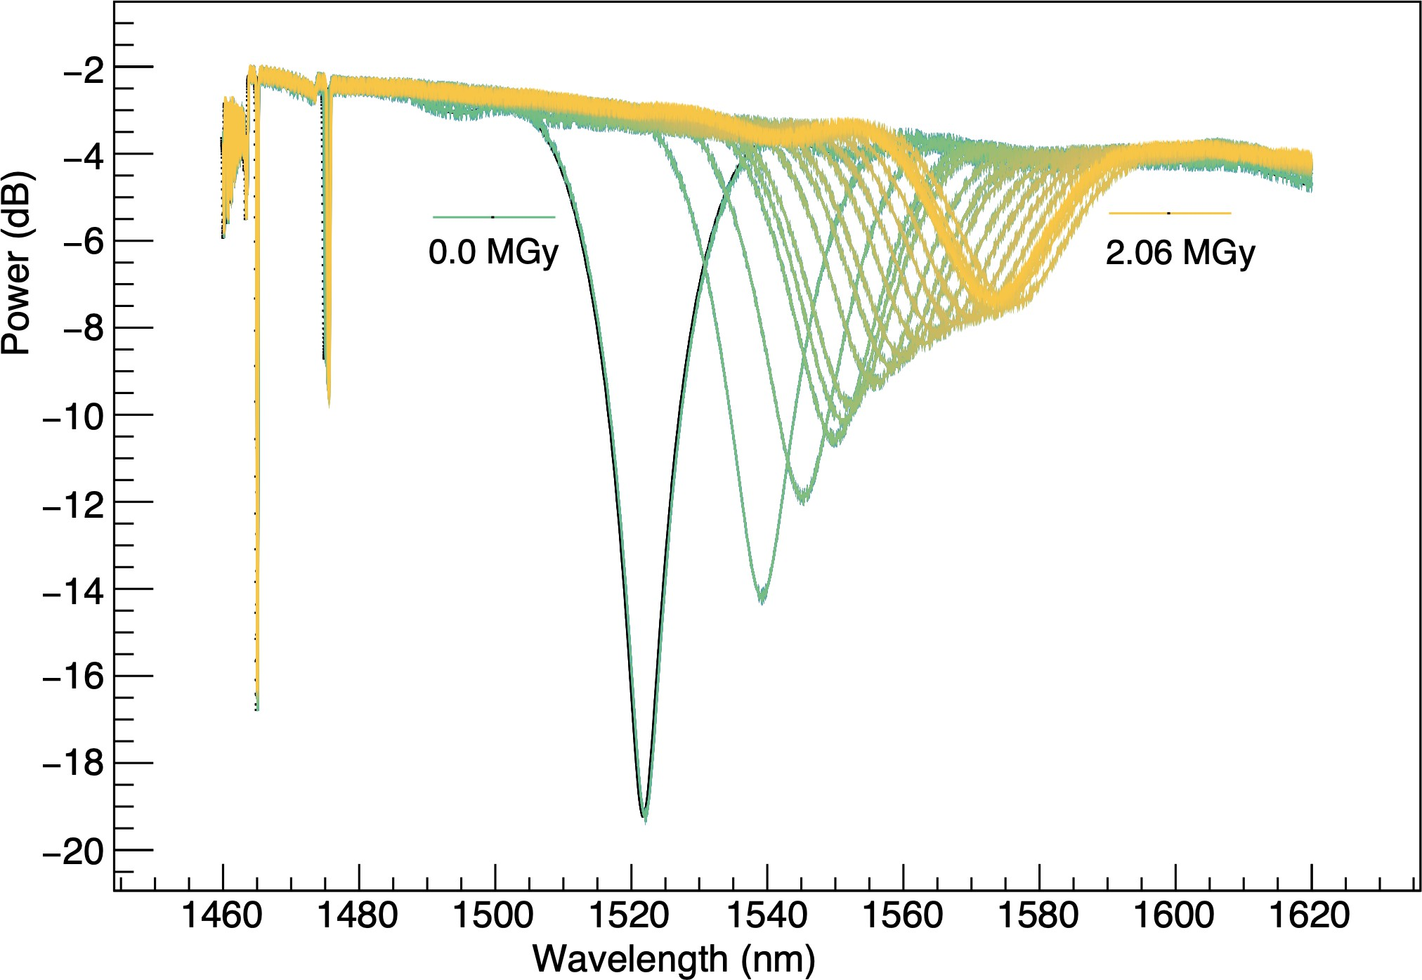
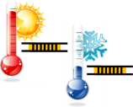
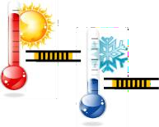
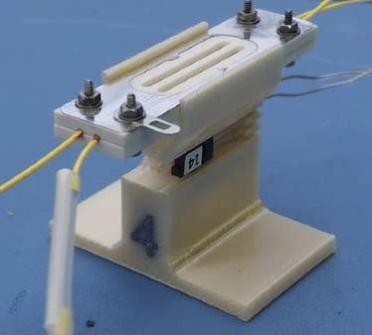
Fibre Optic Sensor (FOS) Package: 2 FBGs + LPG, 2 MGy
Novel
Pre-commercial
FOAK
Survives 2MGy
Alive, measuring
R&D @
CERN,
Sannio,
Johannesburg
FBG(T,D)
~55 nm
LPG functional coating – TiO₂ with 8 layers
Beam Properties:
Beam type = p⁺
Dose = 2 MGy
Momentum = GeV/C
Beam area = 3 cm x 3 cm
LPG(T,D,RH)
FBG(T)
14

Slide 15
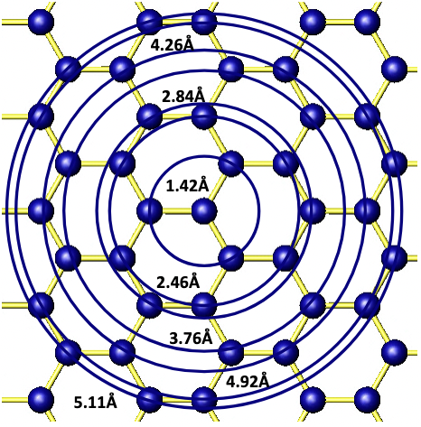
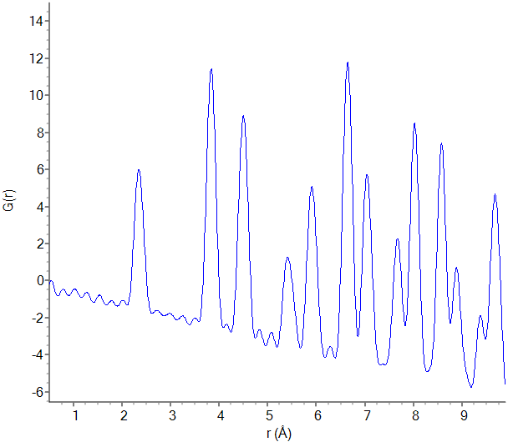
Envisaged Analysis of the FOS at ESRF
Some of the Material Analysis Techniques we are considering for our FOS samples include:
1. Pair Distribution Function (PDF) Analysis:
It is a technique used to study short- and medium-range atomic ordering in materials.
It provides information on atom-to-atom distances, which would indicate structural order-disorder pre- and post-irradiation as affected by radiation.
It should give us insights into the local crystallographic structure of our SiO₂ samples.
Information content
Peak positions
Bond lengths, interatomic distances
Peak areas
Coordination number
Peak widths
Static and Dynamic disorders
15

Slide 16
Envisaged Analysis of the FOS at ESRF
2. Phase Contrast Imaging (PCI):
PCI is an X-ray imaging technique that enhances the visualization of minute structural details, particularly useful for examining low-contrast features such as voids, microcracks and subtle density variations that result from radiation exposure.
PCI should reveal radiation-induced defects within the fibre core, and cladding layer(s).
16

Slide 17
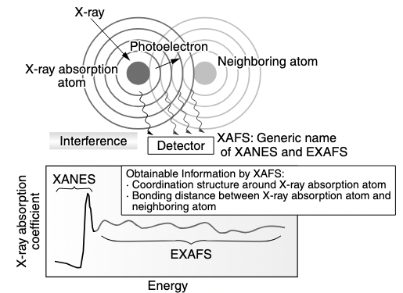
Damage Analysis of the FOS Samples
3. X-ray Absorption Fine Structure (XAFS) Spectroscopy:
XAFS is a powerful tool for investing local chemical environments, bonding, and electronic states of specific elements within a material.
It is sensitive to subtle structural and electronic changes and is ideal for examining radiation-induced defects in the fibre material.
By comparing irradiated and control samples, we will be able to determine any shifts in bond lengths, or coordination numbers.
It will reveal whether ionizing radiation has altered the local atomic structure around silicon or dopant atoms, helping to identify the specific nature of the defects.

Slide 18
Conclusions
We have irradiated 3 sets of fibres – acrylate coated, ORMOCER, and an uncoated (Naked) fibres at SAFARI-1 MTR at NECSA.
Irradiated the fibres for a period of 21 days to an integrated fluence of $\sim 2 ×{10}^{21}n/{{cm}^{2}}$.
Optical analysis using light scanning microscope did not show any discoloration of the fibre (the Naked) post-irradiation.
Further analysis tests on the Naked fibre are being arranged at the ESRF synchrotron to test the level of damage in the fibres.
The tests will include the Phase Contrast Imaging (PCI), Pair Distribution Function(PDF), and X-ray Absorption Fine Structure (XAFS) techniques which will determine if there is any underlying damage at a microscopic or atomic level of the structure.

Slide 19
References
B. Maqabuka, G. H. Daniels, S. H. Connell, F. Pieterse, L. Bedhesi, E. Chinaka, P. Naidoo, D. Nicholls, and J. Slabber; “An Optical Analysis of Radiation-Induced Damage in Nuclear Reactor Optical Fibres”; 2024 32nd Southern African Universities Power Engineering Conference (SAUPEC), Stellenbosch, South Africa, 2024, pp. 1-4, doi: 10.1109/SAUPEC60914.2024.10445064.
B. G. Maqabuka, D. Nicholls, S. H. Connell, P. Naidoo, F. Pieterse, J. Slabber, L. Bedhesi, E. Chinaka, G. Daniels; “Fibre Optic Sensors for Nuclear Power Reactors”; 10th CIGRE Southern Africa Regional Conference 2nd-4th November 2021, Johannesburg, South Africa.
Yoshiro SAITO, Junji IIHARA, Koji YAMAGUCHI, Tetsuya HARUNA and Masashi ONISHI; “Structure Analysis Technology for Amorphous Materials by Synchrotron Radiation X-ray Measurements and Molecular Dynamics Simulations”; Sie Technical Review 67, 27 – 32 (2008).
P. Cloetens, W. Ludwig, J. Baruchel, D. Van Dyck, J. Van Landuyt, J. P. Guigay, and M. Schlenker; “Holotomography: Quantitative phase tomography with micrometer resolution using hard synchrotron radiation x rays.”; Applied Physics Letter 75, 2912 (1999).
17

Slide 20
Thank you!
18

Slide 21
Next Phase of FOS development: Instrumented FOS irradiation
Fibres connected to an interrogator for in situ measurement.
Differential studies of light attenuation and performance of fibres/sensors at logarithmic intervals of irradiation dose.
Encapsulate the irradiated fibres in a “sword” of pure reactor grade Al tube.
Perform accompanying simulations to support the testing and engineering development of the fibres.
Quantify the fibre functionality at full reactor operation.
19

