Slide 1

Synchrotron Techniques on Moisture Triggered Crystallization of Triple Cation Perovskite to Elucidate Phase Progression Nucleation
Miller Shatsala
Advanced Light Source, Lawrence Berkeley National Laboratory, Berkeley,CA,USA.
Department of Physics, Masinde Muliro University of Science and Technology, Kakamega, Kenya

Slide 2
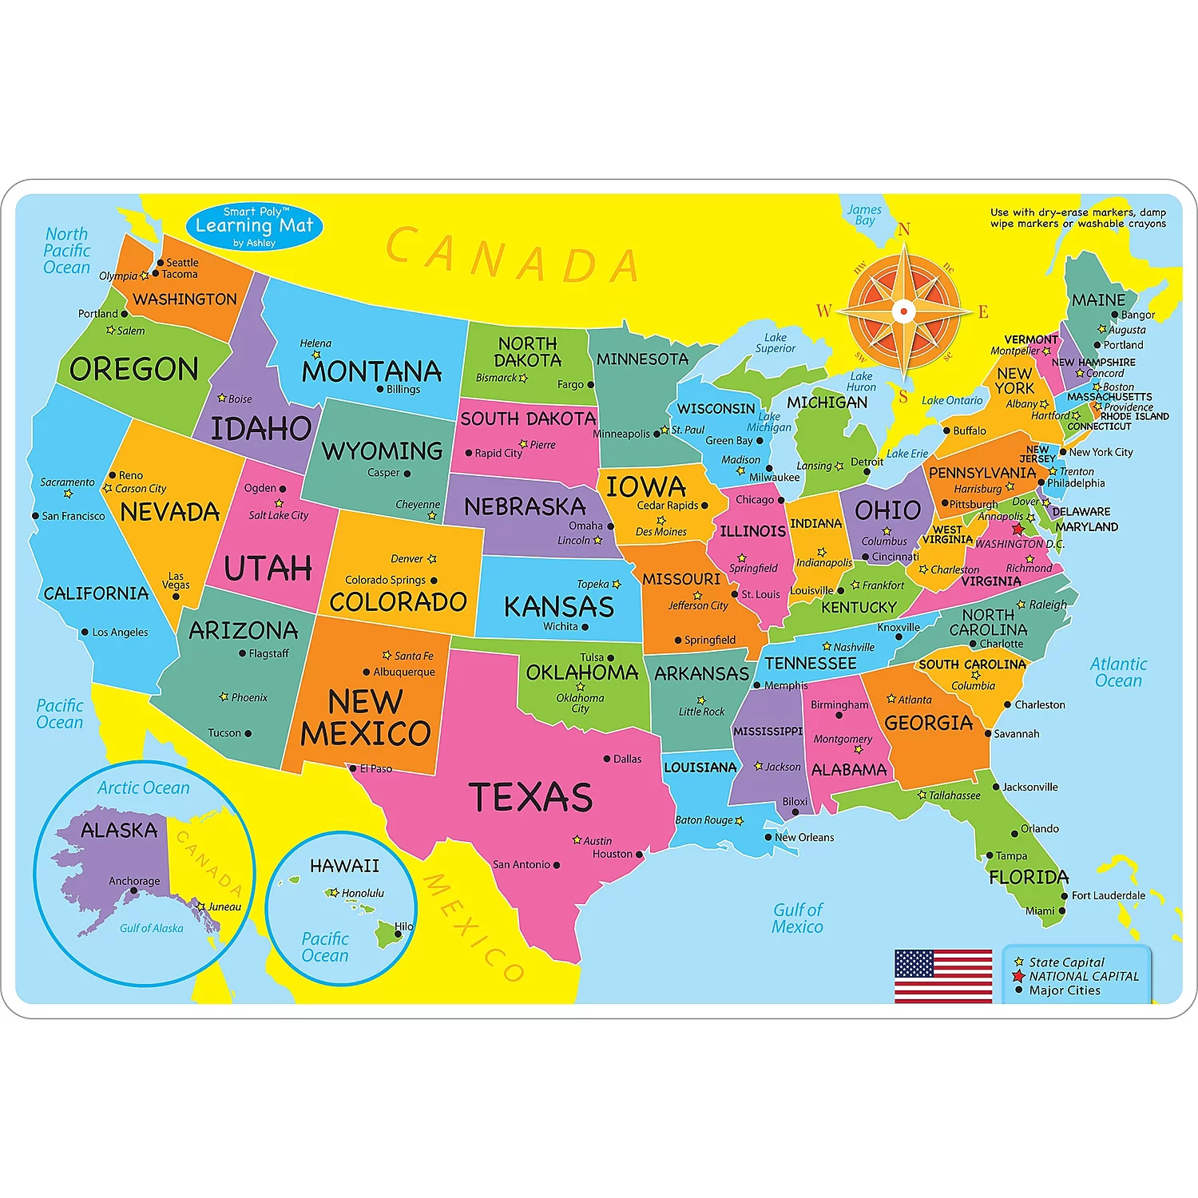

Current: LAAAMP FAST award & ALS fellowship
Google source

Slide 3

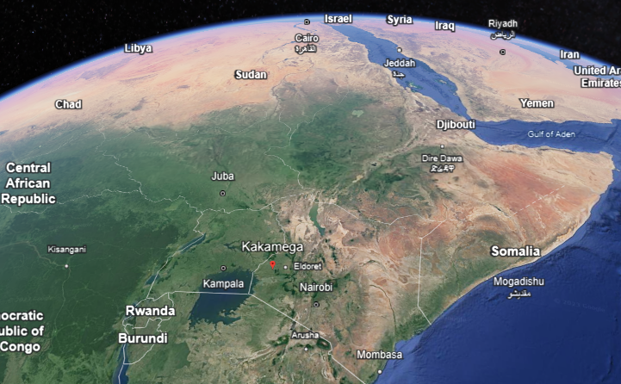
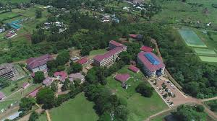
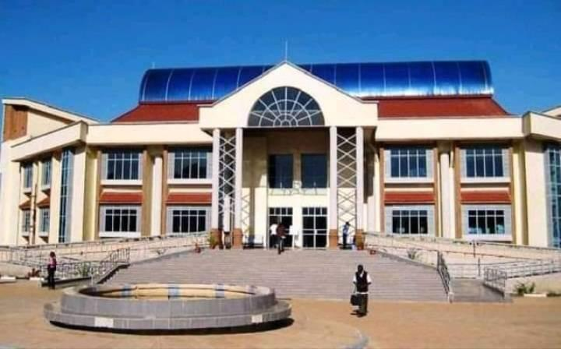
Home: Masinde Muliro University of Science and Technology

Slide 4
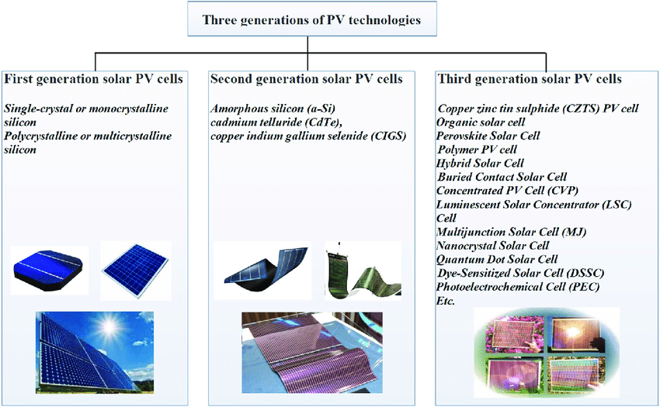
Motivation
PEROVSKITE USES
Sensors and catalyst electrodes
fuel cells
solar cells
Lasers
memory devices
Spintronics
ISSUES
INSTABILITY
Zhang, T., Wang, M., & Yang, H. (2018). Energies, 11(11), 3157.

Slide 5
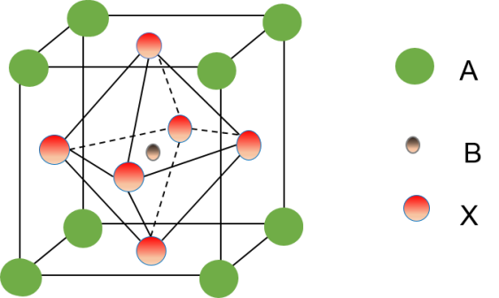
Perovskites
ABX₃
MA: methyl ammonium
FA: formamidinium
A: (CH₃NH₃)⁺, Cs⁺, (CH₃(NH₂)₂)⁺,…
B: Pb²⁺, Sn²⁺,…
X: I⁻, Br⁻, Cl⁻
Processing from salt solutions
CH₃NH₃PbI₃: mature, most prominent
E_{g} = 1.55 eV, long diffusion length
CH₃NH₃Pb(IxBr1-x)₃: tunability of E_{g}
Cs(MA,FA)Pb(IxBr1-x)3: increase of stability
Kojima et al., J. Am. Chem.Soc. 131 (2009) 6050
Stranks et al., Science 342 (2014) 341

Slide 6

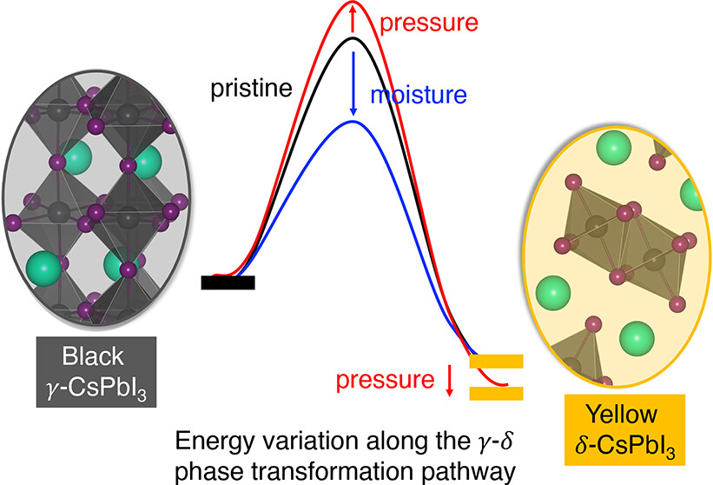
Sample preparation
100ul of precursor solution spin coated onto a substrate in two steps 30s.
Annealing at 150⁰C for 15 minutes on a hot plate with 500 rpm..
Anti-solvent introduced after 20s of spin coating (CB/EA)
Precursor dropping
ITO substrate
Hot plate
Perovskite film
Spin Coater
Reversible

Slide 7
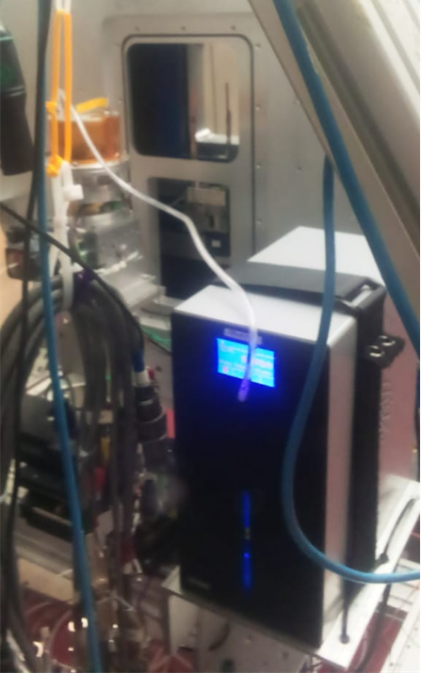
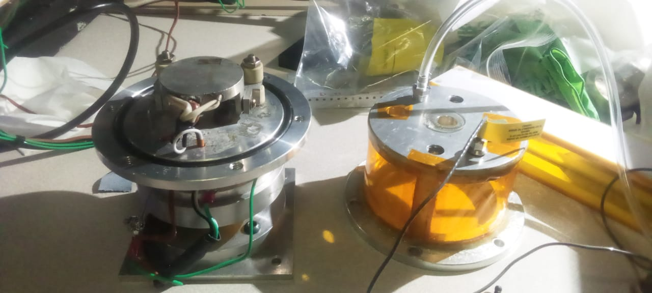
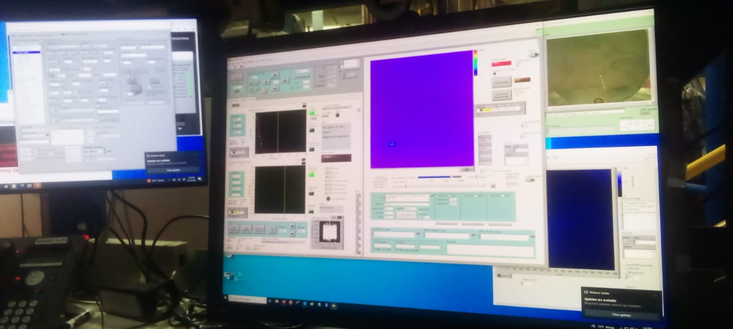
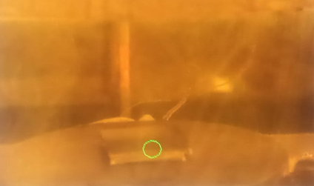
Beamline Technique
MMSC mounted on the stage
custom-built Multi-Modal Spin Coater with auxiliary inputs.
Sample viewed from the computer interface
Computer Interface
Humidity Controller

Slide 8
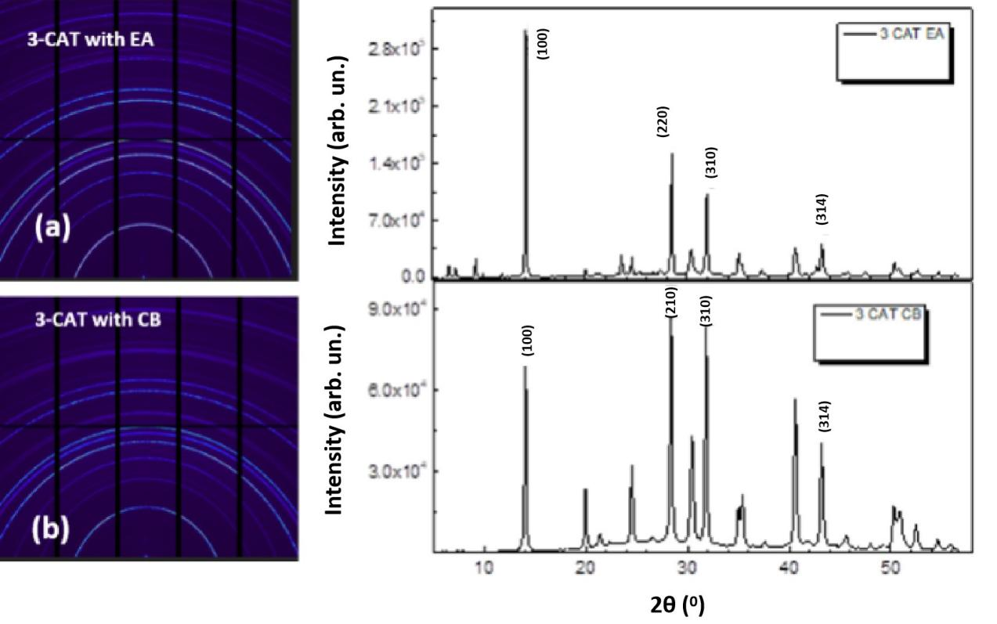
Micro-difraction Results
3-CAT Peak identificatication (CB/EA)
Beamline 12.3.2 Advanced Light Source
Figure 1| Micro-diffraction peaks for 3-CAT dissolved in both EA and CB. Sharp peaks of the perovskite phase (100) with small peaks of crystal planes of (220), (310) and (314) corresponding to plane angles of 14.1⁰, 28.5⁰, 34.1⁰ and 43.6⁰ respectively.

Slide 9
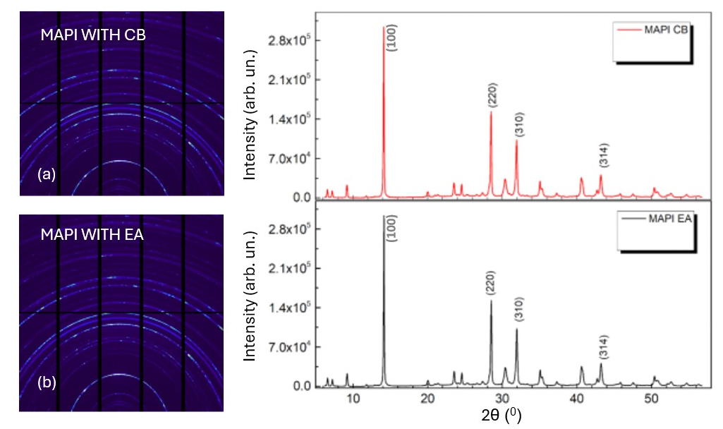
Micro-difraction Results
MAPI Peak identificatication (CB/EA)
Beamline 12.3.2 Advanced Light Source
Figure 2| Micro-diffraction synchrotron maps for films treated with different anti-solvents (a) MAPI treated with CB and the corresponding 1D peaks adjacent. (b) MAPI treated with EA with the adjacent 1D peaks.

Slide 10
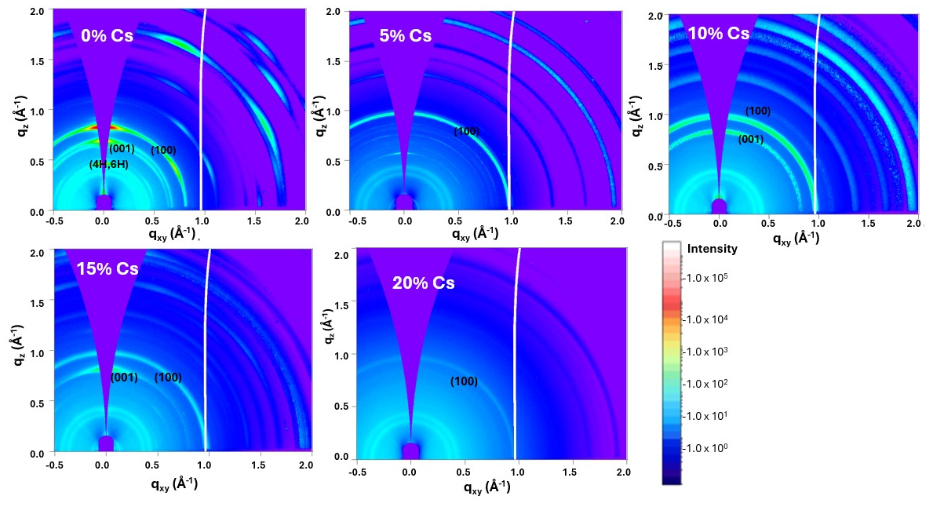
GIWAXS Results
Cs variation for 3-CAT
Beamline 7.3.3 Advanced Light Source
Figure 3| GIWAXS maps of triple cation (3-CAT) with varying cesium concentration in triple cation at (a) 0% Cs ; (b) 5% Cs; (c) 10% Cs; (d) 15% Cs and ( e ) 20%

Slide 11
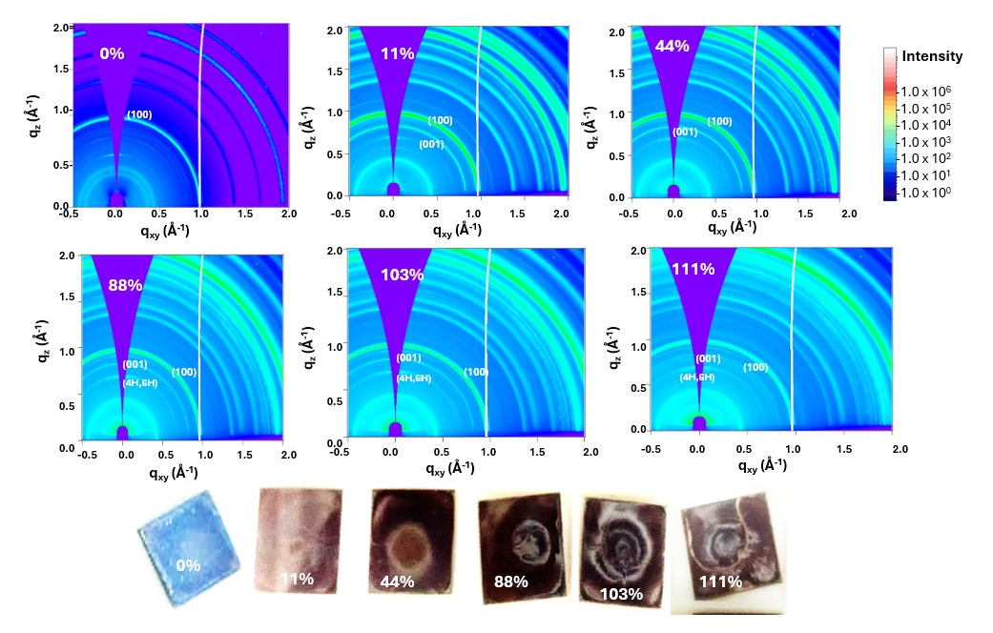
GIWAXS Results
Humidity probing for 3-CAT
Beamline 7.3.3 Advanced Light Source
Figure 4| GIWAXS maps of triple cation (3-CAT) upon exposure to moisture of relative humidity for (a) 0% (b) 11 % (c) 44 % (d) 88 % (e) 103% and (f) 111 %. The real perovskite films with respective humidities are shown.

Slide 12
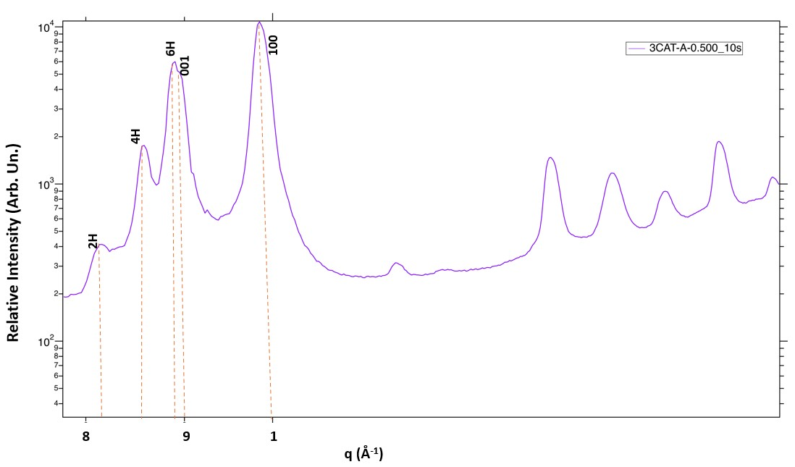
GIWAXS Results
1D profie for humidity
Beamline 7.3.3 Advanced Light Source
Figure 5| GIWAXS of triple cation with 5% Cs in q-space for RH of 111%

Slide 13
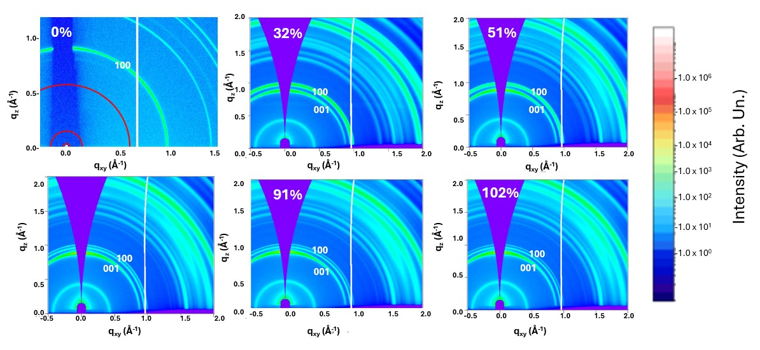
GIWAXS Results
Humidity probing for MAPI
Beamline 7.3.3 Advanced Light Source
Figure 6| GIWAXS maps of MAPI when exposed to relative humidity (RH) of (a) 0% % (b) 32%; (c) 51% (d) 82% (e) 91% and (f) 102%

Slide 14
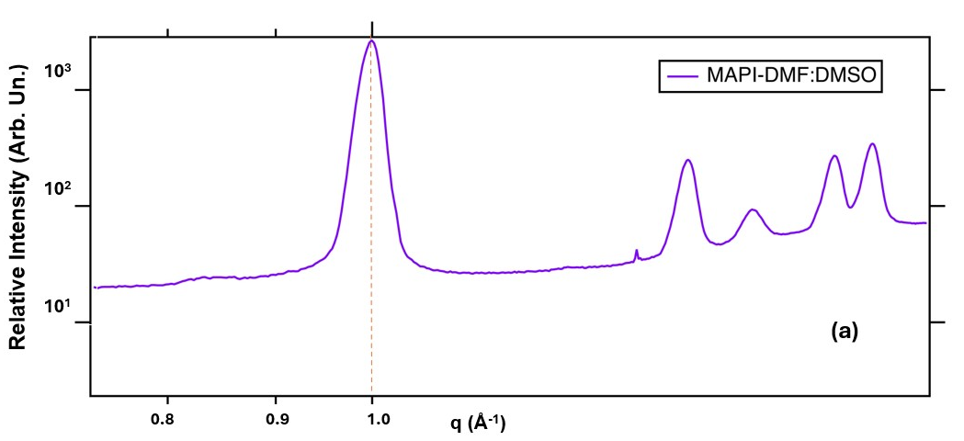
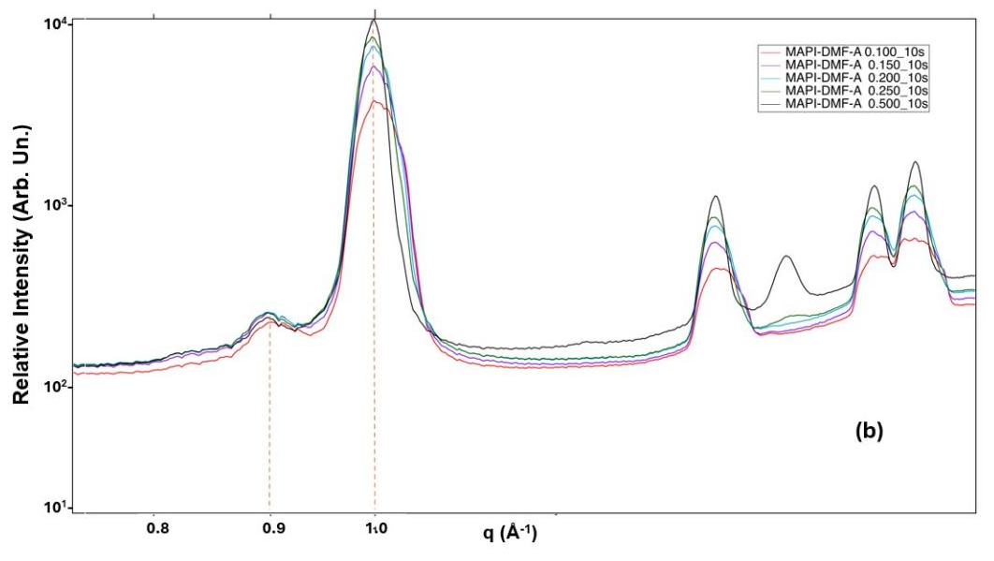
GIWAXS Results
1D profile for MAPI humidity
Beamline 7.3.3 Advanced Light Source
Figure 7|GIWAXS peaks of MAPI when exposed to 10% relative humidity (RH) for 10s with a slight variation of scanning points ranging from 0.100mm to 0.500mm starting from the edge of the sample.

Slide 15






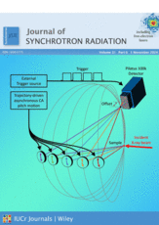


Acknowledgements
Prof. Sekazi Mtingwa- LAAAMP
Ashley White - Deputy Director communications- ALS
Chenhui Zhu and Nobumichi Tamura – Advanced Light Source (LBNL)
Carolin Sutter-Fellow- Molecular Foundary (LBNL)
Dr. Celine Awino -MMUST
Prof. Husein Golicha, Dr. Maxwell Mageto - MMUST

Slide 16
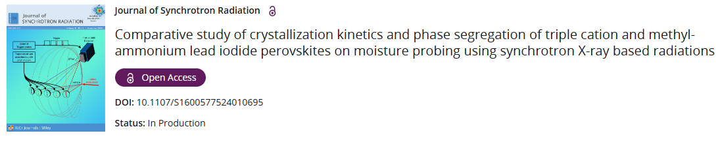


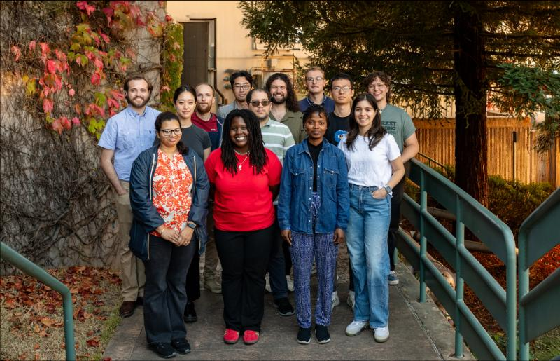

Publication
AfLS Outreach for potential users
Omolara Bakare
Virgia Tech
Tianying Liu
University of Boston
Nushrat Naushin
UC Davis
Nicole Taylor
Havard University
Nadja Maldonado Luna
UC San Francisco

Slide 17
Thank You.
Any Questions?

