Slide 1
AfLS7
Updates on Synchrotron and Crystallography Human Capacity and Infrastructure Building in Developing Countries
Sekazi K. Mtingwa
Chair, Executive Committee, LAAAMP
Member, Executive Committee, AfLS
19 November 2024

Slide 2

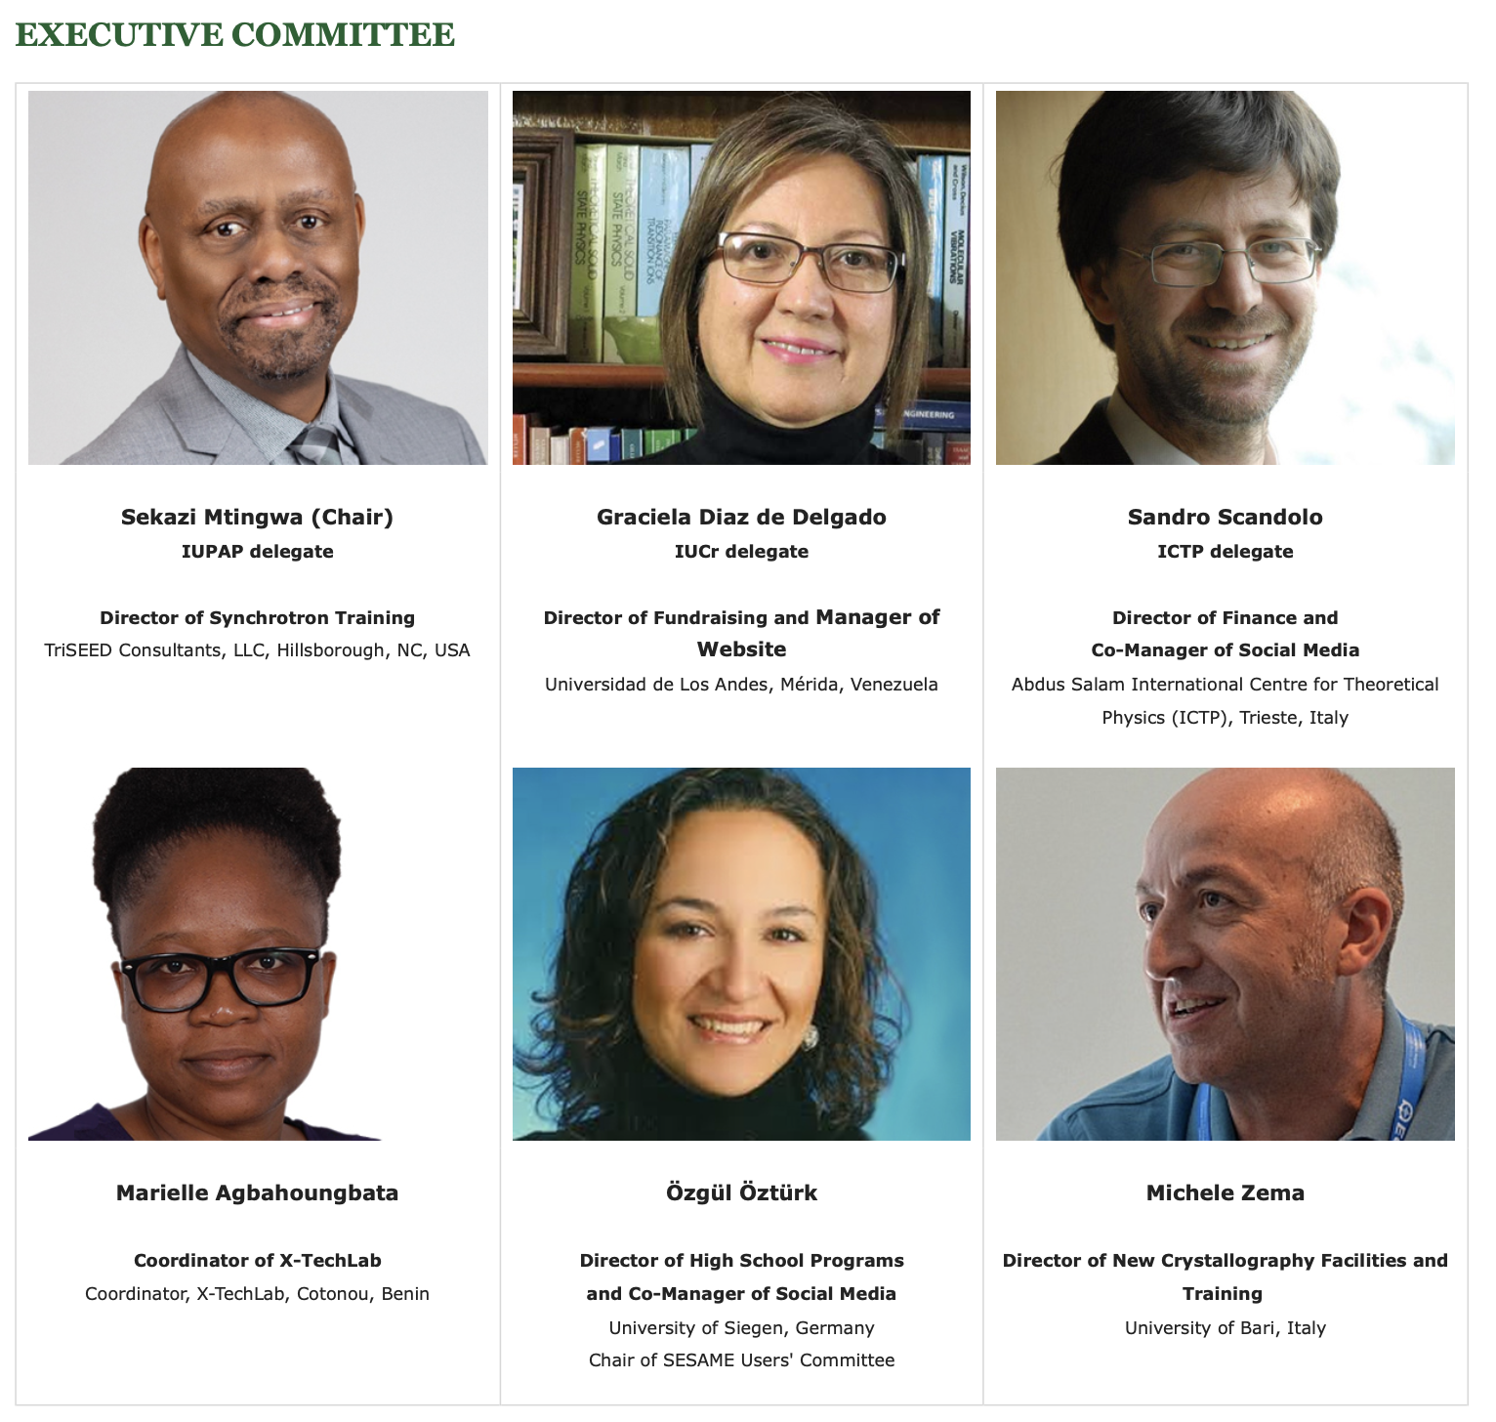



https://laaamp.iucr.org/

Slide 3
LAAAMP Participating Advanced Light Sources
Advanced Light Source (ALS), Lawrence Berkeley National Laboratory (LBNL)
Advanced Photon Source (APS), Argonne National Lab (ANL)
ALBA Light Source (Barcelona, Spain)
Australian Synchrotron, Australian Nuclear S&T Org. (ANSTO), (Clayton, Melbourne)
Canadian Light Source (Saskatoon, Canada)
DELTA Light Source (Dortmund, Germany)
Elettra Light Source (Trieste, Italy)
European Synchrotron Radiation Facility (ESRF, Grenoble, France)
MAX IV Laboratory (Lund, Sweden)
National Synchrotron Light Source-II (NSLS-II), Brookhaven National Lab (BNL)
Photon Factory, Institute of Materials Structure Science (IMSS) of KEK (Tsukuba, Japan)
Pohang Accelerator Laboratory (Pohang, Republic of Korea)
SESAME Light Source (Allan, Jordan)
SIAM Photon Source (SPS), Synchrotron Light Research Inst. (Nakhon Ratchasima, Thailand )
Sirius Light Source (Campinas, Brazil)
SLAC National Accelerator Laboratory
Taiwan Photon Source (TPS), Nat’l Synch. Radiation Res. Center (NSRRC, Hsinchu, Taiwan)

Slide 4
LAAAMP Tasks
Regional Committees develop Strategic Plans for each Region
TASK 1
Establish an AdLS/Crystallography Colloquium Programme, leading to Regional Crystallography Research & Hubs
TASK 2
Publish and Disseminate an AdLS/Crystallography Information Brochure
TASK 3
Promote and Facilitate Researcher and Student Short- & Long-Term Visits/Study at International AdLS and Crystallography Facilities and Schools (including IUCr-UNESCO OpenLabs)
TASK 4

Slide 5
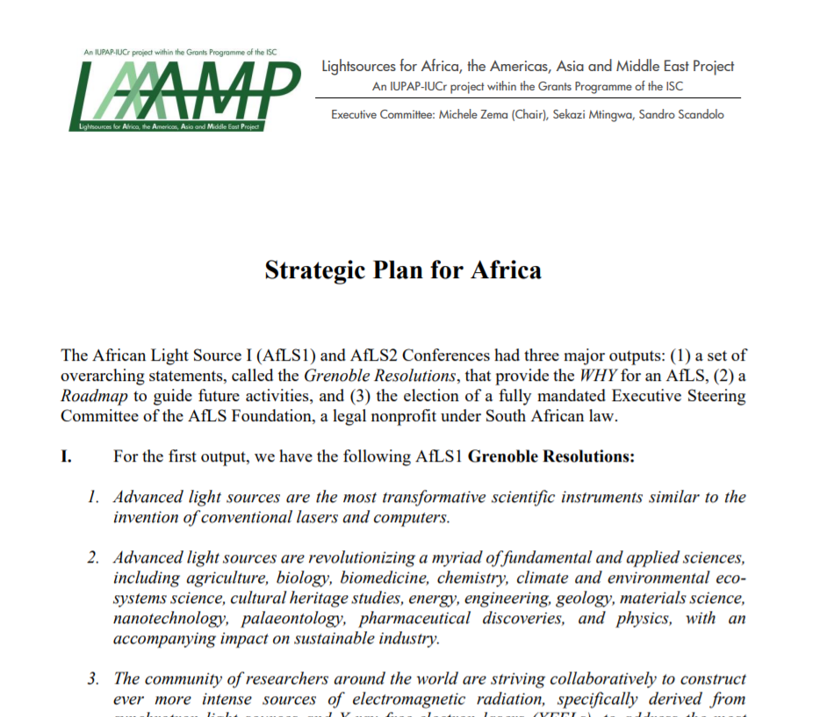
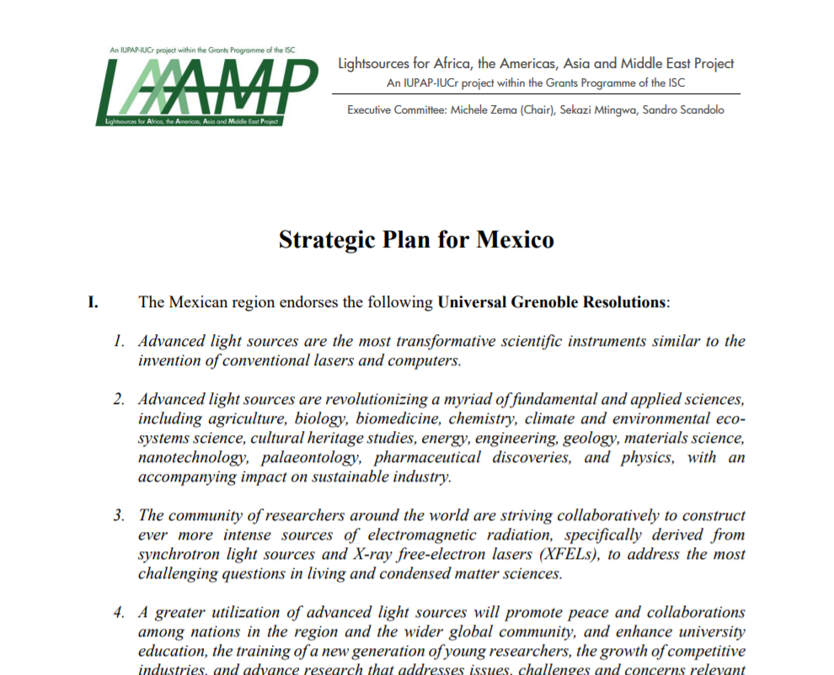
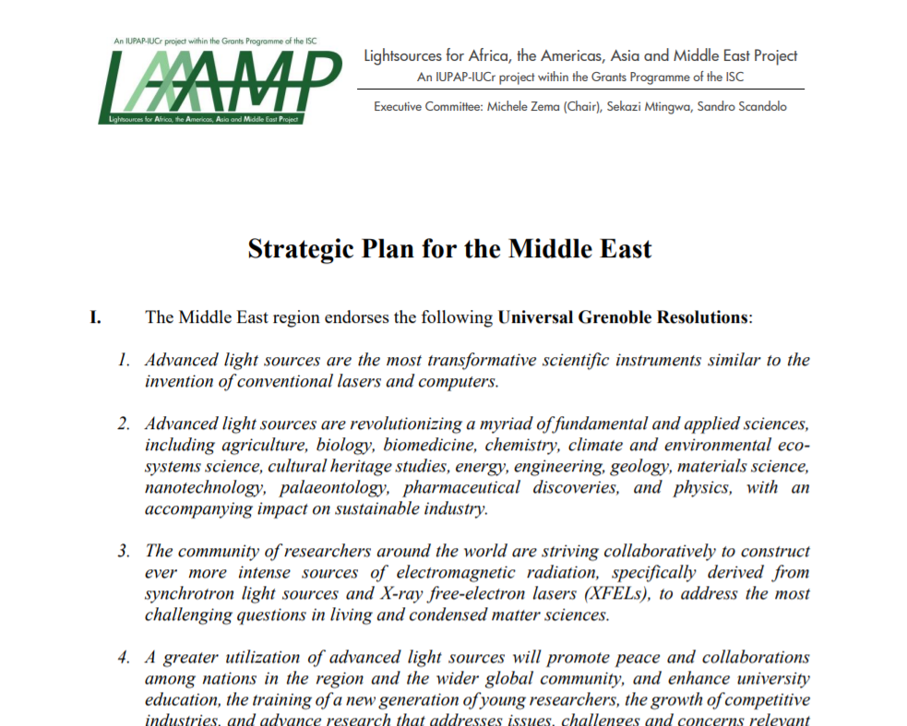
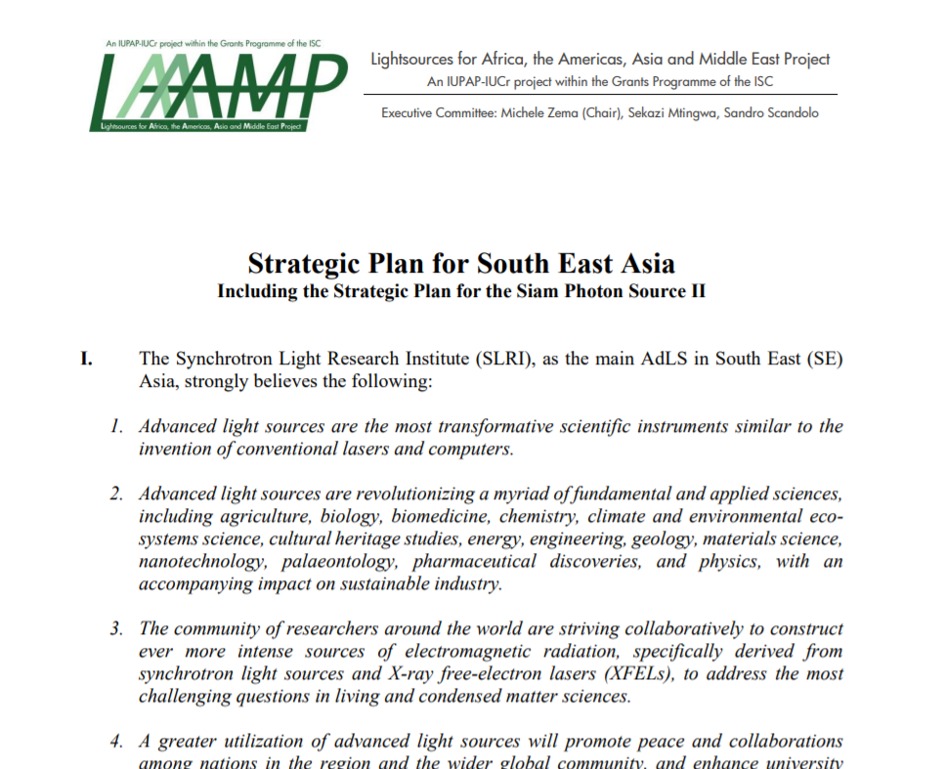

https://laaamp.iucr.org/tasks/strategic-plans

Slide 6


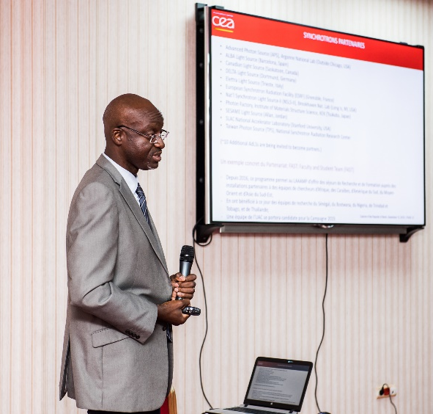
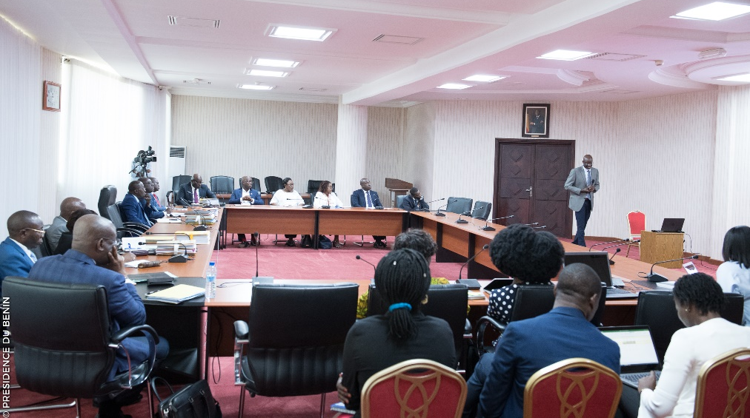

X-TechLab at Sèmè City, Benin
Thierry d’Almeida presenting LAAAMP and the X-TechLab project to the Cabinet of the Government of Benin.
X-TechLab is aimed at training Faculty and Master’s and Ph.D. students from African countries every year, and at establishing a permanent user research facility with experienced, permanent staff to act as a hub for the region.

Slide 7
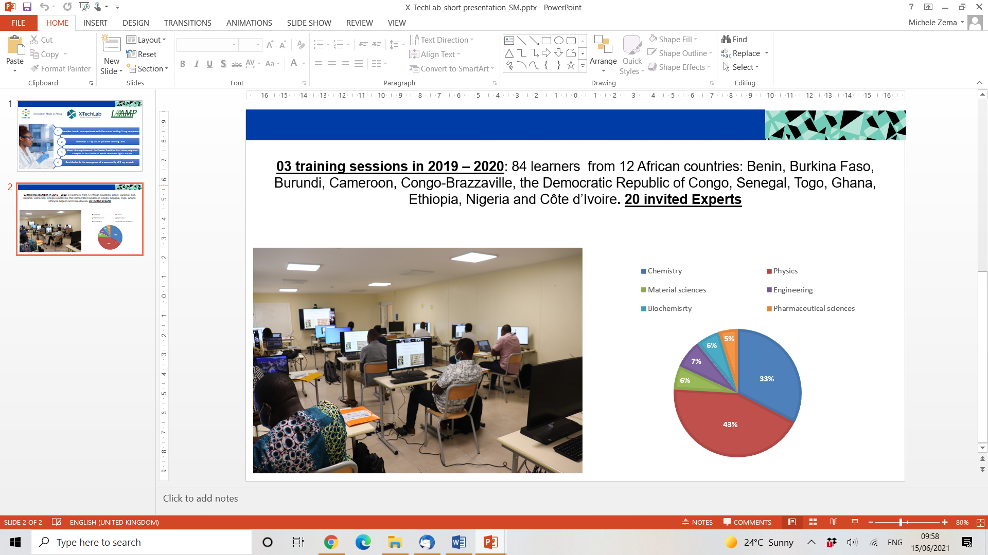
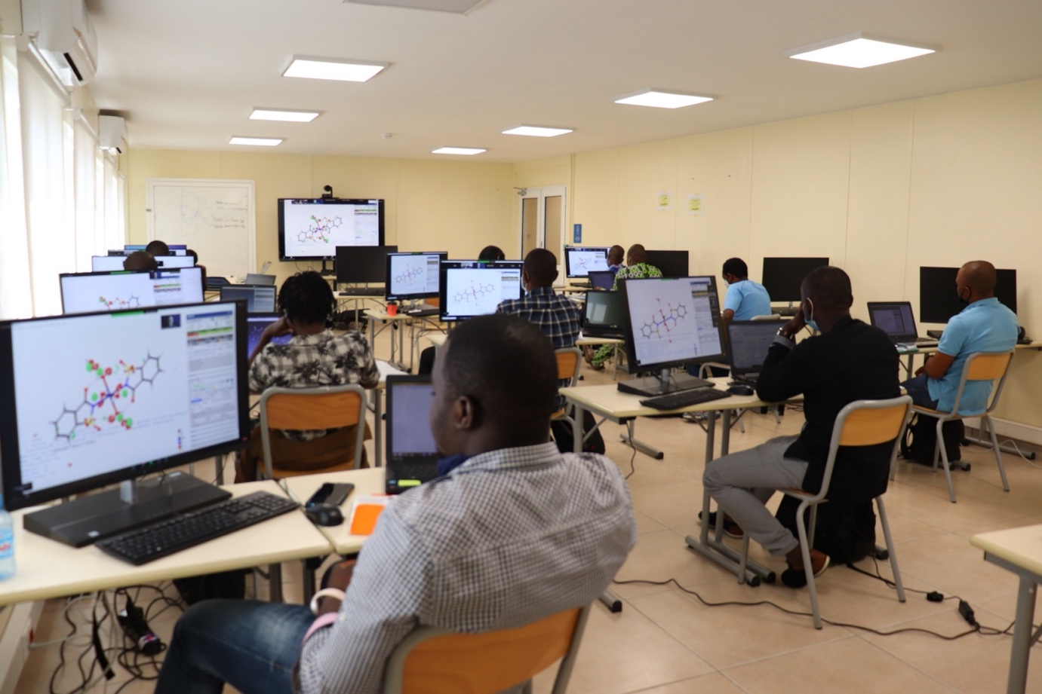
X-TechLab at Sèmè City, Benin
3 training sessions in 2019-2020: 84 learners from 12 African countries: Benin, Burkina Faso, Burundi, Cameroon, Congo-Brazzaville, the Democratic Republic of Congo, Senegal, Togo, Ghana, Ethiopia, Nigeria and Côte d’Ivoire. 20 invited experts.

Slide 8
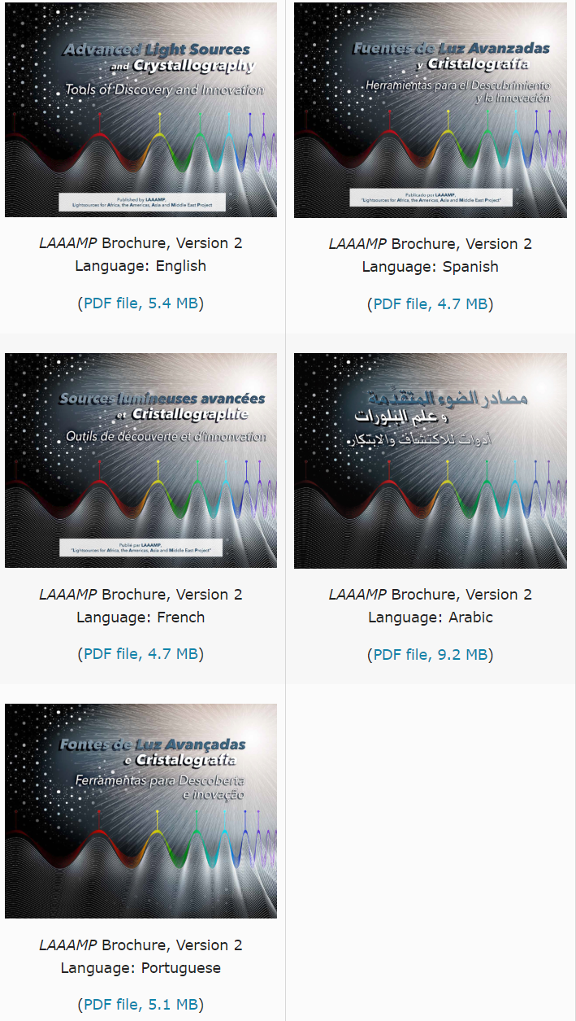
The LAAAMP brochure “Advanced Light Sources and Crystallography: Tools of Discovery and Innovation” is available in English, Spanish, French, Arabic and Portuguese.
Translations have been made available thanks to a collaboration with the International Atomic Energy Agency (IAEA).
Brochure editor: Ernie Malamud
DOWNLOAD FOR FREE at https://laaamp.iucr.org/tasks/brochure

Slide 9
TASK 4: FAculty-STudent (FAST) teams visits at AdLSs
Eligibility
Faculty members at universities in Africa, the Caribbean, Latin America, Central Asia, SE Asia, Middle East, and Pacific. Interested in using AdLSs to further one’s research and training endeavors. Previous experience with using AdLSs is limited to a year or less. Ability to spend 2 months as a full-time visitor in residence at an AdLS that is a LAAMP collaborative partner.
Student registered as full-time Ph.D. student and supervised by the Faculty member.
Categories
Continuing and New applications are considered.
Financial Support
LAAAMP provides 2,000 Euros per person to cover transportation and (partially) accommodation costs. The remainder of accommodation and subsistence should be negotiated with the host AdLS and other sources of support.

Slide 10
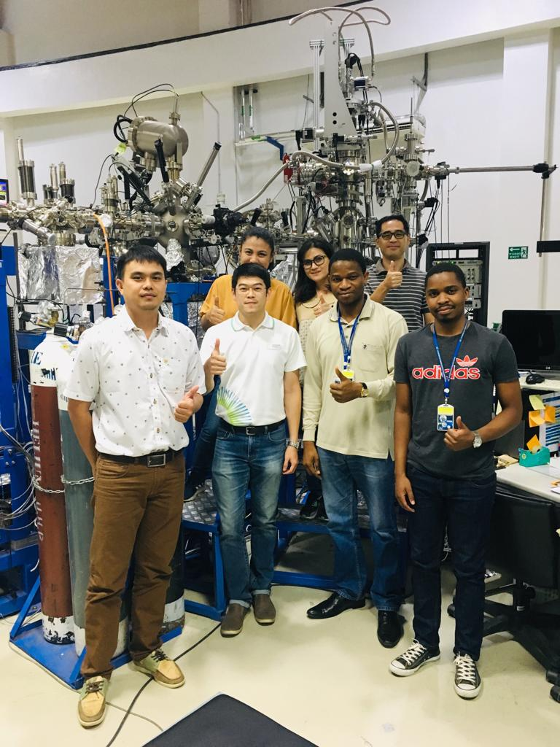
Dr. Philip Oladijo and graduate student from Botswana International University of Science and Technology trained for 2 months at Thailand’s Synchrotron Light Research Institute with Dr. Hideki Nakajima.

Slide 11
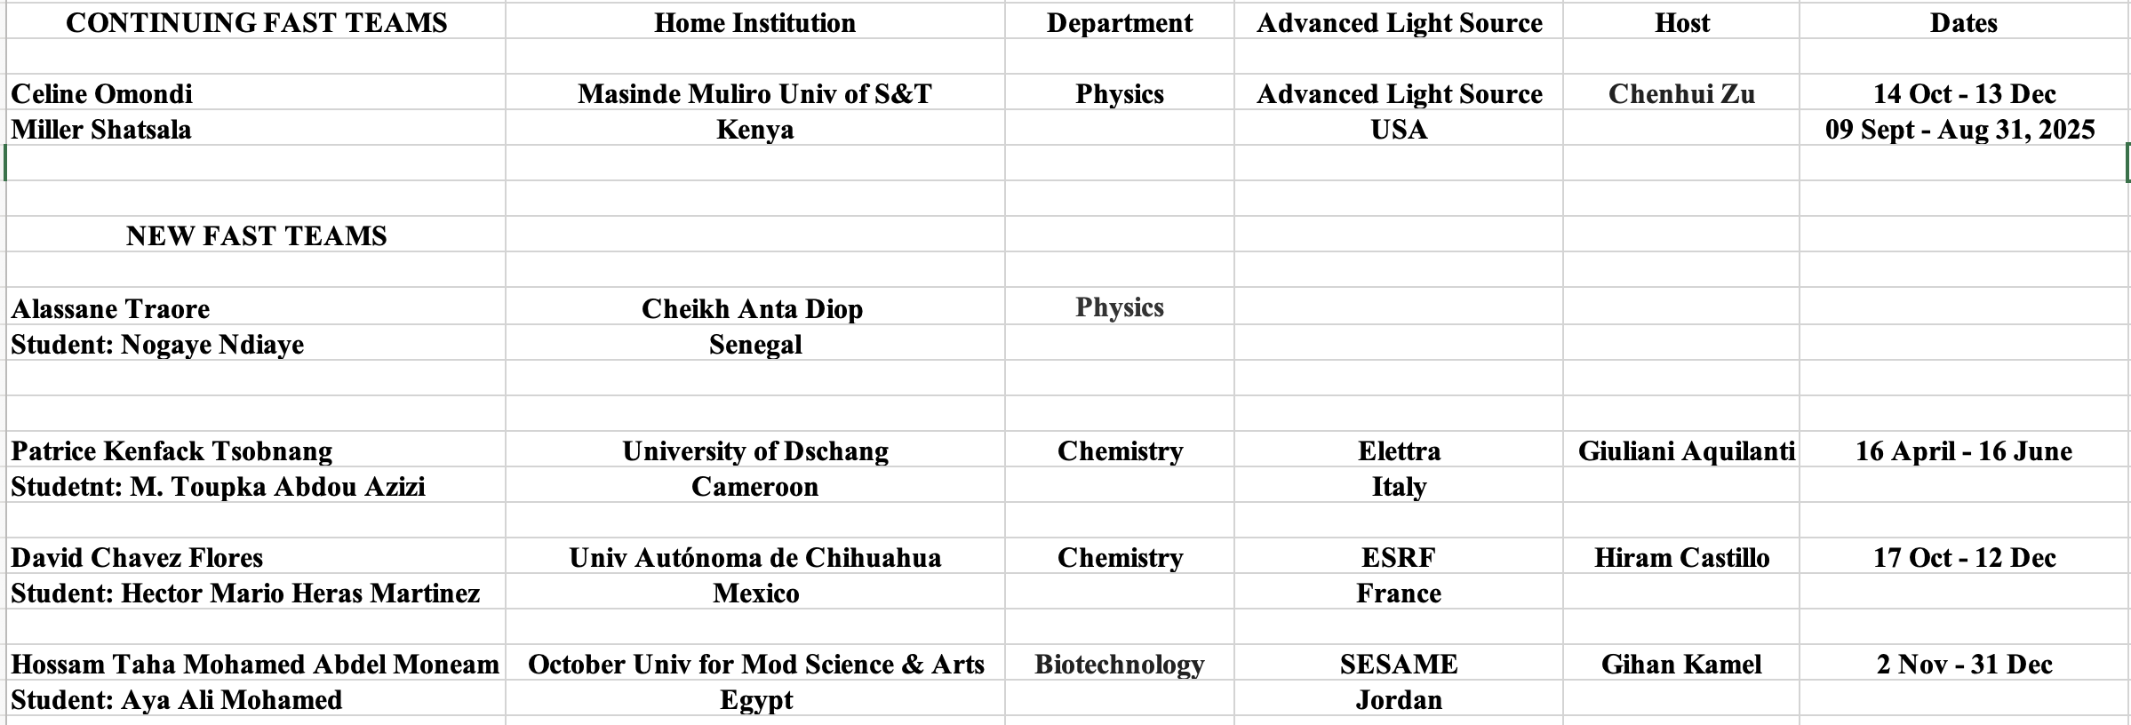
FAST Teams for 2024

Slide 13
Caribbean Regional X-ray Science toward
Advancement Laboratory (crXstal)
Located in Dept of Chemistry at U of West Indies in Jamaica
Single crystal diffractometer from Bruker was installed.
Marvadeen Singh-Wilmot (Manager) in discussions with IAEA about crXstal and other items.
Michele Zema (LAAAMP) went to Jamaica in Oct 2024 and spent a couple of weeks there to start training faculty and students.

Slide 14
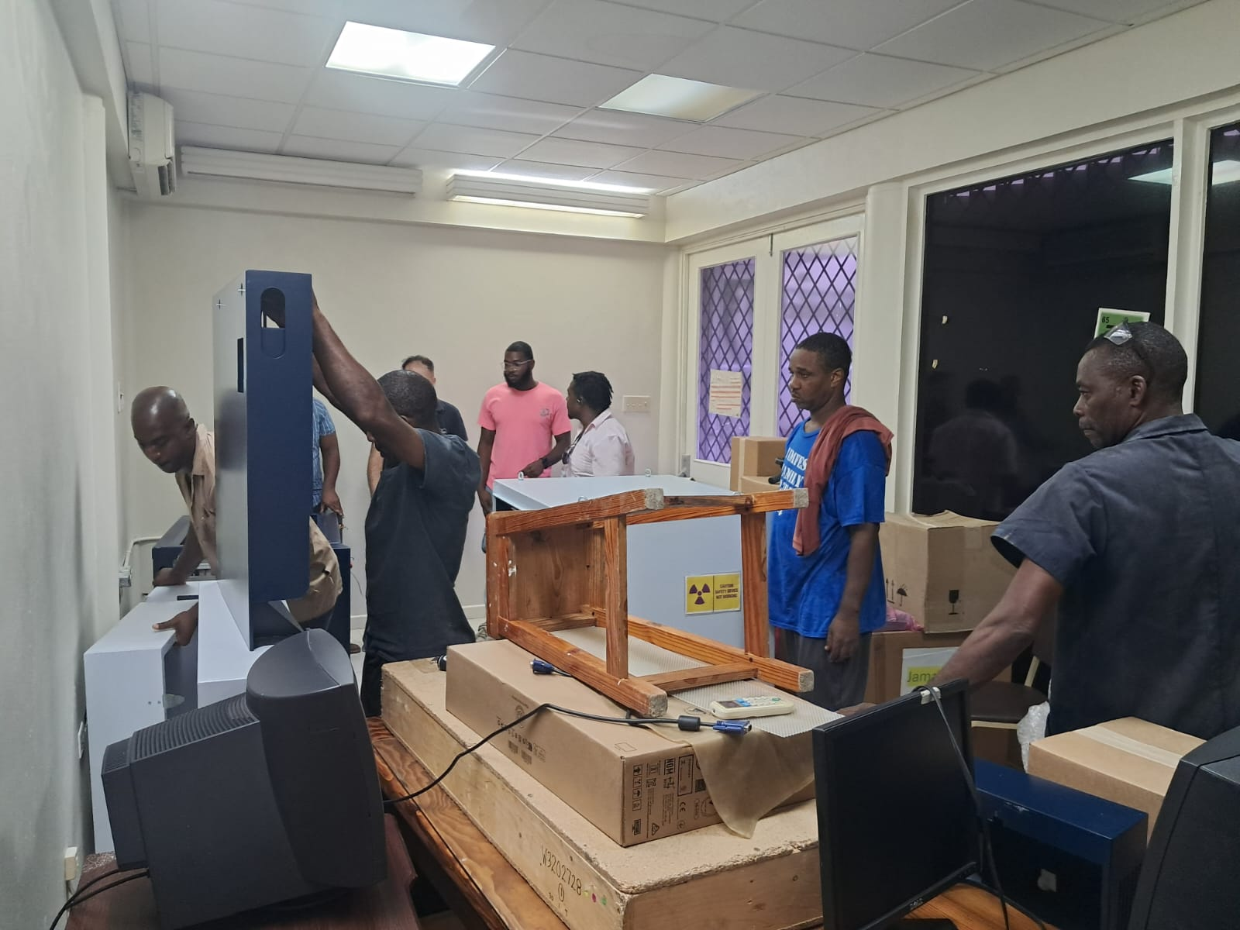

Slide 15
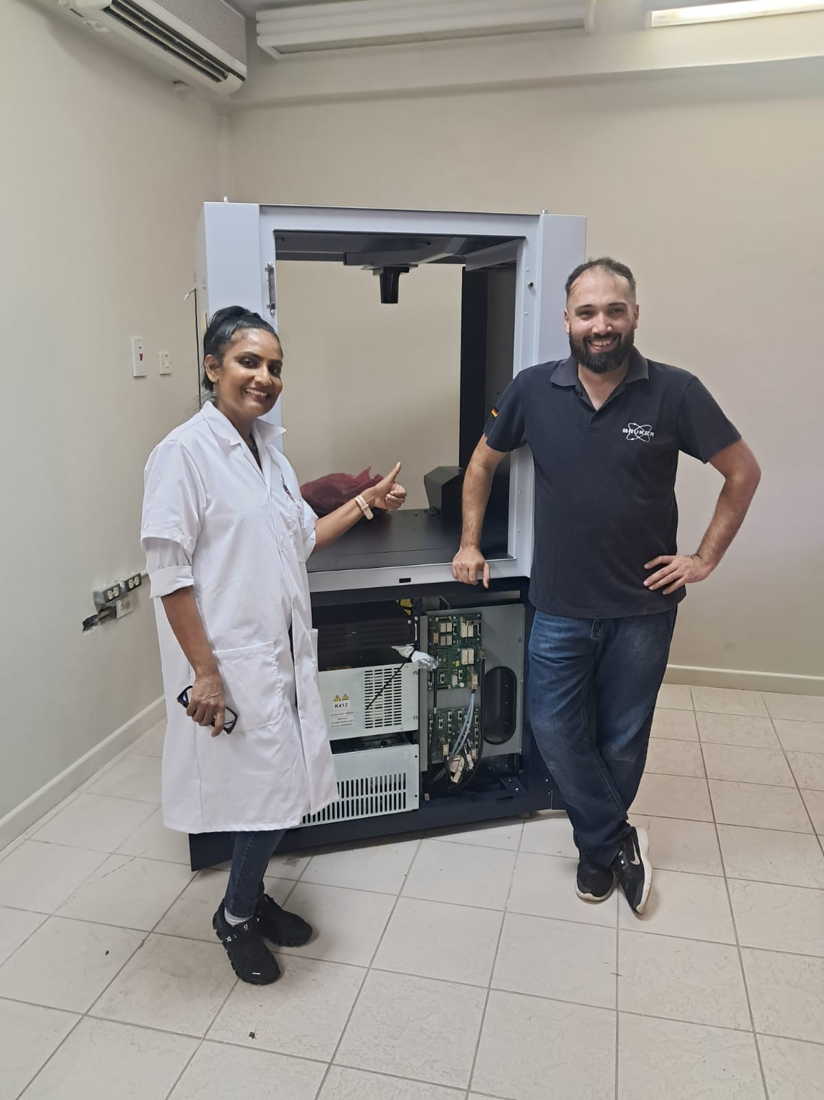

Slide 16
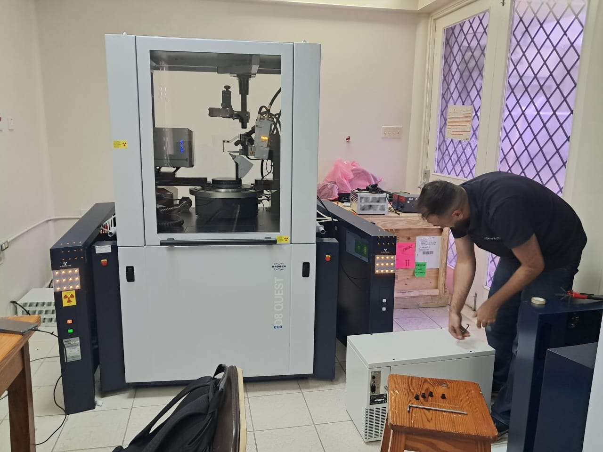

Slide 17
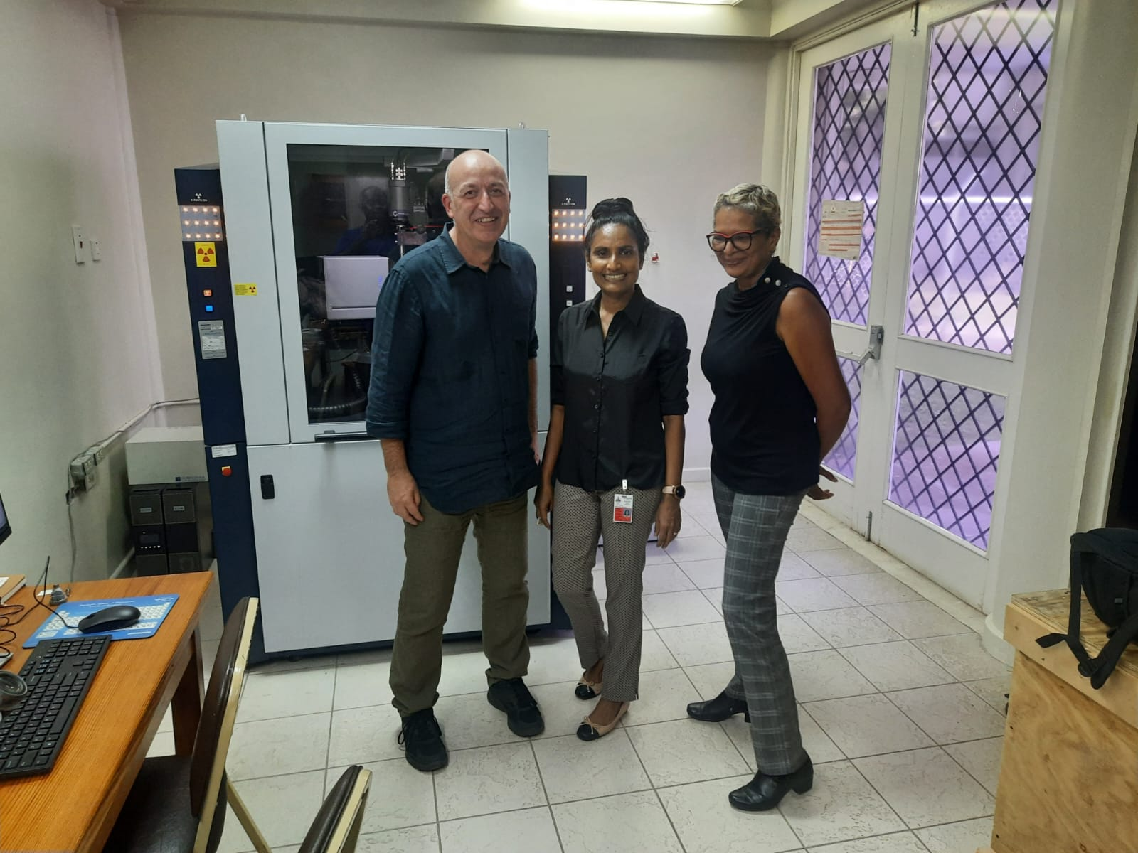

Slide 18
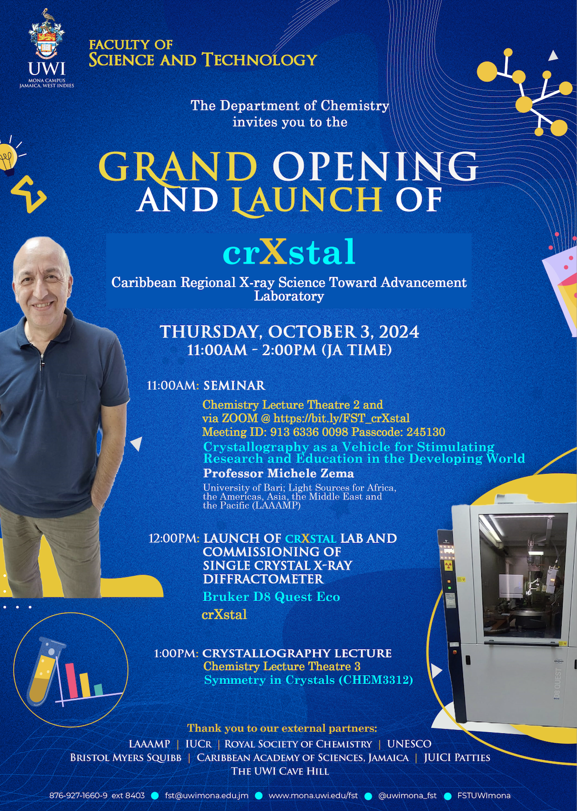

Slide 19
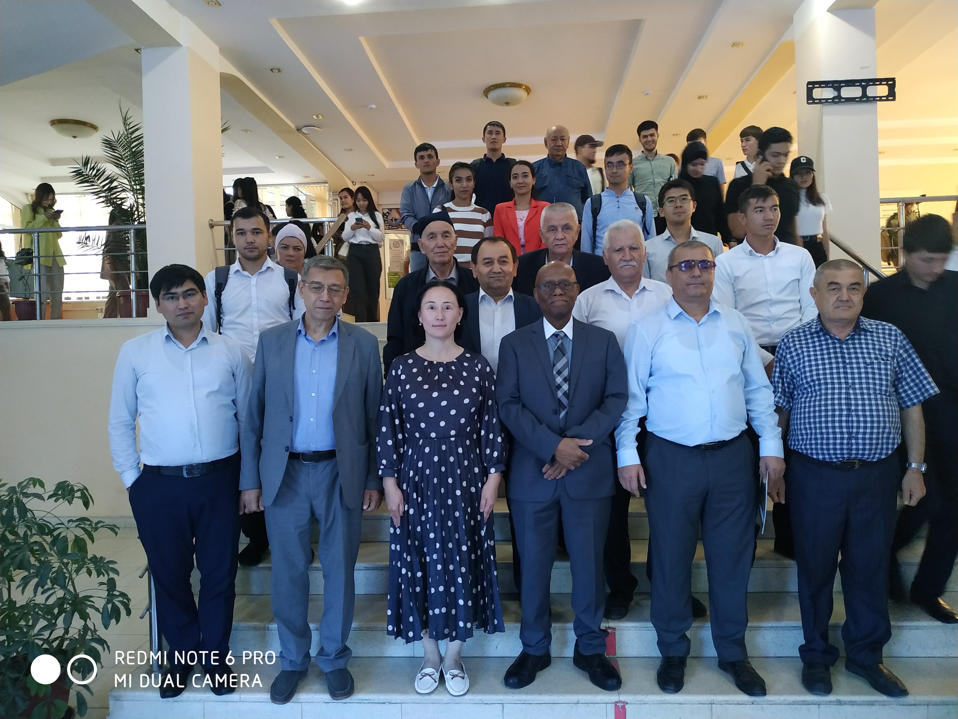
Central Asian Light Source Initiative
National University of Uzbekistan, Sept 2023

Slide 20
Crystallography Research & Training Hub in Uzbekistan
Michele Zema traveled to Uzbekistan to initiate the training program there during Oct 2024.
Goal is to establish a crystallography research and training hub in Uzbekistan.
This center and crXstal are both based on the X-Tech model that serves all of Africa.

Slide 21
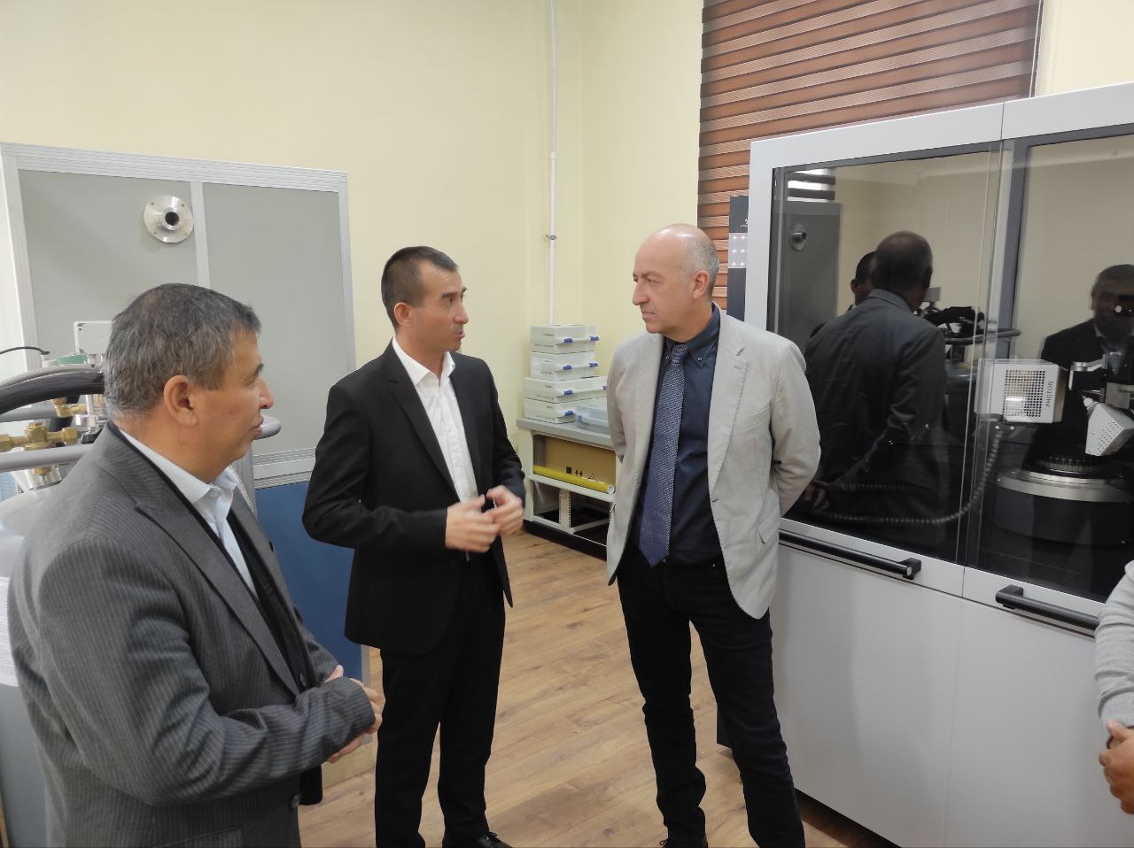

Slide 22
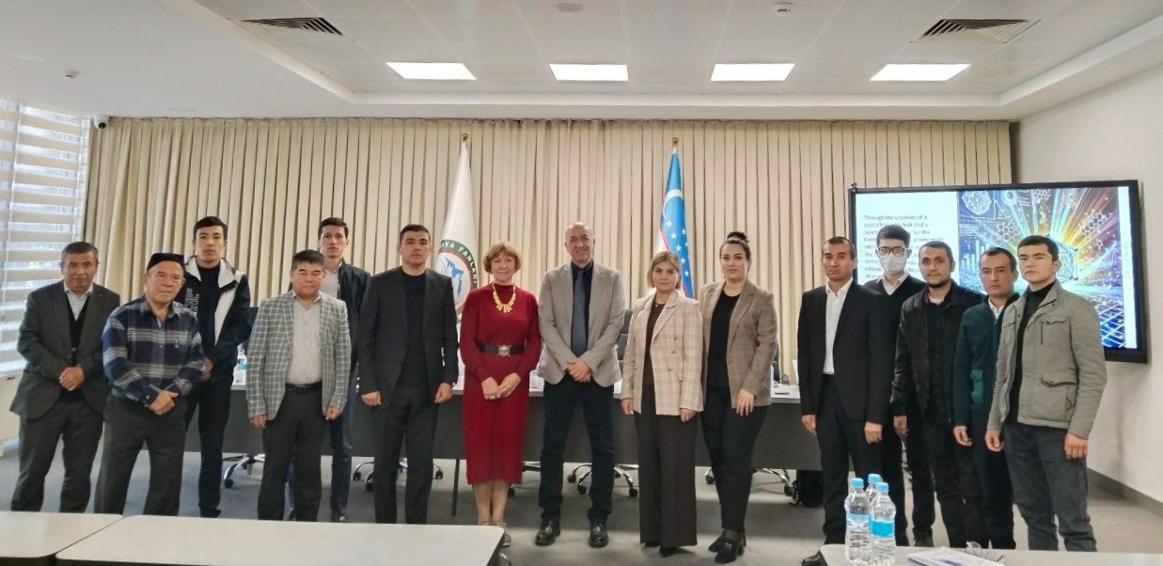

Slide 23
THANKS FOR YOUR KIND ATTENTION!
sekazi.mtingwa@gmail.com

