Slide 1
FABRICATION AND CHARACTERISATION OF SOLID-STATE PEROVSKITE SOLAR CELLS USING PLATINUM-BASED MULTIWALLS CARBON NANOTUBES AS COUNTER ELECTRODE.
BY
IBRAHIM, Olalonpe Sharifat
PhD/SNAS/2012/471
DEPARTMENT OF PHYSICS, SCHOOL OF PHYSICAL SCIENCES, FEDERAL UNIVERSITY OF TECNOLOGY MINNA.

Slide 2
INTRODUCTION
Energy consumption is one of the most important aspects in people’s everyday life. It exists in different forms, from burning woods to obtain fire in prehistoric times to electricity productions in modern age.
Mechanical, chemical, light, electrical
Forms of energy

Slide 3
Challenges
Rapid growth in industrialisation worldwide, increased the demand in consumption of energy and as a result, the original sources of energy that the people used to harvest from, have shown signs of deficiency
Excessive emission of greenhouse gases, caused by burning fossil fuel, result in global warming threatening earth’s ecosystem.
Waste disposal by people from nuclear power generation as a viable alternative to carbon based fuel.

Slide 4
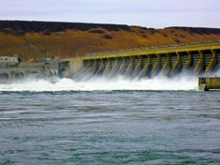


Solution
Scientific focused on the design of technologies that utilises one of the primary renewable energy sources; water, biomass, wind, geothermal and solar irradiation for power generation.
Water
Biomass

Slide 5



Solution continues
Geothermal
Wind
Solar

Slide 6
Photovoltaic Technology
Photovoltaic (PV), also called solar cells, are electronic devices that convert sunlight directly into electricity.
First generation: Crystalline Silicon Cells.
Second generation: Thin-Film Solar Cells.
Third-generation: New concept
Solar cell generations

Slide 7
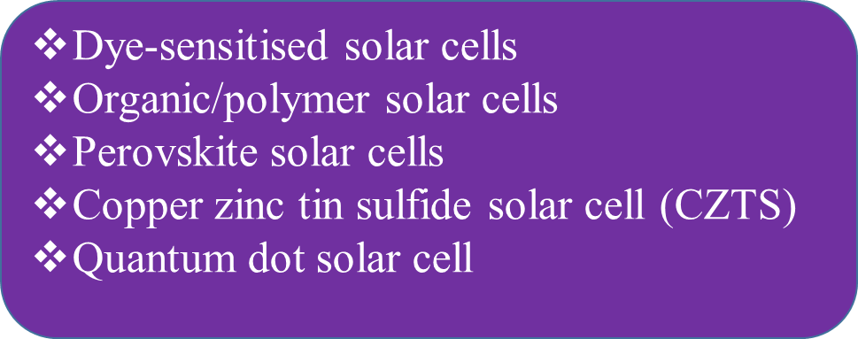
Third generation solar cells
Dye-sensitised solar cells
Organic/polymer solar cells
Perovskite solar cells
Copper zinc tin sulfide solar cell (CZTS)
Quantum dot solar cell
Materials for Perovskite solar cells development
Blocking layer
Scaffold layer
Sensitizer (Perovskite)
Hole-Transport Material
Electrode

Slide 8
ELECTRODE MATERIALS FOR SOLAR CELLS DEVELOPMENT
Carbon electrodes
Metal oxide electrodes
Polymer electrodes
Nanocomposite electrodes
are
  carbon nanotubes (CNTs)
  Graphene oxide (GO)
  Fullerene
Carbon electrodes are

Slide 9
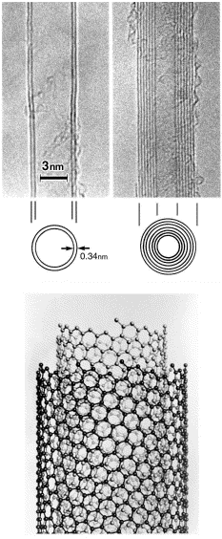
Types of Carbon nanotubes (CNTs)
Single- walled
Double-
walled
Multi-
walled

Slide 10
Statement of the Problem
High cost of fabrication of conventional silicon solar cells.
They are heavily reliant on the weather.
Use of high cost Platinum (Pt) as counter electrode.
Their installation cost is higher than those of electrical systems.

Slide 11
The aim of this research work is to fabricate and characterized dye sensitized solar cell using platinum-based multiwall carbon nanotubes as counter electrode.
Produce Platinum multiwalled carbon nanotubes (Pt-MWCNTs)
Characterized the Pt-MWCNTs produced
Assembled the optimised component materials (FTO, TiO₂ compact layer, TiO₂ mesoporous layer, perovskite layer and Pt-MWCNT) together.
Test for the performance evaluation of the solar cells
This aim was achieved through the following outline objectives;

Slide 12
SIGNIFICANCE OF THE STUDY
Commercial production of DSSCs by using affordable carbon materials as counter electrode.
Providing alternative to the platinum-based counter electrode of DSSCs.
To reduce the amount of pollution caused from using non-renewable energy resources, by producing a much safer renewable energy resources.

Slide 13
Scope of the study
This study focused on the synthesis of multiwall carbon nanotubes (MWCNTs) using catalytic vapour deposition (CVD) method. The as-synthesised MWCNTs were functionalised, characterised and then doped with platinum to produce Pt-MWCNTs catalyst as counter electrode. The DSSCs was then be fabricated by assembled the optimised component materials (FTO, TiO₂ compact layer, TiO₂ mesoporous layer, sensitizer, (dye) and Pt-MWCNT) together and the electrolyte was then injected into it. Finally the performance of the assembled solar cells was tested using solar simulator.

Slide 14
LITERATURE REVIEW
AUTHOR | WORKDONE | RESULTS/PCE | LIMITATIONS
Yasemin et al., (2021) | Polypyrrole and multi-walled carbon nanotube (MWCNT) composite film was produced by electrochemical polymerization of pyrrole with MWCNT on ITO surface | 2.60 % | The porous structure of PPy electrodeposed in MWCNT improved the roughness and specific surface area of the MWCNT and increased the electronic transmission capacity of PPy.
Wu & Wenjun, (2022) | A three component (MWCNTs, carbon black and graphite) carbon electrode material for DSSC devices combined with the advantages of high electron transfer kinetics of MWCNTs, plentiful catalytic sites in crystal edges of carbon black and superior electrical conductivity and catalytic activity of graphite. | 10.26% | The DSSC Pt + tri-carbon has high PCE due to the bottom cell's full usage of transmitted light. The Jsc and FF were close to 20 mA/cm² and 73.33, respectively, with a parallel mode used.
Zheng et al., (2015) | A counter-electrode (CE) for dye-sensitized solar cells (DSSCs) was prepared by coating a slurry containing acid-oxidized multi-wall carbon nanotubes and nano-graphite powder onto a fluorine-doped tin oxide conducting glass substrate. | 4.10% | Results show that the cell with the CE exhibits the best photoelectric properties of all the carbon-based CEs investigated. The short-circuit current density (J_{sc}) is 4.67 mA/cm², the open-circuit voltage (V_{oc}) is 0.53 V and photoelectric conversion efficiency is up to 4.10%, which are comparable with those of the Pt-based CE in DSSCs.

Slide 15
Materials and Methods
Materials for Dye Sensitized solar cells are:
Fluorine doped tin oxide (FTO) glass 10cm x 10cm (15Ω/m²)
Blocking layer (compact layer TiO₂)
Oxide film (mesoporous TiO₂)
Sensitizer (dye)
Counter-electrode (Pt/MWCNT, MWCNT and Elcocarb).
Iodide/triiodide (electrolyte)

Slide 16
Methods
Preparation of Counter-electrode
Catalyst Preparation
Carbon Nanotube Production
Purification and functionalization of CNTs produced
Preparation of Pt-MWCNT
Development of Electrode (Counter-Electrode)

Slide 17
Catalyst production
2³ factorial experimental design was used for optimisation of synthesis parameters on Fe-Co/CaCO₃ bimetallic catalyst.
2.47 g mass of Co(NO₃)₂.6H₂O
and
3.62 g mass of Fe(NO₃)₃.9H₂O
+
8-10 g of CaCO₃ all in 50 ml of distilled water.
To age for 60 minutes under constant stirring on magnetic stirrer until it become a gel.
Baked between 100 °C and 120 °C for 8 or 12 hours.
Cool to room temperature
Screened through 150µm sieve into fine powder.
Calcined at 400 °C for period of 16 hours in a furnace.

Slide 18
Results and Discursions
Catalyst
Table 1: 2³ Experimental Matrix showing Yield after Drying and Calcined at 400 ⁰C
Run | Mass of Support (g) | Drying Temperature (°C) | Drying Time (hrs) | Yield (%) After Drying | Yield (%) After Calcination at 400 ⁰C
1 | 10 | 100 | 8 | 76.50 | 86.69
2 | 8 | 120 | 12 | 67.25 | 76.79
3 | 10 | 120 | 8 | 77.50 | 85.31
4 | 8 | 120 | 8 | 82.25 | 78.00
5 | 8 | 100 | 8 | 76.00 | 85.10
6 | 10 | 120 | 12 | 78.75 | 95.71
7 | 10 | 100 | 12 | 70.25 | 86.45
8 | 8 | 100 | 12 | 74.00 | 84.60

Slide 19
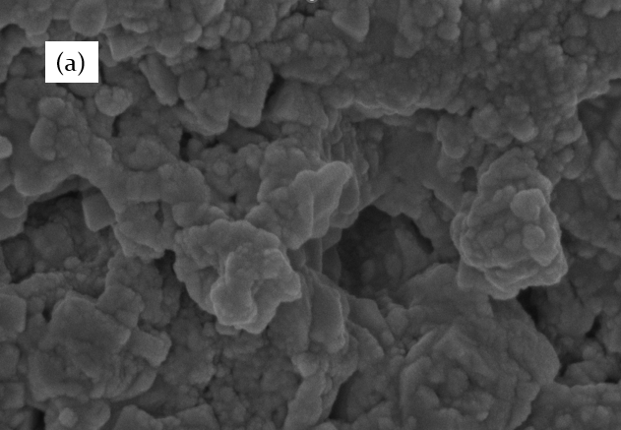
CHARACTERIZATIONS OF CATALYST
(b)
Figure 1: (a) SEM image showing nanoparticles of Fe and Co dispersed on CaCO₃ support and (b) EDS elemental compositions of catalyst sample

Slide 20
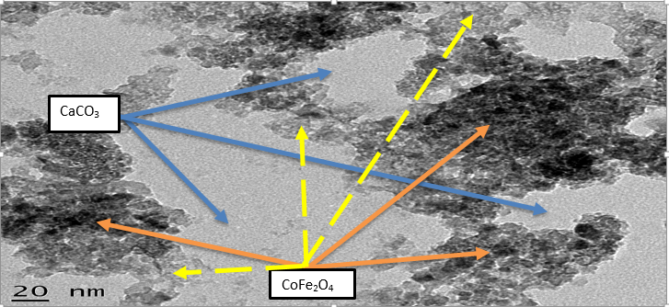
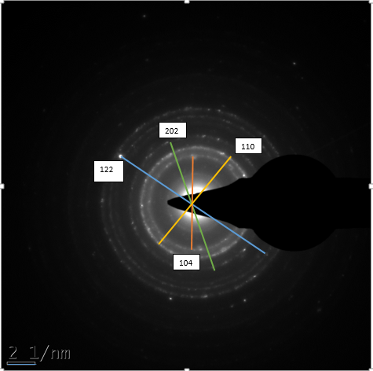
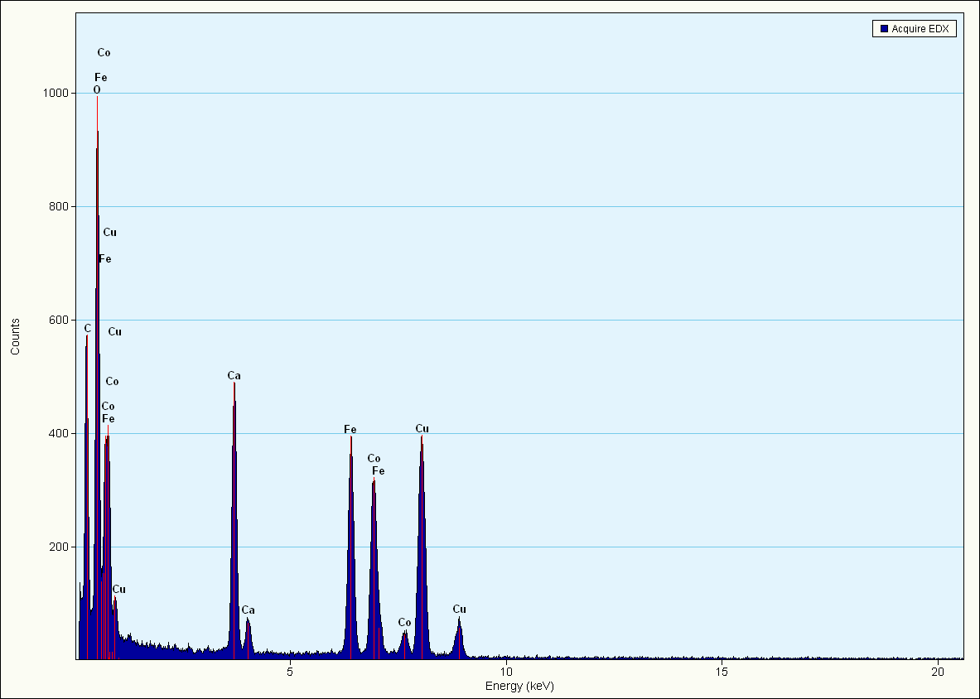
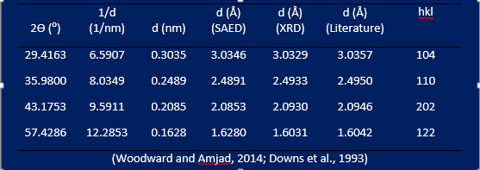
Figure 2: HRTEM images of the catalyst showing a clear view of coloured metal ions; (light brown Fe³⁺, dark/black Co²⁺) and white CaCO₃ bulk with modified crystal morphologies.
Figure 3: SAED of the Fe-Co/CaCO₃ catalyst showing sharpest rings of CaCO₃ at (104) plane.
Table 2: Rhombohedral CaCO₃ phase identification in SAED pattern
Reference: (Amjad, 2014; Downs et al., 1993)
Figure 4: TEM/EDS of the Fe-Co/CaCO₃ catalyst

Slide 21
Figure 5: Specific surface area of catalyst was found to be 3.904 m²/ g while CaCO₃ used as support possessed specific surface area of 3.842 m²/ g (Mhlanga et al., 2009).
No significant change in surface area because there is no thermal decomposition of the major catalyst component, CaCO₃, occurred at the treatment temperature of 450 ºC (Al-Fatesh and Fakeeha, 2012).
Dispersion of Fe and Co nanoparticles in the support matrix is attributed for the slight increase in surface area.
Catalyst has specific pore volume of about 0.002 cm³/g, and pore radius of between 0.184 and 1.4 nm
Figure 6: DLS before and after calcination shows that the catalyst sample particles were in the ranges from 160.8-765.7 nm and 96.6-109.0 nm respectively.
Figure 5: Surface area of CaCO₃ and Fe-Co/CaCO₃ catalyst
Figure 6 (a) and (b): Catalyst particle sizes after drying at 120 ⁰C calcination at 400 ⁰C

Slide 22
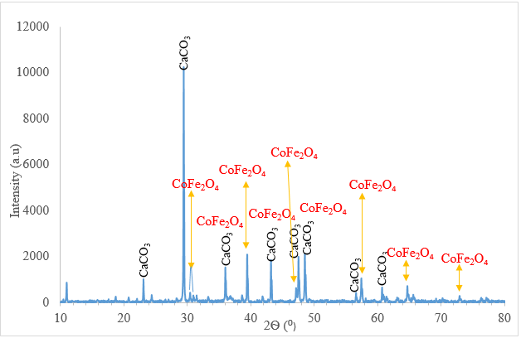
(a)
(b)
Figure 7: XRD pattern of Fe-Co/CaCO₃ catalyst showing (a) phases of CaCO₃ and CoFe₂O₄, (b) Polycrystalline particles with sizes ranging from 39.6 nm to 79.4 nm

Slide 23
SAMPLE ID | Weightloss (%)
1 | 31.72
2 | 29.65
3 | 33.61
4 | 31.15
5 | 25.65
6 | 26.35
7 | 22.51
8 | 21.35
Figure 8: The thermal decomposition curve of the Fe-Co/CaCO_{3­} catalyst

Slide 24
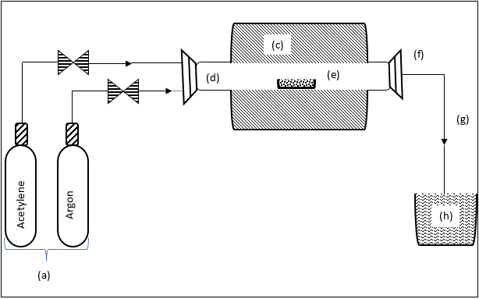
Synthesis of carbon nanotubes
Mass of catalyst | 0.5 g
Heating rate | 10 °C min⁻¹
Initial argon flow rate | 30 ml min⁻¹
Reaction temperature | 700 °C
Acetylene flow rate | 290 ml min⁻¹
Final argon flow rate | 190 ml min⁻¹
Reaction time | 60 min
Figure 9: Schematic diagram of experimental set-up for CNT synthesis in CVD

Slide 25
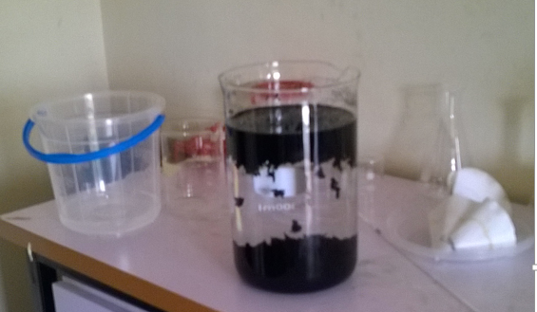
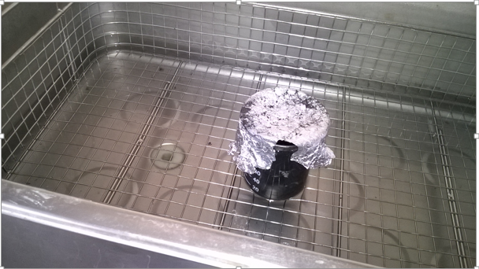
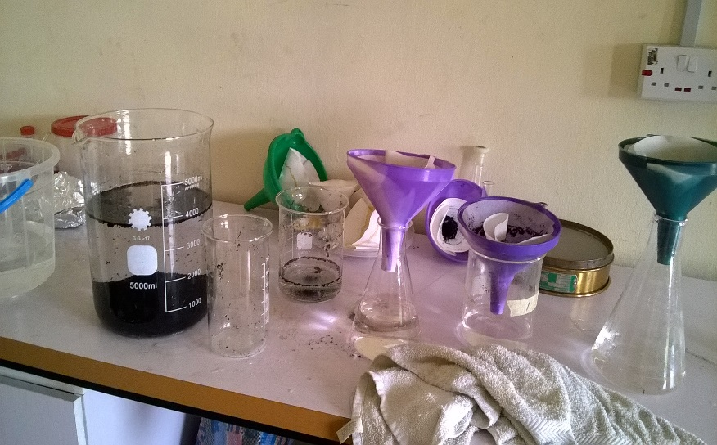
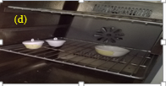
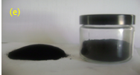
(a) CNTs +acid in ratio 3: 1 (H₂SO₄:HNO₃) to remove metallic impurities
(b) Sonicate for 3 hours at 45 ⁰C temperature to enhance metal dispersion
(c) Washing with distilled water to a pH of 7
Dried in the oven at 120 ⁰C for 12 hours & CNTs
Plate(s) 1 (a) to (e): Purification process of Carbon Nanotubes (CNTs)

Slide 26
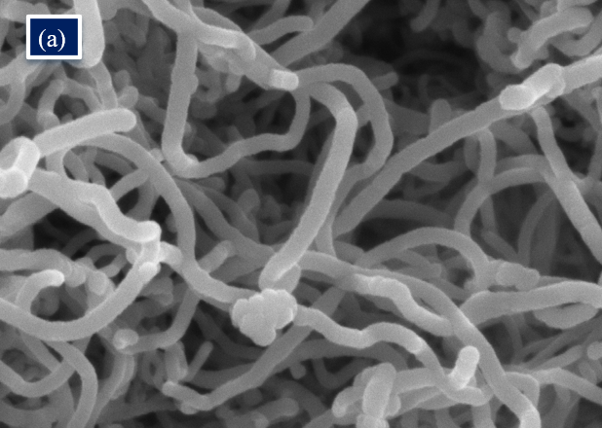
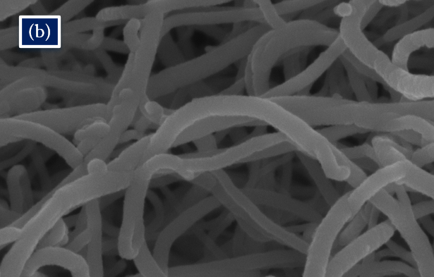
CNTs
Figure. 10: is SEM image (a) exhibits a slight degree of agglomeration with some bright spots, which corresponds to the residual metal particle from catalyst metal particles, support materials, and amorphous carbon on the surface of CNTs while (b) ex­hibit a clear defined tubular morphology (nodules like structure).

Slide 27
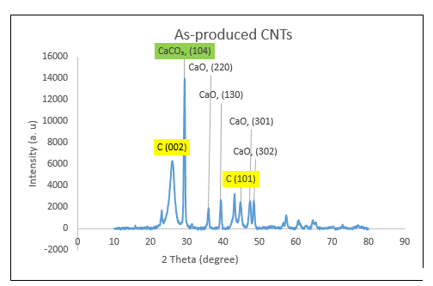
(b)
(a)
Figure 11: XRD pattern of (a) as-produce and (b) purified. The crystallite sizes range from 5.64 nm to 32.24 nm and 1.8 nm to 12.10 nm respectively

Slide 28
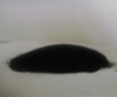
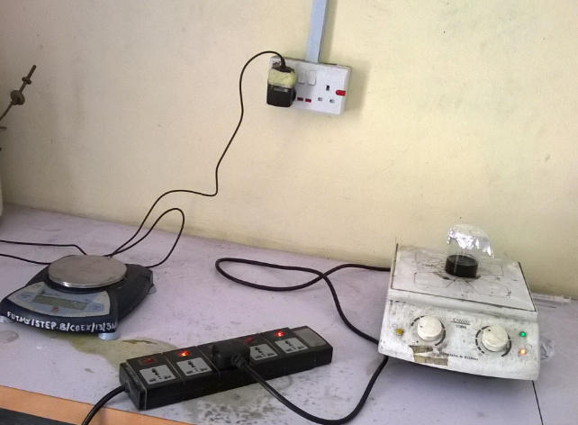
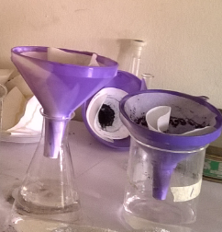
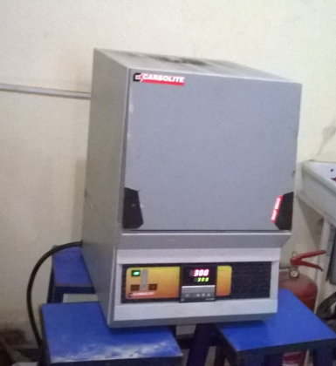
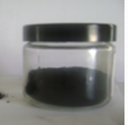
CNTs +PEG+ K₂PtCl₄ on magnetic stirrer
Pt-MWCNTs
Filtrate
Purified CNTs
Drying at 120 °C
Calcination at 300 °C
Pt-MWCNTs
Plate 2 : Preparation procedure of Pt-MWCNTs

Slide 29
Figure 12: (a) XRD pattern of Pt-MWCNTs. Major diffraction peak was found to be Pt (111) at 2 theta of 39.60. with crystallite size of 1.35 nm.

Slide 30
Pt-MWCNTs
Table 3: UV Analysis showing Pt percentage concentration on CNTs
Dispersion time (mins) | Absorbance (a.u) | Filtrate Concentration | Concentration of Pt on CNTs | % Concentration of Pt on CNTs
270 | 0.887 | 3.52 | 0.65 | 15.54
300 | 0.854 | 3.37 | 0.79 | 19.05
330 | 0.772 | 3.01 | 1.16 | 27.79
360 | 0.751 | 2.92 | 1.25 | 30.03
390 | 0.722 | 2.79 | 1.38 | 33.12
420 | 0.708 | 2.72 | 1.44 | 34.62
450 | 0.689 | 2.64 | 1.53 | 36.64
480 | 0.665 | 2.53 | 1.63 | 39.20

Slide 31
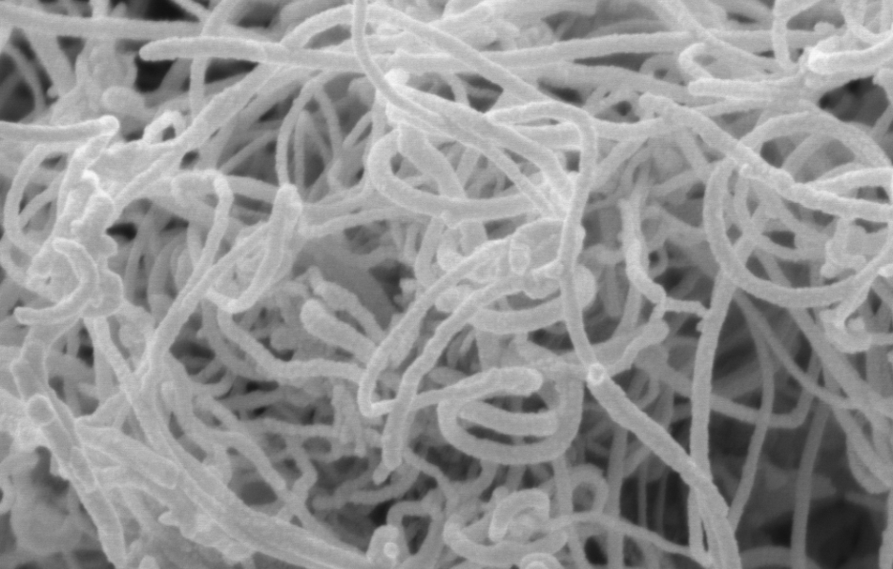
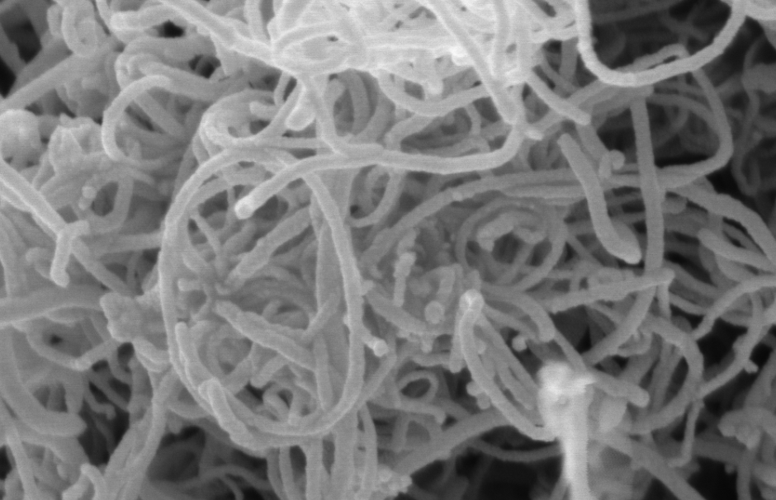
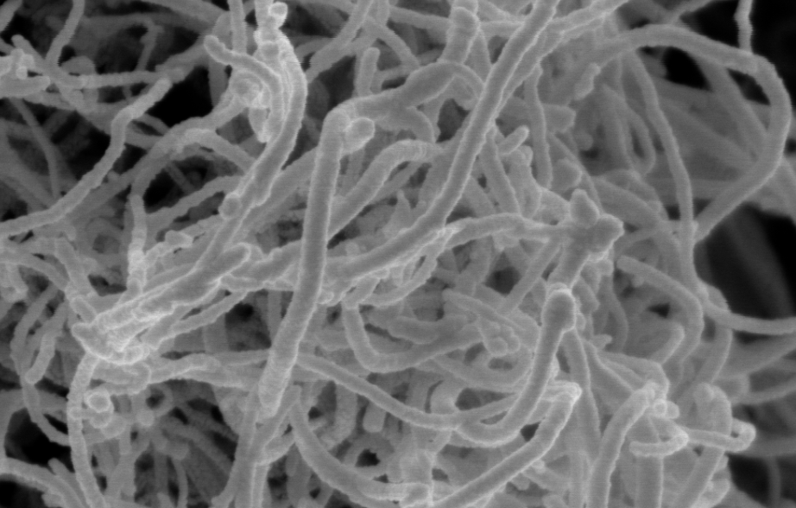
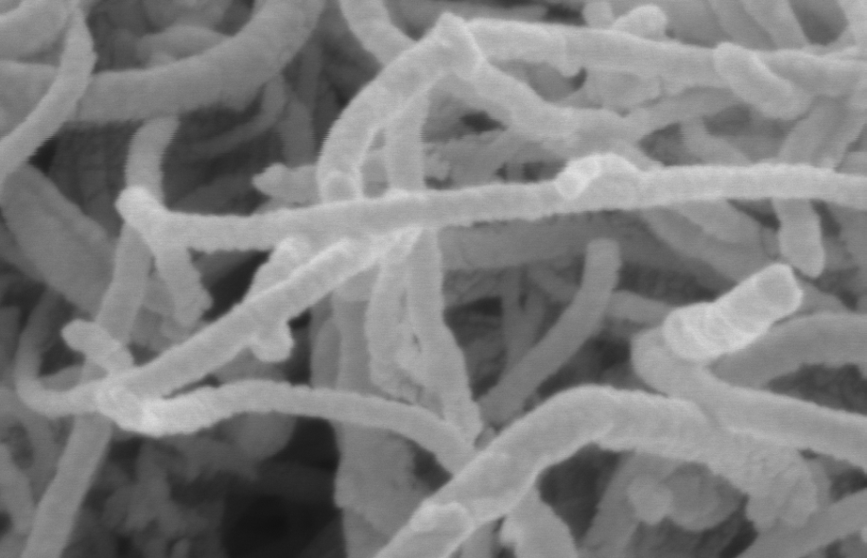
(1)
(2)
(3)
(4)
Figure 13: SEM Images (1) to (4) Showing Effect of Pt % concentrations
from (15.54 %) to (30.03 %) on MWCNTs respectively.

Slide 32
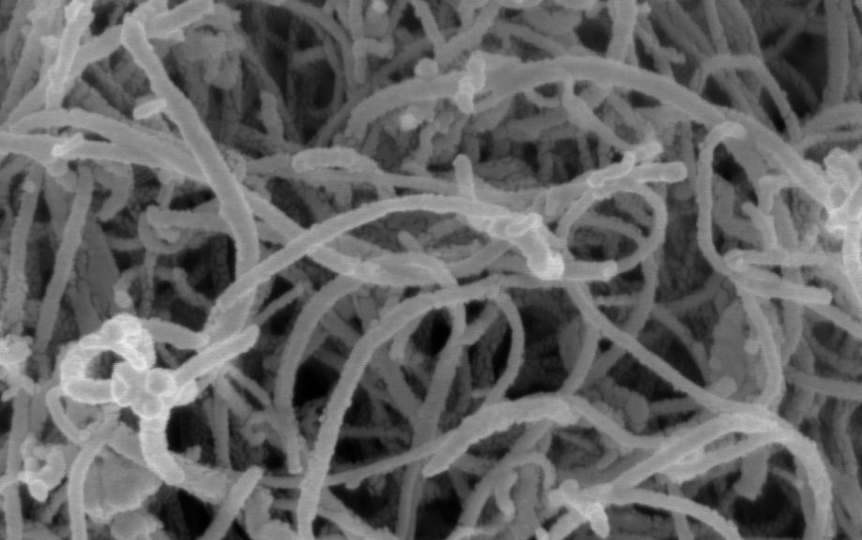
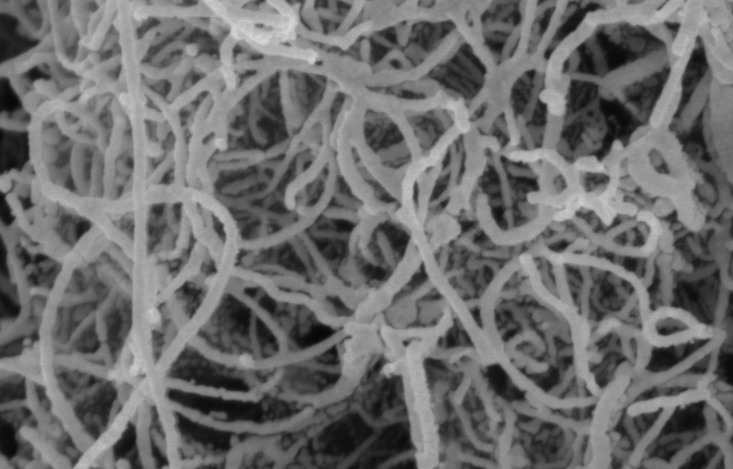
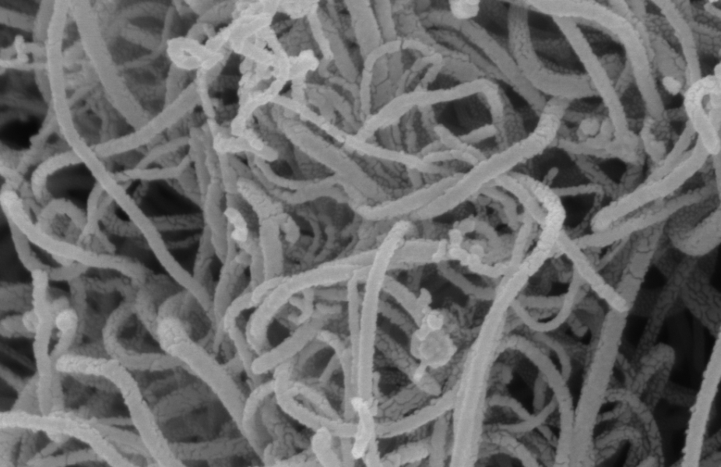
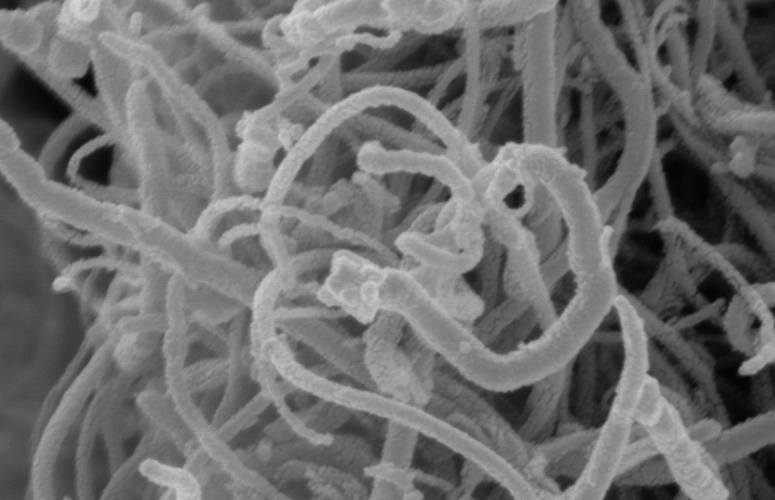
(5)
( 6)
(7)
(8)
Figure 14: SEM Images (5) to (8) Showing Effect of Pt % concentrations from (33.12 %) to (39.20 %) on MWCNTs respectively.

Slide 33
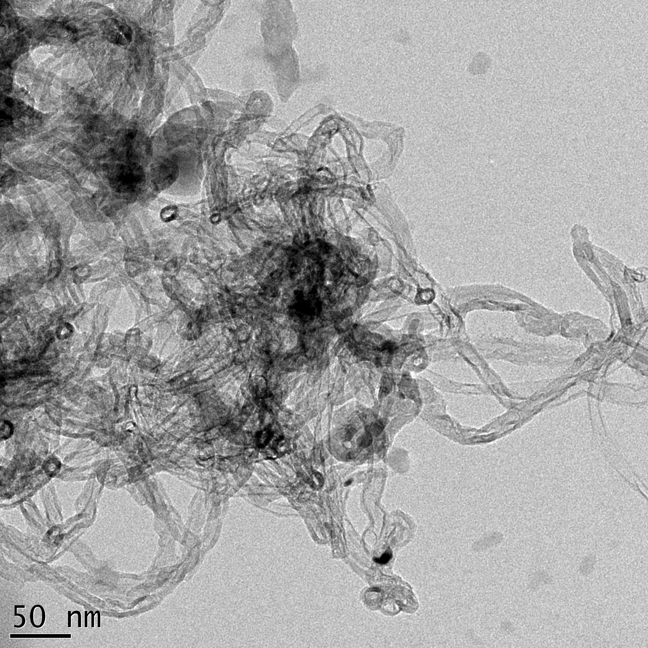
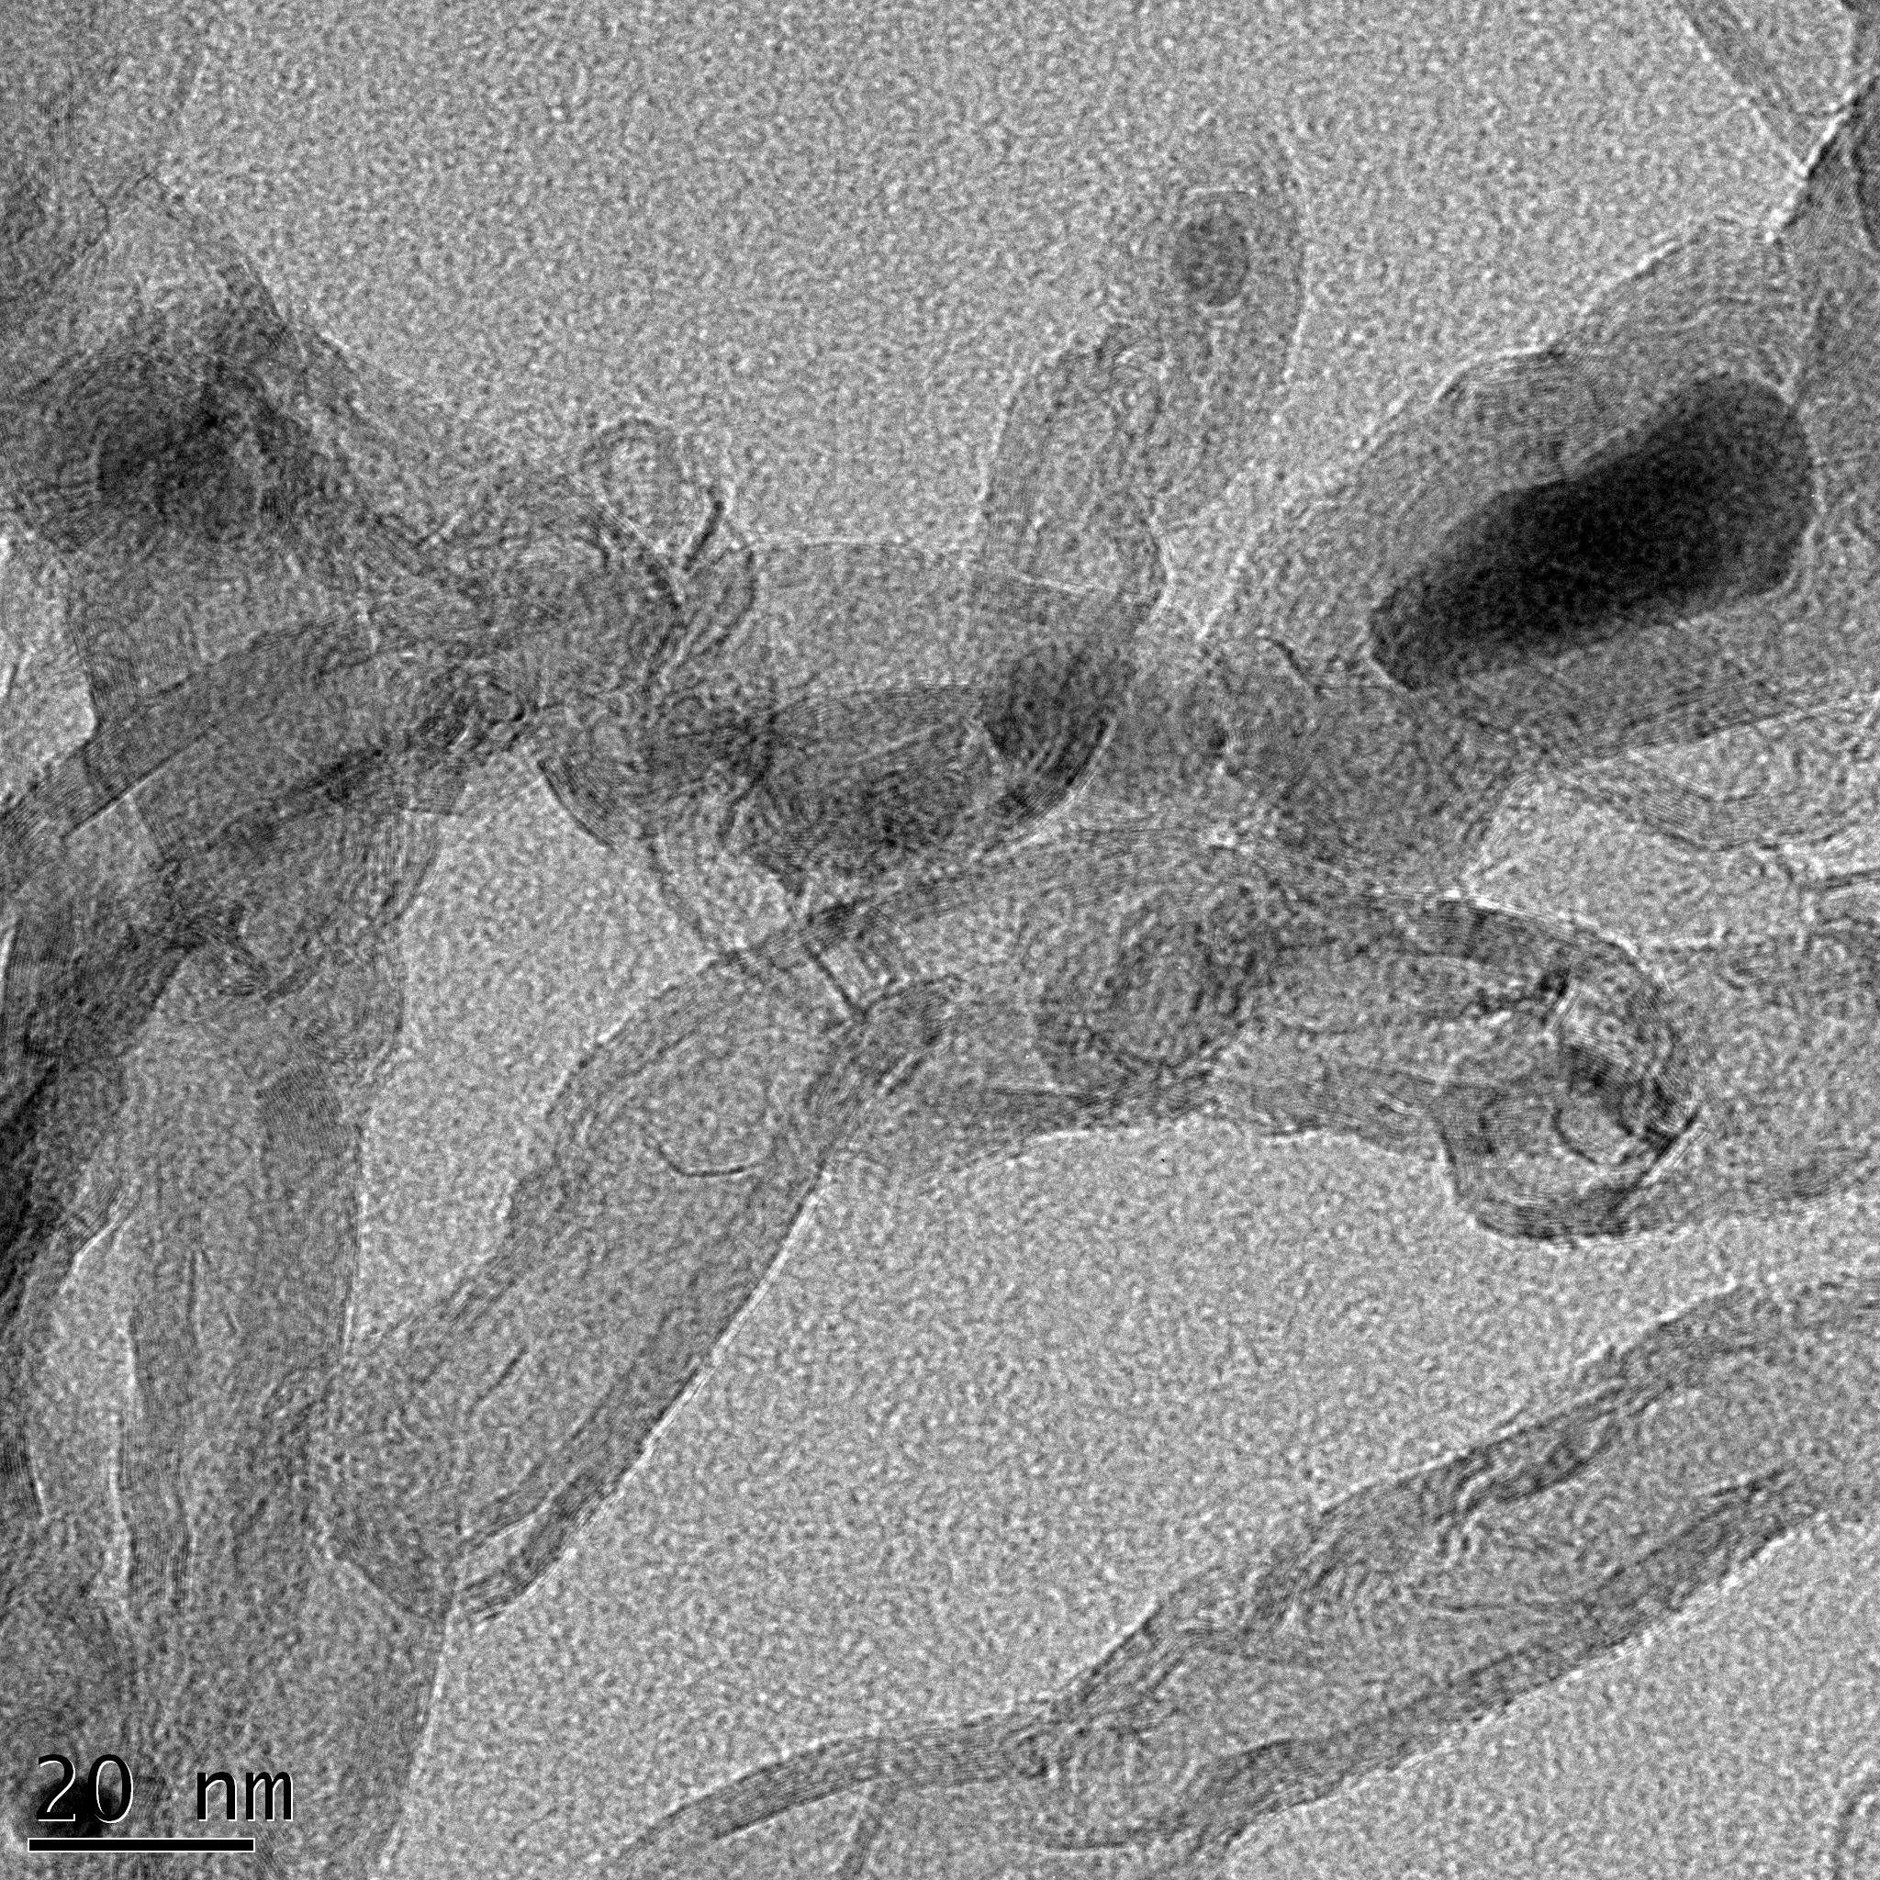
(a)
Walls structures of varied diameters
(b)
Encapsulated metal nanoparticles.
Figure 15: TEM images of (a) as-produced MWCNTs and (b) purified CNTs showing encapsulated metal nanoparticles along the inside diameter. Wall structures vary and their diameter distribution are not the same

Slide 34
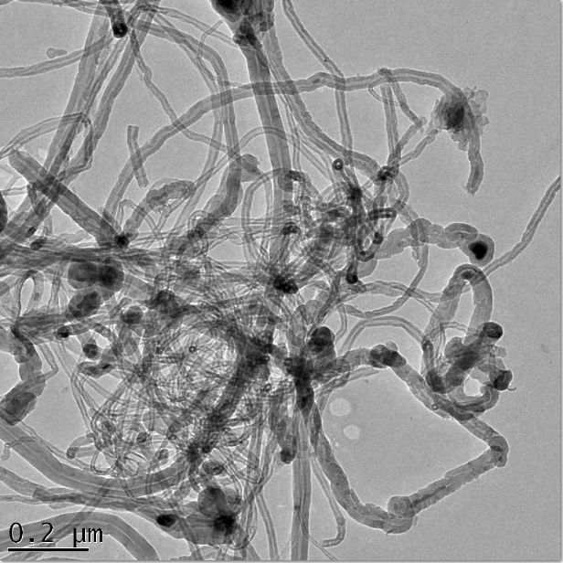
(a)
(b)
Platinum nanoparticles
Carbon nanotubes
Figure 16: (a) showing evidence of Pt. catalyst on the nanotube, (b) showing evidence of tubes of different diameters with Pt nanoparticles evenly distributed on the outer surface of the tubes.

Slide 35
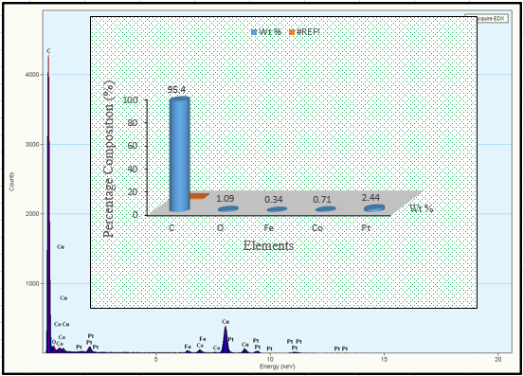
Figure 17: TEM/EDX analysis of the Pt–MWCNT catalyst sample confirming the presence of Pt.

Slide 36
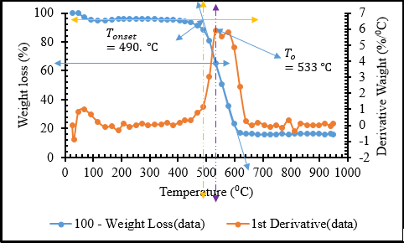
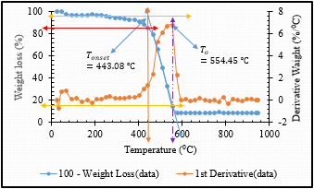
(a)
(b)
Figure 18: is the TGA/DTG curves of (a) purified and (b) functionalised MWCNTs with the weight loss of about 34.87 % and 85 % respectively.

Slide 37
Table 4: BET analysis of As-produced, Purified and Pt-MWCNTs catalyst samples
MWCNTs.
As-produced
Purified
33.12 wt% Pt. (Pt-MWCNTs)
34.62 wt% Pt. (Pt-MWCNTs)
39.20 wt% Pt. (Pt-MWCNTs)
Surface area
(m²g⁻¹)
272.98
274.06
432.6
609.2
858.7
Pore volume (cm³g⁻¹)
62.72
62.97
19.14
26.82
38.82
Ultrasound process breaks the CNTs agglomerates and resulting in more separate CNTs in the same mass and volume, thus more surface area.

Slide 38
FABRICATION OF DSSCs
Cleaning and Preparations of FTO glass
Deposition of TiO₂ paste on FTO glass using Dr blading technique
Annealing of deposited films
Sensitizing the TiO₂ layers
Preparation of counter electrode
Injecting the electrolyte into the cells

Slide 39
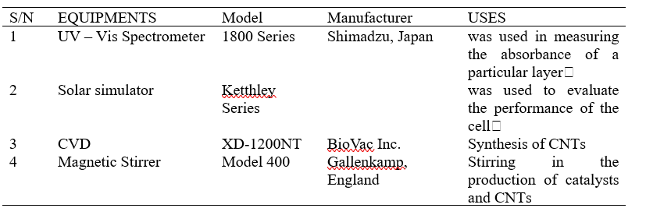
Table 5: Equipment used for Production and Characterisation of the Cells:

Slide 40
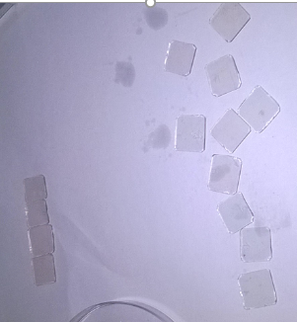
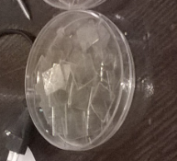
Preparation of FTO glass substrate
Plate 3: FTO glass preparation process

Slide 41
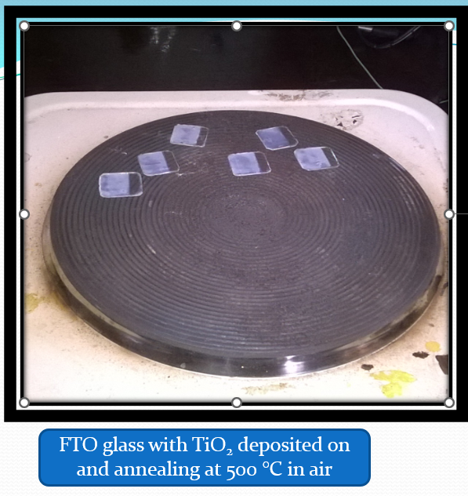
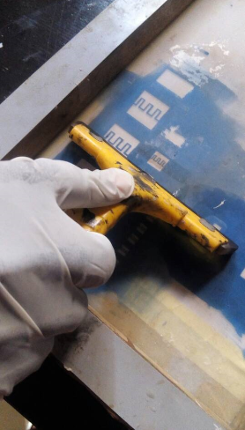
0.5 g of Pt-MWCNT + 10 ml of Texanol + 5 ml Acrylic resins mixed together to form a paste screen print on the glass substrate
Plate 4: (a) and (b): FTO glass with TiO₂ annealing at 500 °C and screen printing of paste of Pt-MWCNTs on FTO glass with TiO₂ compact layer, TiO₂ mesoporous layer and the dye

Slide 42
RESULTS AND DISCUSSION
UV-Vis optical absorbance analysis:
The optical band gap of cells were evaluated from the absorption spectra using Tauc plot and using the equation
αhv = A (hv - E_{g})^{n}
Where:
A is constant, Eg is band gap, n is different allowed transition
Figure 19: PEAK Absorbance of CNTs and Pt-MWCNTs

Slide 43
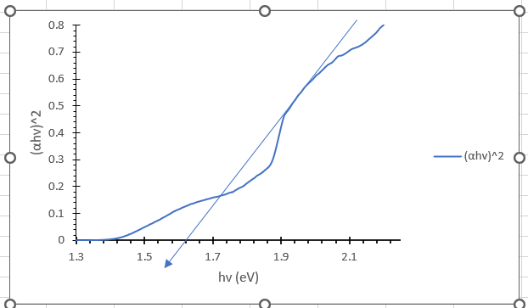
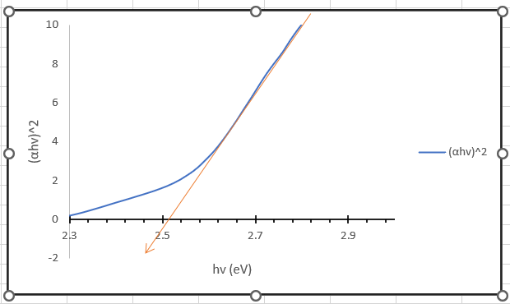
Optical band gap of CNT 1.62
Optical band gap of Pt-MWCNT 2.52
Figure 20: Band gap energy of MWCNTs and Pt-MWCNTs

Slide 44
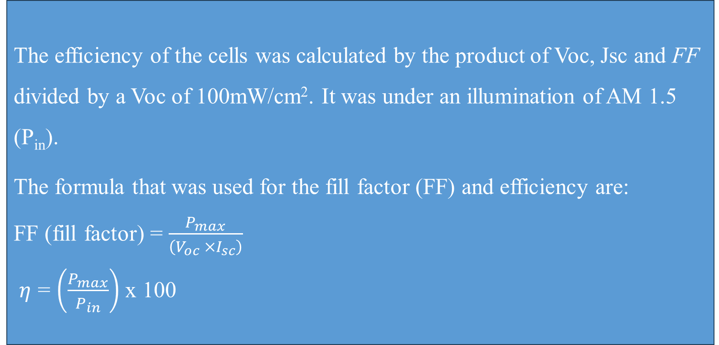
  Current-voltage analysis
The efficiency of the cells was calculated by the product of Voc, Jsc and FF divided by a Voc of 100mW/cm². It was under an illumination of AM 1.5 (P_{in}).
The formula that was used for the fill factor (FF) and efficiency are:
FF (fill factor) = $\frac{P_{max}}{\left(V_{oc} ×I_{sc}\right)}$
$η$ = $\left(\frac{P_{max}}{P_{in}}\right)$ x 100

Slide 45
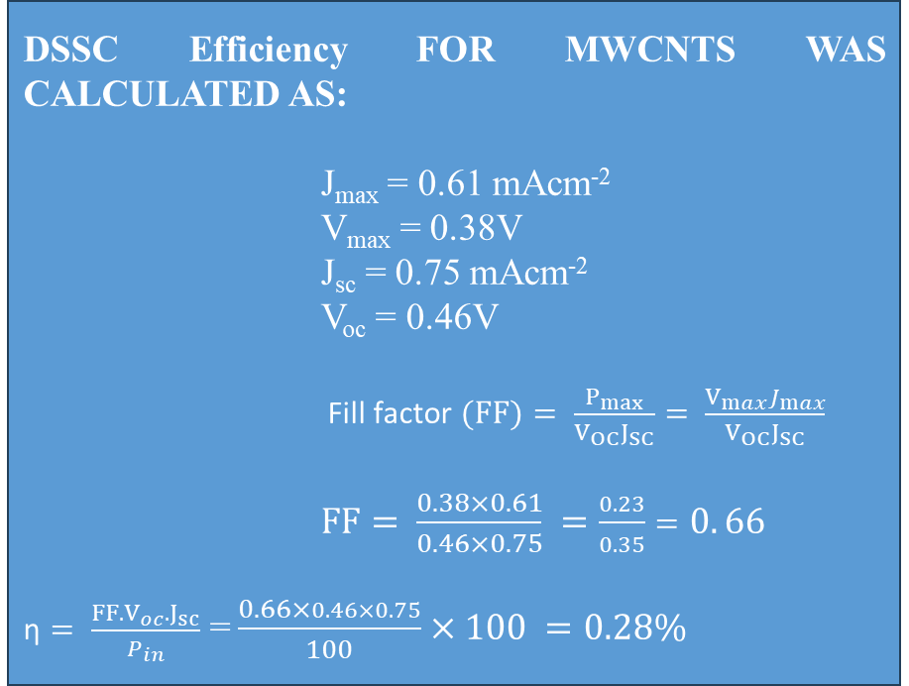
MWCNTs
DSSC Efficiency FOR MWCNTS WAS CALCULATED AS:
J_{max} = 0.61 mAcm⁻²
V_{max} = 0.38V
J_{sc} = 0.75 mAcm⁻²
V_{oc} = 0.46V
$\text{Fill} \text{factor} (FF)= \frac{P_{max}}{V_{OC}J_{SC}}= \frac{V_{max}J_{max}}{V_{OC}J_{SC}}$
$FF= \frac{0.38×0.61}{0.46×0.75} =\frac{0.23}{0.35}=0. 66$
$\text{η}= \frac{{FF.V}_{oc}.J_{sc}}{P_{in}}$ =$\frac{0.66×0.46×0.75}{100}×100 =0.28\%$
Figure 21: I-V Curve of MWCNTs

Slide 46
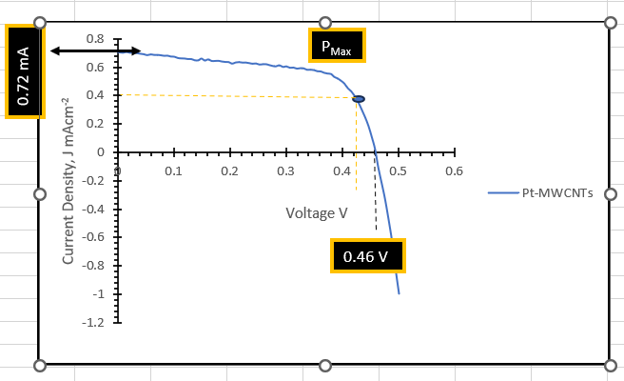
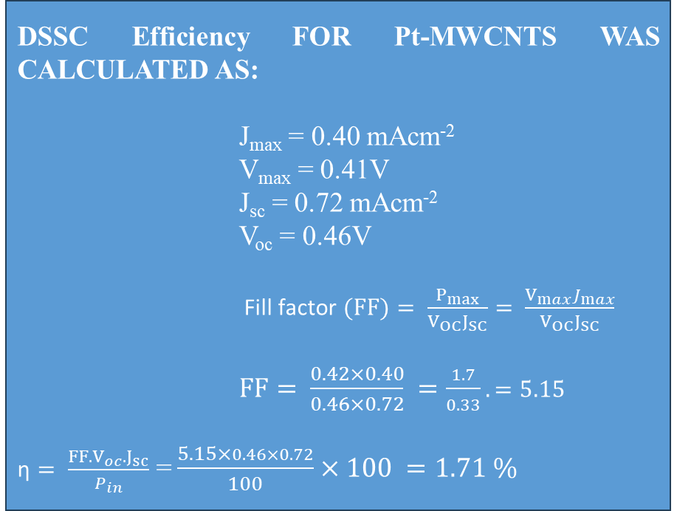
Pt-MWCNT
DSSC Efficiency FOR Pt-MWCNTS WAS CALCULATED AS:
J_{max} = 0.40 mAcm⁻²
V_{max} = 0.41V
J_{sc} = 0.72 mAcm⁻²
V_{oc} = 0.46V
$\text{Fill} \text{factor} (FF)= \frac{P_{max}}{V_{OC}J_{SC}}= \frac{V_{max}J_{max}}{V_{OC}J_{SC}}$
$FF= \frac{0.42×0.40}{0.46×0.72} =\frac{1.7}{0.33}.=5.15$
$\text{η}= \frac{{FF.V}_{oc}.J_{sc}}{P_{in}}$ =$\frac{5.15×0.46×0.72}{100}×100 =1.71 \%$
Figure 22: I-V Curve of Pt-MWCNTs

Slide 47
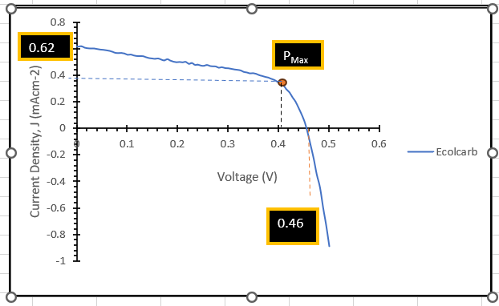
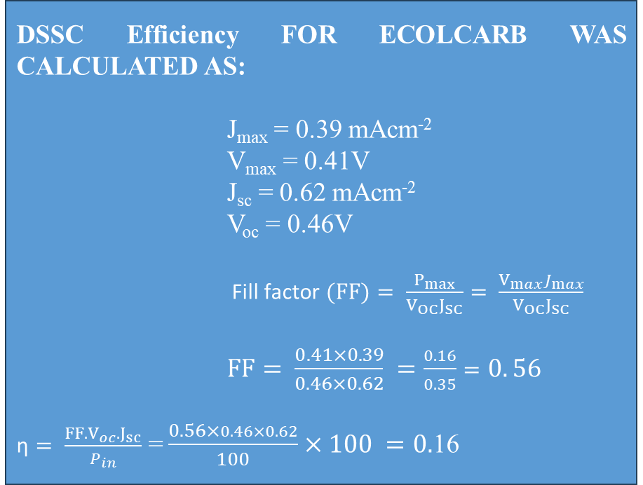
ECOLCARB
DSSC Efficiency FOR ECOLCARB WAS CALCULATED AS:
J_{max} = 0.39 mAcm⁻²
V_{max} = 0.41V
J_{sc} = 0.62 mAcm⁻²
V_{oc} = 0.46V
$\text{Fill} \text{factor} (FF)= \frac{P_{max}}{V_{OC}J_{SC}}= \frac{V_{max}J_{max}}{V_{OC}J_{SC}}$
$FF= \frac{0.41×0.39}{0.46×0.62} =\frac{0.16}{0.35}=0. 56$
$\text{η}= \frac{{FF.V}_{oc}.J_{sc}}{P_{in}}$ =$\frac{0.56×0.46×0.62}{100}×100 =0.$16
Figure 23: I-V Curve of Elcocarb

Slide 48

Current-Voltage Analysis
Table 6 : I-V Characterisation Parameters of DSSC with MWCNTs, Pt- MWCNT and Elcocarb

Slide 49
CONCLUSION
Optimisation and preparation of Fe-Co/CaCO₃ catalyst was achieved by method of wet impregnation with the best catalyst yield of 95.71 %.
The SEM/HRTEM/XRD analysis confirmed that multiwalled CNTs were produced with sizes ranging from 1.8 nm to 12.1 nm.
UV spectroscopy shows that the quantity of Pt deposited on the surface of CNTs depend on the time of deposition when all other factors are kept constant.
DSSCs with Pt-MWCNTs as counter electrode give a better efficiency than MWCNTs and Elcocarb.
RECOMMENDATIONS
Further work on how to increase the efficiency of the cell need to be looking into.
The stability of DSSCs still a challenge; therefore, the issue need to be address properly for the purpose of its commercialisation
To encourage researchers working on renewable energy especially solar cell, a functional solar simulator is required, therefore government should provide our research institutions with this machine.

Slide 50
REFERENCE
Abdulkareem, A. S., Suleiman, B., Abdulazeez, A. T., Kariim, I., Abubakre, O. K. and Afolabi, A. S., (2016). Synthesis and Characterisation of Carbon nanotubes on Fe/Al₂O₃ Composite Catalyst by Chemical Vapour deposition Method. Proceedings of the World Congress on Engineering and Computer Science, San Francisco, USA, 11. Retrieved February 2017. ISBN: 978-988-14048-2-4
Afolabi, A. S., Abdulkareem, A. S., Mhlanga, S. D., & Iyuke, S. E. (2011). “Synthesis and purification of bimetallic catalysed carbon nanotubes in a horizontal CVD reactor”. Journal of Experimental Nanoscience, 6(3), 248-262
Afolabi, A. S. (2009). Development of carbon nanotubes platinum electro catalytic electrodes for proton exchange membrane fuel cell. Unpublished PhD thesis, University of the Witwatersrand, Faculty of Engineering and the Built Environment. Johannesburg, South Africa, 65-80.
Al-Fatesh, A. S. A. and Fakeeha, A. H., (2012). Effects of calcination and activation temperature on dry reforming catalysts. Journal of Saudi Chemical Society, 16, 55-61
Aliyu, A., Abdulkareem, A. S., Kovo, A. S., Abubakre, O. K., Tijani, J. O., Kariim, I. (2017). Synthesize multi-walled carbon nanotubes via catalytic chemical vapour deposition method on Fe-Ni bimetallic catalyst supported on kaolin. Carbon Letters , 21, 33-50.
Al-Fatesh, A. S. A. and Fakeeha, A. H., (2012). Effects of calcination and activation temperature on dry reforming catalysts. Journal of Saudi Chemical Society, 16, 55-61

Slide 51
REFERENCE Continues
Amjad, Z., (2014) Mineral scales in biological and industrial systems. CRC Press Taylor and Francis group London New Yolk.
Ball, J. M., Lee, M. M., Hey, A., Snaith, H. J., (2013). Low-temperature processed mesosuper structured to thin-film perovskite solar cells. Energy Environmental Science. 6, 1739–1743.
Chiwaye, N. (2012), “In Situ X-Ray Diffraction Analysis of Fischer Tropsch Synthesis”. Unpublished MSc. Thesis, University of the Witwatersrand, Johannesburg.
Cruz-Gutiérrez, C.A., Félix-Navarro, R.M., Calva-Yañez, J.C. et al. (2021). Carbon nanotube-carbon black hybrid counter electrodes for dye-sensitized solar cells and the effect on charge transfer kinetics. J Solid State Electrochem 25, 1479–1489. https://doi.org/10.1007/s10008-021-04932-y
Downs, R. T. (1993). Interactive software for calculating and displaying X -ray or neutron powder diffractometer patterns of crystalline materials. American Mineralogist, 78, 1104-1107.
Ibrahim, S., Kasim Uthman Isah, Abdulkareem, A. S., Umaru Ahmadu, Jimoh Oladejo Tijani, & Roos, W. (2020). Synthesis and characterization of platinum multi-walled carbon nanotubes nanocomposite film electrode. Journal of Materials Science: Materials in Electronics. https://doi.org/10.1007/s10854-020-03550-0

Slide 52
REFERENCE Continues
Amjad, Z., (2014) Mineral scales in biological and industrial systems. CRC Press Taylor and Francis group London New Yolk.
Shao, W., Wu, W. (2022) High-Efficiency (Over 10%) Parallel Tandem Dye-Sensitized Solar Cells Based on Tri-Carbon Electrodes. Trans. Tianjin Univ. 28, 414–422. https://doi.org/10.1007/s12209-022-00318-x
TORLAK, Y., YENEL, E., & Metin, A. K. (2021). Fabrication and electrochemical properties of po lypyrol/multi-walled carbon nanotube composites for solar cell applications. JOURNAL OF MATERIALS AND ELECTRONIC DEVICES, 4(1), 9-14.
Trunschke, A. (2013). Surface Area and Pore Size Determination. Modern Methods in Modern Methods in Heterogeneous Catalysis Research, 1-18

Slide 53
THANK YOU FOR LISTINING

