Slide 1
Deconvoluting source function from two-particle correlations in Heavy-ion Collision Pierre NZABAHIMANA
AFLS-AFPS2023 conference: 13-17th Nov. 2023

Slide 2
Outlines
Particle correlations
Deblurring technique
Application
Deblurring Source function from particle correlations
Summary
The main results were recently published in PLB:
Nzabahimana, P., & Danielewicz, P. (2023). Physics Letters B, 138247.

Slide 3
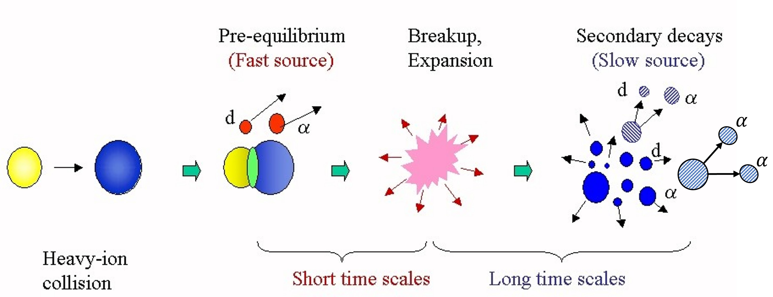
Particle Correlations in Heavy-Ion Collision
Particles emission during Heavy-Ion collision: Heavy nucleus, $A>$ 4
$q$: Two-particle relative momentum Identical particle
$q= 0.5(p_{1}−p_{2})$
$p_{1,2}$momentum of 1, 2
Non-identical particle
$q=0.5μ(v_{1}−v_{2})$ -$μ$is the reduced mass and velocity -$v_{1,2}$
We are interested in charged particle: deuteron, d and Alpha, $α$
Two-particle Correlation Function
$$R\left(q\right)+1=\frac{P_{12}(p_{1},p_{2})}{P_{1}\left(p_{1}\right)P_{2}(p_{2})}$$
Numerator- probability of coincident particle emission
Denominator- product of the probability of single emission

Slide 4
Particle Correlation Functions (CF)
Theoretically CF is approximated using Koonin-Pratt (KP) formula
$C\left(q\right) =R\left(q\right)+1=\int{d^{3}r \underbrace{S(r)}\underbrace{{\left|Ψ(q,r)\right|}^{2}}}$
-Squared relative wave function
-Obtained– solving Schrodinger equation(SE)
Known:
From experiment measurements
Source Function :Studying relative distribution of two-particle emission gives access to space-time characteristics of the emitting system
Unknown- need to be Estimated
Steven E. Koonin. Phys. Let. B, 70(1):43–47, 1977.
Scott Pratt and M. B. Tsang. Phys. Rev. C, 36:2390–2395, Dec 1987.
David H. Boal and Julian C. Shillcock. Phys. Rev. C, 33:549–556, Feb 1986.

Slide 5
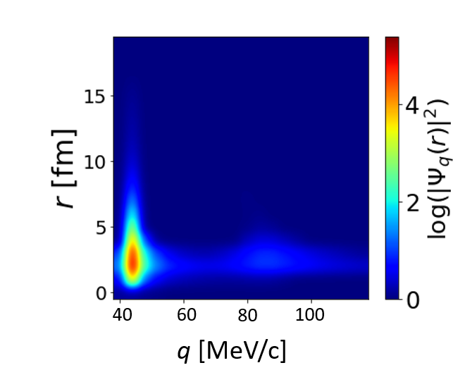
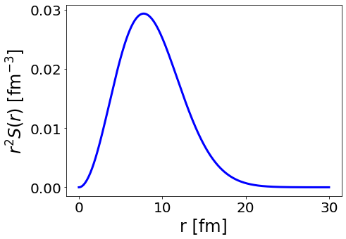
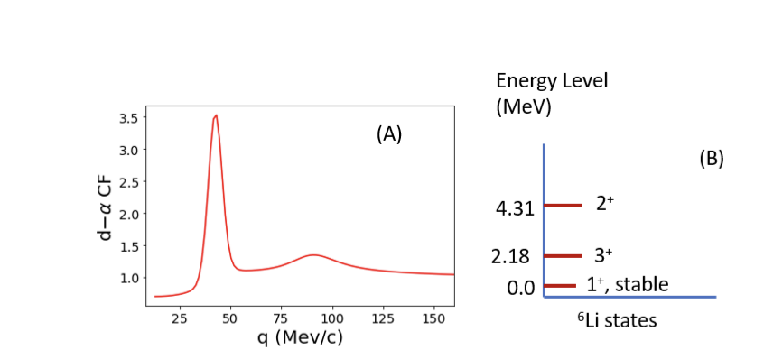
KP formula with Gaussian source : case of d$+α$
$C\left(q\right)=4π\int{dr \underbrace{r^{2}S(r)}\underbrace{{\left|Ψ(q,r)\right|}^{2}}}$
Log(${\left|Ψ(q,r)\right|}^{2}$)
Gaussian
Bright spots corresponds to peaks in CF
Peaks correspond to Li-6 Energy Levels
2nd Peak
1st Peak

Slide 6
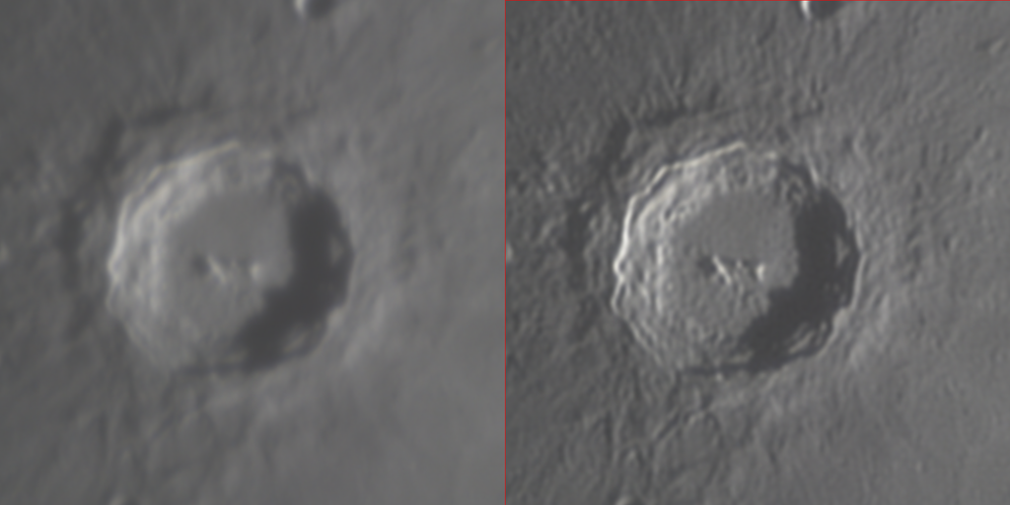
Deblurring Technique: overview
1. Deblurring in optical image processing
Original image
Optical System
Blurred image
DOI: 10.1109/ELINFOCOM.2016.7562935
Source: https://doi.org/10.1016/j.matpr.2020.11.076
Deblurring:
- Technique to restore the original image
- Originally developed in Optics
- Use Richardson-Lucy (RL) Algorithm,
derived from Bayesian Theory
Before and after deblurring of image of lunar crater Copernicus
https://en.wikipedia.org/ wiki/Deconvolution

Slide 7
Deblurring and RL algorithm
Blurred/Measured function
$f\left(E_{d}\right)=∫dE_{d}^{’}H\left(E_{d} | E_{d}^{’}\right)F\left(E_{d}^{’}\right)$ or $f_{i}=\sum_{j}{H_{ij}F_{j} }$
with $H(E_{d}|E_{d}^{’})$– probability to measure particle
characteristic to be $E_{d}$ when it is actually $E_{d}^{’}$ Optical terminology:
H - blurring or transfer matrix/ Response Matrix.
With noise:${\hat{f}}_{i}=\sum_{j}{H_{ij}F_{j} }+N_{j}$, ${ N}_{j} :$ noise model
RL-algorithm
Solves $F$ ( true function ) iteratively
$f_{j}^{n}\left(E\right)=$ ${\sum_{j}{H_{ji}}F}_{i}^{n}$
$F_{i}^{\left(n+1\right)}=\sum_{j}{\frac{f_{j}}{f_{j}^{n}}}T_{ji}F_{i}^{n}$
-$T_{ji}=\frac{W_{j}H_{ji}}{\sum_{j′}{W_{j}′H_{j′i}} }$, normalized TM , $\sum_{j}{T_{ji}=1}$
n = number of iterations , $F^{0}≥0$, guess i.e., $F^{0}$=1
$F^{n}$, $T_{ji}$, $f_{i}$, and $H_{ji}$ are kept positive
c
Nzabahimana, P., et al. (2023), W. H. Richardson(1972), L. B. Lucy, (1974)
P. Danielewicz and M. Kurata-Nishimura (2022)

Slide 8
RL algorithm for source function
Recall
C$\left(q\right)=\int{d^{3}r{S(r)\left|Ψ\left(q,r\right)\right|}^{2}}$ and
Write CF in discretized form
$C_{i}=\sum_{j=1}^{N}{K_{ij}S_{j}}$
Source function:
$S≅\sum_{j=1}^{N}{S_{j}(r)g_{j}(r)}$
$g_{j}\left(r\right)=\left\{\begin{aligned}1 r_{j−1/2}<r<r_{j+1/2} \\ 0 otherwise\end{aligned}\right.$
$K_{ij}=4π\int_{r_{j−1/2}}^{r_{j+1/2}}{dr r^{2}{\left|Ψ\left(q_{i},r\right)\right|}^{2}}$: -Kernel Matrix (Transfer matrix in the deblurring terminology)
in RL algorithm,
$f_{i}=\sum_{j}{H_{ij}F_{j} }$ and $F_{i}^{\left(n+1\right)}=\sum_{j}{\frac{f_{j}}{f_{j}^{n}}}T_{ji}F_{i}^{n}$
$K_{ij}↔H_{ij}$, $C_{i}↔f_{i}$ and
$S_{j}↔F_{j}$
D.A. Brown and P. Danielewicz (1997)
D.A. Brown and P. Danielewicz (2001)
Nzabahimana, P., & Danielewicz, P. (2023)

Slide 9
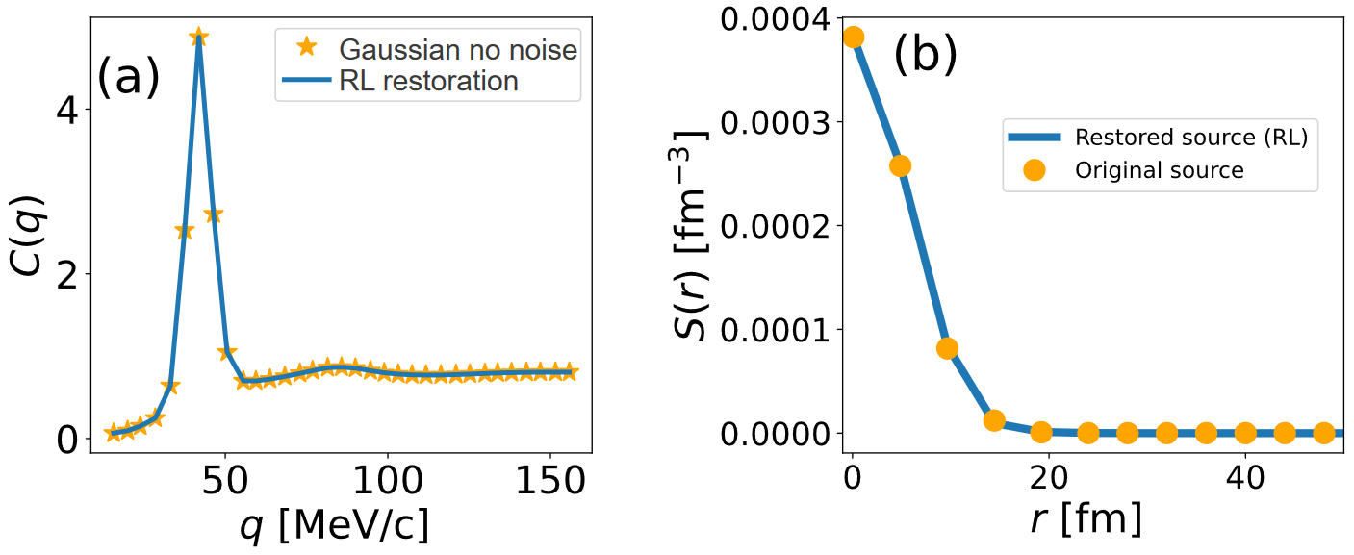
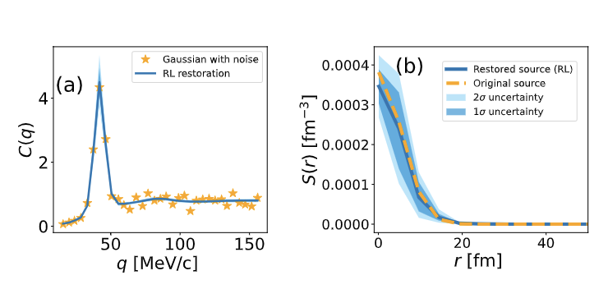
$d−α$source function recovering: Simulated Correlations
$d−α$CF (stars)Using KP formula assuming Gaussian source function (dots) with radius, $R_{0}=5.5$fm
The blue bands are uncertainties associated with noise resampling in $C\left(q\right)$
Noise is add on C(q):
$C\left(q\right)↔C\left(q\right)+σ_{c}(q)𝒩(0,1)$
$σ_{c}(q)=λ√C(q)$, $λ$=0.15
$𝒩(0,1)$: normal distribution
Nzabahimana, P., & Danielewicz, P. (2023)

Slide 10
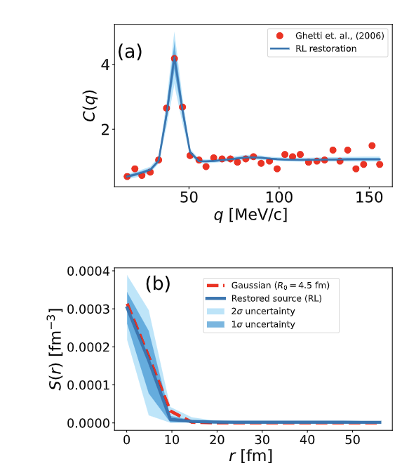
$d−α$source function recovering: Measured correlations
Experimental data
d-α CF with data(stars) from ⁴⁰Ar+²⁷Al reaction at E=44 MeV/U (R. Ghetti, et al., 2004)
Restored solid line (blue line) and (orange dashed) SF for $d−α$system
The structure at low r corresponds to physics
Peaks at 42 and 84 MeV/c correspond to the resonance decay of ⁶Li into d$−α$ at - 2.18 MeV and 4.31 MeV
The blue bands are uncertainties associated with resampling point of measured CF .
Nzabahimana, P., & Danielewicz, P. (2023)

Slide 11
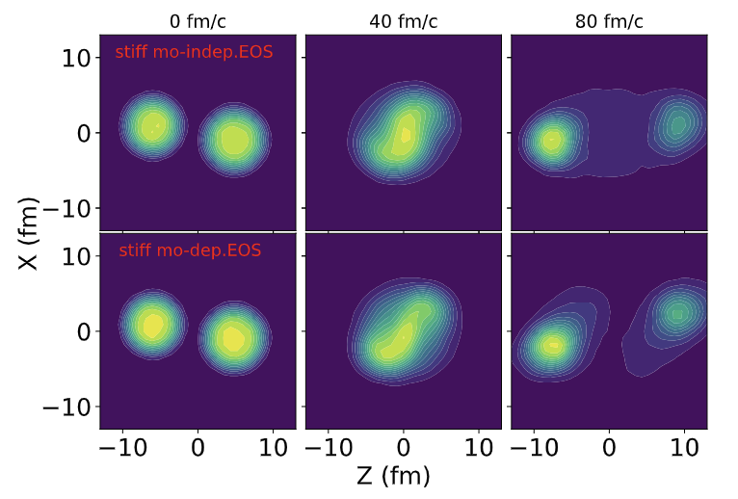
Transport model, Boltzmann-Uehling-Uhlenbeck BUU
BUU model: $\left(\frac{∂}{∂t}+\frac{P}{m}.∇_{r}−∇_{r}U\left(r\right)∇_{p}\right)f=I_{col}\left(σ_{in}, f\right)$,
Collision term: $I_{col}\left(σ_{in},f\right)$, nucleon-nucleon collision
LHS describe the motion of particle in the mean field potential, $U$
$S^{BUU}\left(r\right)=\frac{\int{d^{3}R f(\frac{P}{2}, R+\frac{r}{2}, t_{>})f(\frac{P}{2}, R−\frac{r}{2}, t_{>})}}{{\left|\int{d^{3}r f}\right|}^{2}}$
where $R=0.5\left(r_{1}+r_{2}\right)$, $r=r_{2}−r_{1}$,
-$f$ particle phase-space distribution, $t_{>}$ time between emissions
Light system: Ar +Sc, at E/A=80 MeV, b=1.9 fm
$S\left(r\right)= S^{BUU} \left(r\right)+C{\left(\frac{r}{B}\right)}^{2}\exp\left(−\frac{r}{B}\right)$
$C=0.63×{10}^{−4}$fm⁻³ and
$B=5$fm.
The tail represents the source function of emissions from secondary decays,
the BUU code does not provide.
Mo-indep: momentum independent,
mo-dep: momentum dependent
P. Danielewicz Nucl. Phys. A, 673 (2000)

Slide 12
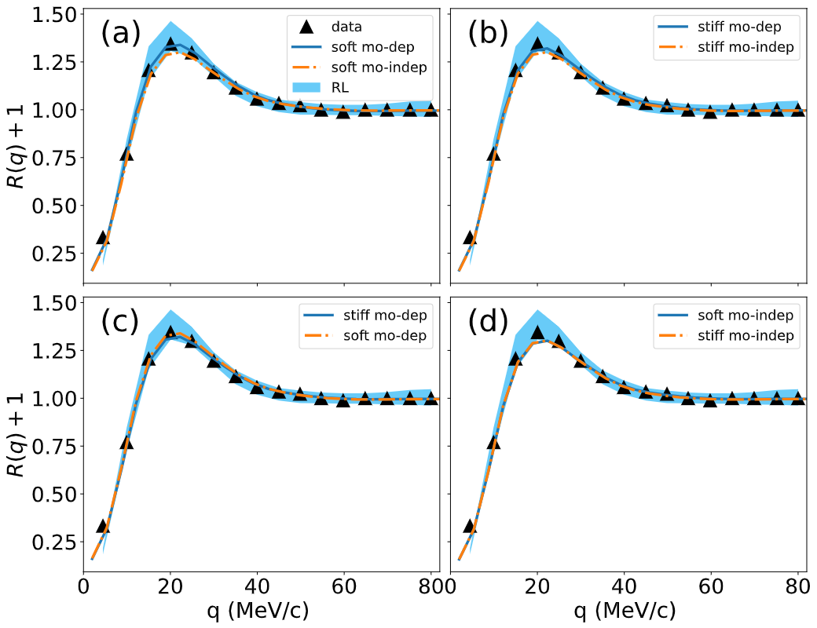
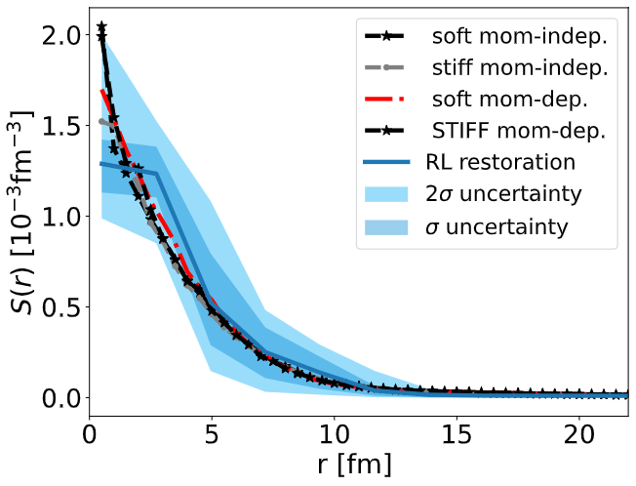
P-P correlations function: BUU and RL algorithm
Source function
Paper in preparation
Triangles represent p-p correlation from
Verde et al., 2003 (PhysRevC.67.034606)

Slide 13
Summary
Discuss deblurring for decay energy and source function
For CF the TM is due to physics and is very different from that in other cases
Deblurring restored d-alpha source function
We discuss BUU for PP correlation
Adding a tail to BUU p-p source reproduces measured
Outlook:
BUU: PP correlation for high energy reaction - source deformation
Deblurring: extend the method to 3D to analyze 3D particle correlations data

Slide 14
Thank you for your attention !!!
Co-author: Pawel Danielewicz
Funding agencies
US DOE, DE-SC001920

Slide 15
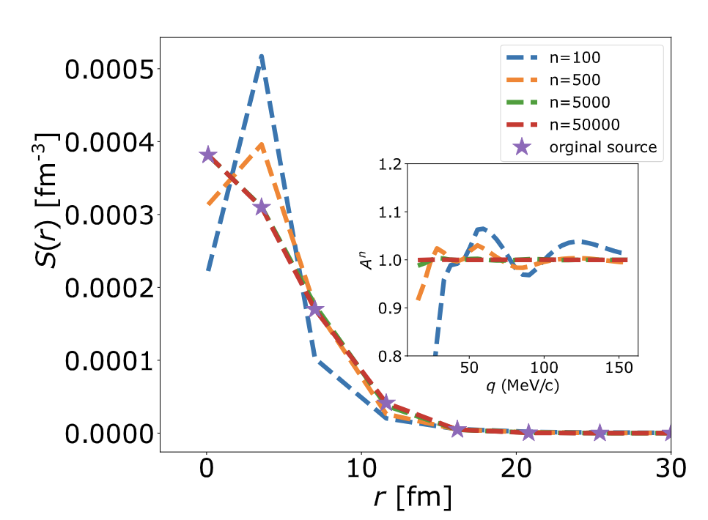
$d−α$source function recovering: Simulated Correlations
Recall
$$F_{i}^{\left(n+1\right)}=\sum_{j}{\frac{f_{j}}{f_{j}^{n}}}T_{ji}F_{i}^{n}$$
Performance of RL algorithm for iterations, n .
$A^{n}=\frac{f}{f^{n}}$ (inserted plot)
$d−α$CF (stars)Using KP formula assuming Gaussian source function (dots) with radius, $R_{0}=5.5$fm
Source resolution and momentum resolution used were obtained by performing a $χ^{2}$minimization of $d−α$CF
Nzabahimana, P., & Danielewicz, P. (2023). Physics Letters B, 138247.

Slide 16
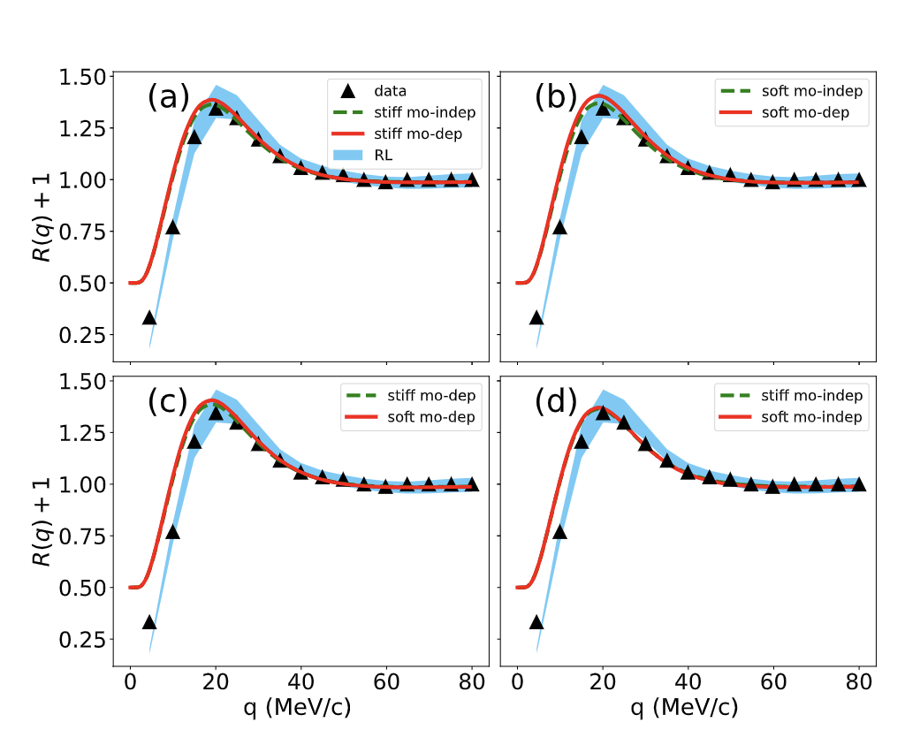
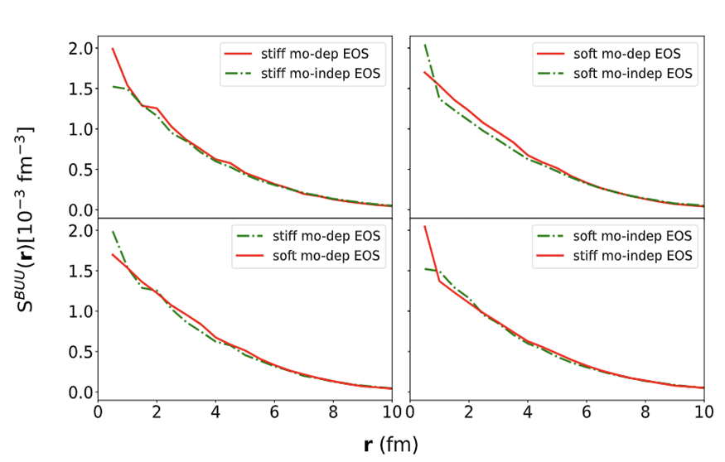
P-P correlation from BUU and Deblurring
C$\left(q\right)=\int{d^{3}rλ{ S^{BUU}(r)\left|Ψ_{pp}\left(q,r\right)\right|}^{2}}$
Ar +Sc, at E/A=80 MeV, 200-400 MeV/c, Tot. momentum
Ar +Sc, at E/A=80 MeV, 200-400 MeV/c, Tot. momentum, $λ=0.5$
Triangles represent p-p correlation from
Verde et al., 2003 (PhysRevC.67.034606)

Slide 17
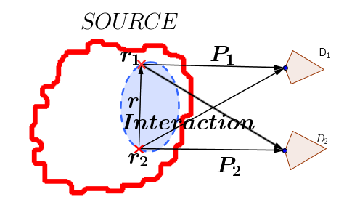
Source Function (SF)
$$C\left(q\right) =R\left(q\right)+1=\int{d^{3}r \underbrace{S(r)}\underbrace{{\left|Ψ(q,r)\right|}^{2}}}$$
SF: relative distribution of final state particles in the system.
Studying relative distribution of two-particle emission gives access to space-time characteristics of the emitting system
Interactions and symmetrization, affecting the relative state of two particles on their way to the detectors, and encoded in the relative wave function, allow inferring characteristics of particle emission from correlation functions
Method to estimate S(r):
-KP formula with Gaussian Source
- Imaging SF (D.A. Brown and P. Danielewicz (1997))
-Restoration of SF by Deblurring Method

Slide 18
Richardson-Lucy (RL) Algorithm for deblurring
Blurred/Measured function or Forward relation
$f_{i}=\sum_{j}{H_{ij}F_{j} }$
H is a transfer matrix (TM)/response Matrix
RL-algorithm
Solves $F$ ( true function ) iteratively
$f_{j}^{n}\left(E\right)=$ ${\sum_{j}{H_{ji}}F}_{i}^{n}$
$F_{i}^{\left(n+1\right)}=\sum_{j}{\frac{f_{j}}{f_{j}^{n}}}T_{ji}F_{i}^{n}$
-$T_{ji}=\frac{W_{j}H_{ji}}{\sum_{j′}{W_{j}′H_{j′i}} }$, normalized TM $\sum_{j}{T_{ji}=1}$
n = number of iterations
$F^{0}≥0$, guess i.e., $F^{0}$=1
$F^{n}$, $T_{ji}$, $f_{i}$, and $H_{ji}$ are kept positive
Add a noise term on the blurring model
${\hat{f}}_{i}=\sum_{j}{H_{ij}F_{j} }+N_{j} \sim 𝒫\left(\sum_{j}{H_{ij}F_{j} }\right)$
$𝒫:$ noise model
RL algorithm becomes
$F_{i}^{\left(n+1\right)}=\sum_{j}{\frac{{\hat{f}}_{j}}{{\hat{f}}_{j}^{n}}}T_{ji}F_{i}^{n}$
$$f\left(E_{d}\right)=∫dE_{d}^{’}H\left(E_{d} | E_{d}^{’}\right)F\left(E_{d}^{’}\right)$$
Discretized
c
Backward
Nzabahimana, P., et al. Phys. Rev. C 107.6 (2023): 064315.
W. H. Richardson, JoSA 62, 55 (1972)
L. B. Lucy, the Astronomical journal 79, 745 (1974)
P. Danielewicz and M. Kurata-Nishimura, Physical Review C 105, 034608 (2022)

Slide 19
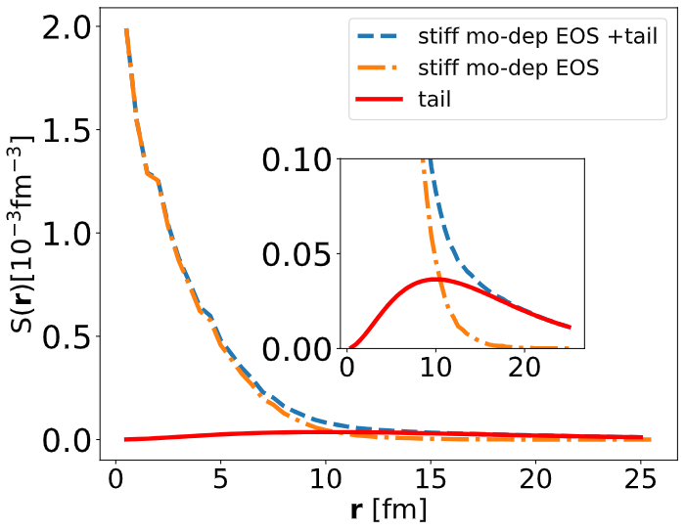
Addition of a tail (correction ) to BUU source
$$S\left(r\right)= S^{BUU} \left(r\right)+C{\left(\frac{r}{B}\right)}^{2}\exp\left(−\frac{r}{B}\right)$$
$C=0.63×{10}^{−4}$fm⁻³ and
$B=5$fm.
The tail represents the source function of emissions from secondary decays,
the BUU code does not provide.

Slide 20
$d−α$source function recovering: Noisy simulated Correlations
Add fluctuation in in simulated $d−α$CF
Assuming Gaussian source function with radius, $R_{0}=5.5$fm
Nzabahimana, P., & Danielewicz, P. (2023). Physics Letters B, 138247.

Slide 21
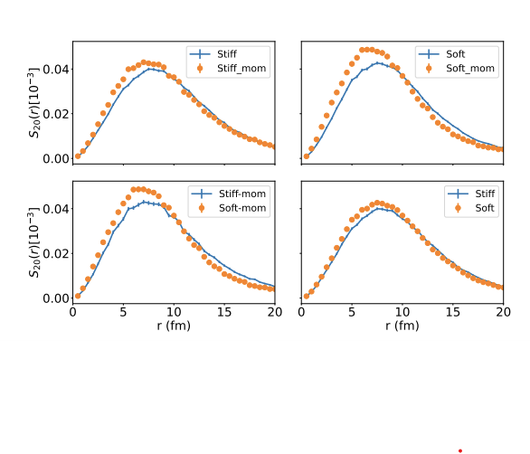
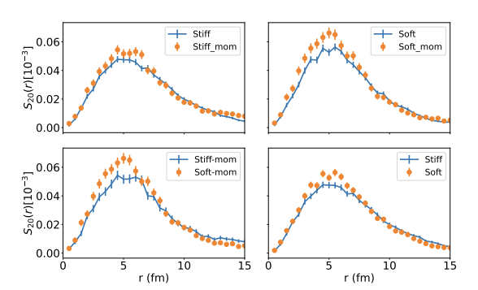
P-P source deformation: Quadrupole component of the P-P source
Monopole component of source: angular momentum l=0, angle averaged source, i.e., source discussed before
Quadrupole component, l=2, $S_{20}∝A(r)Y_{20}=\frac{1}{4}\sqrt{\left(\frac{5}{π}\right)}3(cos{\left(θ\right) }^{2}−1)$
Xe + Au, at E/A=80 MeV, 200-400 MeV/c, Tot. momentum, b=3.1fm
Ar +Sc, at E/A=80 MeV, 200-400 MeV/c, Tot. momentum
The corresponding correlations are the next step

Slide 22
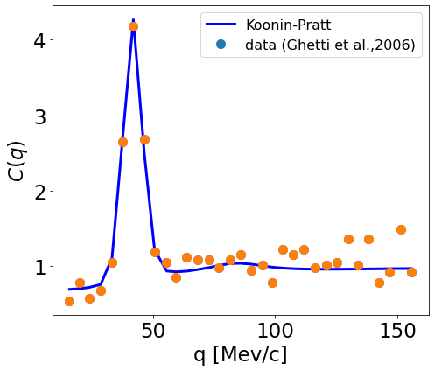
Comparison: $d−α$ correlations from Deblurring and Koonin-Pratt with Gaussian source
Both reproduce data, dots
RL algorithm does much better in fitting data
Koonin-Pratt formula with a Gaussian source
Nzabahimana, P., & Danielewicz, P. (2023). Physics Letters B, 138247.

Slide 23
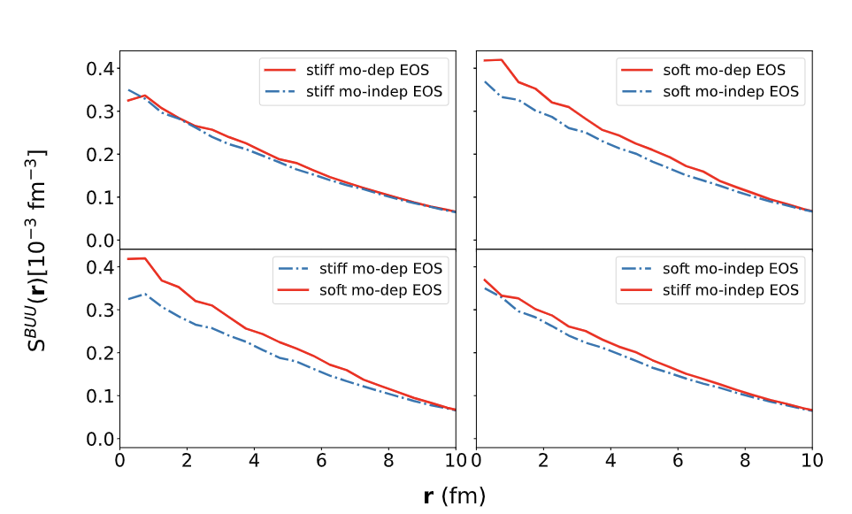
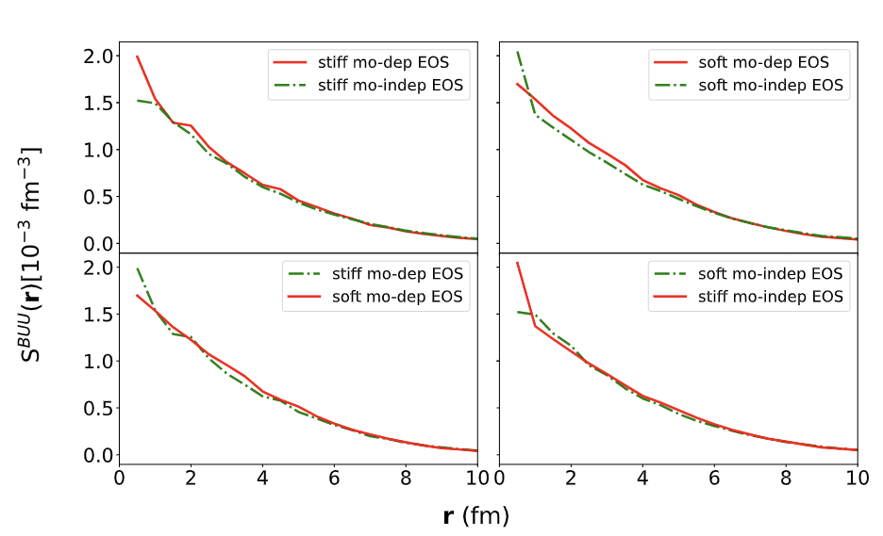
The source function from BUU: Results Proton- Proton
$S^{buu}\left(r\right)=\frac{\int{d^{3}R f(\frac{P}{2}, R+\frac{r}{2}, t_{>})f(\frac{P}{2}, R−\frac{r}{2}, t_{>})}}{{\left|\int{d^{3}r f}\right|}^{2}}$ where $R=0.5\left(r_{1}+r_{2}\right)$, $r=r_{2}−r_{1}$,
-$f$ particle phase-space distribution, $t_{>}$ time between emissions
Xe + Au, at E/A=80 MeV, 200-400 MeV/c, Tot. momentum
Ar +Sc, at E/A=80 MeV, 200-400 MeV/c, Tot. momentum
Verde et al 2003, PhysRevC.67.034606

Slide 24
High resolution in source function

Slide 25
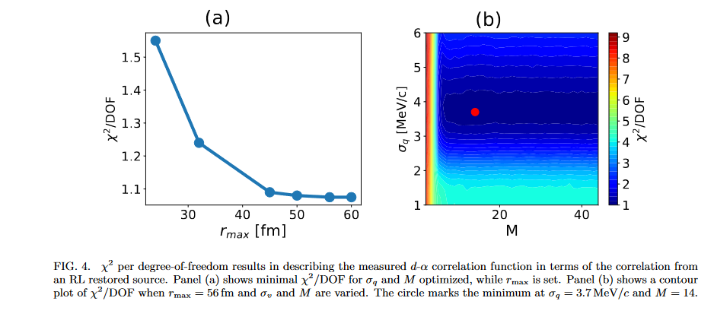
Chi-square minimization for q and source resolution

Slide 26
Baye’s theory for deblurring
Measured/blurred observable is defined as
$f(E_{d})=$ $\int{H\left(E_{d} | E_{d}^{′}\right)F\left(E_{d}^{′}\right)dE_{d}^{′}}$
-F : quantity we want to find
-H: Transfer matrix
In discretized form
$f_{i}=\sum_{j}{H_{ij}F_{j} }$
-We shall use discrete form in the derivation
-$\sum_{j}{H_{ij} }=1$, implies $\sum_{j}{f_{j} \text{=}\sum_{j}{F_{j} }}=N$ all produced particle were detected
-$f$, $H$ are know except $F$
Assume
$p(F_{i})\sim \frac{F_{i}}{N}$ -probability that $F_{i}$ occurs
and $p(f_{i})\sim \frac{f_{i}}{N}$ -probability that $F_{i}$occurs
Then Baye’s theory
$H_{ki}=p\left(F_{k} | f_{i}\right)=\frac{p\left(f_{k}|F_{i}\right)p\left(F_{i}\right)}{\sum_{j}{p\text{(}f_{k}\left|F_{j}\right) }p\left(F_{j}\right)}$
$p\left(F_{k} | f_{i}\right)$ - probability that $F_{k}$occurs
given $f_{i}$ and is a complement of
$p\left(f_{k} | F_{i}\right)$
Pawel Danielewicz and Mizuki Kurata-Nishimura
Phys. Rev. C 105, 034608 (2022)
G. D’Agostini, Nucl. Instrum. Methods. Phys. Res. A 362, 487 (1995). Res. A 362, 487 (1995)

