Slide 1
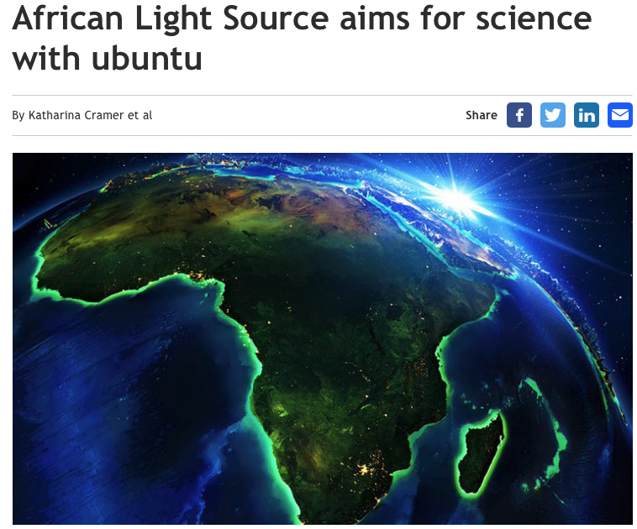
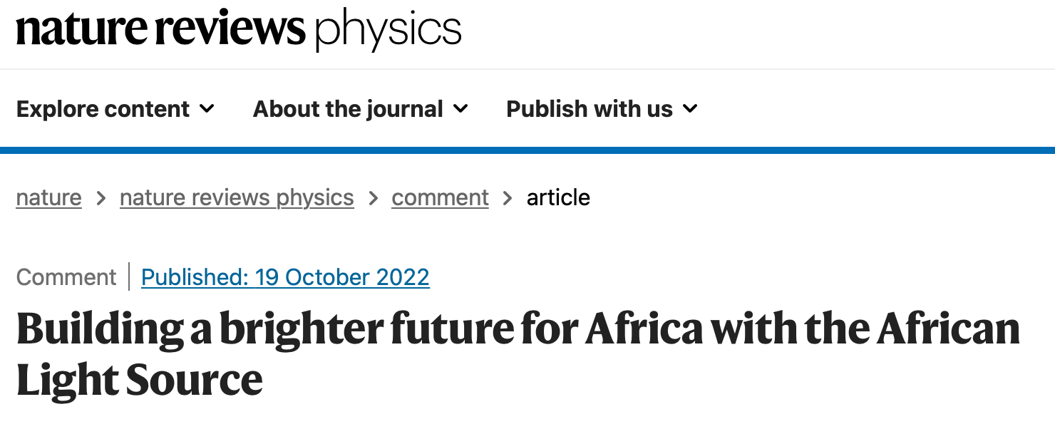
AfLS Website https://www.africanlightsource.org
Johannesburg – Soccer World Cup 2010
Debating the Societal Impact of Big Science in the 21st Century
To appear soon …..
https://www.worldscientific.com/doi/abs/10.1142/S0217732318300033
2023-06-14 Science and Public Policy 00 (2023) 1-12 “Science diplomacy from the Global South: the case of intergovernmental science organizations“
http://lamp.ictp.it/index.php/aphysrev/article/view/1610/586
https://i0.wp.com/www.africanlightsource.org/wp-content/uploads/2022/12/Nature-Review-Physics.png?ssl=1
https://link.springer.com/article/10.1007/s12551-019-00578-3
https://www.worldscientific.com/doi/abs/10.1142/S0217732318300033
https://www.researchprofessionalnews.com/rr-news-europe-views-of-europe-2022-5-african-light-source-aims-for-science-with-ubuntu/

Slide 2
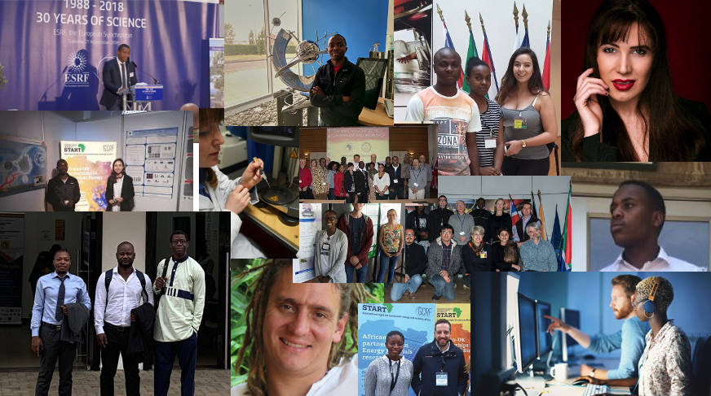
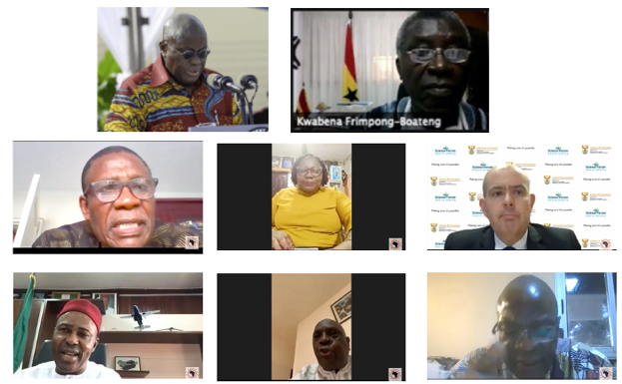
Roadmap : AfLS Conference 2015
http://events.saip.org.za/conferenceDisplay.py/getPic?picId=66&confId=61
Bottom Up
Human Capacity: scientists, engineers, technicians
African scientists access existing LSs
African relationships with existing LSs.
Involvement of industry
Community for the African light source Users
Conferences, Workshops, Outreach, Media
Top Down
Strategic approach to African Governments and (Pan) African orgs.
Conceptual Design Report (CDR)
Inter-African co-operation on Regional feeder infrastructure
African multinational beamlines at existing LSs
Regional / Pan African membership of existing LSs
Technical Design Report (TDR)
Ready soon !!!!
MoU
LoS

Slide 3
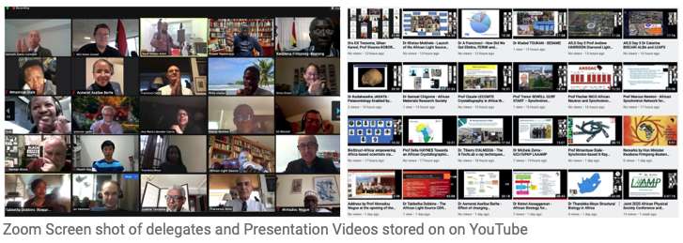
Conferences
2015, 2019, 2020,
2021, 2022,
2023
2021
Now 5 African Governments involved
Many co-conveners
Prof bodies
Academies
2022
~1000 registrations
2021
>500 registrations
AfLS1 2015 https://events.saip.org.za/event/61/
AfLS2 2019 https://events.saip.org.za/event/145/
AfLS3 2020 https://events.saip.org.za/event/211/
AfLS4 2021 https://events.saip.org.za/e/AFLS3
AfLS5 2022 https://events.saip.org.za/e/AfLS2022
AfLS6 2023 https://events.saip.org.za/event/243/

Slide 4
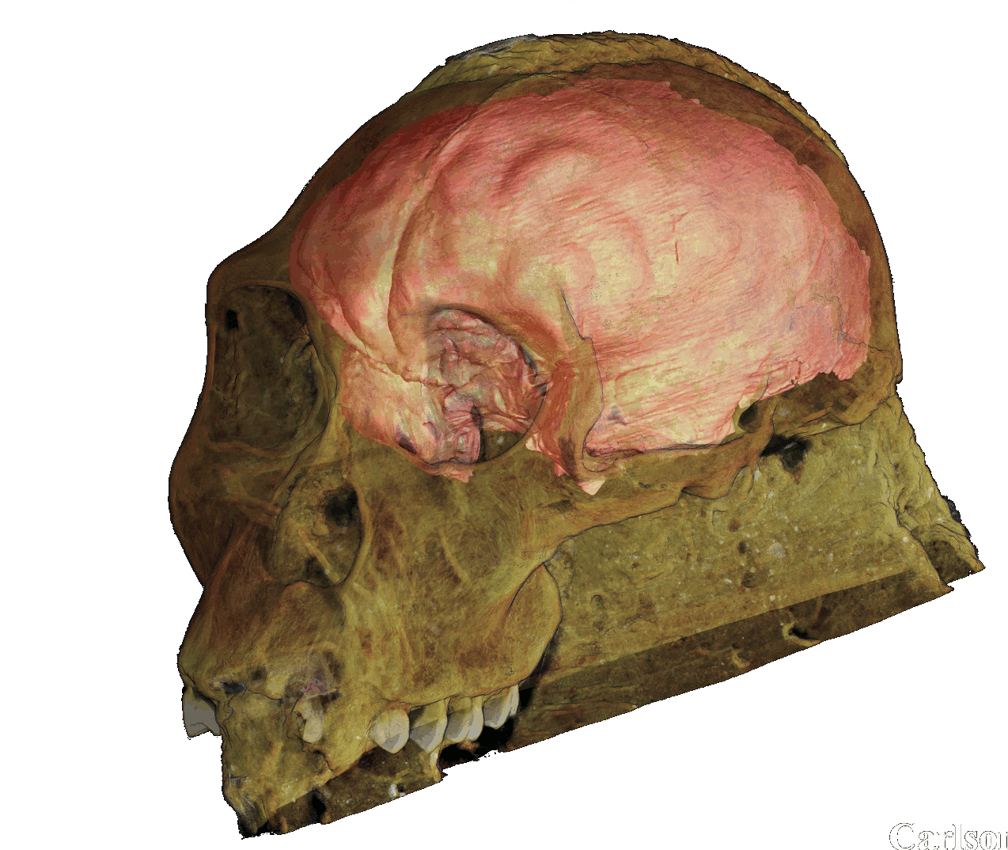
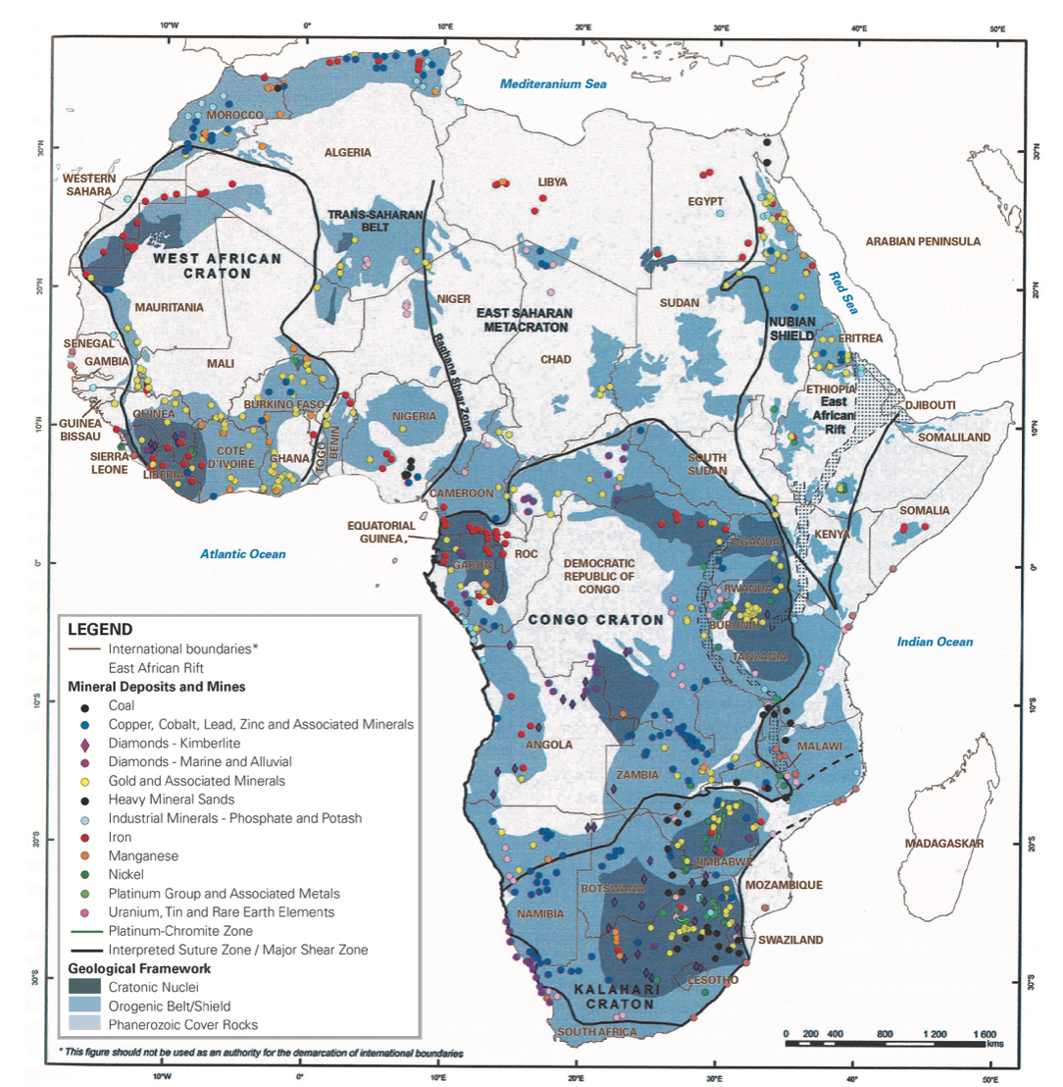
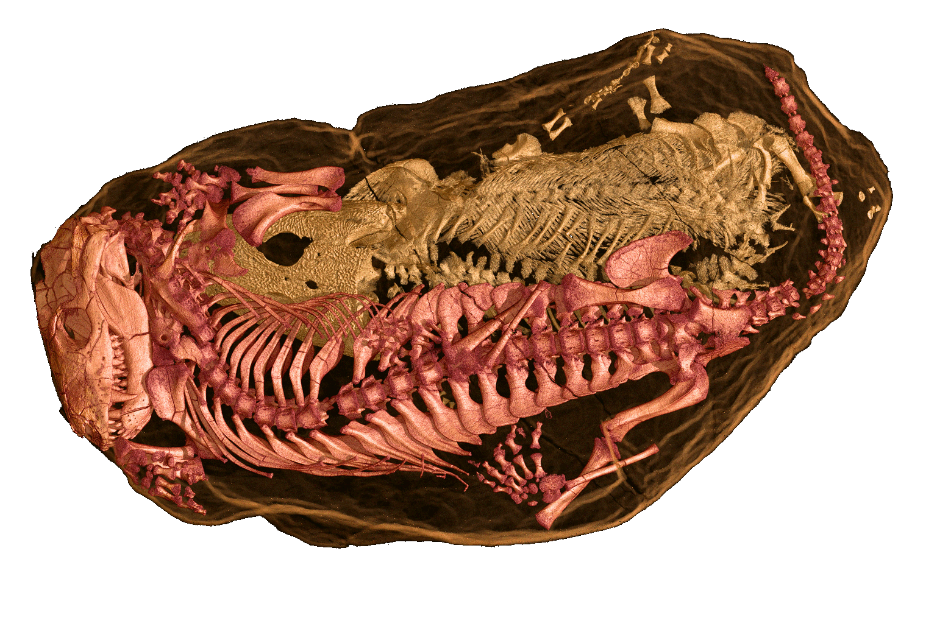
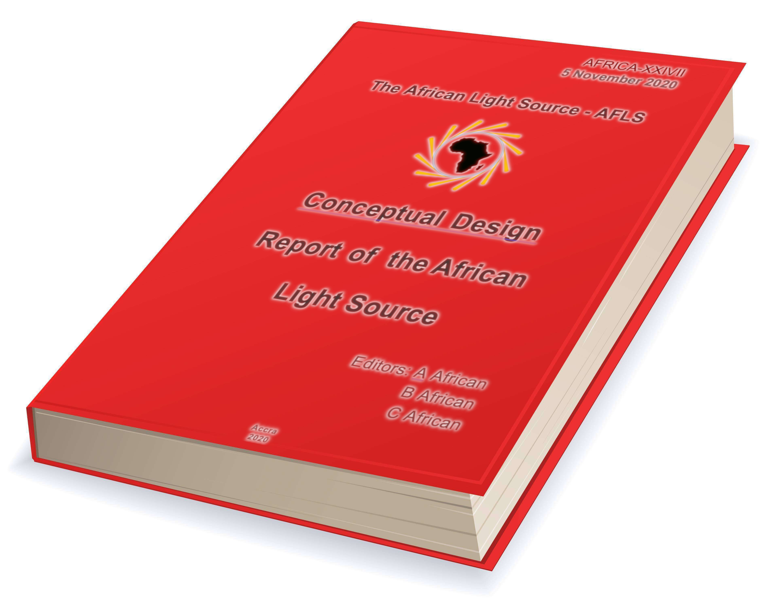
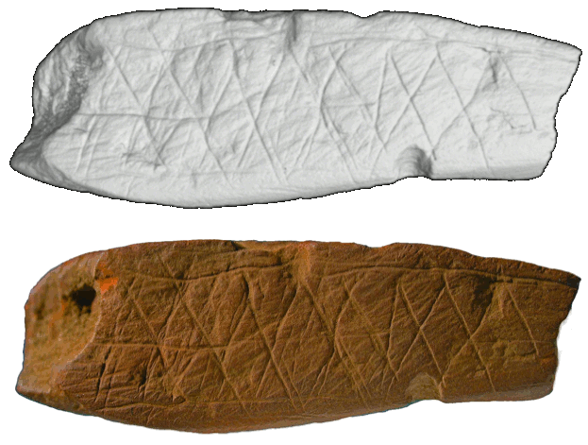
Global and Africa relevant Research and Innovation – by Africans and partners
Developing medical interventions for Africa’s disease burden, Malaria, HIV, TB, Ebola ….
Beneficiating Africa’s mineral wealth: Mining Review Africa
African Cultural and Paleo Heritage
Energy Materials
Innovations
AfLS-CDR Conceptual Design Report
….. and much more

Slide 5
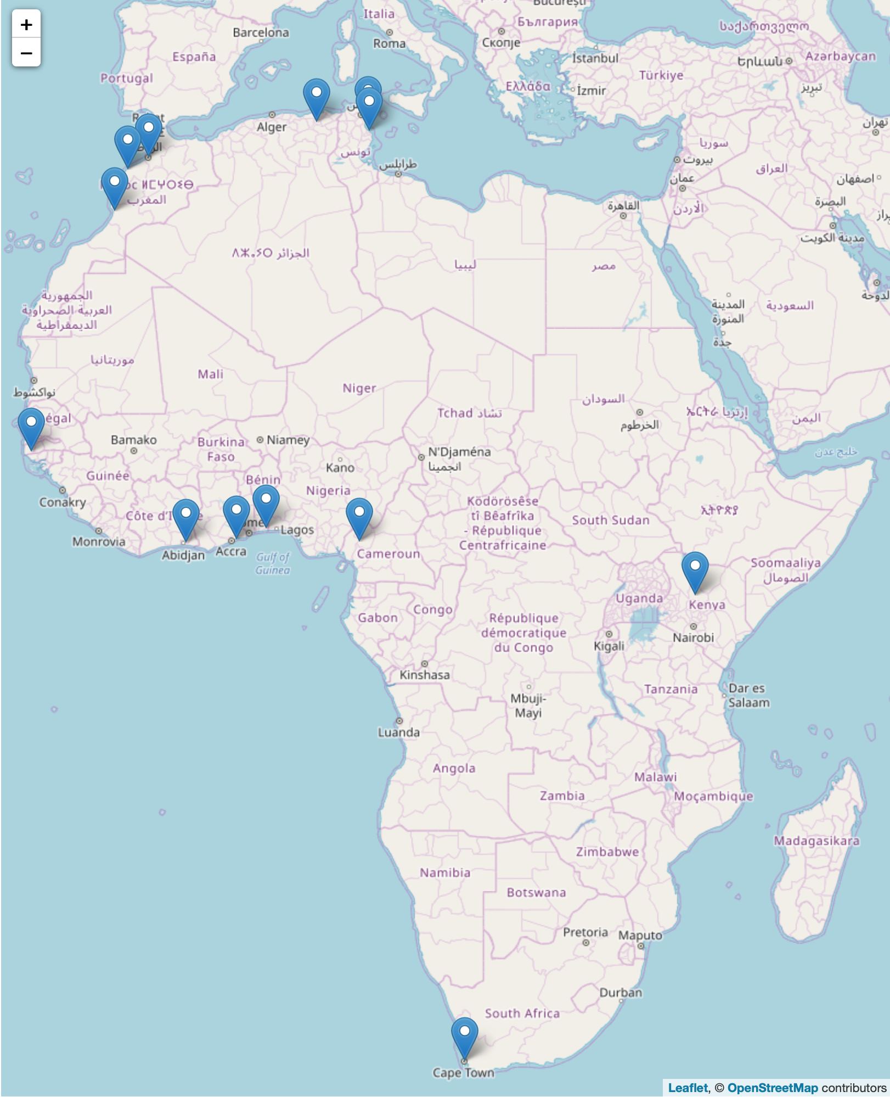
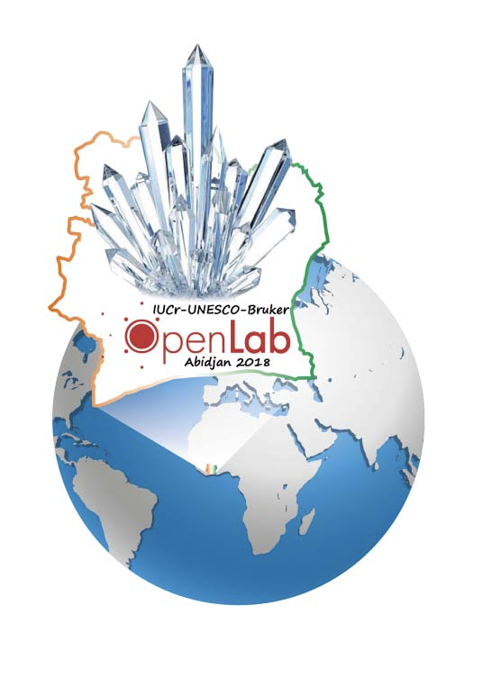
Feeder Facilities
South Africa
Aaron Klug Centre, UCT, link, U Witwatersrand, U Free State, U Stellenbosch, iThemba
Benin, X-TechLab, Benin, link
Ghana, U Ghana, link
Côte d'Ivoire, LaCPM, Universite Felix Houphouet Boigny, Abidjan, link
Senegal, Ziguinchor, link
Cameroon, Dschang, link
Kenya, Kenyatta University, link
Tunisia
Monastir, link, Nabuel, Tunisia, link
Algeria, Constantine 1, link
Morocco
U Rabat,, link, El Jadida, Morocco, link , Agidir, Morocco, link
Significant facilities
IUCr OpenLab venues with facilities

Slide 6
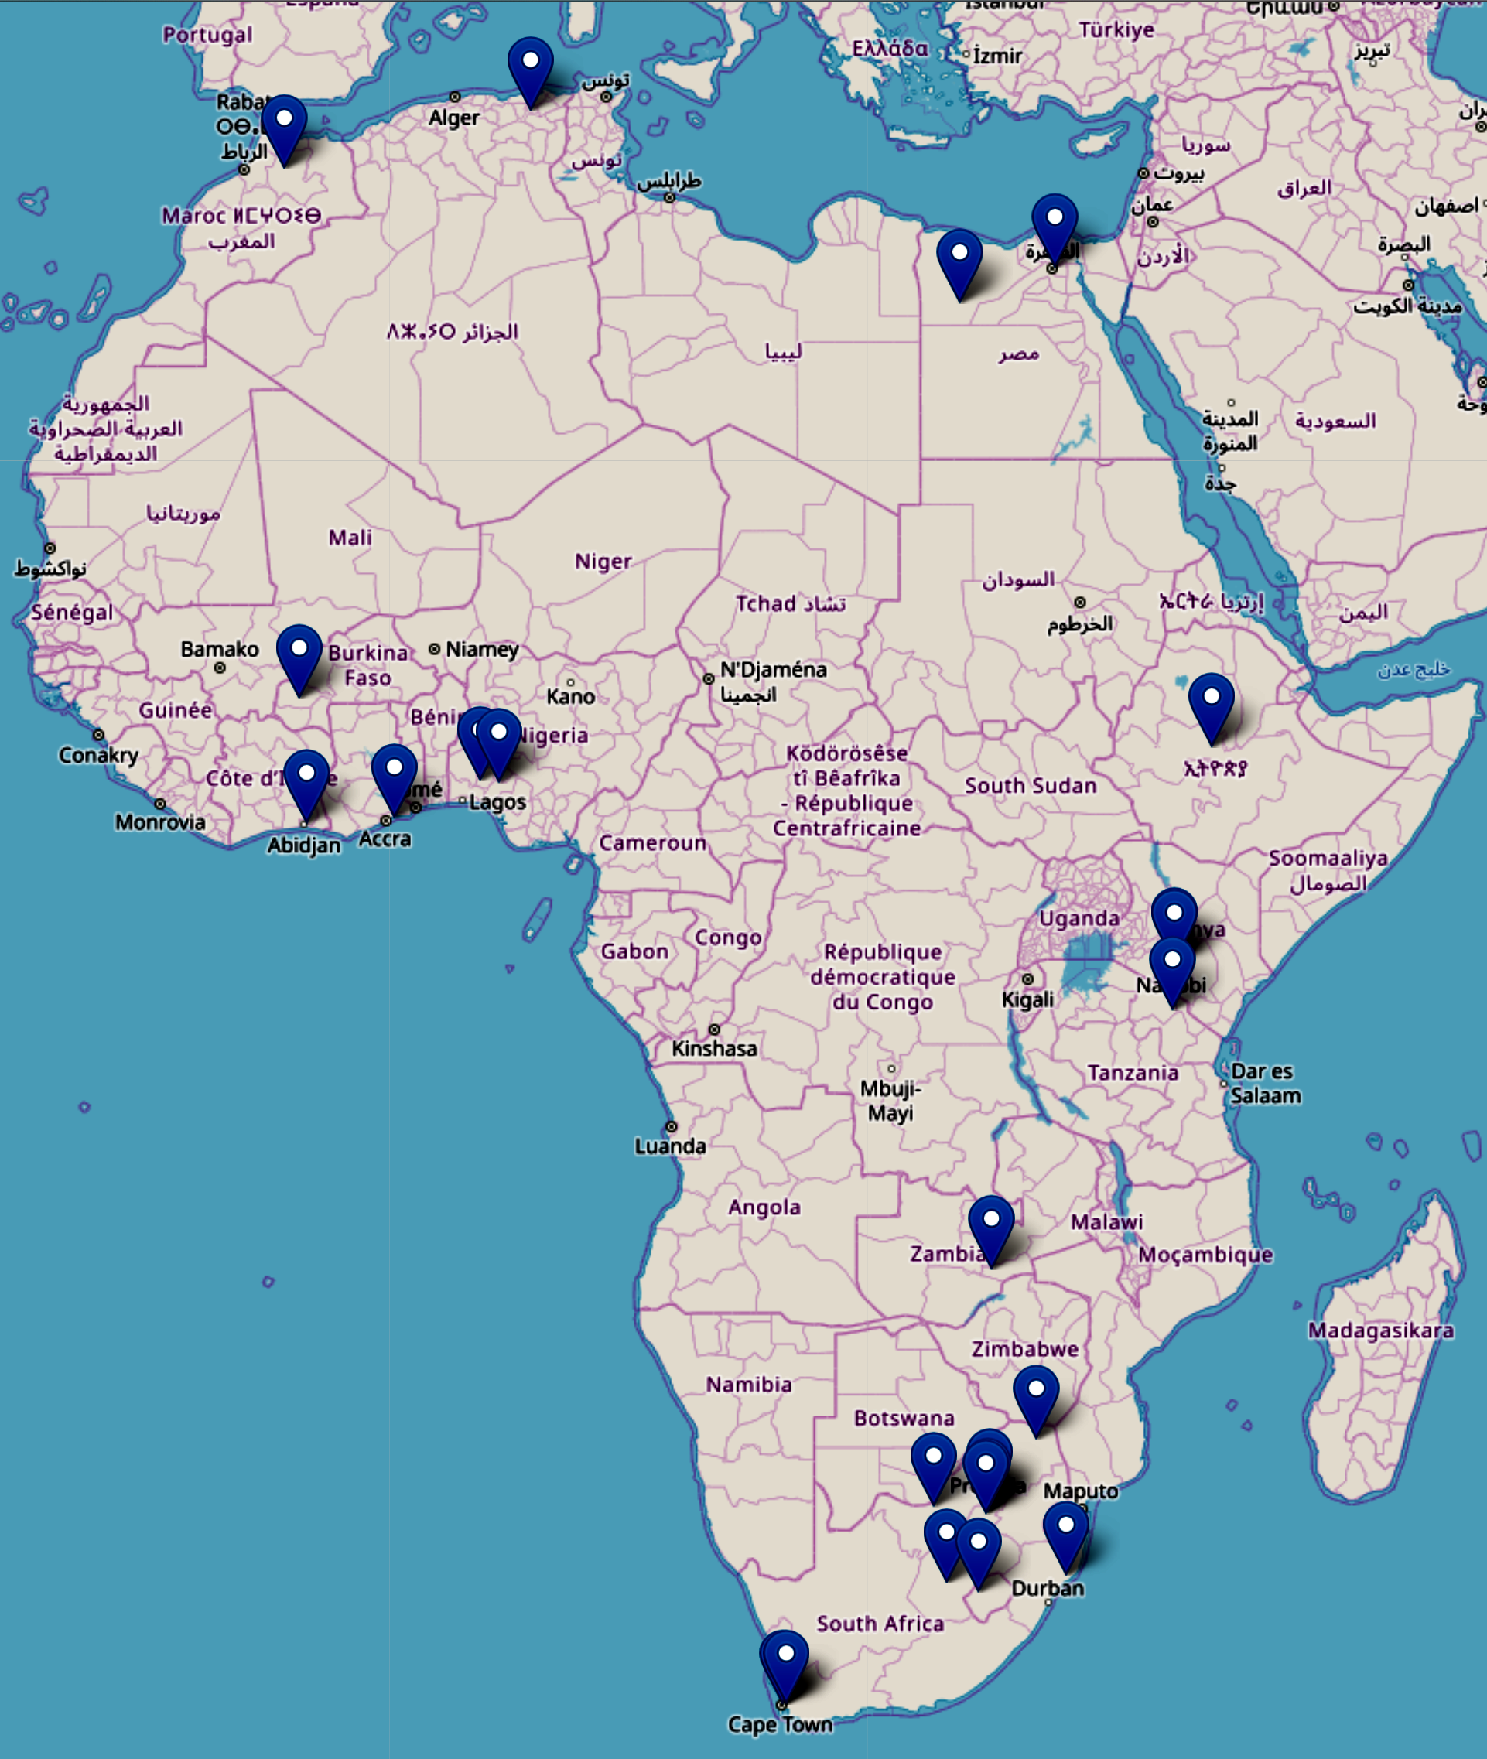
Bottom Up
Bio-Science Capacity in Africa
Ghana
University of Ghana
Zambia
The University of Zambia
Algeria
Ecole Nationale Polytechnique de Constantine
Nigeria
Federal University of Technology, Akure
University Ile-Ife
Burkina Faso
Institute of Research in Health Sciences, Burkina Faso
Morocco
University Sidi Mohamed Ben Abdellah
Ivory Coast
Universite Felix Houphouet Boigny
Egypt
Helwan University, Ain Shams University
Lesotho
National University of Lesotho
Ethiopia
Addis Ababa University

Slide 7
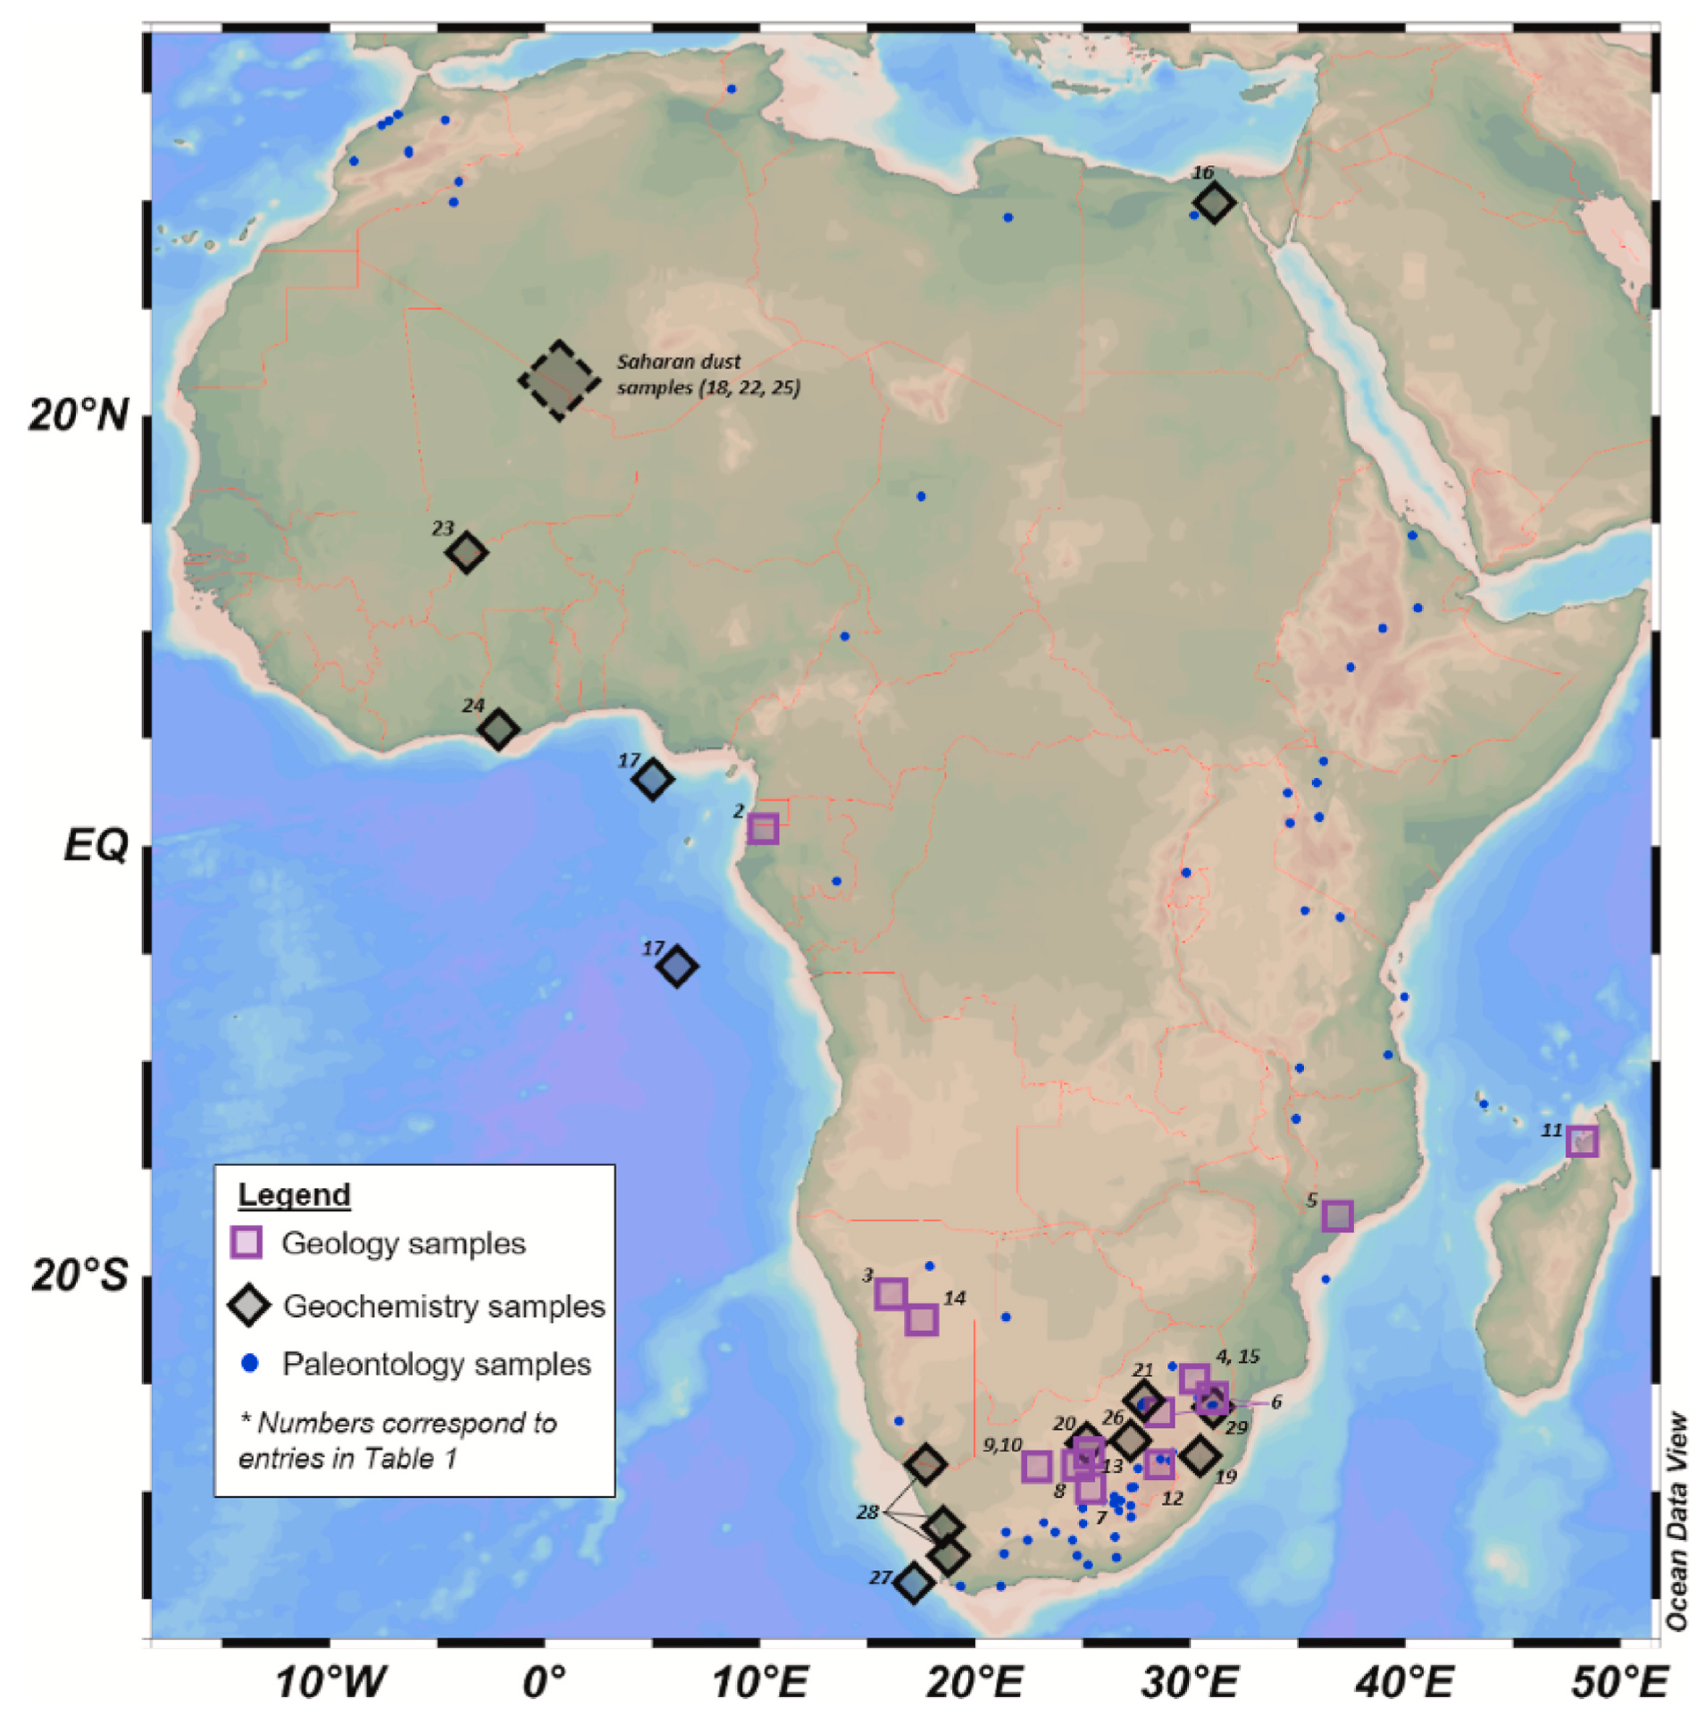

Slide 8
Bottom Up
28/52 > 50%
PhD / Paper / Programme

Slide 9
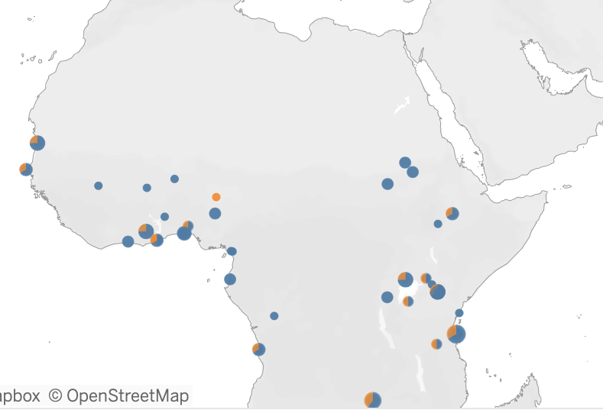
237
Northern Africa
Clinical Linacs
Possible extra route to skills development ?
https://dirac.iaea.org/Query/Map2?mapId=2
88
Middle Africa
107
Southern Africa

Slide 10
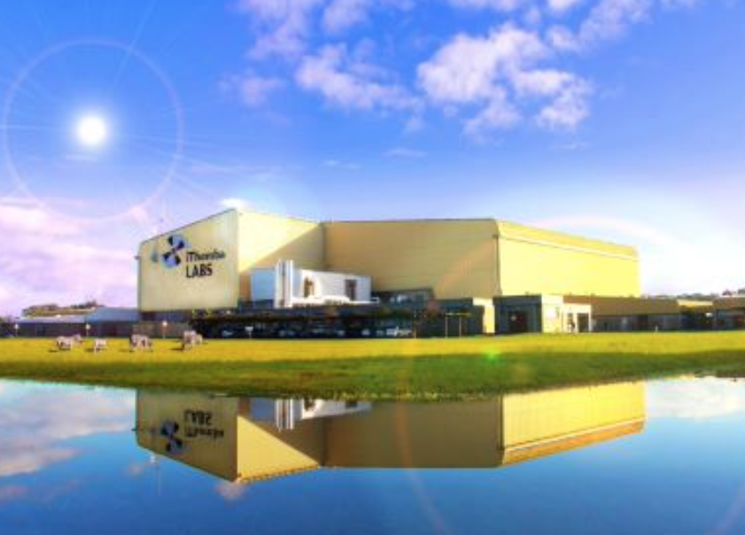
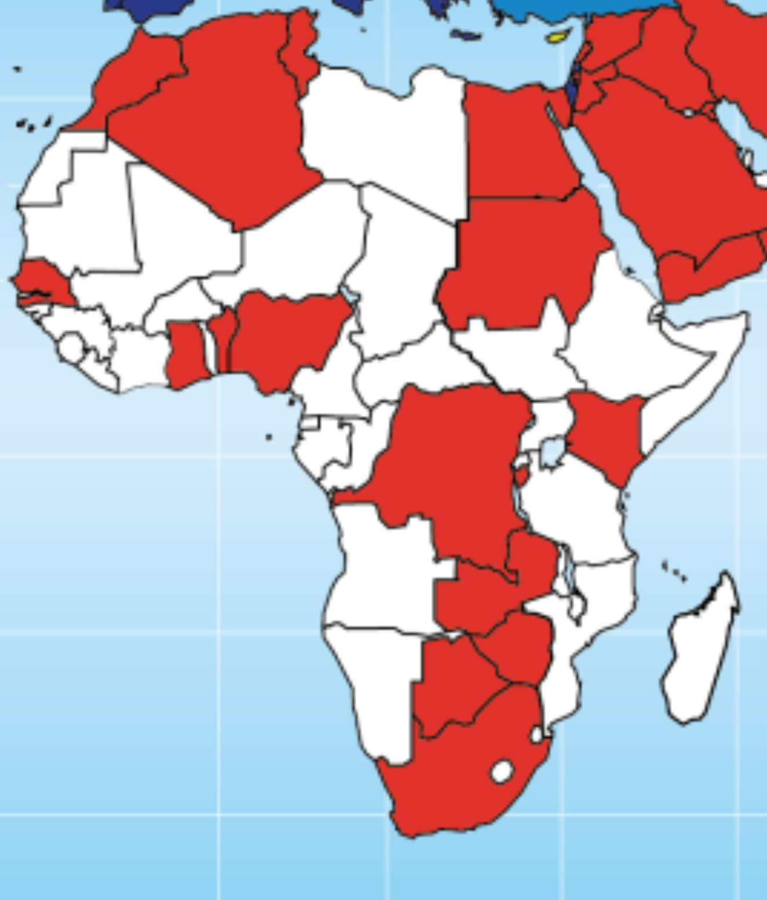
Instrumentation and Control Systems Capacity in Africa
South Africa:
iThemba LABS
Instrumentation / Control
SARAO
Instrumentation / Control
SKA
Instrumentation / Control
Necsa
Nuclear Energy Corporation of SA
Instrumentation / Control
St James Software
JlogBook - e-log-book
With ESRF interfaces to TANGO
Stellenbosch U
Presenting at ICALEPCS
CERN participation by African Countries
Algeria, Egypt, Ghana, Madagascar, Morocco, Mozambique, Rwanda, South Africa, Tunisia, Many others
Tech Transfer, Operations, Upgrade, Instrumentation, AI etc

Slide 11
Some Existing Regional Facilities
X-TechLab - Benin
Materials analysis, spectroscopy for many disciplines.
Energy, health, environment, agriculture, materials
Microscopy Centre – UCT in SA
Structural biology resource widely used in SADEC region
African Laser Centre
Pan-African NEPAD flagship initiative
ICTP-EAIFR - Rwanda
Condensed matter, Geology, Particle Physics, Cosmology, Astroparticle physics
Partner with LAAAMP, IUCr – OpenLABS, START, Others ….

Slide 12
3 Strategic Task Forces to report by Dec 2023
The African Beamline at an international AdLS
This is an African designed and operated beamline at an International AdLS that can address selected African Research Imperatives. It leads additionally to the training of engineers and technologists and will result in Technology Transfer.
The Collective African membership of an international AdLS
Here several African countries jointly acquire formal membership of an international AdLS. They leverage a threshold of participation that allows African Government involvement in the Council of the Facility, so that there is increased African Access of Researchers, technologists, Industries and also Governments.
African Regional Infrastructure
This is research infrastructure that is both highly competitive in its own right but which is also seen as important training and feeder infrastructure to an AdLS.
“Leave no country behind.”

Slide 13
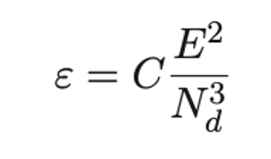
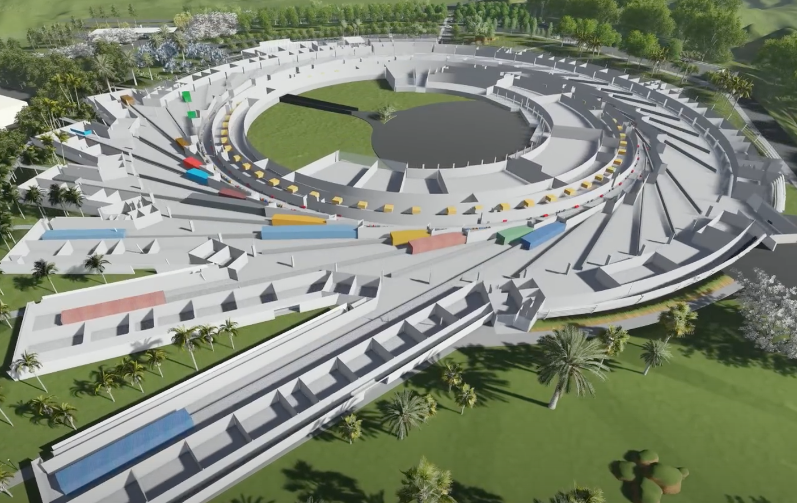
4th Generation - MBA Upgrades
10⁴ x better :
x100 – emittance,
x100 - detectors
ESRF upgrade → EBS
Sirius in Campinas, Brazil
MAX IV in Lund, Sweden
3 GeV, MBA, 20 Beamlines
Imaging
Diffraction
Spectroscopy
5th Generation ?

Slide 14
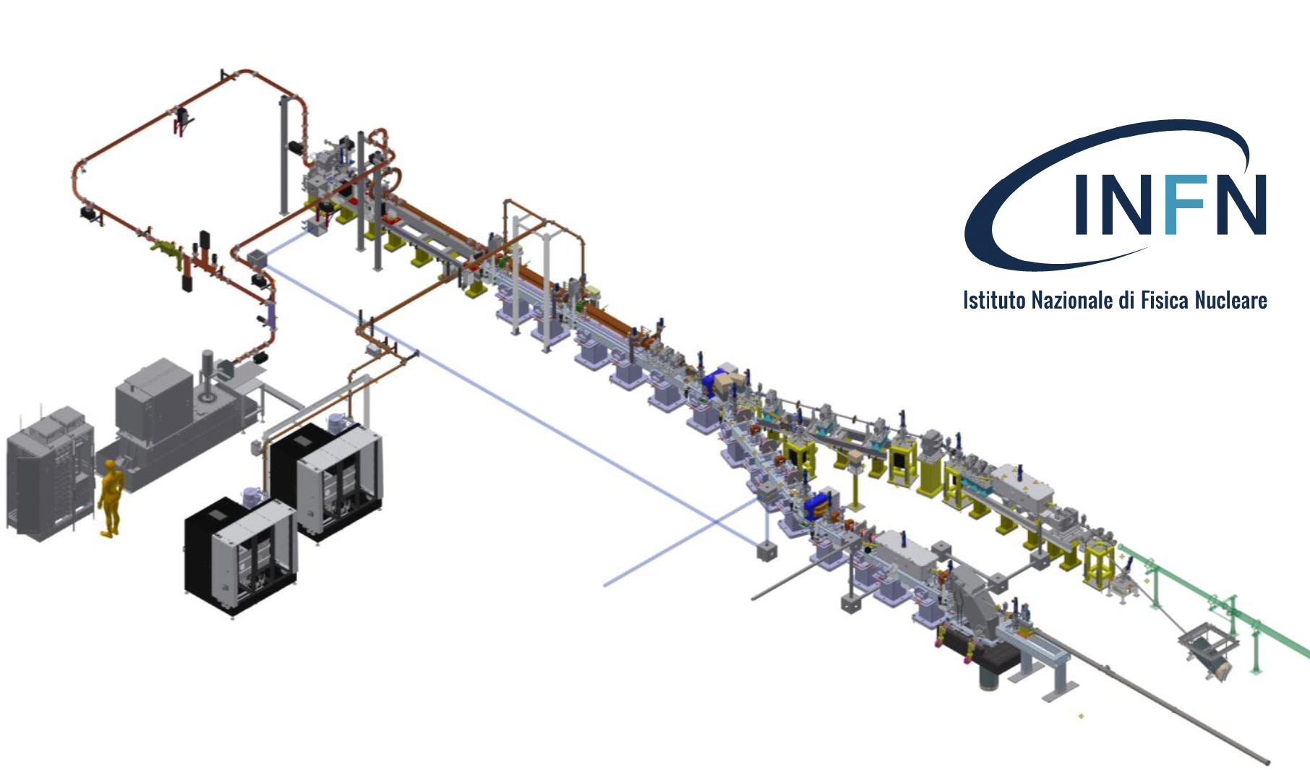
Compact Light Source : Inverse Compton Scattering : STAR in Calabria
Logarithmic performance : lab source - CLS - synchrotron
African Regional Infrastructure
Workshop
Milestone on AfLS Roadmap → Destination is AfLS !

Slide 15
Accelerator Physics Capacity in Africa
Ghana: Accelerator Laboratory at the Obafemi Awolowo University. 1.7MV Pelletron Tandem Accelerator
Nigeria: Accelerator Laboratory at the Obafemi Awolowo University. 1.7MV Pelletron Tandem Accelerator
Egypt: Nuclear Research Centre (NRC).
MGC-20 cyclotron, 3 MV Tandetron (commissioned ?)
Algiers: Nuclear Research Centre of Algiers (CRNA).
3.75 MV Van de Graaff accelerator
South Africa: iThemba LABS 200 MeV separated-sector cyclotron with two injector cyclotrons., 11 MeV PET Isotopes, 6 MV Tandem accelerator, 3 MV Tandetron.

Slide 16
Milestones on the Timeline of the Roadmap
End 2023
6th AFLS Conference,
CDR published
Strategic Task Force feedback
End 2026
AfLS is a regular session in meetings such as AUC-ESTI, AfDB, All Pan African and Regional meetings of African National Science Ministries
End 2026
African joint National participation in an AdLS.
African Beamline at an AdLS
5 new National / Regional facilities (1 x CLS)
End 2025
Audit >1000 active
Updated Roadmap
African Light Source Secretariat
Executive Office
End 2026
Model for African National contributions.
Income stream → training, conferences, Executive office etc.
End 2026
The AfLS established as next large-scale research Infrastructure to follow on from the SKA
2035
An operational African light source, for Africa

