Slide 1
The Global South in Big Science: Maximizing Benefits from Membership and Participation
African Light Source Conference, 13-17 November 2023
Anna-Lena Rüland, Leiden University
Nicolas Rüffin, University of Bonn
Katharina Cramer, University of Bonn
Manoj Saxena, King’s College London
Prosper Ngabonziza, Louisiana State University
Stefan Skupien, Berlin Social Science Center

Slide 2
Background
“Old generation” of Big Science organizations in Global North increasingly internationalized
“New generation” of Big Science projects established in world regions where until recently no or very few existed
Emerging powers of the Global South increasingly active in both types of Big Science
Yet, so far, little research on the role of the Global South in Big Science

Slide 3
Research Questions
What objectives do emerging powers of the Global South pursue in Big Science collaborations?
Under which conditions are they likely to achieve these objectives?

Slide 4
Study Set-up
We conducted a comparative analysis of the participation of emerging powers of the Global South in:
Source: See last slide.

Slide 5
Study Set-up
We examined participation during two phases in the life cycle of a Big Science organization:
Initiation (early planning and construction phase)
Development (late construction and operational phase)
We combined a document analysis with qualitative interviews

Slide 6
Findings

Slide 7
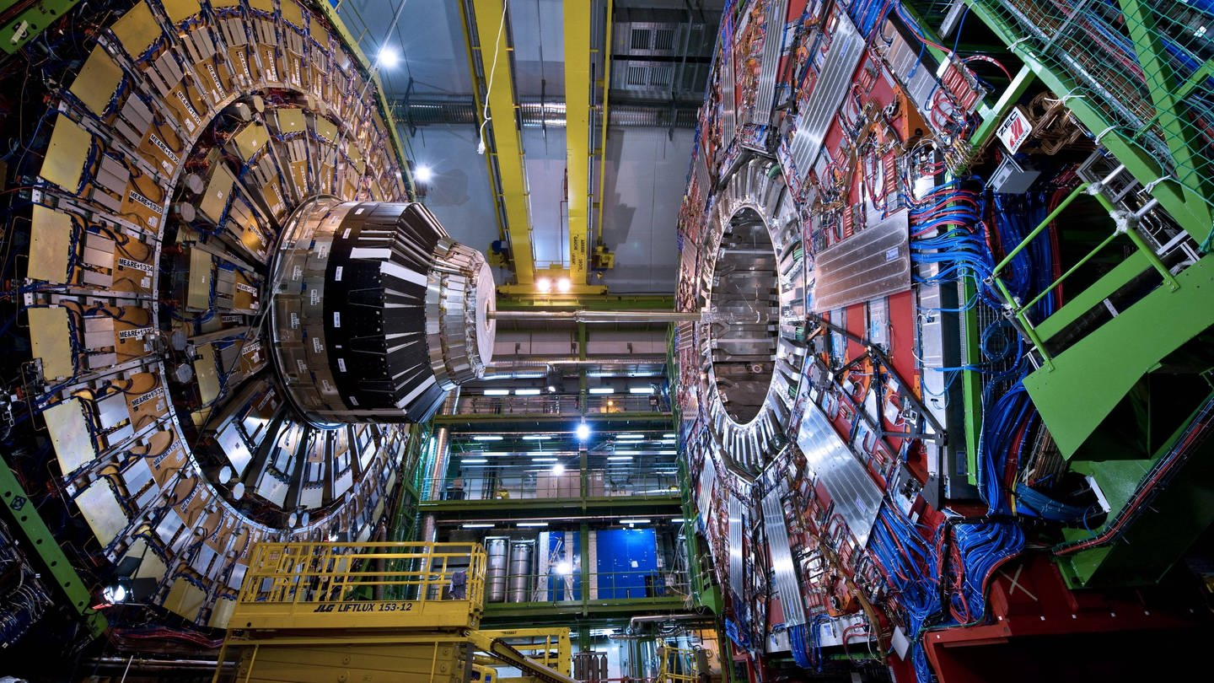
CERN
Big Science collaboration in high energy physics
Founded in 1954
Governance was and is dominated by European founding members
Need for bigger and costlier instruments (e.g. LHC) enbled non-founding members to take on a more prominent role in the organization
Source: https://www.swr.de/wissen/1000-antworten/wie-gefaehrlich-ist-der-lhc-teilchenbeschleuniger-am-cern-in-genf-100.html
Notes:
- e.g. founding members can veto the accession of a new member

Slide 8
India in CERN
India’s motivation for involvement in early phase of LHC:
Strengthen national high energy physics program
Showcase technological capabilities
Strengthen reputation as regional science and technology power
Observer status only granted during LHC construction phase
Another 15 years before India became associate member
Status that increases a country’s political standing and prestige in CERN
Ultimately new membership types have not significantly changed CERN’s governance
Only three European states in pre-stage to full membership

Slide 9
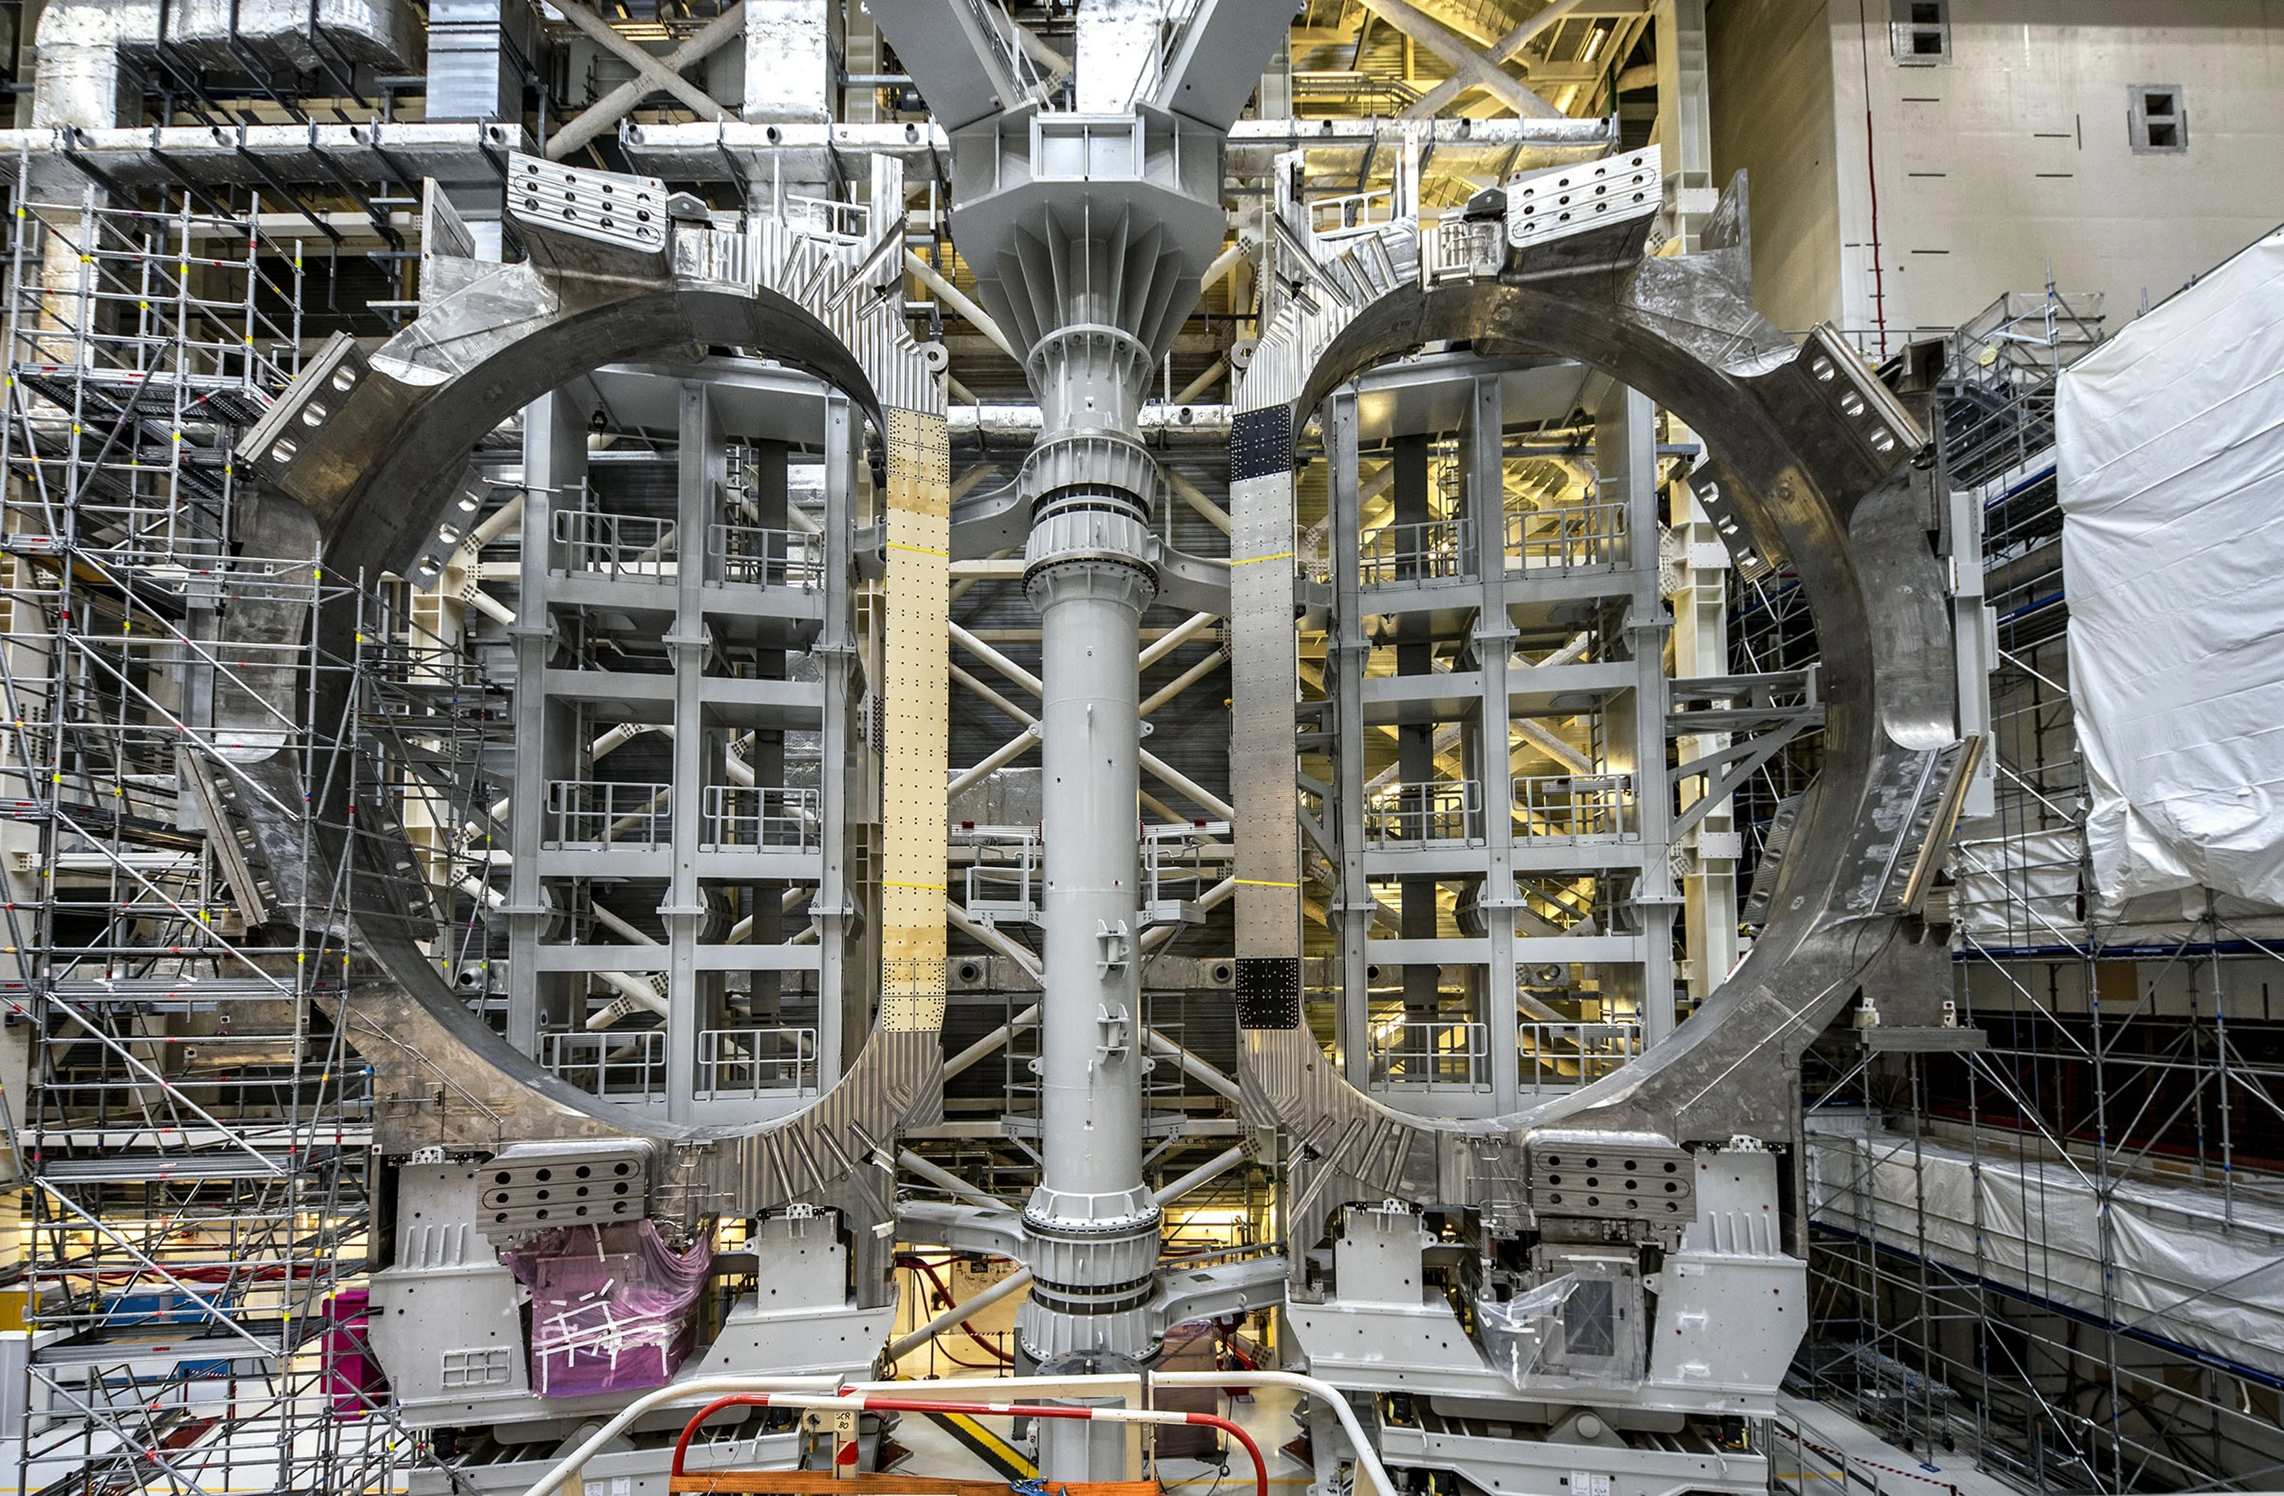
ITER
Big Science collaboration in nuclear fusion
Established in 2007 with roots going back to 1980s
Founding members: United States, European Union, South Korea, China, Russia and India
Currently under construction in Cadarache, France
Source: https://www.scientificamerican.com/article/worlds-largest-fusion-project-is-in-big-trouble-new-documents-reveal/

Slide 10
India in ITER
India last to join but able to determine some key institutional issues
No influence on scientific objectives
Motivation to join:
Strengthen national capacities in fusion research
Re-estblish itself as a trustworthy nuclear power
Institutional setting in theory favorable
But India does not exploit it to its advantage
Too little personnel at ITER
Fails to provide in-cash contributions; this leads to ill-will among remaining partners

Slide 11
SKA
Big Science collaboration in radio astronomy
Formally established in 2019; earliest deliberations began in late 1980s
Founding members: The UK, Portugal, China, Italy, The Netherlands, Australia and South Africa
Under construction in South Africa and Australia
Source: https://physicsworld.com/a/construction-go-ahead-for-e2bn-square-kilometre-array/

Slide 12
South Africa in SKA
South Africa got involved in early deliberations for SKA
Early on, its radio astronomy community proposed and worked towards hosting SKA
Was aware of geographic advantage
Built up significant capacity in radio astronomy
Two main motivations:
Develop national science and technology skills
Reconnect with regional and international scientific and political communities
Through its early involvement, South Africa had considerable influence on the institutional set up of SKA

Slide 13
AfLS
Idea first brought up in 1990s
By 2018 establishment of the AfLS Foundation
Motivation for the establishment of an AfLS:
Advance African research agendas and capacity-building
Decrease scientific and technological dependency
AfLS promoted as a project “by the community for the community” by African (diaspora) science community
Unclear if this community spirit will prevail when siting and funding need to be discussed

Slide 14
Lessons Learned
& Policy Implications
Notes:
That depends on:
The objective(s) that the country in question is pursuing
The institutional maturity of the collaboration
A country’s scientific, political and industrial capacities

Slide 15
Lessons Learned
Our comparative analysis indicates that:
Countries can leverage their in-cash and in-kind contributions to take on a stronger role in Big Science collaborations of an “older” generation (see CERN).
An active and strong scientific (diaspora) community is often a requirement for a country to get involved in a Big Science collaboration (see SKA & AfLS).
Strong industrial capacities are needed to take on procurement contracts for the large infrastructures that many Big Science collaborations rely on.
If a Big Science collaboration has strict geographic requirements, countries that meet said requirements can use their location as a leverage (see SKA).

Slide 16
Policy Implications Part I
Our study indicates that the institutional maturity of a Big Science collaboration conditions what objectives countries can pursue
If the goal is to:
Take a leadership position, then countries are well advised to get involved as early as possible.
Strengthen capacities in science and technology, then countries can join later on.
Notes:
Our study indicates that the earlier a country joins a Big Science collaboration, the liklier it will have a sizable impact on the collaboration’s scientific goals and institutional set-up
If a country seeks to take a leadership position in a collaboration, it should thus get involved as early as possible
Strengthen capacities:
Big Science collaborations with more rigid frameworks (e.g. CERN) still allow non-founding countries to gain crucial experience in cutting-edge research
If the objective is to acquire such experience, countries can join collaborations later on

Slide 17
Policy Implication Part II
Many countries of the Global South have to navigate investments into Big Science under more acute political, human resource and economic constraints
They may benefit from strategically investing into Big Science
E.g. prioritise collaborations in research areas in which they possess a competitive advantage
A requirement for strategic investments is to map out one’s objectives

Slide 18
Thank you for your attention!
Questions or comments?
Get in touch: a.n.ruland@sbb.leidenuniv.nl
This project has received funding from the European Research Council (ERC) under the European Union’s Horizon 2020 research and innovation programme (Grant Agreement No. 819533)

Slide 19
References and images
CERN logo: https://1000logos.net/cern-logo/.
ITER logo: https://www.crwflags.com/fotw/flags/int-iter.html.
SKA logo: https://projectescape.eu/partners/square-kilometre-array-organisation-united-kingdom.
AfLS logo: https://en.wikipedia.org/wiki/African_Light_Source.
Anna-Lena Rüland et al. (2023). Science Diplomacy from the Global South: The Case of Intergovernmental Science Organizations, Science and Public Policy, 50 (4): 782-793. DOI: https://doi.org/10.1093/scipol/scad024.

