Slide 1

African Regional Infrastructures Strategic Task Force
Prof. Diouma KOBOR
UASZ/Senegal
Chair
Objective of the Group
Develop the understanding of the relevant issues
Science Cases
Survey of locations
Skills development audit
Analysis of deliverables, advantages, disadvantages
Cost - Benefit Analysis, short term, longer term

Slide 2
AfLS-ARI Expected Work
CLS - In or out of the AfLS Roadmap?
The answer is clearly Yes. But how and where without compromising our Final Objective which is the African LightSource
Motivations: Background/Definitions
Scientific questions, principles related and reasons to get CLS and AfLS
Existing Examples/Case Studies in Africa and Worldwide
What type of CLS? For what applications? domain etc…
Costs/Benefits-ROI/Risks and SWOT analysis or similar
Recommandations
Presentation to the Executive Committee by 1 December 2023
During AfLS conference in South Africa

Slide 3
AfLS-ARI Expected Work
CLS - In or out of the AfLS Roadmap?
Despite the excellent performance of a CLS, the final destination for Africa remains absolutely, unequivocally, a very competitive top of the range AdLS.
Africa must have a premier instrument. The scale of an AfLS means a larger critical mass of experts on site, locally, working together, This advanced cohort consists of Scientists, Engineers, Technologists. This means the AfLS provides more training, more research, more development, more innovation than a CLS.
The CLS is an important milestone on the Roadmap, however, its not the endpoint.
The AfLS is what ultimately brings the co-located megatroplis of new industrial start-ups as a new innovative industry hub.
This is what will have the highest likelihood of African Nobel Prizes. This is a hub that builds the other nodes of African Excellence everywhere.

Slide 4
Motivations: Background/Definitions
Typical facilities would be tube and rotating anode scale X-ray facilities (for spectrometry, imaging and diffraction), sample preparation systems and associated analytical measurements. However, there is an intermediate class of instrument known as the Compact Light Source, and these are also included in the Roadmap towards the AfLS.
While large storage ring and Lightsource facilities can be the size of many football fields, and cost upwards of $1b USD in construction plus 10% of that to operate per year, CLS can cost $20-30m USD to procure, and less than 10% of that to operate per year.
CLS machines fit logarithmically between the small laboratory-based facilities and the advanced light sources in terms of the brilliance of the X-ray.
CLS would be an enhanced opportunity for engineering and technician training and technology transfer towards an Advanced light source
It would boost regional African research and African participation in Advanced Light Source based science

Slide 5
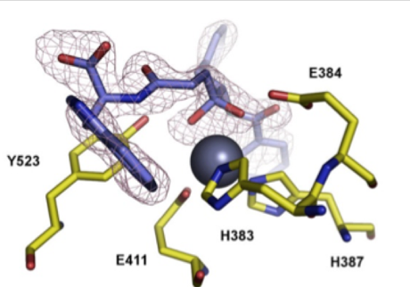
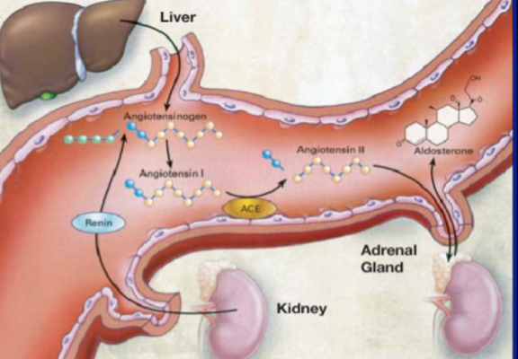
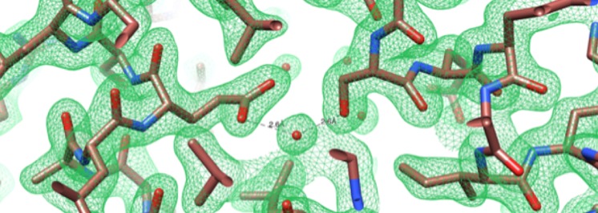
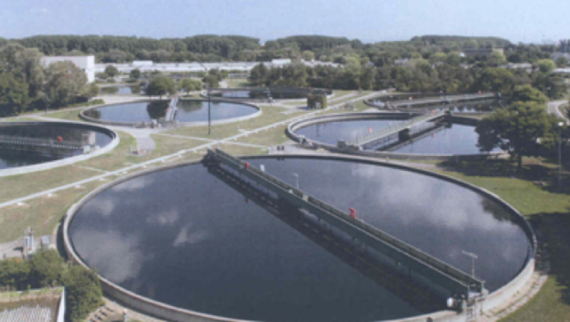
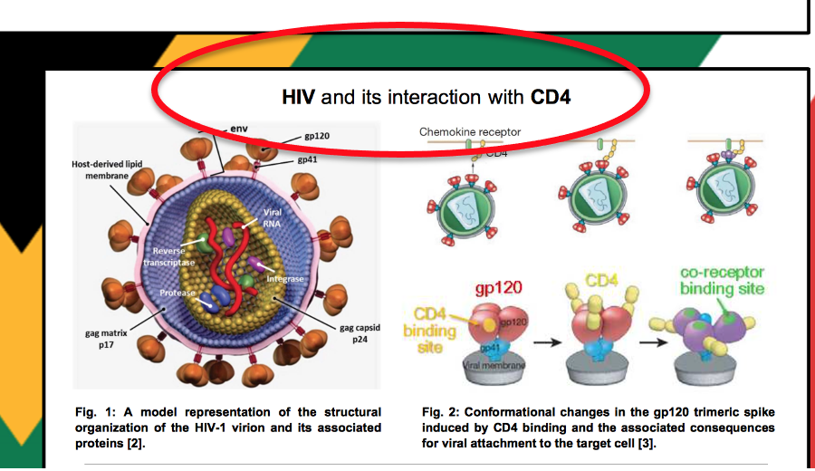
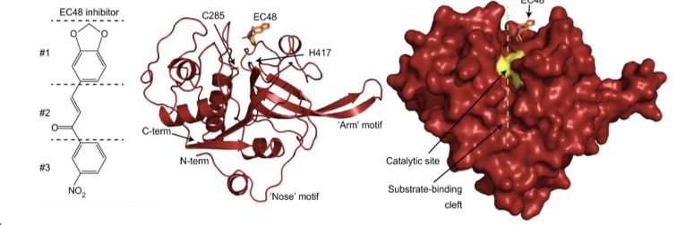
Motivations: Background/Definitions
Example motivation based on Bio Science
SARS-CoV-2,
snakebite envenomation,
HIV, tuberculosis,
malaria,
bilharzia,
human papilloma virus,
cardiovascular disease,
human metabolic disorders,
African Horse Sickness virus,
Industrial enzymes
Simon Connell

Slide 6
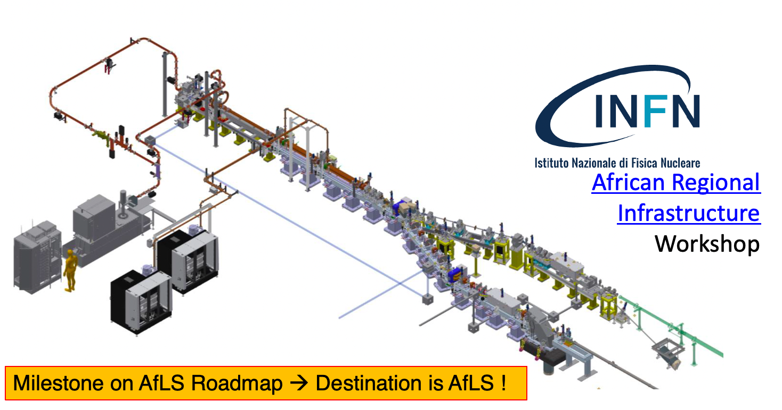
Existing Examples/Case Studies in Africa and Worldwide
Compact Light Source : Inverse Compton Scattering (STAR in Calabria)
STAR ICS SOURCE
e- infrastructure
Accelerating section (1 S-band and 2 C-band LINACs)
High Energy branch «STAR-HE-Linac»
Low Energy branch «STAR-LE-Linac»
Beam dumps
Impact chambers
Courtesy of Prof. R. Agostino - UniCal
STAR (Southern Europe Thomson source for Applied Research) is a Compton Source of mono-chromatic X-rays tunable in the range 20-350 keV, devoted to advanced non-invasive diagnostics of cultural heritage/archeological samples.
STAR Beamlines
ICS:
HE-LINAC µTomo2 - Elettra Sincrotrone Trieste
LE-LINAC SoftX - ASF Metrology

Slide 7
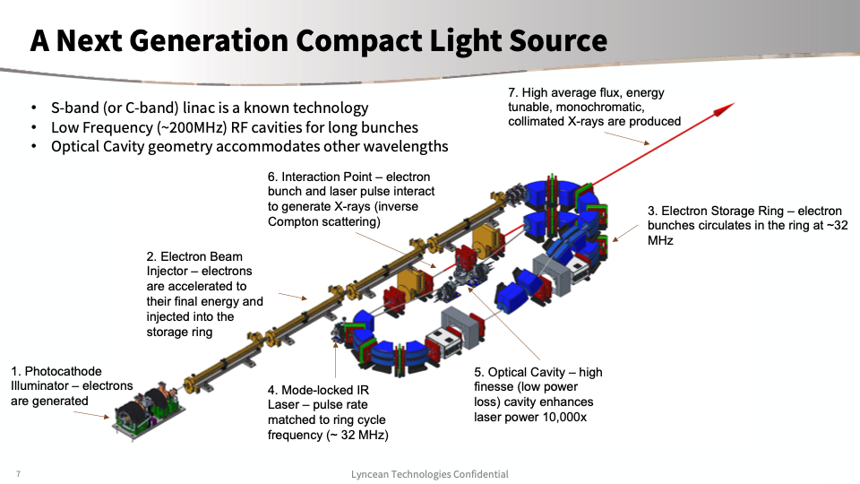
Existing Examples/Case Studies in Africa and Worldwide
2. The Lyncean Compact Light Source
A Next Generation CLS opens up a new application space
High brightness, monochromatic, tunable high energy
Provides capabilities that can only be found at a handful of synchrotron beamlines
High flux density at high energy is ideal for micro-CT of materials science samples
Supports the growing demand for high energy, high resolution diffraction
Lyncean

Slide 8
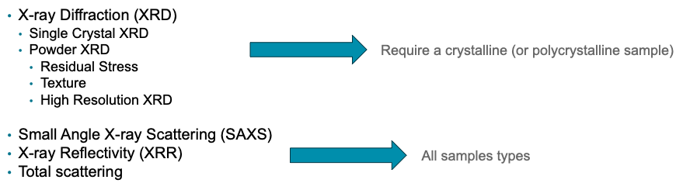
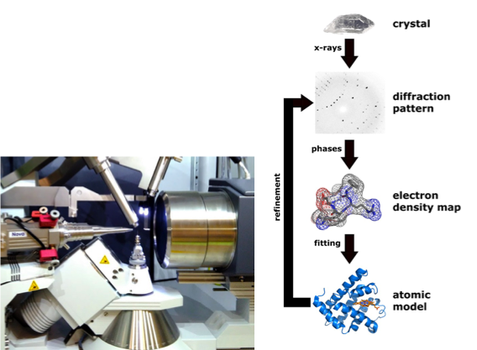
Existing Examples/Case Studies in Africa and Worldwide
3. Lab scale X-ray facilities and X-ray scattering techniques
Powder X-ray Diffraction
Residual Stress
XRD can be used to accurately and non-destructively measure residual stress
Texture
The texture of a material refers to the relative orientation of its grains,
High Resolution X-Ray Diffraction (HRXRD) can permit to determine parameters such as layer thickness, composition, strain, relaxation and structural quality
SAXS
X-ray Reflectivity
Total scattering
X-ray spectroscopy techniques
Single Crystal XRD
Techniques to solve the structure of unknown compounds

Slide 9
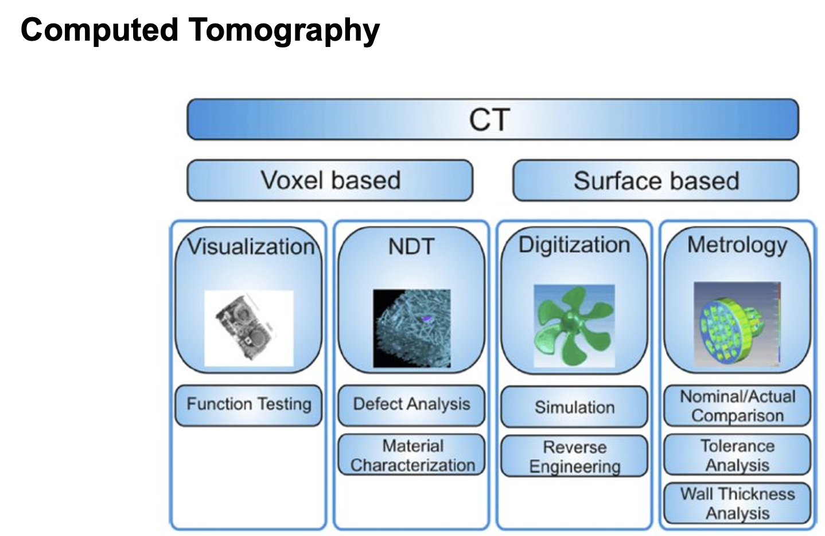
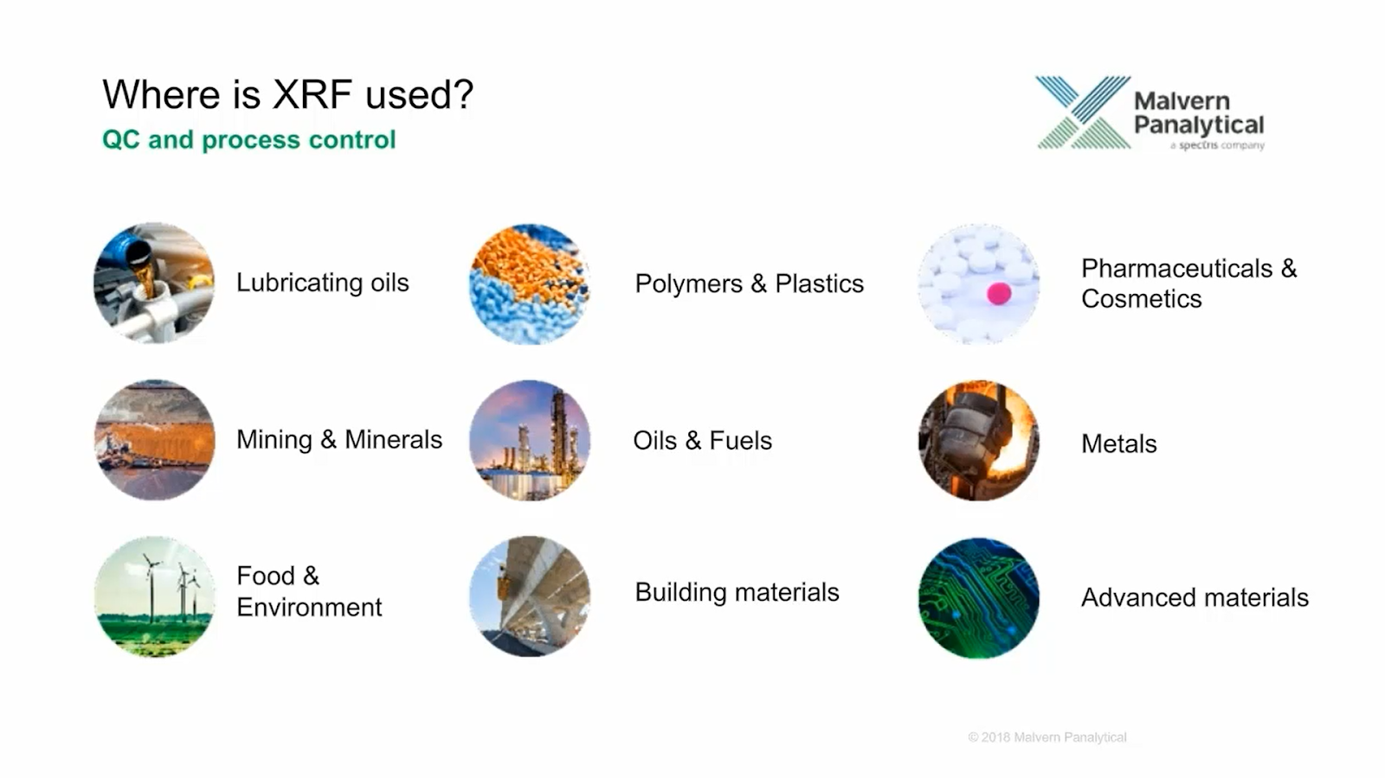
Existing Examples/Case Studies in Africa and Worldwide
3. Lab scale X-ray facilities and X-ray scattering techniques
Small-angle X-ray scattering (SAXS) is a technique that measures the intensities of X-rays scattered at small angles (typically in the range of 0.1 deg to 5 deg)
A SAXS signal is observed whenever a material contains structural features on the length scale of nanometers, typically in the range of 1-100 nm
Typical samples that can be studied by SAXS include liquid nanoparticle dispersions / colloids, nano powders, biomacromolecules…
From SAXS is possible to obtain information e.g. nanoparticle size distribution, particle shape and particle structure (e.g. core-shell)

Slide 10
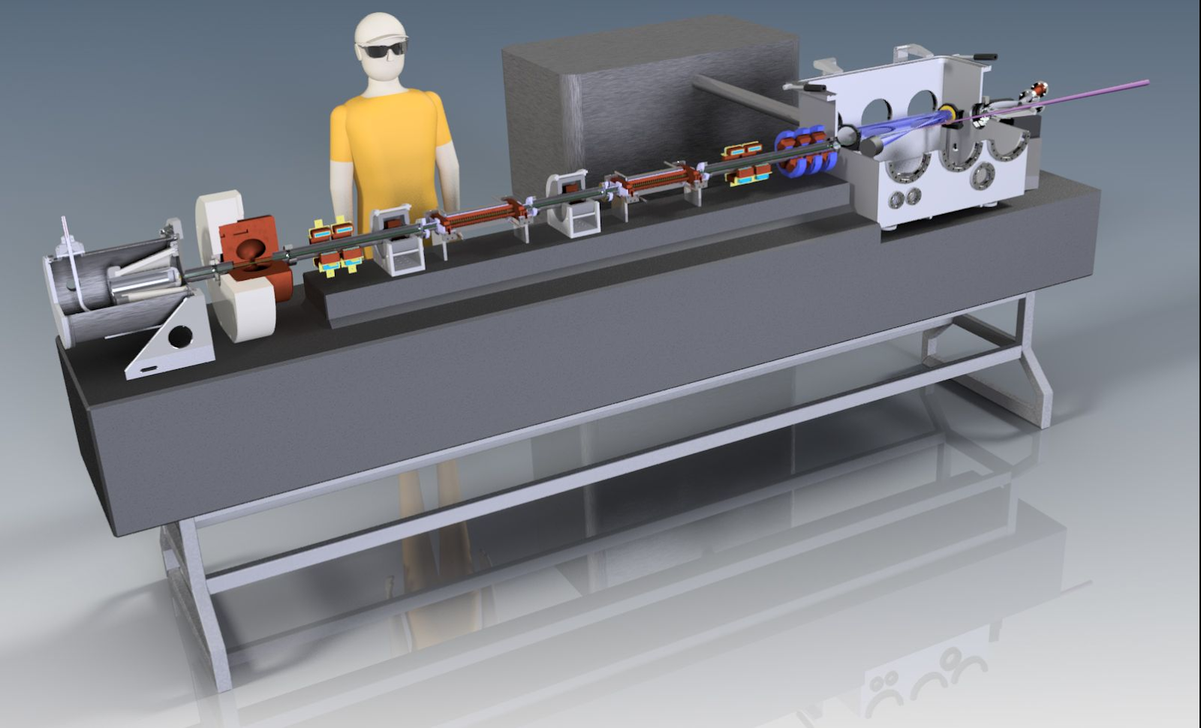
Existing Examples/Case Studies in Africa and Worldwide
4. SmartLicht in the Netherlands
Collisions between laser and electrons
Smart*Light uses new accelerator technology to convert laser light into intense and coherent X-rays by making them collide (via 'inverse Compton scattering')
SMART*LIGHT: A ‘TABLE-TOP SYNCHROTRON’ FOR MATERIALS SCIENCE RESEARCH, MEDICAL DIAGNOSTICS AND CULTURAL HERITAGE
Research project Smart*Light aims to develop a compact and bright X-ray source with tunable X-ray energy. To achieve this, a consortium of 13 partners in the Netherlands and Flanders has received 2.85 M€ of the European Regional Development Fund (EFRO) funding from Interreg. The Smart*Light X-ray source can expectedly be applied in clinical diagnostics, in state-of-the art materials science research and for the investigation of important artworks.

Slide 11
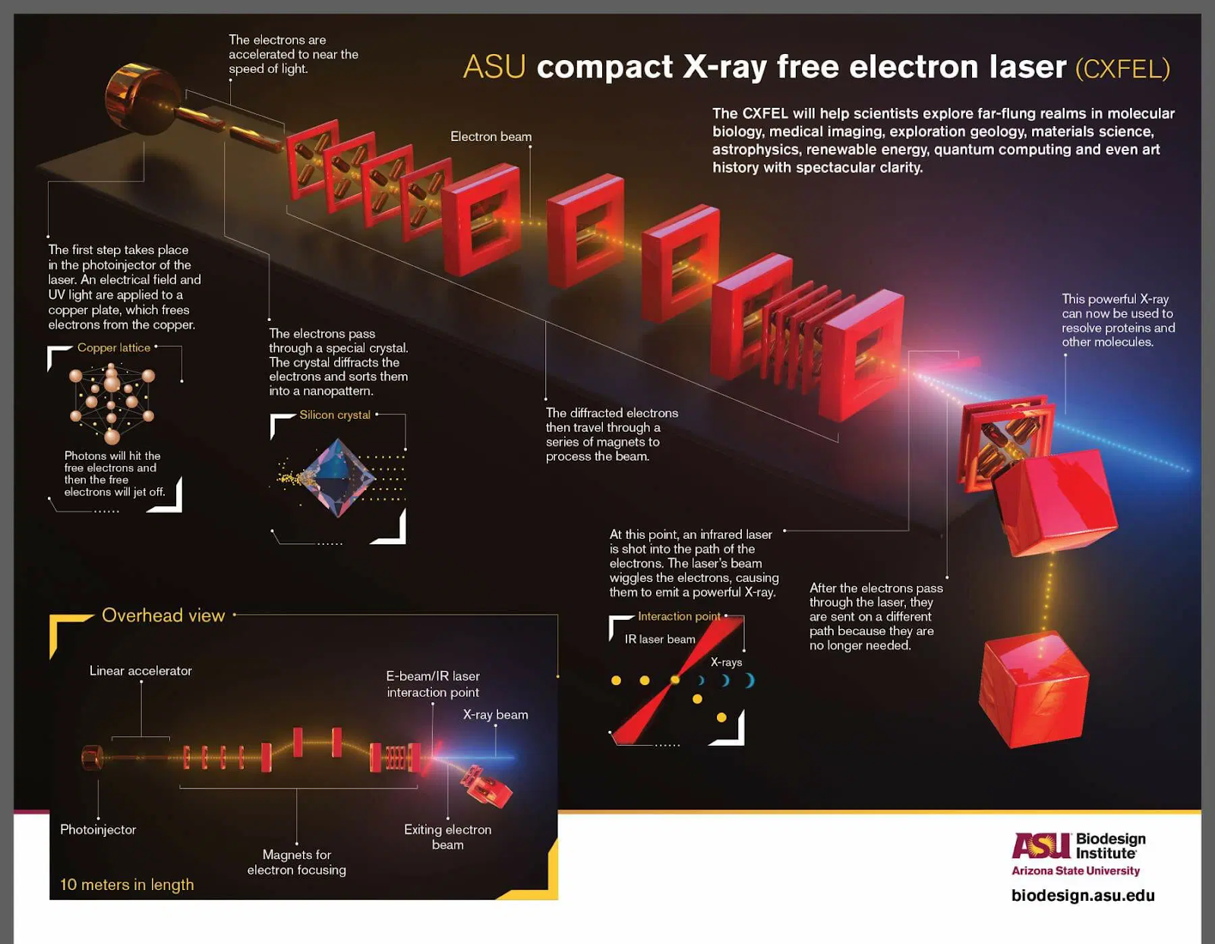
Existing Examples/Case Studies in Africa and Worldwide
5. CXFEL-Compact X-ray
The CXFEL will enable
To visualize drugs binding to receptors at the surface of a cancer cell will fuel development of novel drugs with more specific binding and fewer side effects.
Visualizing biopsy samples with fine resolution of the cell structure at much higher detail than even a CT scan.
To unravel the mechanism of superconductance of quantum material

Slide 12
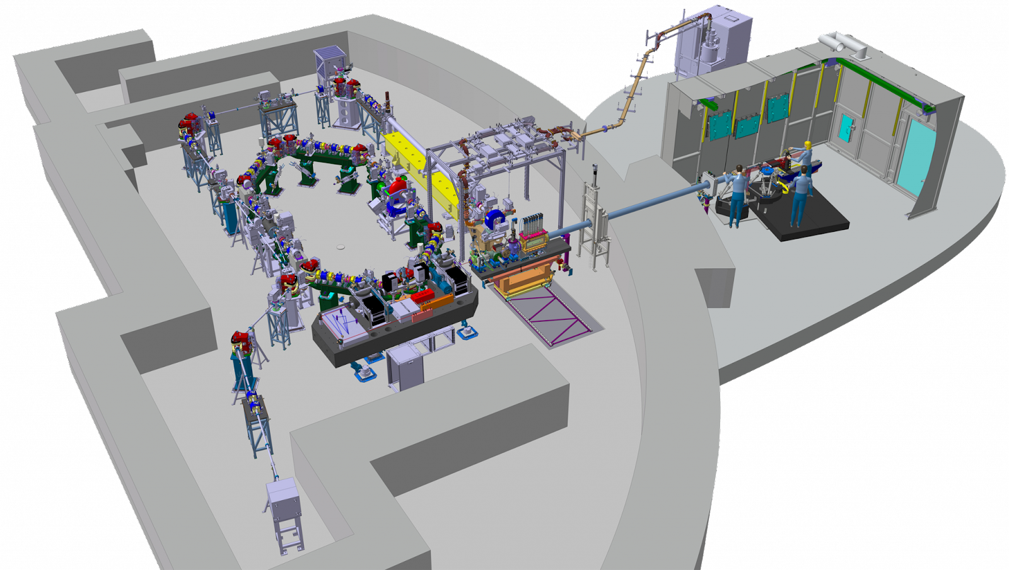


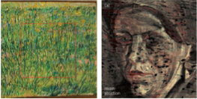
Existing Examples/Case Studies in Africa and Worldwide
6. ThomX in France
ThomX is an electron accelerator aimed at generating X-rays. It is installed in IGLEX, on the Paris-Saclay faculty in Orsay (France)
ThomX is a demonstrator of a compact source of high flux of X-rays generated by the inverse Compton effect.
Demonstrator: it is a prototype whose aim is to demonstrate the feasibility of such a machine.
What are the benefits for the health sector?
- human body with better resolution for details than a traditional x-ray.
- treat pathologies.
- Reconstruction of extremely complex crystallized molecules in 3D.
(popular with pharmaceutical companies to study and develop new drugs).
Face hidden “under” the lawn and revealed by X-rays
(“A Corner of Grass” (1887), Vincent van Gogh, in
J. Dik et al., Analytical Chemistry, 2008, 80, 6436)

Slide 13
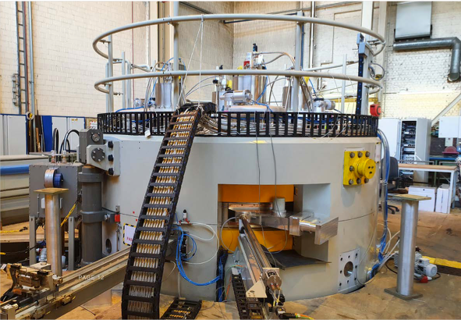
Existing Examples/Case Studies in Africa and Worldwide
7. iThemba LABS
RESEARCH EXCELLENCE AND INFRASTRUCTURE AT ITHEMBA
The research activities are spread over three accelerator laboratories and facilitated by stable beams from the 200-MeV Separated Sector Cyclotron (SSC), the 3-MV Tandetron and the 6-MV Tandem.
TIP - TECHNOLOGY INNOVATION PLATFORM
G-IRI - GATEWAY TO INTERNATIONAL RESEARCH INFRASTRUCTURE
INTERNATIONAL COLLABORATIONS
ALICE DEVELOPMENT AND TESTING FACILITY
CONFERENCES: SHARING KNOWLEDGE AND SHOWCASING EXCELLENCE
FUNDAMENTAL STUDIES WITH THE SEPARATED SECTOR CYCLOTRON (SSC): ALBA and AFRODITE+PLUS, GAMKA, AFRODITE+PLUS, ALBA, SCIENCE WITH THE TANDEM ACCELERATOR, SCIENCE WITH THE TANDETRON ACCELERATOR,

Slide 14
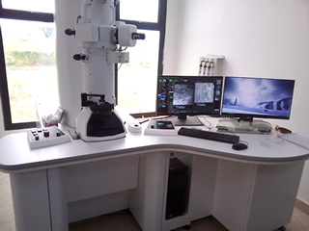
Existing Examples/Case Studies in Africa and Worldwide
Some current examples are the OpenLabs started in several African countries together by the IUCr, X-TechLab in Benin, Crystallography Summer Schools in Senegal and a NCEM and a 1T Data centre in Dakar-Senegal.
TEM Microscope
SEM microscope

Slide 15
Human Ressources and Skills Development
The number of people required depends on the hours of operation.
Users can be trained as operators, or you can designate specific people to operate the CLS
An accelerator physicist or laser expert is not needed but some knowledge in these areas need to be acquired.
The skills required can be found in a synchrotron beamline scientist or other instrumentation engineer.

Slide 16
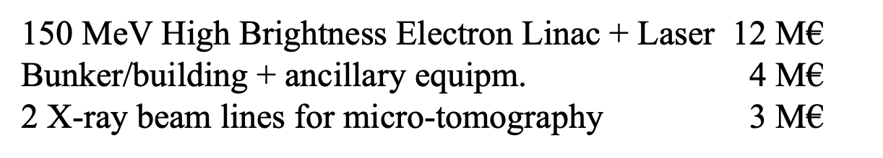
Costs of different CLS
CLS 300 at Lycean CLS: CLS Facility Costs: The cost of executing a project to establish a CLS facility is on the order of USD 20M.
for a CXFEL facility in USA: Total Awarded Amount to Date: $31,627,021.00
ThomX in France: around 15 M€
Lycean CLS: 20 M $
You want to join the AfLS Project Community please register to our different event and Answer to our Survey.
AfLS Community Survey
6th AfLS Conference in South Africa

