Slide 1
I. LAAAMP: Lightsources for Africa, the Americas, Asia, Middle East and Pacific
II. AfLS Geopolitical CDR
Sekazi K. Mtingwa
Chair, Executive Committee, LAAAMP
Editor-in-Chief, AfLS Conceptual Design Report
Co-Chair, Greater Caribbean Light Source Initiative
Co-Chair, Central Asian Synchrotron Light Source Initiative
IUPAP C13 Commission on Physics for Development
Principal Partner, TriSEED Consultants, LLC, USA
14 November 2023

Slide 2
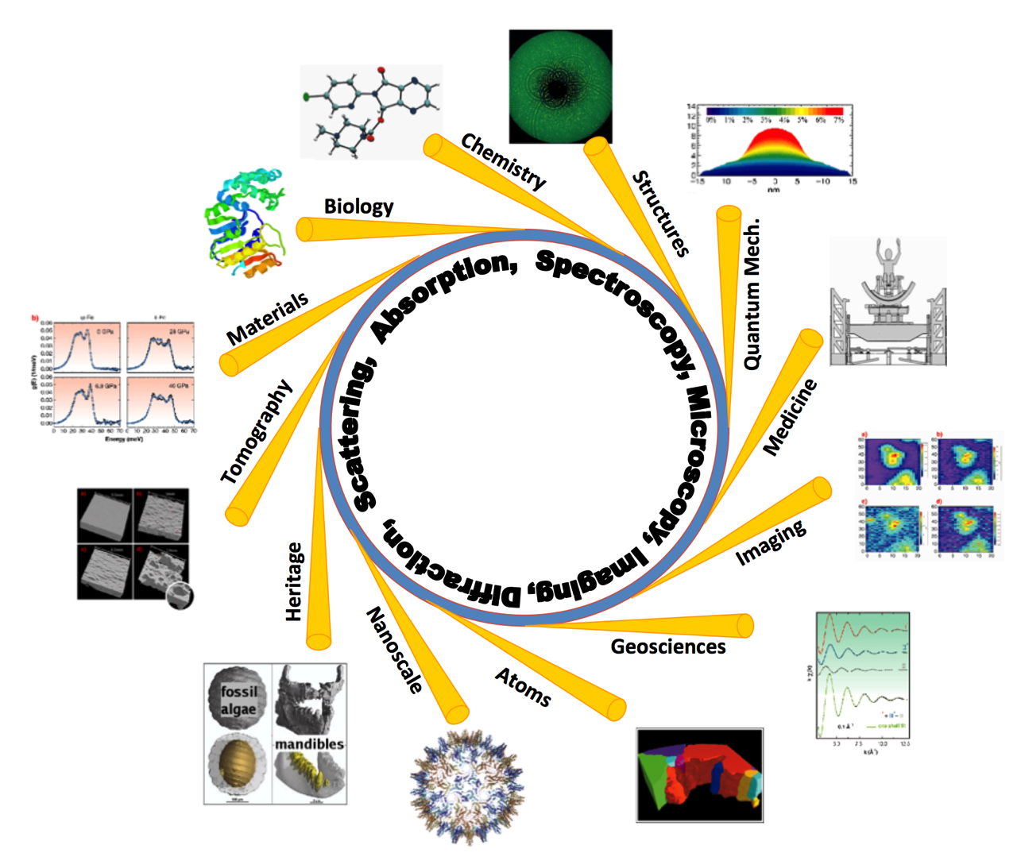
What is a synchrotron
Sirius in Brazil
90% local manufacture
Some examples of Science with Synchrotrons
Multidisciplinary
Research
Technology
Industry
* Credit inferred from each slide

Slide 3
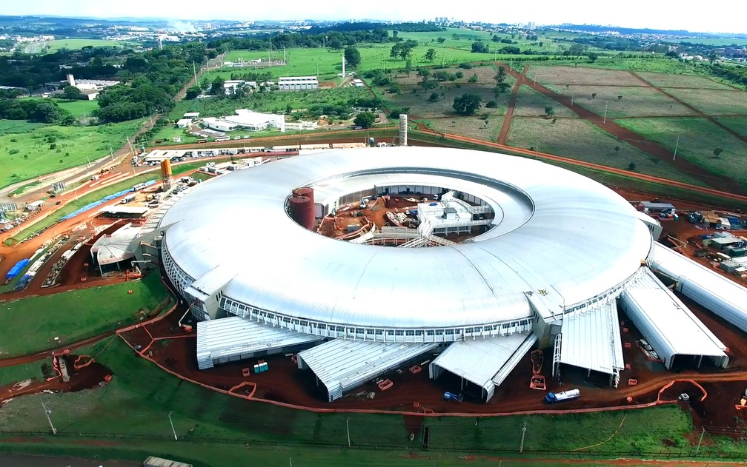
What is a synchrotron
Sirius in Brazil
90% local manufacture

Slide 4
World Map of advanced Light Sources

Slide 5
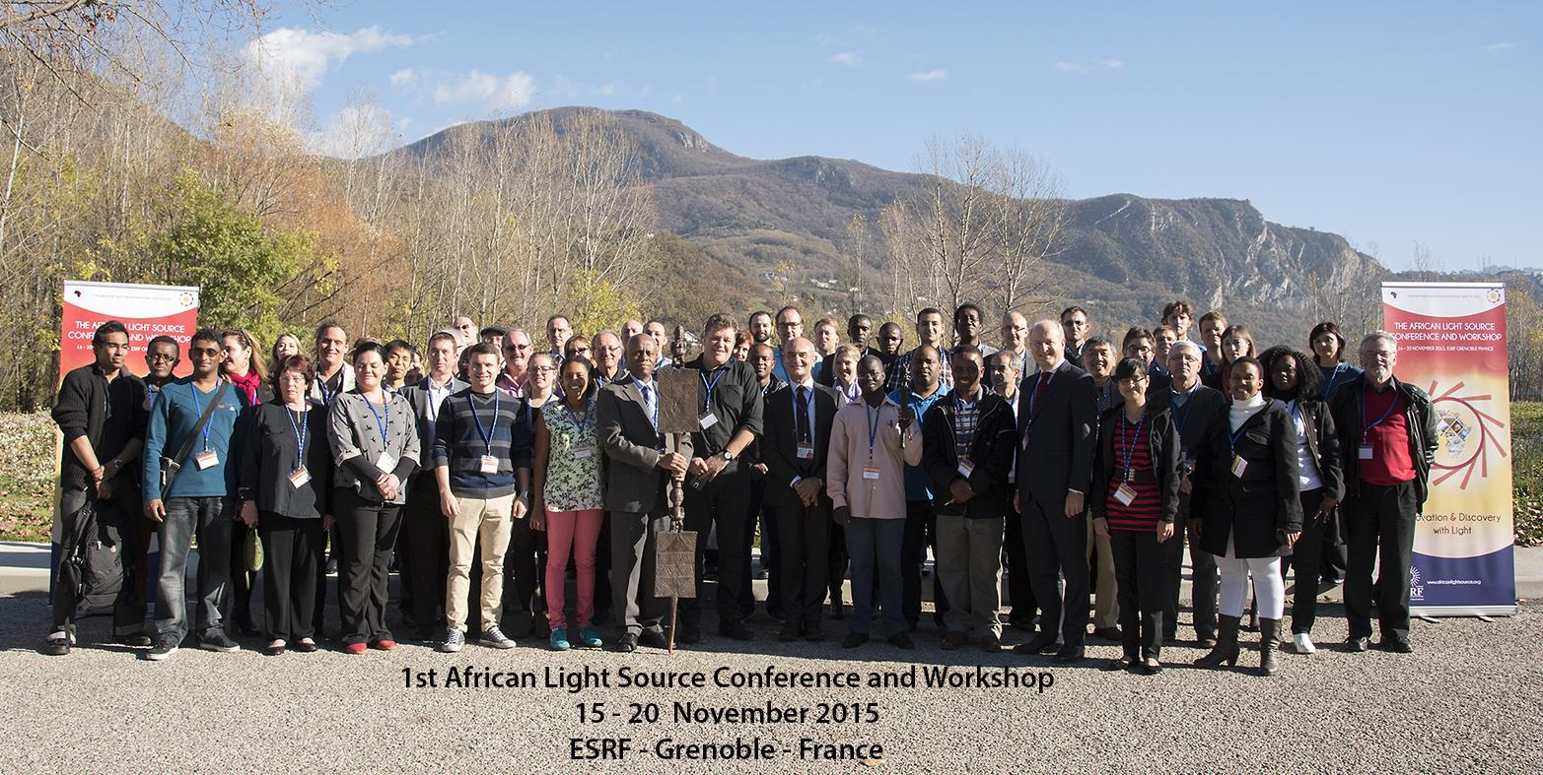

Slide 6
Why is an AfLS essential?

Slide 7
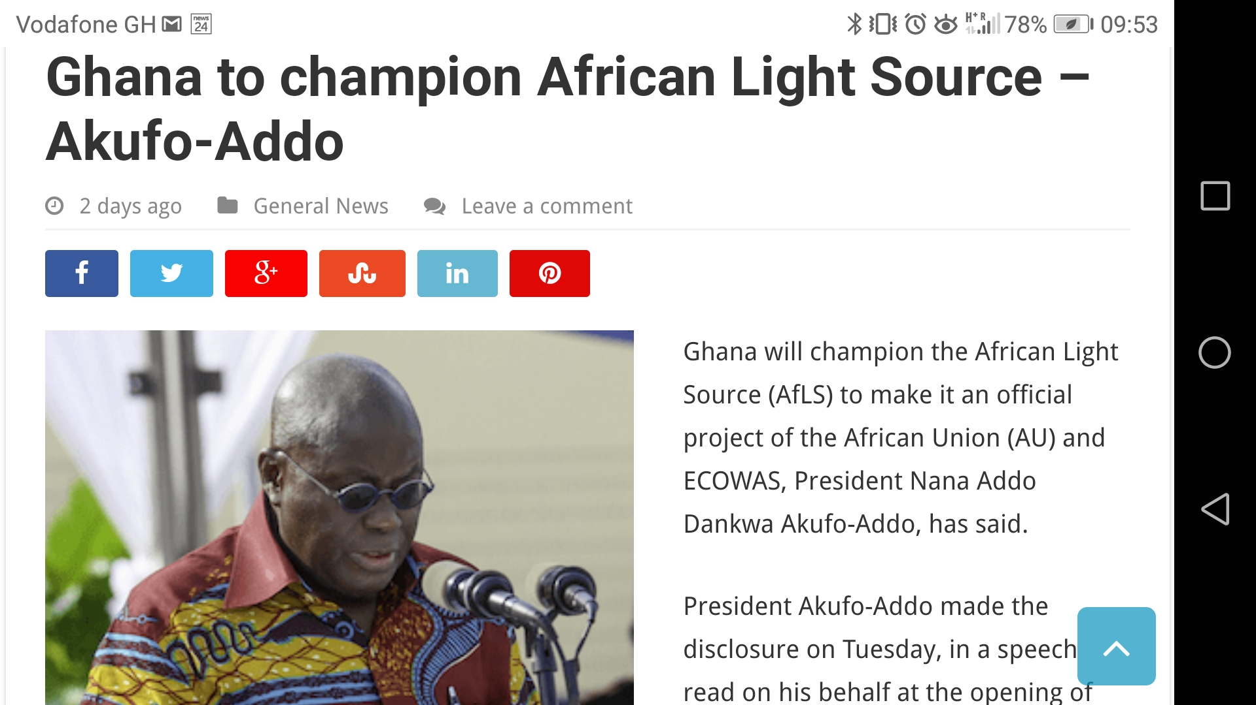
Top-Down

Slide 8
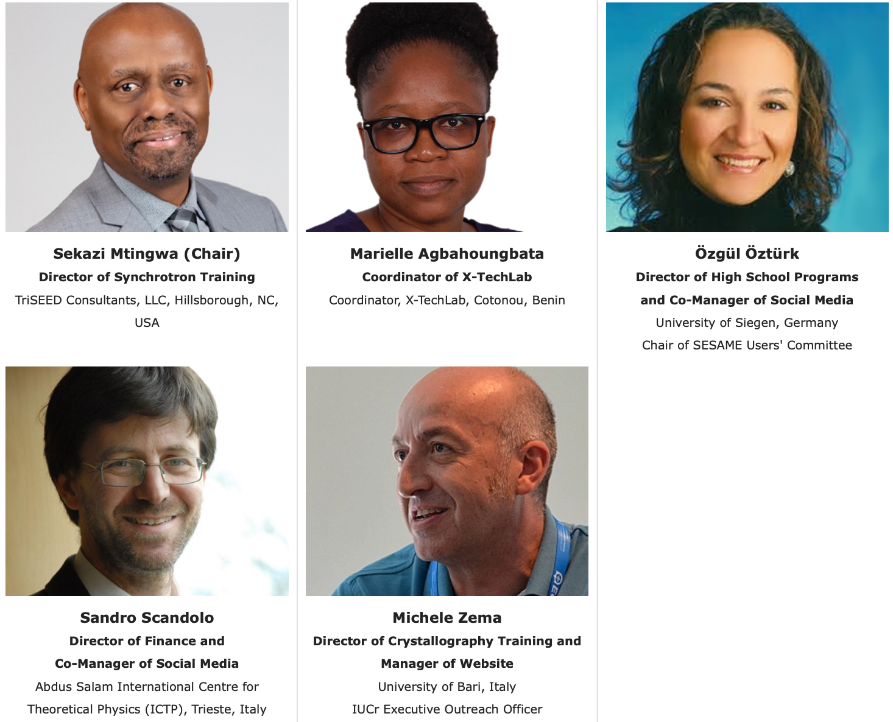
Bottom-Up Training
https://laaamp.iucr.org/

Slide 9
LAAAMP Participating Advanced Light Sources
Advanced Light Source (ALS), Lawrence Berkeley National Laboratory (LBNL)
Advanced Photon Source (APS), Argonne National Lab (ANL)
ALBA Light Source (Barcelona, Spain)
Australian Synchrotron, Australian Nuclear S&T Org. (ANSTO), (Clayton, Melbourne)
Canadian Light Source (Saskatoon, Canada)
DELTA Light Source (Dortmund, Germany)
Elettra Light Source (Trieste, Italy)
European Synchrotron Radiation Facility (ESRF, Grenoble, France)
MAX IV Laboratory (Lund, Sweden)
National Synchrotron Light Source-II (NSLS-II), Brookhaven National Lab (BNL)
Photon Factory, Institute of Materials Structure Science (IMSS) of KEK (Tsukuba, Japan)
Pohang Accelerator Laboratory (Pohang, Republic of Korea)
SESAME Light Source (Allan, Jordan)
SIAM Photon Source (SPS), Synchrotron Light Research Inst. (Nakhon Ratchasima, Thailand )
Sirius Light Source (Campinas, Brazil)
SLAC National Accelerator Laboratory
Taiwan Photon Source (TPS), Nat’l Synch. Radiation Res. Center (NSRRC, Hsinchu, Taiwan)

Slide 10
LAAAMP Tasks
Regional Committees develop Strategic Plans for each Region
TASK 1
Establish an AdLS/Crystallography Colloquium Programme in each Region
TASK 2
Publish and Disseminate an AdLS/Crystallography Information Brochure
TASK 3
Promote and Facilitate Researcher and Student Short- & Long-Term Visits/Study at International AdLS and Crystallography Facilities and Schools
TASK 4

Slide 11
https://laaamp.iucr.org/tasks/strategic-plans

Slide 12
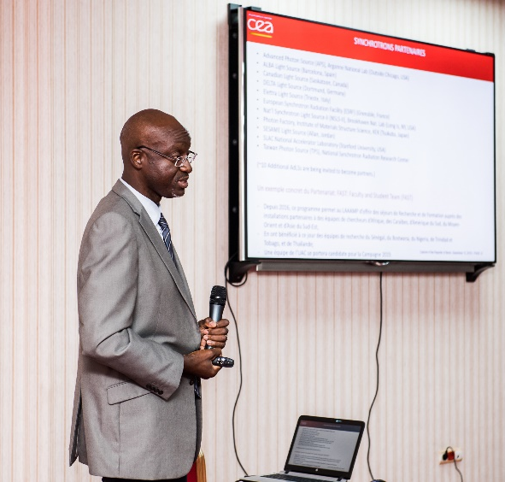
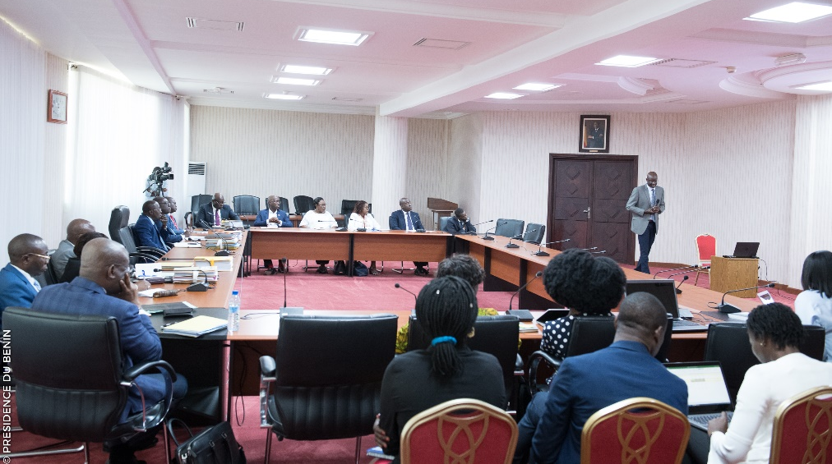
X-TechLab at Sèmè City, Benin
Thierry d’Almeida presenting LAAAMP and the X-TechLab project to the Cabinet of the Government of Benin.
X-TechLab is aimed at training Master and Ph.D. students from Benin and neighbouring countries every year, and at establishing a permanent user research facility with experienced, permanent staff to act as a hub for the region.

Slide 13
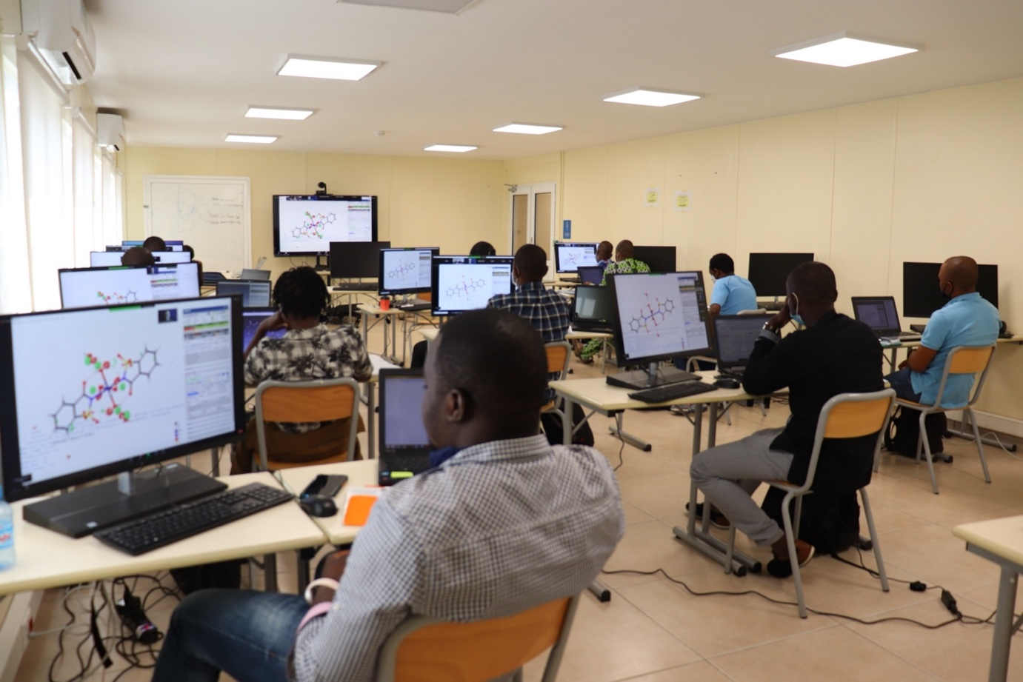
X-TechLab at Sèmè City, Benin
3 training sessions in 2019-2020: 84 learners from 12 African countries: Benin, Burkina Faso, Burundi, Cameroon, Congo-Brazzaville, the Democratic Republic of Congo, Senegal, Togo, Ghana, Ethiopia, Nigeria and Côte d’Ivoire. 20 invited experts.

Slide 14
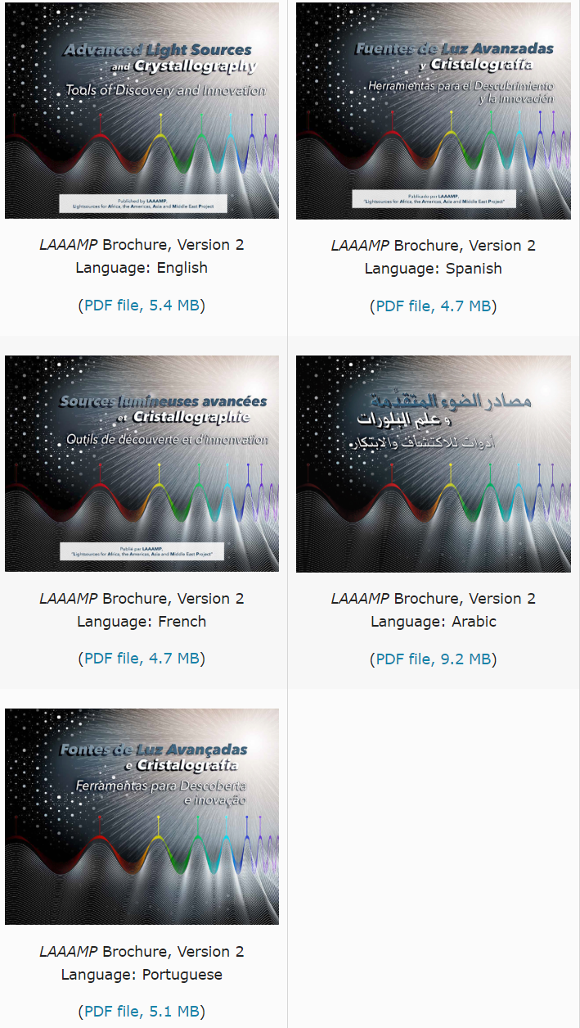
The LAAAMP brochure “Advanced Light Sources and Crystallography: Tools of Discovery and Innovation” is available in English, Spanish, French, Arabic and Portuguese.
Translations have been made available thanks to a collaboration with the International Atomic Energy Agency (IAEA).
Brochure editor: Ernie Malamud
DOWNLOAD FOR FREE at https://laaamp.iucr.org/tasks/brochure

Slide 15
TASK 4: FAculty-STudent (FAST) teams visits at AdLSs
Eligibility
Faculty members at universities in Africa, the Caribbean, Mexico, SE Asia, Middle East, and Pacific. Interested in using AdLSs to further one’s research and training endeavors. Previous experience with using AdLSs is limited to a year or less. Ability to spend 2 months as a full-time visitor in residence at an AdLS that is a LAAMP collaborative partner.
Student registered as full-time Ph.D. student and supervised by the Faculty member.
Categories
Continuing and New applications are considered.
Financial Support
LAAAMP provides 2,000 Euros per person to cover transportation and (partially) accommodation costs. The remainder of accommodation and subsistence should be negotiated with the host AdLS and other sources of support.

Slide 16
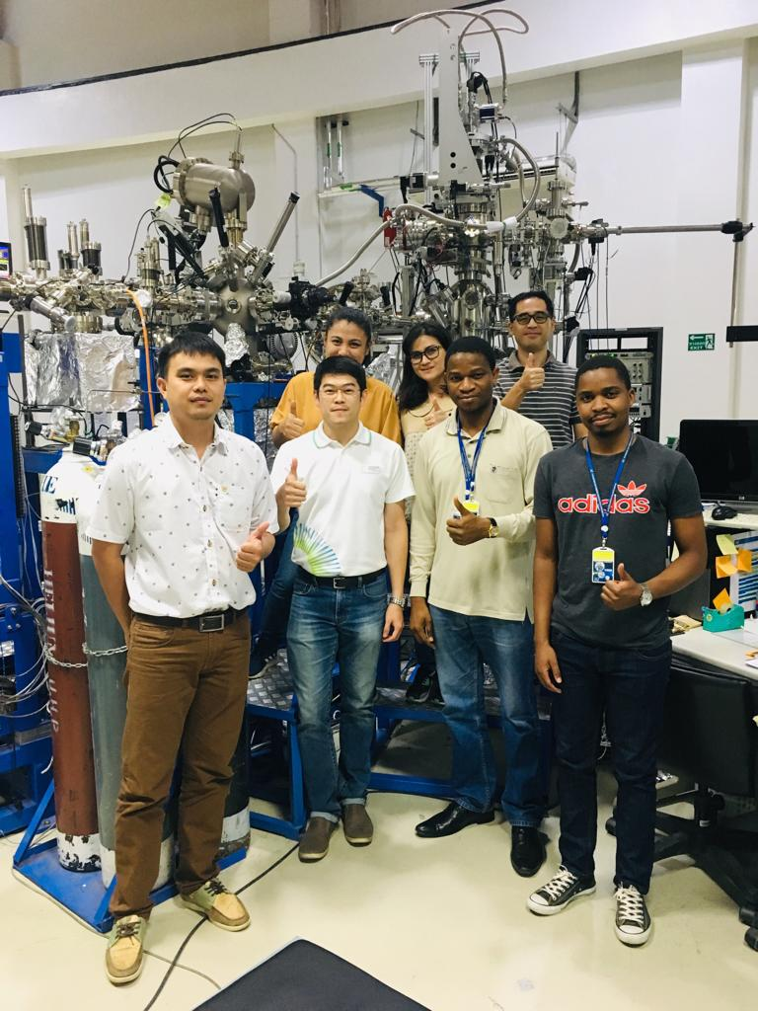
Dr. Philip Oladijo and graduate student from Botswana International University of Science and Technology trained for 2 months at Thailand’s Synchrotron Light Research Institute with Dr. Hideki Nakajima.

Slide 17
https://indico.ictp.it/event/10455
Deadline to apply: 10 Dec 2023

Slide 19
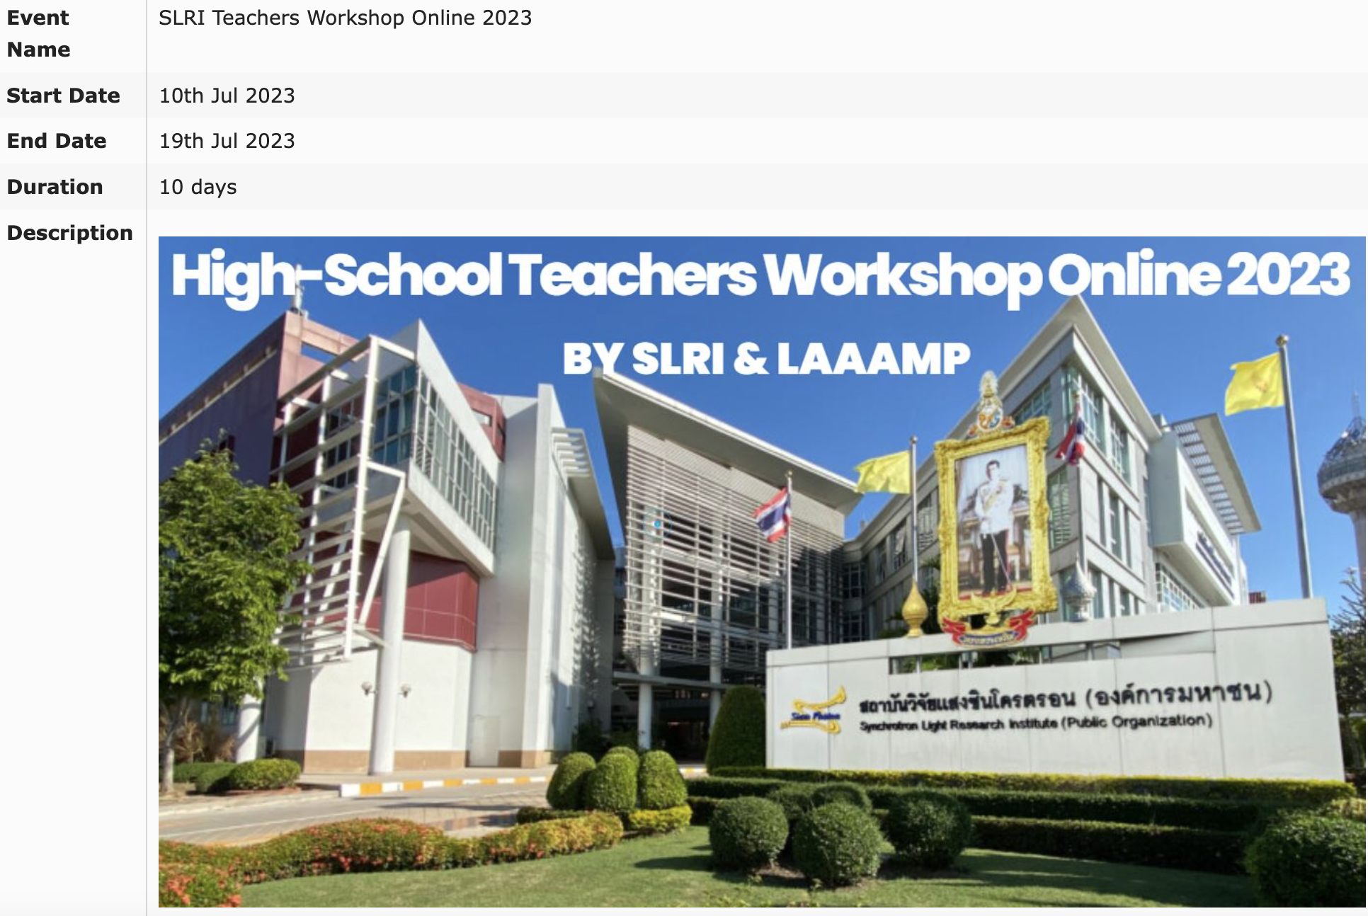

Slide 20
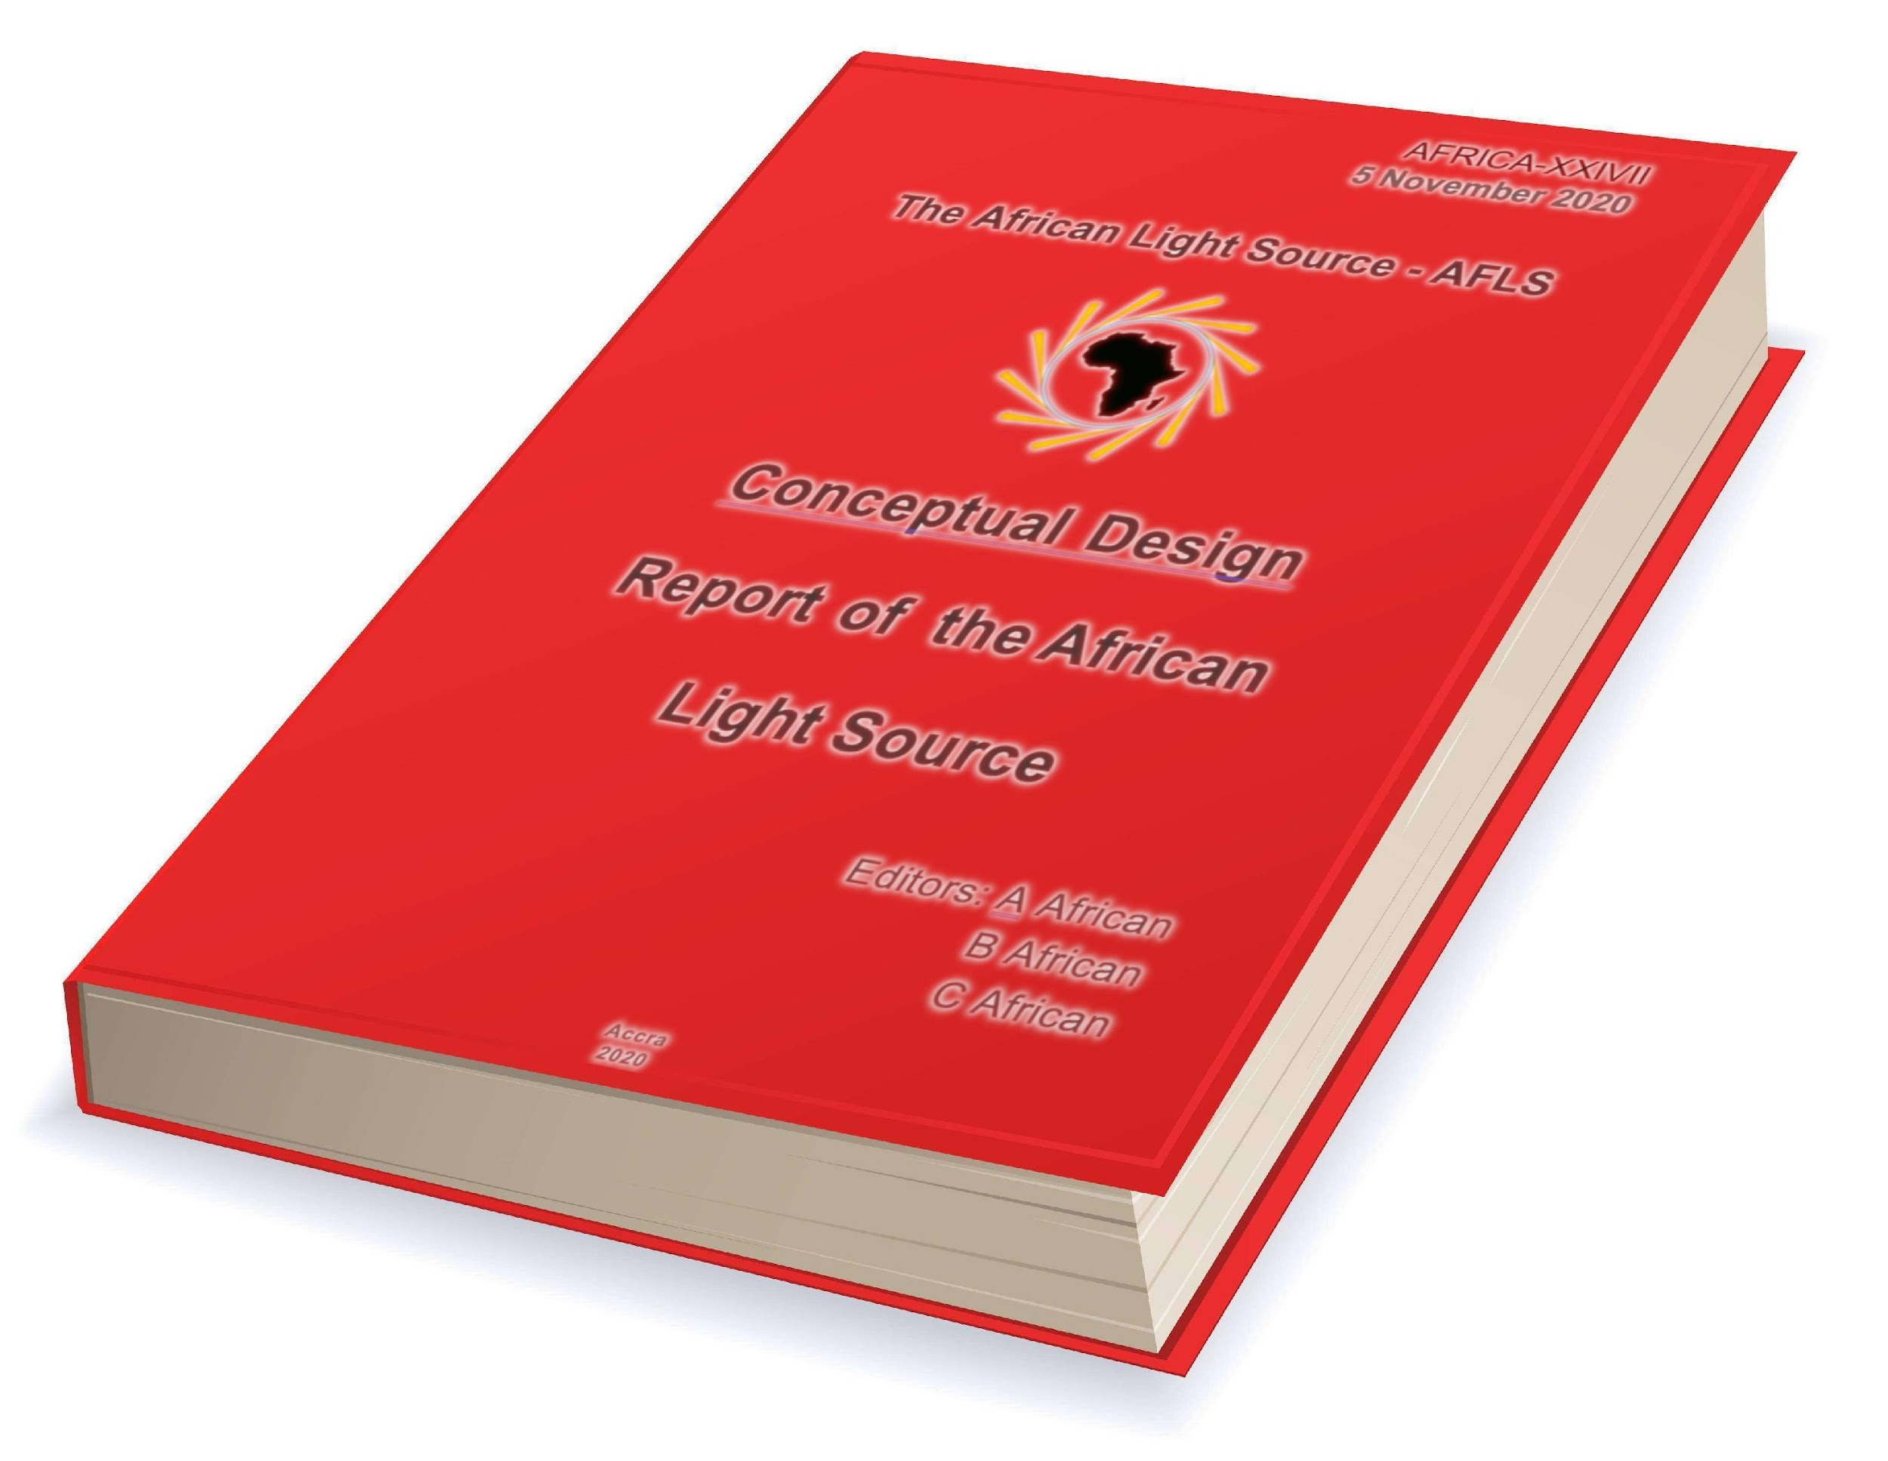
Conceptual Design Report
Motivation for an African Light Source

Slide 21
Editorial Staff
Professor Tabbetha Dobbins
Chair, CDR Organizing Committee
Rowan University, USA
Professor Sekazi K. Mtingwa
Editor-in-Chief, Conceptual Design Report
Chair, LAAAMP Executive Committee
IUPAP C13 Commission
IUPAP Working Group 14 on Accelerator Science
Professor Connie L. McNeely
Deputy Editor, Conceptual Design Report
George Mason University, USA
Professor Michael Steinitz
Senior Editor, Conceptual Design Report
St. Francis University, Canada
Mr. Dorian Bohler
Co-Editor: Machine Design Concepts
SLAC National Accelerator Laboratory, USA
Professor Simon Connell
Editor: Technical Infrastructure and Building Design
University of Johannesburg, South Africa
Dr. Christine Darve
Co-Editor: Machine Design Concepts
European Spallation Source, Sweden
Dr. Ken Evans-Lutterodt
Editor: Sci. Capabilities & Beamline Tech. Concepts
Brookhaven National Laboratory, USA
Originally from Ghana
Professor Jean-Pierre Ezin
Editor: Multinational Governance and Finance
Institute of Mathematics and Physical Sciences, Benin
Professor Marcus Newton
Editor: Scientific, Socio-Economic, Ed. & Pol. Benefits
University of Southampton, UK

Slide 22
CDR Contributors
Hitoshi Abe (Japan), Marielle Agbahoungbata (Benin), Omololu Akin-Ojo (Rwanda, Nigeria), Thierry d’Almeida (France, Benin), El-Hachemi Amara (Algeria), Aba Andam (Ghana), Felix Emeka Anyiam (Nigeria), Riccardo Bartolini (Germany, Italy), Julien Benoit (South Africa), Asmeret Asefaw Berhe (USA, Eritrea), Muaaz Bhamjee (South Africa), Saphina Biira (Uganda), Caterina Biscari (Spain, Italy), Paul Buah-Bassuah (Ghana), Carlos Cabrera (USA, Puerto Rico), Richard Catlow (UK), Kelly Chibale (South Africa, Zambia), George Clerk (UK), Lowry Conradie (South Africa), Joseph Daafour (Ghana), Mmantsae Diale (South Africa), Rudolf Dimper (France, Germany), Tabbetha Dobbins (USA), Tchana Kamgne Duclair (Cameroon), Ahmed El-Hussein (Egypt), Ken Evans-Lutterodt (USA, Ghana), Ndèye Coumba Yandé FALL (Senegal), Vincent Fernandez (UK), Michel Fodje (Canada, Cameroon), Alfonso Franciosi (Italy), Benson Frimpong (Ghana), Gabriel Gwanmesia (USA, Cameroon), Maria Hamunyela (Namibia, South Africa), Messaoud Harfouche (Jordan, Algeria), Andrew Harrison (UK), Delia Haynes (South Africa), Kudakwashe Jakata (South Africa, Zimbabwe), W. Estella Johnson (USA), Akorede Kalejaiye (Nigeria), Gihan Kamel (Jordan, Egypt), Paul Abidemi Kappo (Nigeria, South Africa), Abebe Kebede (USA, Ethiopia), Patrice Kenfack (Cameroon), Nkem Khumbah (USA, Cameroon), Diouma Kobor (Senegal), Frank Lehner (Germany), Enzo Lombi (Australia), Kirsi Lorentz (Cyprus, Finland), Malik Maaza (South Africa, Algeria), Ernie Malamud (France, USA), Priscilla Masamba (South Africa), Brian Masara (South Africa, Zimbabwe), Genito Maure (Mozambique), Wilfred Mbacham (Cameroon), Stephen McGuire (USA), Connie L. McNeely (USA), Mongezi Mdhluli (South Africa), Gift Mehlana (Zimbabwe),
Country of origin listed second

Slide 23
CDR Contributors (cont’d)
Roland Mfondoum (Austria, Cameroon), Edward Mitchell (France, UK), Thandeka Moyo-Gwete (South Africa), Alfred Msezane (USA, South Africa), Célestin Nzanzu Mudogo (Democratic Republic of Congo), Andani Mulelu (South Africa), Kiran Mundboth (Canada, Mauritius), Amor Nadji (France), Peter Ngene (The Netherlands, Nigeria), Jean-Paul Ngome Abiaga (Jamaica, Gabon), Lawrence Norris (USA), Tshepo Ntsoane (South Africa), Abimfoluwa, Oluseyi Philip Oladijo (Botswana, Nigeria), Gideon Olaleye (Canada, Nigeria), Özgül Öztürk (Germany, Turkey), Resego Phiri (Botswana), María Josefina Robles Águila (Mexico), Alakendra N. Roychoudhury (South Africa), Ana Karen Sánchez-Hernández (Mexico), Yasien Sayed (South Africa), Sandro Scandolo (Italy), Wolf-Dieter Schubert (South Africa), Dereje Seifu (USA, Ethiopia), Bridinette Thiodjio Sendja (Cameroon), Francesco Sette (France, Italy), Trevor Sewell (South Africa), Sam Sloetjes (Sweden), Dawit Solomon (USA), Michael Steinitz (Canada, USA), Jean Susini (France), Mourad Telmini (Tunisia), Khaled Toukan (Jordan), Daouda Traore (France, UK, Mali), Bjorn von der Heyden (South Africa), Ahmadou Wagué (Senegal), Herman Winick (USA), Paul Woafo (Cameroon), Mostafa Zeidan (Egypt), Michele Zema (Italy)
List not quite complete: ~100 Contributors

Slide 24
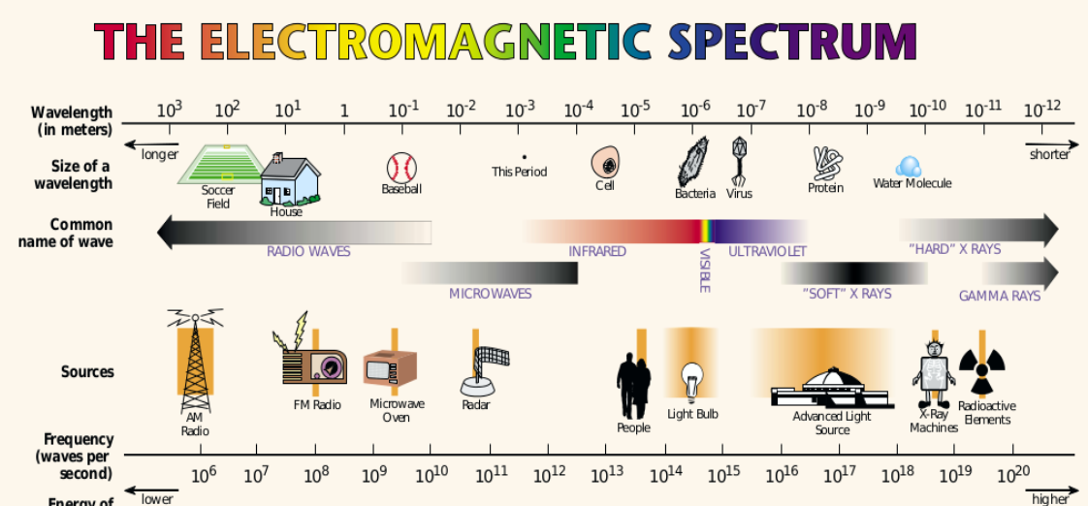
Chapter 1: Overview and Description of an Advanced Light Source
EM spectrum compared to well-known objects and sources of radiation
(Figure courtesy of Lawrence Berkeley National Laboratory, USA)

Slide 25
Chapter 2: Scientific Benefits
2.1 Structural Biology
2.1.3 Role of Synchrotron Light Sources in Studying Infectious Diseases Prevalent in Africa
2.2 Materials for Energy Applications
2.2.2 Solar Energy
2.2.3 Rechargeable Batteries
2.3 Geoscience
2.4 Environmental Science
2.5 Plant and Soil Science
2.6 Palaeontology and Archaeology

Slide 26
Chapter 3: Social and Economic Benefits
3.1.1 Disease Prevention and Cure
3.1.2 Food Security
Improvements in food and packaging characterisation; structure determination of products, including chocolate, oils and fats; and determining the oxidation states of products used for agriculture .
3.1.3 Clean Energy
AfLS would prove to be a powerful tool for developing materials and processes, including batteries, fuel cells, catalysts and catalytic processes.
AfLS would characterise sources of ecological damage, such as CO₂ and asbestos, and develop catalysts and materials to convert them to less harmful products.
3.2 Economic Benefits
According to Andrew Harrison, Former CEO, Diamond Light Source
“For every English pound put into the facility, 3.5 pounds come back into the economy.”

Slide 27
Chapter 4: History of the African Light Source
Group Photo of the 1st African Light Source Conference and Workshop
ESRF, Grenoble, France, 2015

Slide 28
Chapter 5: Local Technical Infrastructures and Human Capacity Building
5.1 African Laser Centre (ALC, https://africanlasercenter.org/)
To Transform the Laser Community in Africa
5.2 Atomic, Molecular and Optical Sciences Network (LAM Network)
To Develop Optics and Photonics in Africa (https://lamoptinet.org/)
5.3 Lightsources for Africa, the Americas, Asia, Middle East and Pacific (LAAAMP, https://laaamp.iucr.org/)
To Enhance the Utilisation of Crystallography and Advanced Light Sources in the Developing World
5.4 X-TechLab (https://www.xtechlab.co/)
To Transform Crystallography Research and Training in Africa

Slide 29
Local Technical Infrastructures and Human Capacity Building (cont’d)
5.6 ICTP School on Synchrotron Light Sources and their Applications
https://indico.ictp.it/event/10057/ 23 Jan – 3 Feb 2023 (Free Virtual School)
5.9 African Crystallographic Association
(AfCA, https://www.iucr.org/outreach/africa/afca/)
To advance science on the African continent via crystallography
5.10 BioStruct-Africa (https://www.biostructafrica.org/)
To build capacity in the field of structural biology for Africa-based scientists.
5.11 Synchrotron Techniques for African Research and Technology
(START, https://start-project.org/)
Seeks to foster the development of synchrotron techniques for African research and technology, with initial emphasis on structural biology and energy materials.

Slide 30
Chapter 6 Directors’ Comments
Caterina Biscari, Director, ALBA, Barcelona, Spain
Alfonso Franciosi, President & CEO, Elettra, Trieste, Italy
Andrew Harrison, CEO, Diamond Light Source, UK
Francesco Sette, Director-General, ESRF, Grenoble, France
Khaled Toukan, Director, SESAME, Allan, Jordan

Slide 31
Chapter 7: Proposed Statutes of the African Light Source
ARTICLE I Purpose and Functions
ARTICLE II Membership and Participation
ARTICLE III The Council
ARTICLE IV Standing Committees
ARTICLE V Directorate
ARTICLE VI Duties of the Director-General
ARTICLE VII Legal Status
ARTICLE VIII Financial Arrangements
ARTICLE IX Contributions
ARTICLE X Other Contributions from the African Union et al.
ARTICLE XI Loss of Membership
ARTICLE XII Final Clauses

Slide 32
Chapter 8 4th Generation Synchrotron Light Source Accelerator
Explain why 4th Generation Multi-Bend Achromat (MBA) lattices improve electron beam emittances compared to 3rd Gen.
Describe a prototype 3 GeV, ~500 meter, ~100 psec horizontal emittance storage ring.
Describe Ancillary Requirements
Offices
Food Services
Housing for Users
Water
Waste Disposal
Describe Electrical Power Plant
Provide schematic for a nominal 10 MW Solar Power Plant à la SESAME.

Slide 33
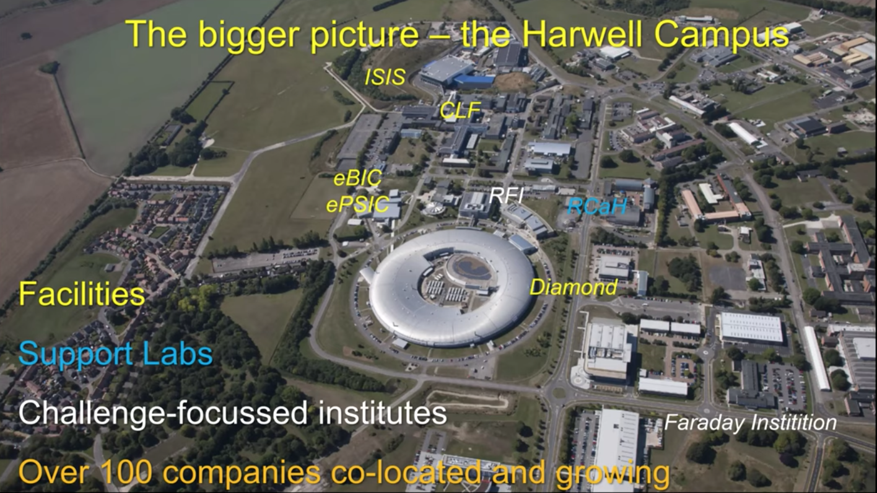
Chapter 9: Integrated Science and Technology Park

Slide 34
Chapter 10: Recent Beamline Experiments Sponsored by LAAAMP
10.1 Study of Diagenesis in Ancient Egyptian Bones
Ahmed El-Hussein and Mostafa Zeidan (Student)
National Institute of Laser Enhanced Sciences, Cairo University, Egypt
Research Conducted at the ALBA Advanced Light Source, Barcelona, Spain
10.2 Study of Materials for Possible Energy Applications
Diouma Kobor and Ndèye Coumba Yandé FALL (Student)
University Assane Seck of Ziguinchor, Senegal
Research Conducted at the ESRF, Grenoble, France
10.3 Study of Nano-Crystalline WC-Co Films
Oluseyi Philip Oladijo and Resego Phiri (Student)
Botswana Int’l U. of S&T, Gaborone, Botswana
Research Conducted at the Synchrotron Light Research Institute
Nakhon Ratchasima 30000, Thailand

Slide 35
Chapter 11: Concluding Remarks
The Concept of Ubuntu and African Identity in Pursuit
of the African Light Source

Slide 36
THANKS FOR YOUR KIND ATTENTION!
sekazi.mtingwa@gmail.com

