Slide 1

Temperature and Moisture Triggered Crystallization of Triple Cation-Mixed Halide Perovskite Cells to Reduce Phase Segregations
Miller Shatsala and Celline Awino
Department of Physics
Masinde Muliro University of Science and Technology, Kakamega, Kenya

Slide 2


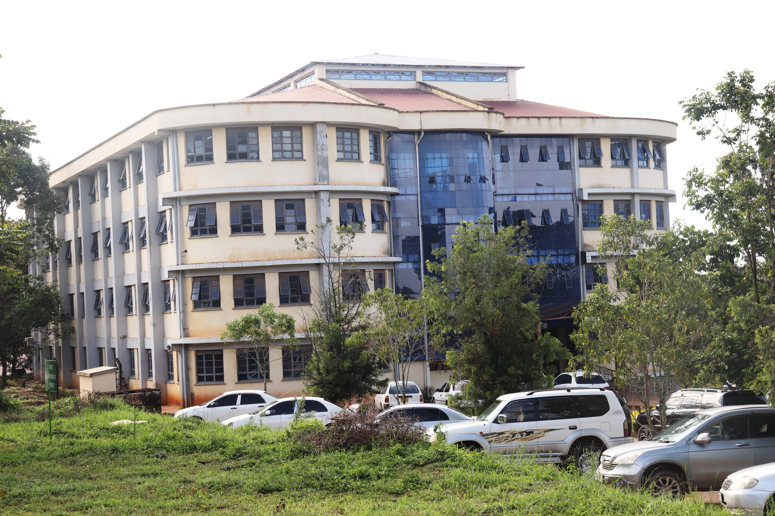

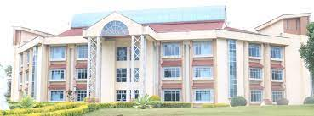

Slide 3


Google source

Slide 4
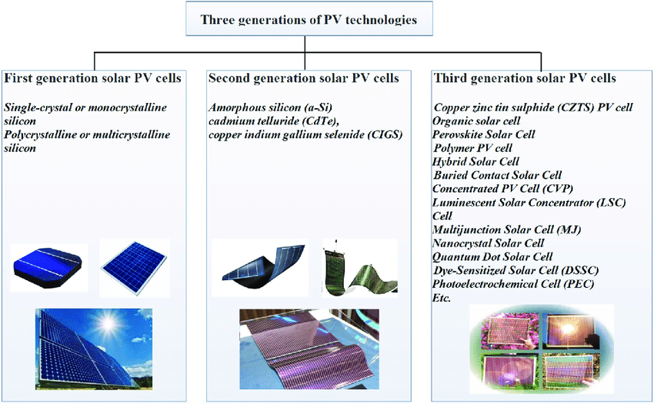
PEROVSKITE USES
Sensors and catalyst electrodes
fuel cells
solar cells
Lasers
memory devices
Spintronics
ISSUES
INSTABILITY
Zhang, T., Wang, M., & Yang, H. (2018). Energies, 11(11), 3157.

Slide 5
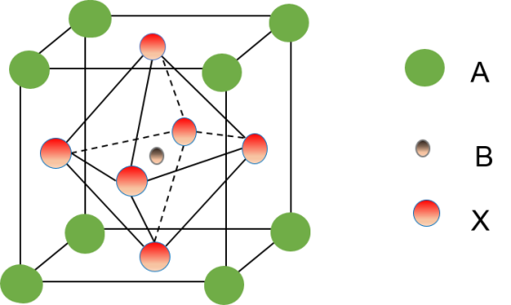
Perovskites
ABX₃
MA: methyl ammonium
FA: formamidinium
A: (CH₃NH₃)⁺, Cs⁺, (CH₃(NH₂)₂)⁺,…
B: Pb²⁺, Sn²⁺,…
X: I⁻, Br⁻, Cl⁻
Processing from salt solutions
CH₃NH₃PbI₃: mature, most prominent
E_{g} = 1.55 eV, long diffusion length
CH₃NH₃Pb(IxBr1-x)₃: tunability of E_{g}
Cs(MA,FA)Pb(IxBr1-x)3: increase of stability
Kojima et al., J. Am. Chem.Soc. 131 (2009) 6050
Stranks et al., Science 342 (2014) 341

Slide 6
Motivation
Perovskite crystallization has not been understood well to date.
Over emphasis on their efficiencies.
Difficulty in measuring the critical nucleus sizes in the range of 100 to 1000 atoms.
Synchrotron radiation-based X-ray techniques allow structural characterization providing valuable information about the inner film morphology.

Slide 7
Sizes, shapes, distances, and correlations of particles are determined from these measurements.
These parameters are fundamental in understanding the process of nucleation and growth.
We seek to address the influence of heat stress and moisture probing on the crystallization kinetics of triple cation-mixed halide perovskite cells.
Using in situ and static GIWAXS/GISAXS, Micro-Diffraction and Optical microscopy through photoluminescence techniques.

Slide 8
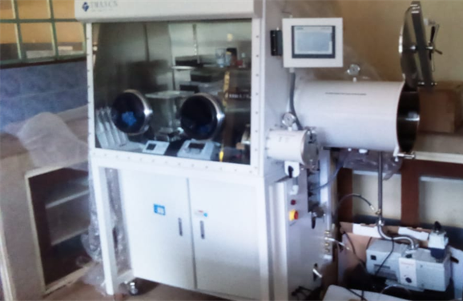
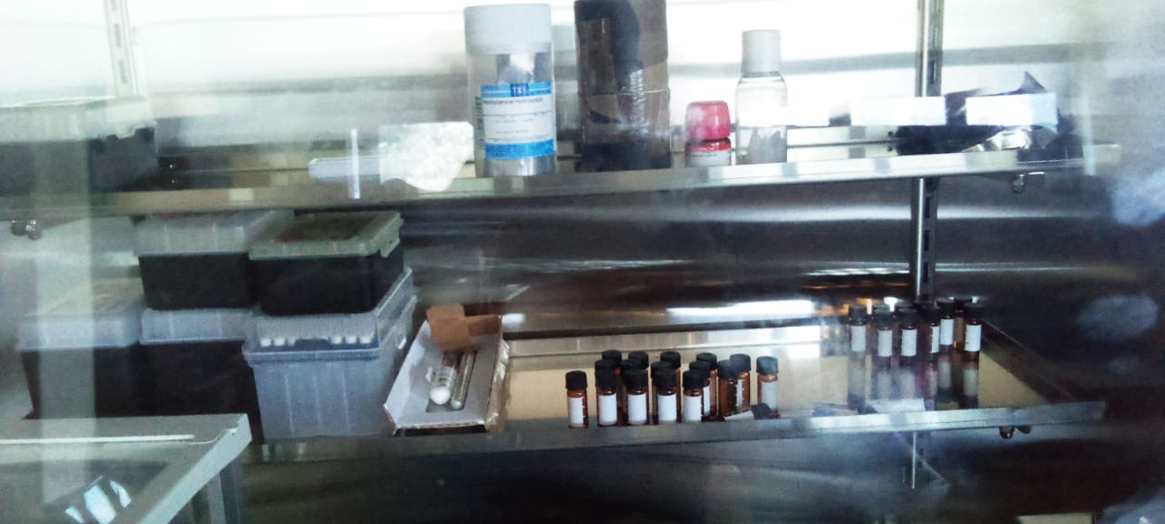
Perovskite preparation
Sample Preparation:
dissolved in 800 µl of DMF and 200 µl dimethyl sulfoxide (DMSO) in ratio of 4:1
CsI, MAI & FAI and PbI₂ & PbBr₂ in stoichiometric ratios
Mixed overnight at 60° C in a nitrogen filled glovebox.
MMUST – MRL Glove Box
Precursor Solution

Slide 9

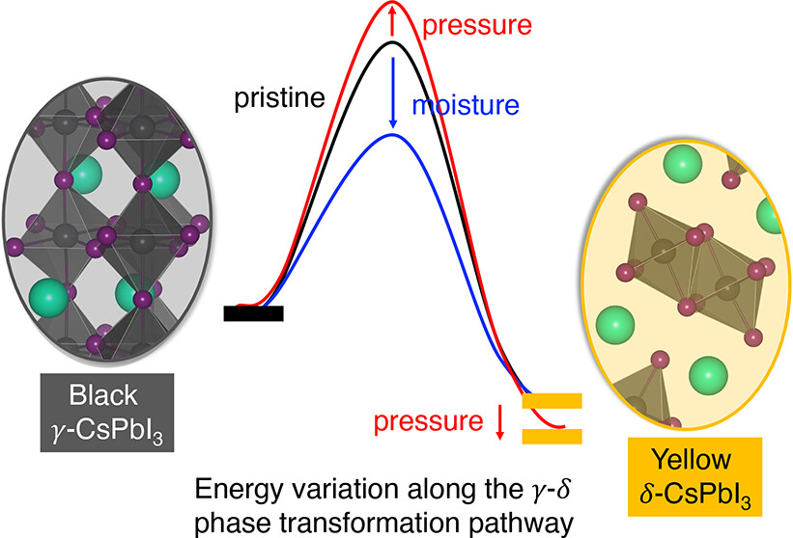
100ul of precursor solution spin coated onto a substrate in two steps 30s.
Annealing at 150⁰C for 15 minutes on a hot plate with 500 rpm..
Anti-solvent introduced after 20s of spin coating
Precursor dropping
ITO substrate
Hot plate
Perovskite film
Spin Coater
Reversible

Slide 10
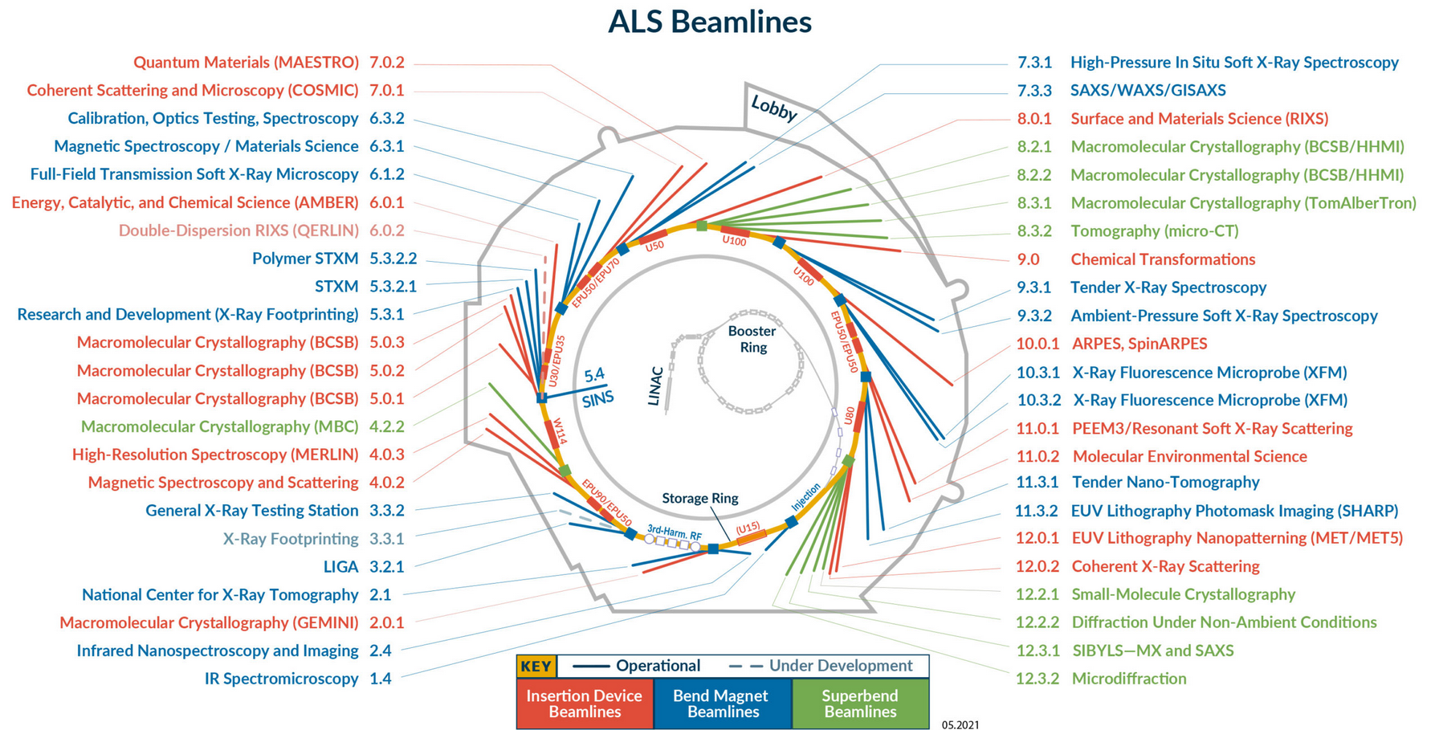

Slide 11
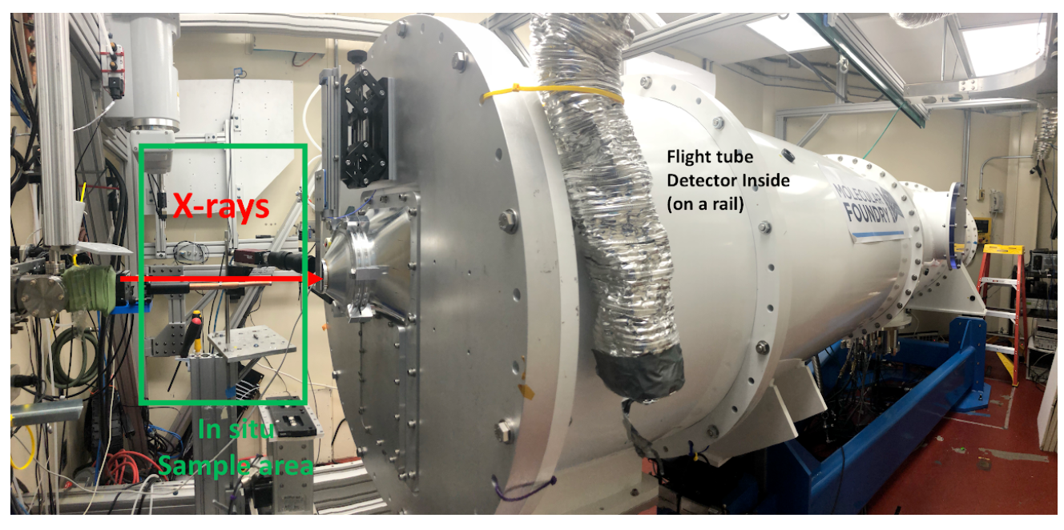
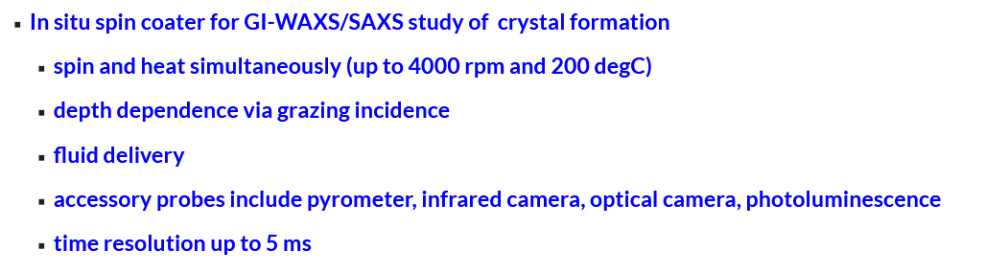
7.3.3 GIWAXS/GISAXS
Beamline 7.3.3 is a GISAXS/GIWAXS beamline, covering a wide q range (0.004 - 3 Å⁻¹) and length scale (2 - 1500 angstrom)

Slide 12
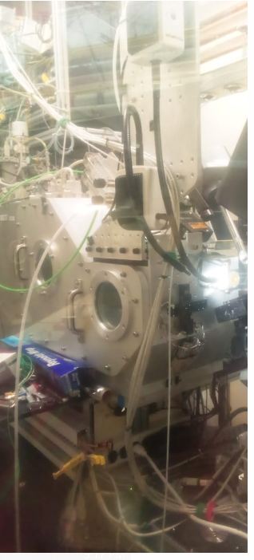
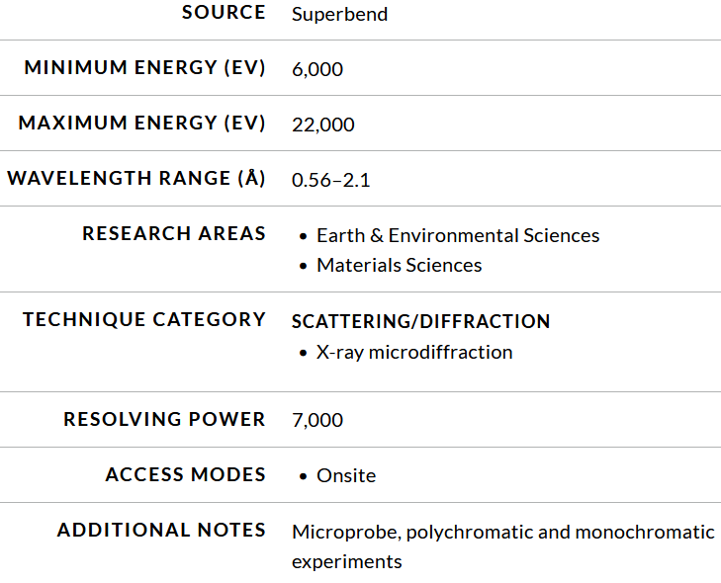
12.3.2. Microdiffraction

Slide 13
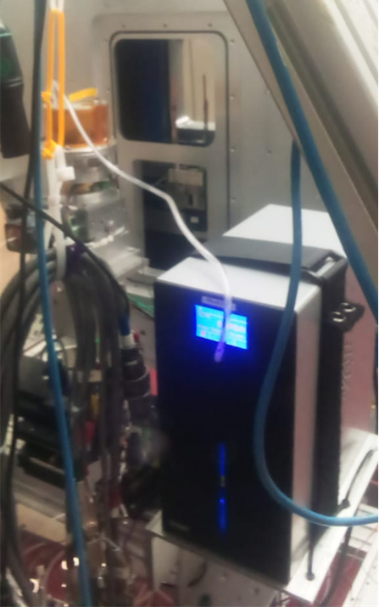
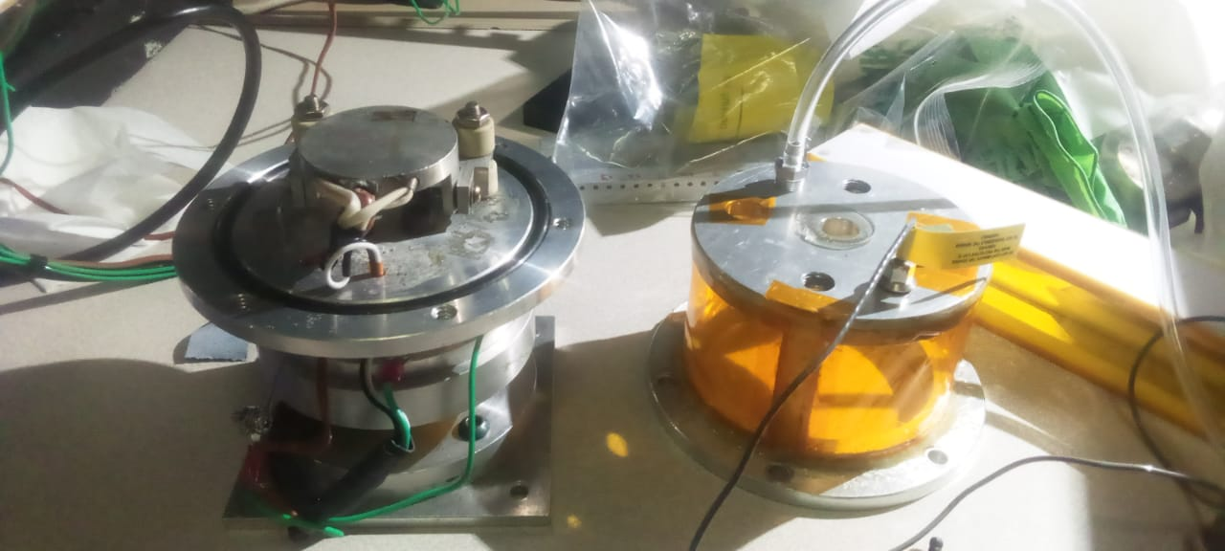
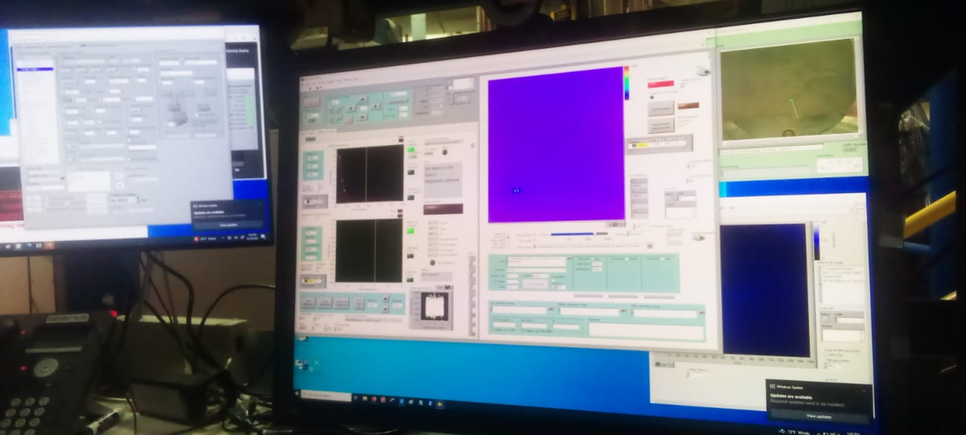
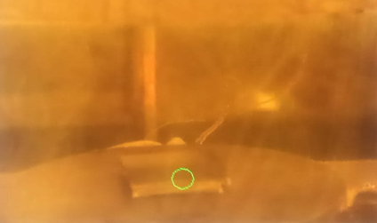
Sample Testing
MMSC mounted on the stage
custom-built Multi-Modal Spin Coater with auxiliary inputs.
Sample viewed from the computer interface
Computer Interface
Humidity Controller

Slide 14
Results
Diffraction characteristics of 2T films.
GIWAXS spectra of 2T films based on precursor solutions prepared by different solvent conditions: GBL, GBL/MeOH, GBL/DMSO, GBL/DMSO/MeOH.
Coffey, A. H. et al. (2023). Advanced Energy Materials, 13(33), 2201501.

Slide 15
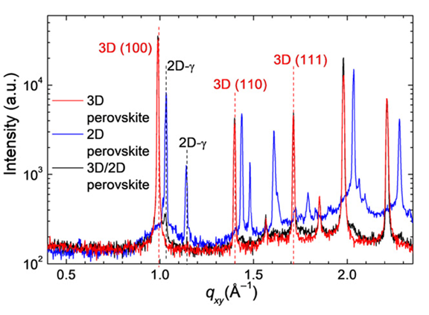
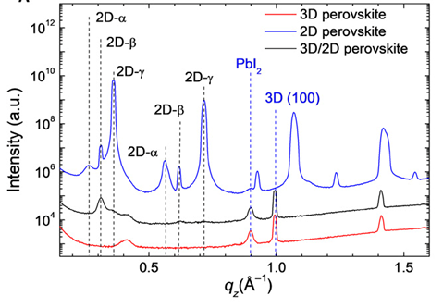
Liu, Y. et al. (2019). Science advances, 5(6), 2543.

Slide 16
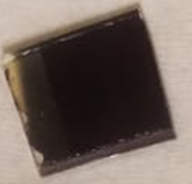
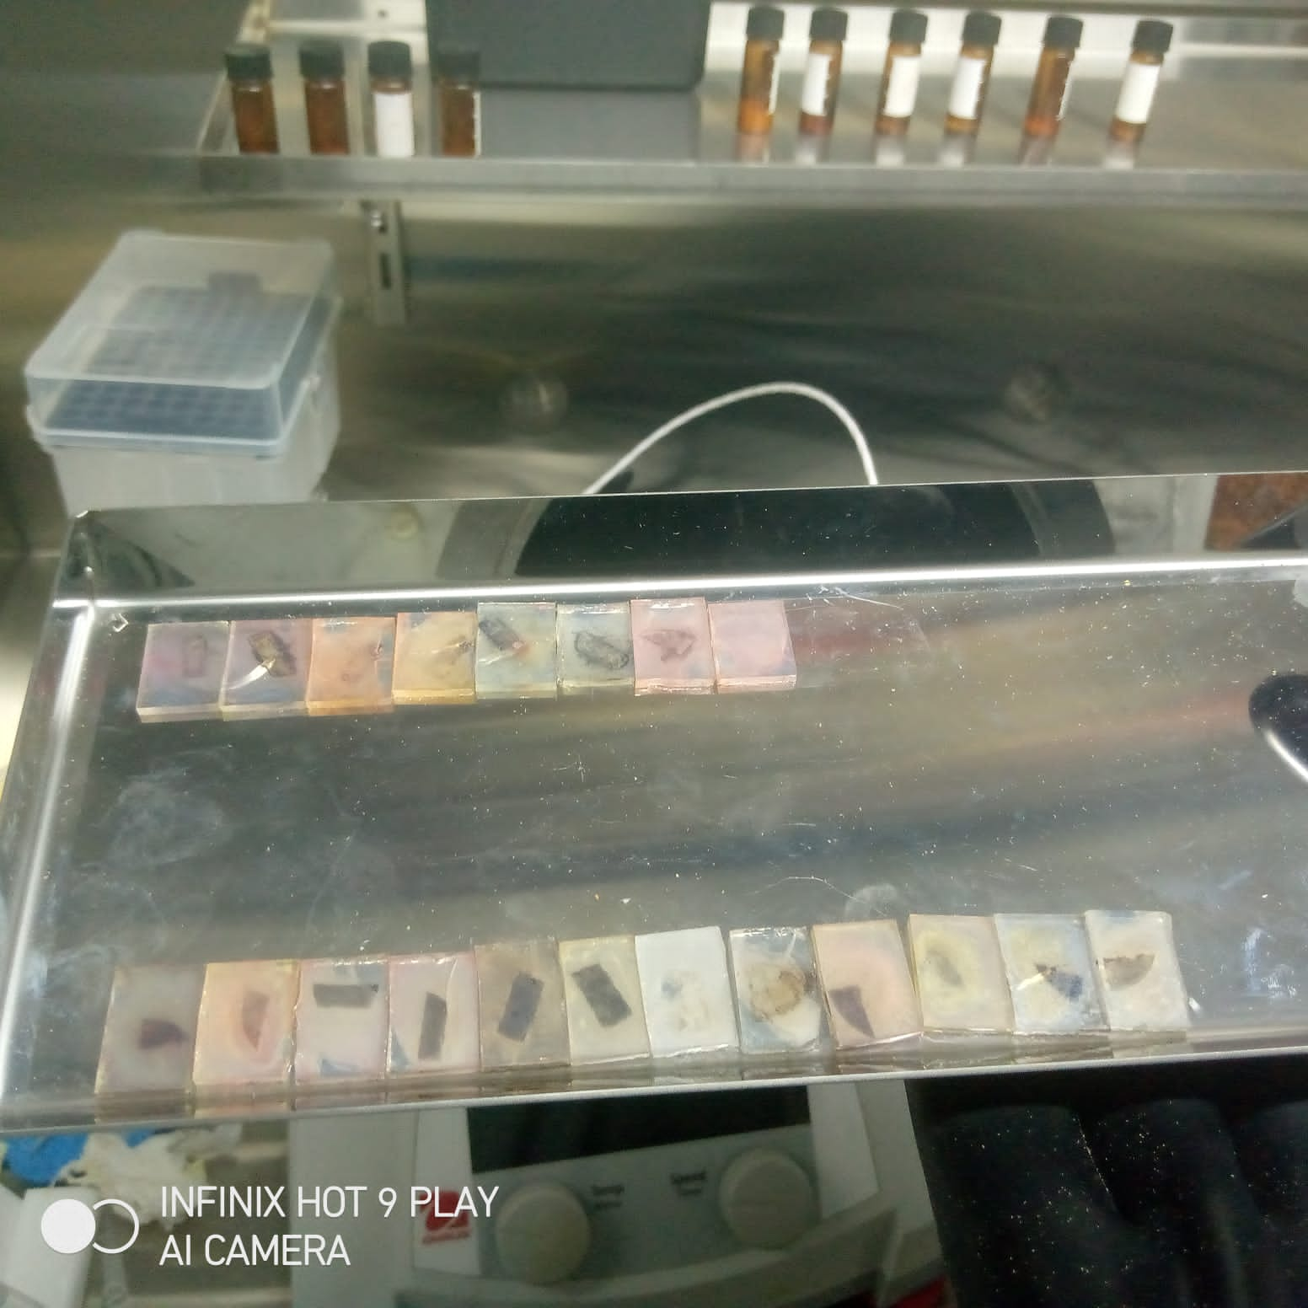
Degradation of perovskite samples
Fresh samples Degraded samples

Slide 17
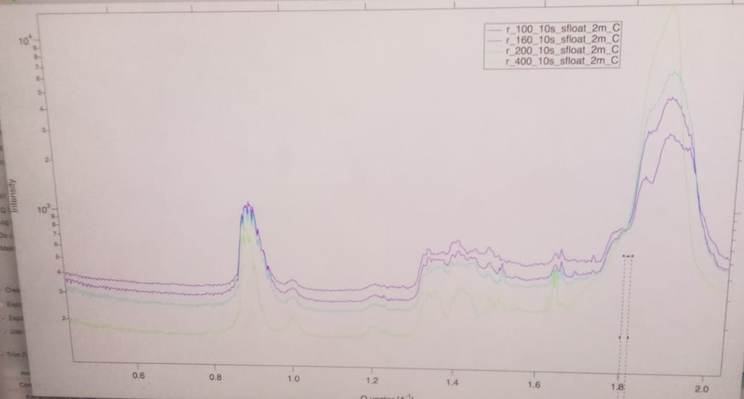

Slide 18
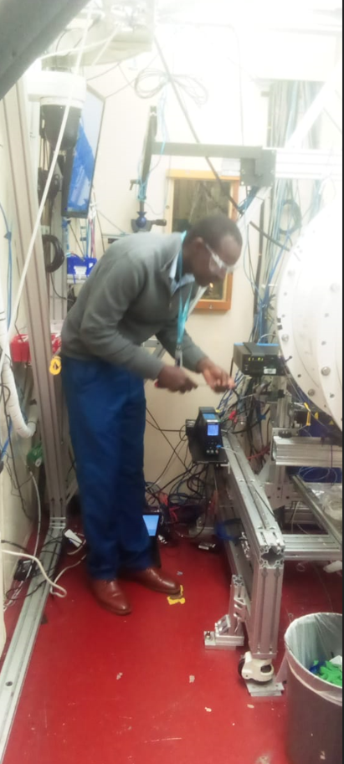
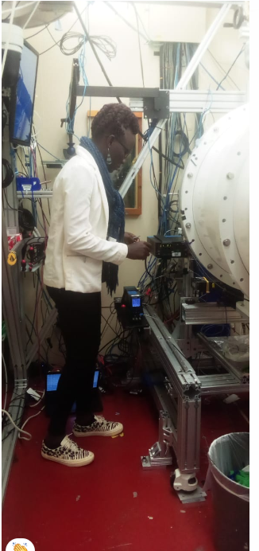

Slide 19








Acknowledgements
Chenhui Zhu and Aidan Coffey – Advanced Light Source (LBNL)
Carolin Sutter-Fellow- Molecular Foundary (LBNL)
Prof. Husein Golicha and Dr. Maxwell Mageto - MMUST

Slide 20
Thank You.

