Slide 1

ASESMA
African School for Electronic Structure
Methods and Applications
The second decade and its role in new initiatives for scientific research
ASESMA
Richard M. Martin
University of Illinois and Stanford

Slide 2
ASESMA
African School for Electronic Structure
Methods and Applications
The second decade and its role in new initiatives for scientific research
Why
Electronic Structure
Theory
(with no equations!)
Role in Research Today
ASESMA
Richard M. Martin
University of Illinois and Stanford

Slide 3
ASESMA
African School for Electronic Structure
Methods and Applications
The second decade and its role in new initiatives for scientific research
Role of theory
1) Research in all fields today
2) Research at Light Sources
ASESMA
Richard M. Martin
University of Illinois and Stanford

Slide 4
ASESMA
A 10-year program from 2010 to 2020
Endorsed by IUPAP (International Union of Pure and Applied Physics)
Supported by ICTP (International Centre for Theoretical Physics) , …..
Schools each 2 years to foster
a collaborative network for research and higher education within Africa
A new larger vision for ASESMA – 2020-2030
Endorsed by IUPAP for a second decade
Based on accomplishments in the first 10 years
More emphasis on
Problems related to biology
Machine Learning
……….
The key is the long term support of ICTP and IUPAP

Slide 5
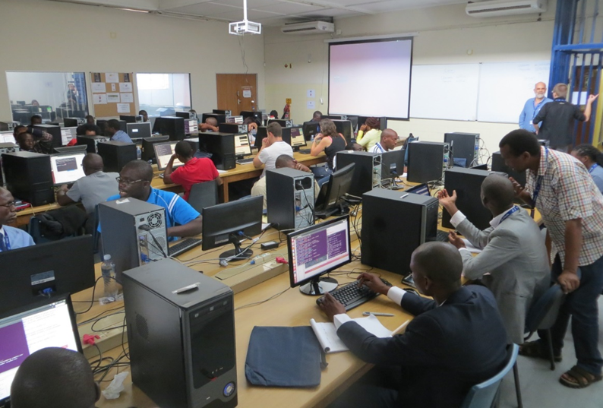
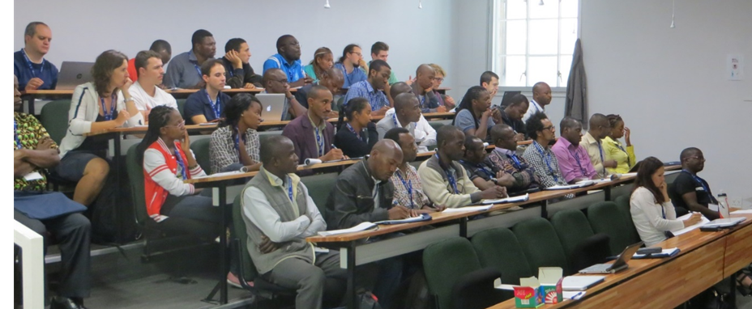
The ASESMA Approach
Computational Science
The core guiding principle is that computation makes it possible to do world-class research
with modest investment. Computation is important in every area of science and technology.
Choice of Topics
Electronic structure is an important field that is narrow enough to build up a network for joint work and collaboration, yet broad enough to span the range from fundamental physics to applications in materials science, chemistry, and many other fields.
An ASESMA school
Typically ~ 1/2 participants new to the field, 1/2 returning to increase their knowledge, collaborate, and tutor the new people.
Each school includes basic theory and methods and hands-on computing.
Each participant is involved in a project in an area of current research.

Slide 6
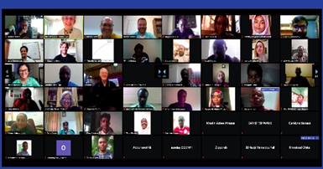
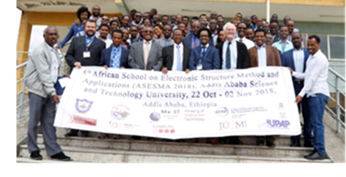
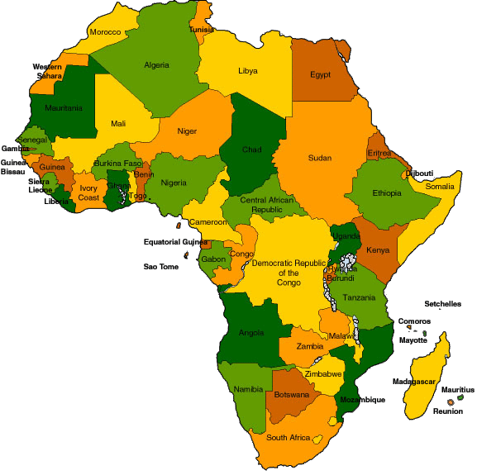
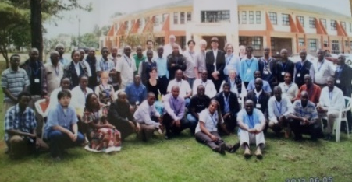
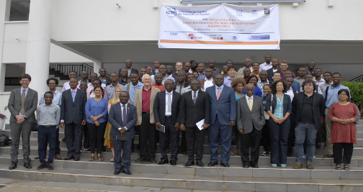
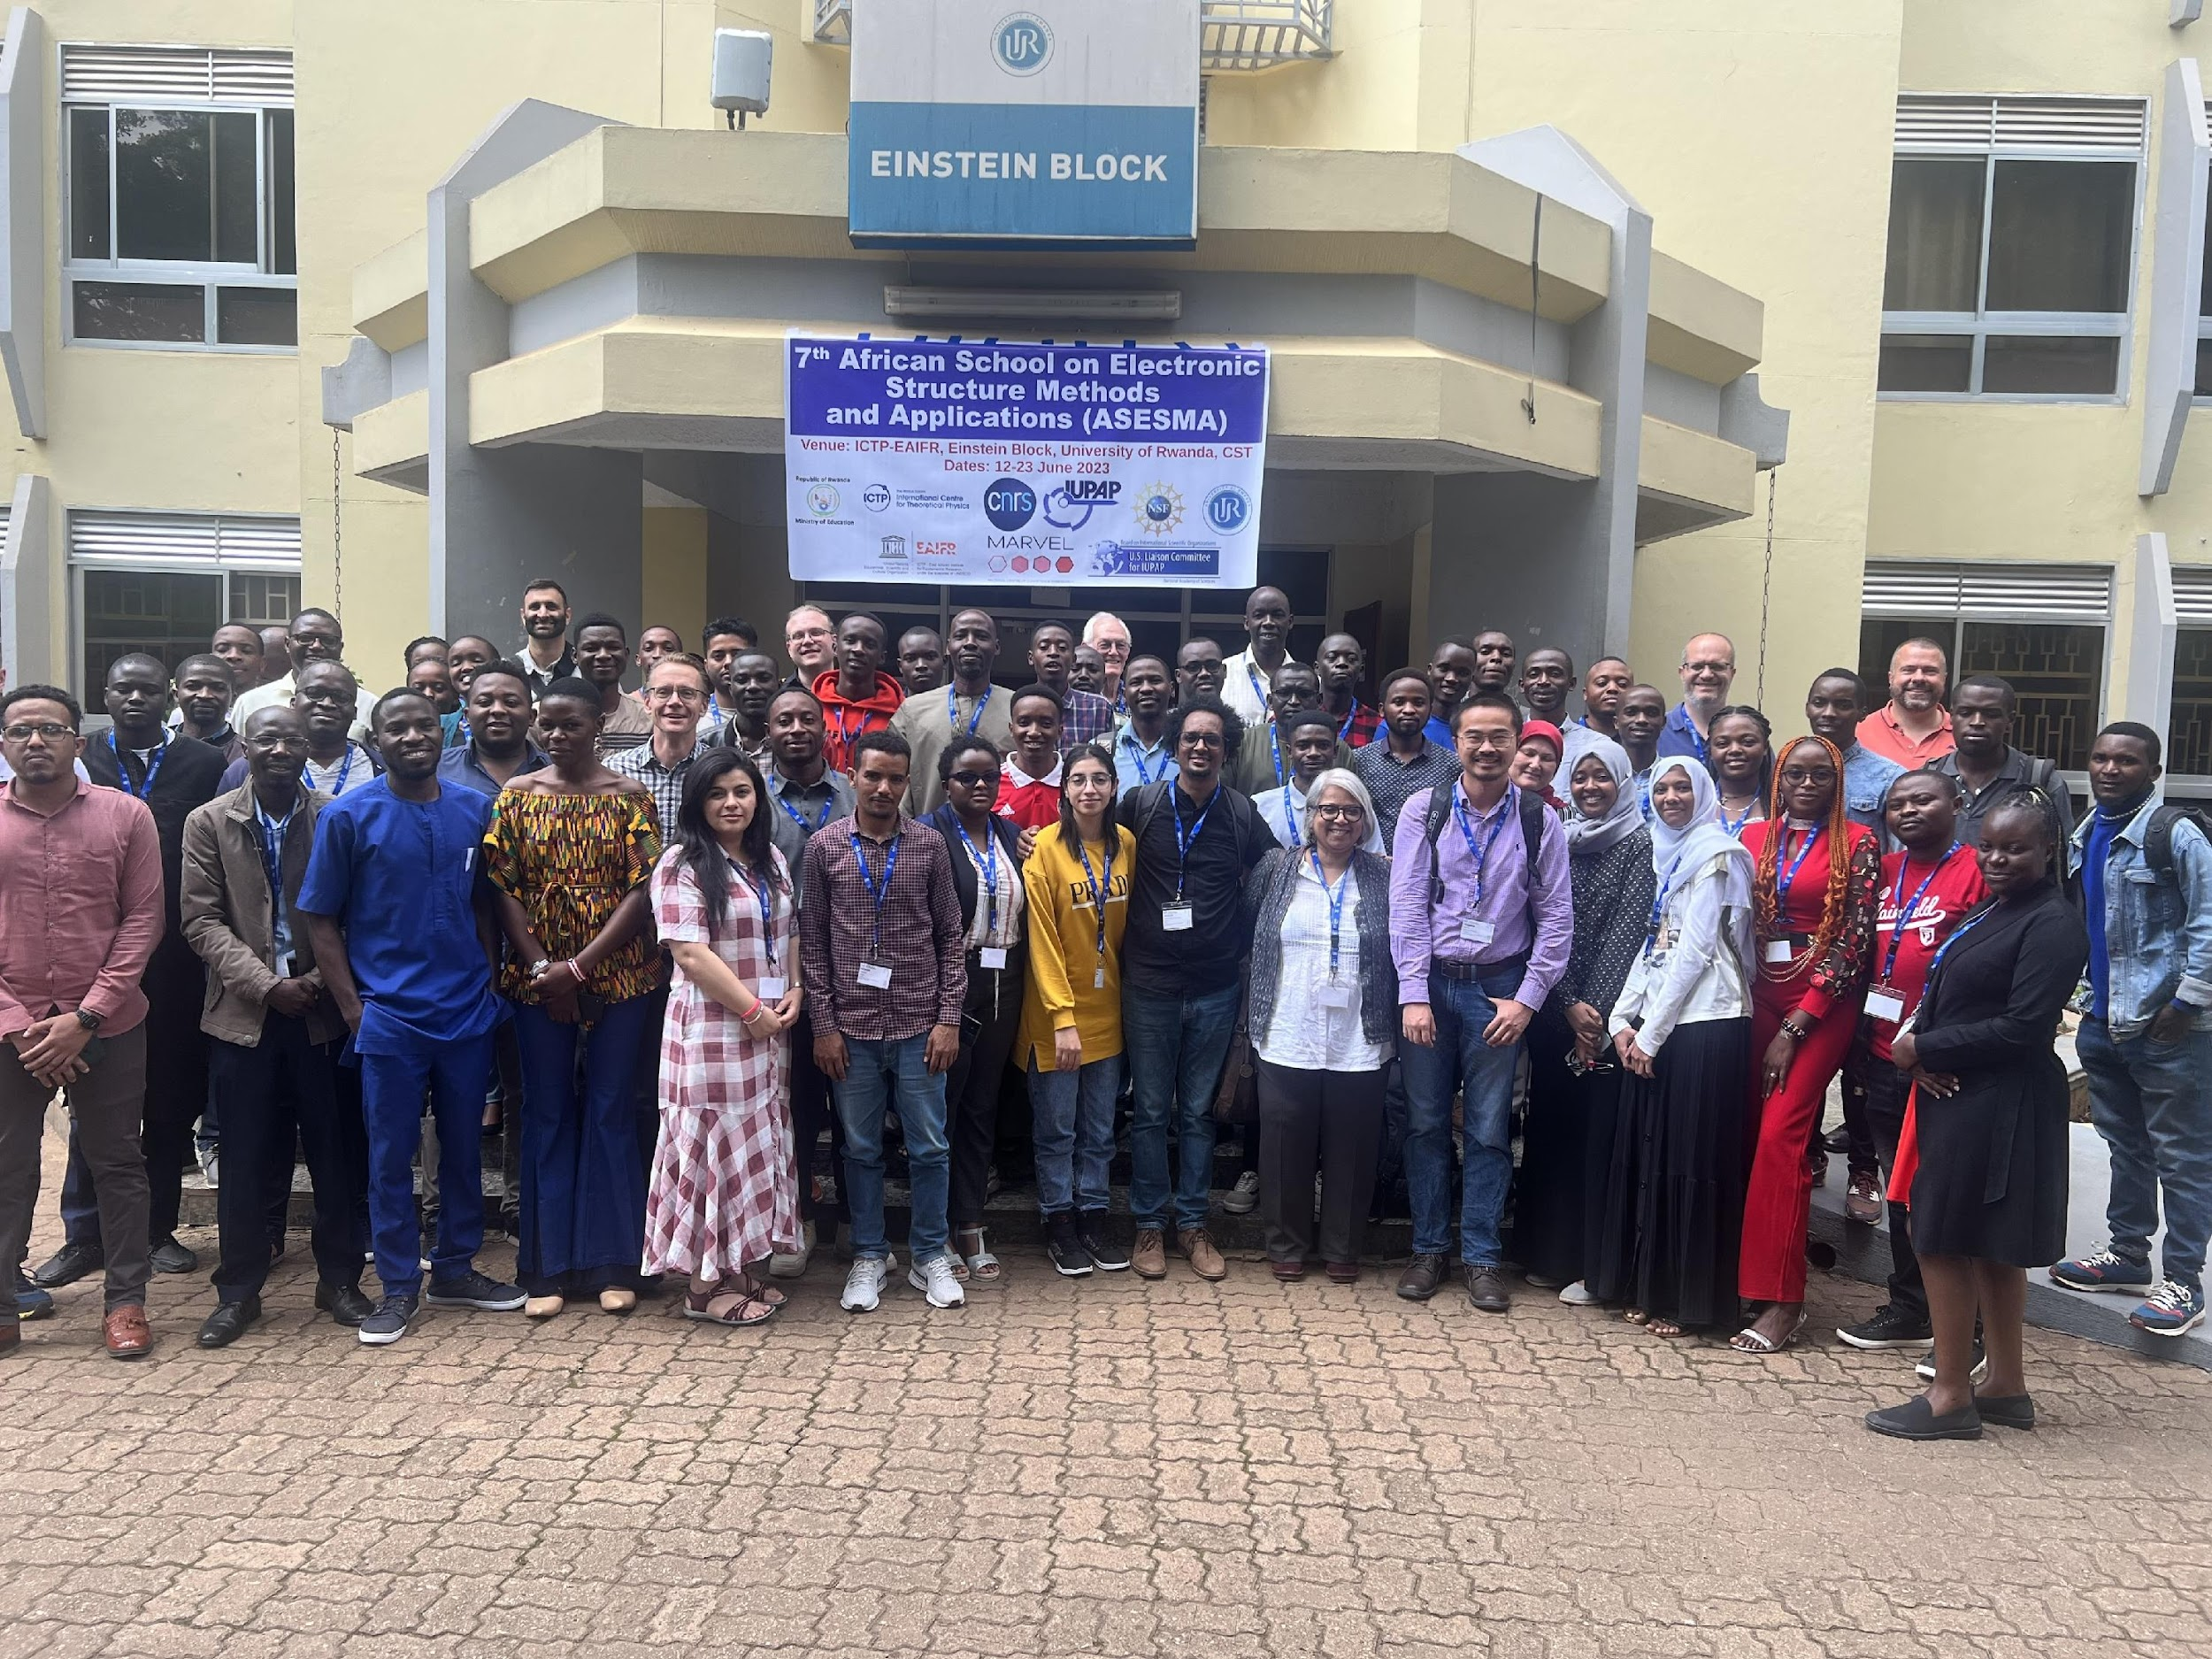
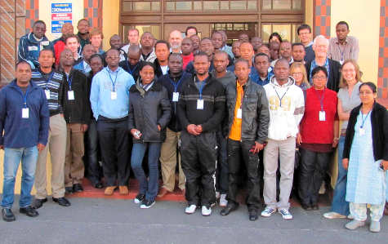
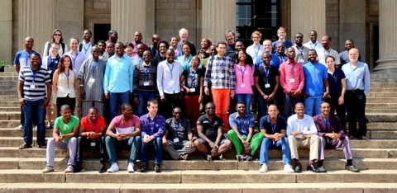
ASESMA Schools
279 participants from 29 African countries (2008 -2023)
ASESMA 2021 - Virtual
ASESMA 2018 - Ethiopia
(Showing only Lecturers, Mentors)
Now Many Active Research Groups!
Sudan 2013, 2015, 2017
Tutorials at Khartoum Workshop
on Advanced Materials
ASESMA 2012 - Kenya
Regional workshops
(Mini-ASESMAs)
Republic of Congo – 2017, 2021, 2023
Dem. Rep. of Congo - 2022
Cameroon 2018, 2019, 2022
Ethiopia – 2021
Kenya - 2021, 2022, 2023
Rwanda - 2019, 2023
South Africa – 2019, 2022
Tanzania - 2019
ASESMA 2016 - Ghana
ASESMA 2023-Rwanda
ASESMA 2010 - Capetown
Sessions at African
Materials Science Society
Botswana – 2017
Tanzania – 2019
Senegal - 2022
ASESMA 2015 - Johannesburg
2008 - Capetown - Workshop that
led to foundation of ASESMA

Slide 7
Active Research Groups
Indicating countries,
many (most!) with several active groups
These are teachers of future scientists/citizens!

Slide 8











Sponsors – so far

Slide 9
Why Electronic Structure?
Electronic Structure is one of the
grand challenges of physics
With Application to Physics, Chemistry,
Materials Science, and many other areas

Slide 10
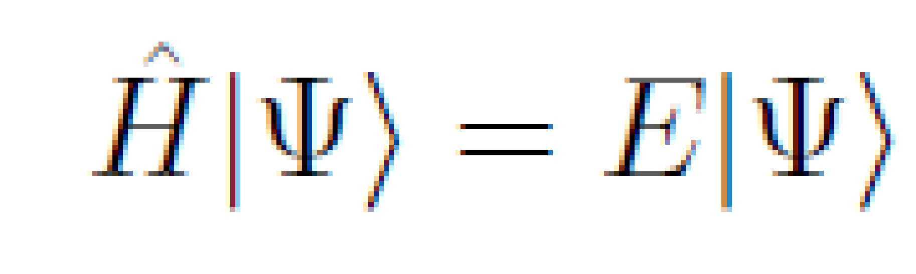
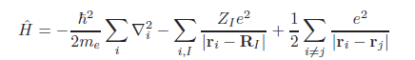
Electronic Structure is one of the
grand challenges of physics
Many-Body problem of interacting electrons
and nuclei in molecules, solids, liquids, ….
Two Equations!
We must solve the many-body Schrodinger Equation
Kinetic energy
of electrons
electron-nuclei interactions
electron-electron interactions
The reason to show the equations is to emphasize that we are
dealing with the REAL problem - not some model!

Slide 11
Electronic Structure is one of the
grand challenges of physics
Many-Body problem of interacting electrons
and nuclei in molecules, solids, liquids, ….
We can understand the challenges without Equations!
We must solve the quantum mechanics problem
The Hard Problem
The Grand Challenge
of Many Interacting Electrons
Vast array of Problems
Must be solved accurately
in a system defined by the Nuclei

Slide 12
Density Functional Theory (DFT)
Hohenberg-Kohn Theorem
All properties of the system are determined
by the ground state density n₀(r)
Function of r
3 dimensions
Sounds like magic! How can this possibly be true?
Answer
1. All properties of the system are determined by the potential acting on the electrons (due to the nuclei) V_{ext}(r)
Function of r
3 dimensions
2. HK showed there is a one-to-one correspondence V_{ext}(r) n₀(r)
3. Therefore all properties of the system are determined by n₀ (r)
Each property is a functional of n₀ (r): F[n₀ (r)]
But
The “theorem” gives no way to calculate any property except to solve the original problem!
A Nobel Prize for that?

Slide 13
The Kohn-Sham Auxiliary System
This is the idea worth a Nobel Prize!
Construct a soluble independent-particle problem with
density equal to the density n₀ (r) of the full interacting electron problem
Energy = E_{Ind. part.} + E_{xc}[n₀ ]
Soluble on a computer!
Many very efficient codes
All the hard parts of the problem!
(Exchange-correlation)
A Nobel Prize because this construction made possible
accurate approximations for E_{xc}[n₀ ]

Slide 14
How useful is it?
There are good approximations!
LDA - Local density approximation, proposed by Kohn and Sham in the 1964 paper
GGAs - Generalized Gradient approximations
Hybrid – GGA + Hartree-Fock
. . . . .
Now an essential part of research!
Calculations of structures – lattice constants with ~1% accuracy
-- phonons ~5% accuracy
-- structures of molecules ……
Useful approximations for many other properties
Physics, Chemistry, Materials science, Engineering, . . .

Slide 15
How useful is it?
The Kohn-Sham papers are the most widely cited papers in Physics
The ability to do accurate calculations of the minimum energy structure of a complex solids and molecules has transformed research!
Approximately 50,000 papers per year!
(Estimate based on current trends and a study of the literature
10 years ago, which found ~30,000 papers per year.)
I made a little survey of papers in Nature and Science
Of all papers on experimental materials at the atomic level
almost 1/2 involved DFT calculations working together with experiments

Slide 16
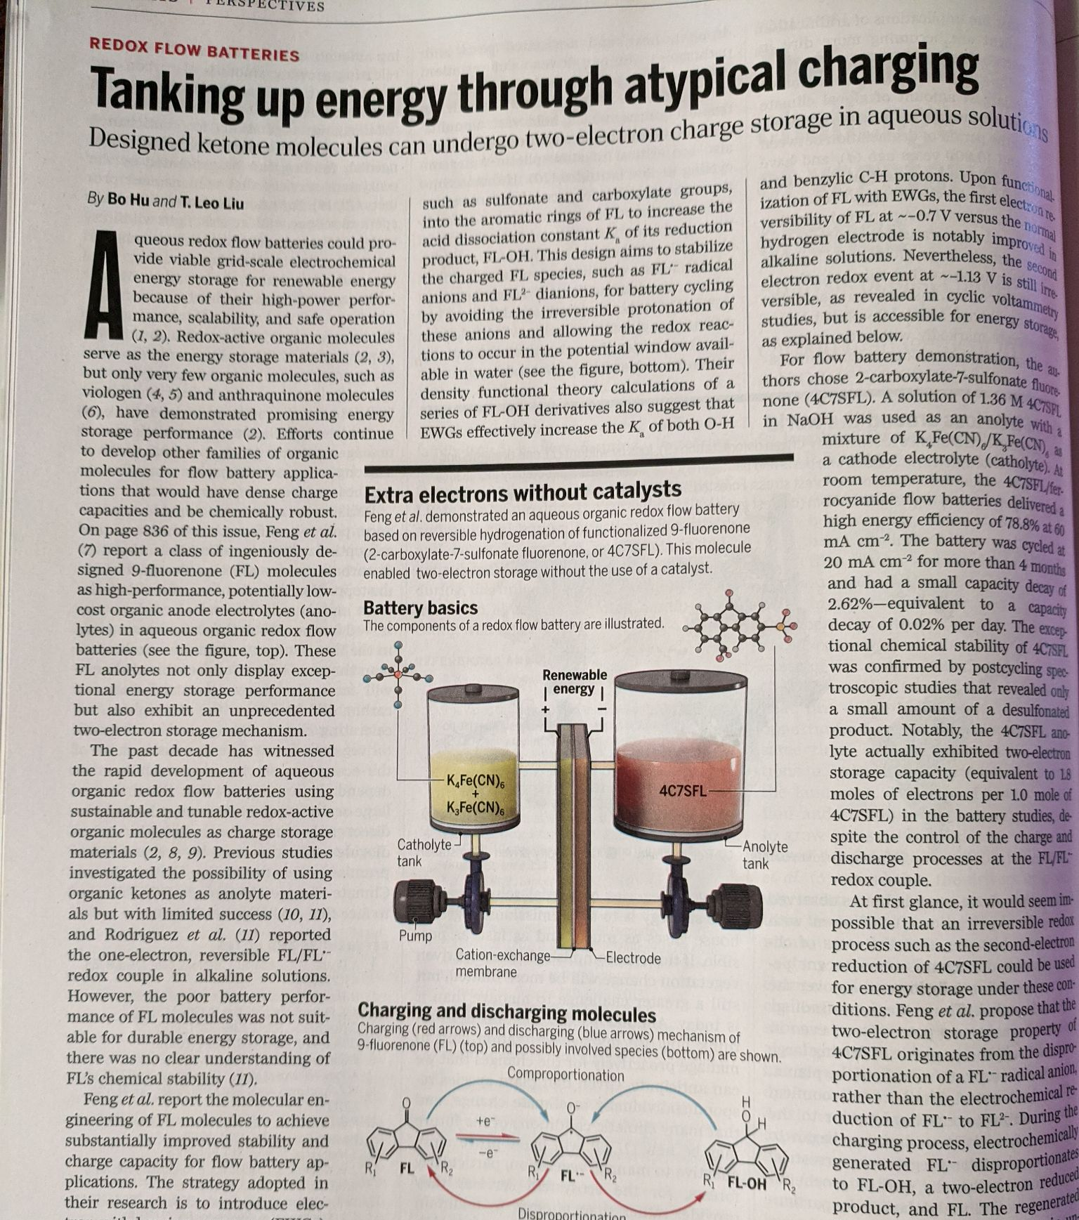
Electronic Structure Calculations are
REALLY USEFUL !
Example in Science Magazine
Aqueous redox flow batteries could provide viable grid-scale elecrochemical energy storage for renewable energy because …...
density functional theory calculations of a series of FL-OH derivatives also suggest that …...

Slide 17
One must go beyond DFT for many things!
Kohn-Sham DFT is amazing good for structures:
Where are the atoms?
What are vibration frequencies?
But DFT is NOT meant to give spectra correctly
Often very bad - “The band gap problem”
For Spectra one needs methods like:
Time-dependent DFT
Many-body perturbation theory (The GW method, etc.)
It is a hard problem!
There is great experience in how to understand and use the methods!

Slide 18
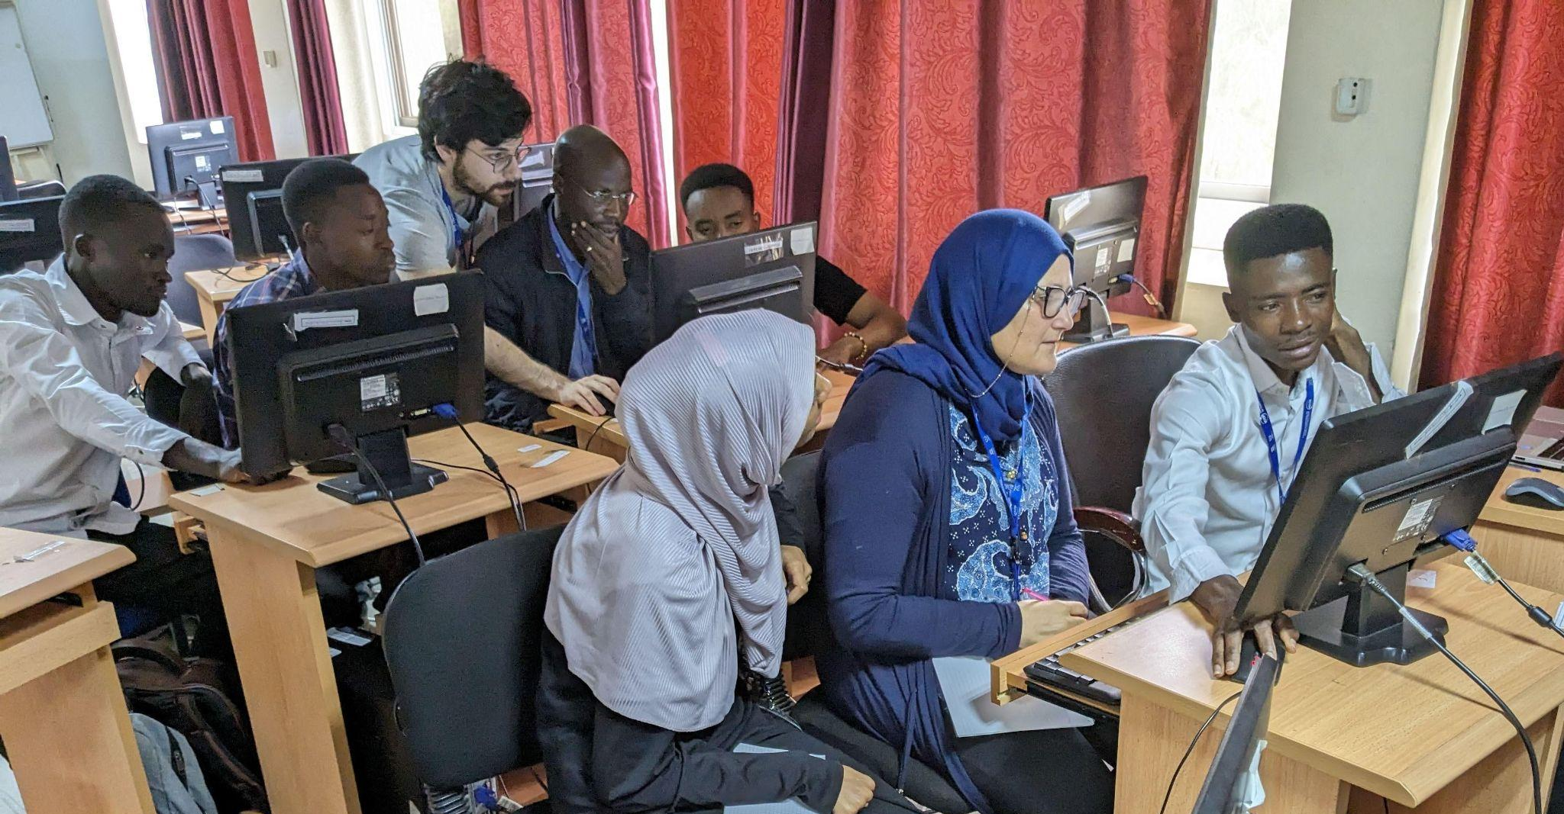
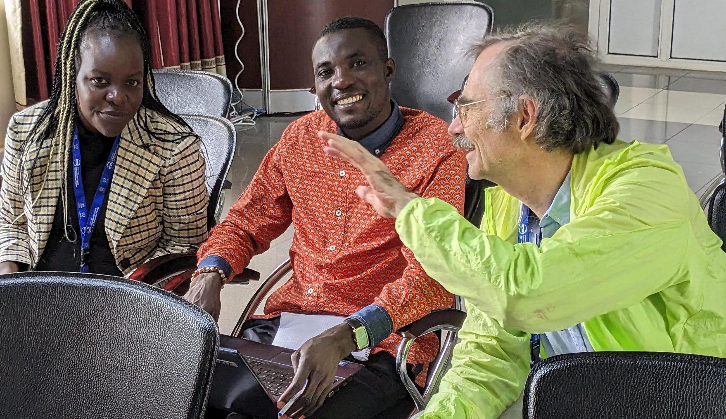
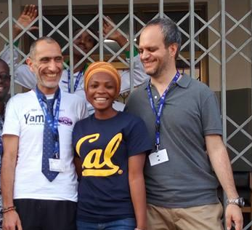

ASESMA
Core Topics + Hands-on Tutorials and Projects
Quantum Chemistry
and molecular systems
Many-body methods
for spectroscopy
Density Functional Theory
Alberto Carta - Mentor helping students in DFT project in 2023
Marc Casida – pioneer of time-dependent DFT
with project in 2023
Azima Seidu from Ghana in 2016
with the lecturers
Andrea Marini and Matteo Gatti
(Afterward Azima visited Gatti in France.)
Three ASESMA participants
are working in Gatti’s group
right now!
Machine Learning
Alex Urban leading project
in 2023

Slide 19
ASESMA
Results (in addition to the ASESMA network!)
Just a few Examples
ASESMANet
Program for providing small amounts of funds for meetings and collaborations
US-Africa Initiative of the American Physical Society
Next slide
One example of a collaborations started in ASESMA

Slide 20


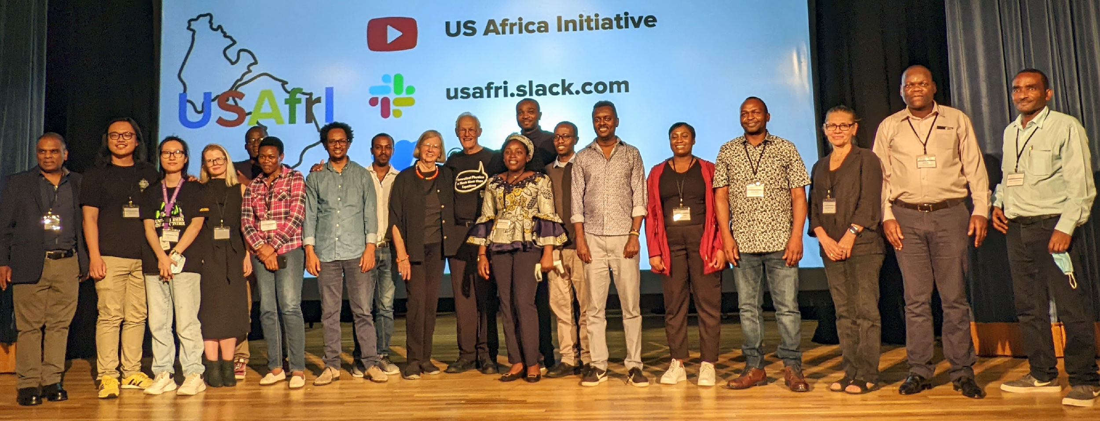
US Africa Initiative for Electronic Structure (USAfrI)
Sponsored by the APS
2019 Innovation Fund
USAfrI was created by a grant from the APS with the far-reaching goal
“to create a platform for exchange between African and U.S. physicists with opportunities to have a major impact on research and education in Africa.”
The APS funded a set of workshops and visits of
15 African Scientists to Universities and Labs in the US to initiate collaborations
It could happen only because of ASESMA and the network of African scientists at a level to fully participate in global community
USAfrI finished in 2022. What is needed is long-term support!
USAfrI is just an example of what can be done. There is great interest and willingness to participate. Over 100 US scientists were definitely interested in USAfrI!
For more information see
https://usafricainitiative.org/

Slide 21
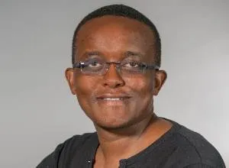
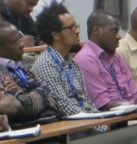
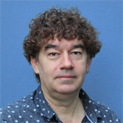
Results of ASESMA: One Example
2010
Prosper Ngabonziza attended ASESMA
when he was a student
2012
Several times Prosper proposed making
experiment/theory project in ASESMA
---
Prosper
2015
Garu Gebreyesus attended ASESMA
Had not worked in Electronic Structure before
Organized ASESMA in 2016 in Ghana!
2020
Garu in audience in 2015
Started ASESMA collaboration (Ghana, Nigeria, Rwanda, Italy, Germany, US) based on Prosper’s experimental work
Photoemission (ARPES) on Sr₄Ru₃O₁₀
Phys. Rev. paper in 2022
2022
New Idea from that work led to new collaboration with experimentalists at Advanced Light Source In US
Remote Access!
Paper submitted 2023
Jonathan Denlinger
2023
New Discoveries from that work are leading to further work

Slide 22
Results of ASESMA: One Example
A successful collaboration!
Young physicists Prosper and Garu experiment/theory collaboration
with help from senior people in theory and experiment
2 papers and new discoveries (confirmation of theory and additional unexpected discoveries!) leading to further work
What could be better?
For this to be standard - not take 13 years!
Scientists working together with local support (funding, colleagues)
as part of the global community

Slide 23
Role of ASESMA for the future
Theoretical calculations are an essential part of research!
Can be world class with much less cost than experimental facilities!
Any Major Research Project needs a theory component
Especially a light source!
Theory should not be “and add-on”
It should be part of planning from the start
Example:
There is now remote access for experiments at light sources in the US and elsewhere. The LAAAMP program provides the possibility for a professor and a student to visit a Lab to learn techniques and use remotely or in person
A multiplier effect!
Combining with theory at the start can build up expertise for analysis, choosing experiments, teaching students, …..
Low cost and -- more important -- an essential part of science

