Slide 1
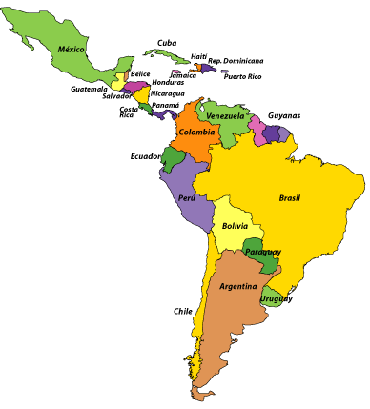
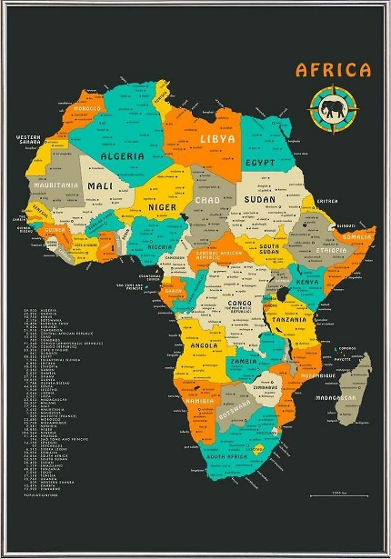
LATAM Synchrotron in the Greater Caribbean and AfLS
Galileo Violini
Co-chair GCLSI Executive Committee
CIF, Bogota
6° AfLS Conference, November 16, 2023

Slide 2
Some Data
Continent | GDP per capita ($) | Educaion GDP % | Science GDP %
North America | 64300 | (USA) 6 | 3.32
Europe | 50100 | 4.8 | 2.02
South America | 19500 | (LAC) 3.8 | 0.55
Africa | 6300 | 5 | 0.33-0.74

Slide 3
Typical economic Matrix
- Explotation of Natural Resources
- Agriculture
- Tourism
- Trade – Internal economies
- Import of technological goods
- Services
- Migrant Remittances
A need: High Technology industry (Scientific and technological development prerequirement)

Slide 4
Latin American scientific big infrastructure
Astronomy & Astrophysics:
Chacaltaya Lab in Bolivia, 1947 (pion discovery)
La Silla (ESO) and Cerro Tololo (Interamerican) Observatories, 1969
Pierre Auger Observatory (Mendoza, Cronin) 1999
Several current projects, both open-sky (e.g.HAWC, Puebla, Mexico) and underground (ANDES, Argentina- Chile tunnel)

Slide 5
Bernardo Houssay, 1954
It is very common in backward* countries an inordinate concern for immediate applications, and therefore it is customary to boast of practical judgment and to call for research exclusively of immediate application and useful to society
* backward may look politically uncorrect, and it could be surprising its use by Houssay. The modern “developing “ Word would become popular only later, in the 60’ies

Slide 6
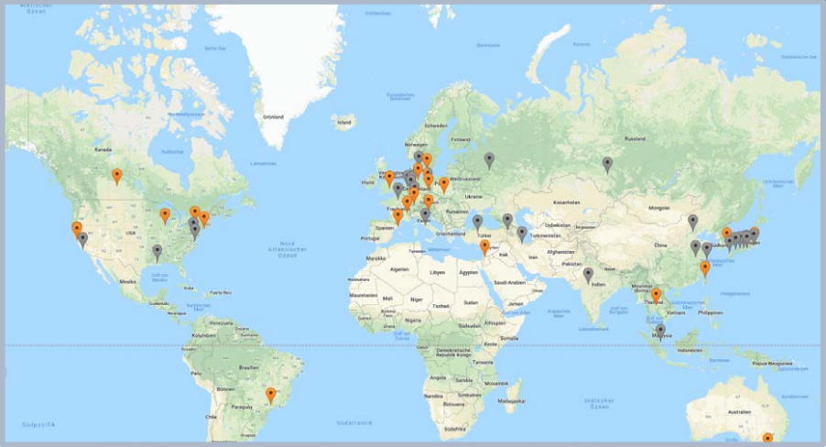
Synchrotrons in the World
Research Teaching Society
Nanomaterials Master & Ph D Thesis Industrial development
Materials Science Technician training Medical imaging
and engineering Radioisotopes
Chemistry Minerals
Archaeology Governance Environment
Paleontology Science Diplomacy Climate
Geophysics
Informatics
Space

Slide 7
Synchrotrons Versatility
Research Teaching Society
Nanomaterials Master & Ph D Thesis Industrial development
Materials Science Technician training Medical imaging
and engineering Radioisotopes
Chemistry Minerals
Archaeology Governance Environment
Paleontology Science Diplomacy Climate
Geophysics
Cultural heritage
Informatics
Space

Slide 8
2021 Regional Proposal
https://arxiv.org/abs/2109.11979
A Synchrotron as Accelerator of Science Development in Central American and the Caribbean
Galileo Violini, VÍctor M. Castaño, Juan Alfonso Fuentes Soria, Plácido Gómez Ramírez, Gregorio Medrano Asensio, Eduardo Posada, Carlos Rudamas

Slide 9
A Name for the GCS
English acronym with Spanish interpretation
LAMISTAD
Latin American International Synchrotron for Technology, Analysis and Development

Slide 10
African and LA common problems
Need of scientific development
Need of industrial development
Industrial Demographic growth
Immigration
Interest to political stability
Big inequalities between and within countries
Social integration
They need immediate action

Slide 11
Humancapacity available in the Human capacity – Do we have?
Potential users
Available, especially in areas where Region’s non-scientific demand is high, such as health, food safety, biodiversity.
They must be trained and a first need is to broadly explain that main use of synchrotrons is not for physics research.
Not to be forgotten posible demand from outside the Region
Engineers, staff and technicians of the to-be Synchrotron.
Only apparent problem. SESAME’s experience of SESAME. When building the facility, enough time to realize a vigorous training program.
Civil engineering is strong
}

Slide 12
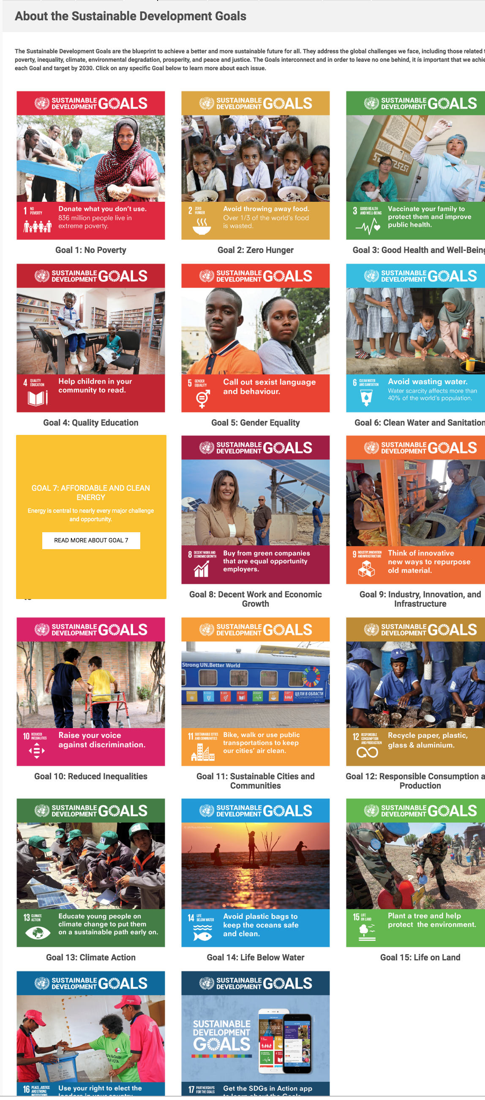
Synchrotrons and SGD
(courtesy of V. Del Río)
Research at Synchrotrons can
contribute to the achievement
of 13 out of 17 of the UN
Sustainable Development
Goals.

Slide 13
TourismHumancapacity available in Tourism
African Tourism Investment Summit – April 2023
Cooperation in human capital development, particularly training, and building out of investment
Opportunities for investment in tourism industry
More air connectivity

