Slide 1
Nuclear Orientation Thermometry using the UCT Dilution Refrigerator
By Yanga Ntolosi
Supervisor :Dr Steve Peterson
Co-Supervisor :Prof Mark Blumenthal & Dr Dominique Gouveia

Slide 2
Table of content
Introduction
What is Nuclear Orientation
Aim
Preparation of Nuclear Orientation Thermometer
Dilution Refrigerator at UCT and Experimental Set up
Temperature calculations
Results and Conclusion
Bibliography

Slide 3
Introduction
The accurate measurement in low temperature physics is important for research purposes and for the development of the low temperature scale.
A significant challenge in low temperature thermometry is the accurate measurement of temperatures below 1 K.
The traditional approach of using a resistance thermometer to measure low temperature has its shortcomings and an alternative approach is needed.
Nuclear Orientation (NO) is a non-electronic technique to measure ultra-low temperature accurately as opposed to traditional resistive thermometers.

Slide 4
What is Nuclear Orientation
NO is basically the degree of ordering of a nuclear spin system from which the absolute temperature can be derived from the Boltzmann distribution.
The self-heating of gamma ray anisotropy thermometer, which is caused by the radioactivity of the nuclide, is small as compared to a resistance thermometer

Slide 5
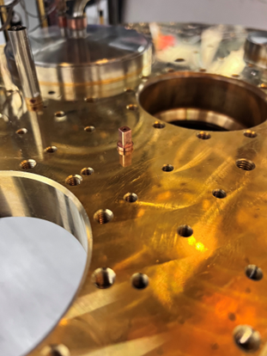
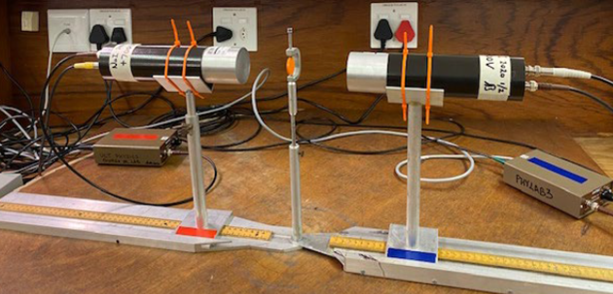
Aim
The aim is to develop a NO thermometry system using the recently procured gamma-ray anisotropy thermometer (⁶⁰CoCo(hcp) crystal) source for use in the University of Cape Town Department of Physics Dilution refrigerator.

Slide 6
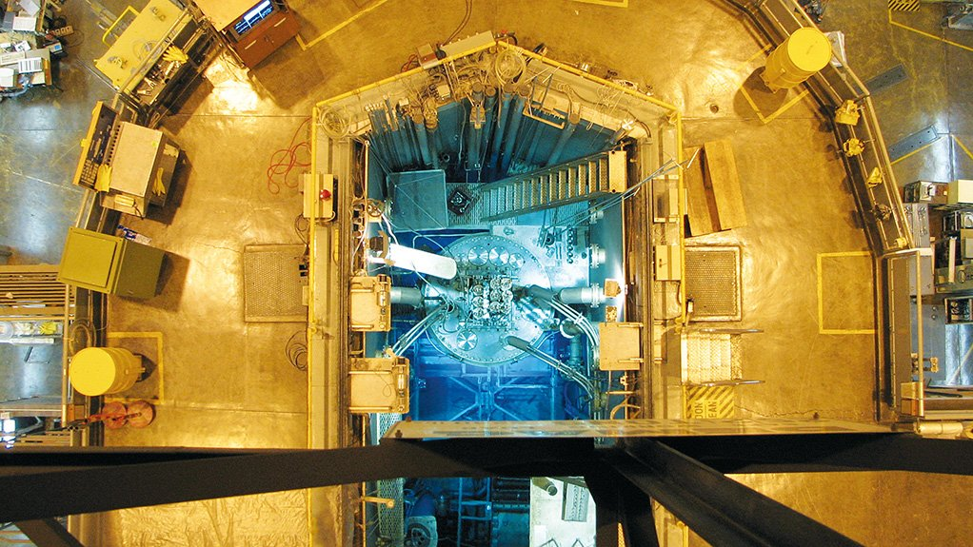
Preparation of gamma-ray anisotropy thermometer
The cobalt used is a high-quality cobalt of high purity.
This high-quality cobalt was cut into size (approx. 10x1x1${mm}^{3}$) and the long side will be cut parallel to c-axis which was accurately determined.
The cobalt source was irradiated (made unstable) at NECSA (Nuclear Energy Corporation of South Africa) using the SAFARI-1( South African Fundamental Atomic Research Installation) nuclear reactor

Slide 7
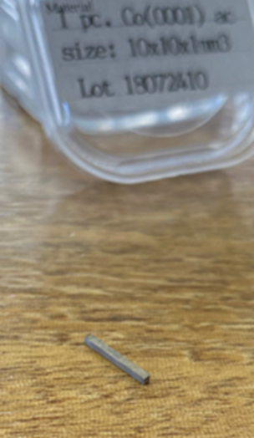
The sample was irradiated using a rabbit which is a PTS (pneumatic transport system) that is used for precisely-timed irradiation. The rabbit facility uses a vacuum system to position and remove the sample for the core of the reactor.
⁶⁰Co crystal was irradiated for 6 mins and a preliminary activity of 1.3MBq was achieved.

Slide 8
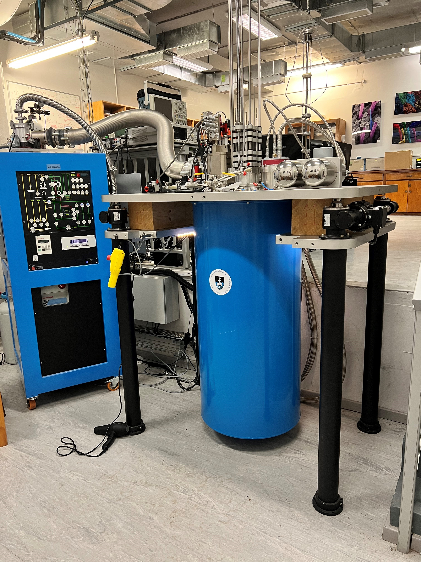
Dilution Refrigerator at UCT
The UCT dilution refrigerator consists of a dilution cryostat unit ,a GHS (gas handling system) and a pulse tube compressor.
A dilution refrigerator is able to achieve ultra-low temperatures by taking advantage of the properties of the 3-He and 4-He with boiling points of 1 K and 3 K.
When 3-He and 4-He are mixed and cooled, they separates into two phases which increases the cooling power. The process is known as the dilution process. The UCT dilution refrigerators is able to achieve ultra-low temperatures down to 8mK (-273.142 ºC) .

Slide 9
Experimental Set up
Figure 1: Cross section of the UCT Dilution Refrigerator with the ⁶⁰CoCo(hcp) crystal placed next to the Mixing Chamber
Figure 2: Detector positioned at a 0◦ angle
from the ⁶⁰CoCo(hcp) crystal.

Slide 10
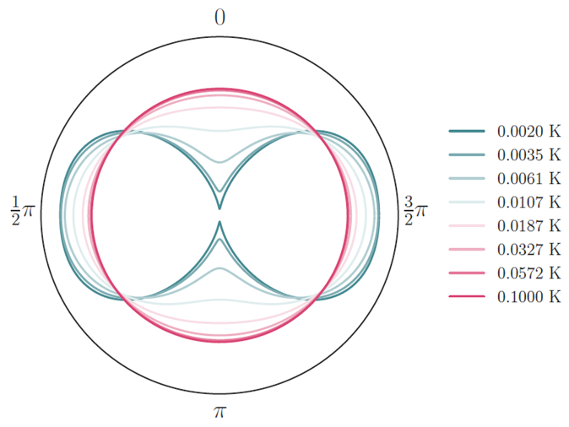
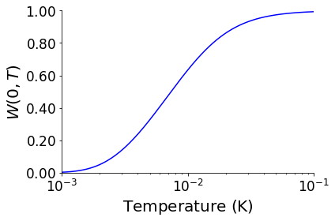
Temperature calculations
The directional distribution function is defined as,
W(θ) = $\sum_{λ_{=0}}^{λ_{=max}}{B_{λ}\left(I,T\right)U_{λ}A_{λ}Q_{λ}P_{λ}cos⁡(θ)}$
W$\left(θ\right)$ distribution which is defined by the orientation function that contains our variable T and the experimental gamma radiation $W_{e}\left(θ\right)$.

Slide 11
$W_{e}\left(θ\right)$ is defined as a ratio given as,
$W_{e}(θ)$ = $\frac{C_{c}}{C_{w}}$
$C_{w}$ is determined at a temperature where anisotropy does not occur (> 1 K)
$C_{c}$ will be measure at the desired temperature of interest (<100 mK) which is the base temperature of the UCT dilution refrigerator.
The value of $C_{c}$ and $C_{w}$ are determined by calculating the area under the peak of the gamma spectrum.
To calculate for the absolute temperature, we will have to solve for T in the given equation,
$W(θ,T)′$= $W(θ,T)−{W(θ)}_{e}$

Slide 12
Results

Slide 16
Conclusion
The more directional the radiation the less uncertainty of measurement
LaBr3 detector give a more accurate temperature measurement in the upper temperature range of the ⁶⁰Co as compared to the NaI detector
More repeated measurement need to be done to improve the overall accuracy of the NO thermometer.

Slide 17
Bibliography
Marshak,H.(1983) ‘Nuclear Orientation Thermometry’,Vol.88,175-217p
Hyslop,N.(2017) ‘Practical Considerations when Performing Nuclear Orientation Thermometry for the Helium Dilution Fridge in the Physics Department of the University of Cape Town ’ ,University of Cape Town.
New,T.(2016) ‘60CoCo(hcp) nuclear orientation thermometry’, University of Cape Town
https://www.crediblecarbon.com/news-and-info/news/sas-nuclear-medicine-facility-ready-to-restart-production/

