Slide 1
A Physics Approach to Ecological Networks
Prof Alan Matthews
School of Chemistry and Physics
University of KwaZulu-Natal

Slide 2
Ecosystem
Environment
+
Ecology
Biology
Chemistry
Geology
Geography
Physics!
Living organisms

Slide 3
Ecological Network
Flow of energy, mass, nutrients
trophic transfer
herbivores
detritivores
carnivores
source
d, e
plants
sunlight
top carnivores
d
heat loss
detritus
R

Slide 4
Compartment (group of species)
trophic transfer
(food)
being eaten
“mortality”
non-predation death, excretion
respiration
(heat loss)
biomass
eating

Slide 5
Node in Network
being eaten
R
Outflow $T_{out}$
M
Static network
$$T_{in}=T_{out}$$
B
directed links
Inflow $T_{in}$
eating

Slide 6
Trophic Transfer and Entropy
Trophic Transfer
Entropy (Information Theory)
$$T_{in}=\sum_{i}{t_{ij}}$$
$$j$$
Measure of order
$$H=−\sum{p_{ij}\log_{2}{p_{ij}}}$$
Probability of energy through link $(ij)$
$$p_{ij}=\frac{t_{ij}}{\sum{t_{ij}}}$$
$$t_{ij}$$
$$i$$

Slide 7
Directed Graph
Vertices (nodes)
Edges (links)
Directed edges also called “arcs”
H
V
Source
C
P
S
“King” carnivore
K
Global bridge
Z
Sink
M
R
Mortality
D

Slide 8
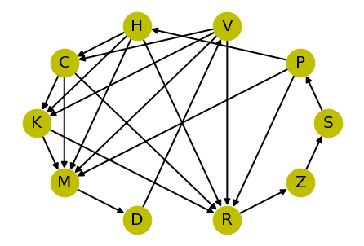
Python: Networkx
Nodes
and
Edges

Slide 9
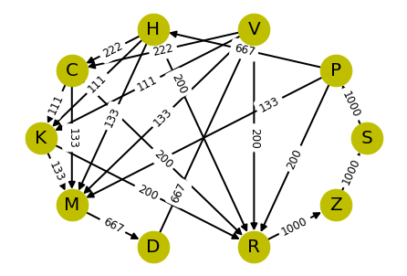
Network has:
$m=10$ nodes
$n=21$ edges
Flow vector $x$
of $n$flow values
With edge flow values
$$x_{1}$$
.
.
$$x_{k}$$
.
.
$$x_{n}$$
$$x_{k}≡t_{ij}$$

Slide 10
Linear Inverse Model (LIM)
Constraints (equalities): $\sum{a_{ik}x_{k}}=0$ (per node $i$)
Inequalities: $x_{k}>0$ for all edges (negative flows are unphysical)
Solve with matrix methods ($Ax=0$ and inequalities)
Gives basis:
Set of basis flows (represented as vectors)
Each basis flow is a solution
Flow solution = weighted sum of basis flows
$n−m$ free variables ($+1$ for global scale): 12 in this example

Slide 11
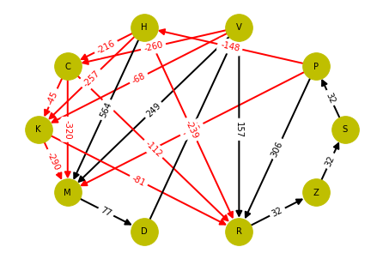
Singular Value Decomposition
Basis flow
example
Orthonormal basis, very nice, but …
Many negative flows
Plants eat herbivores
Herbivores eat carnivores
Carnivores rise from the dead
Heat recovered
Must exclude negative flows
(Same with QR decomposition)
Values scaled up by 1000

Slide 12
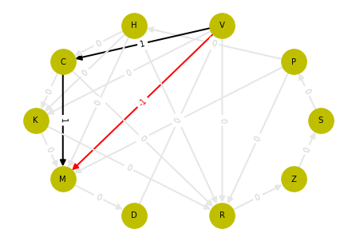
Reduced Row-Echelon Form
Basis flow
example
Simpler basis (simple cycles), but …
Still has negative flows
As for other LIM, basis not interpretable (no meaning)

Slide 13
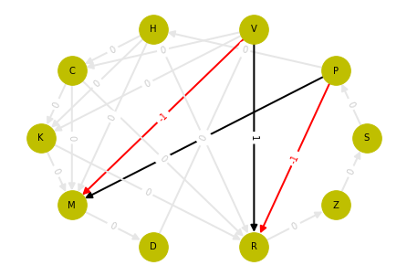
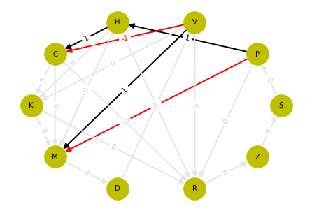
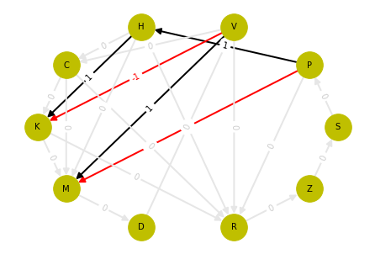
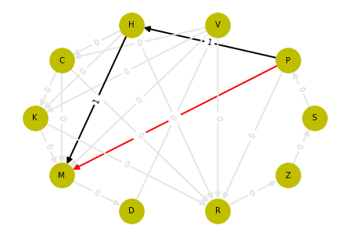
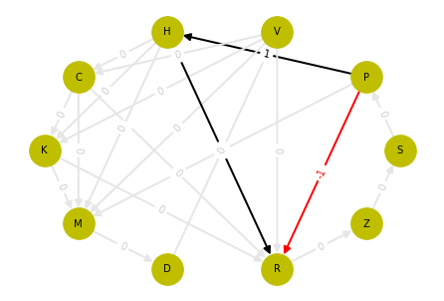
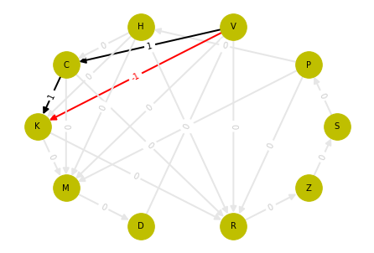
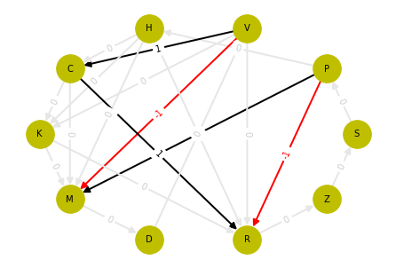
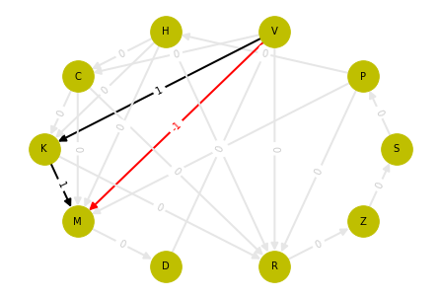
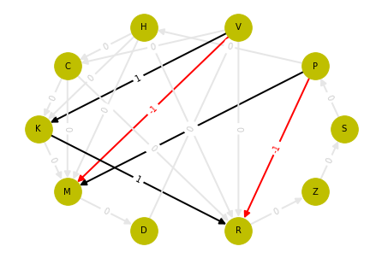
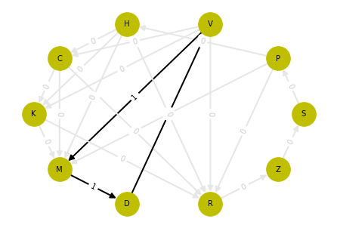
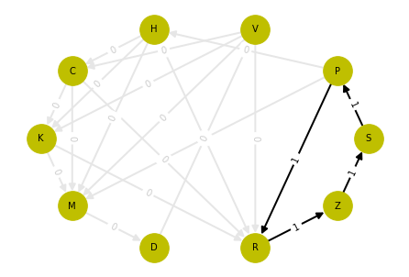
Set of 12 basis flows

Slide 14
“Physics” Approach
Avoid negative flows (unphysical, biologically implausible)
Mechanisms (respiration, mortality)
Conservation of energy
Try iterative algorithm (only positive flows)

Slide 15
Iterative Solution
Continue until S-flow = Z-flow
Send energy backwards
Split among in-edges

Slide 16
Iteration needed for cycles
Cycle

Slide 17
“Diet fraction”
Constraint
$$\sum{f_{i}}=1$$
One per node
K
Flow along edge
$$x_{i}=f_{i}T_{in}$$
$\left\{f_{k}\right\}$ $∀$ edges has
$n−m$ free variables
Just like LIM
$$f_{1}$$
$$f_{3}$$
$$H=−\sum{f_{k}\log_{2}{f_{k}}}$$
$$f_{2}$$
Fraction of inflow $f_{i}$

Slide 18
Solution for equal diet fractions
But mechanisms need attention …
Next step
$$t_{ZS}=1000$$

Slide 19
CONCLUSION
Iterative method: No negative flows
Diet fraction is interpretable
Can specify biomass, respiration, mortality
Also interpretable
Ecosystem structure: many interesting questions
Ecological networks can be applied to other systems

