Slide 1
Fast neutron transmission spectroscopy for the non-destructive analysis of concrete
Naledi Segale
Tanya Hutton, Andy Buffler & Sizwe Mhlongo
SAIP2023

Slide 2
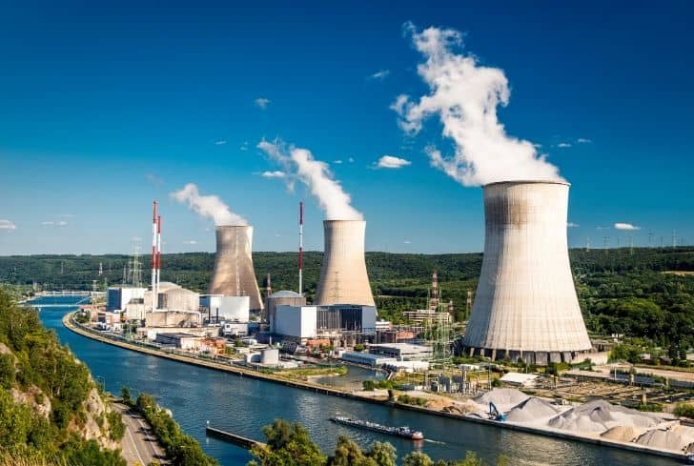
Concrete in nuclear power plants
… is used for:
structural support
containment
radiation shielding
… and is exposed to:
cyclic loadings
radiation
extremely varying temperatures
… induces concrete degradation over time, particularly
with respect to water (hydrogen) content

Slide 3
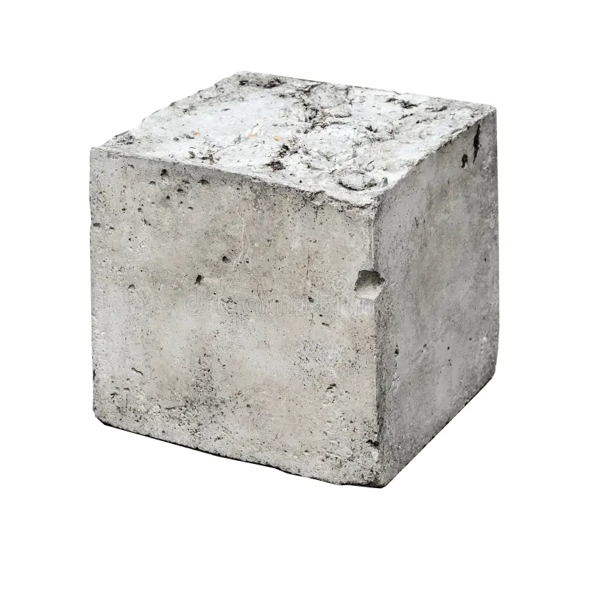
Ordinary concrete composition
Constituent | Percentage by mass (%)
Large aggregate (stone) | 61
Small aggregate (sand) | 11
Portland cement | 13
Water | 15
Additives, voids, variations in the mixing and curing increase
the complexity of the composition of concrete

Slide 4
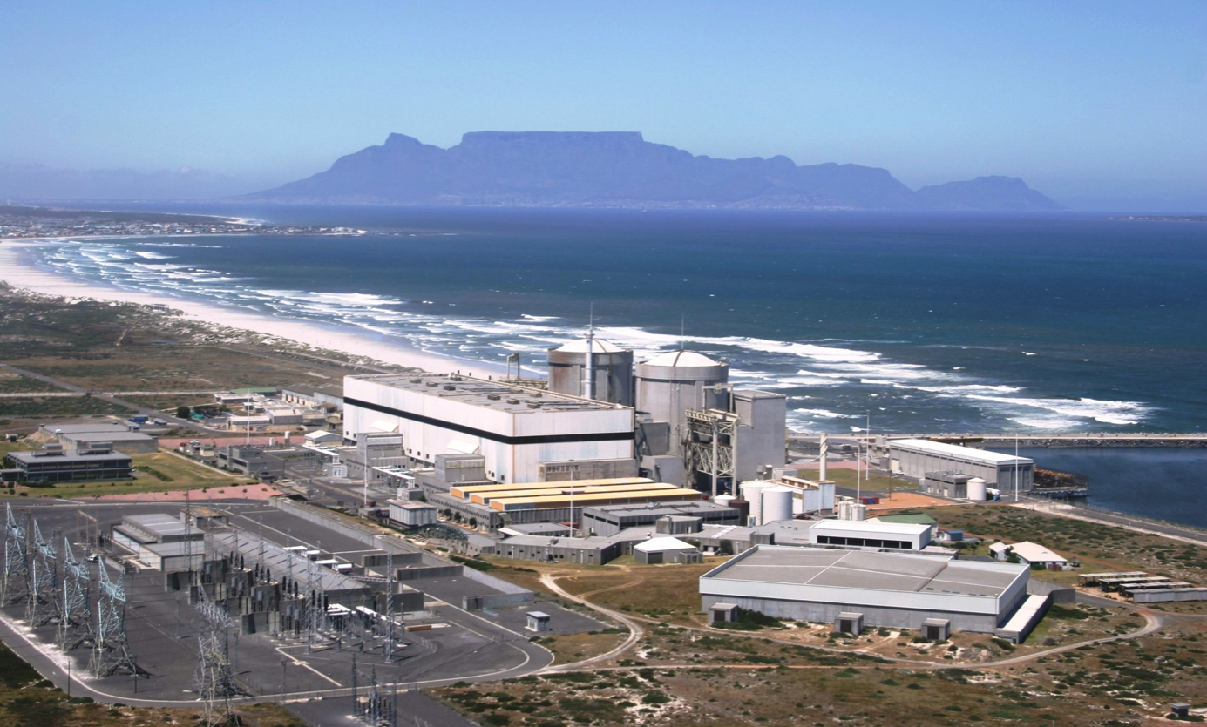
Koeberg NPP
2 x 970 MW PWR units
Commissioned in 1980s and its license expires in July 2024
The plan is to extend its life by 20 more years, overseen by National Nuclear Regulator
The non-destructive testing of existing concrete structures is crucial to the plant life extension
Koeberg, Eskom

Slide 5
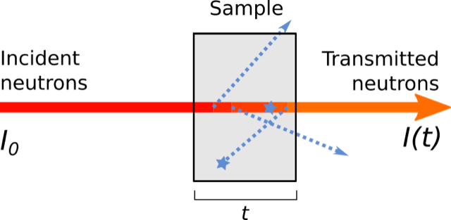
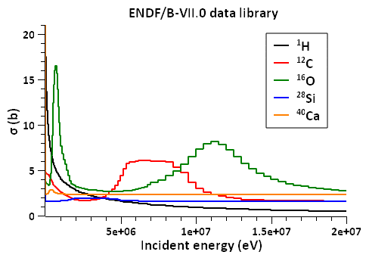
Fast Neutron Transmission Spectroscopy
$$\frac{I(t)}{I_{0}}=e^{−Σ_{R}t}$$
Effective removal
cross section
Energy dependent cross section
is unique to each element
Mass ratio of component k
$$\frac{Σ_{R}}{ρ}=\sum_{k=1}^{n}{m_{k}\frac{Σ_{R,k}}{ρ_{k}}}$$

Slide 6
Aim
To build a repository of elemental response functions, thus determine the elemental composition of aging concrete used in nuclear facilities. Starting off with sand, an integral part of any concrete as an example case
Measure $Σ_{R}$ for $SiO_{2} and CaCO_{3}$
Simulate $Σ_{R}$ for $SiO_{2} and CaCO_{3}$ in FLUKA
Use XRF data to reconstruct $Σ_{R}$ for sand and compare to measured and simulated data
Objectives
Validate FLUKA simulations in the context of neutron transmission

Slide 7
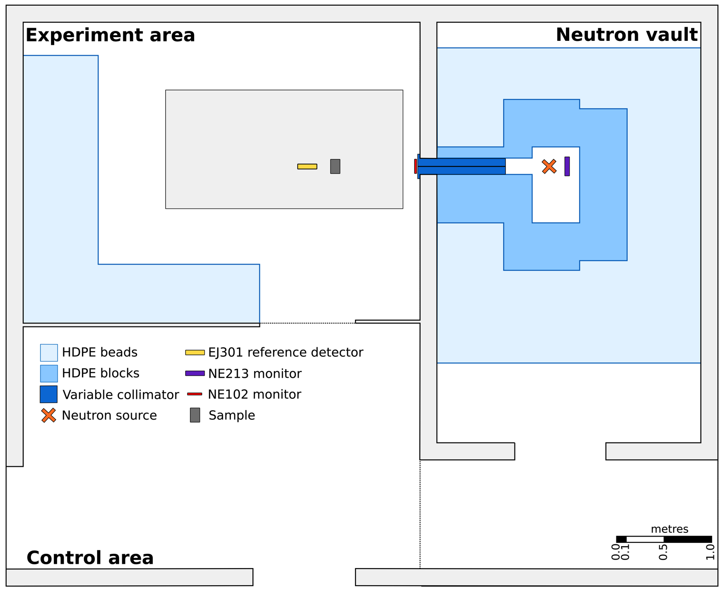
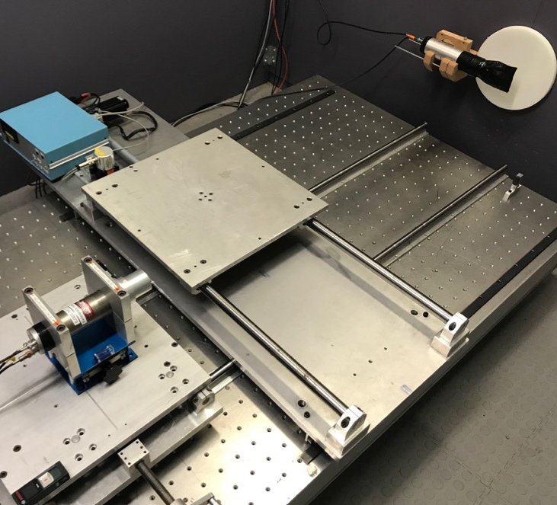
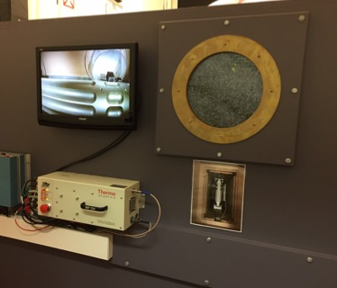
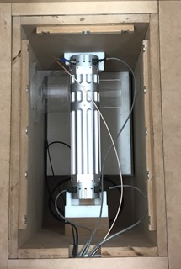
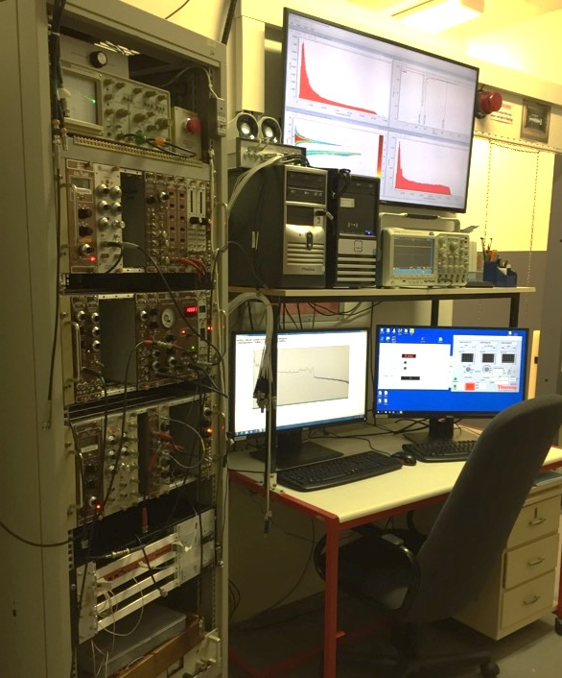
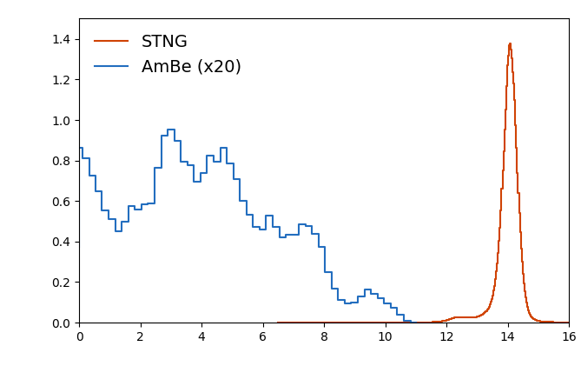
Fast neutron facility at UCT
 | STNG | AmBe
Type | Accelerator | Radioisotopic
Reaction | t(d, n)a | ⁹Be(a, n)¹²C*
Energy | 14.1 MeV | < 11 MeV
Yield | 10⁸ s⁻¹ | 10⁷ s⁻¹
Fluence rate (cm⁻²s⁻¹)
Neutron energy (MeV)

Slide 8
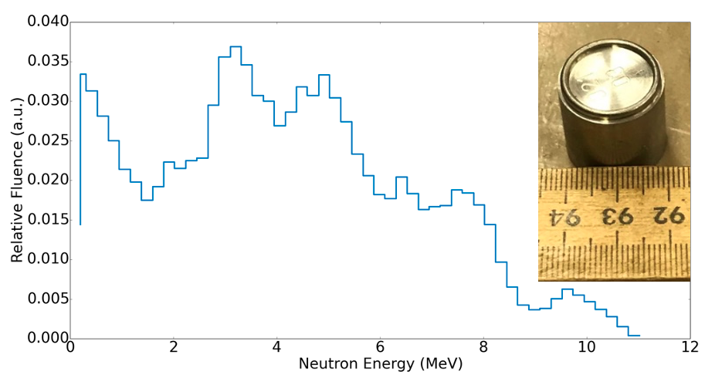
neutron
source
sample
detector
analysis
220 GBq ²⁴¹Am-⁹Be radioisotopic source
Neutron beams produced with HDPE collimator (∅ 0.8 cm)
Neutron fluence rates of 40 cm⁻² s⁻¹ at 1.50 m

Slide 9
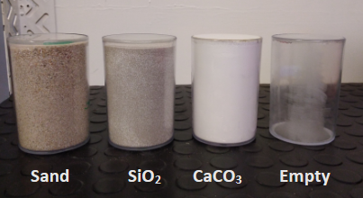
neutron
source
sample
detector
analysis
Sample | $ρ$ $[$g cm⁻³]
Sand | 1.53 ± 0.03
SiO₂ | 1.26 ± 0.03
CaCO₃ | 0.693 ± 0.029
Sample container has dimensions of 6.2 (b) $×$ 6.6 (t) $ϕ×$ 10.0 cm
8

Slide 10
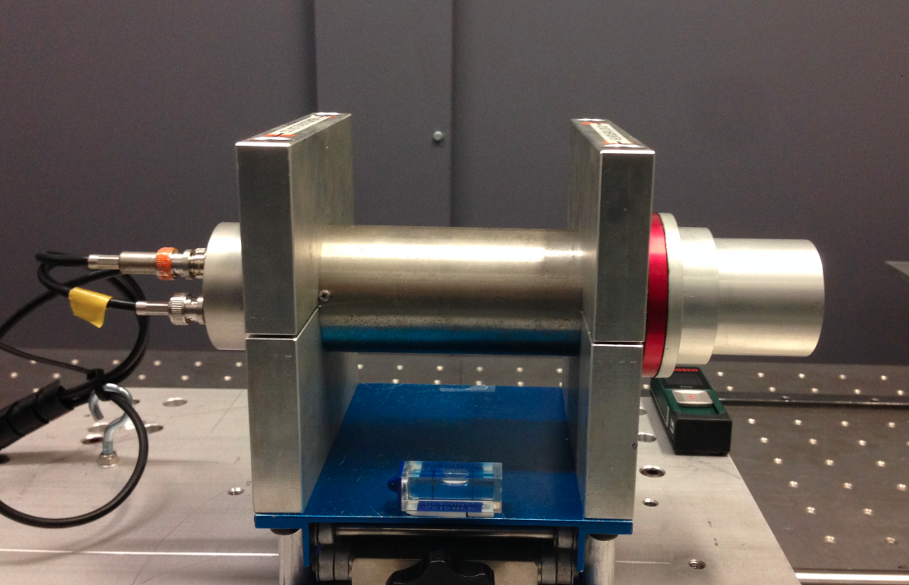
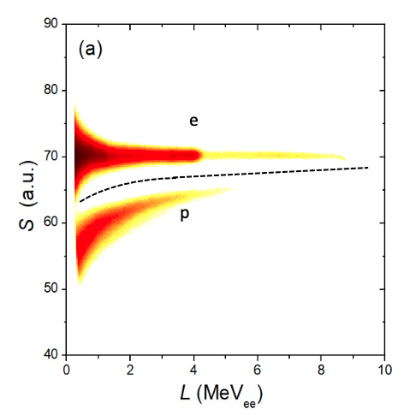
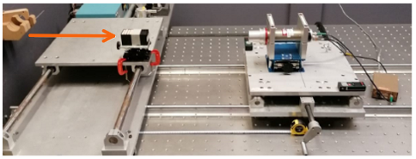
neutron
source
sample
detector
analysis
EJ-301 reference detector
2”x 2” organic liquid scintillator
Well characterised
Pulse shape discrimination to exclude gamma rays
Digital data acquisition and pulse processing (QtDAQ)
neutrons

Slide 11
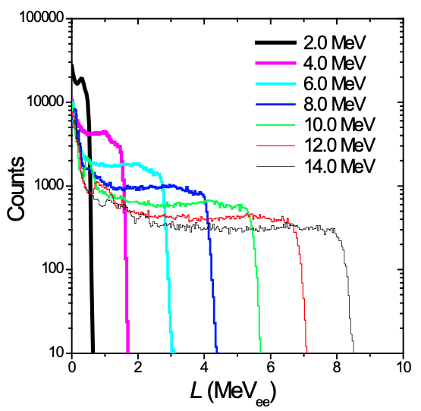
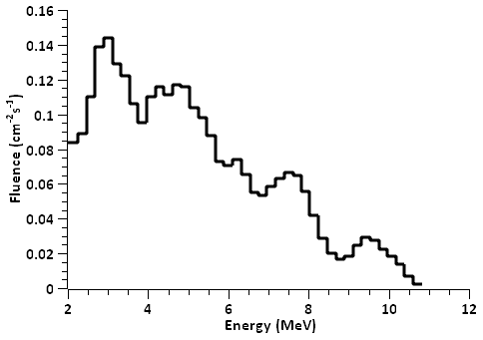
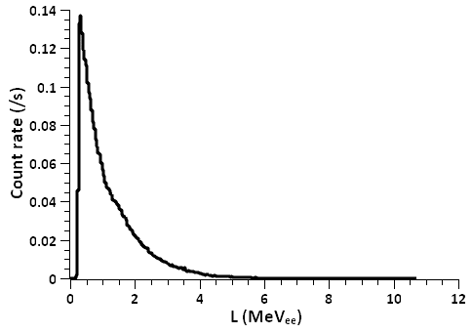
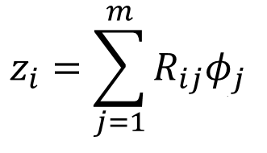
Spectrum unfolding
… is unfolded (GRAVEL) using detector response functions…
Measured pulse neutron height spectrum…
… to produce neutron energy spectrum

Slide 12
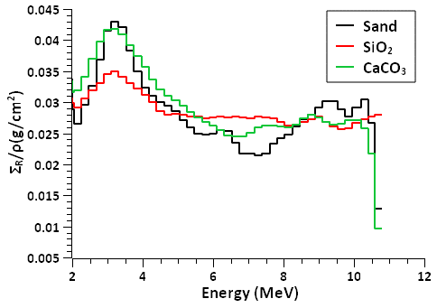
Measurements with sand
Neutron energy
unfolded
with GRAVEL
Energy dependent
removal cross sections
$$\frac{φ(t)}{φ_{0}}=e^{−Σ_{R}t}$$

Slide 13
Measured sand
Sand is made up of 78.5 % SiO₂ and 18.6 % CaCO₃ with the remaining 2.9 % consisting of other oxides
$${Σ_{R}}/ρ=\sum_{k=1}^{n}{m_{k}{Σ_{R,k}}/{ρ_{k}}}$$

Slide 14
FLUKA simulations
Simulate the energy dependent neutron fluence transmitted through sand, $SiO_{2} and CaCO_{3}$
Source:
²⁴¹Am-⁹Be
neutron
source
Detector:
$$r=5.0 cm$$
Energy dependent
neutron fluence
Sample:
t= 10.0 cm, r= 5.0 cm
Sample | $ρ$(g cm⁻³)
SiO₂ | 1.42
CaCO₃ | 0.372

Slide 15
Simulated ${Σ_{R}}/ρ$
Preliminary simulation results for all three samples.

Slide 16
Simulated sand
Known ratios were applied to simulated SiO₂ and CaCO₃ .

Slide 17
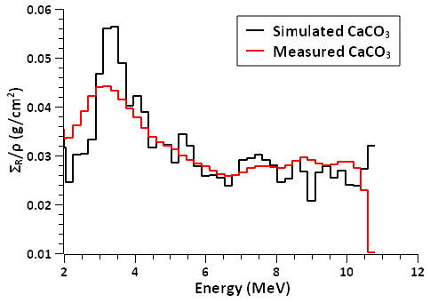
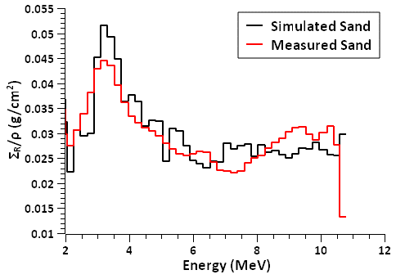
Results
Overall shape is well matched between simulation and measurement.
Around the 3 MeV region, the enhancement due to O is consistent in
simulated and measured data.
Broadened features in measured data due to measurement process.

Slide 18
Summary
Non-destructive testing of concrete is crucial to nuclear industry.
Fast neutron transmission measurements for sand and its constituents were made.
Effective removal cross sections determined via measurement and simulation.
Preliminary investigations show good agreement between measured and simulated removal cross sections.

Slide 19
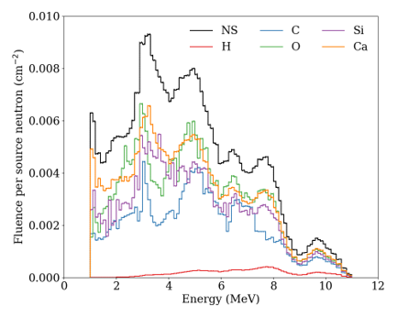
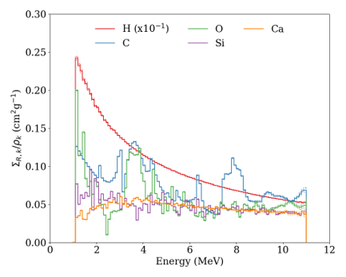
Next steps
More experimental validation is required to investigate the energy broadening in measured vs. simulated data.
Build a repository of elemental response functions.
Investigate elemental unfolding to determine mass ratios for known and unknown samples.

Slide 20
Thank you

