Slide 1
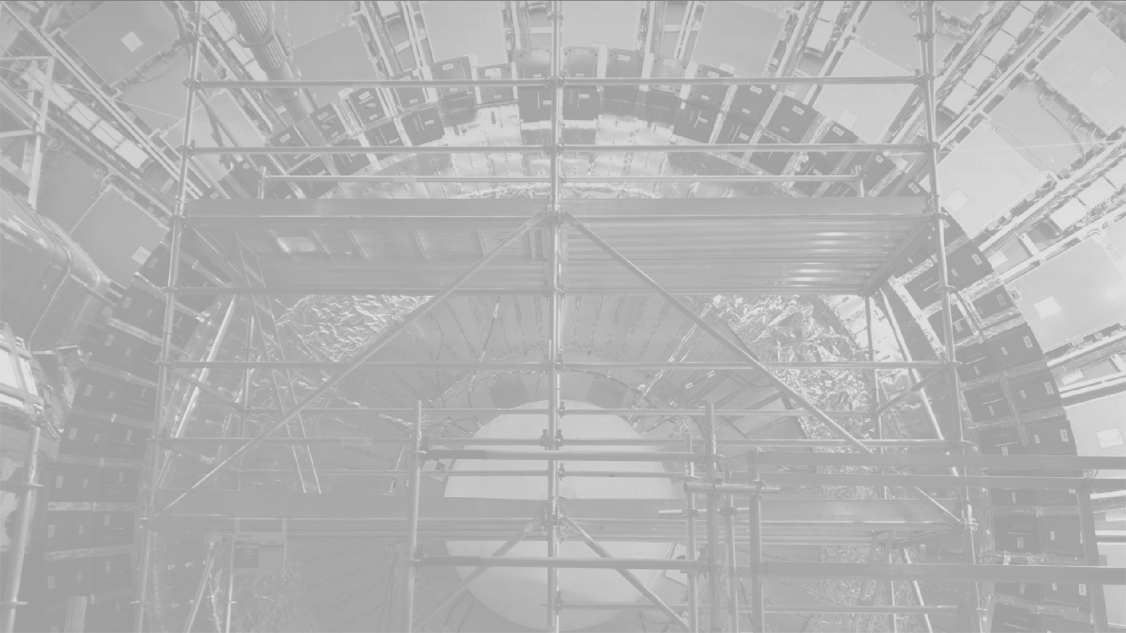
SA contribution to the ATLAS Tile Calorimeter Phase-2 Upgrade
Edward Nkadimeng, Ryan Mckenzie, Khathutshelo Phadagi, Thabo Pilusa, Mpho Gololo and Bruce Mellado
NRF iThemba LABS/ICPP
SAIP2023 Conference, UniZulu Richard’s Bay campus
3-8 July 2023

Slide 2
HL-LHC Timeline
‹#›

Slide 3
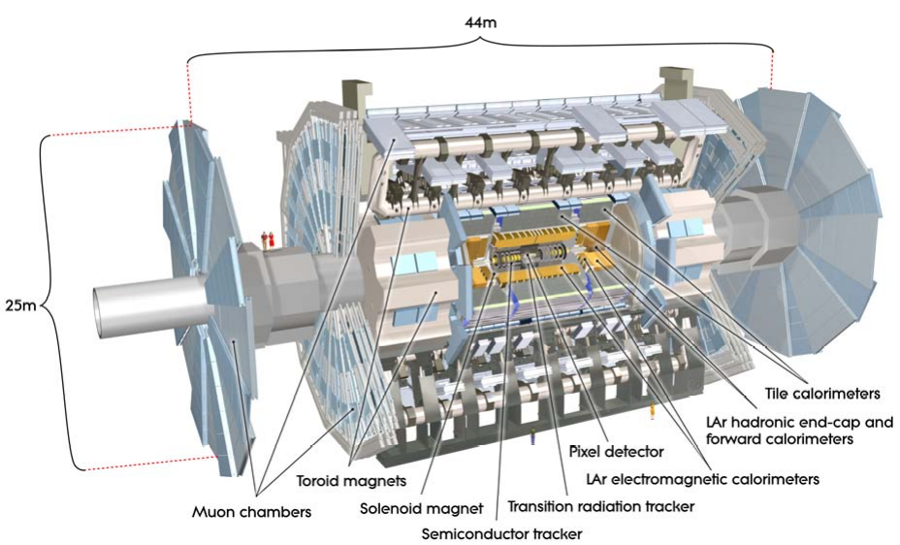
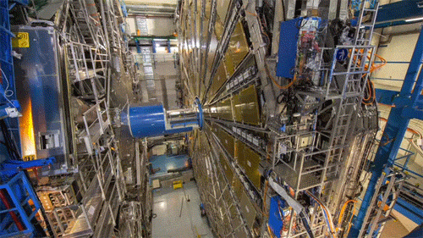
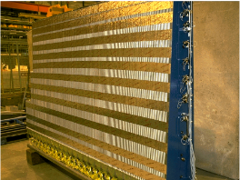
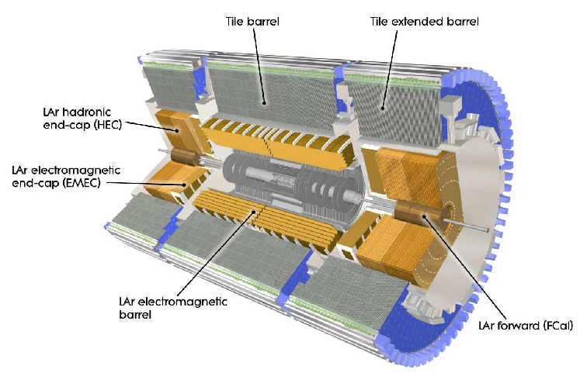
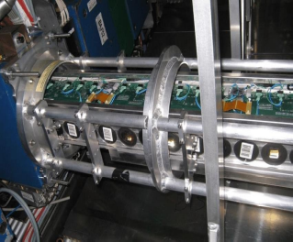
Context
256 modules in detector, ~10,000 readout channels.
Iron as absorber and plastic scintillator as active material.
ATLAS detector
Off detector electronics (PPr +TDAQi) (USA15)
LV distribution (Module ‘’ finger’’)
ATLAS Cavern
Laser system
TileCal barrel
Tile Calorimeter architecture
‹#›

Slide 4
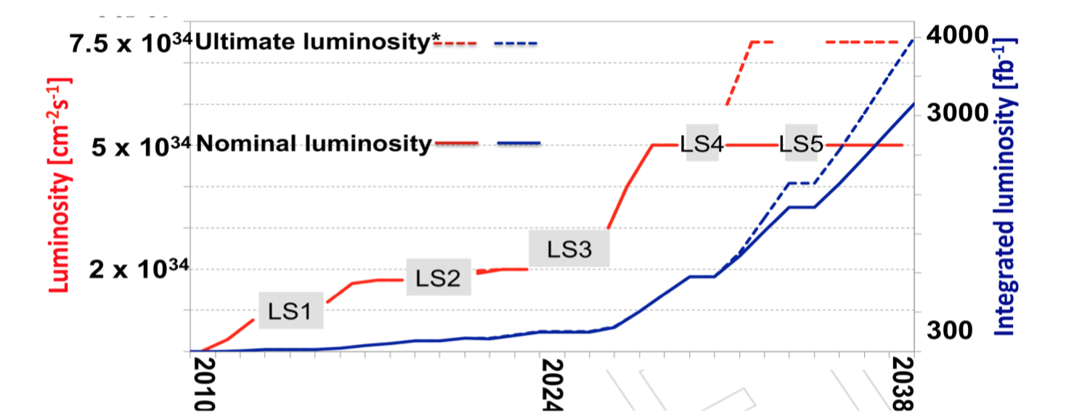
TileCal P2-Upgrade Project
Upgrade project contribution from SA institutions
There is a very wide physics program defined for HL-LHC: https://cds.cern.ch/record/2703572/files/94-87-PB.pdf
Community to work on replacing all electronics because of long‐term reliability with increased luminosity
Involves replacing all electronics and increasing the radiation hardness for handling a maximum total integrated radiation dose - ~480 Gy of TID, 4 x 10¹² n/cm² of NIEL and 2.5 x 10¹² p/cm² of SEE estimated over 15 years of operation.
Reliability is important, difficult access to detector!
ATLAS Tile Calorimeter Phase-II Upgrade Technical Design Report : https://cds.cern.ch/record/2302628/
Upgrade of Tile Calorimeter of the ATLAS Detector for the High Luminosity LHC Journal of Physics, DOI:10.1088/1742-6596/928/1/012024,2017.
‹#›

Slide 5
Read-out architecture
New readout strategy for HL-LHC
On-detector electronics will transmit full digital data to the off-detector electronics at the LHC frequency
WITS University/ iThemba LABS contribution
All on and off-detector electronics will be replaced.
24% of the production of the Tile Preprocessor (PPr)
Two of the boards within the PPr fully manufactured in SA
Contribute to fare-share share of FPGAs
South Africa’s contribution to the TileCal Phase-II Upgrade:
50% of the production of the Low Voltage Power Supply Bricks (LVPS)
Fully manufactured in South Africa
Fully tested in South Africa
‹#›

Slide 6
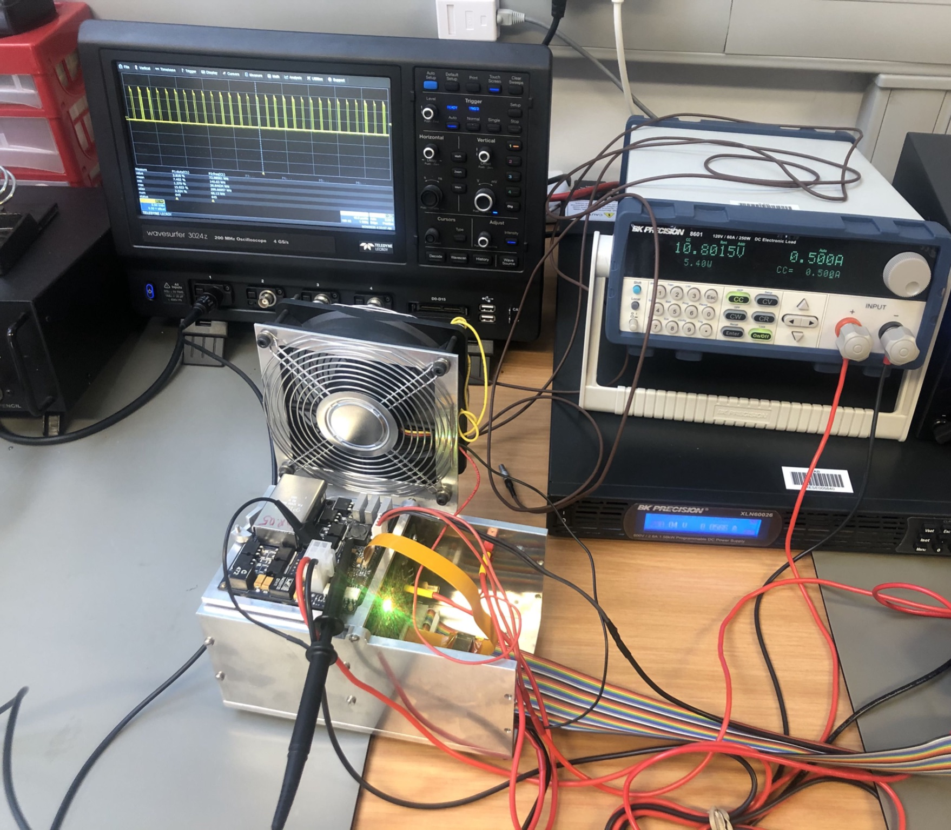
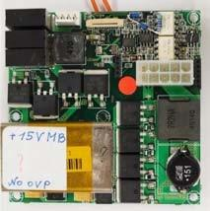
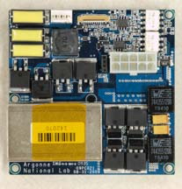
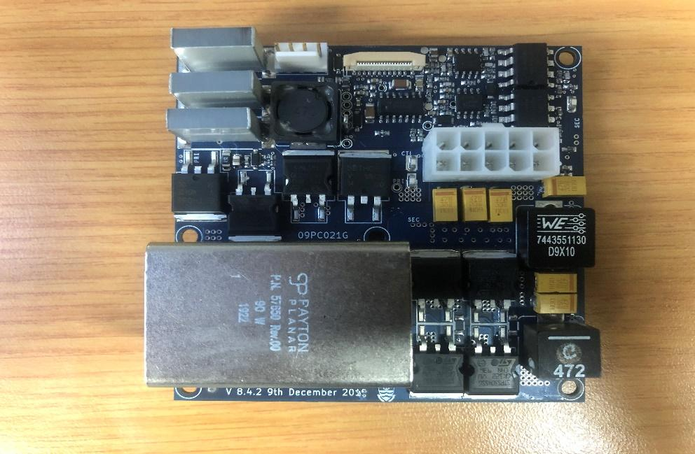
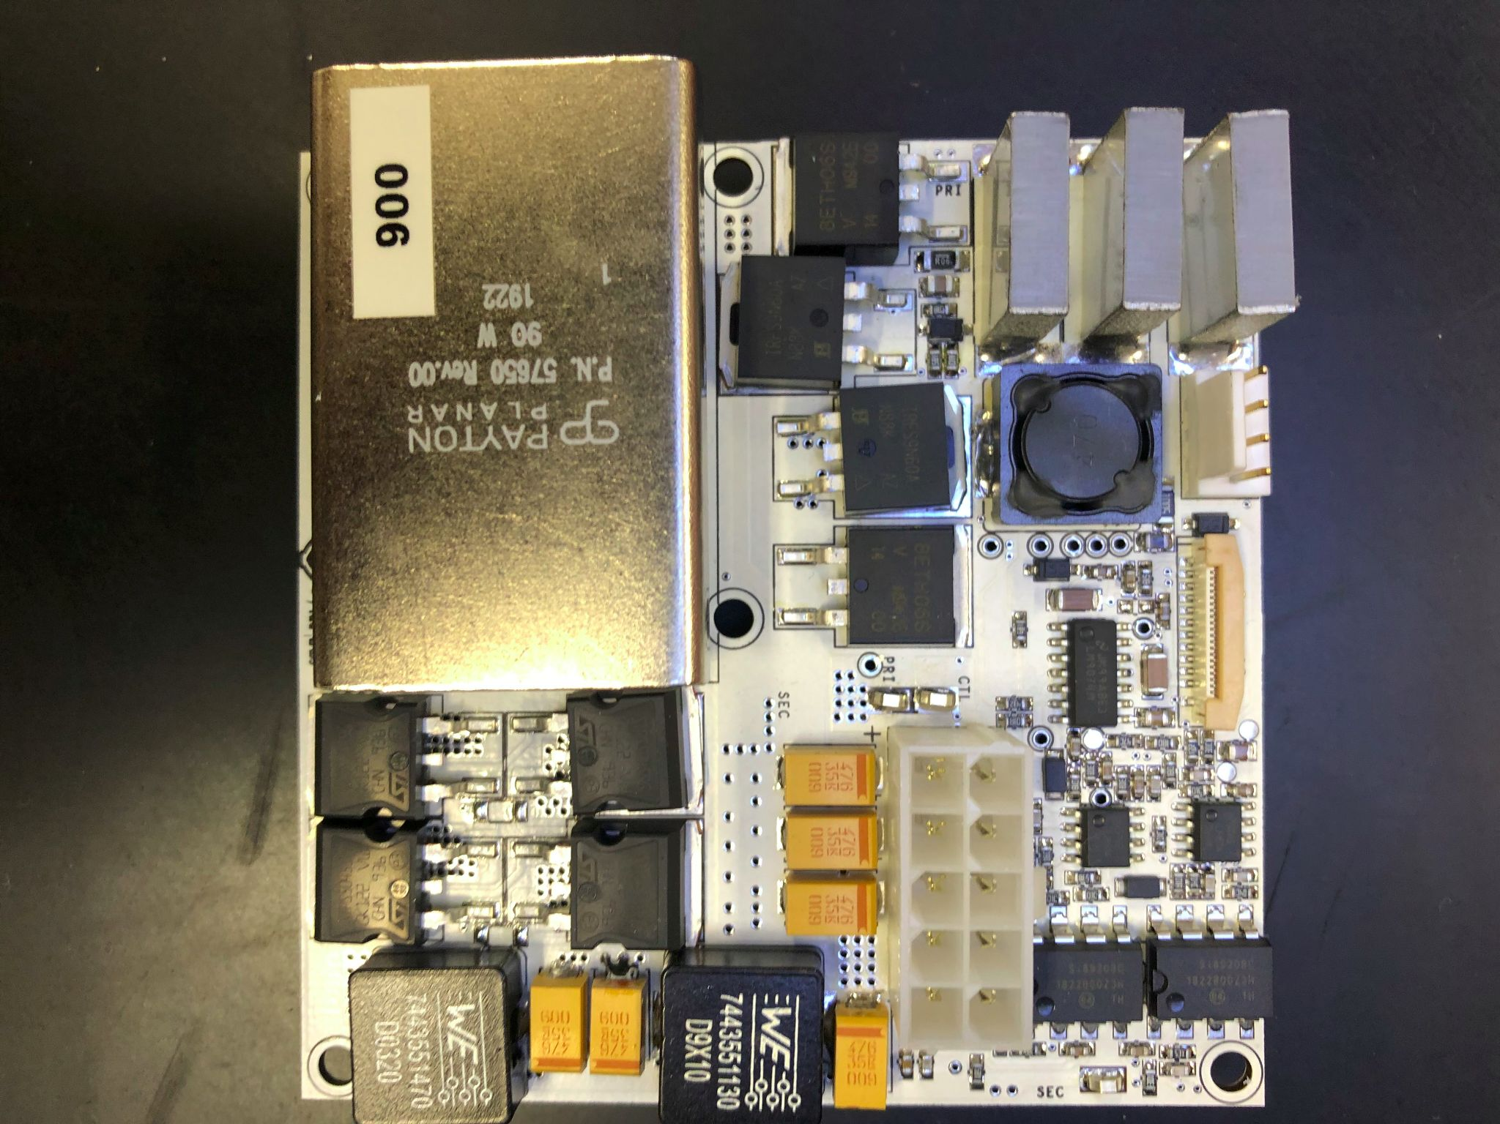
On-detector contribution
The Radiation environment on detector requires Rad- Hard DC-DC converters.
200 V_{DC} is transformed to 10 V_{DC} to power the Point of Load regulators on the on-detector electronics boards.
The DC/DC converters are controlled by custom made AUX_Board located in the underground counting room.
ELMB chip is used as CANbus interface to transfer monitored data.
There are strong constraints in terms of radiation tolerance, noise, power efficiency and reliability.
Features:
Customly built, compact,
Water cooled using Al2O3 components ;
10 V bricks, 2.3 A
Environment: Magnetic field; Radiation tolerant
Efficiency target: 75%
Original bricks to upgrade design
6.5.1 Original Brick
v 7.5 ANL brick
Old 8.1.0 WITS Prototype
‹#›
Last produced WITS Prototype 8.4.2

Slide 7
Radiation Criteria: ATLAS Radiation Policy
ATLAS Extraction Tool enables to locate the highest irradiated area, close to the edges of the Tilecal Long Barrel
Safety factors are introduced by the ATLAS Electronics Coordination Group as specified in Table below to account for error margins associated with the different types of radiation tests.
Safety Factors: SF_{sim} (Safety Factor on the simulation giving the Doses or Fluences) and SF_{lot} (Safety Factor corresponding to the variation from lot to lot of components)
General guidelines for radiation testing for ATLAS specify that 10 units be tested with actual load³.
Radiation Type | Location | Simulated Dose/ Fluence | SFsim | SFlot | Target Dose/ Fluence
TID [Gy] | Barrel | 53.6 | 1.5 | 5 | (321)
 | End-caps | 34.3 | 1.5 | 5 | (206)
SEE [p/cm2] | Barrel | 5.3 x 1011 | 1.5 | 2 | 4.24 x 10¹²
 | End-caps | 9.8 x 10¹⁰ | 1.5 | 2 | 7.84 x 10¹¹
3. ATLAS Radiation Policy: https://inspirehep.net/literature/1195265
‹#›

Slide 8
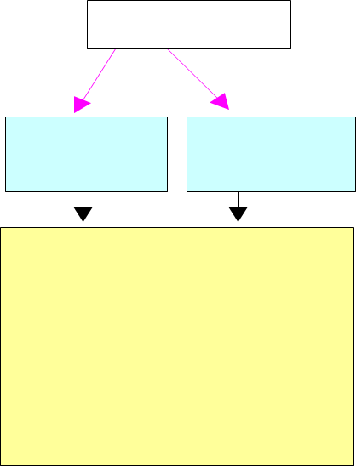
Radiation Testing
Component-level tests of single batch to find candidates with
No/acceptable degradation with Total Ionizing Dose (TID) & Neutron Ionizing event loss (NIEL)
As well as no catastrophic failures due to Single Event Effects (SEE)
Challenges
Huge number of (active) components to test and additional requirements i.e single lot components
Large variations in test conditions vs operating conditions
Availability of test facilities used for radiation testing of bricks: proton beams, gamma irradiation
Two types of SEEs: non-destructive and destructive:
Non-destructive, or soft, SEEs can be recovered by a system reset, re-programming/re-configuring the device or reprocessing of affected data.
When a device fails, destructive or hard SEEs occur, resulting in lasting device or system damage
Particle radiation
Ionizing & Non-Ionizing Dose
Single Event Effects
-Degradation of micro-electronics
-Degradation of optical components
-Data corruption
-Noise on Images
-System shutdowns
-Circuit damage
Testing for SEE/TID performed at Proton Irradiation Facility, PSI, Switzerland.
Potential to do the tests at iThemba LABS aswell with 200 MeV proton beam
‹#›

Slide 9
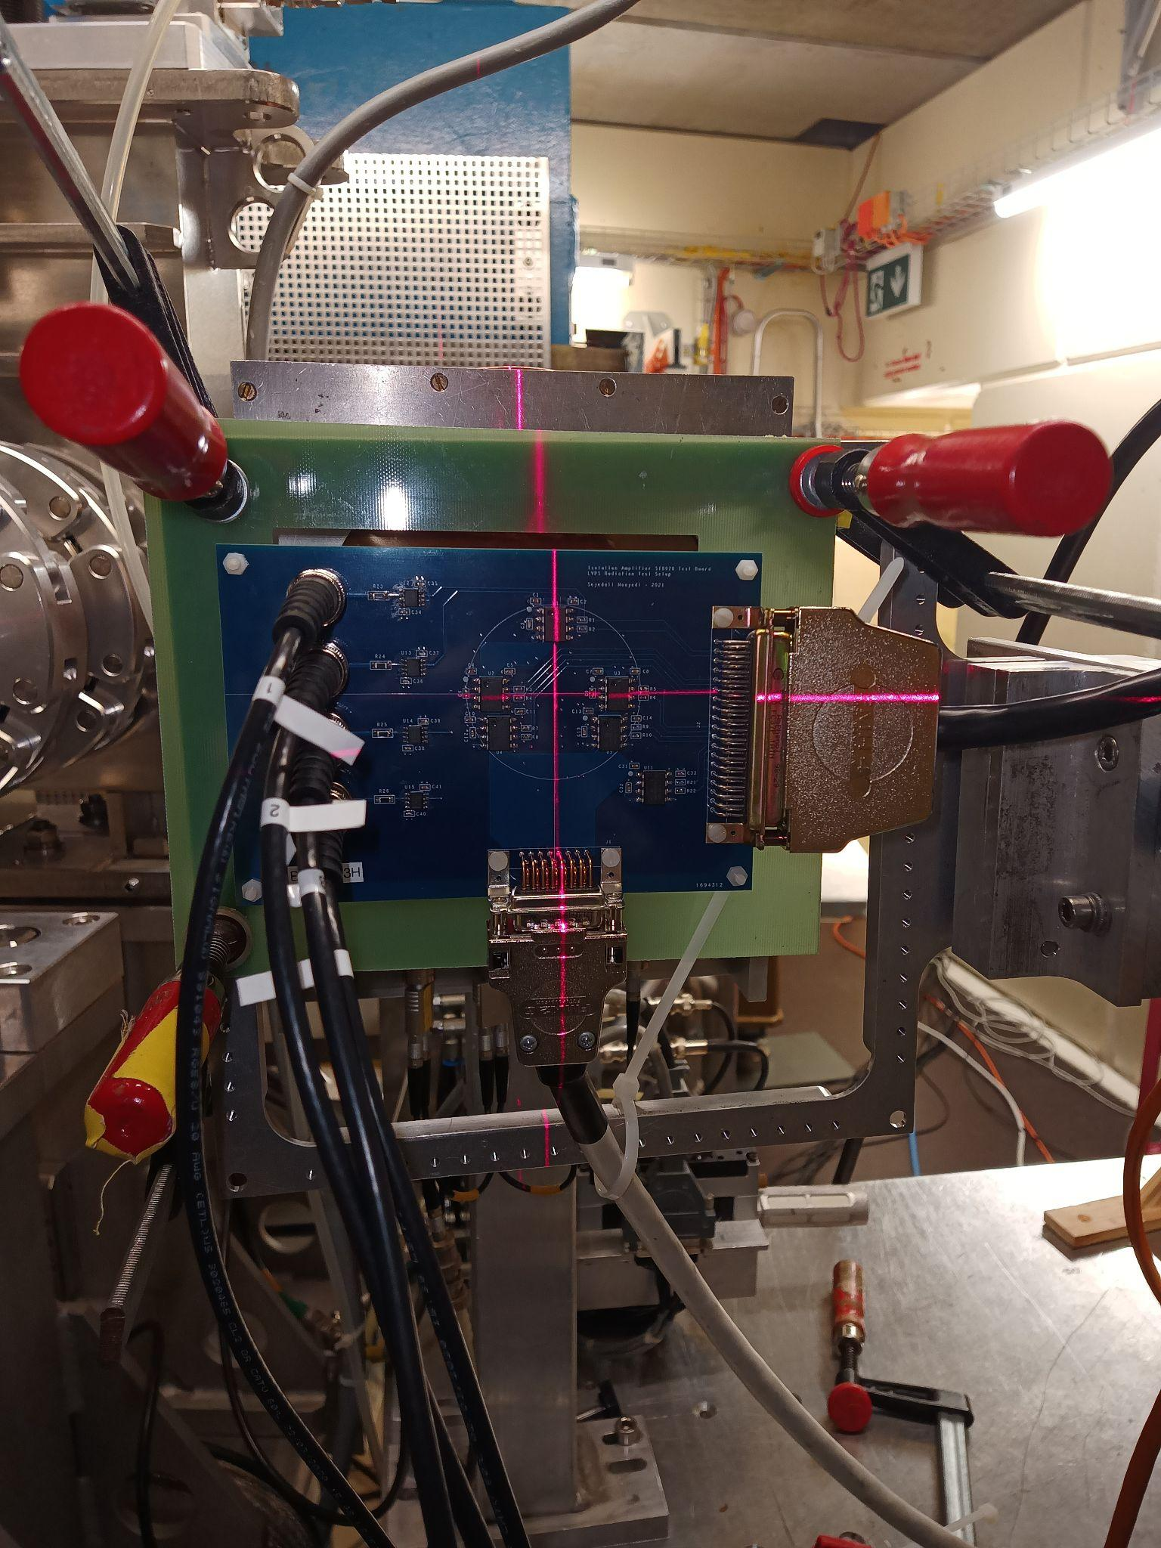
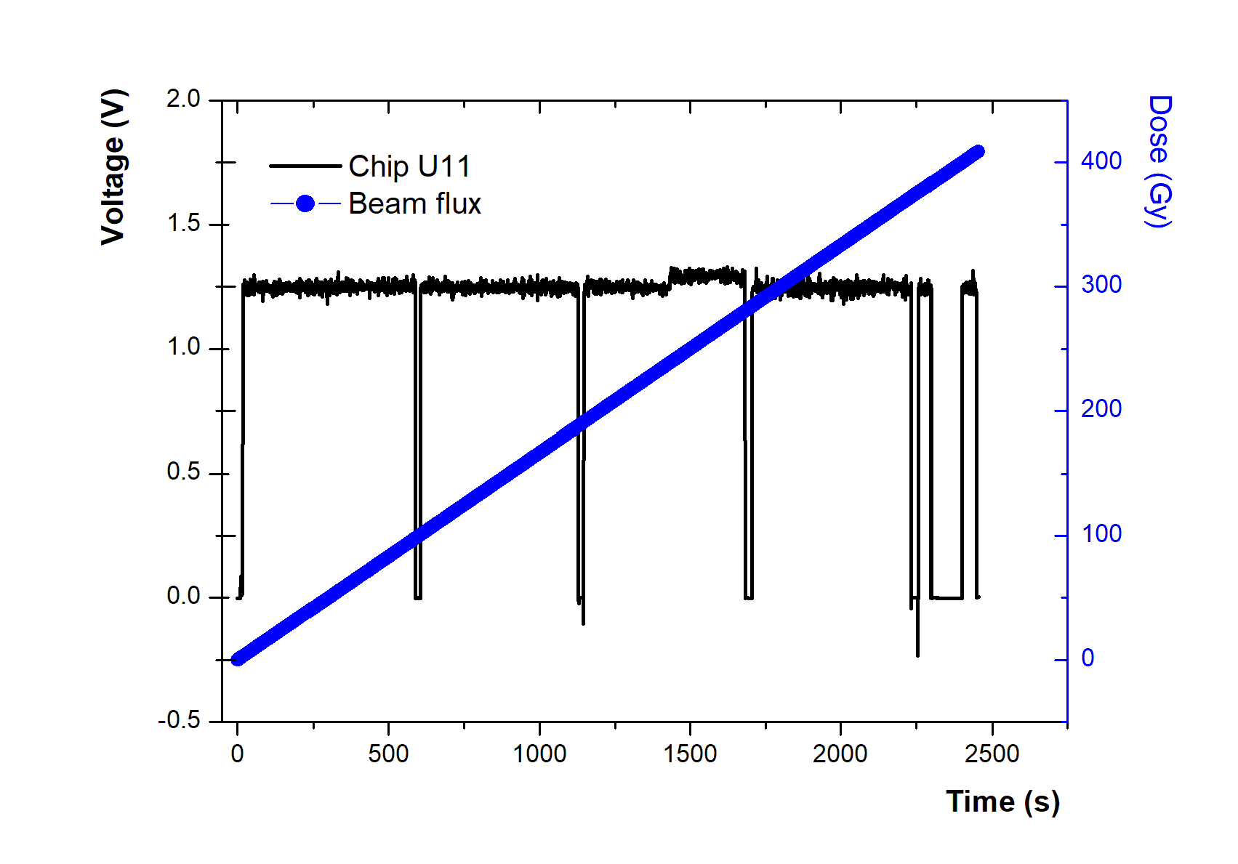
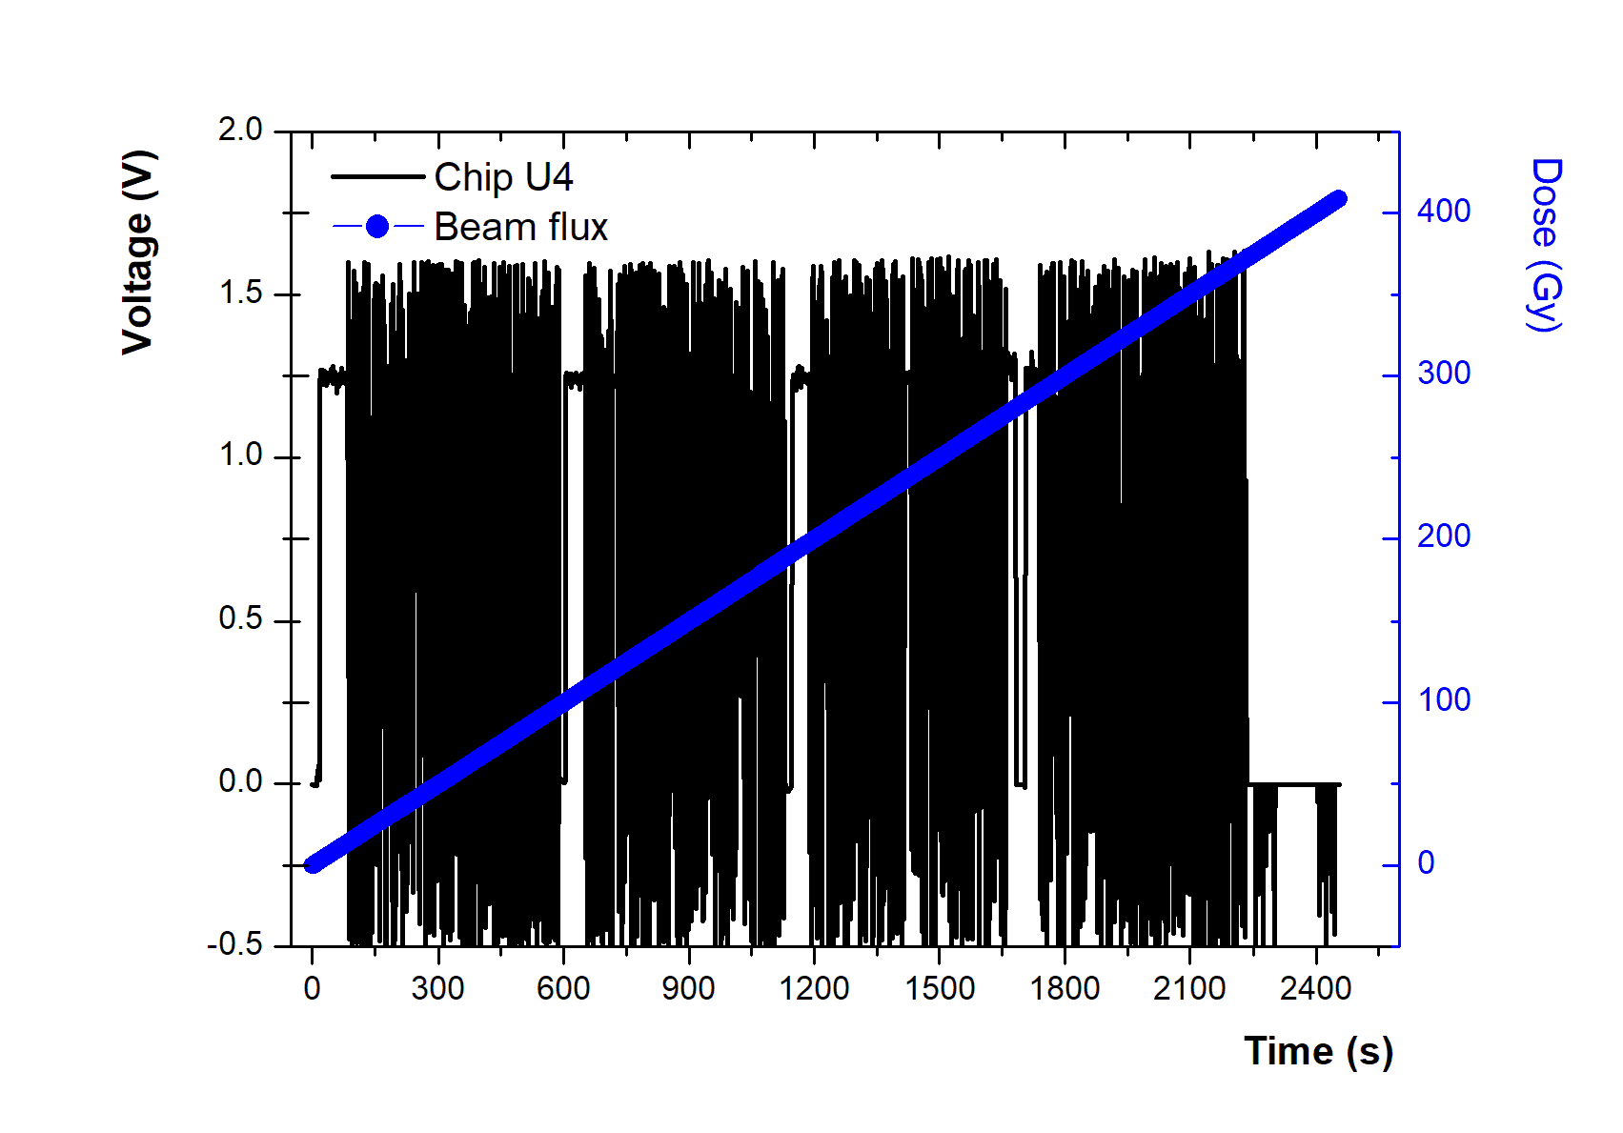
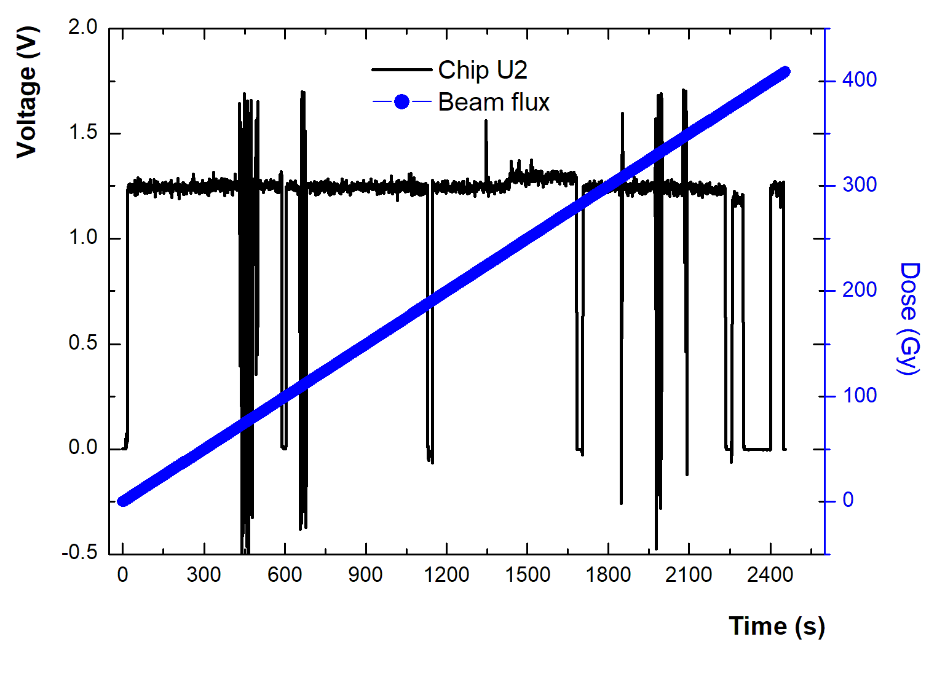
Selected radiation campaign
The tests were performed with 200 MeV proton beam with a flux of 3.5 x 10⁸ p/cm2/s
Each board was tested for around 30 minutes to reach 6.47 x 10¹¹ p/cm² (equivalent to 400 Gy)
The chip has a fixed gain of 8.1, and by setting an input voltage of 0.15 V on all the chips, we expected to have an output voltage of 1.22 V
The result will only focus on the SI8920 Isolation amplifier
Chip U11 is reference chip and Chip U2 and U4 were positioned in the path of the beam
ATLAS Work in progress
ATLAS Work in progress
ATLAS Work in progress
‹#›

Slide 10
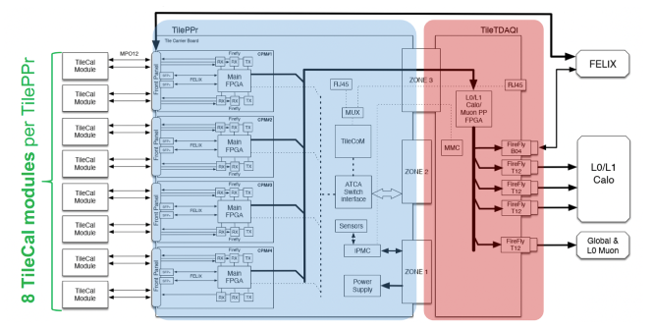
Off-detector contribution
32 ATCA blades.
ATCA blade will readout the detector, the TilePPr, consists of a carrier board with 4 Advanced Mezzanine Card, the Compact Processing Module CPMs
The TilePPr is controlled and monitored through the TileCom custom mezzanine.
A custom Gb ethernet switch provides the communication between the different components, the GbE.
These modules transmit timing and control to the On-detector electronics, process the data to compute energies and prepare trigger primitives for the Calorimeter
The Compact Processing Module processes from 2 modules
Compact Processing Module (CPM)
‹#›

Slide 11
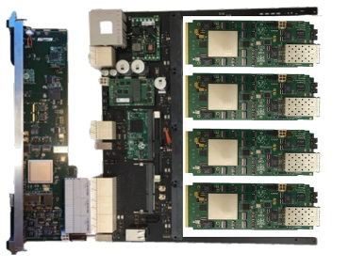
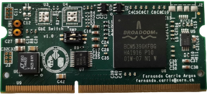
Off-detector contribution
First prototypes off-detector modules have been produced for pre-production in SA
CPM modules currently being tested during test beams
Tile GbE Switch and TileCoM boards – Produced by South African industry
PPr Final Design review planned for Q3 2023 after completing the integration test benches
(Communication between the CPM, TDAQi and FELIX systems ongoing) – More details in the back-up
‹#›

Slide 12
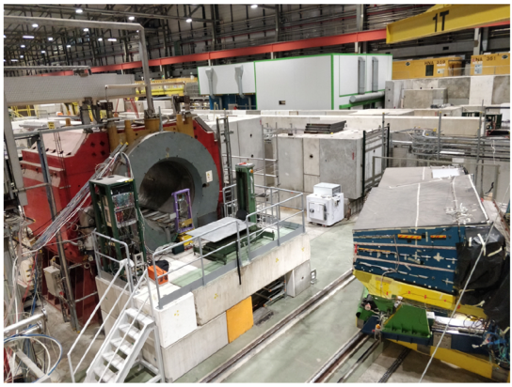
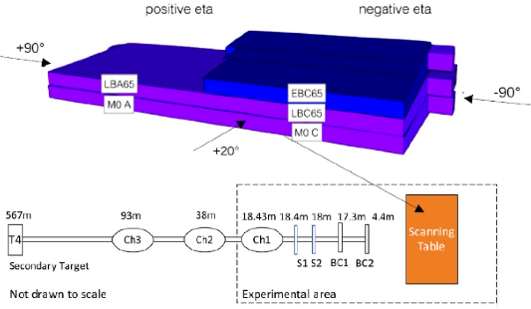
Upgrade electronics at Test-beam
12 beam test campaigns were performed in the SPS-H8 beam line between 2015 and 2023 to validate the hardware and perform physics studies
Different designs of the front-end electronics have been used over the years
The setup is partially equipped with new electronics, the remainder with the current electronics
We used electron, muon and hadron beams, of various energies and the detector positioned in different orientation
Cherenkov detectors, part of the beam instrumentation allow for particle ID
‹#›

Slide 13
Summary
The HL-LHC area will extend the detector lifetime by decades and bring new challenges:
A harsher radiation environment, higher pile-up, higher luminosity and read-out
For this we will replace all on- and off-detector electronics and 10% of the PMTs in LS3 (2026-2028)
Quality control testing at Wits ongoing and test benches are operable.
Regular test-beam campaigns throughout the project helped validate designs but also collect data to improve our understanding our detector and the physics underlying hadronic calorimetry.
E. Nkadimeng et al 2022 JINST 17 P07025
M.G.D. Gololo et al 2022 JINST 17 P06020
Supported by:
‹#›

Slide 14
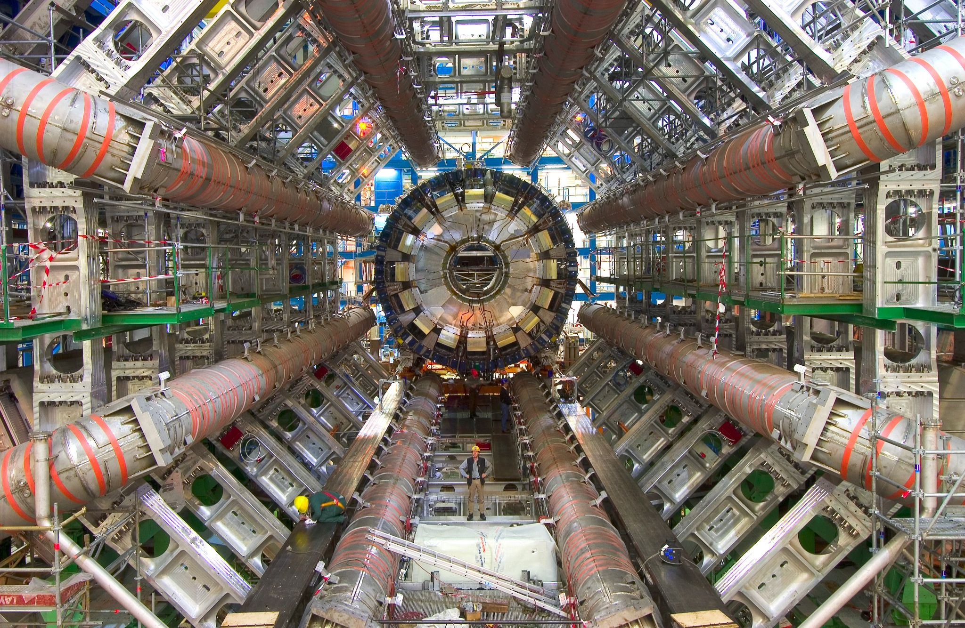
Thank You Very Much!
Email: edward.khomotso.nkadimeng@cern.ch

Slide 15
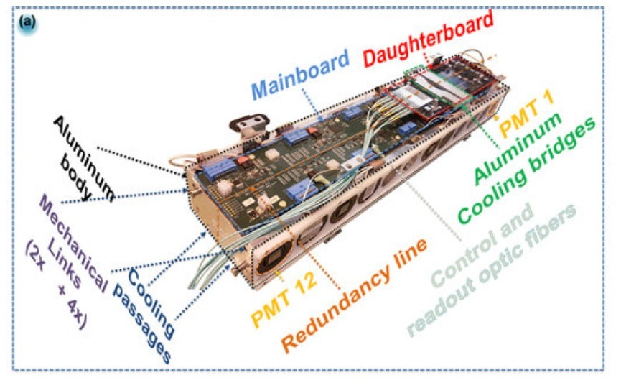
Read-out architecture
:
→ 40 Tbps to read out the entire detector
iThemba LABS/WITS University contribute to 50% of LVPS Bricks
on detector and test benches and 24% PPr boards for
off detector
ON-DETECTOR
OFF-DETECTOR (USA15)
Data buffering and transmission
Signal Signal conditioning conversion
Data formatting and transmission
System configuration and control LV distribution

Slide 16
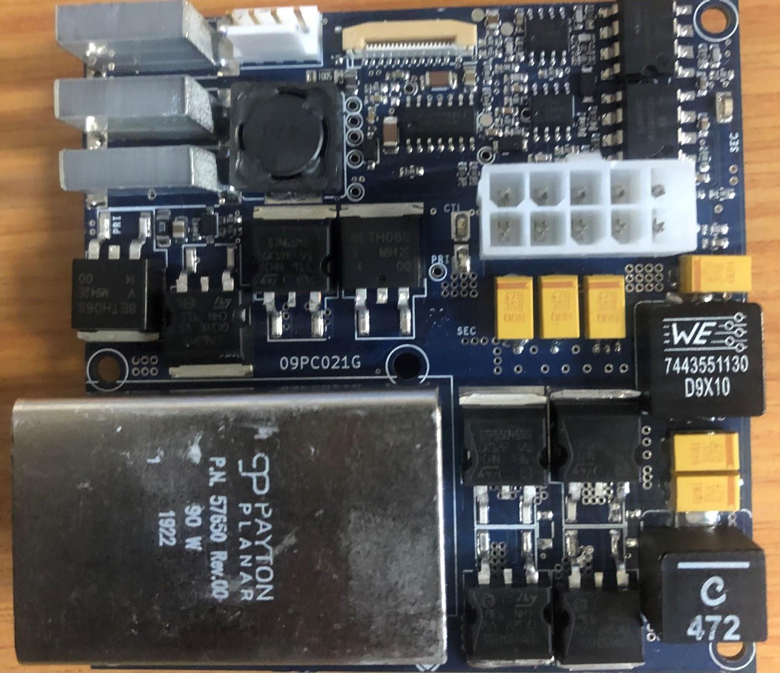
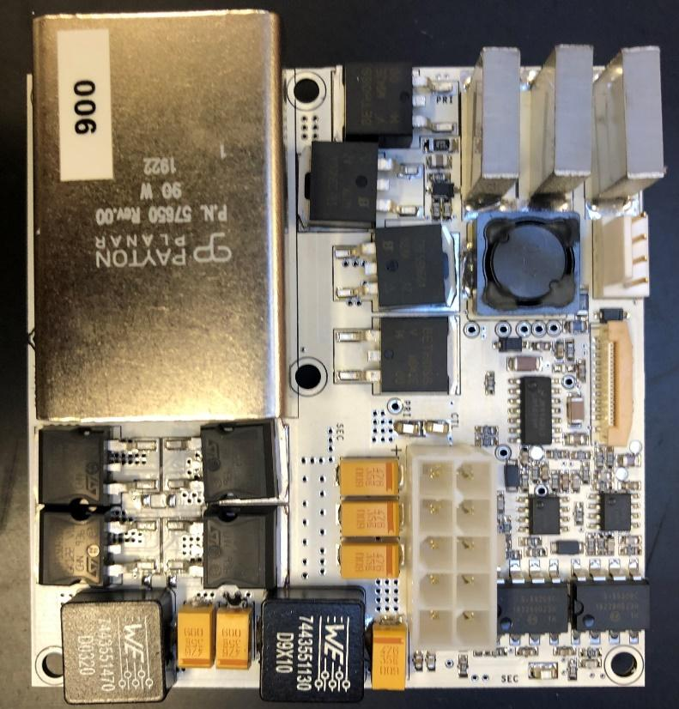
Latest brick production at WITS
PCB design v8.4.2 was used for the latest round of eight (8) bricks populated in SA.
Design changes include a different output inductor (736-2037, Wurth, WE-HCI,) and different MOSFET (RFS9N60APBF) as was identified in thermal testing undertaken at CERN, showed a brick efficiency increase from 55-60 % to 68-75%. (component still to be rad certified!)
14 thermal posts per brick used for heat transfer from components to the cold plate from which 8 are metalized and 6 non-metalized. For the latest iteration eight (8) bricks populated using purely Al2O3 ceramic cylinders.
MOSFETS: STB57N65M5
MOSFETS: IRFS9N60APBF
Inductor: 7443551470
Inductor: XAL1010-472MEB
Hybrid brick
High Efficiency brick
‹#›
ATLAS Upgrade Session | June 2021

Slide 17
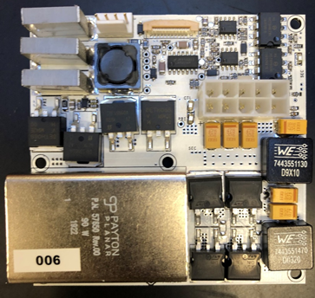
Pre-production plans
LVPS panel component assembly
LVPS brick

Slide 18
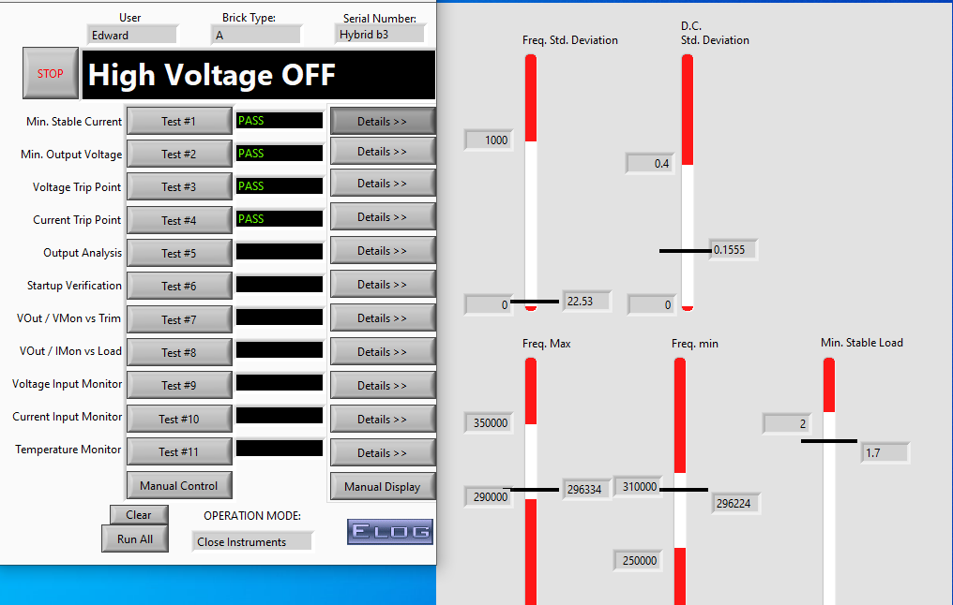
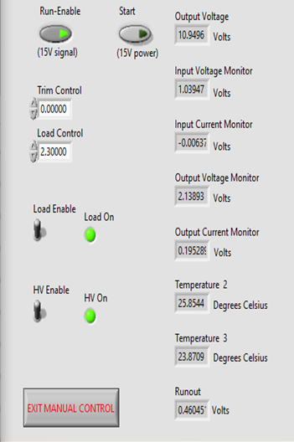
Testing of prototypes at Wits
Bricks were tested and monitored for ~15 minutes on 18/19 May ‘21, and all 8 bricks managed to start without issues.
‹#›

Slide 19
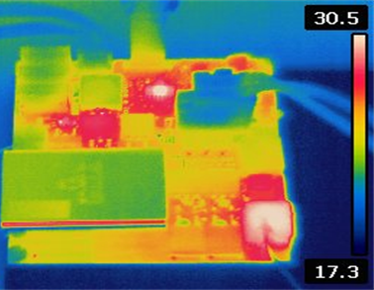
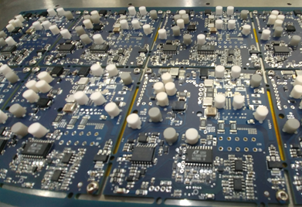
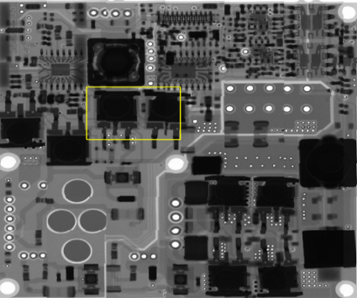
Brick Improvements thus far
Original Version
Improved
Reliability
Critical Issues
HF Printed circuit boards
Reliability studies conducted
Better thermal management (Still to be rad validated)
Better ESD protection of ICs and Capacitor
Thermal Image
Medium‐Impact Issues
Population of power supplies
Improved stability
Improved trip circuitry
Power sequencing
Fabrication and soldering quality from supplier
X-ray Inspection technology
Low critical but desirable
Start‐up pulse current
Improve monitoring circuitry
Reduce/improve tuning for final output Voltage
Improved Performance
‹#›

