Slide 1



Measurements of neutron response functions for a BC-501A liquid organic scintillator between 5 – 66 MeV at the iThemba LABS high energy neutron beam facility
Kutullo Maibaneª, Andy Bufflerª, Tanya Huttonª, Peane Maleka^{b}, Zina Ndabeni^{a,b}
ª Metrological and Applied Sciences University Research Unit (MeASURe), Department of Physics, University of Cape Town
^{b} iThemba LABS, Faure, Cape Town
67th Annual Conference of the South African Institute of Physics “SAIP” 03 – 07 July 2023, University of Zululand, Richards Bay Campus

Slide 2
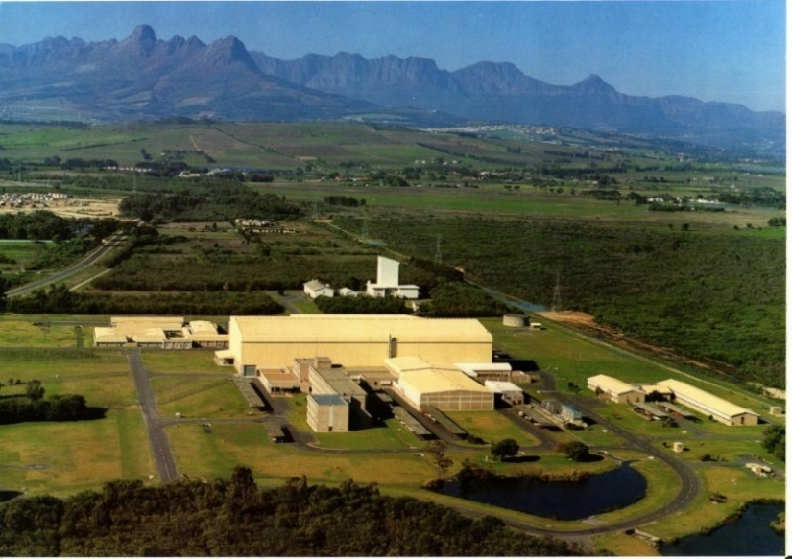
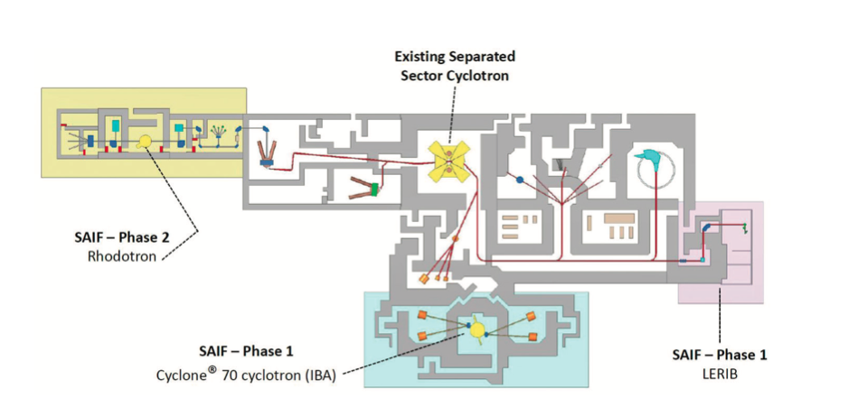
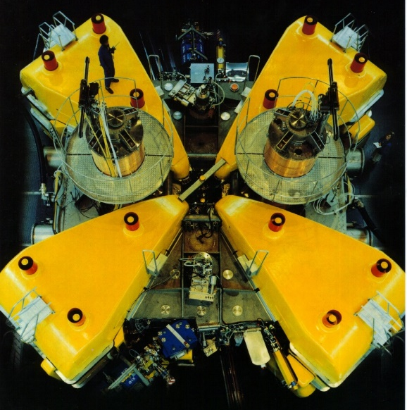
iThemba LABS: k = 200 Separated Sector Cyclotron
National Laboratory
Neutron Vault

Slide 3

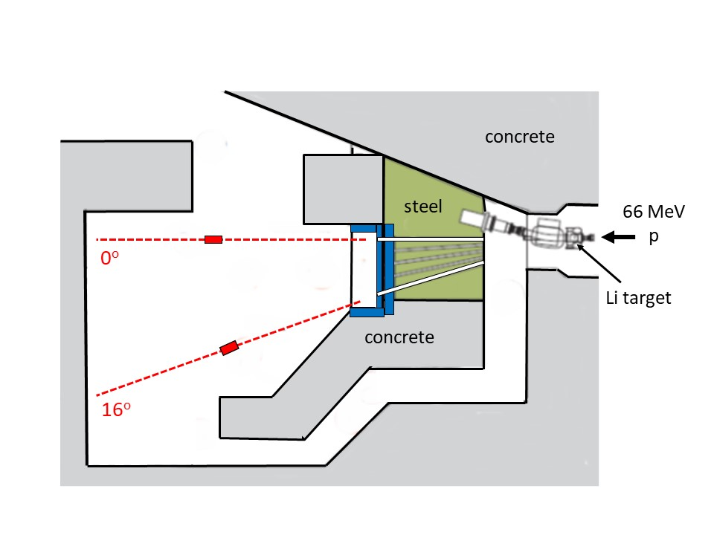




High Energy Neutron Facility at iThemba LABS
Towards an ISO-accredited
high energy neutron metrology facility
at iThemba LABS
continuum well supressed

Slide 4
  Fluence measurements with a ²³⁸U Fission Chamber
Gas flow tubes
Tantalum electrodes
Incident Neutrons
Tantalum window
  6 tantalum electrodes “90 mm diameter” with fissile materials on both sides - 76 mm sensitive diameter - 99.9823 ± 0.0001 % relative amount of ²³⁸U - 443 μg/cm² coating thickness of ²³⁸U - 3 kBq activity - 240.931 mg total mass of ²³⁸U

Slide 5
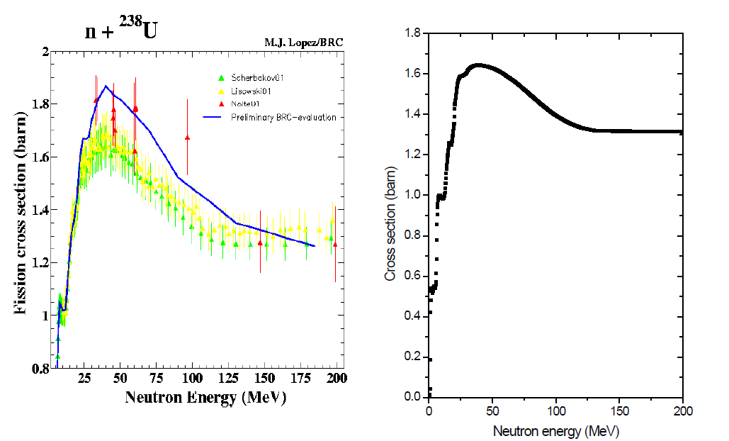
The fission reference cross-section (barn) for ²³⁸U(n,f)
63.5 MeV
[IAEA-NDS]

Slide 6
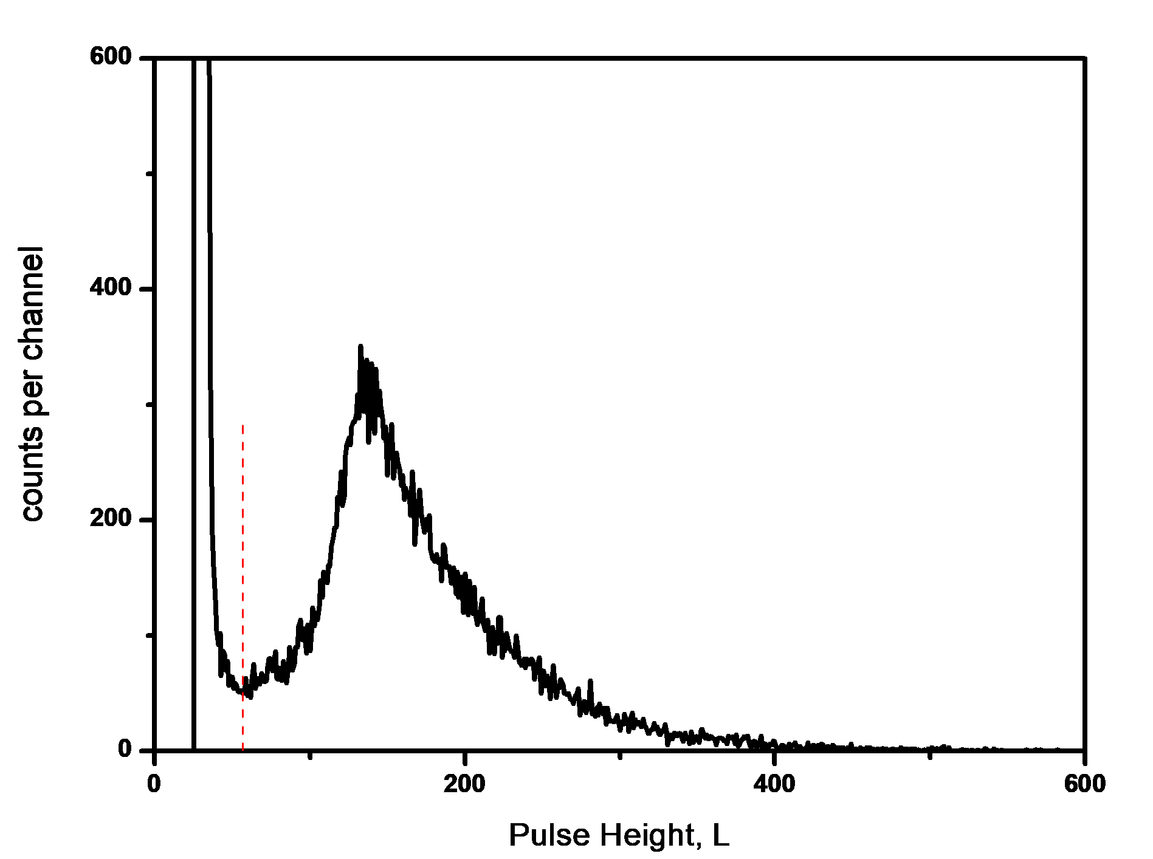
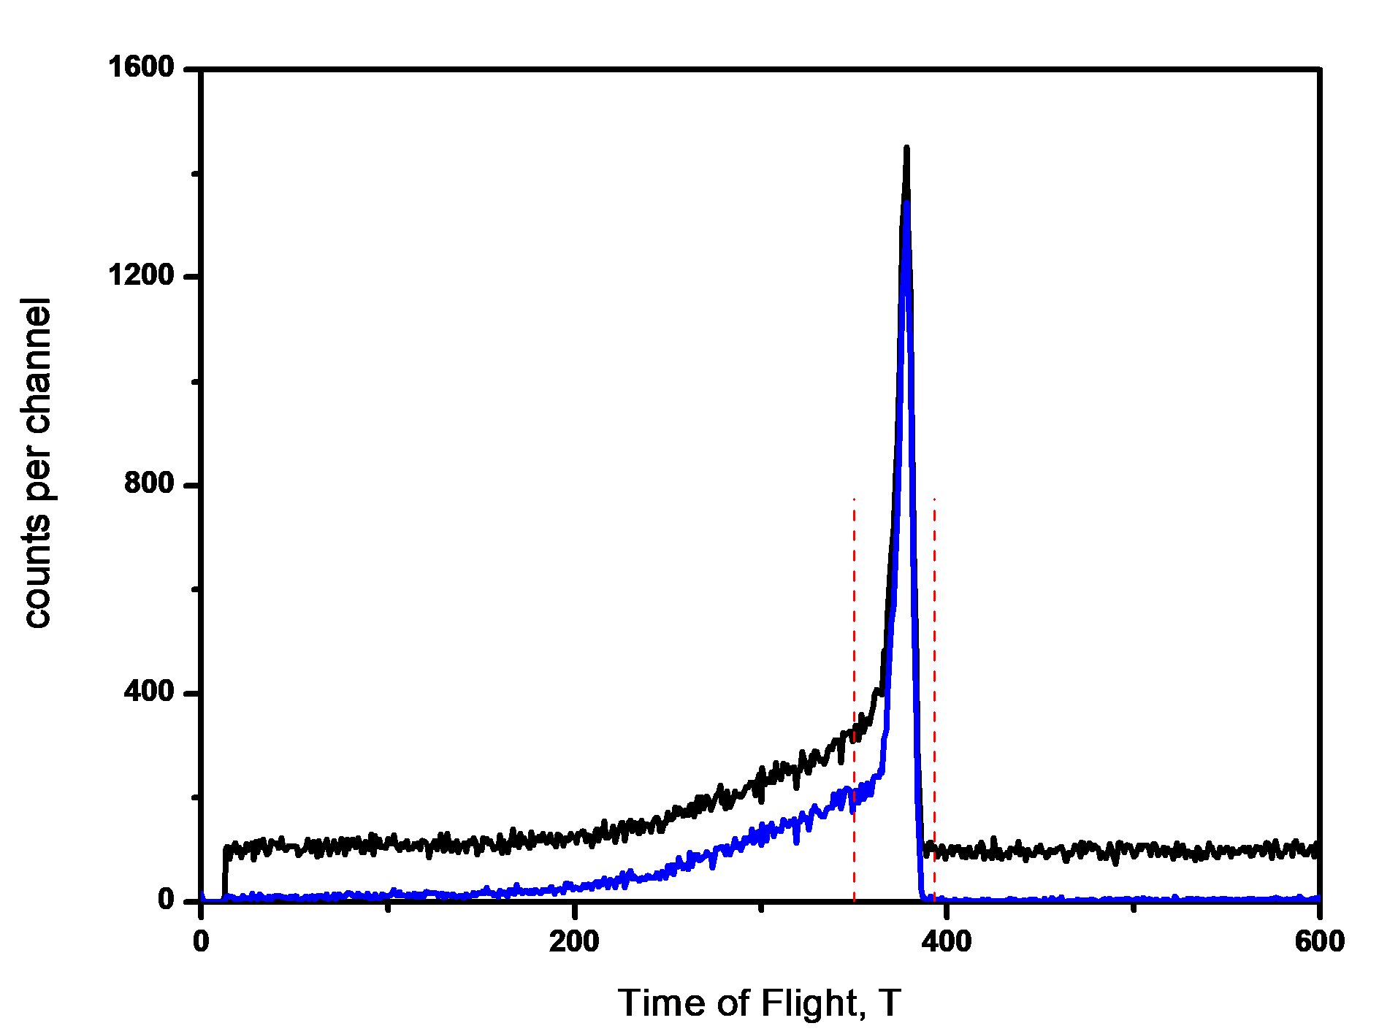

Fluence measurements using the ²³⁸U fission chamber at 66 MeV, 8.0 mm ^{nat}Li, @ 0º, d = 8.00 m
alpha events
fission events only
fission events
alpha events
Pulse Height spectrum of the ²³⁸U FC with the data cut applied to veto counts due to alpha events in the chamber
Corresponding Time of Flight spectra showing the effect of separating the time independent alpha scattering events from the fission events “blue spectrum”

Slide 7
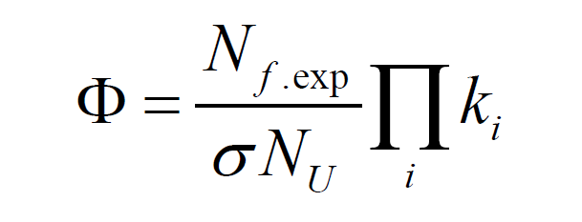

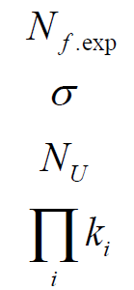
Peak Neutron Fluence
peak neutron fluence [unknown]
number of peak fission events (measured)
fission cross section (known quite well)
number of ²³⁸U atoms in FC (known very well)
correction factors for efficiency, neutron absorption and multiplication in the FC, loss of events below threshold, dead time, neutron attenuation in air, beam profile and time resolution
(together add about 5% to total uncertainty in fluence)

Slide 8
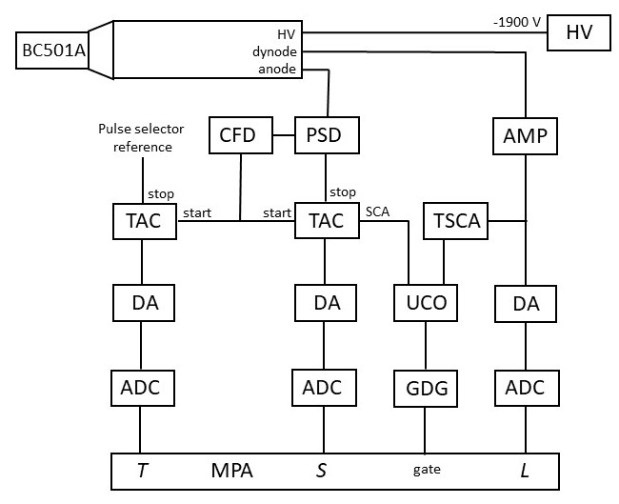
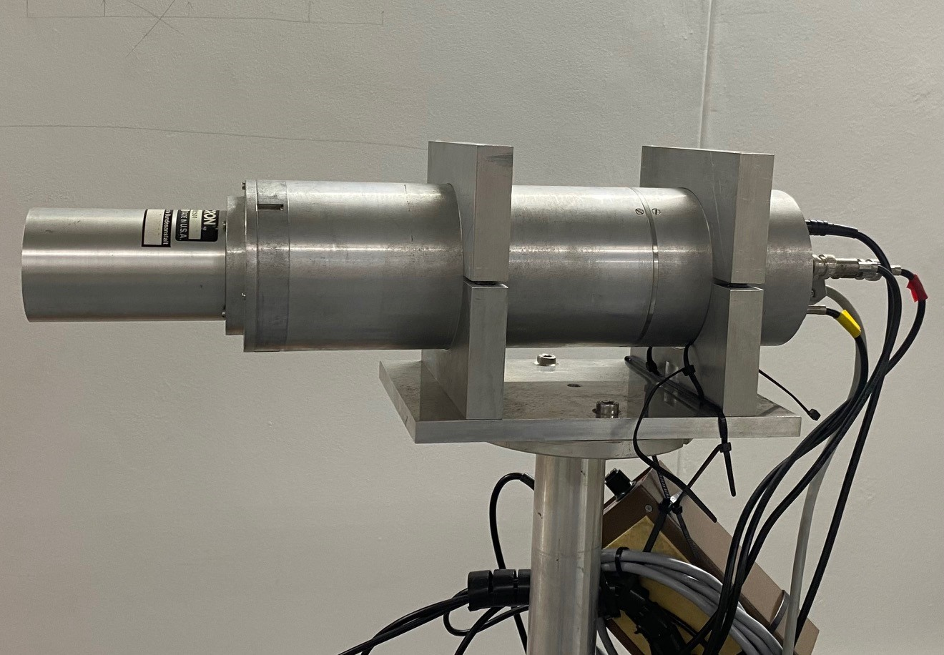
Neutron Spectroscopy: Time of Flight (ToF)
Liquid Scintillator: NE-213 / BC-501A / EJ-301
2” diameter x 4” length, gain-stabilised photomultiplier, neutron-gamma discrimination, time resolution 2 ns “FWHM”
Data are recorded in coincidence in list mode using the standard NIM-based acquisition system:
T: time-of-flight S: pulse shape L: pulse height

Slide 9
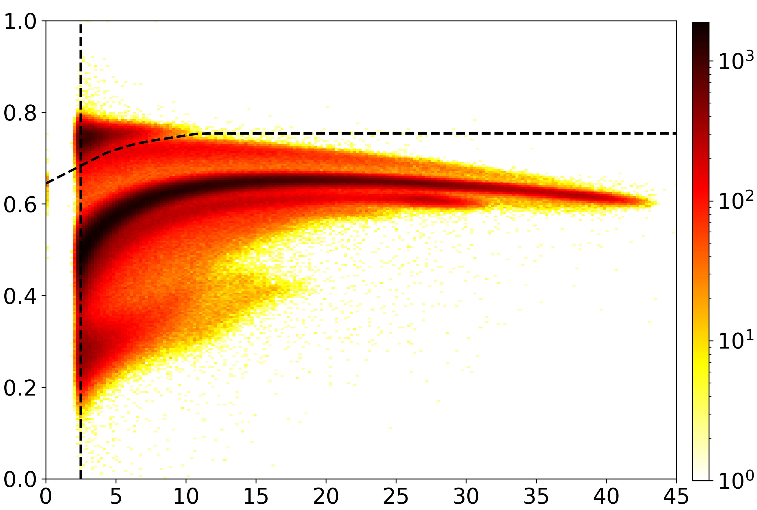
Neutrons and gamma-rays produced by a 66 MeV proton beam irradiating a 8.0 mm Li target, measured by a 2” x 4” BC-501A detector at 0º
gamma ray-induced events
e
t
d
p
Pulse shape S (arbitrary)
neutron-induced events
α
Ralf Nolte
Efficiency calculated with MC codes SCINFUL and MCNPX
Pulse height L (MeV_{ee})

Slide 10
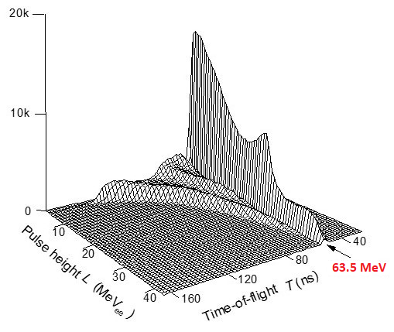
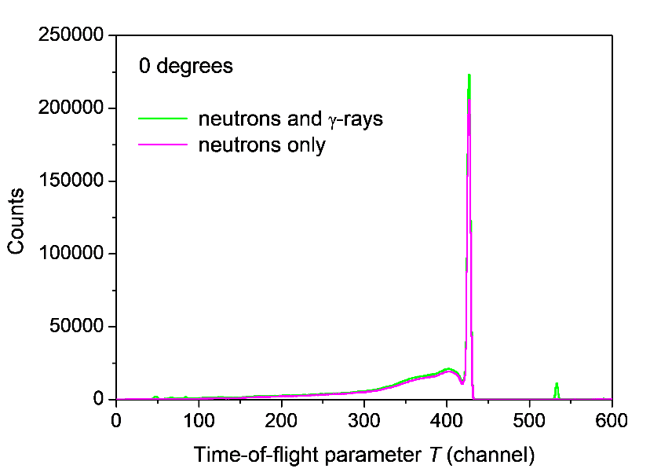
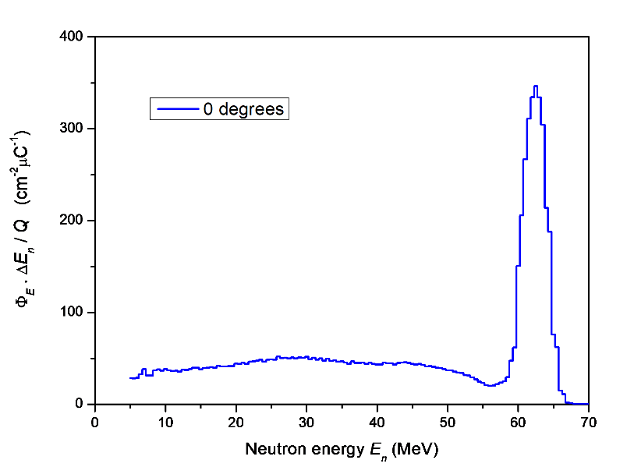
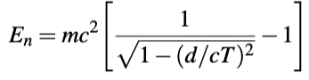

Time-of Flight measurement of neutrons produced by a 66 MeV proton beam irradiating a 8.0 mm ^{nat}Li target. (BC-501A at 8.00 m from the target at 0º)

Slide 11
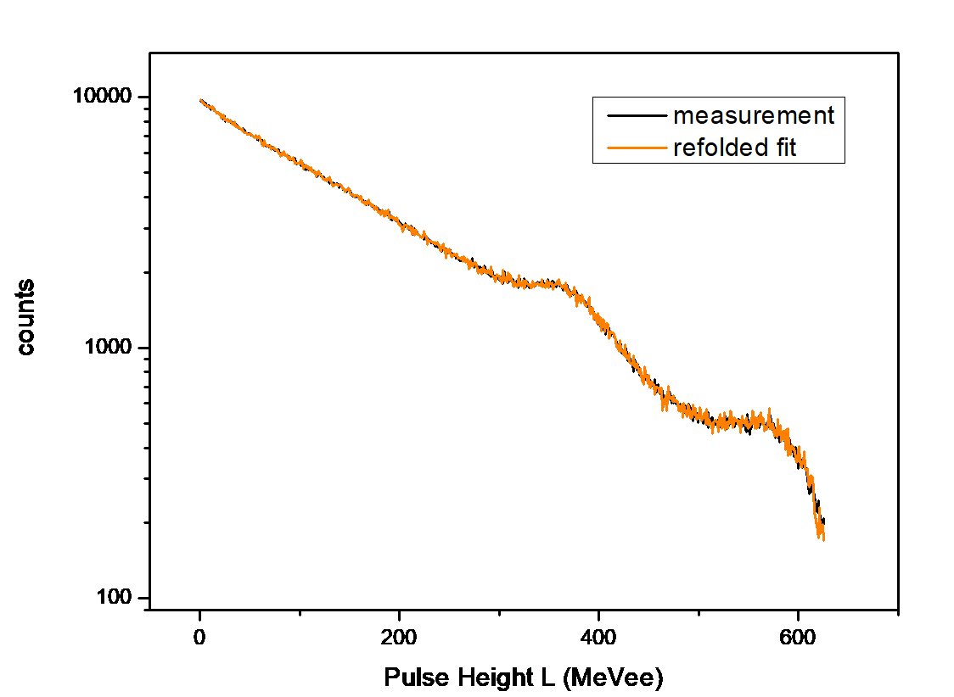
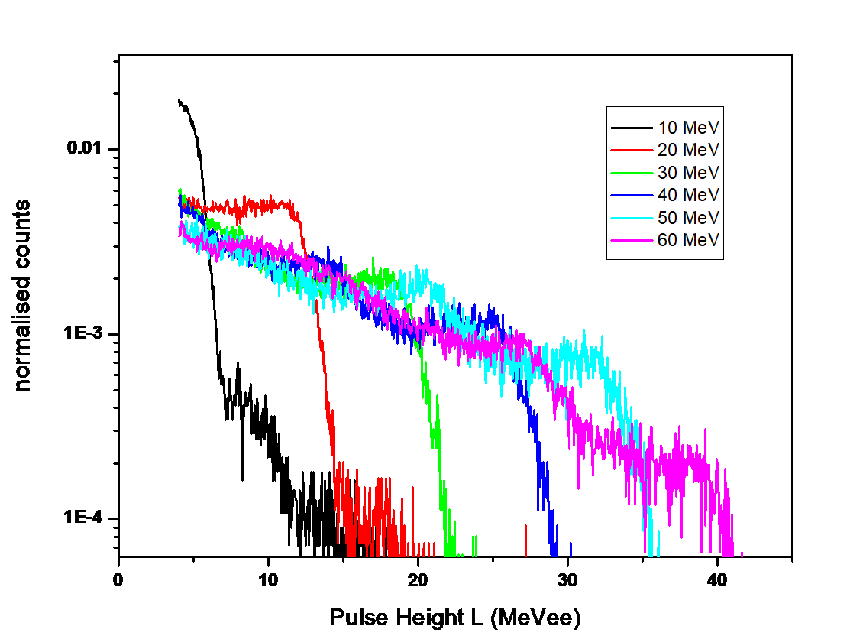
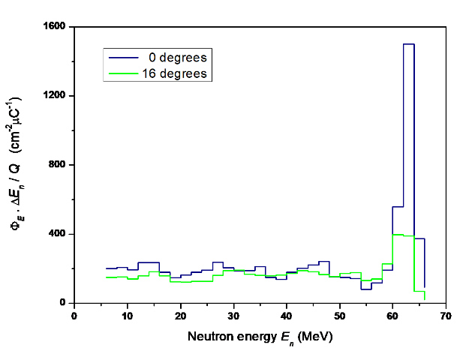

Neutron Spectroscopy: Unfolding
Measured neutron pulse height spectrum (channel i)
Detector response matrix (pulse height spectra for monoenergetic neutrons)
$$z_{i}=\sum_{j=1}^{m}{R_{ij}φ_{j}}$$
Neutron energy spectrum (bin j)
The full L-T matrix provides the data for selecting nearly monoenergetic pulse height (L) spectra as a function of neutron energy.
… is unfolded using a
known detector
response matrix …
measured neutron pulse height spectrum …
… to produce the neutron energy spectrum
UMG-3.3 unfolding package (GRAVEL & MAXED)

Slide 12
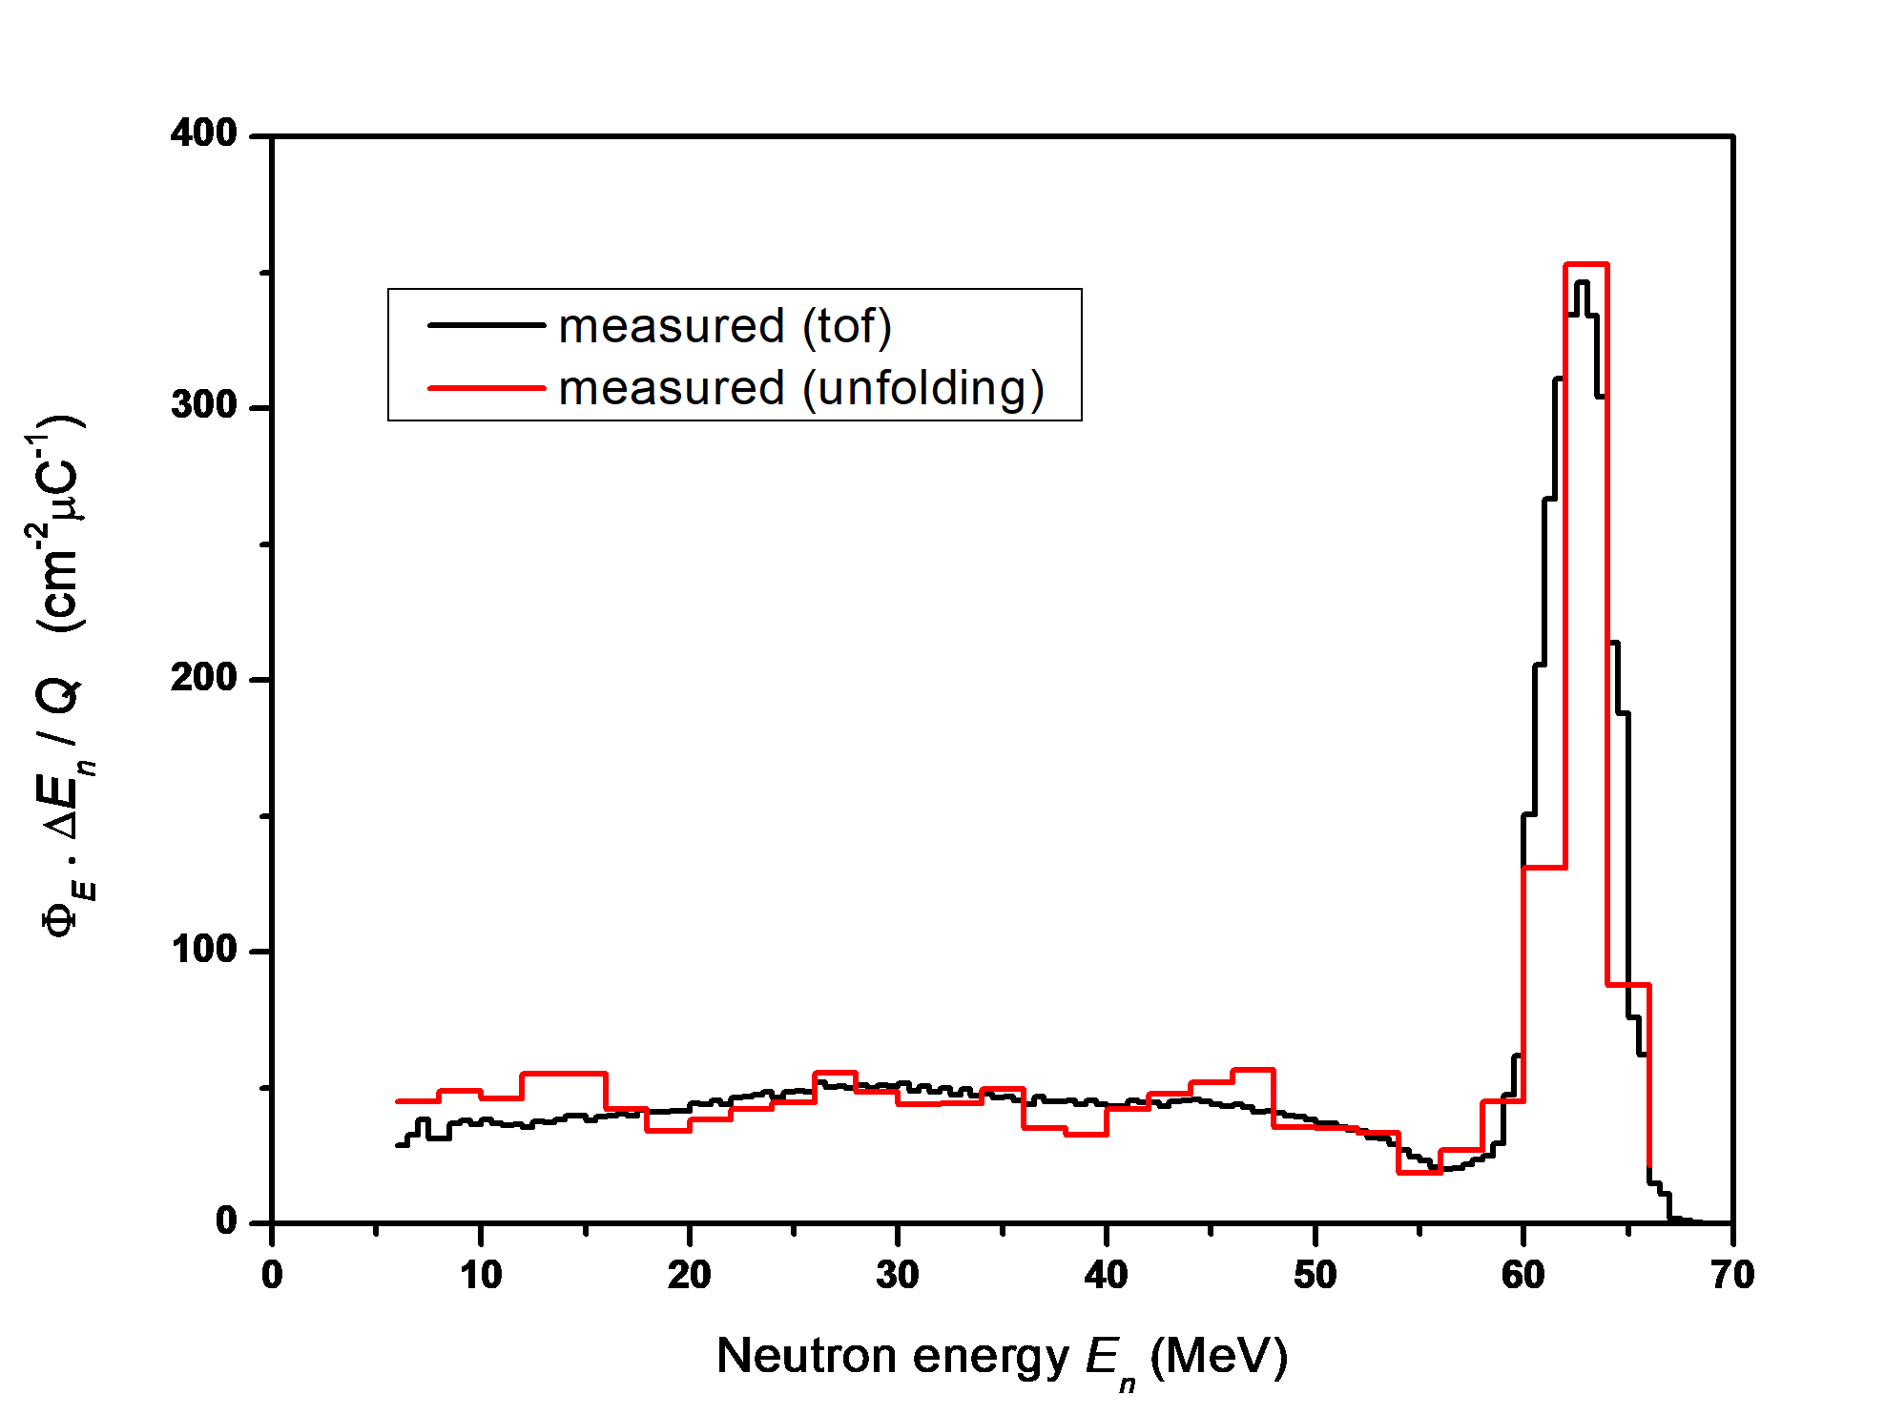
Measured (tof and unfolded) neutron energy spectra

Slide 13
Conclusion
Detector response functions were measured at the iThemba LABS fast neutron facility using time-of-flight between 5 - 66 MeV for the reference BC-501A.
There is a good agreement between the measured (tof and unfolded) neutron energy spectra. This provides a validation of the experimentally determined response matrix and of the method used for the unfolding.
The use of unfolding methods and experimentally determined response functions allows neutron spectrometry with BC-501A detector in unknown fields, such as in aircraft and in space.

Slide 14
…next steps
Further beam characterisations are planned for 100 MeV and 200 MeV, with improved statistics to extend range of applications.
Measurements at 4K binning are planned, which will allow response functions to be determined over the full energy range [5 MeV to 66 MeV and/or above] for every 0.5 MeV.
New or upgraded ²³⁸U Fission Chamber detector.

Slide 15
Thank You…

