Slide 1
Constraining 2HDM+S model through W-boson mass measurements
Anza-tshilidzi Mulaudzi
In collaboration with Mukesh Kumar, ashok goyal, bruce Mellado
Anza-Tshilidzi Mulaudzi South African Institute of Physics

Slide 2
Motivation of the W boson mass beyond the Standard Model
The SM prediction:
$$M_{W}^{SM}=80.353 GeV$$
World Average (arXiv:2204.04204):
$$M_{W}^{World Avg.}= 80.3595±0.0054 GeV$$
PDG measurement (https://doi.org/10.1093/ptep/ptaa104):
$$M_{W}^{PDG}=80.379±0.012 GeV$$
CDF measurement (https://doi.org/10.1126/science.abk1781):
$$M_{W}^{CDF−New}=80.4335±0.0094 GeV$$
LEP measurement:
$$M_{W}^{LEP}=80.4242±0.0087 GeV$$
ATLAS measurement (ATLAS-CONF-2023-004):
$$M_{W}^{ATLAS−New}=80.360±0.016 GeV$$
Anza-Tshilidzi Mulaudzi South African Institute of Physics
Notes:
The motivation for this study is that we saw that the CDF and ATLAS measured the mass of the w boson and it was seen that CDF had a 7-sigma deviation from the SM prediction. So our purpose is to explore the parameter space of a BSM which is motivated by the multi-lepton anomalies and also using the benchmark points motivated by the excesses seen at CMS at 95 GeV and also the combinations from the ATLAS and CMS datasets of different channels at 152 GeV, we want to see which parameter space can be fitted for the measurement of the w mass. And, subsequently, we would like to show the muon g-2 with the contributions from VLL, so that we could see what the w boson mass from the VLL contributions can be fitted to the SM prediction.

Slide 3
Outline
Recent measurements of the W boson mass
Excesses at $\sim$95 GeV and $\sim$152 GeV
Two Higgs Doublet with an additional Singlet model
Theoretical and experimental constraints
Prediction for $M_{W}$ for 95 and 152 GeV scalars
Muon g-2 measurement in the 2HDM+S+f’
VLL (f’) contributions to the S, T, and U parameters
Conclusion
Anza-Tshilidzi Mulaudzi South African Institute of Physics

Slide 4
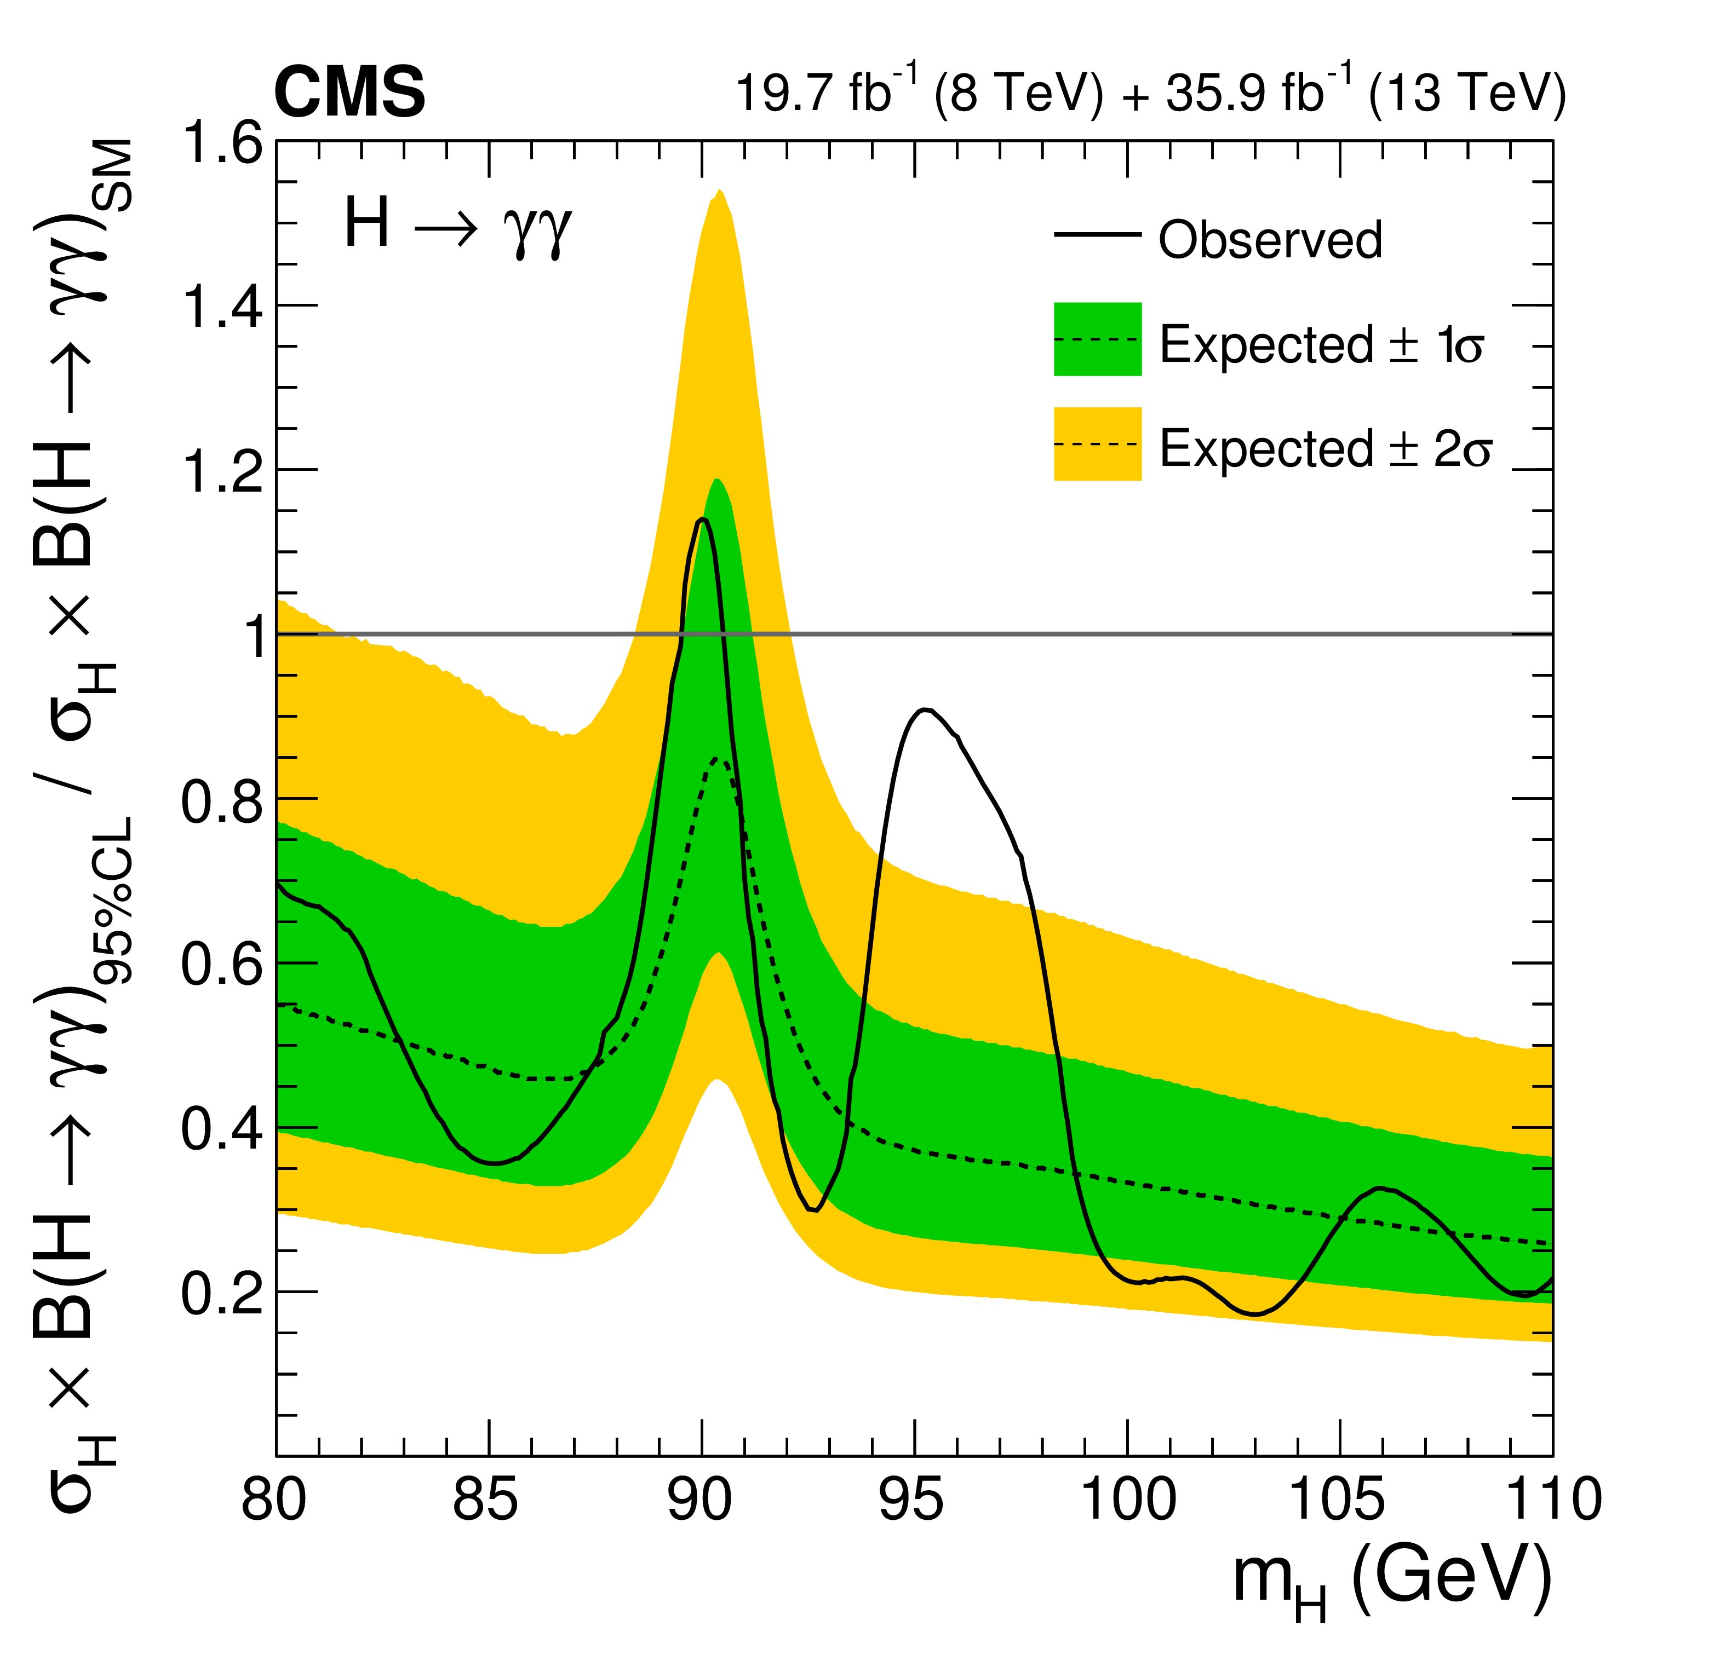
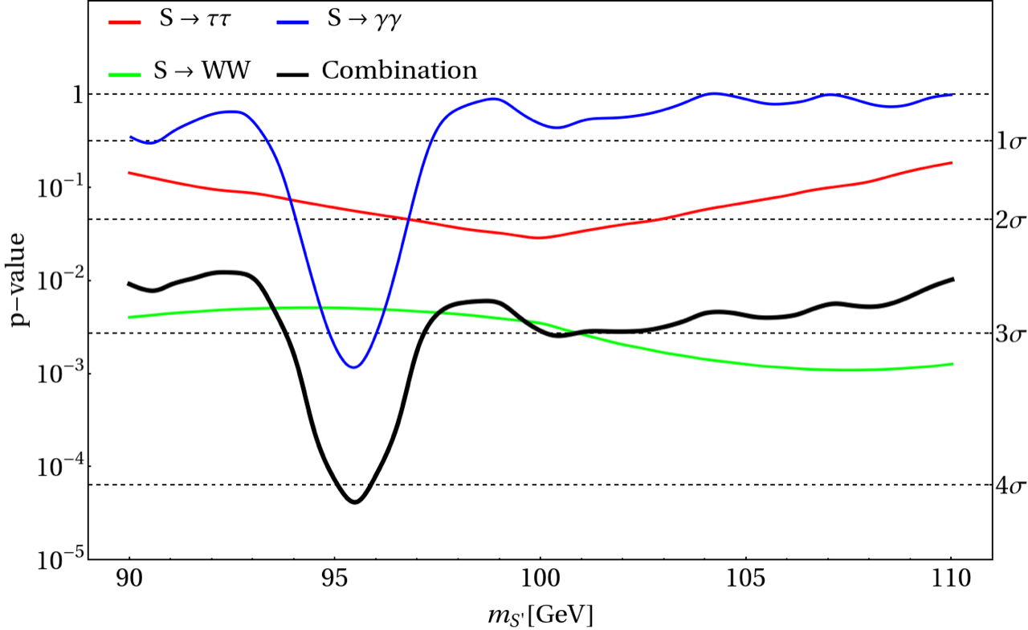
Excesses at $\sim$95 GeV
CMS has observed two excesses with a local significance of 2.8$σ$ in the $γγ$ and $τ^{+}τ^{−}$ final states for a hypothetical Higgs boson mass around 95 GeV.
These excesses are compatible with the corrections corresponding to ATLAS limits.
Another excess was observed in the Higgs boson searches at LEP in the $b\overline{b}$ final state at a local significance of 2$σ$ at a similar mass.
The combination of the $γγ$ and $τ^{+}τ^{−}$ final states from ATLAS data show a local significance of 4.1$σ$.
doi:10.1016/j.physletb.2019.03.064
arXiv:2306.17209
Anza-Tshilidzi Mulaudzi South African Institute of Physics

Slide 5
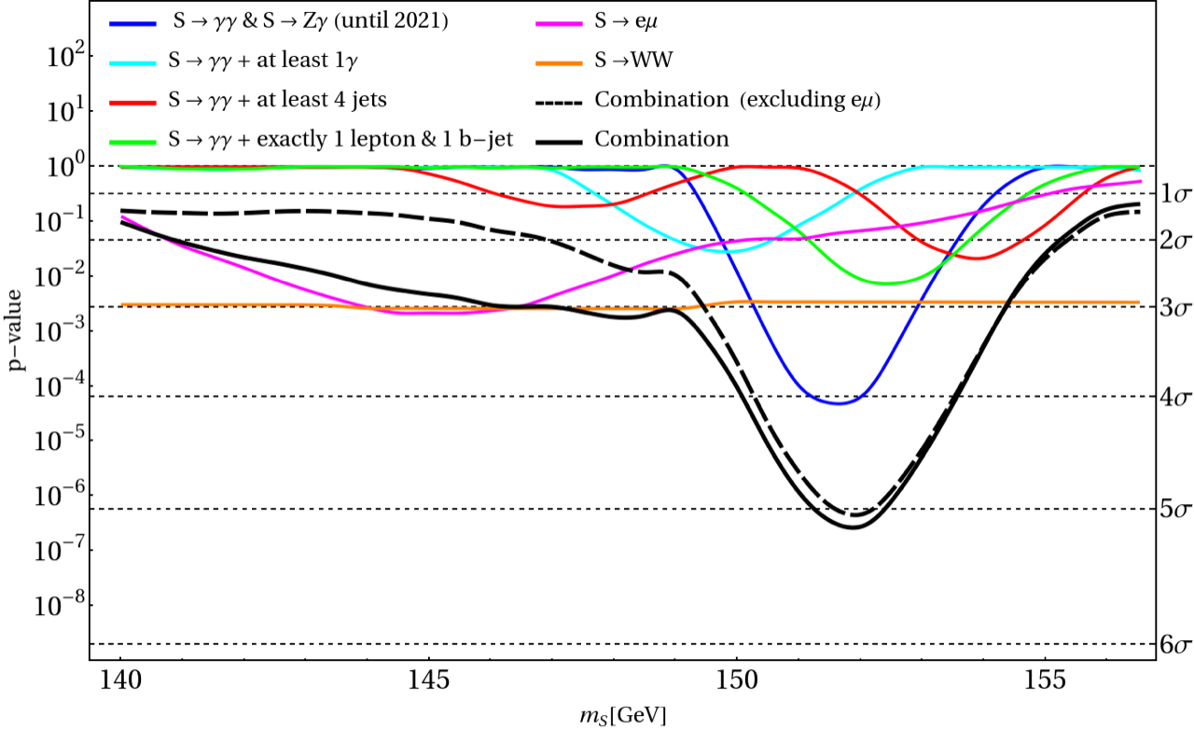
Excesses at $\sim$152 GeV
A search was performed for the signatures of a Higgs-like scalar (S) within a mass region of 130 – 160 GeV, which is a region that has been studied by CMS and ATLAS.
By combining the $γγ$ and the $Zγ$ channels and corresponding missing energy, di-jets and leptons, a local significance of $\sim$4.1$σ$ was obtained and this is a strong indication for a scalar resonance decaying into photons, jets, leptons and missing energy.
The excesses and scalar resonances can be accommodated by a Two Higgs Doublet Model that is extended by a real singlet.
arXiv:2306.17209
Anza-Tshilidzi Mulaudzi South African Institute of Physics

Slide 6
Two Higgs Doublet with an Additional Singlet Scalar Model
Anza-Tshilidzi Mulaudzi South African Institute of Physics

Slide 7
Theoretical and experimental constraints
A scan for our parameter space for the 2HDM+S was performed using ScannerS.
It randomly scans the parameters of our model and evaluates each point by implementing experimental and theoretical constraints through the use of HiggsBounds and N2HDECAY programs.
95 GeV parameter space:
152 GeV parameter space:
$$χ_{γγ,ττ,bb, WW}^{2}=\frac{{\left(μ_{γγ,ττ,bb, WW}−μ_{γγ,ττ,bb, WW}^{Exp}\right)}^{2}}{{\left(Δμ_{γγ,ττ,bb, WW}^{Exp}\right)}^{2}}$$
$$χ_{M_{W}^{Exp}}^{2}=\frac{{\left(M_{W}^{2HDM+S}−M_{W}^{Exp}\right)}^{2}}{{\left(ΔM_{W}^{Exp}\right)}^{2}}$$
Anza-Tshilidzi Mulaudzi South African Institute of Physics

Slide 8
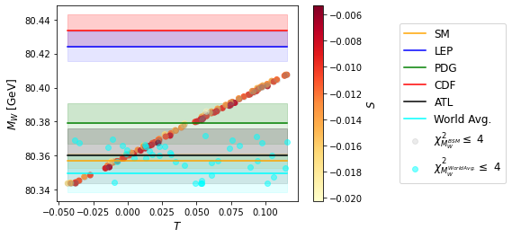
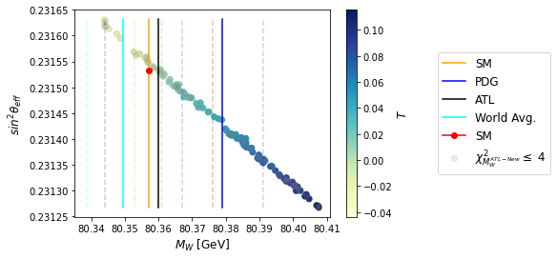
$M_{W}$ prediction for ~95 GeV scalar
2HDM+S Type II
Anza-Tshilidzi Mulaudzi South African Institute of Physics

Slide 9
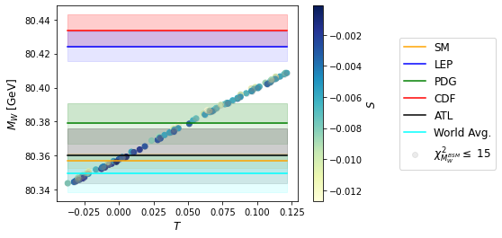
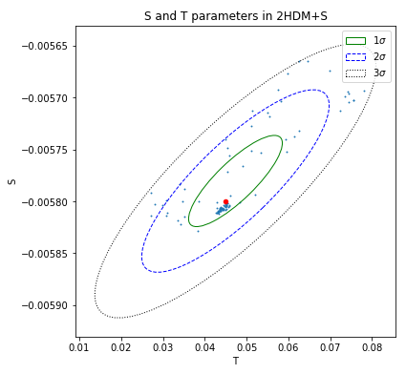
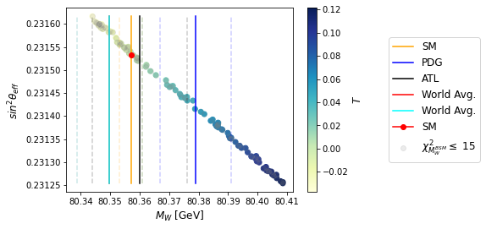
$M_{W}$ prediction for ~152 GeV scalar
2HDM+S Type II
Anza-Tshilidzi Mulaudzi South African Institute of Physics

Slide 10
Muon g-2
The anomalous magnetic moment of the muon, $a_{μ}={\left(g−2\right)}_{μ}/2$, is one of the most important precision observables to test the Standard Model (SM) and provide a complementary, non-collider constraint beyond the Standard Model (BSM) physics.
It is related to its intrinsic spin by the gyromagnetic ratio.
Currently, the discrepancy between the experimental measurement and the SM prediction is $\sim 3.5σ$, where:
$$Δa_{μ}=a_{μ}^{Exp}−a_{μ}^{SM}=2.87\left(80\right)×{10}^{−9}$$
Anza-Tshilidzi Mulaudzi South African Institute of Physics

Slide 11
Muon g-2 measurement in the 2HDM+S
2HDM+S Type II
arXiv:1909.03969
Anza-Tshilidzi Mulaudzi South African Institute of Physics

Slide 12
Muon g-2 measurement in the 2HDM+S+f ’
We consider singly charged SM singlet vector-like leptonic fermions with chiral components.
Where $l_{R}$ and $l_{l}$ are the SM singlet and doublet leptons, and $f_{L/R}^{′}$ are the BSM singly charged Vector-Like-Leptons with left and right-handed chirality.
The interaction, can now be easily cast in terms of the scalar mass eigenstates as in the 2HDM+S lagrangian and now we can subsequently expand it to be the 2HDM+S+f’ model.
Anza-Tshilidzi Mulaudzi South African Institute of Physics
Notes:
We consider singly charged SM singlet vector-like leptonic fermions with chiral components which transform as follows
Lagrangian
Where l_R and L_l are the SM singlet and doublet leptons, and f’_L/R are the BSM singly charged Vector-Like-Leptons with left and right-handed chirality.
The interaction Lagrangian, Eq. (4), can now be easily cast in terms of the scalar mass eigenstates as in the 2HDM+S lagrangian and now we can subsequently expand it to be the 2HDM+S+f’ model.

Slide 13
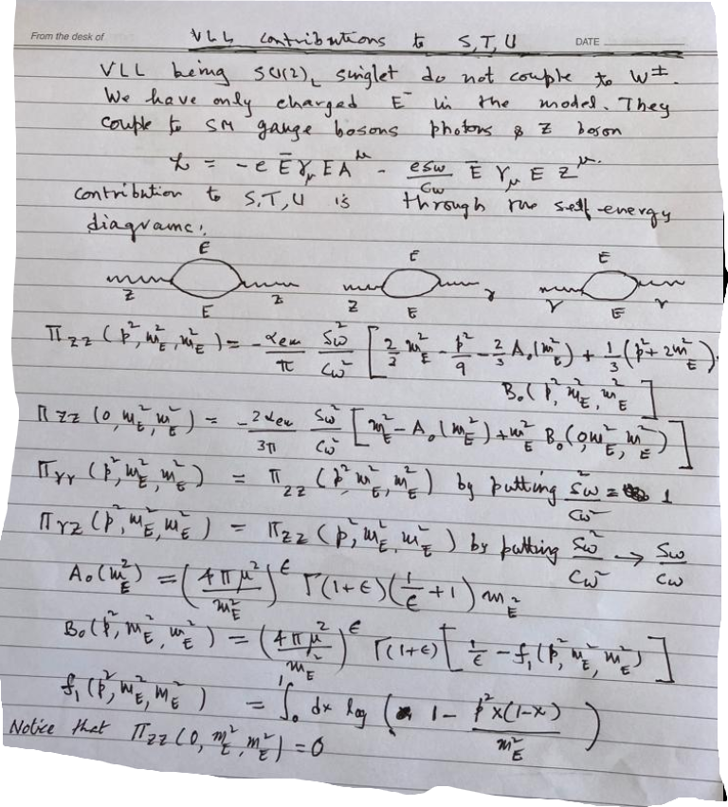
VLL contributions to S, T, U parameters (work in progress)
Anza-Tshilidzi Mulaudzi South African Institute of Physics

Slide 14
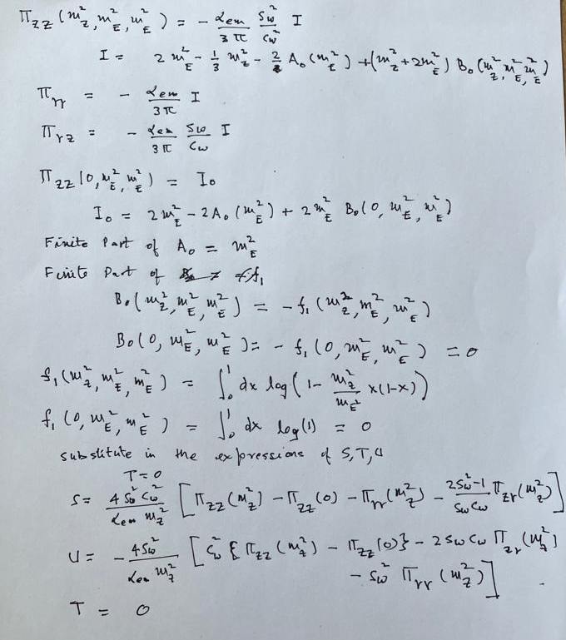
VLL contributions to S, T, U parameters (work in progress)
arXiv:2204.13027
Anza-Tshilidzi Mulaudzi South African Institute of Physics

Slide 15
Conclusion
Based on $M_{W}$ measurements made by CDF, an upward deviation from the SM was seen.
This motivated us to look at the $M_{W}$ in BSM models.
We focused on excesses on the $γγ, τ^{+}τ^{−}, b\overline{b}$ and $WW$ that were observed by CMS and ATLAS.
Results from scans in the 2HDM+S parameter scans, show an agreement with the SM, ATLAS and world average predictions of the $W$ boson mass.
We also see that the measurement of the muon g-2 in the 2HDM+S (and VLL) is in agreement with SM predictions.
Anza-Tshilidzi Mulaudzi South African Institute of Physics

Slide 16
Thank you!
Anza-Tshilidzi Mulaudzi South African Institute of Physics

