Slide 1
An alternative explanation of the Multi-lepton anomalies at the LHC
Anza-Tshilidzi Mulaudzi
In collaboration with:
Guglielmo Coloretti
Bruce Mellado
Andreas Crivellin
Mukesh Kumar

Slide 2
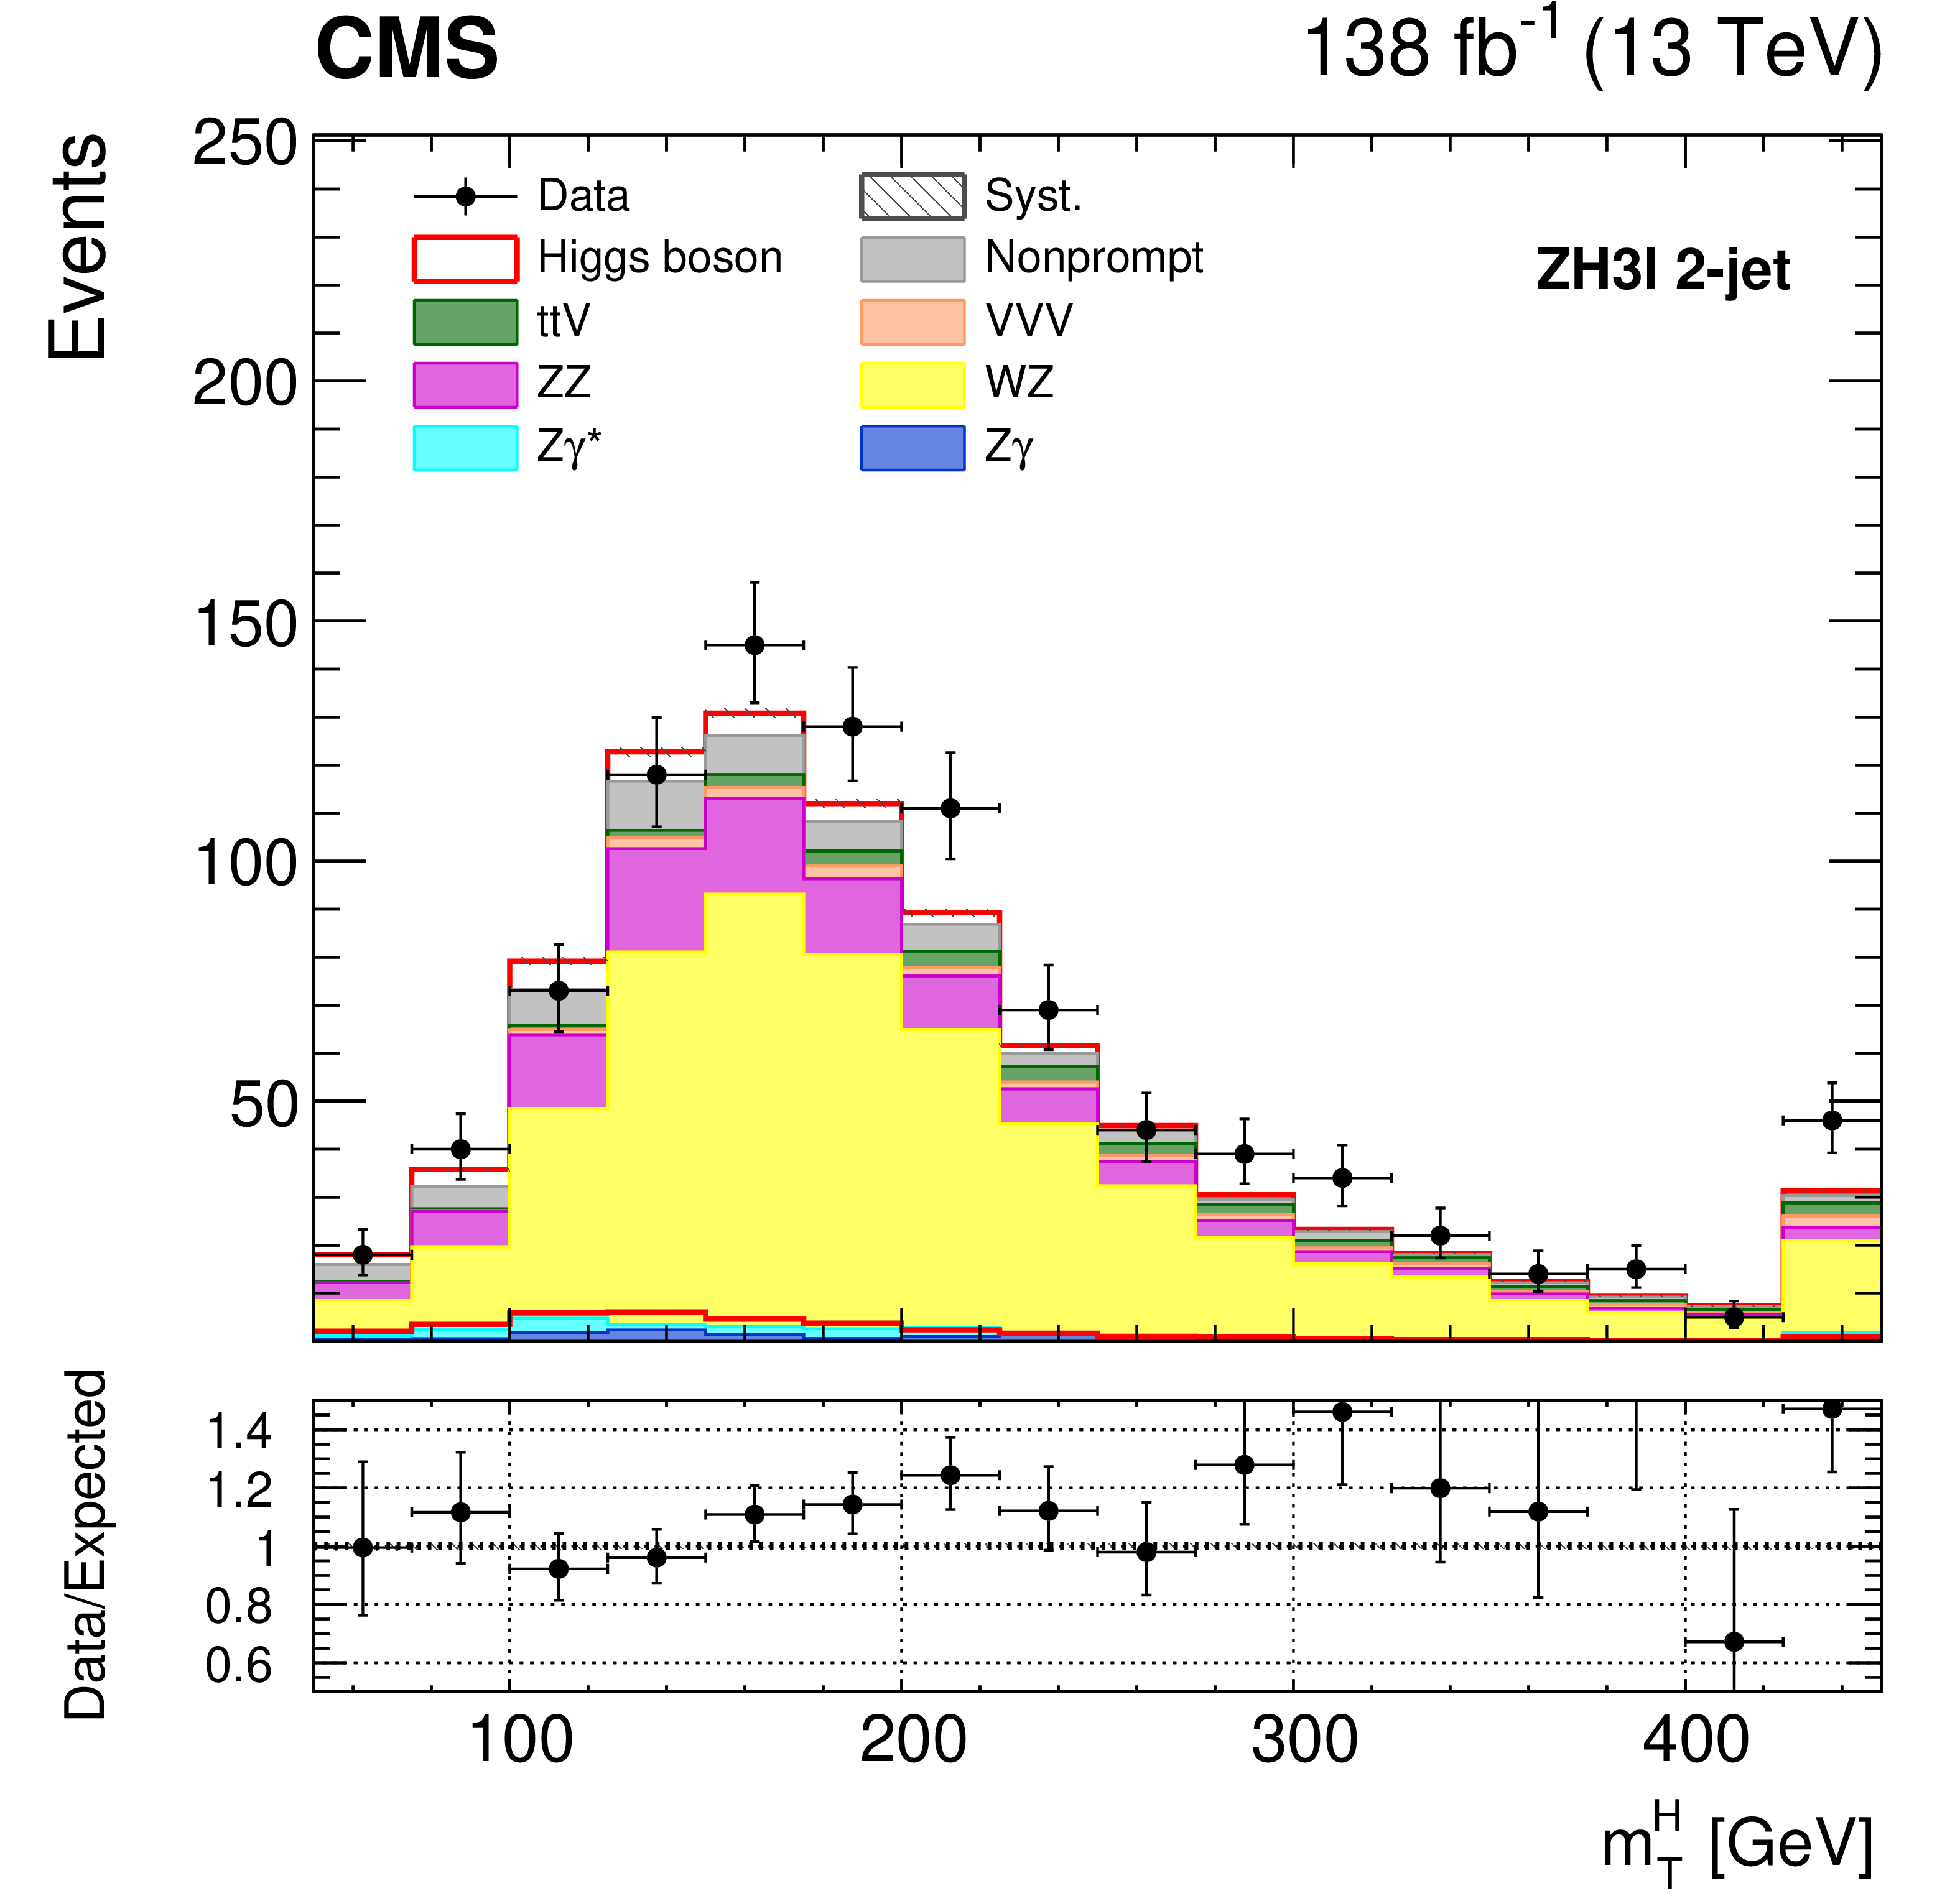
The results for the $H→WW$ in the $ZH3l$ category show a observed (expected) significance of 3.73 (2.19) $σ$
arXiv:2206.09466

Slide 3
Outline
Multi-lepton anomalies at the LHC
Anatomy of the multi-lepton anomalies (2023)
Explaining the multi-lepton anomalies using the 2HDM+S
Strong excesses at 152 GeV
Introduction to the Higgs Triplet Model (Y=0)
Lagrangian and Higgs masses
Properties of the Higgs Triplet Model
Analysis of the 152 GeV Triplet
Conclusion

Slide 4
Multi-lepton anomalies at the LHC
References:
Eur. Phys. J. C (2016) 76:580
J.Phys.G45(2018)11,115003
JHEP10(2019)157
Eur. Phys. J. C 80 (2020) 528
Chin.Phys.C44(2020)6,06310
Physics Letters B 811 (2020) 135964
Eur.Phys.J.C81(2021)365

Slide 5
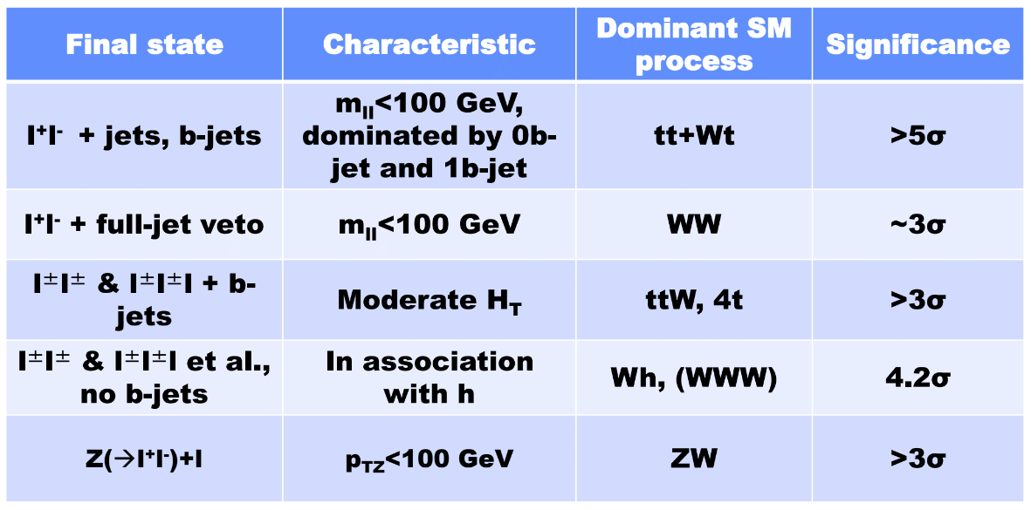
Anatomy of the multi-lepton anomalies (2023)
Notes:
In recent years, hints for multi-lepton anomalies have been accumulated by the analysis of the LHC data. They emerged from the SM predictions in several analyses of multi lepton final states from ATLAS and CMS experiments.
These hints for new physics are statistically most compelling in non-resonant Di-leptons (both opposite and same sign) final states as well as in the three- lepton channel ( without the presence of b-tagged jets).
This table here is a representation of which multi-lepton final states are considered for the multi-lepton anomalies

Slide 6
Explaining the multi-lepton anomalies using the 2HDM+S
$$/S^{∗}$$
Eur. Phys. J. C 80 (2020) 528
Notes:
These signatures can be explained by the decay of a neutral scalar H into a lighter one S and the SM Higgs as referred to as 2HDM+S, which is an extension of the SM by a doublet and also an additional singlet scalar.
The explanation of the multi lepton anomalies in the 2HDM+S framework requires the mass of S to be between 130 and 160 GeV, which is a side band region that is accommodated by CMS and ATLAS for SM Higgs searches.

Slide 7
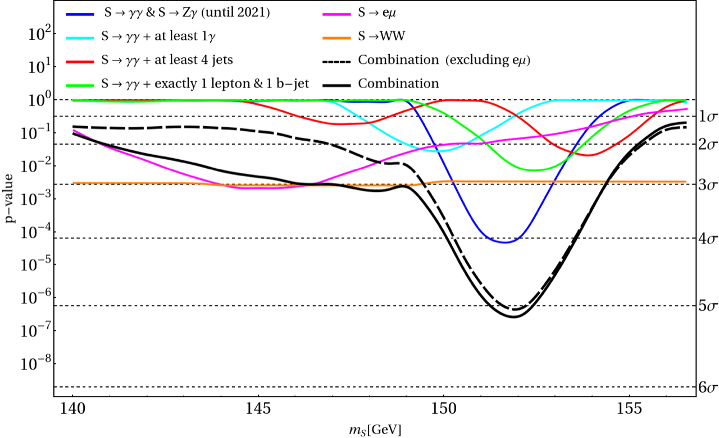
Strong Excesses at 152 GeV
A new boson with mass 152 GeV
Using a combination of the $γγ$ and $Zγ$ spectra in associated production shows an excess at 152 GeV.
New excesses emerged and after incorporating a $WW$ final states to the combination in 2021, the global significance increases to $\sim 5.1σ$.
References:
arXiv:2109.02650
JHEP10(2019)157
arXiv:2306.17209
arXiv:2306.17209

Slide 8
Introduction to the Higgs Triplet Model (Y=0)
References:
arXiv:2001.05335v2
arXiv:1811.03476v1
Eur. Phys. J. C (2018) 78:873
DOI:10.1103/PhysRevD.105.112007
Preprint:2306.15722

Slide 9
Lagrangian and Higgs masses
The Higgs Triplet Model is an extension of the Standard Model (SM), by an $SU{\left(2\right)}_{L}$ Higgs Triplet
The covariant derivative in the adjoint representation for the triplet is
$$D_{μ}Δ=∂_{μ}Δ−ig_{2} [\frac{σ_{k}}{2}W_{μ}^{k}, Δ]$$
Cannot couple with leptons and quarks but interactions with the SM are purely fixed by the gauge interactions
The potential $V(H,Δ)$ can be expressed as
$$V=−μ_{Φ}^{2}Φ^{†}Φ+\frac{λ_{Φ}}{4}{\left(Φ^{†}Φ\right)}^{2}−μ_{Δ}^{2}Tr\left(Δ^{†}Δ\right)+\frac{λ_{Δ}}{4}{\left[TrΔ^{†}Δ\right]}^{2}$$
$$+μΦ^{†}ΔΦ+λ_{ΦΔ}Φ^{†}ΦTr(Δ^{†}Δ)$$
$Φ$ is the SM doublet and we define
$$Δ=\frac{1}{2}\left(\begin{matrix}δ^{0} & \sqrt{2} δ^{+} \\ \sqrt{2} δ^{−} & −δ^{0}\end{matrix}\right), Φ=\left(\begin{matrix}φ^{+} \\ φ^{0}\end{matrix}\right)$$
The potential has a global $O{\left(4\right)}_{H}×O{\left(3\right)}_{Δ}$ symmetry soflty broken by the $μ$ term
The minimization conditions
$$μ_{Φ}^{2}=−μ\frac{ν_{Δ}}{2}+\frac{1}{4}ν^{2}λ_{Φ}+\frac{1}{2}λ_{ΦΔ}ν_{Δ}^{2},$$
$$μ_{Δ}^{2}=−μ\frac{ν^{2}}{4ν_{Δ}}+\frac{1}{2}ν^{2}λ_{ΦΔ}+\frac{1}{4}λ_{Δ}ν_{Δ}^{2}$$
Notes:
The covariant derivative for SU(2)L is fixed in the usual conventions by the corresponding generators, being the Pauli matrices and the representation for the triplet is
equation
Where the square brackets stands for the commutator.
Note that the Feynman rules for the SU(2)L gauge boson interactions are thus a factor of 2 higher w.r.t a scalar doublet.
It should be noted that since the triplet cannot have direct couplings to quarks or leptons, but its interactions with the SM are purely fixed by the gauge interactions
the scalar potential can be expressed as the equation below
V
Where phi is the SM doublet, and it is defined as
Phi, Delta
With delta being real and delta- is equal to the complex conjugate of delta+.
Note that the potential has a global O(4)H x O(3)Delta symmetry softly broken by the mu-term.
After electroweak symmetry breaking, phi0 and delta0 acquire the vacuum expectation values of 246 GeV and v_Delta.
The minimisation conditions are defined by the equations below and
Equation

Slide 10
Lagrangian and Higgs masses
The scalar mass matrices, in the bases ($φ^{+},δ^{+}$) and ($Re(φ^{0},δ^{0})$) are
The resulting mass eigenstates, in addition to the $Im(Φ^{0})$ are
with the CP-even and charged Higgs mixing angles
Among the massive states, the SM-like higgs and, $H$ and $H^{±}$ are defined as
For a vanishing $α$, $m_{H^{±}}^{2}−m_{H}^{2}⋍μν_{Δ}−\frac{λ_{Δ}ν_{Δ}^{2}}{2}$
$$ν_{Δ}≪ν$$
For large $α$, the vacuum stability and perturbative unitarity allows for mass splitting of a few GeV
In limit of small $v_{Δ}$, we see that
$$m_{H^{0}}≈m_{H^{±}}$$
Notes:
we can subsequently right the scalar mass matrices in the bases of phi+ and delta+ as follows.
Eqaution
The resulting mass eigenstates, in addition to the Im(phi0) are
Equations
With the CP-even and charged Higgs mixing angles
Equations*
The massless states G+- and Im(phi0) which are the Goldstone bosons, are eaten by the W+ and Z.
Among the massive states, the SM-like higgs, and H and H+- are the triplet-like neutral charged scalars with masses defined by the equation
Equation
For a vanishing alpha, we see that the components are nearly mass degenerate for vDel << v.
However, for a large alpha, the vacuum stability and perturbative unitarity allow a mass splitting of a few GeV.
In the end, all the parameters of the scalar potential can be expressed in terms of the physical masses and mixing angles and the two VEVs, v and vDelta.
In particular, the couplings of the neutral to the charged higgses can be written as
Equation
In the limit of small vDelta and mH ~= mHP.

Slide 11
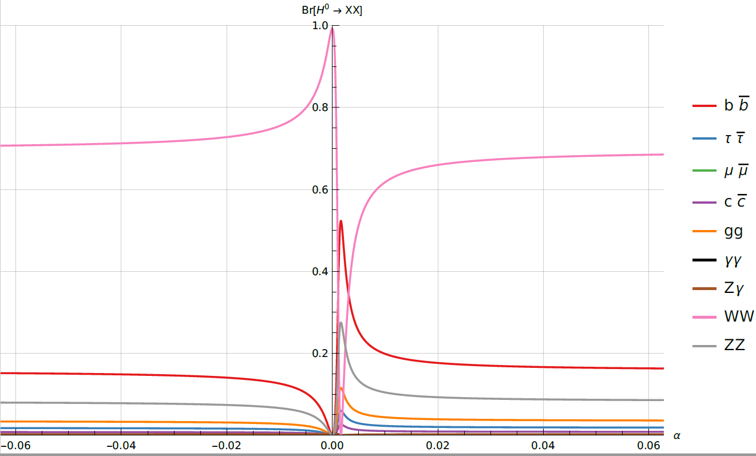
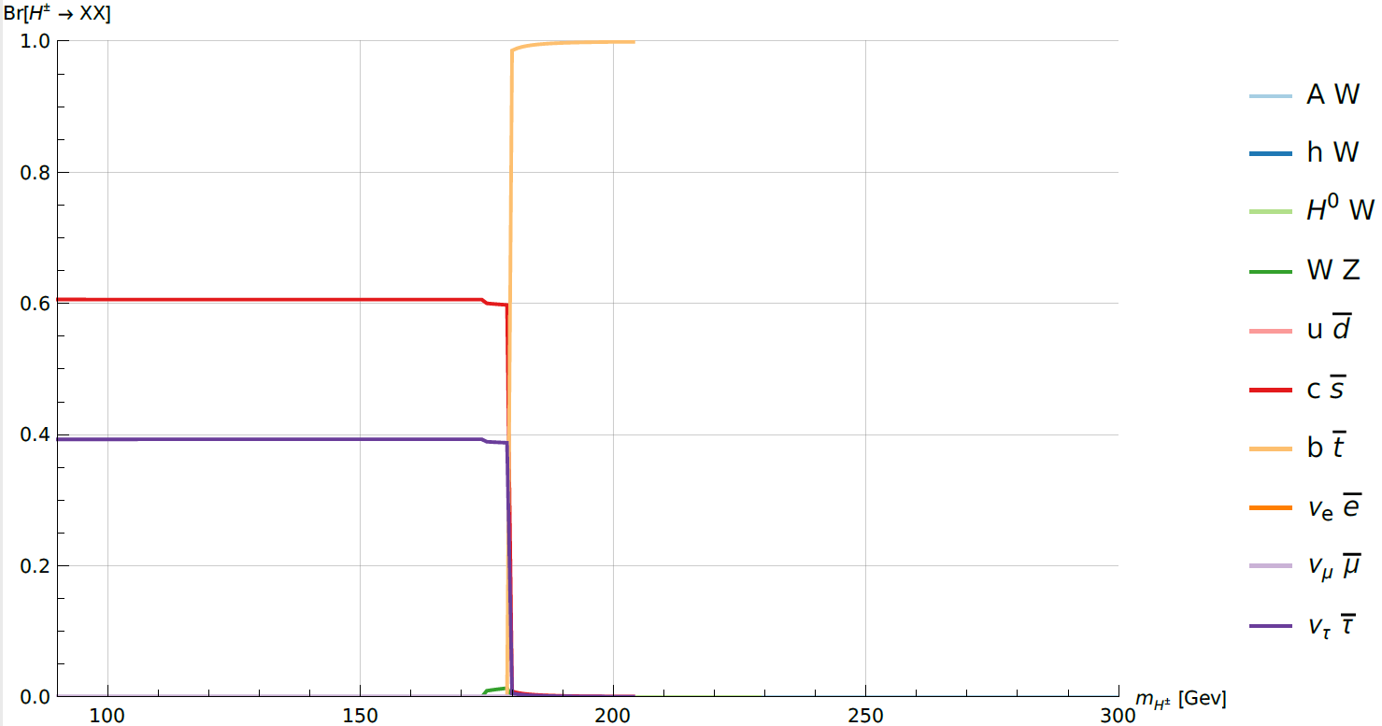
Properties of the HTM0
Branching ratio of $H^{±}→XX$
Branching ratio of $H^{0}→XX$

Slide 12
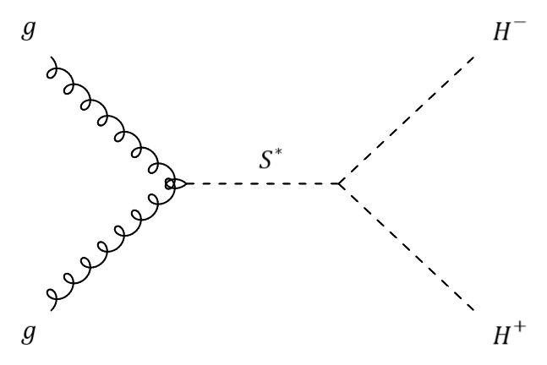
Analysis of the 152 GeV Triplet
Process:
$$gg→S^{∗}→H^{−} H^{+}$$
where $m_{H^{0},H^{∓}}=152 GeV$
The results for the $H→WW$ in the $ZH3l$ category show a observed (expected) significance of 3.73 (2.19) $σ$
arXiv:2206.09466
Notes:
My analysis is based on an analysis that was done by CMS where they looked at measurements of the Higgs boson production cross-section and couplings in the W boson pair decay channel in pp collision at a centre of mass energy of 13 TeV.
I focused on the ZH3L category which targets the ZH > 3lv qq decay. This means that the final state contains three leptons with total charge +-1.
The reason why we chose this category is because it’s main backgrounds are the WZ, ZZ and Z + jets events.
The results shown for this analysis by CMS for the H -> WW in the ZH3L category obtained a observed (expected) significance of 3.73 (2.19) sigma.

Slide 13
Analysis of the 152 GeV Triplet (work in progress)
arXiv:2206.09466

Slide 14
Conclusions
There is a need for BSM models to explain anomalies that are seen in experiments.
The deviations in the multi-lepton final states at the LHC with respect to Monte Carlo simulations are not statistical fluctuations.
The features of Higgs data from the LHC agree with predictions made from the 2HDM+S.
The introduction Higgs Triplet model allows us to probe the $S→ZZ$ channel.

Slide 15
Thank you!

