Slide 1
Using the sf-model to describe spintronic devices
V Nolting
06/07/2023

Slide 2
content
 | Introduction to spintronics The sf-model The zero bandwidth limit Results Applications to 4f-antiferromagnetism Conclusions

Slide 3
(1) Introduction
In spintronics the results of conventional magnetism and semiconductor physics are correlated.
Spintronic devices: storage and processing of data is brought together on a single chip utilizing both the electron’s charge and its spin with the result of accelerated miniaturization and efficiency with lower power consumption.
To achieve this spin dependent electron transport phenomena are desirable [1.2].
Interesting candidates: crystals with atoms from the group of rare earth elements. These atoms contain partially filled 4f and 5f-shells; magnetism and the electric current are caused by two different electron groups.

Slide 4
Applications: giant magnetoresistance devices, nanoelectronic devices, spin based transistors, antiferromagnetic storage media, etc.
The mutual interaction between these electron groups causes interesting phenomena, e.g. RKKY interaction, Kondo and spinglass behavior.

Slide 6
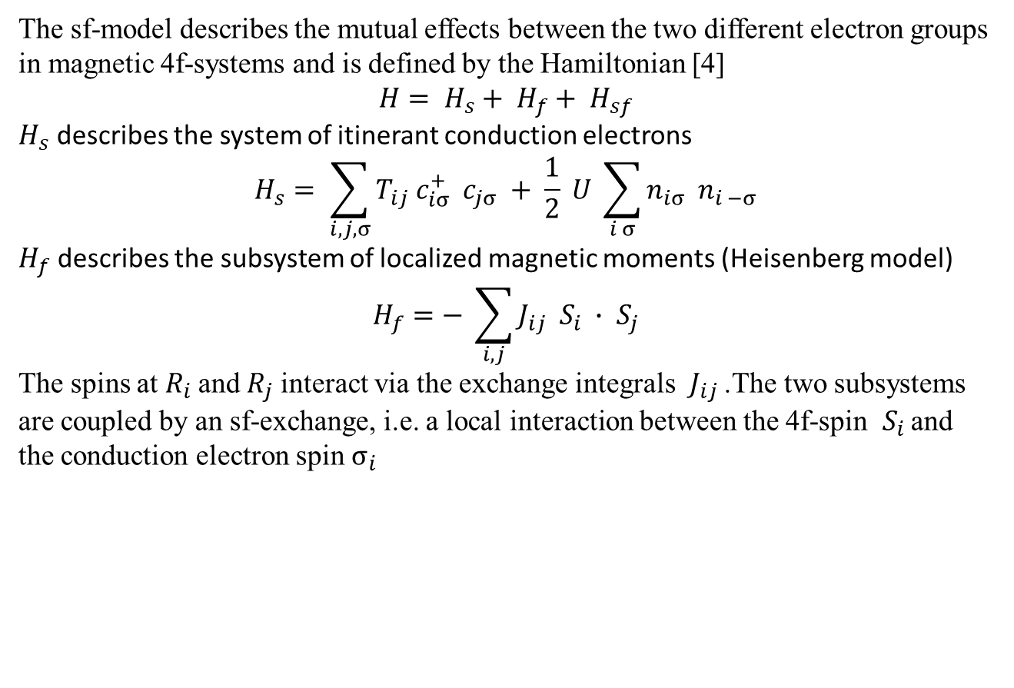
(2) The sf-model
The sf-model describes the mutual effects between the two different electron groups in magnetic 4f-systems and is defined by the Hamiltonian [4]
$$H= H_{s}+ H_{f}+ H_{sf}$$
$H_{s}$ describes the system of itinerant conduction electrons
$$H_{s}= \sum_{i,j,σ}{T_{ij} c_{iσ}^{+} c_{jσ} + \frac{1}{2} U \sum_{i σ}{n_{iσ} n_{i −σ}}}$$
$H_{f}$ describes the subsystem of localized magnetic moments (Heisenberg model)
$$H_{f}=− \sum_{i,j}{J_{ij} S_{i} ∙ S_{j}}$$
The spins at $R_{i}$ and $R_{j}$ interact via the exchange integrals $J_{ij}$ .The two subsystems are coupled by an sf-exchange, i.e. a local interaction between the 4f-spin $S_{i}$ and the conduction electron spin $σ_{i}$

Slide 7
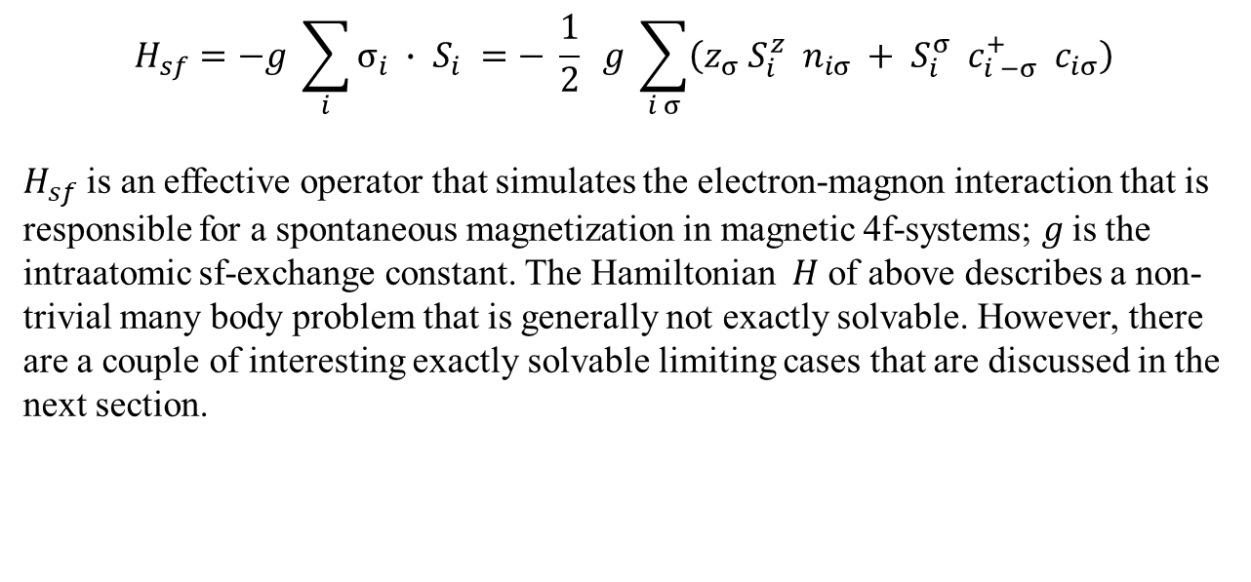
$$H_{sf}=−g \sum_{i}{σ_{i} ∙ S_{i} =− \frac{1}{2} g \sum_{i σ}{\left(z_{σ} S_{i}^{z} n_{iσ} + S_{i}^{σ} c_{i −σ}^{+} c_{iσ}\right)}}$$
$H_{sf}$ is an effective operator that simulates the electron-magnon interaction that is responsible for a spontaneous magnetization in magnetic 4f-systems; 𝑔 is the intraatomic sf-exchange constant. The Hamiltonian $H$ of above describes a non-trivial many body problem that is generally not exactly solvable. However, there are a couple of interesting exactly solvable limiting cases that are discussed in the next section.

Slide 8
The zero bandwidth limit [5]

Slide 9
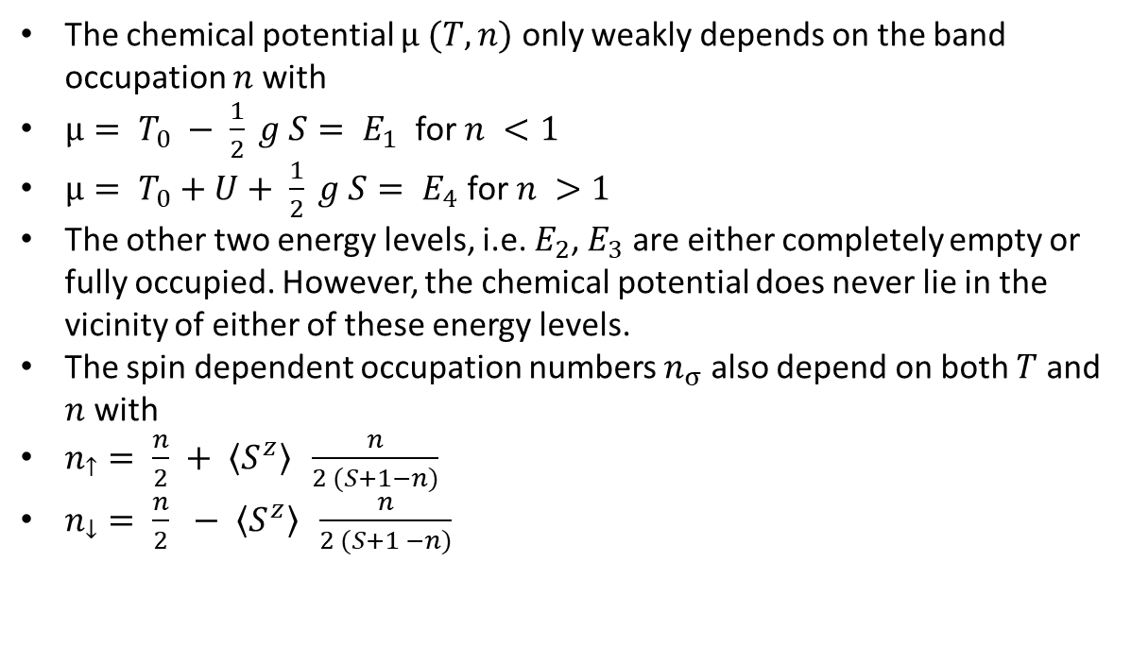
The chemical potential $μ (T,n)$ only weakly depends on the band occupation $n$ with
$μ= T_{0} − \frac{1}{2} g S= E_{1}$ for $n <1$
$μ= T_{0}+U+ \frac{1}{2} g S= E_{4}$ for $n >1$
The other two energy levels, i.e. $E_{2}$, $E_{3}$ are either completely empty or fully occupied. However, the chemical potential does never lie in the vicinity of either of these energy levels.
The spin dependent occupation numbers $n_{σ}$ also depend on both $T$ and $n$ with
$n_{↑}= \frac{n}{2} + \left\langle S^{z}\right\rangle \frac{n}{2 (S+1−n)}$
$n_{↓}= \frac{n}{2} − \left\langle S^{z}\right\rangle \frac{n}{2 (S+1 −n)}$

Slide 10

Here $\left\langle S^{z}\right\rangle$ denotes the temperature and band occupation dependent 4f-magnetization. For its saturation value we obtain
$$\left\langle S^{z}\right\rangle \left(T=0\right)= \frac{S (S+1 −n)}{S+1}$$
$$\left\langle S^{z}\right\rangle \left(T=0, n=0\right)=S$$
The temperature dependence of the 4f-magnetization is plotted in the figure below.

Slide 11
4f-magnetization as a function of temperature

Slide 12
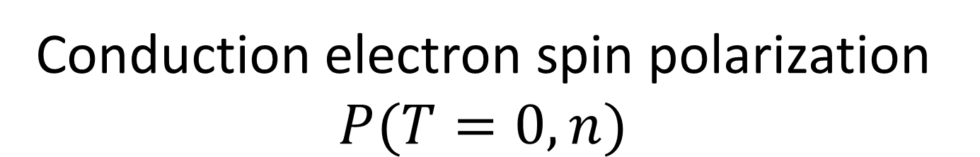
Conduction electron spin polarization $P(T=0, n)$

Slide 13
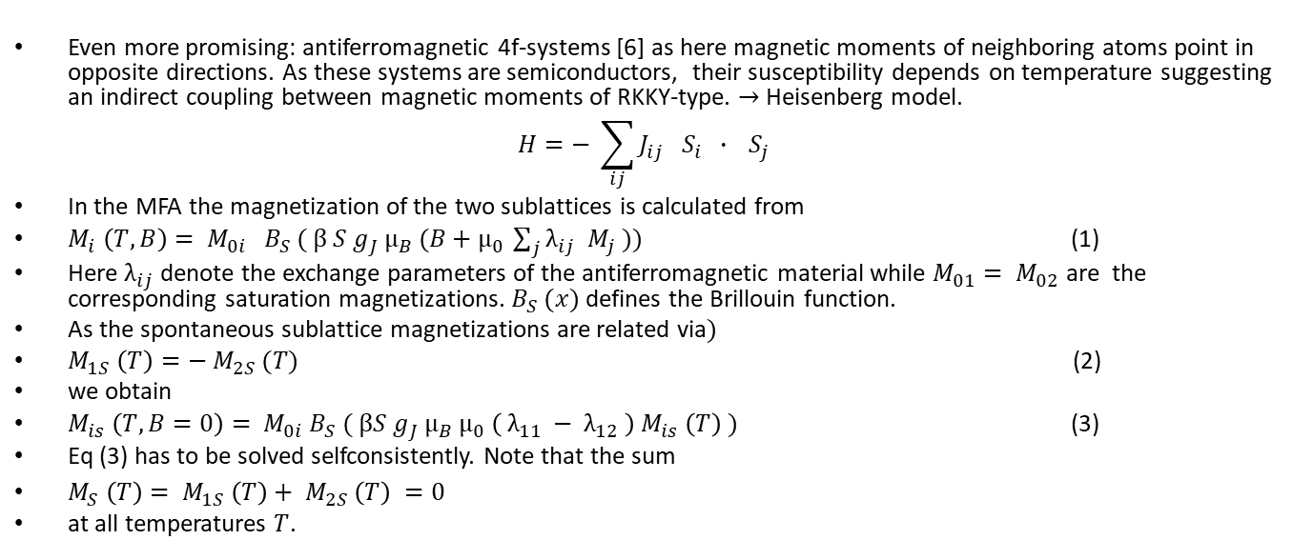
(5) Applications to 4f-antiferromagnetism
Even more promising: antiferromagnetic 4f-systems [6] as here magnetic moments of neighboring atoms point in opposite directions. As these systems are semiconductors, their susceptibility depends on temperature suggesting an indirect coupling between magnetic moments of RKKY-type. $→$ Heisenberg model.
$$H=− \sum_{ij}{J_{ij} S_{i} ∙} S_{j}$$
In the MFA the magnetization of the two sublattices is calculated from
$M_{i} \left(T, B\right)= M_{0i} B_{S} ( β S g_{J} μ_{B} (B+μ_{0} \sum_{j}{λ_{ij} M_{j} ))}$ (1)
Here $λ_{ij}$ denote the exchange parameters of the antiferromagnetic material while $M_{01}= M_{02}$ are the corresponding saturation magnetizations. $B_{S} (x)$ defines the Brillouin function.
As the spontaneous sublattice magnetizations are related via$)$
$M_{1S} \left(T\right)=− M_{2S} (T)$ (2)
we obtain
$M_{is} \left(T, B=0\right)= M_{0i} B_{S} ( βS g_{J} μ_{B} μ_{0} \left( λ_{11} − λ_{12} \right) M_{is} \left(T\right) )$ (3)
Eq (3) has to be solved selfconsistently. Note that the sum
$M_{S} \left(T\right)= M_{1S} \left(T\right)+ M_{2S} \left(T\right) =0$
at all temperatures $T$.

Slide 14
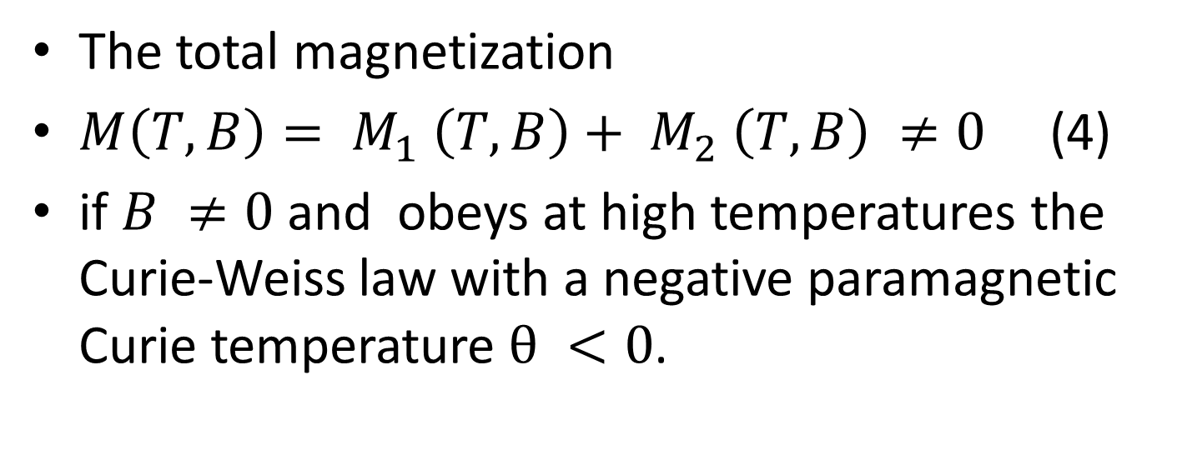
The total magnetization
$M\left(T,B\right)= M_{1} \left(T,B\right)+ M_{2} \left(T, B\right) ≠0$ (4)
if $B ≠0$ and obeys at high temperatures the Curie-Weiss law with a negative paramagnetic Curie temperature $θ <0$.

Slide 15
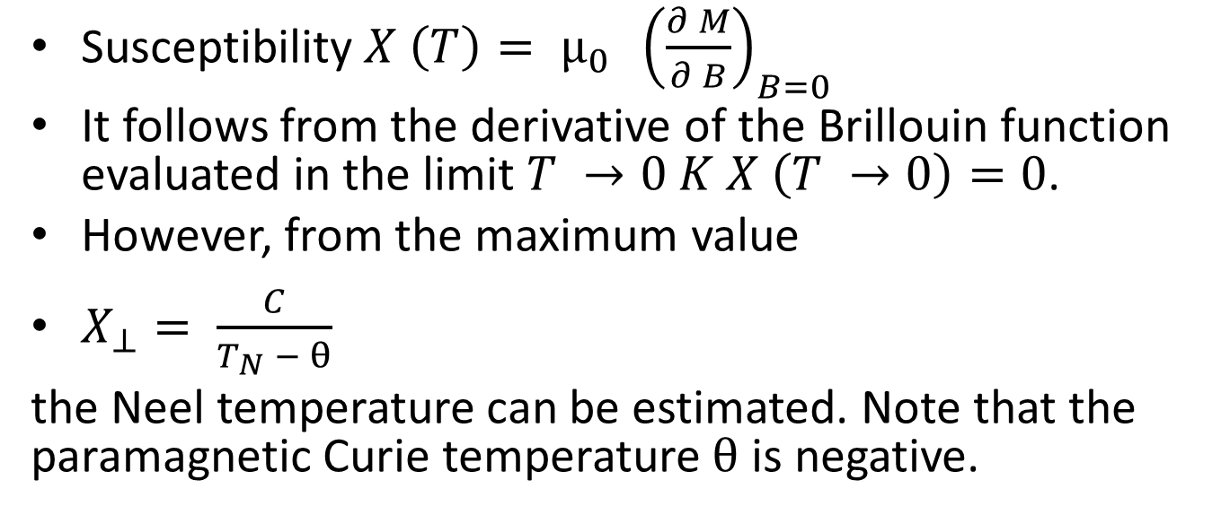
Susceptibility $X \left(T\right)= μ_{0} {\left(\frac{∂ M}{∂ B}\right)}_{B=0}$
It follows from the derivative of the Brillouin function evaluated in the limit $T →0 K$ $X \left(T →0\right)=0$.
However, from the maximum value
$X_{⊥}= \frac{C}{T_{N} − θ}$
the Neel temperature can be estimated. Note that the paramagnetic Curie temperature $θ$ is negative.

Slide 16
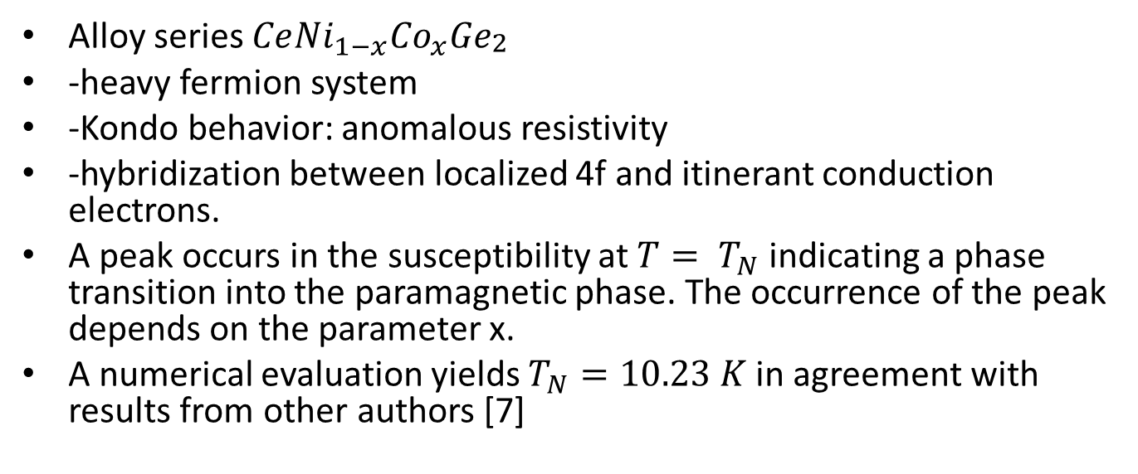
Alloy series $Ce{Ni}_{1−x}{Co}_{x}{Ge}_{\begin{aligned}2 \\ \end{aligned}}$
-heavy fermion system
-Kondo behavior: anomalous resistivity
-hybridization between localized 4f and itinerant conduction electrons.
A peak occurs in the susceptibility at $T= T_{N}$ indicating a phase transition into the paramagnetic phase. The occurrence of the peak depends on the parameter x.
A numerical evaluation yields $T_{N}=10.23 K$ in agreement with results from other authors [7]

Slide 17
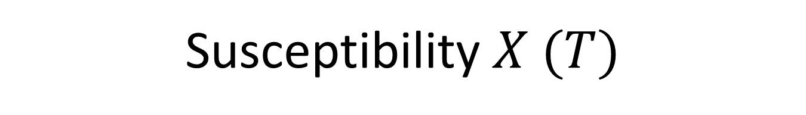
Susceptibility $X (T)$

Slide 18
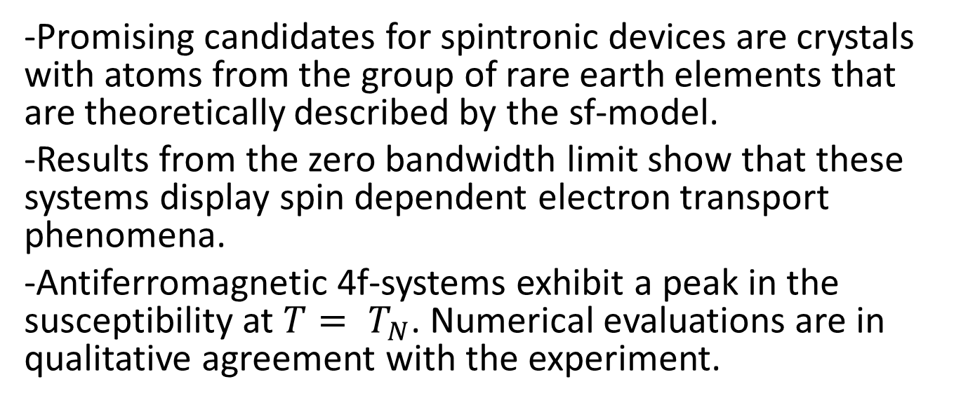
Conclusions
-Promising candidates for spintronic devices are crystals with atoms from the group of rare earth elements that are theoretically described by the sf-model.
-Results from the zero bandwidth limit show that these systems display spin dependent electron transport phenomena.
-Antiferromagnetic 4f-systems exhibit a peak in the susceptibility at $T= T_{N}$. Numerical evaluations are in qualitative agreement with the experiment.

Slide 19
References
[1] S. A. Wolf et al, IBM Journal of Research and Development 50, 101 (2006)
[2] S.A. Wolf, Science 294, 1488 (2001)
[3] A. Hirohata, J Magn and Mag Mat 509 (2020)
[4] W Nolting, Fundamentals of Many Body Physics, Springer (2009)
[5] W Nolting and M Matlak, phys stat sol (b) 123, 155 (1984)
[6] T Jungwirth et al, Nature Nanotechnology 11, 231 (2016)
[7] B K Lee et al, Phys Rev B71 (2005)

Slide 20

THANK YOU

