Slide 1
Multi-messenger analysis of Ultrafaint dwarf galaxies as observational targets for Dark Matter Indirect detection
Raees Noorbhai
Wits University
Centre for Astrophysics

Slide 2
Introduction
Dark Matter dominates the matter content of the Cosmos, from the galactic scale to the particle horizon
Approximately 85% of the universe’s mass content and approximately 27% of the total mass-energy content of the Cosmos
Beyond its gravitational properties, little is understood about this mysterious substance
A number of hypotheses put forward to explain Dark Matter, but none have received experimental verification → WIMP hypothesis
=

Slide 3
A Historical Overview of the Dark Matter Mystery
1933
Zwicky: Calculates that in order to gravitationally bind the Coma Cluster, the actual mass had to be ~ 100 times greater than the observed mass in stars and so postulates an unseen Dark Halo engulfing the cluster
Penzias and Wilson: Published on the detection of the Cosmic Microwave Background (CMB) radiation
Peebles, Dicke, Roll and Wilkinson: Concurrently published interpretations of the observed CMB which situates it within the predictions of a Hot Big Bang
1965
1970
Rubin and Ford: Spectroscopic survey of Andromeda produced anomalous rotation curves, with rotational velocity remaining constant at large distances from the galactic centre
Ostriker and Peebles: N-Body Simulations demonstrate that disk galaxies cannot be rotationally supported and thus another, massive spheroidal component of the galaxies must exist
Roberts (NRAO) and Rots (WSRT): Discovery of three galaxies with rotation curves that suggested the presence of a Dark Halo with undetected mass at large distances away from the galactic centre.
1973
Hut and Lee & Weinberg: Independently introduced heavy, neutral particles which interact on the scale of the Weak Force - Weakly Interacting Massive Particles (WIMPs), a candidate for DM
1977

Slide 4
Direct Detection Experiments
2008
DAMA/LIBRA Direct detection experiment: Announces a controversial detection of an annual modulation in the observed detection rate, which is consistent with the presence of DM particles in the Milky Way Halo
2016
PANDAX-II Direct Detection experiment: No evidence found for the existence of WIMP Dark Matter in first 98.7 days of data
2017
LUX Direct Detection experiment: No evidence for WIMP-Nucleon scattering and Leptophilic WIMP models introduced to relax heavy non-detection constraints upon WIMPs with Hadronic interactions
2018
XENON1T Direct Detection experiment: Failure to detect significant WIMP-Nucleon scattering events, imposing most stringent Direct detection constraints
2021
ANAIS Direct Detection experiment: Failure to detect “WIMP wind” signal and corroborate DAMA result

Slide 5
Collider Searches
2006
LEP Collider search: No evidence found for physics beyond the Standard Model, constraining possible mass of the hypothetical Z’ gauge boson in WIMP models
2012
CMS Detector at the LHC: No signal consistent with the existence of Z’ boson, with results taken at √ s = 7 TeV
ATLAS Detector at the LHC: No signal consistent with physics beyond the standard model at √s = 7 TeV and 8 TeV, confirming CMS result and strengthening constraints upon the parameter space of Z’ mediator boson
2014

Slide 6
Indirect Detection Experiments
2017
ATCA Indirect Radio search: Non-detection of synchrotron emission from WIMP Annihilation or Decay by observations of Reticulum II
Fermi Indirect Gamma Ray Search: Severe non-detection constraints placed upon Decay channel by observational data of the Isotropic Gamma Ray Background radiation
2019
Super-Kamiokande Indirect Neutrino Search: Non-detection of WIMP signal in 20 years of observational data of the Milky Way Halo and Centre
2020
ASKAP/EMU Indirect Radio search in LMC: Non-detection of WIMP Annihilation signal places strong constraints on the cross-section, excluding WIMP masses below 480 GeV and ruling out Annihilation to quarks
2021

Slide 7
Unprecedented Detection Capabilities of Next Generation Multi-Messenger Telescopes
Unprecedented sensitivities: CTA in gamma, KM3NeT in neutrinos and MeerKAT in radio
Observational targets within the field of view of multiple telescopes in multiple observational domains
Allows for a comparative multi-messenger analysis to determine the optimal combination of telescope and target object
=

Slide 8
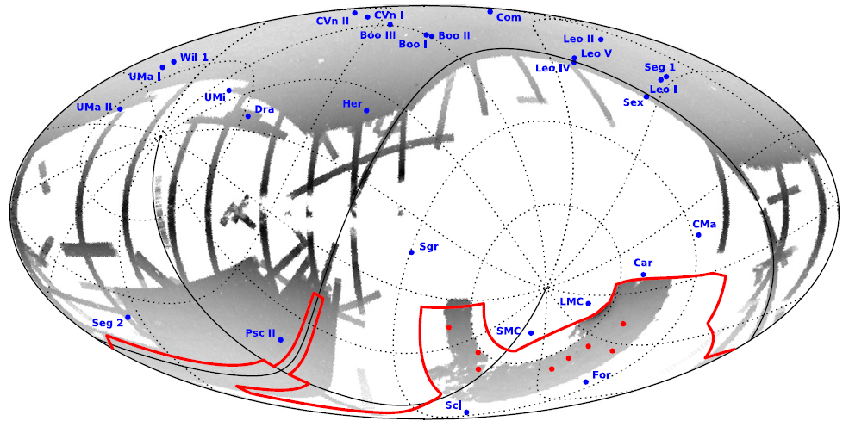
Milky Way Satellites as Target Environments for Dark Matter Indirect Detection
Segue 1
Sextans
Sculptor

Slide 9
Physical Features of Candidate Dwarf Spheroidal Galaxies
Dwarf Spheroidal Galaxy | $$log\left(\frac{J}{GeV^{2}cm^{−5}}\right)$$ | $$σ_{los}$$ $$\left(km s^{−1}\right)$$ | $$r_{h}$$ $$(pc)$$ | $$M_{h}$$ $$\left(10^{6}M_{⊙}\right)$$ | $$M_{V}$$ | $$D_{L}$$ $$(kpc)$$ | Telescopes
Sculptor | $${18.58}_{−0.05}^{+0.05}$$ | $${8.8}_{−0.2}^{+0.2}$$ | $${223}_{−5}^{+5}$$ | $${16.06}_{−1.09}^{+1.09}$$ | $${−11.04}_{−0.5}^{+0.5}$$ | $${83.9}_{−1.5}^{+1,5}$$ | (a), (c), (d)
Sextans | $${17.73}_{−0.12}^{+0.13}$$ | $${7.1}_{−0.3}^{+0.3}$$ | $${523}_{−23}^{+23}$$ | $${24.52}_{−3.15}^{+3.15}$$ | $${−9.1}_{−0.1}^{+0.1}$$ | $${92.5}_{−2.2}^{+2.2}$$ | (a), (c), (d)
Segue 1 | $${19.12}_{−0.58}^{+0.49}$$ | $${3.1}_{−0.8}^{+0.9}$$ | $${21}_{−5}^{+5}$$ | $${0.19}_{−0.14}^{+0.15}$$ | $${−1.5}_{−0.7}^{+0.7}$$ | $${23.0}_{−2.0}^{+2.0}$$ | (a), (b), (c)
Reticulum II B | $${18.88}_{−0.37}^{+0.39}$$ | $${3.4}_{−0.6}^{+0.7}$$ | $${34}_{−8}^{+8}$$ | $${0.37}_{−0.21}^{+0.24}$$ | $${−3.6}_{−0.1}^{+0.1}$$ | $${32.0}_{−2.0}^{+2.0}$$ | (a), (c), (d)
Telescope key
(a): CTA
(b): LHAASO
(c): KM3NeT
(d): MeerKAT

Slide 10
DAMPE’s Detection of an Unexplained Excess Flux

Slide 11
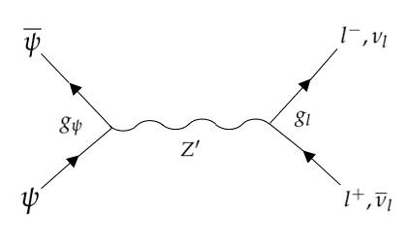
The Wukong WIMPs (Massive Leptophilic Majorana Particles)

Slide 12
Theoretical Basis for Research

Slide 13
Theoretical Basis for Research
Einasto profile
Cored
Burkert profile
Cored
NFW profile
Cusp
Zhao’s generalised version of the NFW profile
Cusp

Slide 14
Theoretical Basis for Research

Slide 15
Theoretical Basis for Research: Radio domain

Slide 16
Theoretical Basis for Research

Slide 17
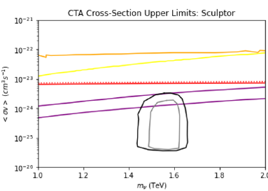
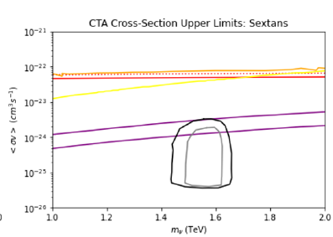
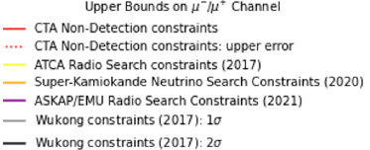
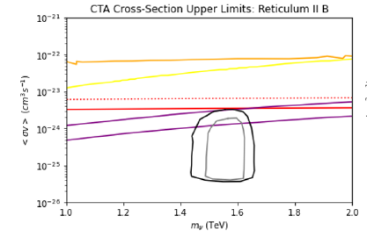
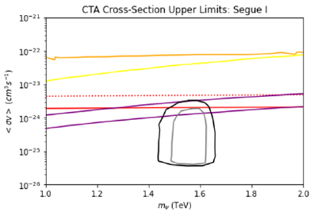
CTA Results: $μ^{−}/μ^{+}$ Channel

Slide 18
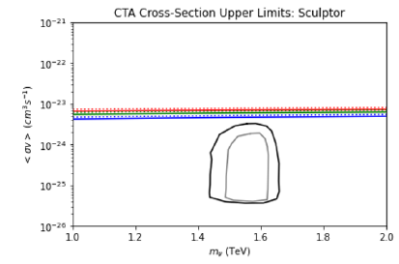
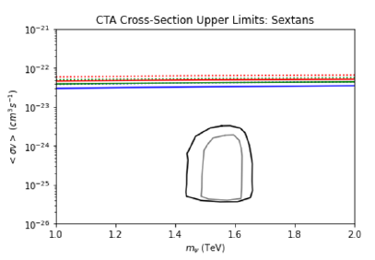
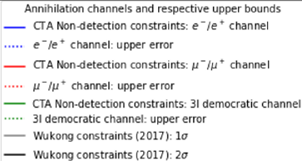
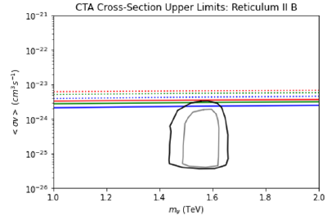
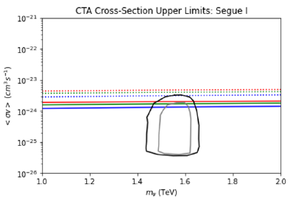
CTA Results: All Leptonic channels

Slide 19
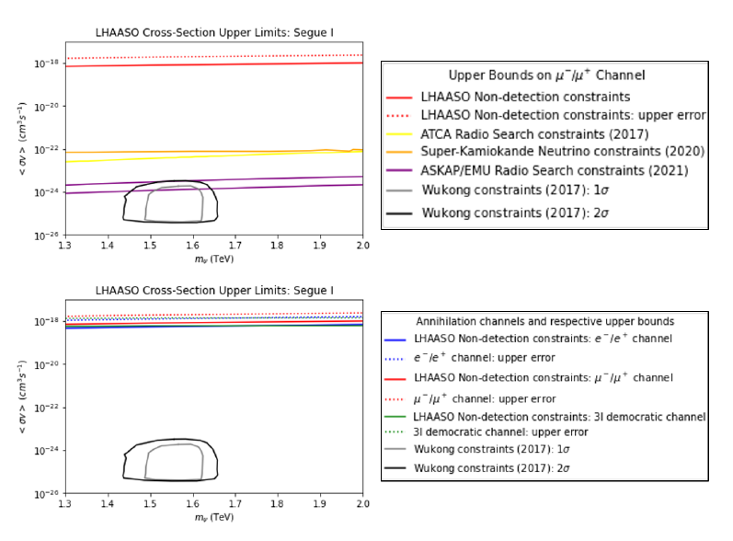
LHAASO Results

Slide 20
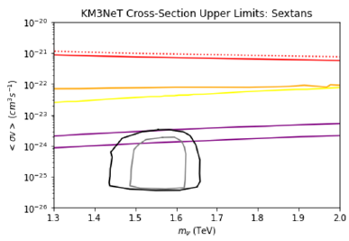
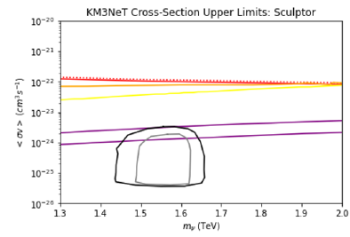
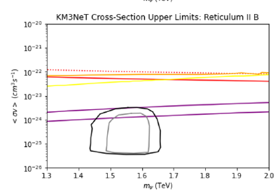
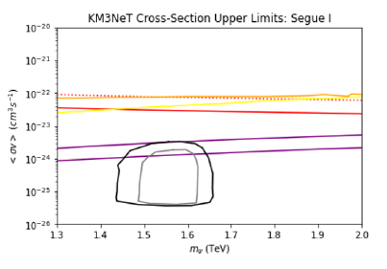
KM3NeT Results: $μ^{−}/μ^{+}$ Channel

Slide 21
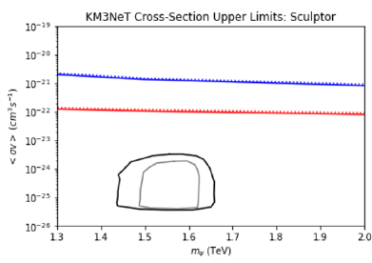
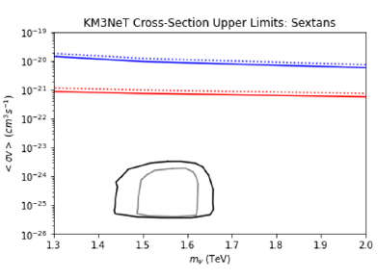
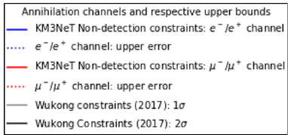
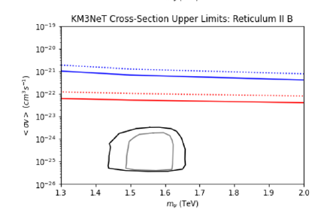
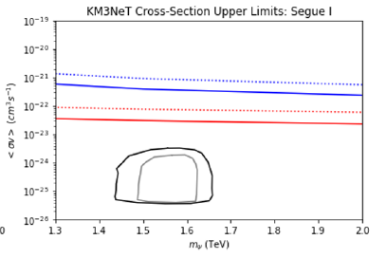
KM3NeT Results:
$e^{−}/e^{+}$ vs. $μ^{−}/μ^{+}$

Slide 22
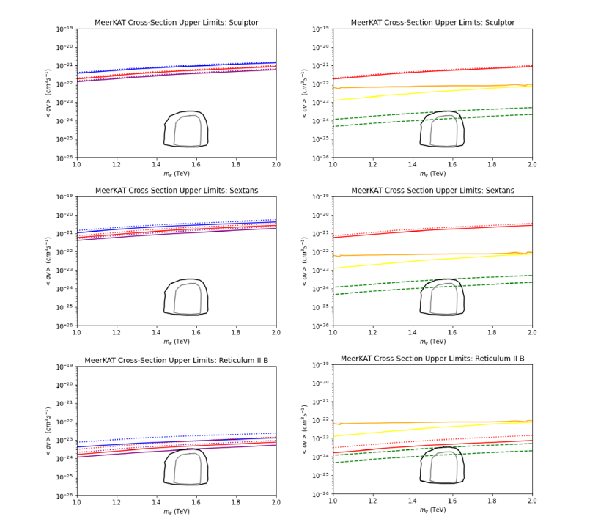
Results: MeerKAT

Slide 23
Results: MeerKAT

Slide 24
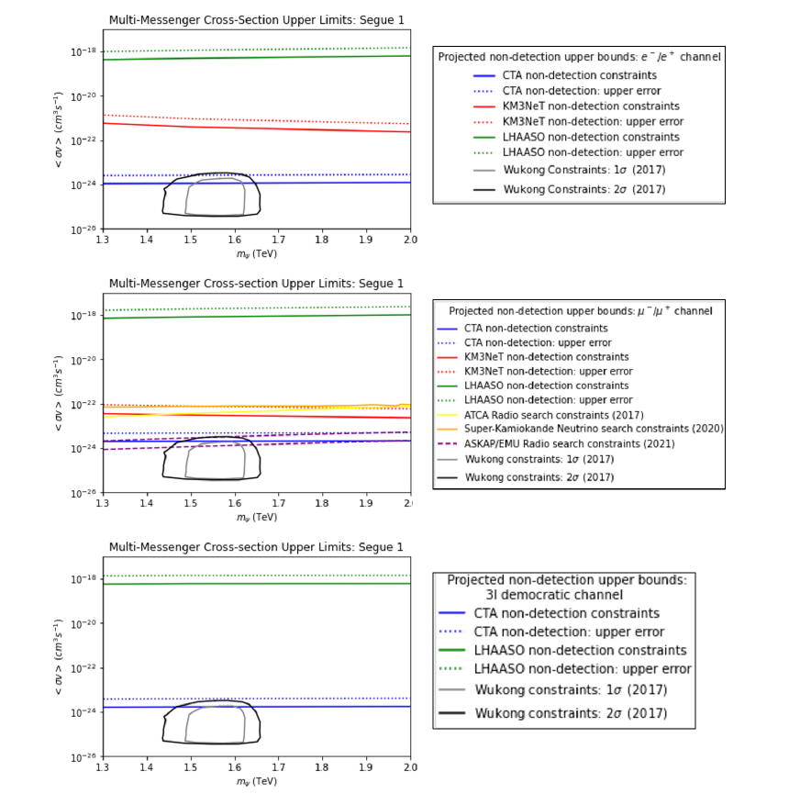
Multi-messenger Analysis: Segue 1

Slide 25
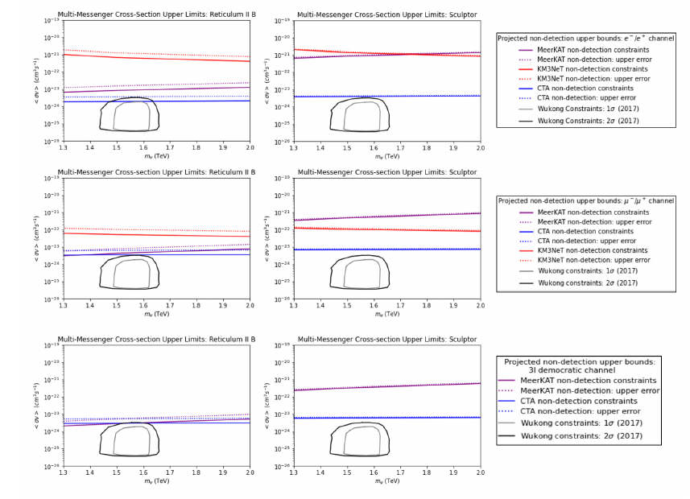
Multi-messenger Analysis: Sculptor and Reticulum II

Slide 26
Multi-messenger Analysis: Sculptor and Reticulum II

Slide 27
Summary and Conclusions
Tracing the historical trajectory of the Dark Matter mystery and the evolution of the Dark Matter paradigm
Repeated failures to detect Dark Matter by terrestrial Dark Matter direct detection experiments
Repeated failures to detect Dark Matter by collider searches
Indirect detection as an alternative and searches conducted thus far
Exploring the potential of next generation multi-messenger telescopes: CTA, LHAASO, KM3NeT and MeerKAT
The Wukong WIMPs
Laying theoretical foundation and devising model-independent test of the massive leptophilic Majorana particles
Dwarf Spheroidal galaxies as potential target environments → Sculptor, Sextans, Segue 1 and Reticulum II

Slide 28
Summary and Conclusions
CTA: Ultrafaints produce stronger non-detection bounds, albeit with larger associated errors.
LHAASO: Non-detection bounds are weakest amongst all telescopes considered → LHAASO non-detection upper bounds for Segue 1 are approximately 5 orders of magnitude weaker than those imposed by CTA
KM3NeT: No novel constraints for all dwarf spheroidals, in the case of all leptonic channels considered
MeerKAT: Non-detection constraints in the case of Reticulum II are stronger than they are for Sculptor and Sextans. The Sculptor constraints are significantly stronger than those for Sextans. For $μ^{−}/μ^{+}$ channel → Stronger than Super-Kamiokande constraints and competitive with ASKAP/EMU constraints
Multi-messenger: Strongest bounds from CTA observations of Segue 1 and MeerKAT observations of Reticulum II
Empirical ground continues to shrink beneath the feet of the WIMP hypothesis
Alternatives? Axions; Sterile Heavy Neutrinos, MOND
=

