Slide 1
Possible origins of > 10 TeV photons detected from the burst of all time (BOAT) GRB 221009A
Soeb Razzaque
Centre for Astro-Particle Physics (CAPP)
University of Johannesburg | South Africa
srazzaque@uj.ac.za | https://www.uj.ac.za/faculties/science/capp

Slide 2
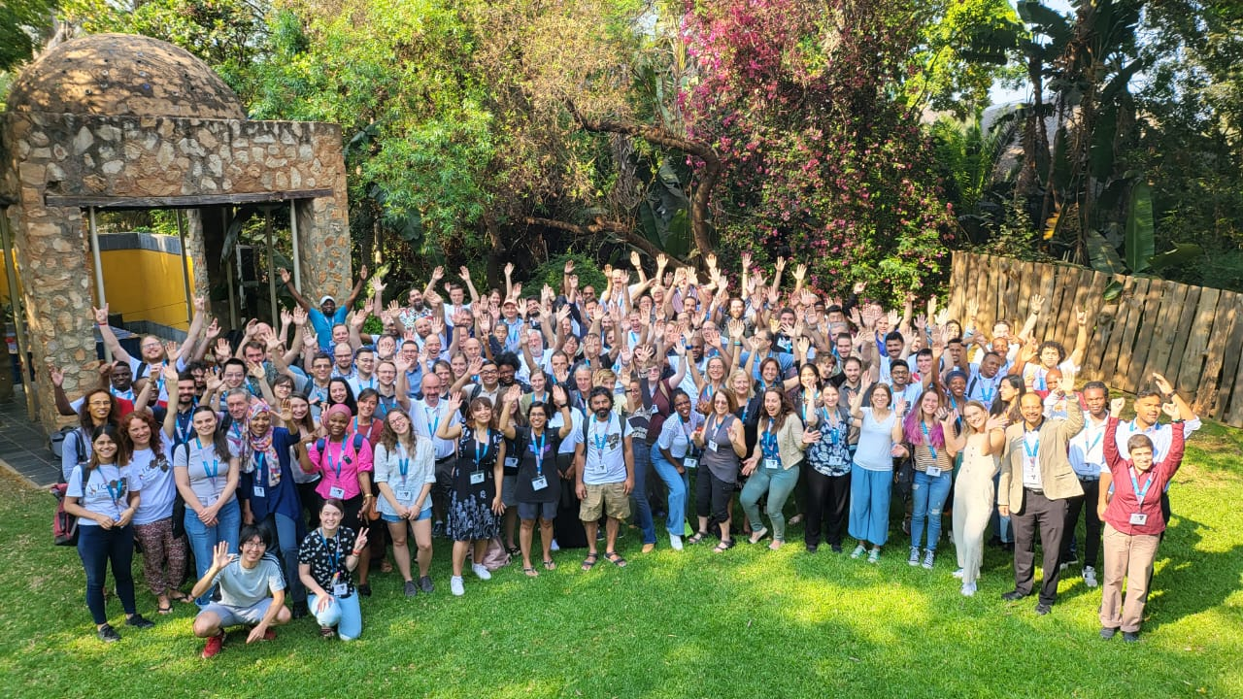
Gamma-Ray Burst on October 09, 2022

Slide 3
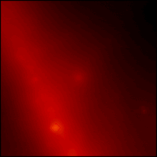
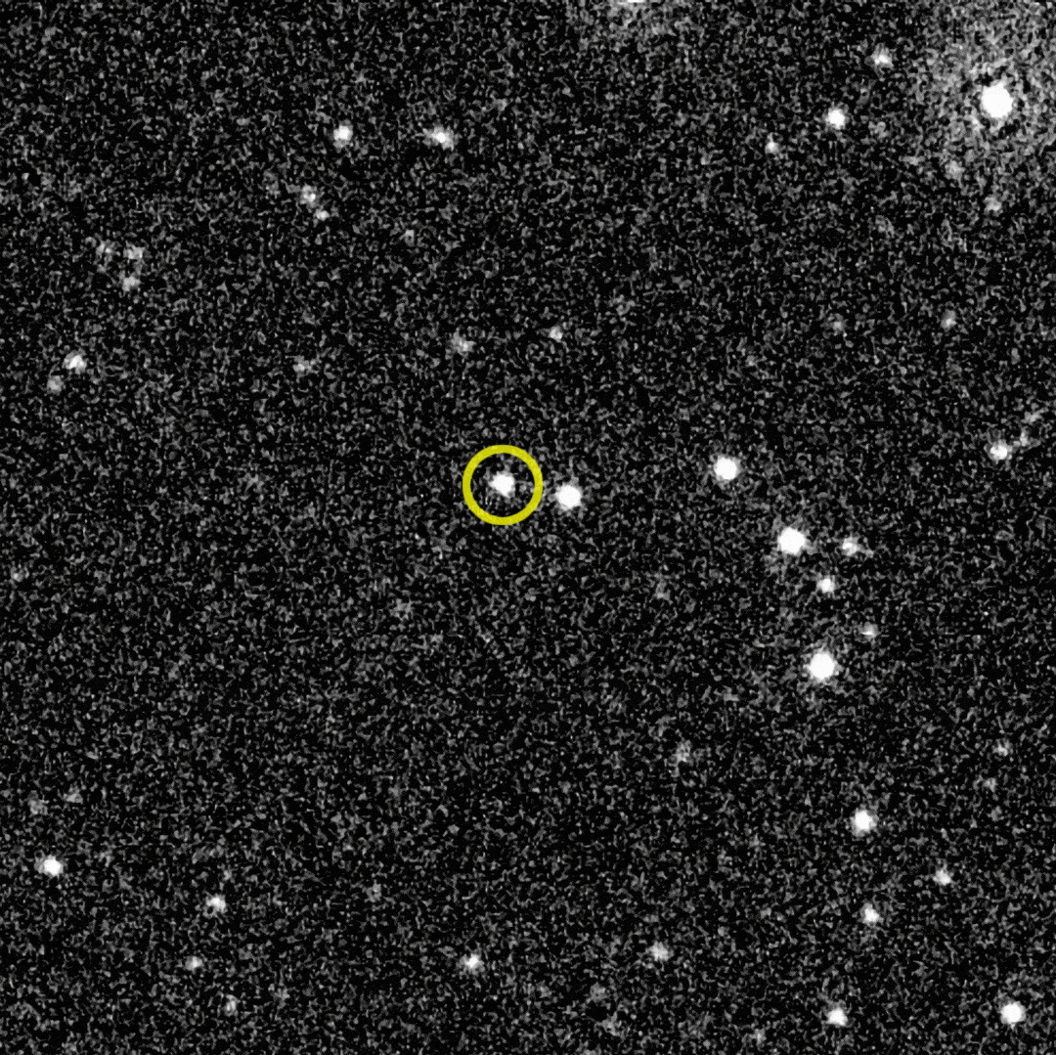
Gamma-Ray Burst on October 09, 2022
Detected by
Swift-BAT (also called Swift J1913.1+1946)
Fermi-GBM (13:16:59.99 UT)
Dichiara+2022
Veres+2022
Fermi-LAT 10 hr time lapse
Redshift 0.151 (2nd nearest long GRB)
de Ugarte Postigo+2022
Brightest GRB ever detected!
Once in ~130 yr!
Atteia-2022
Credit: NASA/DOE/Fermi LAT Collaboration
Isotropic γ-ray energy: (2-6) x10⁵⁴ erg
de Ugarte Postigo+2022
Astronomy Picture of the Day
Fermi-LAT detected >100 MeV γ until 25 ks
Highest-energy γ is 99.3 GeV @ 240 s
Pillera+2022
Bissaldi+2022
Swift-UVOT 10 hr time lapse
LHAASO detected over 5000 γ (0.5-18 TeV) within 2ks
First GRB ever detected with > 10 TeV γ
Huang+2022
Carpet-2 detected a 251 TeV γ @ 4536 s
Credit:
NASA/Swift/B. Cenko
Dzhappuev+2022

Slide 4
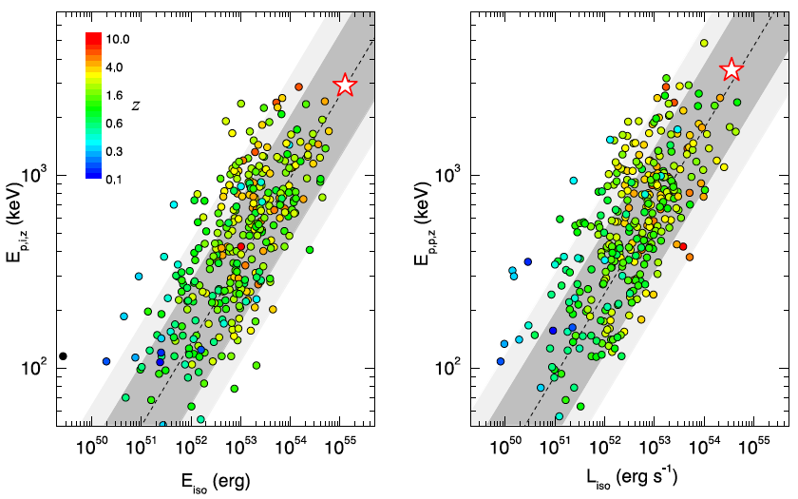
The Burst of All Time (BOAT)
Konus-Wind data
Isotropic-equiv. energy release
$E_{iso}≈1.2×{10}^{55}$ erg
($≥6.5M_{sun}$)
Isotropic-equiv. peak luminosity
$L_{iso}≈3.4×{10}^{54}$ erg/s
Beaming-corrected energetics:
$\sim {10}^{−1}−{10}^{−3}$ times smaller
Amati relation
Yonetoku relation
Depending on the uncertain jet angle
Frederiks+2023

Slide 5
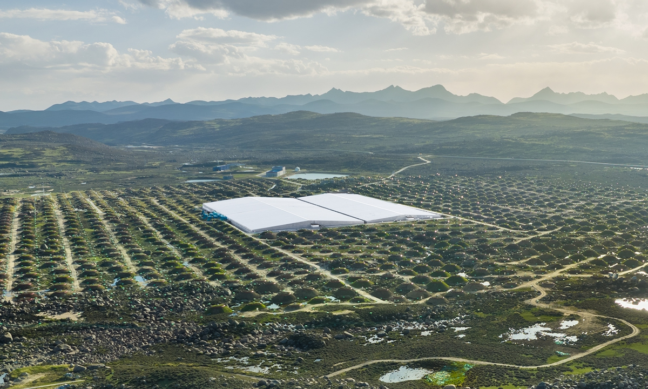
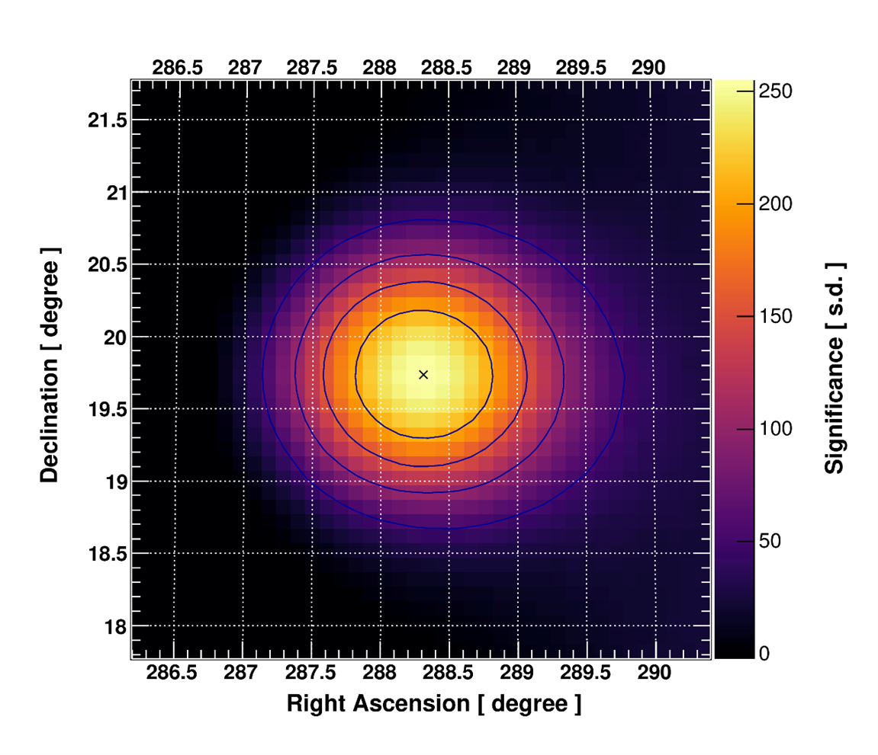
>10 TeV gamma-ray from GRB 221009A
LHAASO detected photons with energy up to 18 TeV
GRB 221009A significance map
CARPET-2 detected a 251 TeV photon!

Slide 6
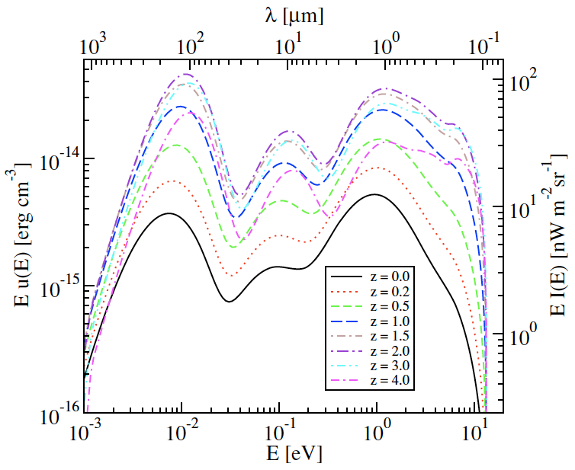
Extragalactic Background Light
$$γ+γ_{EBL}=e^{−}+e^{+}$$
Finke, SR & Dermer 2010

Slide 7
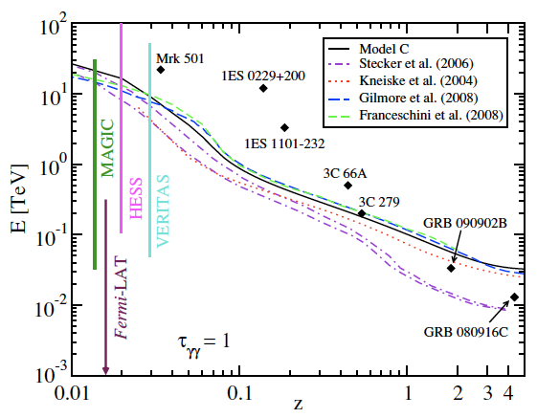
Gamma-ray Horizon of the universe
$$F_{obs}(E)=F_{int}(E) exp⁡[−τ_{γγ}(E,z)]$$
E = 18 TeV, z = 0.15 :
$${≤4.5×10}^{−4.5}$$
Intrinsic flux must be many many orders of magnitude higher, if 18 TeV γ coming directly from the GRB
Finke, SR & Dermer 2010

Slide 8
BSM and Conventional Explanations
Mixing of photons with axion-like particles (ALPs)
Baktash+2022, Galanti+2022, Nakagawa+2023, Troitsky 2022
Lorentz-invariance violation
Finke & SR 2022, Li & Ma 2022, Zhu & Ma 2022
Radiative decay of heavy neutrino with a transitional magnetic dipole moment produced at the source
Cheung 2022, Smirnov & Trautner 2022, Brdar & Li 2023
Invisible decay of active neutrinos to ALPs and converting back to photons
Huang+2023
Uncertainty in the EBL models
Zhao+2023
Gamma-rays produced by Ultrahigh-energy cosmic rays (UHECRs) at the source
Sahu+2022, Zhang+2023
Ultrahigh-energy cosmic ray induced cascade in the intergalactic media
Das & SR 2022, Batista 2022, Mirabal 2022

Slide 9
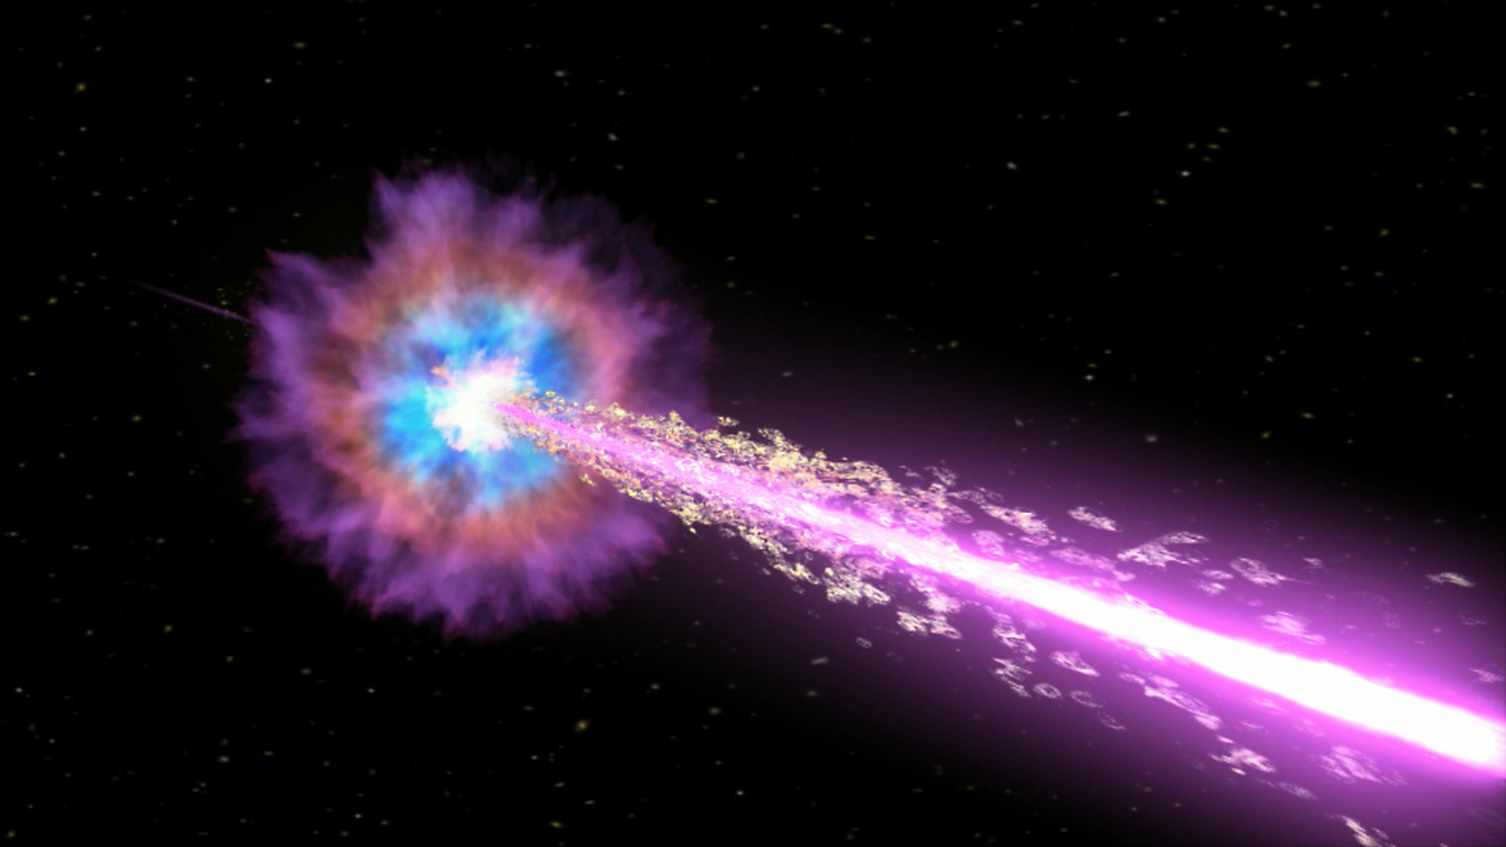
Possible Evidence for Lorentz Invariance Violation

Slide 10
Lorentz Invariance Violation
Quantum gravity theories apply above an energy scale E_{QG} close to the Plank energy
$E_{Planck}=\sqrt{\frac{ℏc^{5}}{G}}≈1.2×{10}^{28}$ eV
At this energy scale Lorentz invariance is violated
Special Theory of Relativity is no longer valid
Speed of light is not constant anymore
Photon dispersion relation in QG
$$E^{2}−p^{2}c^{2}=±E^{2}{\left(\frac{E}{E_{QG}}\right)}^{n}$$
Threshold energy (subluminal) for γγ → e⁺e–
Higher threshold energy →
lower opacity for γ-ray propagation in the intergalactic media filled with IR-UV background radiation fields (extragalactic-background light)
$$E_{th}=\frac{m_{e}^{2}c^{4}}{E_{γ}}{+\frac{1}{4}\left(\frac{E_{γ}}{E_{QG}}\right)}^{n}E_{γ}$$
Jacob & Piran 2008

Slide 11
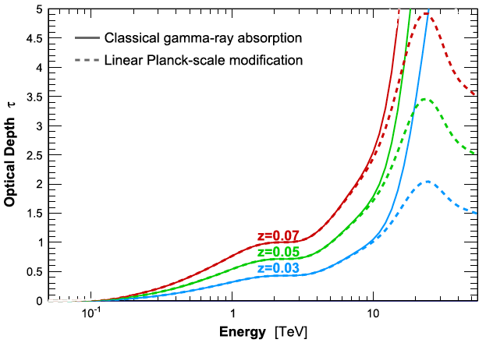
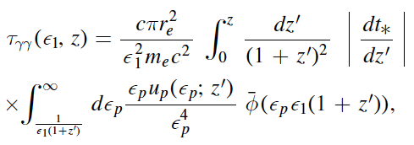
LIV and gamma-ray Opacity
γγ → e⁺e– opacity for a photon with energy ε₁m_{e}c² originated at redshift z
$${n=1; E}_{QG}{=E}_{Planck}$$
Finke & SR ApJL 2023
Biteau & Williams 2015

Slide 12
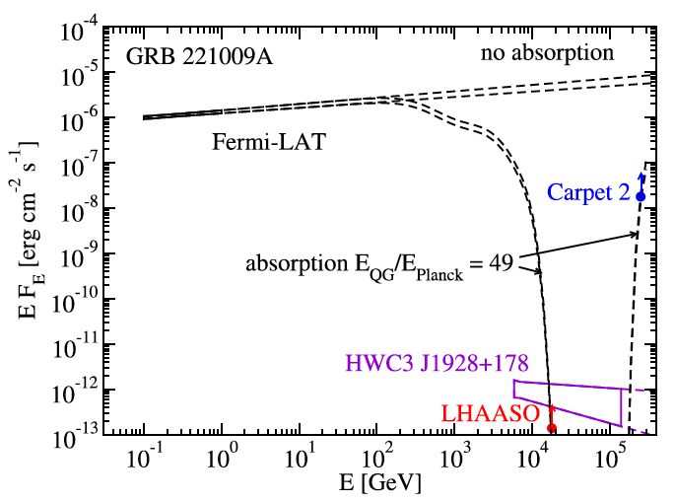
SED of GRB 221009A
Detected
z = 0.151
$${\left.\frac{dN}{dE}\right|}_{obs}={\left.\frac{dN}{dE}\right|}_{int}e^{−τ_{γγ}(E,z)}$$
Fermi-LAT flux
LIV
effect
Pillera+2022, GCN
95% flux limit for
LHAASO flux @ 18 TeV
Carpet-2 flux @ 251 TeV
Finke & SR ApJL 2023

Slide 13
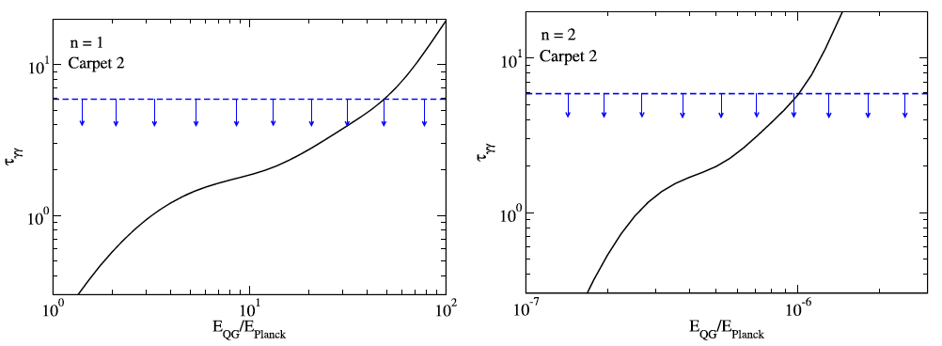
Constraints on QG Energy scale
Assume extrapolated Fermi-LAT flux as the intrinsic upper limit
For LHAASO
Then
Consistent with no-LIV
Limits from 251 TeV photon detected by Carpet 2
$E_{QG} {≤49 E}_{Planck} \left(n=1\right)$
$E_{QG} {≤{10}^{−6} E}_{Planck} \left(n=2\right)$
Finke & SR ApJL 2023

Slide 14
Ultrahigh-energy cosmic ray signature

Slide 15
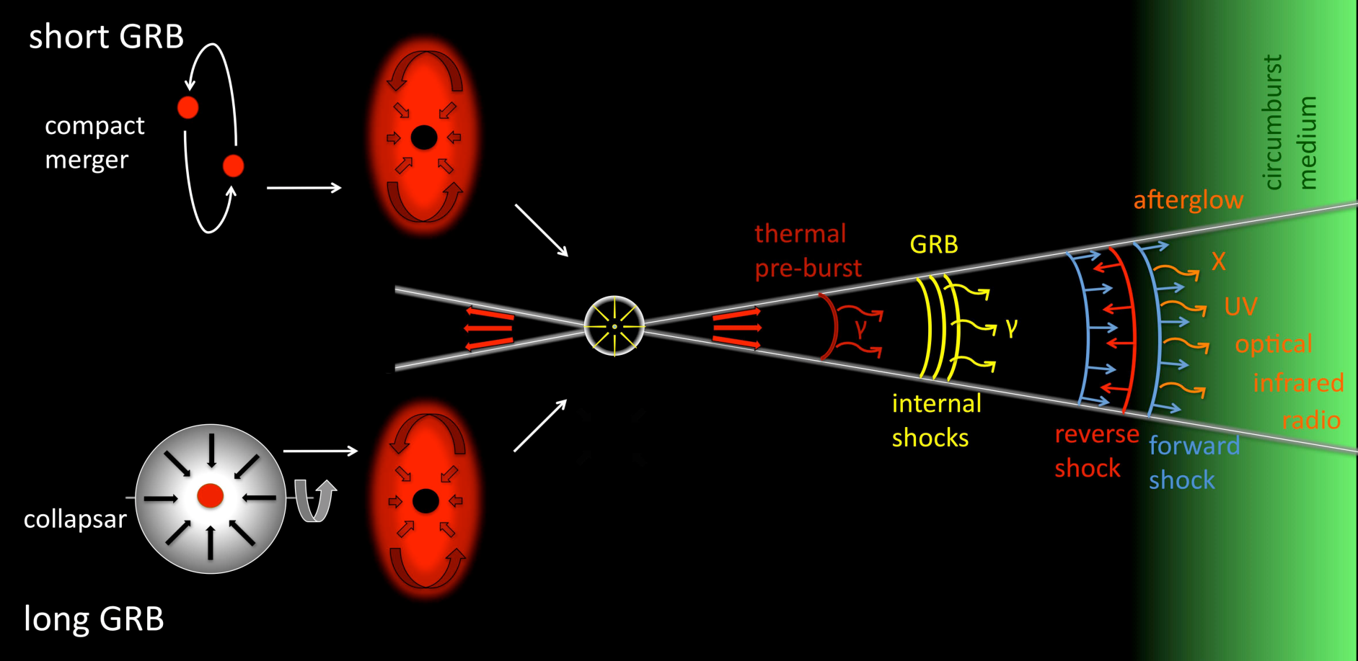
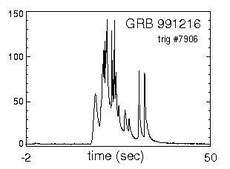
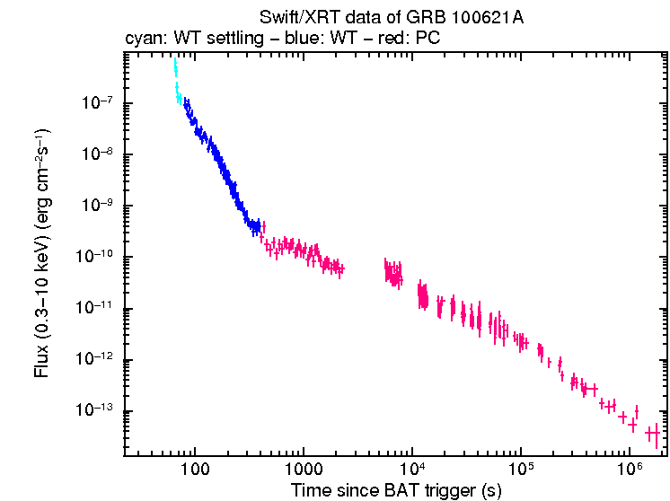
GRB Model
Rees, Meszaros, Paczynski, Narayan, Piran, …
Decelerating plasma material
Collisions between plasma material
Cartoon by Gomboc+2012

Slide 16
SSC and UHECR Line-of-Sight Emissions
The attenuation factor for flux coming directly from the GRB 221009A
$$e^{−τ_{γγ}(18 TeV)} \sim 4.5 ×{10}^{−4.5}$$
Synchrotron-self-Compton (SSC): Very high-energy γ
Ultrahigh-energy cosmic rays (UHECRs)
UHECRs interacts with the CMB and EBL photons:
→ produce pions/kaons and e+e– pairs
initiate an electromagnetic cascade
photons within observable angle
→ line-of-sight emission
Cartoon by Gomboc+2012

Slide 17
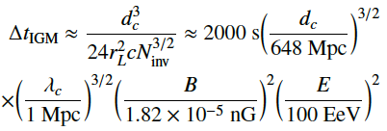
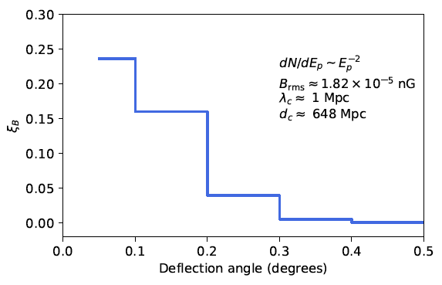
Interpreting LHAASO detection by UHECR-induced L.O.S. emission
Time delay, due to propagation in the extragalactic magnetic field (EGMF), for UHECR protons from the GRB
Use CRPropa Monte Carlo code for proton propagation, interactions and secondary cascades
Fraction of flux within a given opening angle
Constrain on the EGMF
To match with LHAASO detection until 2000 s post trigger → compatible with current constraints on the EGMF from blazar data
Das & SR A&AL 2023

Slide 18
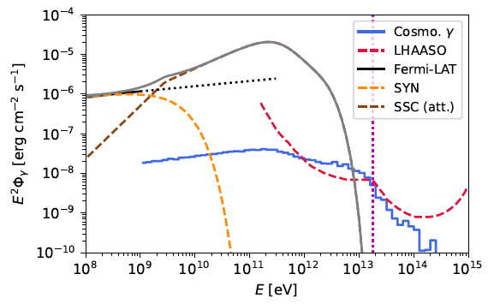
SED of GRB 221009A
Snapshot SED at 500 s post trigger
Detection of a 99.3 GeV γ by LAT
LAT
LHAASO
Scaled LHAASO sensitivity for 2000 s
Das & SR A&AL 2023

Slide 19
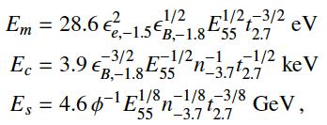
Model Parameters
Adiabatic blastwave in a constant density interstellar medium of density: n = 10^{–3.7}n _{– 3.7} cm^{–3}
Kinetic energy (isotropic) of the blastwave: E_{k} = 10⁵⁵E₅₅ erg
Microrphysical parameters: ε_{e} = 10^{–1.5}ε_{e, – 1.5} ; ε_{B} = 10^{–1.8}ε_{B, – 1.8}
Spectral break energies at t = 10^{2.7}t_{2.7} s
Maximum UHECR proton energy
Slow-cooling spectrum
Total energy (isotropic) in UHECRs :
~ 4 x10⁵³ erg
SSC break energies:
Compare to the total energy (isotropic) in γ :
E_{iso} = (2-6) x10⁵⁴ erg

Slide 20
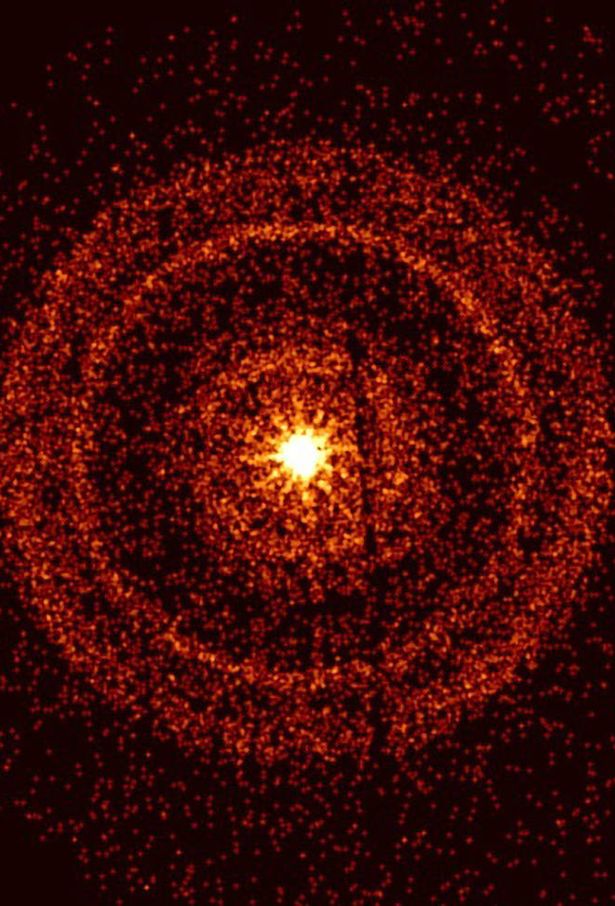
Summary
GRB 221009A provides a rare opportunity to test fundamental physics and astrophysics
Plausible evidence of LIV is intriguing
$E_{QG} {≤49 E}_{Planck} \left(n=1\right)$
$E_{QG} {≤{10}^{−6} E}_{Planck} \left(n=2\right)$
Line-of-sight emission from UHECR propagation provides a natural interpretation of >10 TeV γ detection
Emission coming directly from z = 0.151 is highly attenuated
Could be the first evidence that GRBs produce UHECRs
Swift-XRT detection of GRB 221009A @ 1 hr
Credit: NASA/Swift/A. Beardmore (University of Leicester)

Slide 21
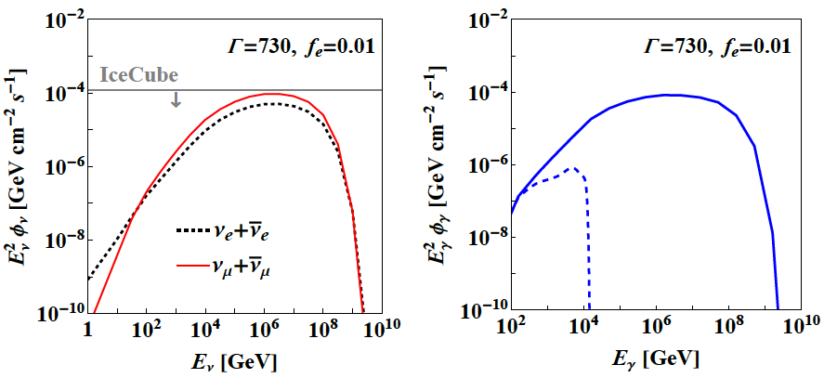
Prompt Neutrino Flux
Huang+2022

