Slide 1


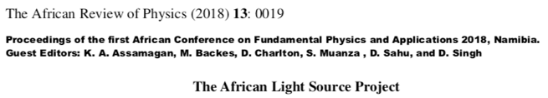

AfLS – deep roots 3 decades, formalised and mandated since 2015
Conferences 2015, … pause for AAS …. 2019, 2020,2021
Formal Roadmap in progress since 2015
  Bottom Up: Training, User Base, W/S, Conferences, Networks
  Top Down: Governments, AU, National & Pan African VAs, PBs, Stakeholders
CDR
LOI & MoUs
Authoring
  Papers, News articles
  Website, Social Media,
Johannesburg – Soccer World Cup 2010
https://www.worldscientific.com/doi/abs/10.1142/S0217732318300033
http://lamp.ictp.it/index.php/aphysrev/article/view/1610/586
  Useful Websites
  AfLS Website http://africanlightsource.org
  AfLS3 2021 https://events.saip.org.za/e/AFLS3
  AfLS4 2022 https://events.saip.org.za/e/AfLS2022

Slide 2
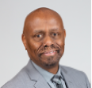

1st formal Pan-African call. AfLS is in the ALC launch docs
Global conversations about the AfLS
Formation of AfLS Interim Steering Committee
AfLS1 Conference and AfLS SC
AfLS2020
IAC, LoS/MoU
CDR Process
AfLS2 Conference
First publications from Egypt then SA
1990
1995
2000
2005
2010
2015
2020
Letter to SA-NRF
1st African HE Summit : AfLS in the Declaration
AfLS Foundation Legal Entity
SA Synchrotron Initiative
AFLS3
Conference
AU: STC-EST, AAS call to support AfLS as a Pan African initiative
EBASI call to enhance local laser infrastructure toward a Pan-African LS.
AU: Exec Council call to support AfLS as a Pan African initiative
Ghana Govt support
+ several others
AAS-ASI
In talks
Many AfLS Roadmap related activities

Slide 3
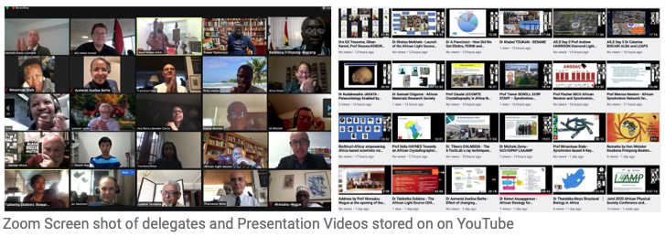
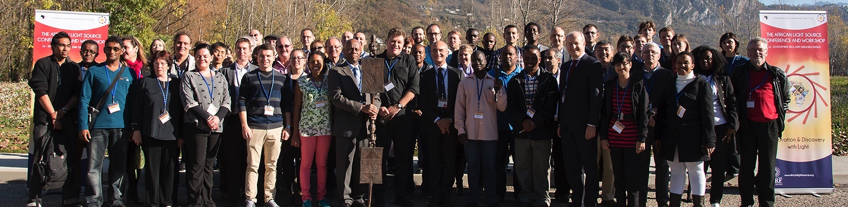
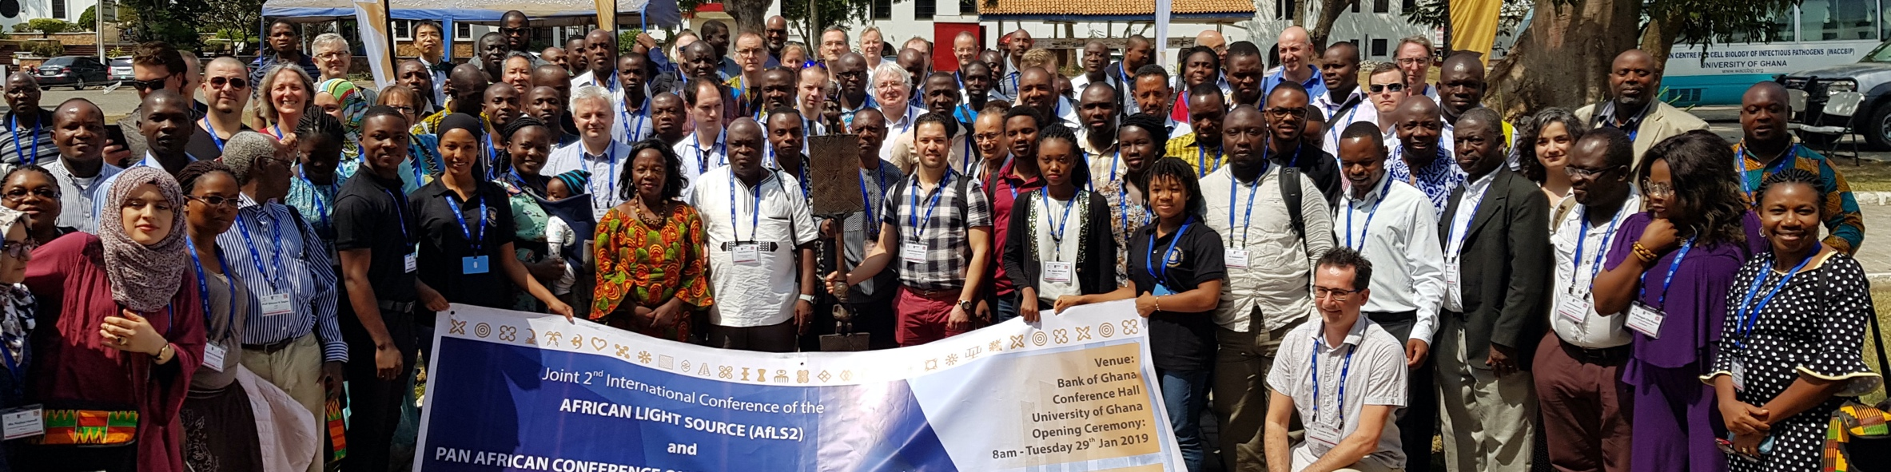
Conferences
2015, 2019, 2020,
2021, 2022
2021
Now 5 African Governments involved
Many co-conveners
Prof bodies
Academies
2021
>500 registrations
  AfLS1 2015
  https://events.saip.org.za/event/61/
  AfLS 2019
  https://events.saip.org.za/event/145/
  AfLS 2020
  https://events.saip.org.za/event/211/
  AfLS3 2021
  https://events.saip.org.za/e/AFLS3
  AfLS4 2022
  https://events.saip.org.za/e/AfLS2022

Slide 4
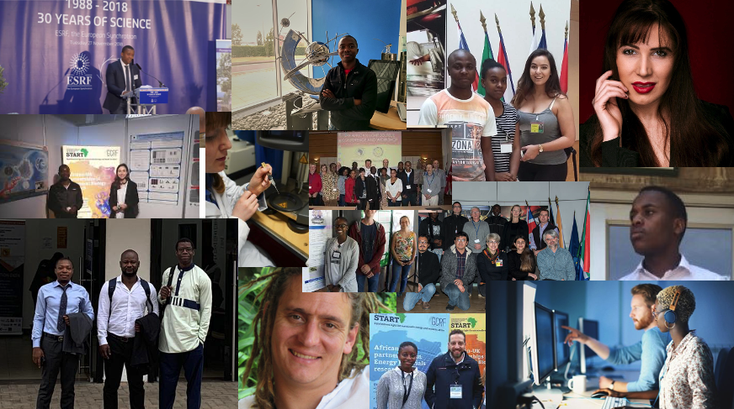






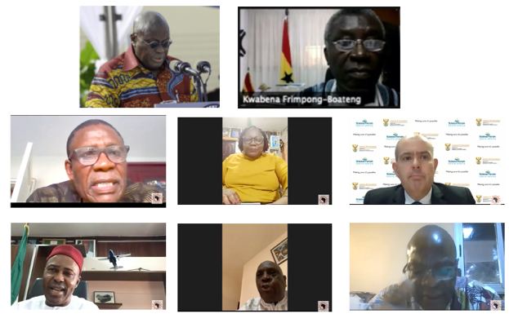

Roadmap : AfLS Conference 2015
    http://events.saip.org.za/conferenceDisplay.py/getPic?picId=66&confId=61
Bottom Up
Human Capacity: scientists, engineers, technicians
African scientists access existing LSs
African relationships with existing LSs.
Involvement of industry
Community for the African light source Users
Outreach
Top Down
Strategic approach to African Governments and (Pan) African orgs.
Conceptual Design Report (CDR)
Inter-African co-operation on Local / Regional feeder infrastructure
African multinational beamlines at existing LSs
Regional / Pan African membership of existing LSs
Technical Design Report (TDR)
MoU
LoS

Slide 5
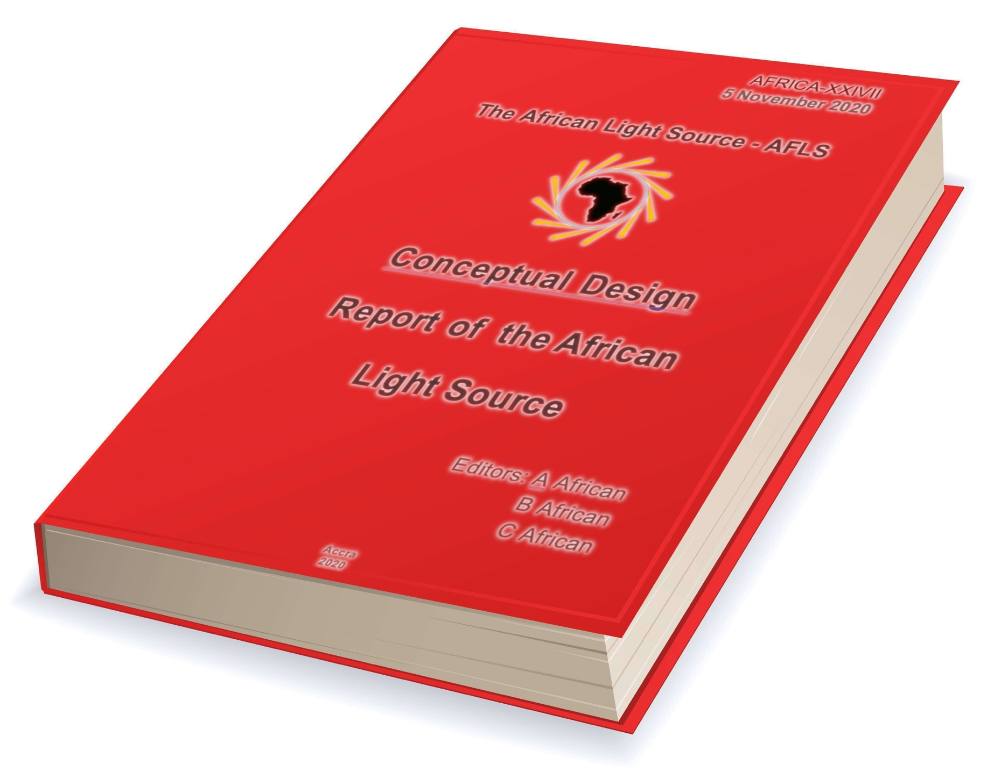
Conceptual Design Review
CDR 5 Volumes
Volume I.
Scientific, Socio-Economic, Educational and Political Benefits
Volume II.
Machine Design Concepts
Volume III.
Scientific Capabilities and Beamline Technical Concepts
Volume IV.
Building Design and Infrastructure
Volume V.
Finance, Governance
Add link to Town Hall … meeting monthly, wrintg is in progress

Slide 6
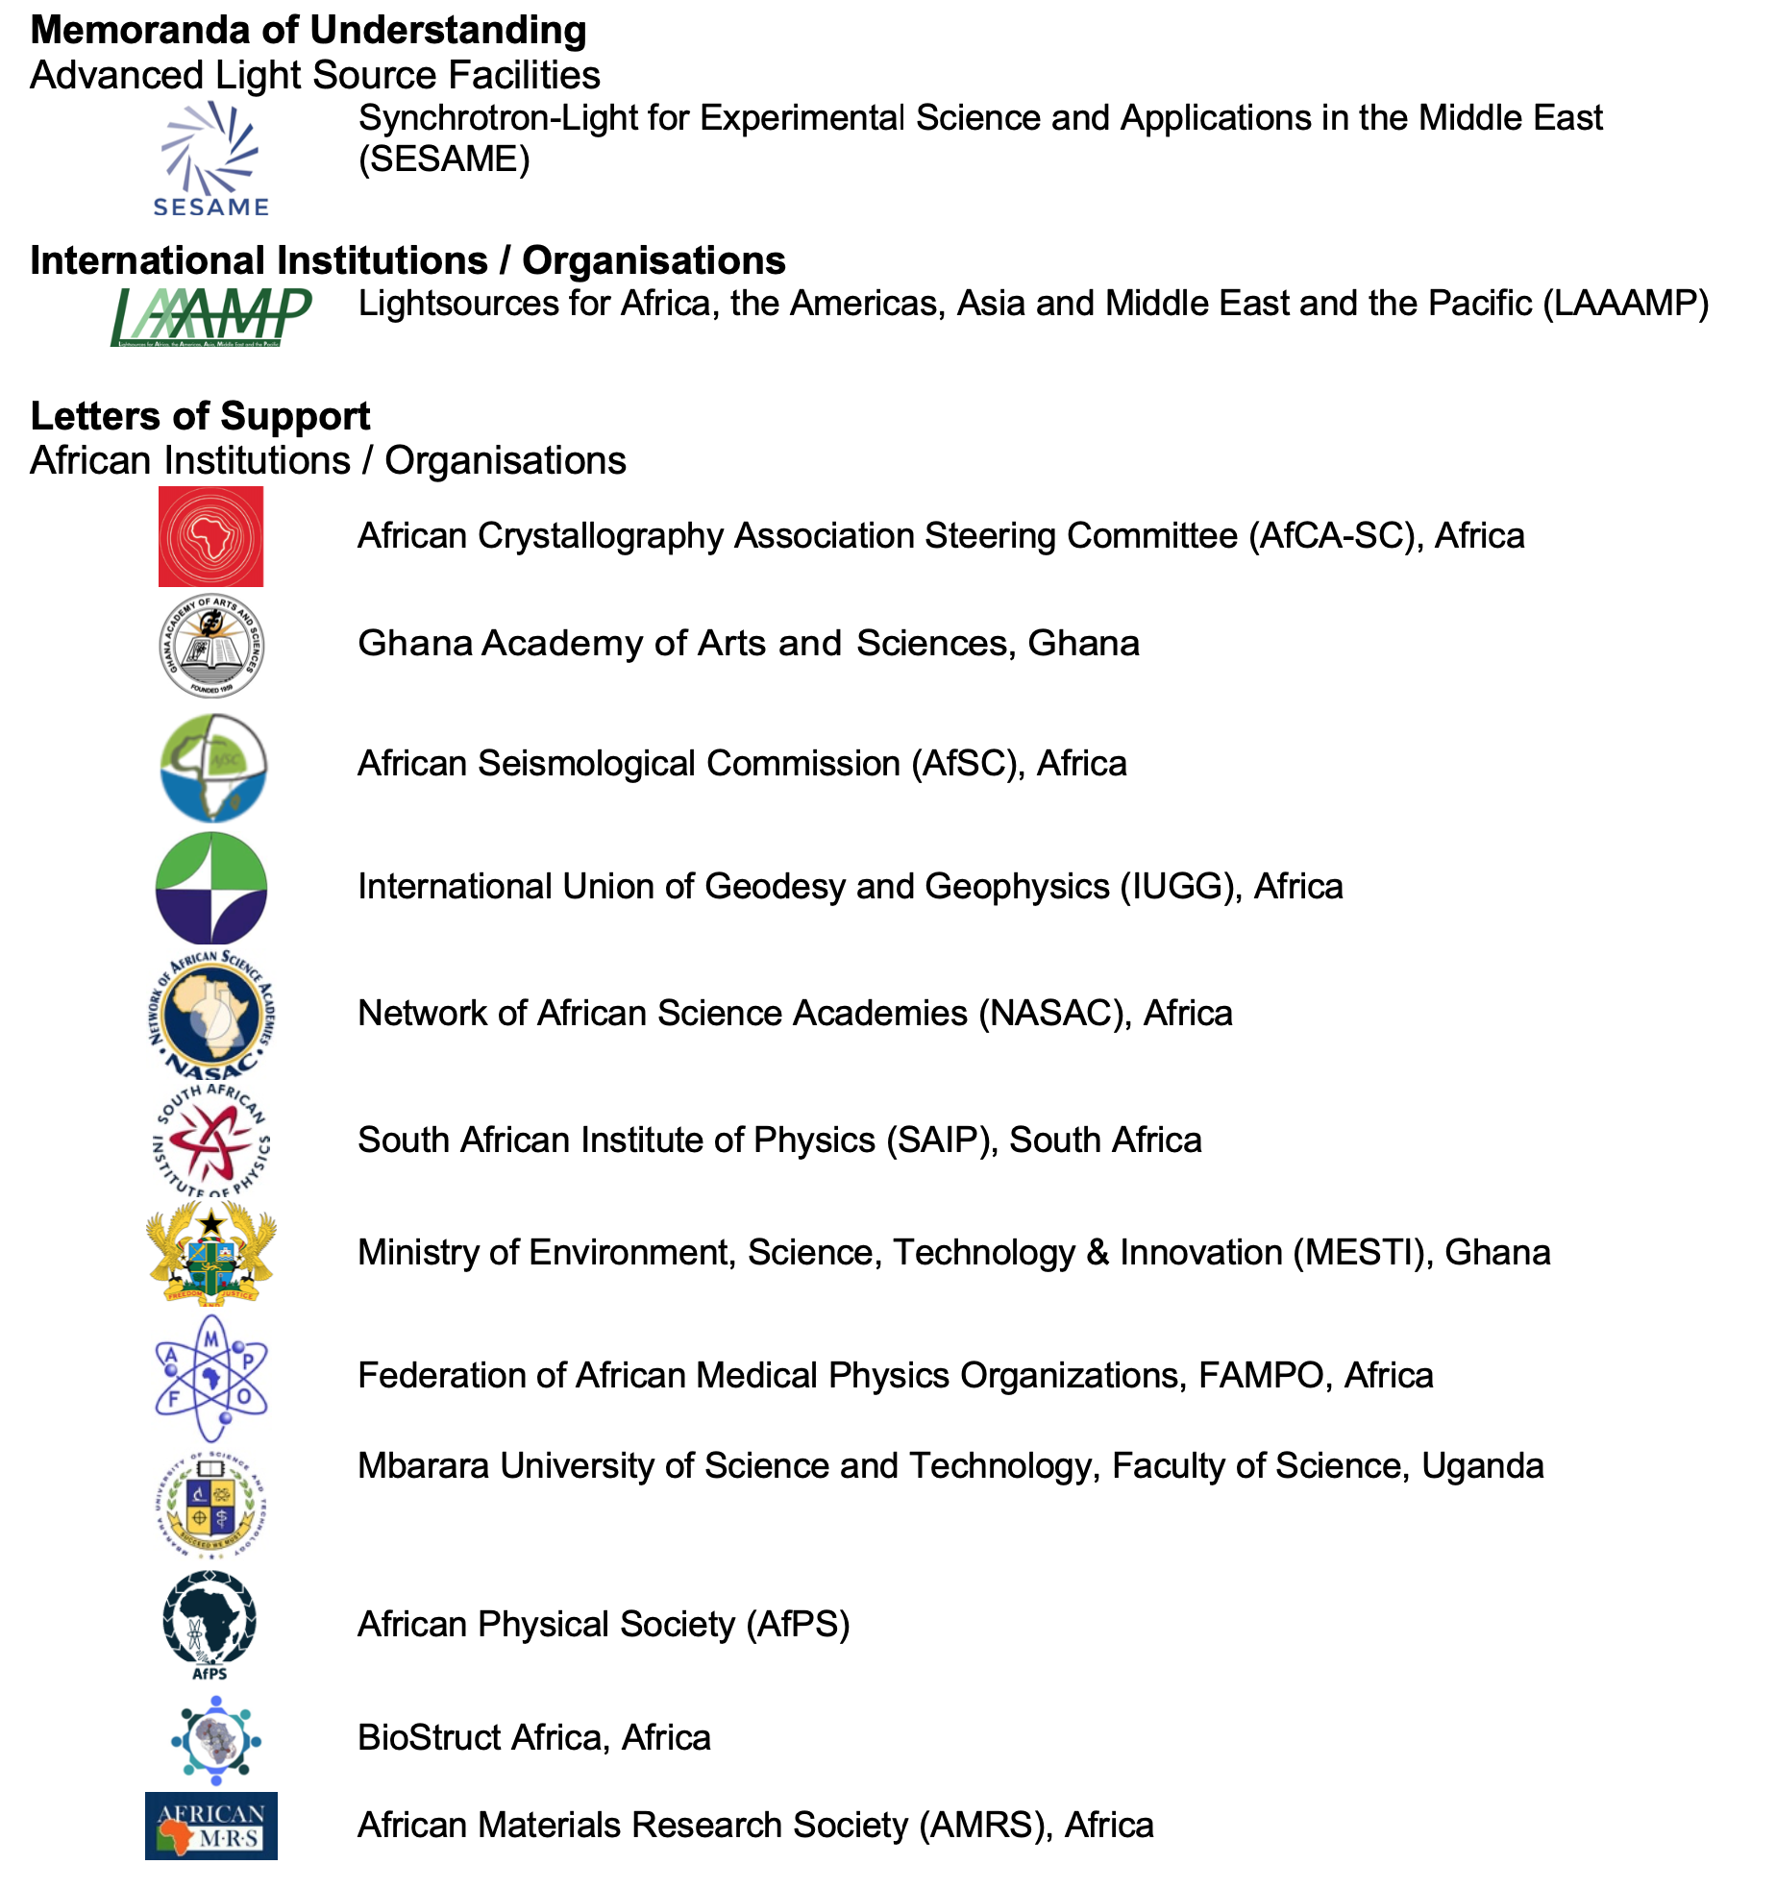
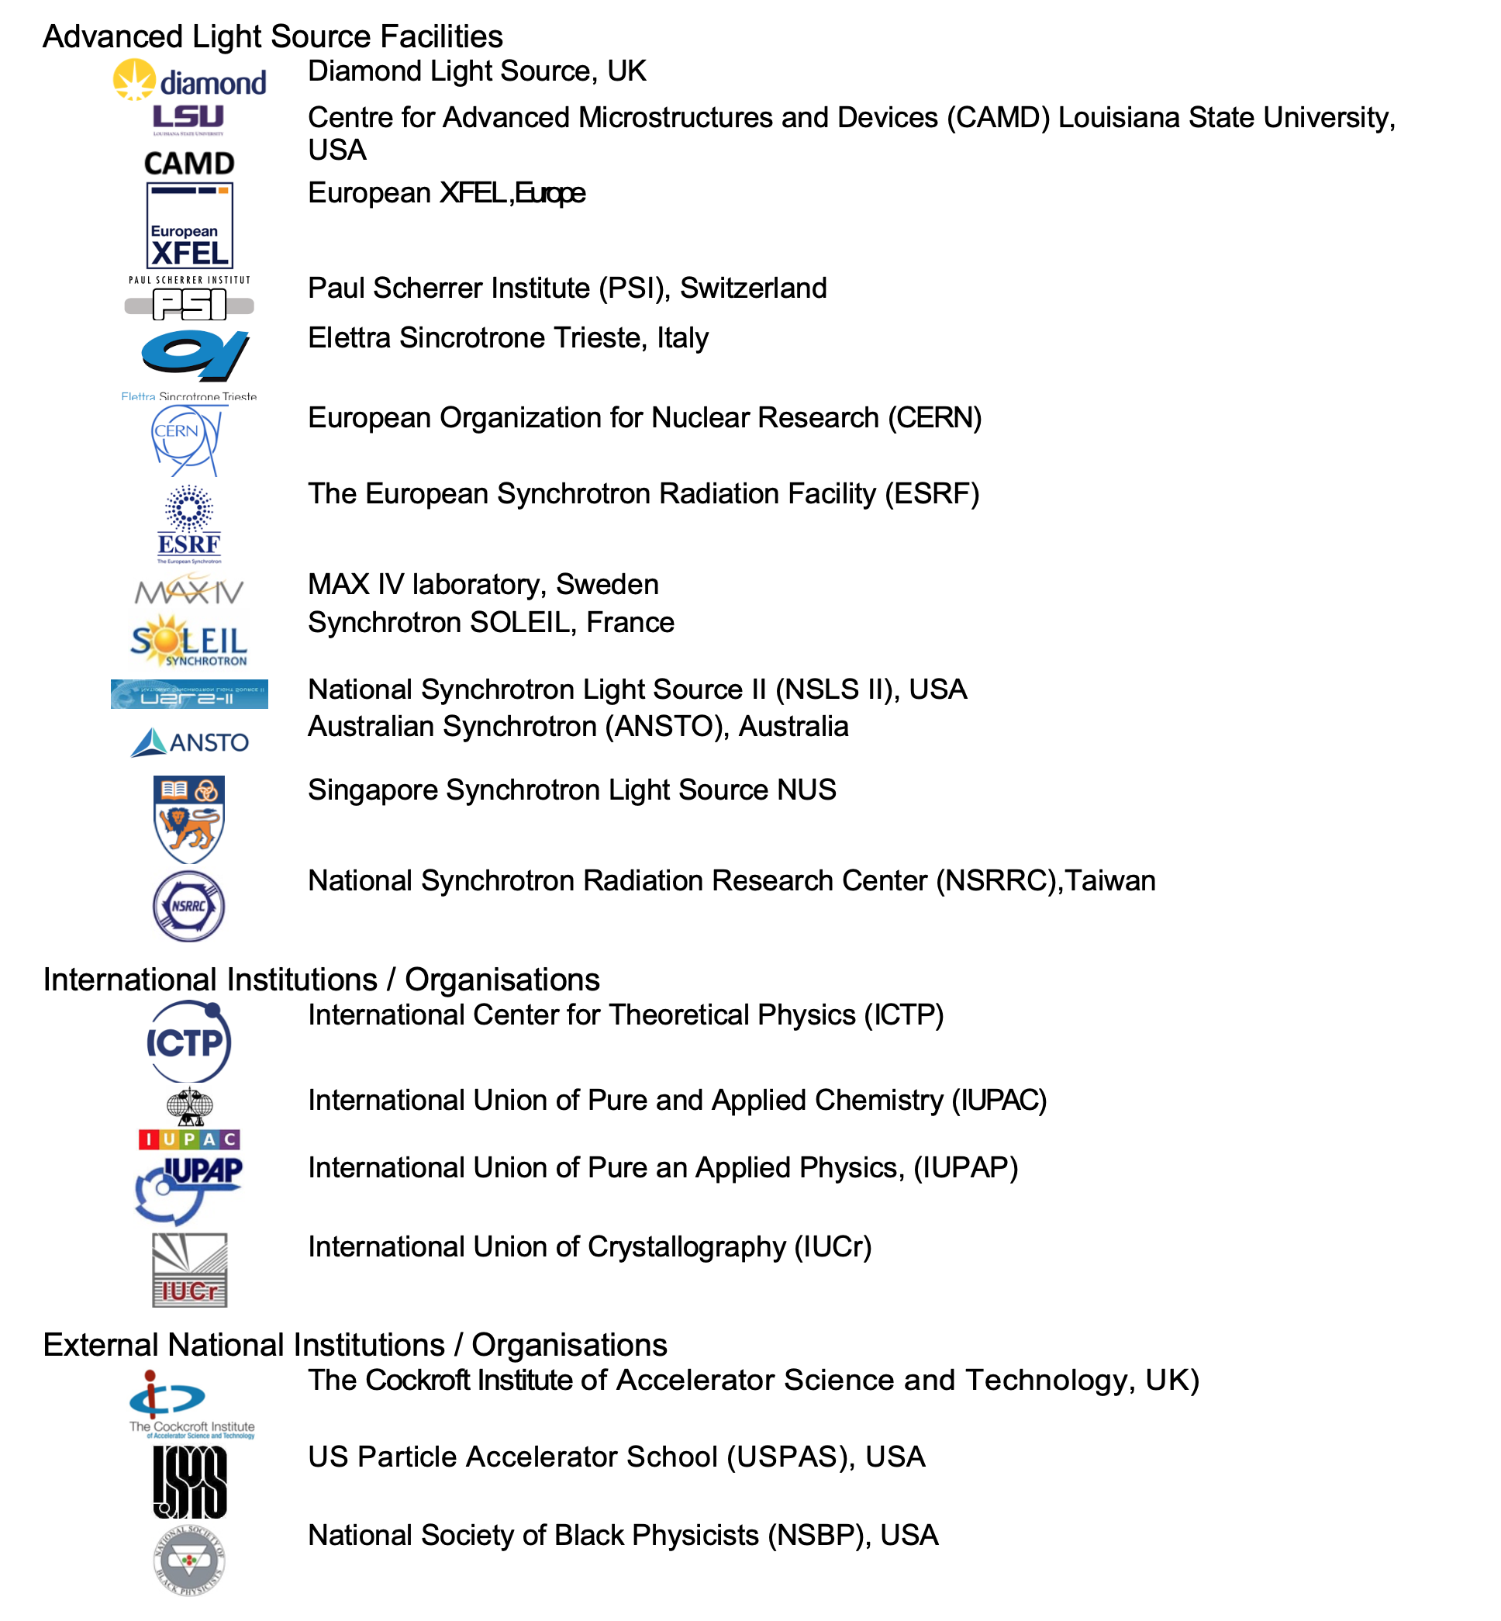

Slide 7


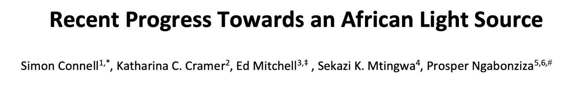


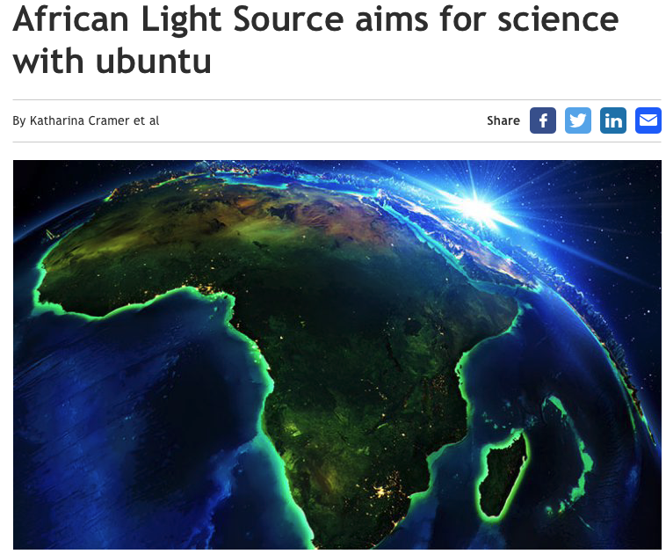

AfLS Profile – Authoring – Website – Social Media
Johannesburg – Soccer World Cup 2010
Debating the Societal Impact of Big Science in the 21st Century
To appear soon …..
https://www.worldscientific.com/doi/abs/10.1142/S0217732318300033
http://lamp.ictp.it/index.php/aphysrev/article/view/1610/586

Slide 8
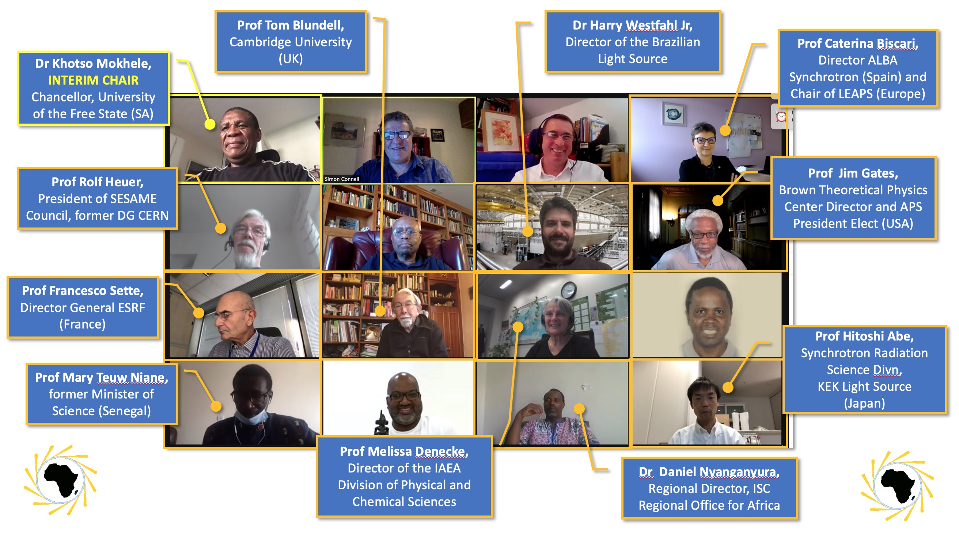
International Advisory Committee

Slide 9
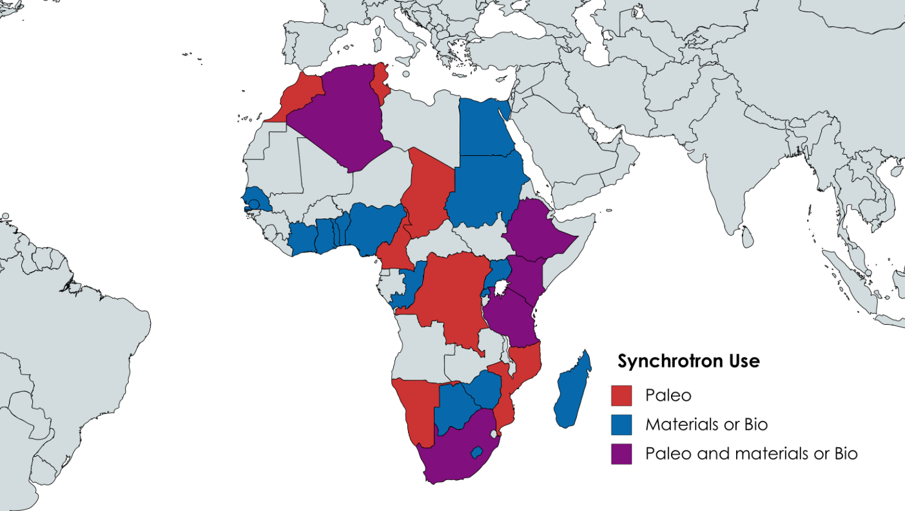
Bottom Up
28/52 > 50%
PhD / Paper / Programme

Slide 10
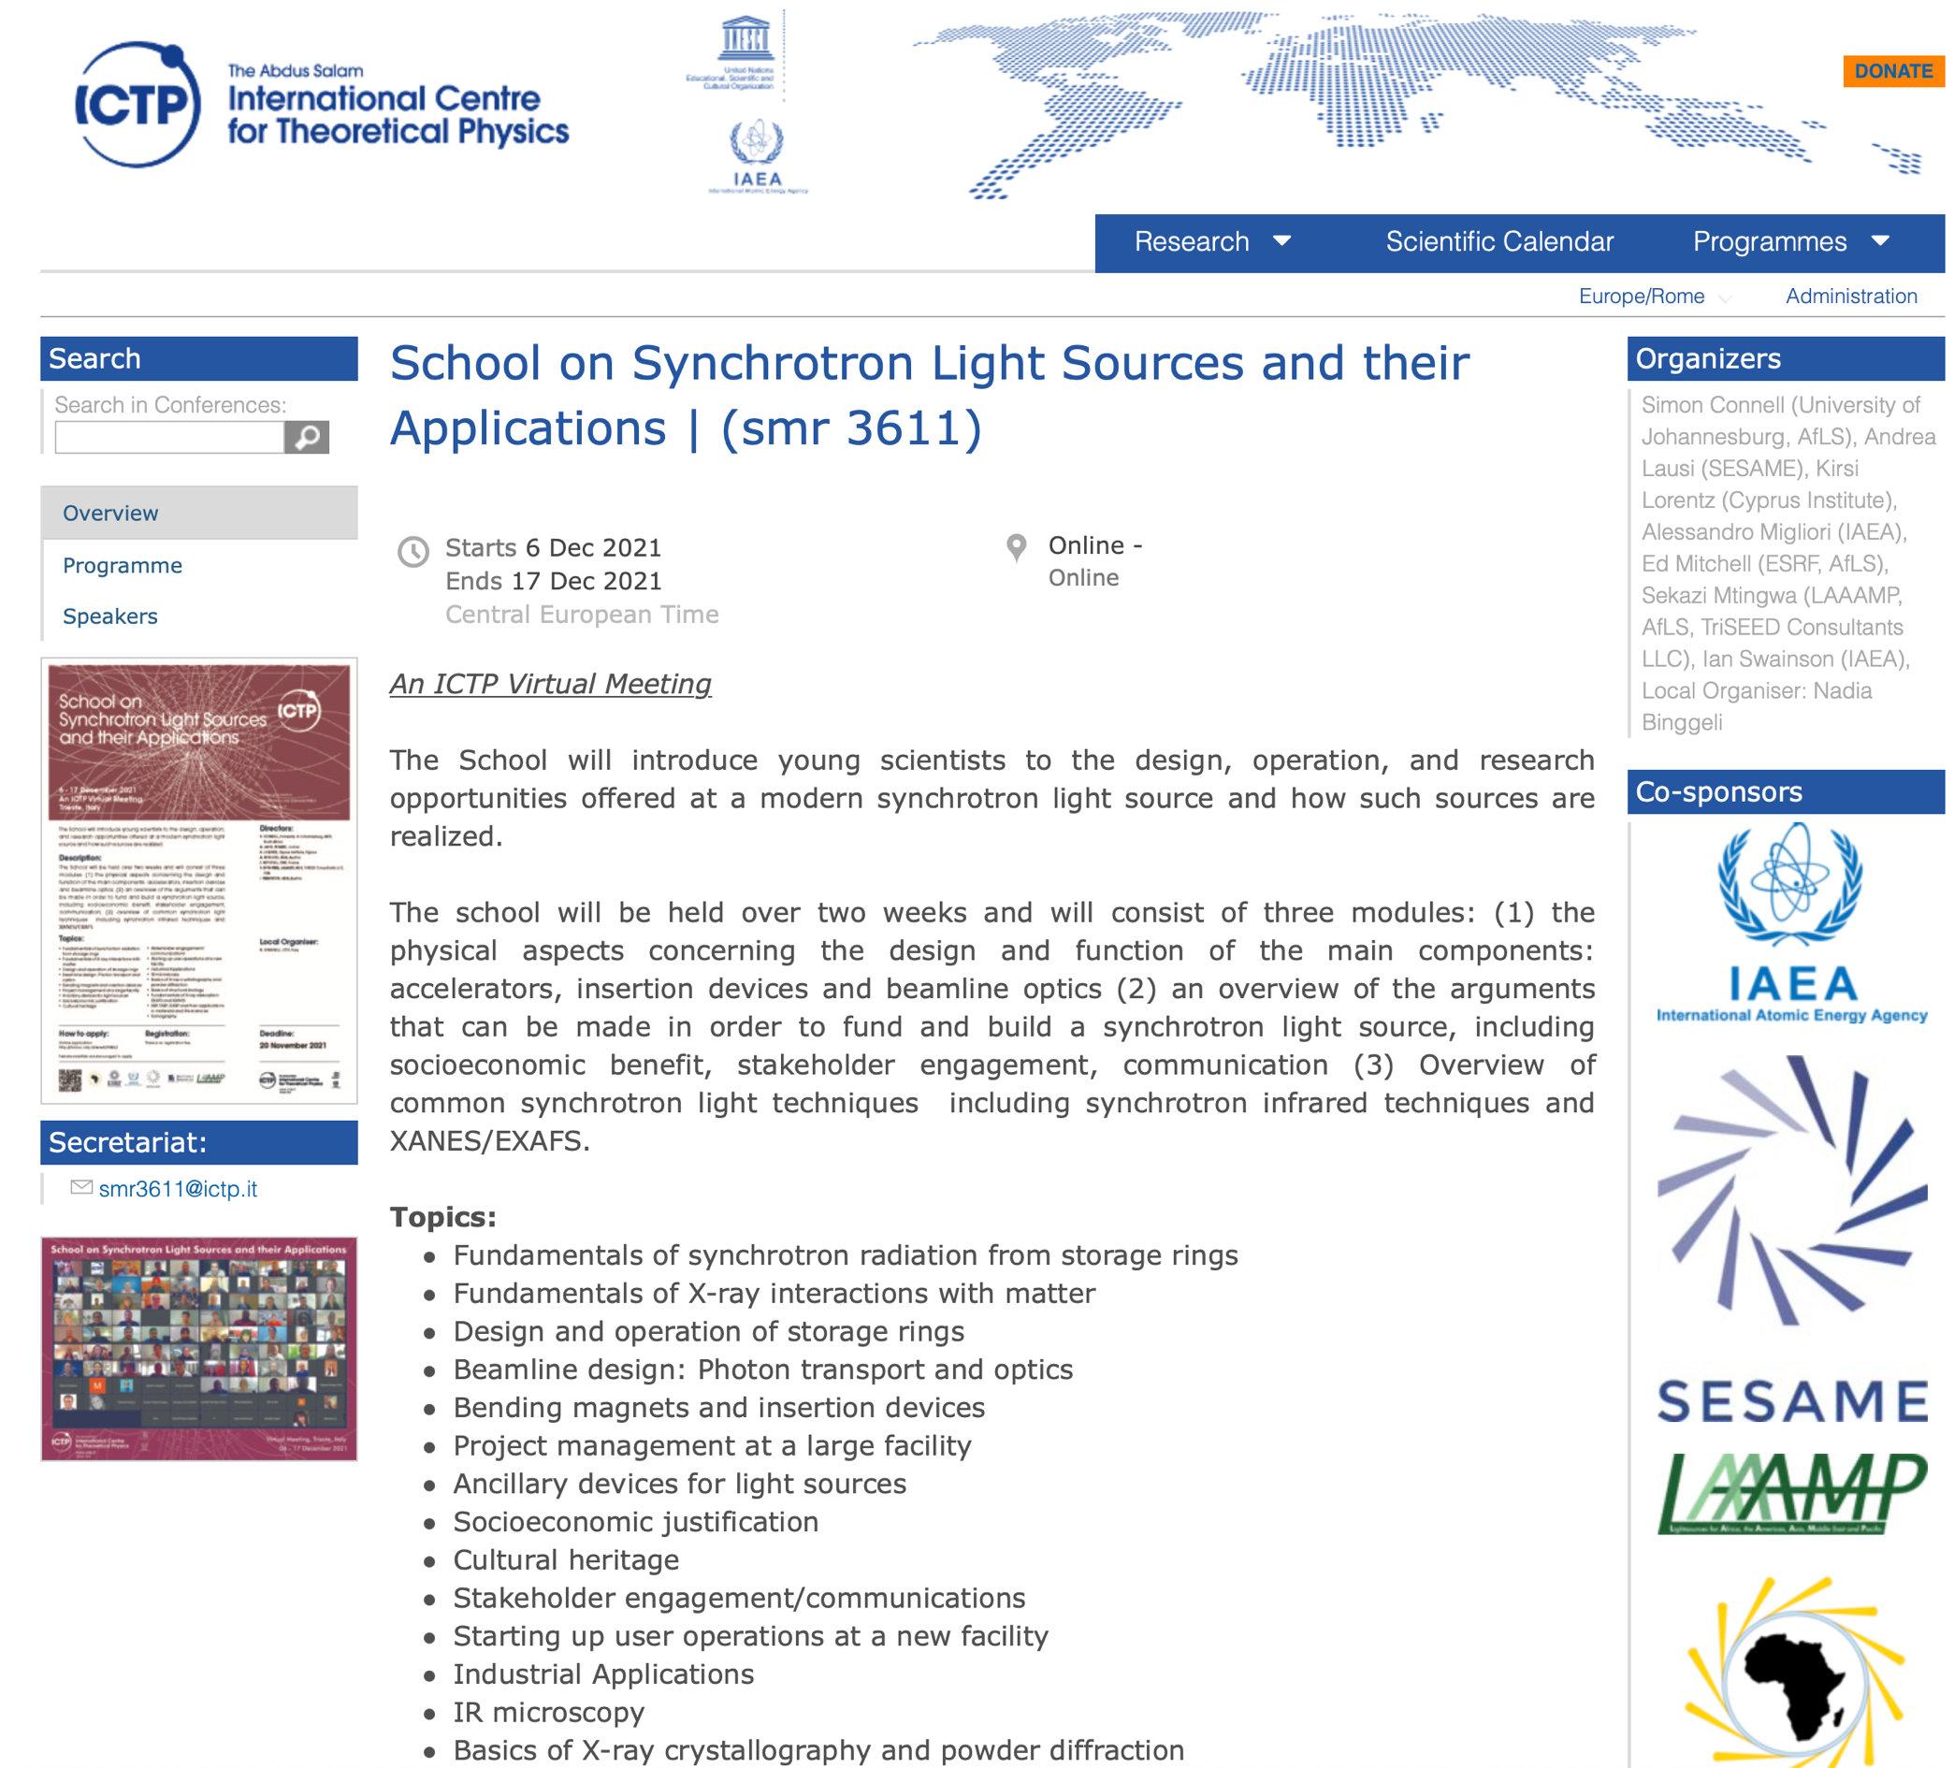
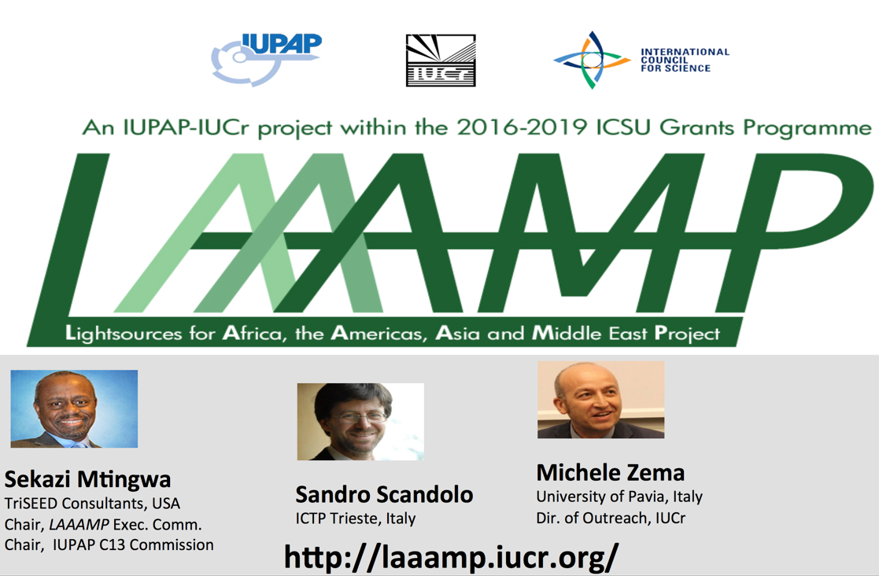
MoU for training
Training
Mobility
Networking
Local Facilities
Conferences
Now IUPAP, IUCr, ICTP

Slide 11


LAAAMP-AfLS Proposal Workshop
2023 FAST Team call (deadline 30 Sept 2022)
8 September 2022 14-17h GMT+2
https://events.saip.org.za/e/LAAAMP2023
https://laaamp.iucr.org/

Slide 12
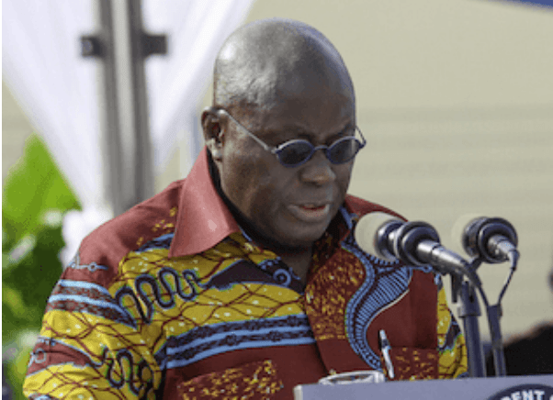
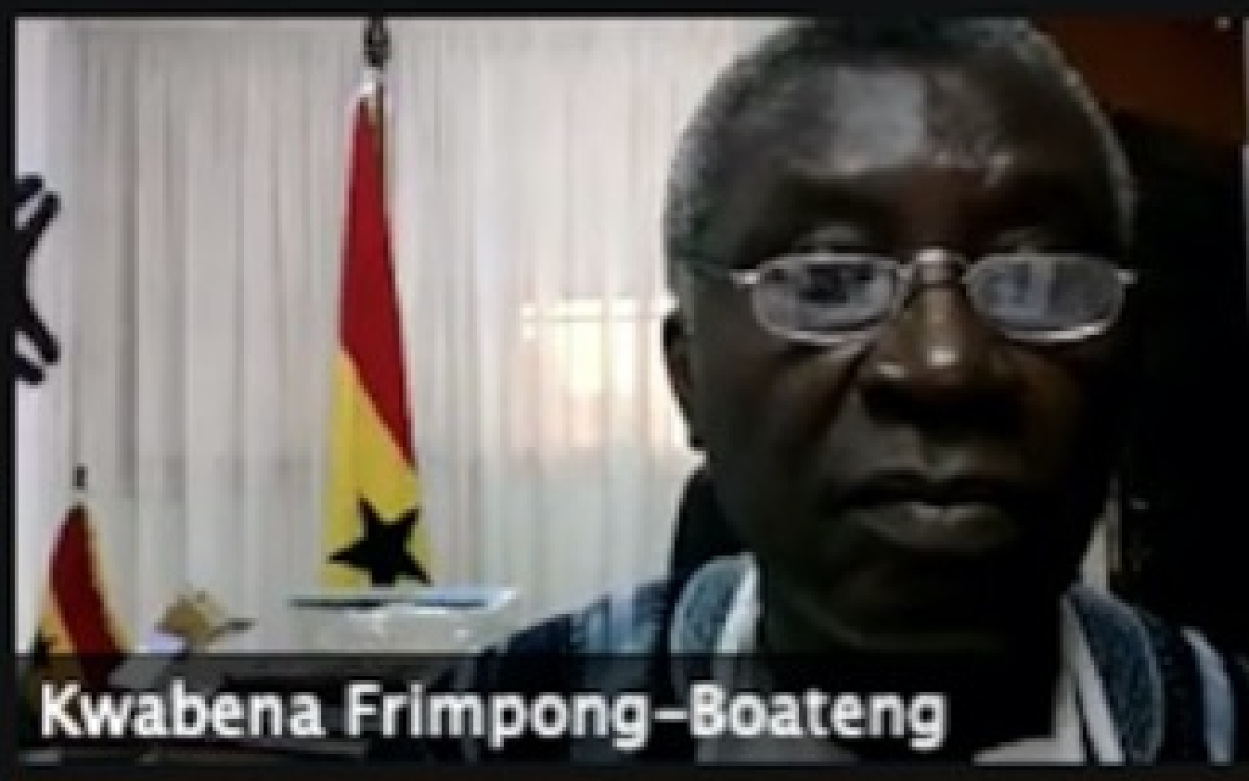
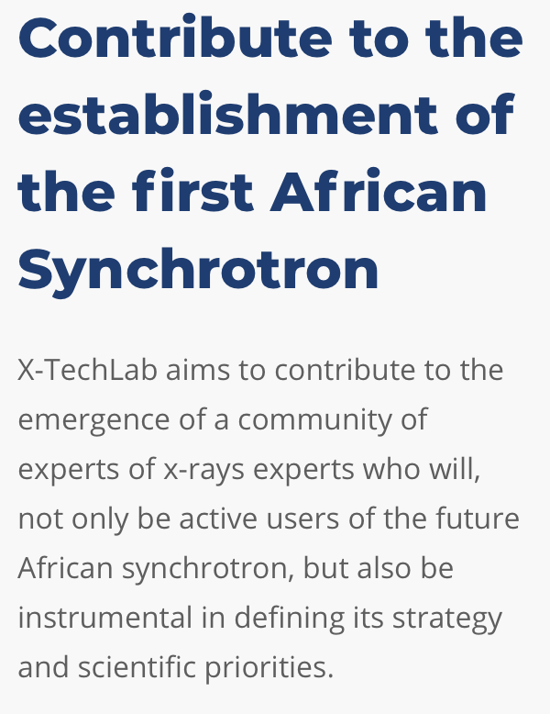

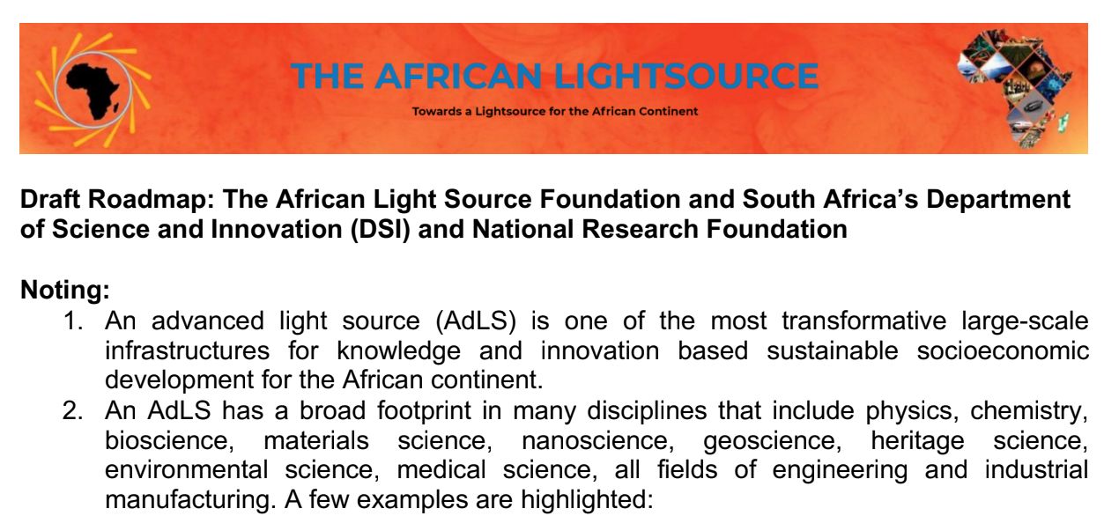
Countries Expressing Commitment
Ghana
2019, the President Akufo-Addo of Ghana
pledged to champion the project in the African Union.
2020, the science minister, Dr. Kwabena Frimpong-Boateng,
reaffirmed Ghana’s support for the African light source
Benin
2019, X-TechLab, as a government priority project,
expresses itself as part of the Roadmap to the AfLS.
SA
2021, SA Dept Science and Innovation and the NRF invite
a proposal towards the AfLS as a “Flagship Project”
2021, Nigeria
Office of the Science Ministry
2021, Cote d’Ivoire
Office of the Science Ministry
2021, AUC-HRST
Developing Process and Actions

Slide 13

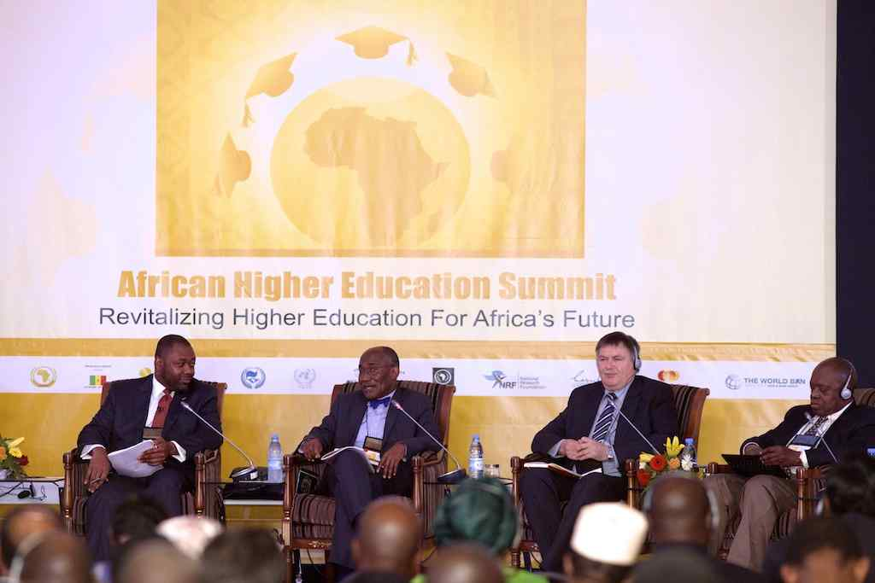
Top Down
AU Involvement
Declaration and Action Plan
1st African Higher Education Summit on Revitalizing Higher Education for Africa’s Future,
10-12 March 2015, Dakar, Senegal.
Article 5.3.2 p 22 : Recommends establishing a Synchrotron as a centralized African scientific facility.
Co written by
Dr Nkem Khumbah,
STEM-Africa Initiative

Slide 14
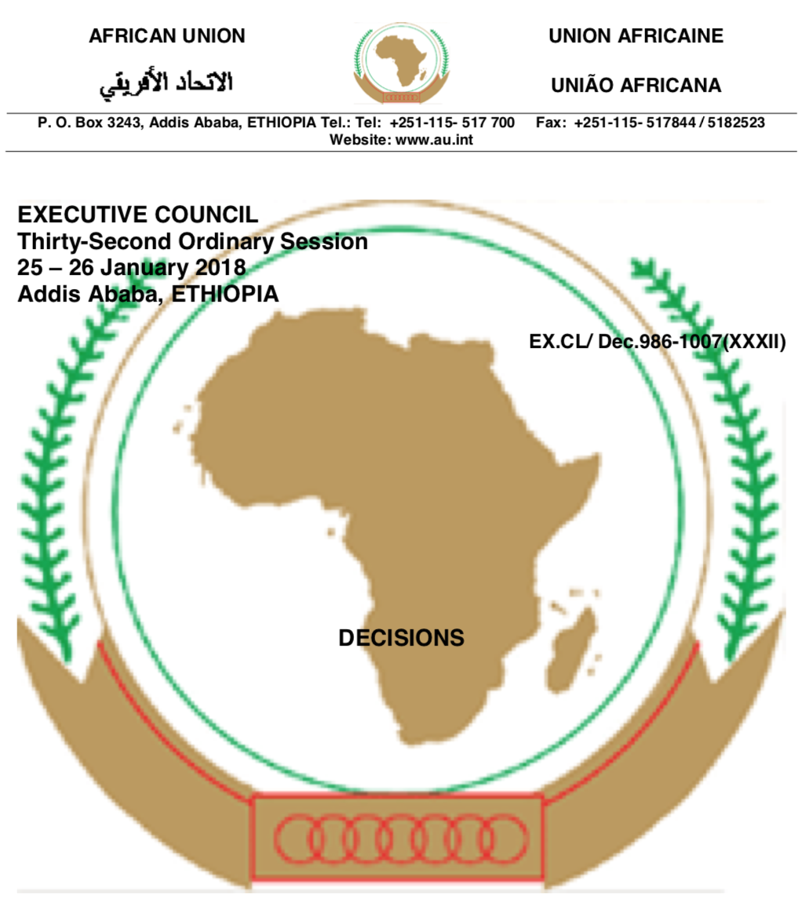
Top Down
AfLS at the AU : Jan 2018
Provided slides for AAS Presentation
DECISION ON THE REPORTS OF THE
SPECIALISED TECHNICAL COMMITTEES (STCs)
The Executive Council,
C. STC ON EDUCATION, SCIENCE AND TECHNOLOGY
CALLS UPON Member States to support the Pan-African Synchrotron Initiative;

Slide 15
Pan African scholarly associations, supporting the AfLS co-convening / co-organizer AfLs Conferences,
Art, Cultural Heritage and Forensics | LNLS, Center for Scientific Studies in the Arts
Biochemistry | Federation of African Societies of Biochemistry and Molecular Biology (FASBMB)
Bioimaging | ABIC
Chemistry | Federation of African Societies of Chemistry (FASC)
Crystallography | AfCA
Earth Sciences | AIPSS, AGS
Electrical Engineering | IEEE-Africa, IEEE Region 8
Engineering | Federation of African Engineering Organizations (FAEO)
Food Science | South African Association for Food Science and Technology (SAAFoST)
Immunology | Federation of African Immunological Societies (FAIS)
Materials Science | African Materials Research Society (AMRS)
Medical Physics | Federation of African Medical Physics Organizations (FAMPO)
Nanoscience and Nanotechnology | AfNN
Optics/Photonics | AfOPS
Paleontology | Eastern African Association for Palaeoanthropology and Palaeontology (EAAPP)
Physics | African Physical Society
Structural Biology | Biostruct Africa
Water Science | African Water Association
Also …. Support from AAU and ARUA, and other members of NASAC

Slide 16
Pan African scholarly associations, supporting the AfLS co-convening / co-organizer AfLs Conferences,
Art, Cultural Heritage, and Forensics | LNLS, Center for Scientific Studies in the Arts
Biochemistry | Federation of African Societies of Biochemistry and Molecular Biology (FASBMB)
Bioimaging | African Bioimaging Consortium (ABIC)
Chemistry | Federation of African Societies of Chemistry (FASC)
Crystallography | African Crystallographic Association (AfCA)
Earth Sciences | African Institute for Planetary and Space Sciences (AIPSS)
Geophysics | African Geophysical Society (AGS)
Electrical Engineering | IEEE-Africa, IEEE Region 8
Engineering | Federation of African Engineering Organizations (FAEO)
Food Science | South African Association for Food Science and Technology (SAAFoST)
Immunology | Federation of African Immunological Societies (FAIS)
Materials Science | African Materials Research Society (AMRS)
Medical Physics | Federation of African Medical Physics Organizations (FAMPO)
Nanoscience and Nanotechnology | African Society for Nanoscience and Nanotechnology (AfNN)
Optics/Photonics | African Optics and Photonics Society (AfOPS)
Paleontology | Eastern African Association for Palaeoanthropology and Palaeontology (EAAPP)
Physics | African Physical Society
Structural Biology | Biostruct Africa
Water Science | African Water Association
Also …. Support from AAU and ARUA, and other members of NASAC

Slide 17

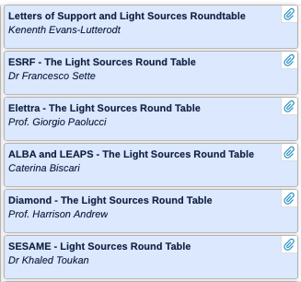
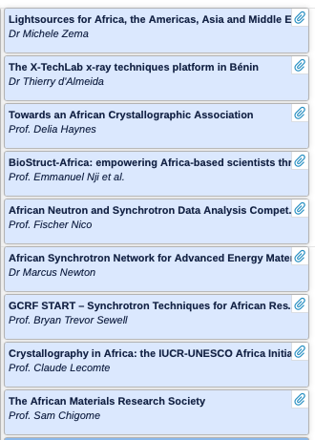
AfLS 2020
Participation by community, PBs, VAs, AdLS

Slide 18
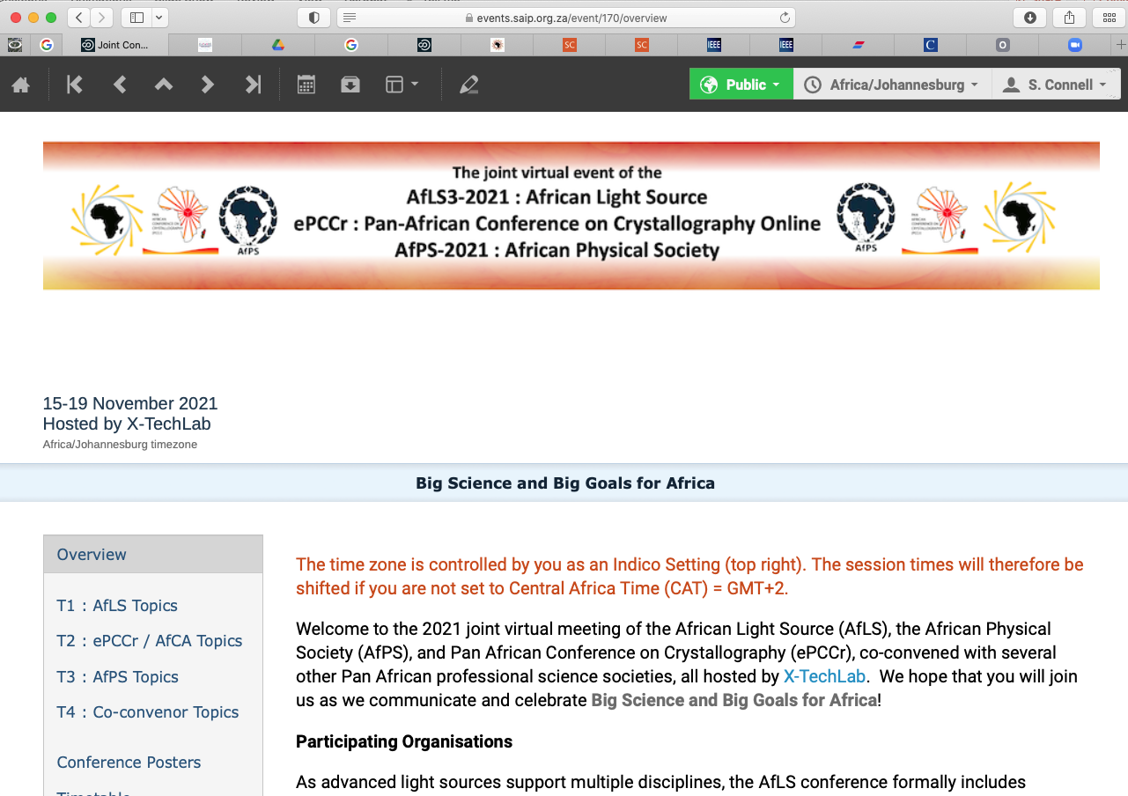
https://events.saip.org.za/e/AFLS3
Now 5 African Governments involved
Many co-conveners
Prof bodies
Academies
>500 registrations

Slide 19
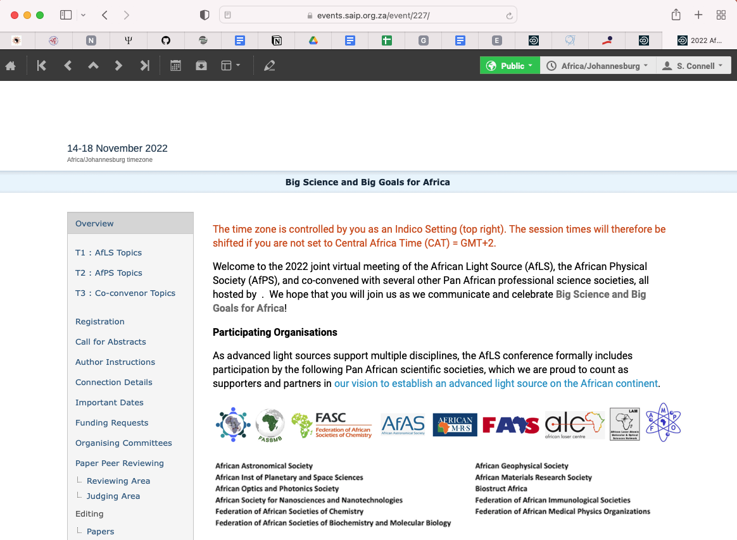
  AfLS4 2022 https://events.saip.org.za/e/AfLS2022

Slide 20
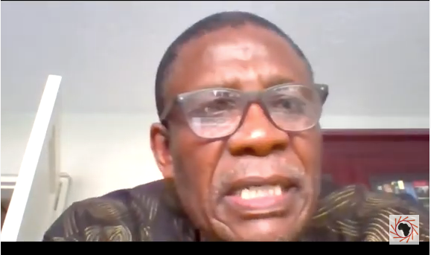
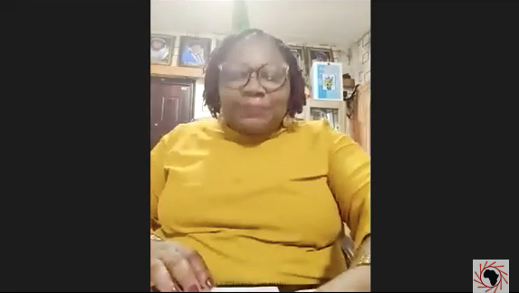
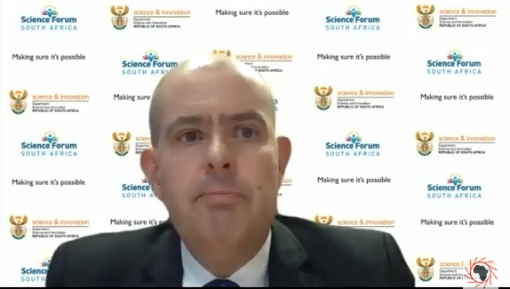
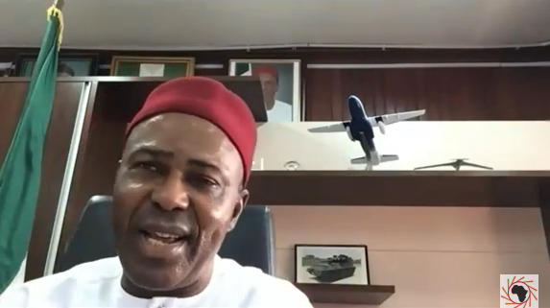
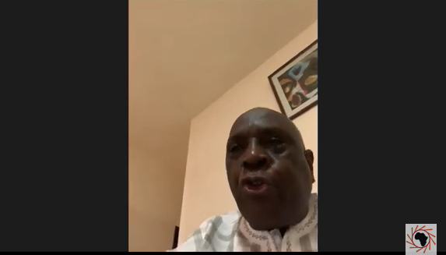
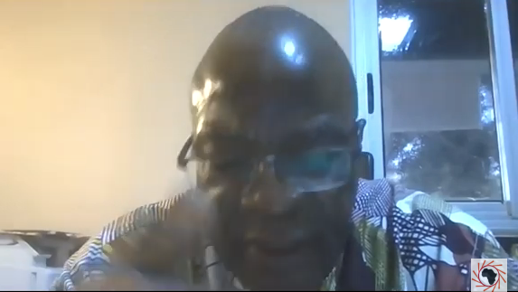
Some Government, Pan African organization and AU level events

Slide 21
2022 and 2021 events
Hands- on training in Structural Biology, a tool for sustainable development in Africa Malaria Research and Training Centre (MRTC) in Bamako, Mali 25-28 April 2022
SESAME-Africa online workshop 6 July 2022
UNGA Science Summit Events 18-27 September 2022
Africa-US Symposium on Synchrotron Science 12-14 October 2022
International Conference on Research Infrastructures (ICRI) 17-18 October 2022
Training Workshop on Synchrotron Technologies and Techniques and their Applications 25-29 July 2022
AfLS4-2022 Virtual Conference from 14-18 November 2022 hosted virtually by BIUST, Botswana.
ICTP School on Synchrotron Light Sources and their Applications 6-17 Dec 2021
AfLS 3 Virtual Conference hosted by X-TechLab, Semi City, Benin 15-20 November 2021
AfLS CDR Town Hall – Reviewing the CDR Process 11 Oct 2021
Biophysics in Africa – 22 -26 March 2021
AfLS engaging from grassroots science and scientists level, up to the policy/politician level

Slide 22
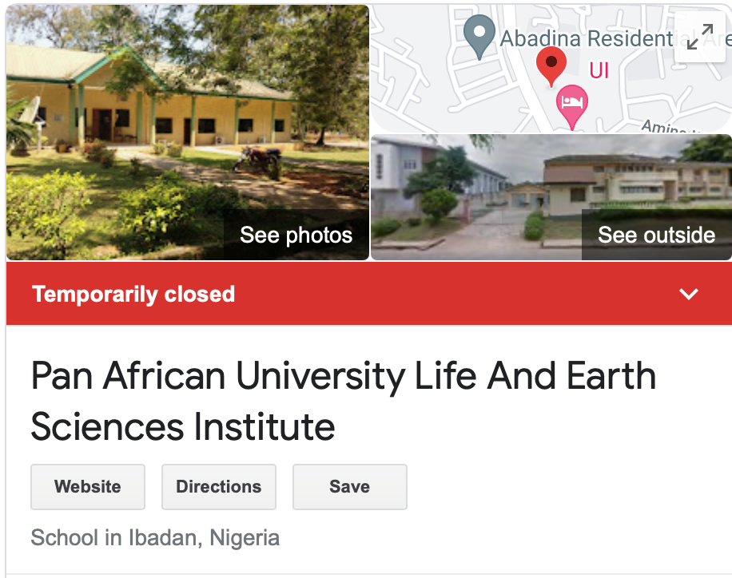
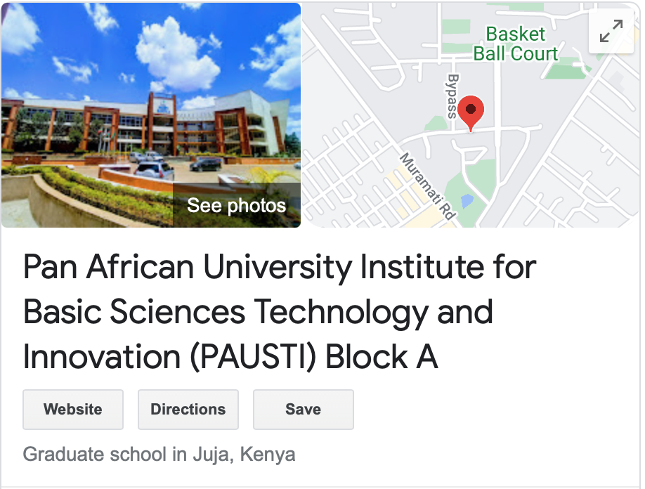
Pan African Virtual University in Light Source Based Science
Pan African University PAU
Hosted within existing Universities
PAU Statutes, Governance Structure, Council and Senate
Each Institute has other institutions operating under it.
Proposal
Desktop study of Statutes, see how the PAVULBS can be set up within PAU structures
Integrate into existing Institute or set up a new one
How the institutes are funded, and evaluation of proposals compatible with the funding.
Make list of clear options

Slide 23
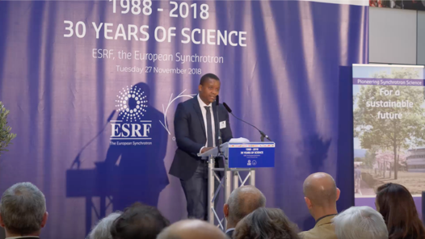
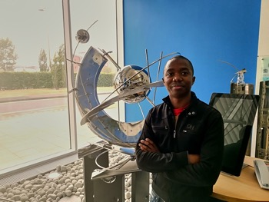
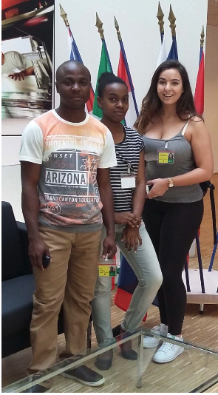
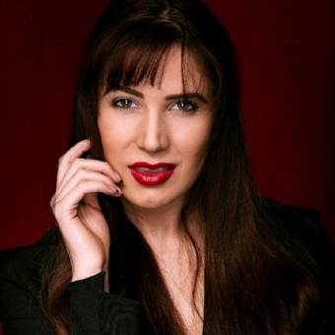
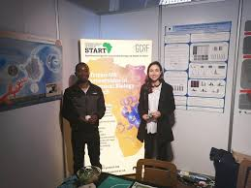
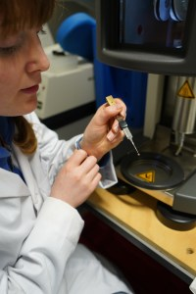
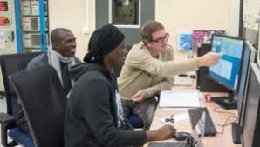
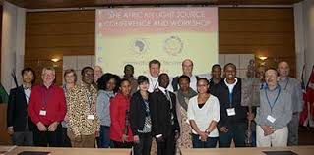
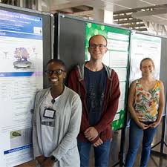
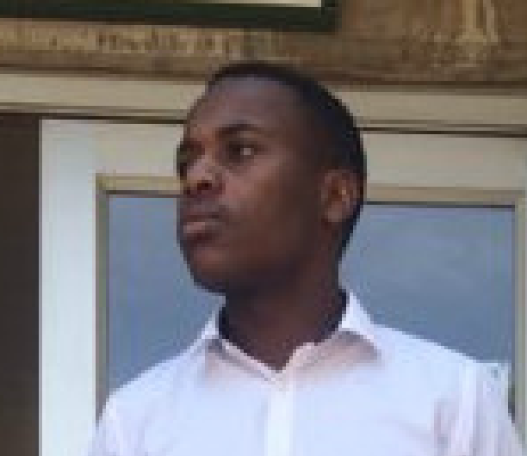
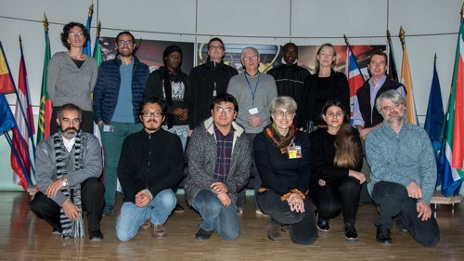
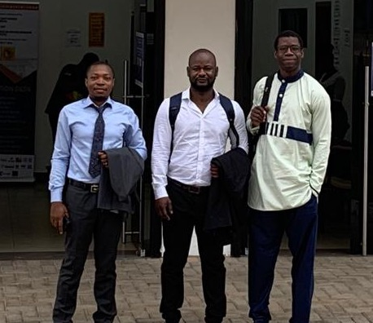
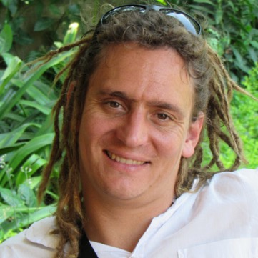

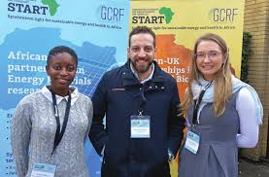
Young scientists ….. Can you see yourself here….

