Slide 1





https://laaamp.iucr.org/
Awarded with a € 300K grant from the for the period 2017-2019

Slide 2

About
Full title of ISC-awarded proposal
Utilisation of Light Source and Crystallographic Sciences to Facilitate the Enhancement of Knowledge and Improve the Economic and Social Conditions in Targeted Regions of the World
LAAAMP’s goal
LAAAMP is aimed at engaging the public and governmental officials in discussions about the role that Advanced Light Sources and crystallographic sciences could play to improve their countries’ educational institutions, economies, social structures, health and world competitiveness.

Slide 3
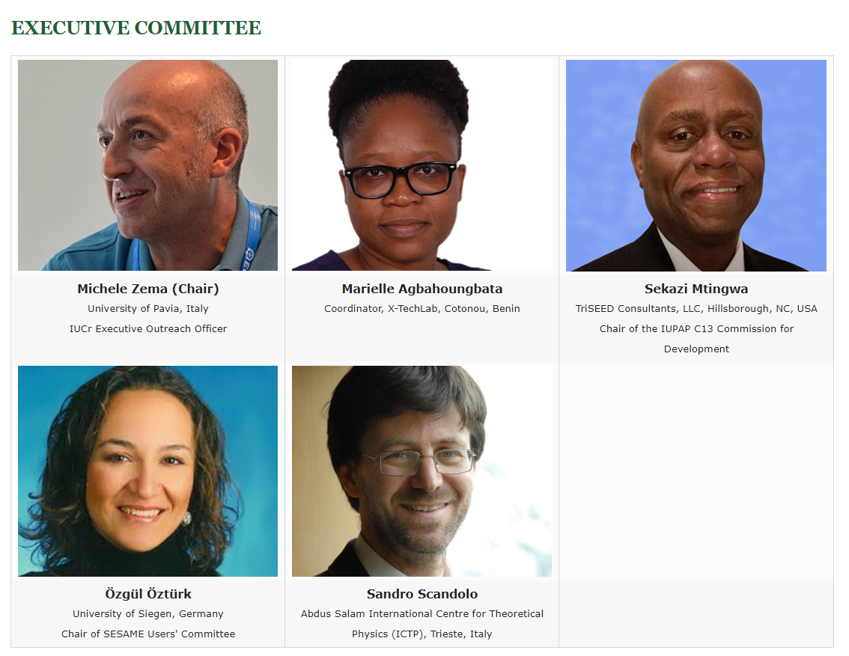
Executive Committee

Slide 4

LAAAMP Regional AdLS Usage & Strategic Plan Committees (USPC)
Africa
Simon Connell (Chair) Univ. of Johannesburg, South Africa
Djamel Bradai UST Houari Boumediene, Algeria
Jean-Pierre Ezin Université d'Abomey-Calabi, Benin
Claude Lecomte Chair of IUCr Crystallography in Africa initiative
Ernie Malamud Fermilab, University of Nevada, USA
Brian Masara SA Inst of Physics, Zimbabwe
Genito Maure Universidade Eduardo Mondlane, Mozambique
Prosper Ngabonziza Dept Solid State Quantum Electronics, Rwanda
Ahmadou Wague University of Cheikh Anta Diop, Senegal
Mexico
Matías Moreno (Chair) Universidad Nacional Autónoma de México
Abel Moreno Cárcamo Coordinator of the Red de Usuarios de Luz Sincrotrón (RedTULS) and Instituto de Quimica, UNAM
Mayra Cuellar Universidad de Guanajuato
José Reyes Gasga President of the Sociedad Mexicana de Cristalografía and Instituto de Física, UNAM
José Ignacio Jiménez Universidad Nacional Autonoma de México Tomás Viveros Universidad Autónoma Metropolitana-Iztapalapa
Caribbean
Carlos Cabrera (Chair) University of Puerto Rico at Río Piedras
Fidel Antonio Castro Smirnov Advisor to the President of the University of Informatics Sciences, Cuba
Noel Blackburn Brookhaven National Laboratory, USA
Eric Sheppard Hampton University, USA
SE Asia
Supagorn Rugmai (Chair) Head of Research Facility, Synchrotron Light Research Institute (SLRI), Thailand
Gwo-Huei Luo President of Asia-Oceania Forum on Synchrotron Radiation Research (AOFSRR) and Director, National Synchrotron Radiation Research Center (NSRRC), Taiwan
Yao-Jane Hsu Secretary General and Staff Scientist, NSRRC, Taiwan
Chia-Hung Hsu Secretary General and Staff Scientist, NSRRC, Taiwan
Michael James Head of Science, Australian Synchrotron
Middle East
Kirsi Lorentz (Chair) The Cyprus Institute, Nicosia, Cyprus
Roy Beck-Barkai Tel-Aviv University, Israel
Musa Mutlu Can Istanbul University, Turkey
Ahmed Farghaly National Research Center, Cairo, Egypt
Jamal Ghabboun Bethlehem University, Palestine
Pacific Islands
To be appointed

Slide 5
LAAAMP Supporting and Collaborative Partners
UNESCO
ICSU Regional Office for Africa
ICSU Regional Office for Latin America & the Caribbean
International Union of Materials Research Societies (IUMRS)
International Centre for Theoretical Physics (ICTP)
TWAS
SESAME Light Source
African Light Source (AfLS) Steering Committee
Cuban Light Source Initiative
Puerto Rican Light Source Initiative
Lightsources.org
Mexican Physical Society
European Physical Society (EPS)
Association of Asia Pacific Physical Societies (AAPPS)
Interdisciplinary Consortium for Research and Educational Access in Science & Engineering
Triangle Science, Education & Economic Development (TriSEED Consultants), LLC
University of California - Los Angeles (UCLA)
….

Slide 6
LAAAMP Participating Advanced Light Sources
Advanced Light Source (ALS), Lawrence Berkeley National Laboratory (LBNL)
Advanced Photon Source (APS), Argonne National Lab (ANL)
ALBA Light Source
Australian Synchrotron, Australian Nuclear Science and Technology Organization (ANSTO)
Canadian Light Source
DELTA Light Source
Elettra Light Source
European Synchrotron Radiation Facility (ESRF)
MAX IV Laboratory
National Synchrotron Light Source-II (NSLS-II), Brookhaven National Lab (BNL)
Photon Factory, Institute of Materials Structure Science (IMSS) of KEK
Pohang Accelerator Laboratory
SESAME Light Source
SIAM Photon Source (SPS), Synchrotron Light Research Institute (SLRI)
SLAC National Accelerator Laboratory
Taiwan Photon Source (TPS), National Synchrotron Radiation Research Center (NSRRC)
…

Slide 7
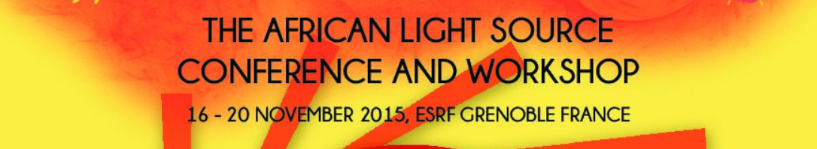
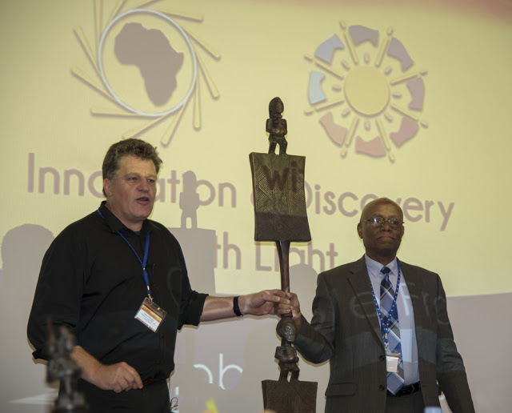
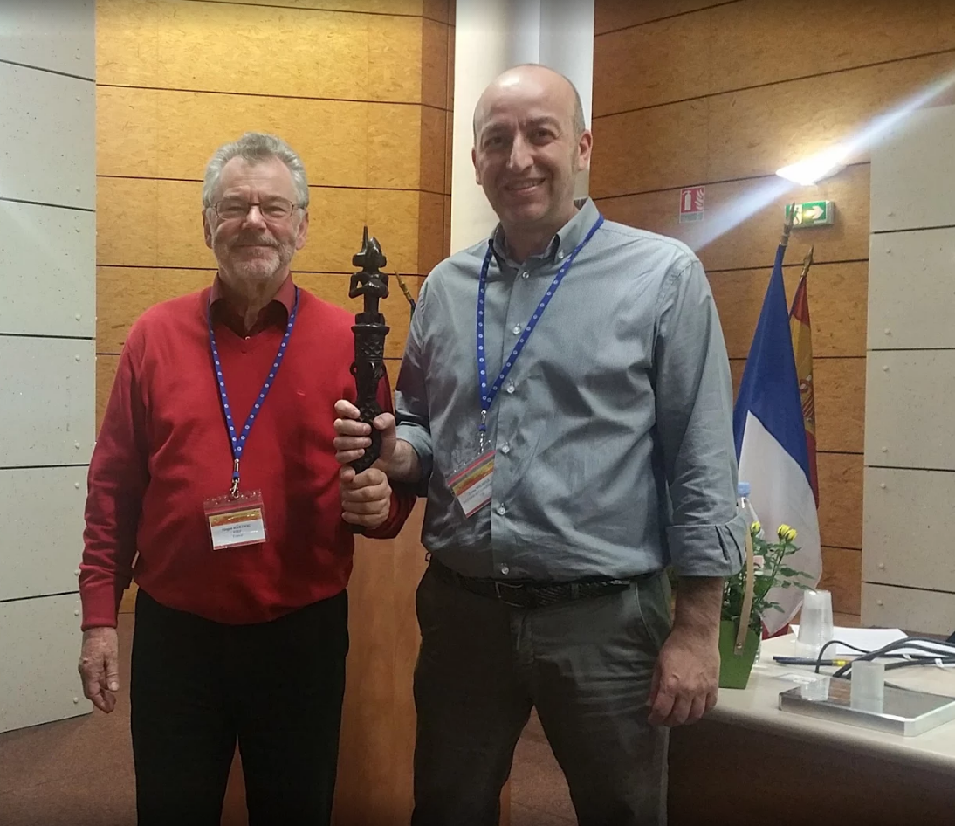
LAAAMP and AfLS: a tight connection
Simon H. Connell and Sekazi K. Mtingwa, Chairs of the AfLS Steering Committee
M. Zema (right) holding the Speaking stick
The idea of LAAAMP started during the 1st African Light Source Conference and Workshop at the ESRF, Grenoble in 2015 when LAAAMP co-founders Sekazi Mtingwa, Sandro Scandolo and Michele Zema met for the first time and discussed about a joint IUPAP-IUCr proposal to be submitted to former ICSU (now ISC) Grants Programme 2016-2019.

Slide 8
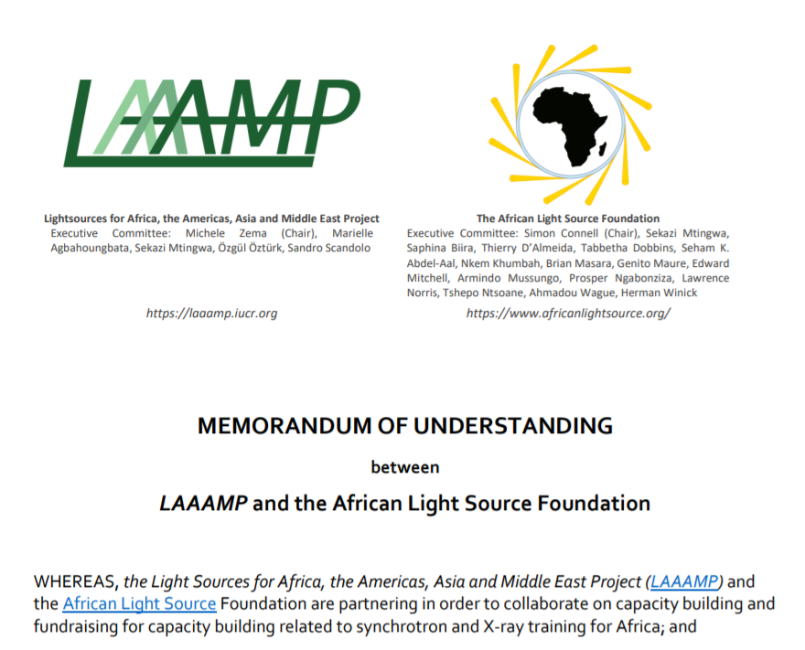
LAAAMP and AfLS: a tight connection

Slide 9
LAAAMP Tasks
Regional Committees develop Strategic Plans for each Region
TASK 1
Establish an AdLS/Crystallography Colloquium Programme in each Region
TASK 2
Publish and Disseminate an AdLS/Crystallography Information Brochure
TASK 3
Promote and Facilitate Researcher and Student Short- & Long-Term Visits/Study at International AdLS and Crystallography Facilities and Schools (including IUCr-UNESCO OpenLabs)
TASK 4
Convene a Meeting at UNESCO Headquarters in Paris to Present the Strategic Plans for the Regions and Launch the Business Plans
TASK 5

Slide 10
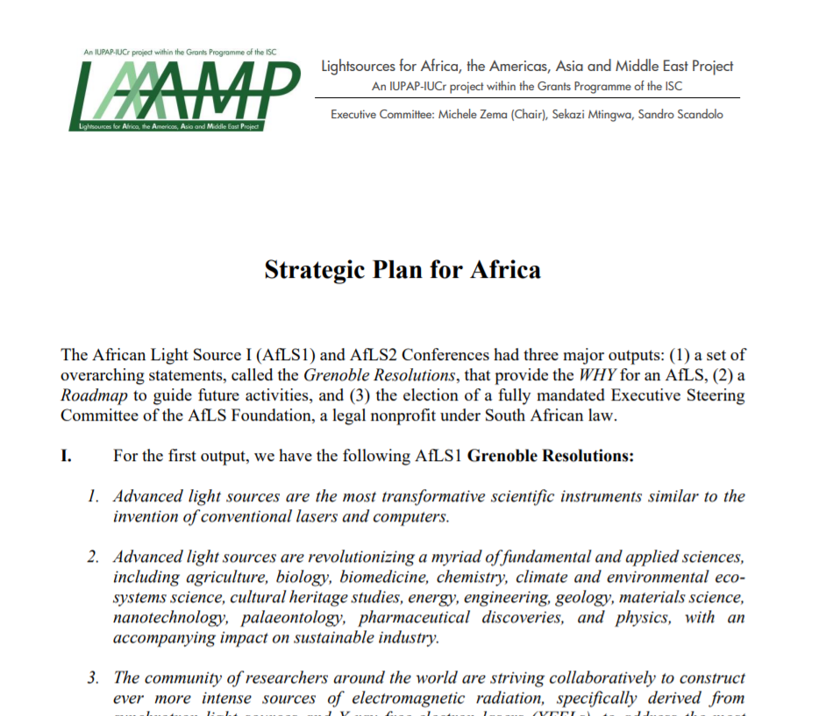
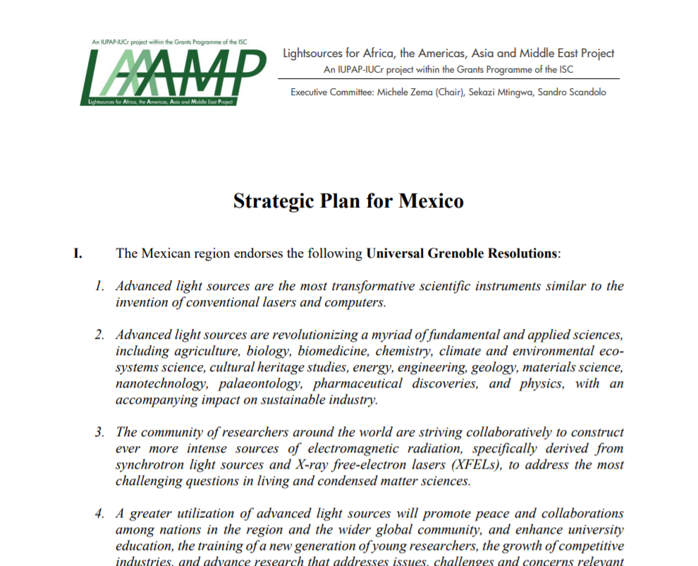
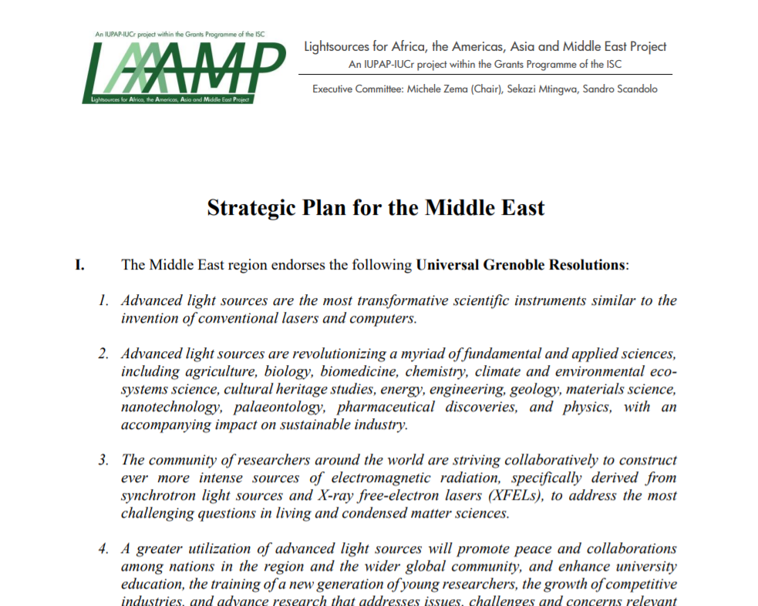
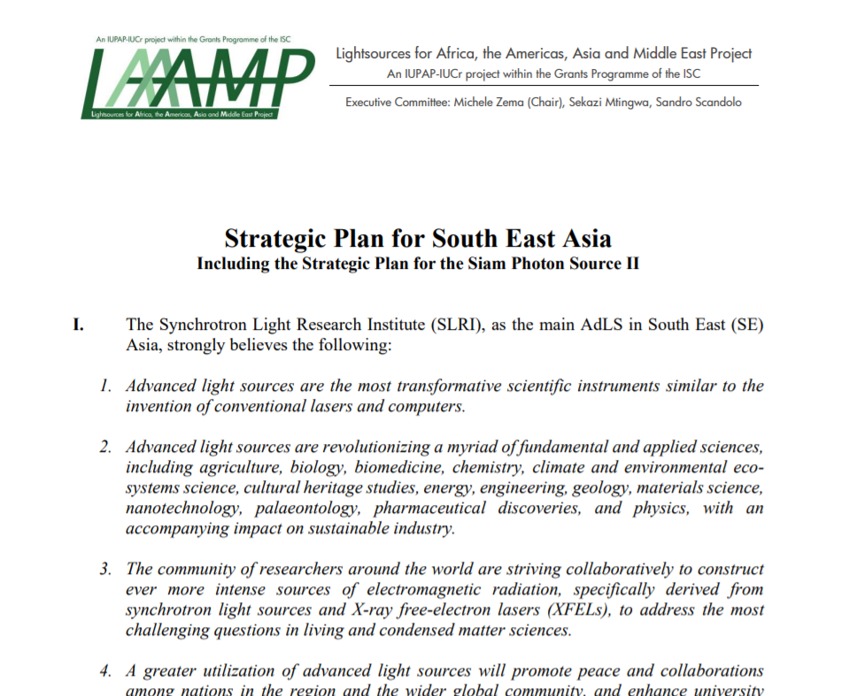

TASK 1: Regional strategic plans
https://laaamp.iucr.org/tasks/strategic-plans

Slide 11
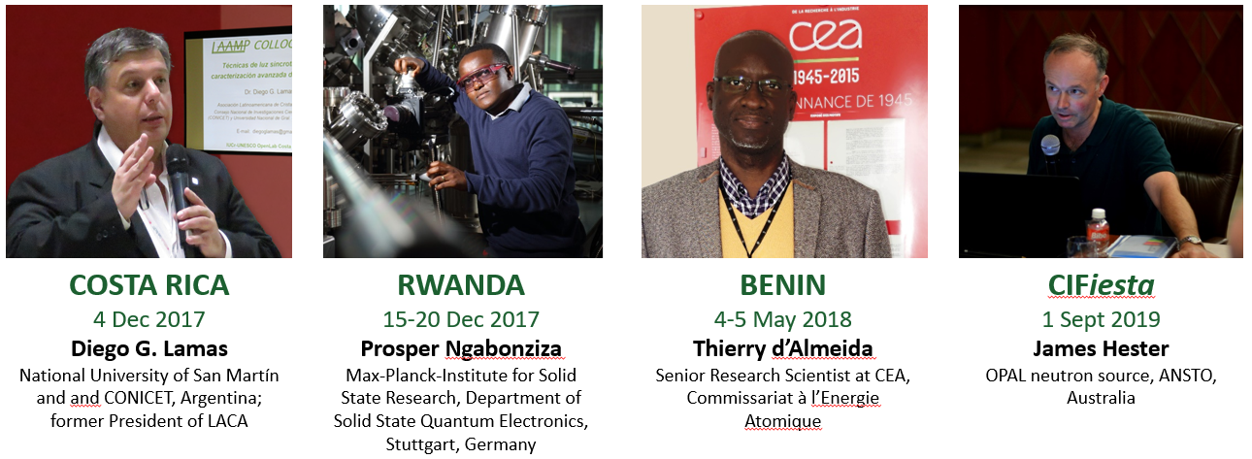
TASK 2: LAAAMP Colloquium Programme
The Colloquium Programme dispatches experienced AdLS users and crystallographers to universities and other institutions to give presentations on the capabilities of AdLSs and crystallography and engage in discussions on how they can enhance researchers' investigations and offer career opportunities for university students. While in a given location, the lecturers will visit government officials to inform about the importance of investing into science and AdLS/crystallographic disciplines in particular.

Slide 12

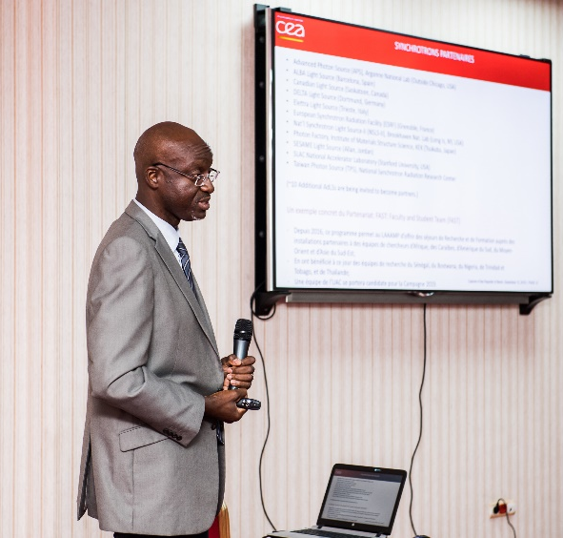
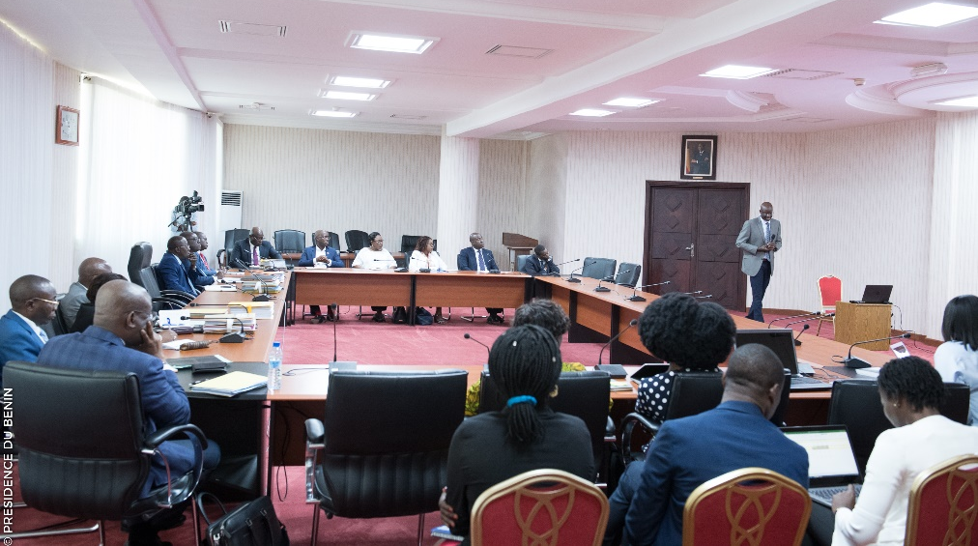

LAAAMP success stories
X-TechLab at Sèmè City, Benin
X-Ray Techniques for Sustainable Development
Thierry d’Almeida presenting LAAAMP and the X-TechLab project to the Cabinet of the Government of Benin.
X-TechLab is aimed at training Master and Ph.D. students from Benin and neighbouring countries every year, and at establishing a permanent user research facility with experienced, permanent staff to act as a hub for the region.

Slide 13
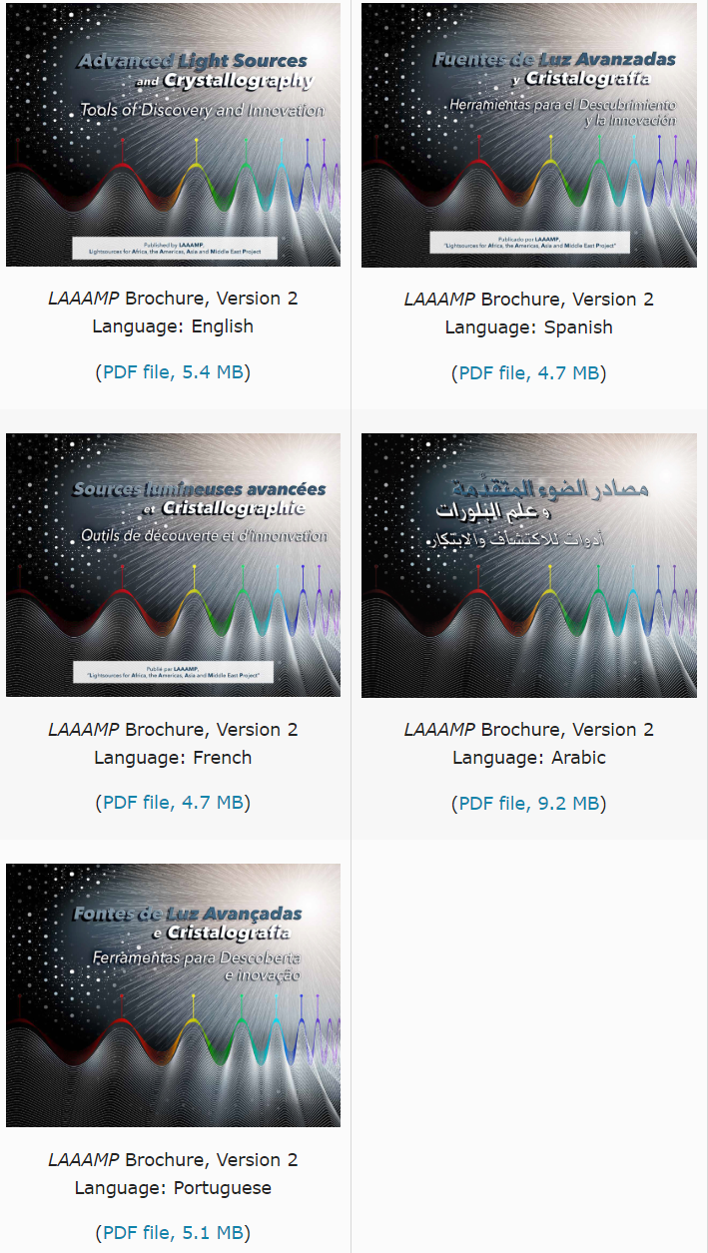
TASK 3: LAAAMP brochure
The LAAAMP brochure “Advanced Light Sources and Crystallography: Tools of Discovery and Innovation” is available in English, Spanish, French, Arabic and Portuguese.
Translations have been made available thanks to a collaboration with the International Atomic Energy Agency (IAEA).
Brochure editor: Ernie Malamud
DOWNLOAD FOR FREE at https://laaamp.iucr.org/tasks/brochure

Slide 14
TASK 4: FAculty-STudent (FAST) teams visits at AdLSs
Eligibility
Faculty members at universities in Africa, the Caribbean, Mexico, SE Asia, Middle East. Interested in using AdLSs to further one’s research and training endeavors. Previous experience with using AdLSs is limited to a year or less. Ability to spend 2 months as a full-time visitor in residence at an AdLS that is a LAAMP collaborative partner.
Student registered as full-time Ph.D. student and supervised by the Faculty member.
Categories
Continuing and New applications are considered.
Financial Support
LAAAMP provides 2,000 Euros per person to cover transportation and (partially) accommodation costs. The remainder of accommodation and subsistence should be negotiated with the host AdLS and other sources of support.
Deliverables
10-page description of the research conducted, including any publications that result.
All publications resulting from the visits must acknowledge the support provided by IUPAP-IUCr LAAAMP within the ICSU Grants Programme 2016-2019.
3-page report that evaluates the non-scientific aspects of the visit, including positive experiences as well as ways that the visit could be enhanced in the future.

Slide 15
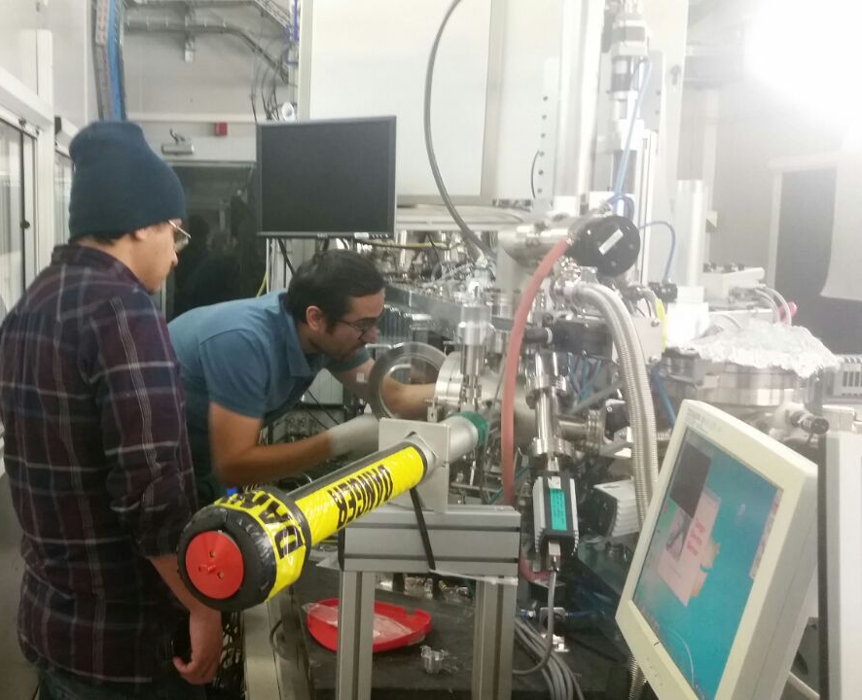
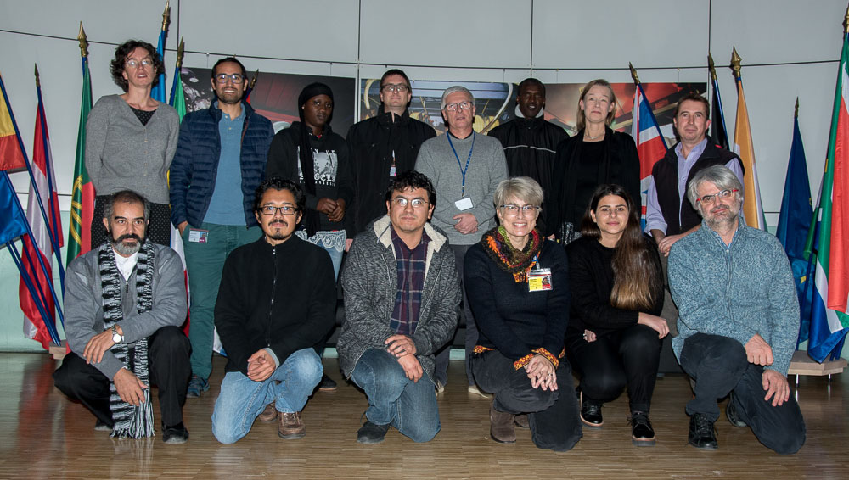
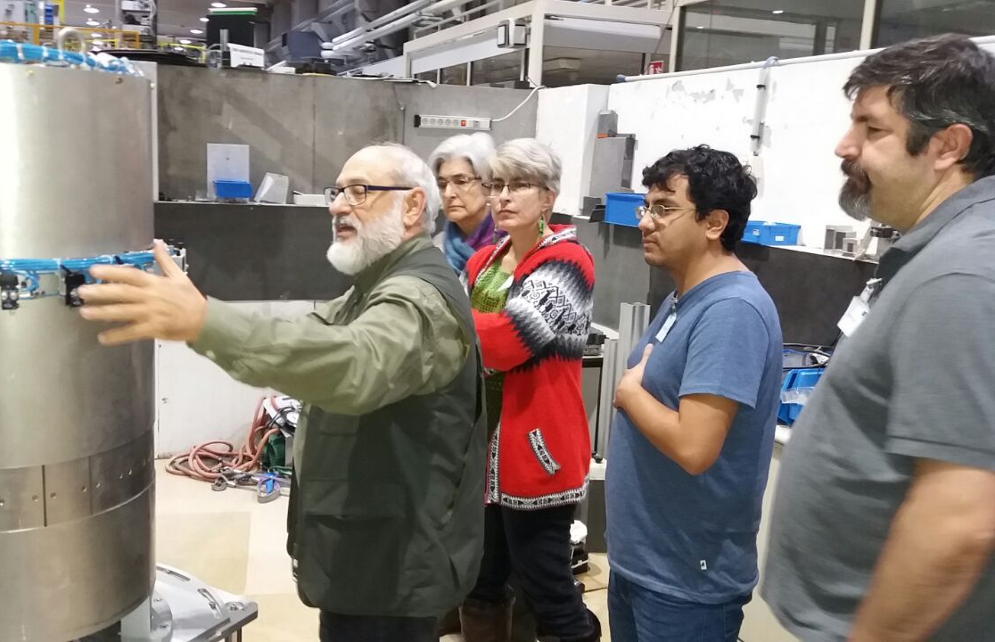
FAculty-STudent (FAST) teams visits at AdLSs

Slide 16
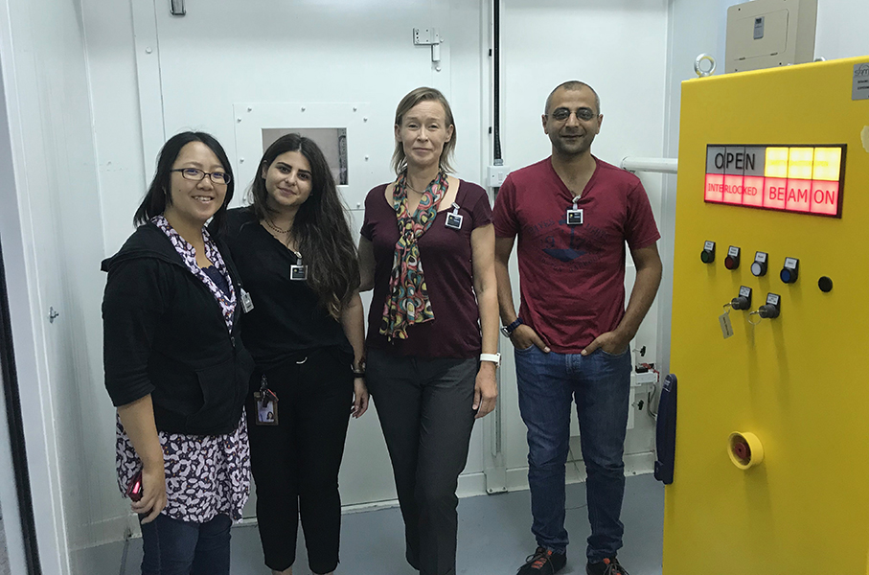
LAAAMP success stories
FORMER LAAAMP AWARDEES ARE THE FIRST SESAME USERS
On 17 July 2018, Dr Kirsi Lorentz, Grigoria Ioannou and their colleagues from the Cyprus Institute arrived at SESAME to perform the first experiment at the XAFS/XRF beamline at SESAME.
Kirsi and Grigoria were awarded a LAAAMP FAST grant in 2017 and a continuing grant in 2018. Thanks to these grants, they were trained at the ESRF.

Slide 17

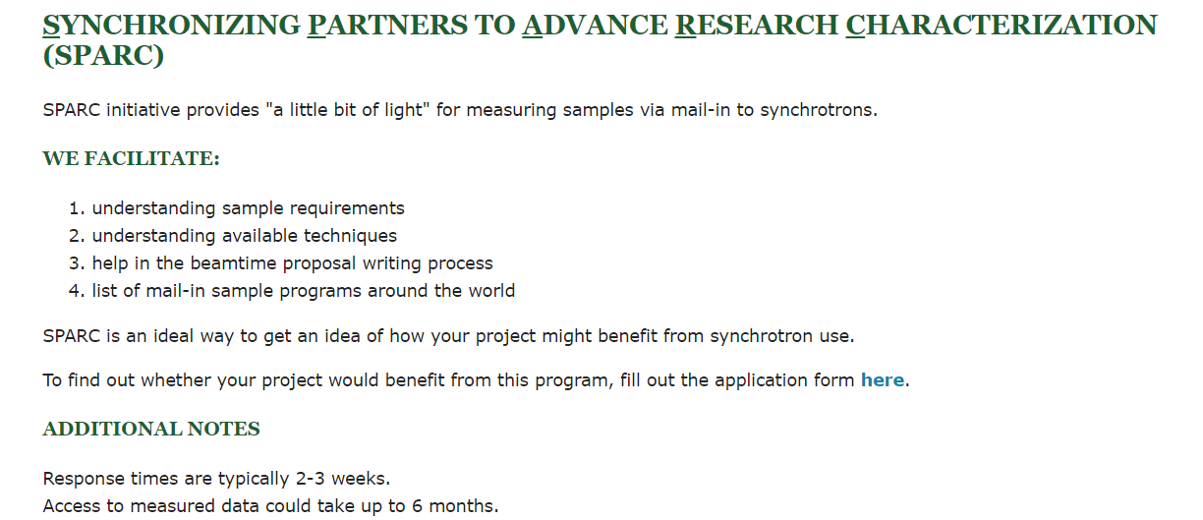
New initiatives
SPARC initiative leader: Tabbetha Dobbins, Rowan University, Glassboro, NJ, USA

Slide 18
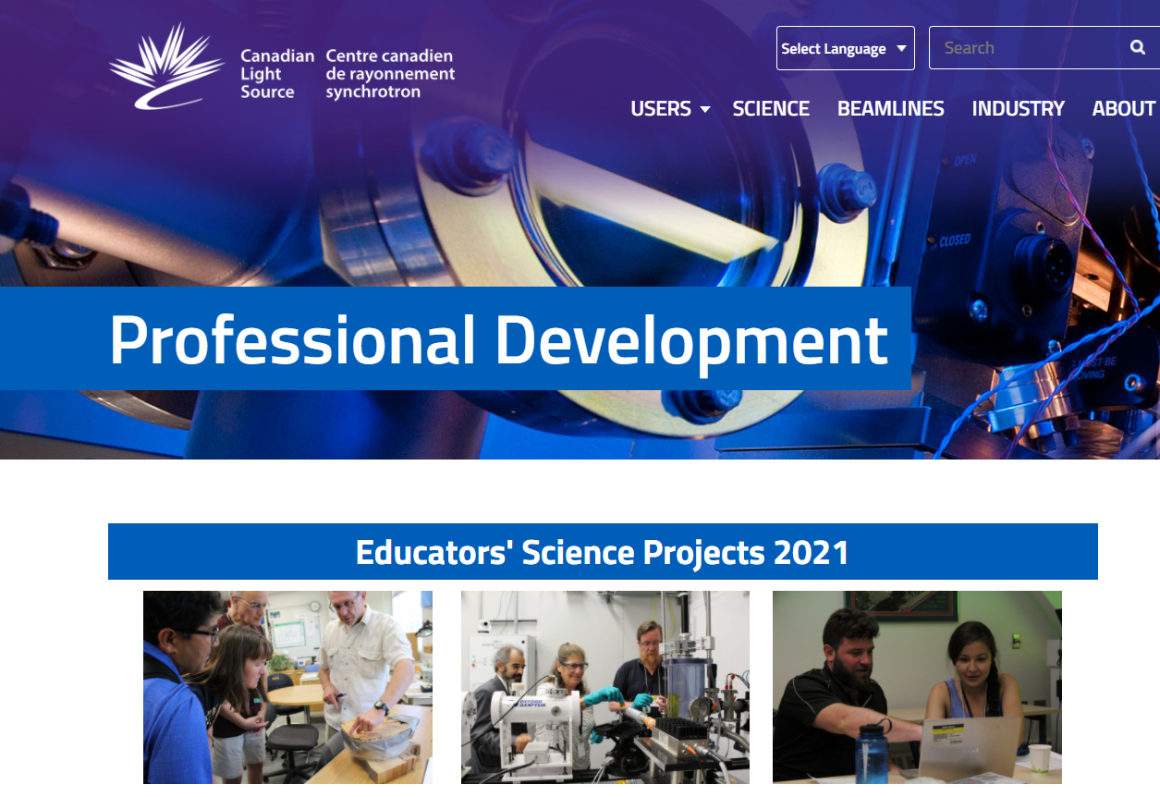
New initiatives
LAAAMP & CLS Teachers’ Workshop 2021

Slide 19
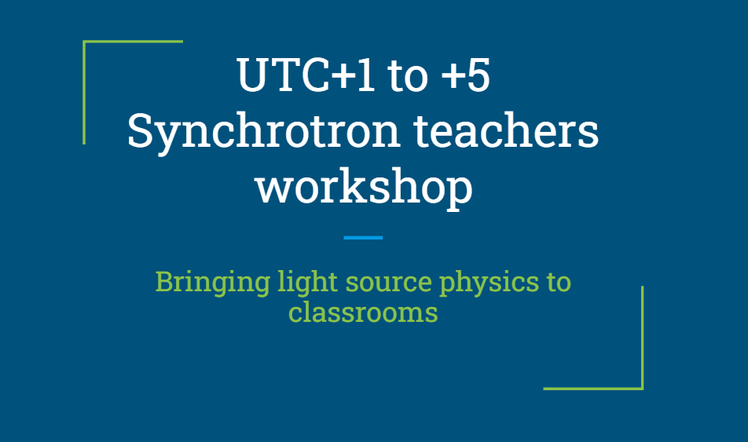


New initiatives
January 2022
Open to high-school science teachers from Africa

Slide 20


New initiatives
LAAAMP & CLS Teachers’ Workshop 2021
An IUCr-UNESCO-LAAAMP OpenLab is being planned to be held in association with the next SESAME Users’ Meeting in 2022.
Organizers:
Özgül Öztürk, LAAAMP Executive Committee and SESAME Users’ Committee
Andrea Lausi, SESAME Scientific Director
IUCr-UNESCO-LAAAMP

Slide 21
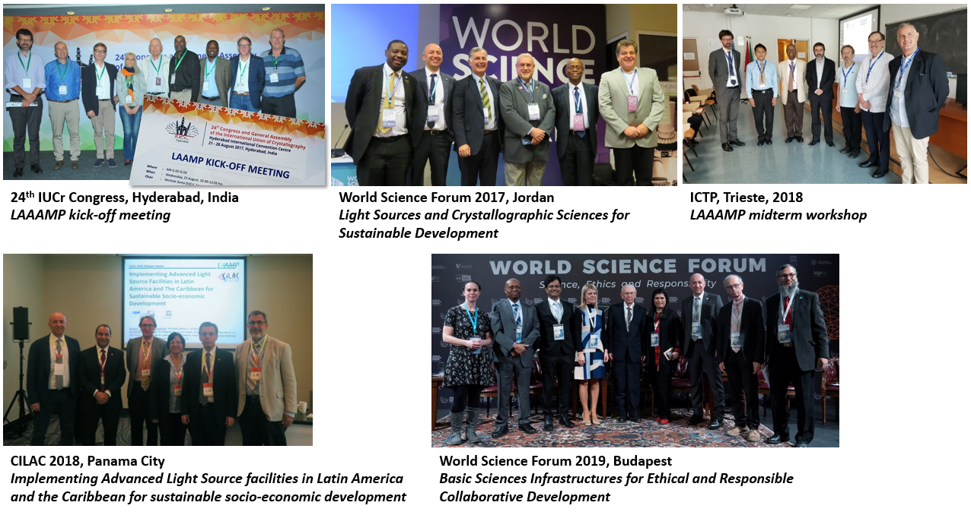
LAAAMP Events

Slide 22

LAAAMP Events
Joint meeting of the
Pan African Conference on Crystallography - PCCr2
and
The African Light Source Conference - AfLS2
Accra (Ghana), 28 January – 2 February 2019

Slide 23
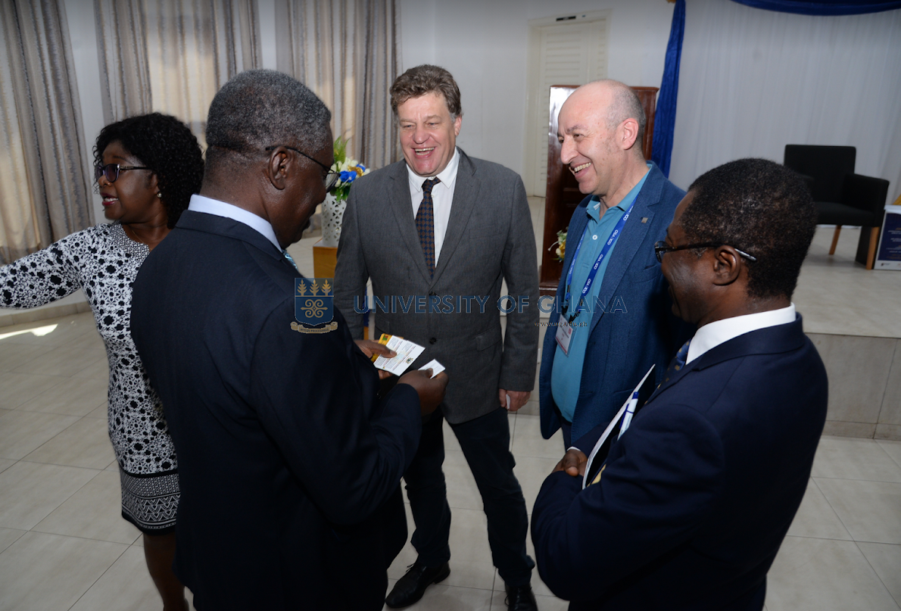
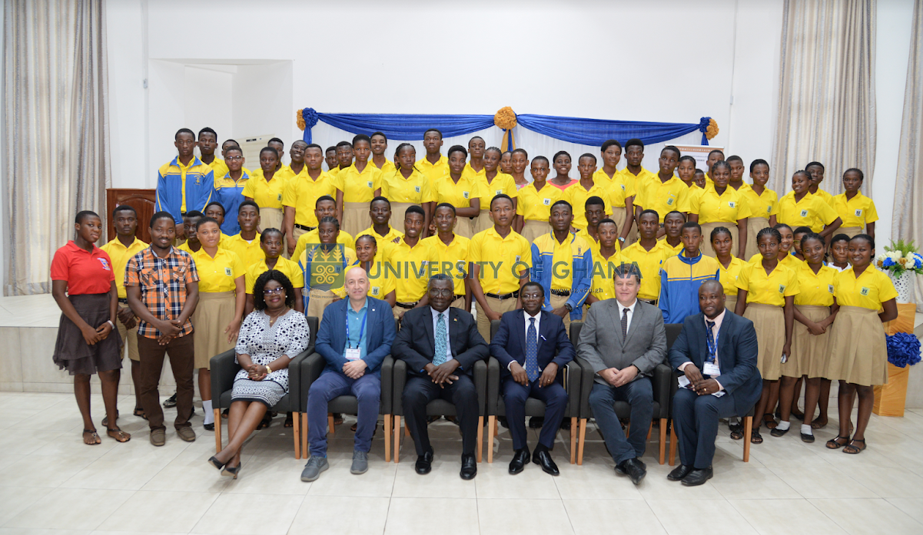
LAAAMP and AfLS: a tight connection
Simon H. Connell (AfLS) and Michele Zema (LAAAMP) discussing with Prof. Kwabena FRIMPONG-BOATENG, Minister of Environment, Science, Technology and Innovation of Ghana, at PCCr2, Accra, Ghana.
The major follow-up of PCCr2 was the formal support given to the African Light Source initiative by the President of Ghana Nana Addo Dankwa AKUFO-ADDO and facilitated by Minister Kwabena FRIMPONG-BOATENG.
Thanks to the Government of Ghana, AfLS is an official project of the African Union (AU) and ECOWAS.

Slide 24
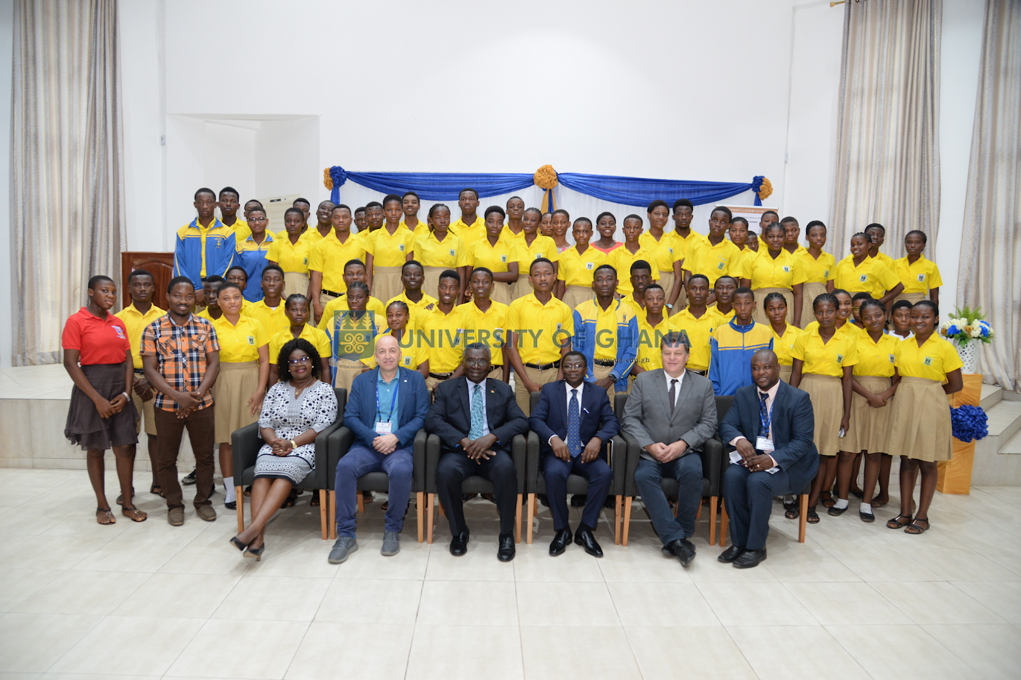
Simon Connell (AfLS), Michele Zema (IUCr, LAAAMP) and David Dodoo-Arhin (PCCr2-AfLS2 LOC) meet Kwabena Frimpong-Boateng, Minister for Environment, Science, Technology and Innovation of the Republic of Ghana.

Slide 25

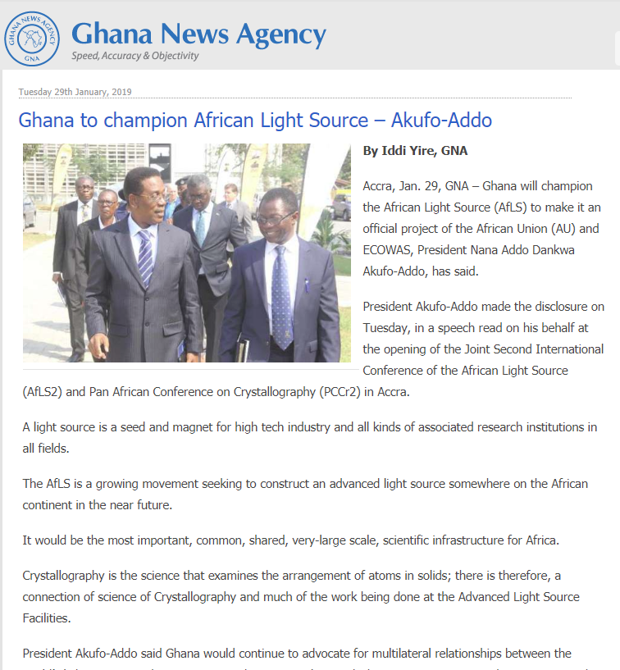
The African Light Source
Project
“[…] the African Light Source will contribute significantly to the African Science Renaissance, the return of the African Science Diaspora, enhancement of university education, the training of new generation of young researchers, the growth of competitive African industries and the advancement of research that addresses issues, challenges and concerns relevant to Africa.”

Slide 26
