Slide 1

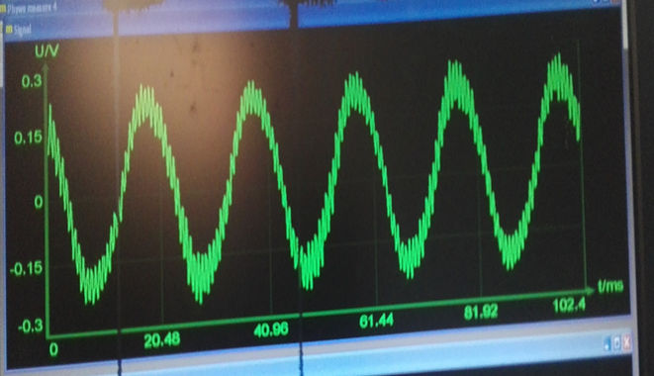
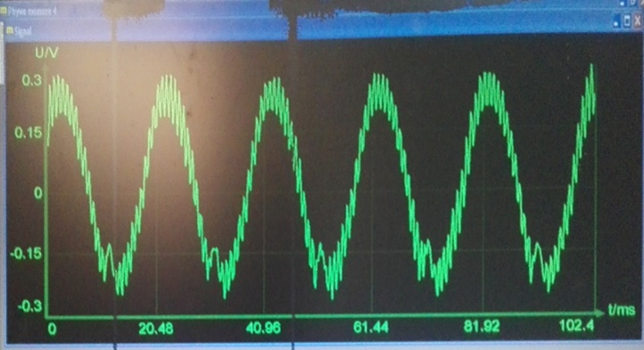
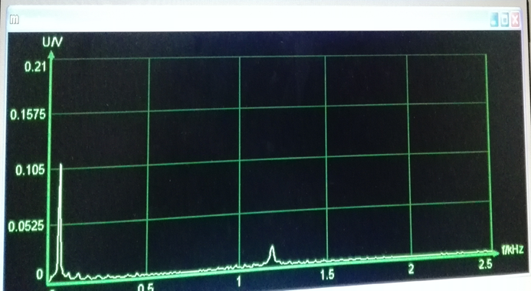
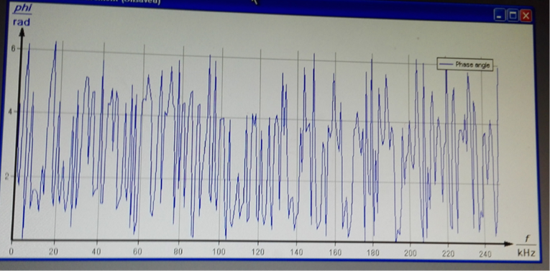
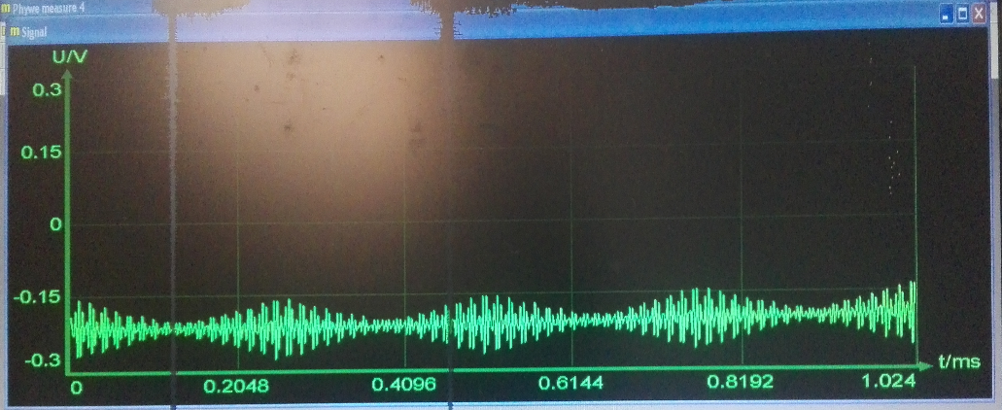
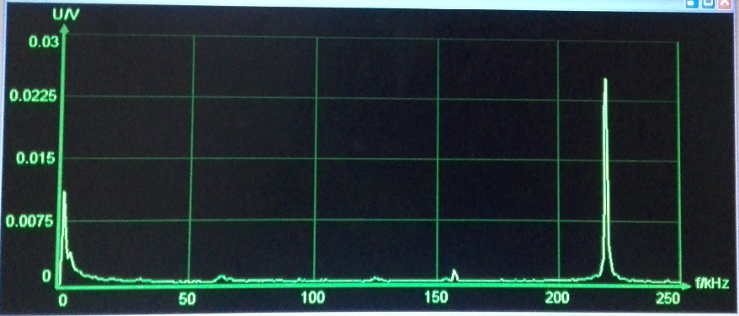

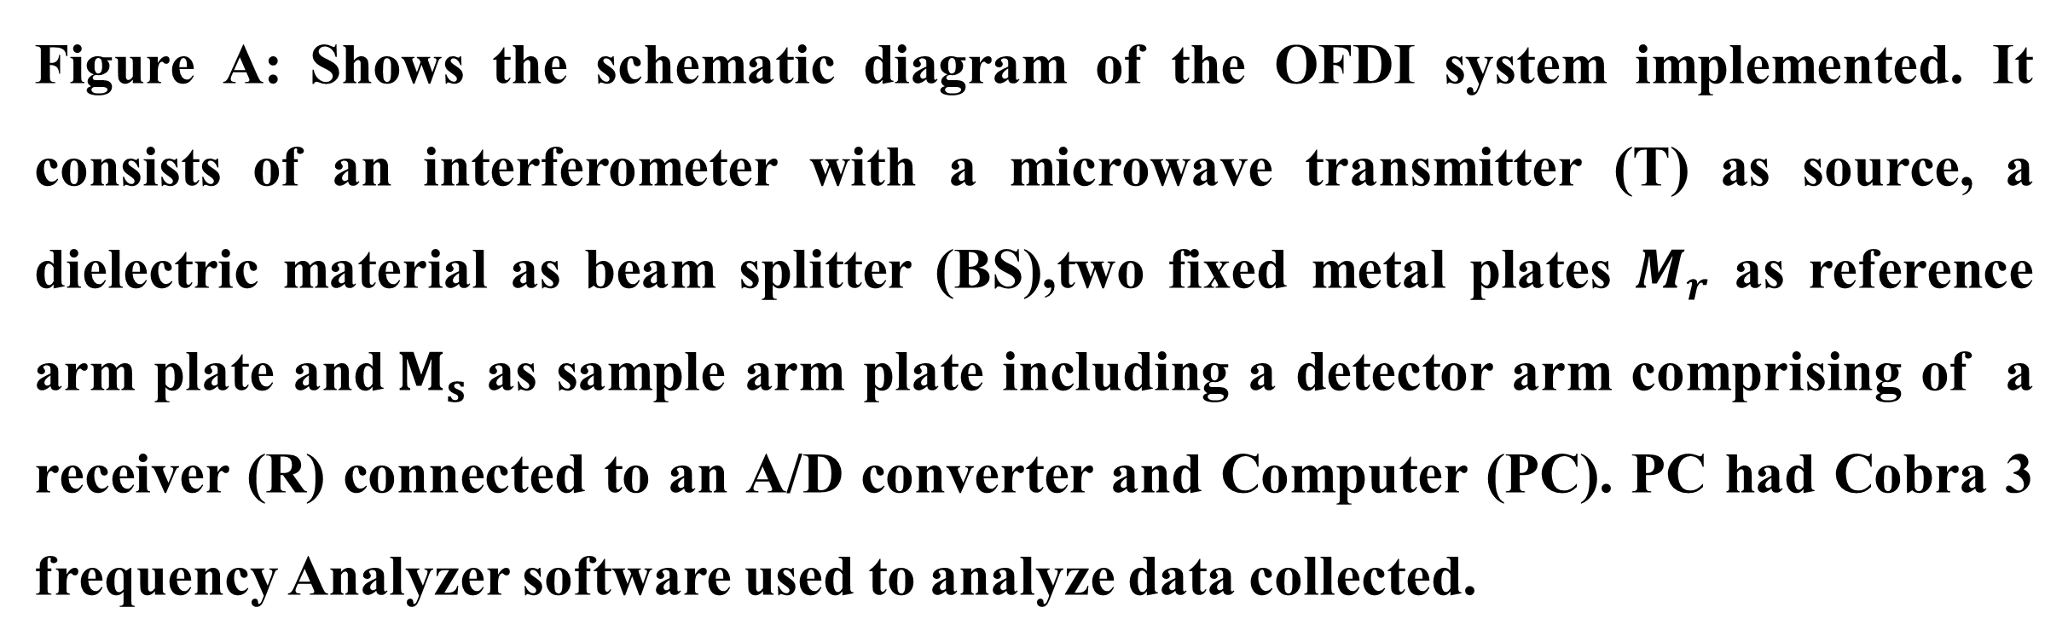
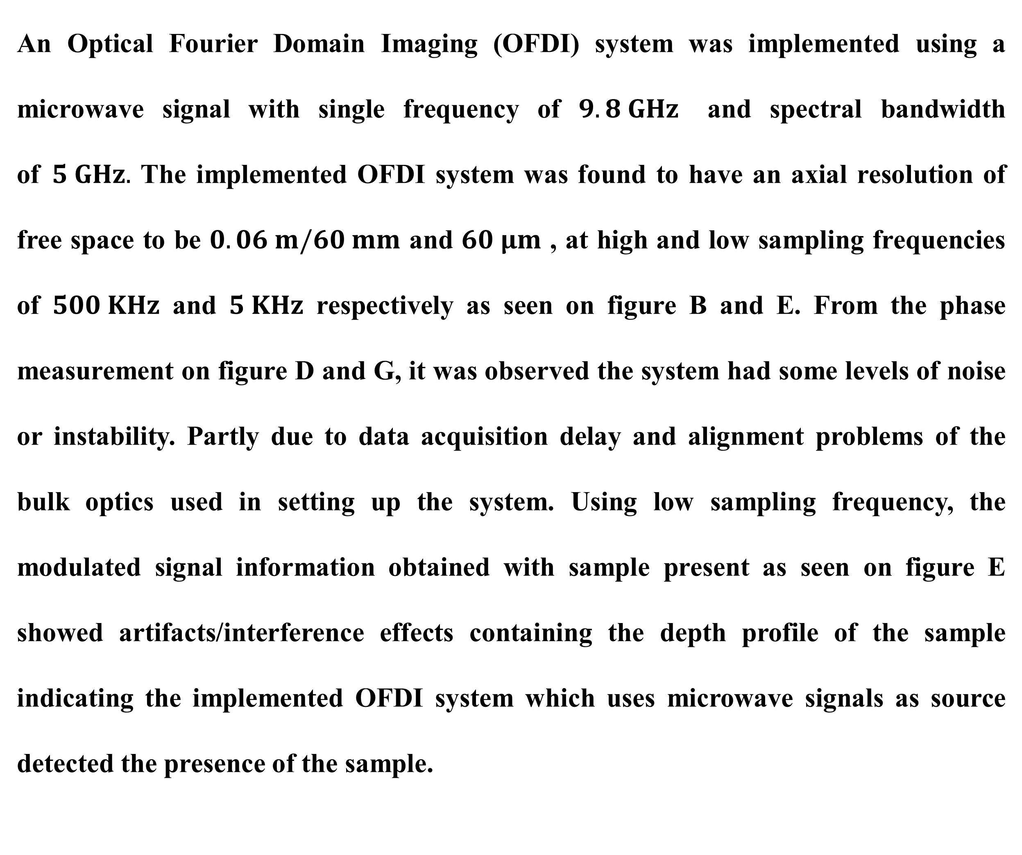

EARLY DETECTION OF BREAST CANCER WITH AN OPTICAL FOURIER DOMAIN SYSTEM USING MICROWAVE SIGNALS AS SOURCE.
R. N. Abugre¹
¹ Department of Physics, University Of Ghana.
Introduction:
Detection of developing breast tumour in women for early treatment in recent times has yielded some results. Yet only developed tumours are detected at the stage where the only treatment method is either to remove or inhibit the growth of tumour which has its effects, possibly leading to loss of human life. Our ongoing research, proposes to simulate the growth stages of tumour in human breast for early detection of tumor with an implemented Optical Fourier Domain Imaging (OFDI) system using microwave signals as source. For now, determination of the depth profile of samples and thickness measurement of sample is demonstrated.
Figure E: Interference signal of system at low sampling frequency (5 KHz).
Method:
$$M_{r}$$
T
BS
$$M_{s}$$
R
C
PC
Figure A: Shows the schematic diagram of the OFDI system implemented. It consists of an interferometer with a microwave transmitter (T) as source, a dielectric material as beam splitter (BS),two fixed metal plates $M_{r}$ as reference arm plate and${ M}_{s}$ as sample arm plate including a detector arm comprising of a receiver (R) connected to an A/D converter and Computer (PC). PC had Cobra 3 frequency Analyzer software used to analyze data collected.
Figure E: Interference signal of system with sample present at low sampling frequency( 5 KHz).
Results:
Figure F:Frequency spectrum at low sampling frequency.
Figure G : Phase measurement at low sampling frequency.
CONCLUSION:
An Optical Fourier Domain Imaging (OFDI) system was implemented using a microwave signal with single frequency of $9.8 GHz$ and spectral bandwidth of$5 GHz.$ The implemented OFDI system was found to have an axial resolution of free space to be $0.06 m/60 mm$ and $60 μm$ , at high and low sampling frequencies of $500 KHz$ and $5 KHz$ respectively as seen on figure B and E. From the phase measurement on figure D and G, it was observed the system had some levels of noise or instability. Partly due to data acquisition delay and alignment problems of the bulk optics used in setting up the system. Using low sampling frequency, the modulated signal information obtained with sample present as seen on figure E showed artifacts/interference effects containing the depth profile of the sample indicating the implemented OFDI system which uses microwave signals as source detected the presence of the sample.
Figure B. Interferogram contained in an envelope at high sampling frequency (500 KHz).
REFERENCES:
R.N.Abugre et al, ‘Thickness measurement with an Optical Fourier Domain Imaging system using microwave signals as source’ In the Joint African Light Source AfLS 2020 and African Physical Society AfPS2020 conference proceedings.
R.N.Abugre et al, ‘Detection of sample with an implemented optical fourier domain system using microwave signals as source’ In the Noguchi Memorial Institute in Biomedical research international conference proceedings,2019.
J. Polivka (2006), In: High Frequency Design microwave imaging, High Frequency Electronics Summit Technical Media, LLC.
Figure C: Frequency spectrum of the interferogram at high sampling frequency.
Figure D: Phase measurement at sampling high frequency.

